Slide 1
Strength of Materials
The STEM Guitar Grant
Doug Hunt
Debbie French, PhD

Slide 2
Purpose:
Throughout lesson, we will be learning about materials testing and relate that information to how luthiers create bended sides for guitars.

Slide 3
Introduction:
How do luthiers (guitar makers) get wood to form the sides on an acoustic guitar?
[Acoustic guitar photo] + [bent sides photo]

Slide 4
Six common forces materials may be exposed to:
Tensile
Compression
Shear
Bending
Hardness
Torsion

Slide 5

1. Tension
Tension is a pulling force, end-for-end

Slide 6

2. Compression
Squeezing, pushing end-for-end (the opposite of tension)

Slide 7
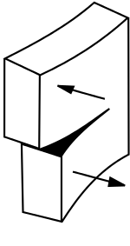
3. Shear
Opposing forces along a plane, like scissors

Slide 8
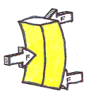
4. Bending
Forces that cause material to flex

Slide 9
5. Hardness
Pressing a standard sized steel ball into a material surface and measuring penetration

Slide 10
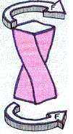
6. Torsion
Twisting force

Slide 11
Material testing
Material testing results follow a fairly predictable progression during loading, or application of force, until failure and completion. Material Scientists and Engineers call this a stress-strain curve. This information is displayed as a graph with applied stress and reaction strain.

Slide 12
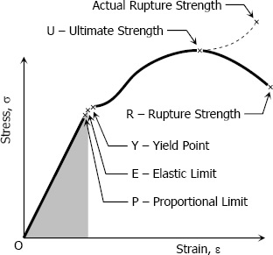



Stress-Strain Curve
Stress: Force applied to the material over a certain area. Stress is abbreviated using the Greek lowercase letter, sigma, 𝛔.
$$σ=\frac{Force}{Area}=\frac{F}{A}$$
$$\frac{Newtons}{m^{2}}=Pascal (Pa)$$
Strain: Expressed as a ratio of change in length with respect to the original length. For strong materials, this number tends to be quite small. Abbreviated using the Greek letter, epsilon, ε, and is unitless.
$$ε=\frac{Change in Length}{Original Length}=\frac{∆L}{L}$$

Slide 13

Young’s Modulus
Young’s Modulus, or the Modulus of Elasticity (E): The ratio of the stress-to-strain at the Proportional Limit. This portion of the graph, where the stress-strain curve is a straight line, is considered to be the elastic region. If the stress is removed, the material will return to its original size and shape.
Numbers for Young’s Modulus tend to be quite high for strong materials, because you are dividing the pressure by a very small number.
$$E=\frac{σ}{ε}=\frac{F∙L}{A∙ΔL}$$

Slide 14
Proportional Limit
Proportional Limit: is the highest stress point where the stress/strain curve is still linear.

Slide 15
Elastic Limit
Elastic limit is the point on the graph where materials will return to their original shape if stress is removed.
Between the Proportional limit and elastic limit, material will also still return to original shape, but the stress-strain relationship is no longer linear.

Slide 16
Yield Point
Yield Point is the amount of stress needed to impart a small amount of deformation, or a strain amount of 0.2%.

Slide 17
Ultimate Strength
The ultimate strength is the point on the graph where the highest stress is applied.

Slide 18
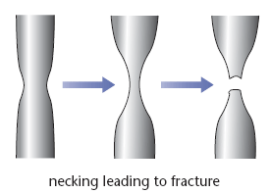
Rupture
When stress is applied beyond the Ultimate strength, the material stretches dramatically. Metal parts in tension (pulling) undergo what is called “necking”. The cross-section greatly reduces and the part elongates.
Image source: https://revisionworld.com/a2-level-level-revision/physics/force-motion/solid-materials/steel

Slide 19
Rupture Point
Rupture Point: Rupture point is the final point of failure where the material separates in to two pieces.

Slide 20
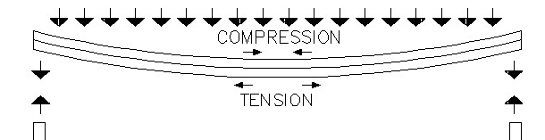
How does this relate to guitars?
To bend acoustic guitar sides, you must apply enough force to exceed the elastic limit, but not so much force as to exceed the ultimate strength.
This subjects the material to which two forces?
  Compression
  Tension

Slide 21
How do luthiers bend sides?
To assist wood in bending, it often has steam applied. The heat and moisture alter the makeup of the wood and makes it easier to bend. The heat and steam affect the lignin in the wood. Lignin is an organic material that binds the cells and fibers in the wood. It makes it easier to compress, however, the tensile limits don’t change much.
ADD PHOTO OF BENT SIDES

Slide 22
Other applications:
There are other applications to steam-bending woods:
Bending wood and other materials to make wings on an aircraft and other parts

Slide 23
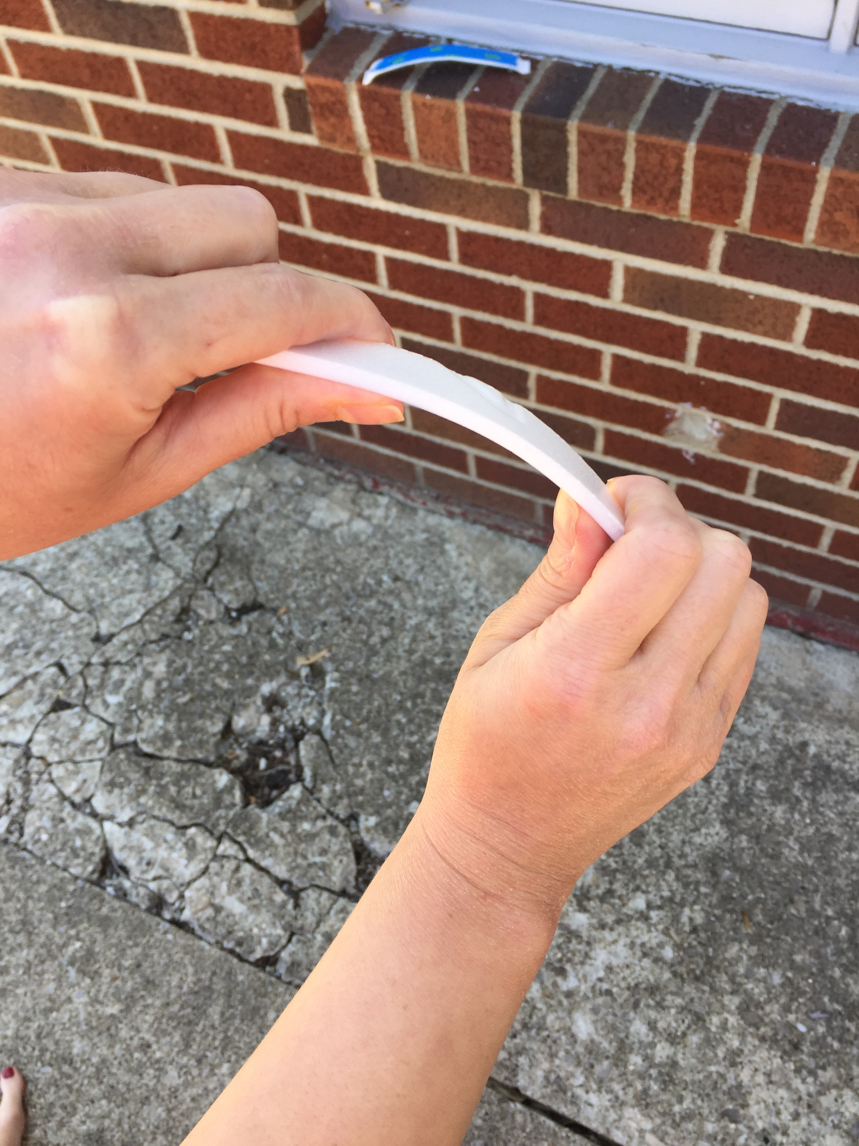
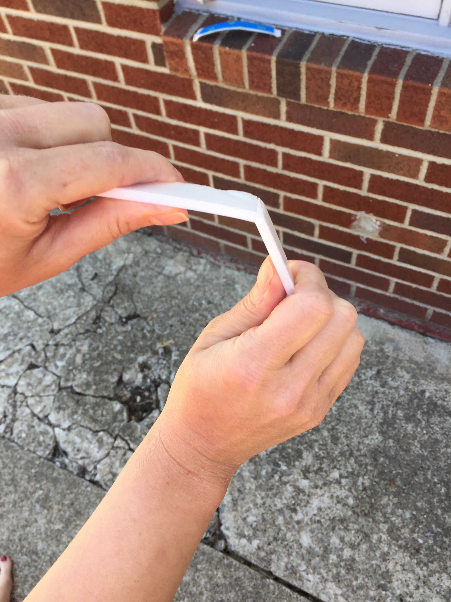
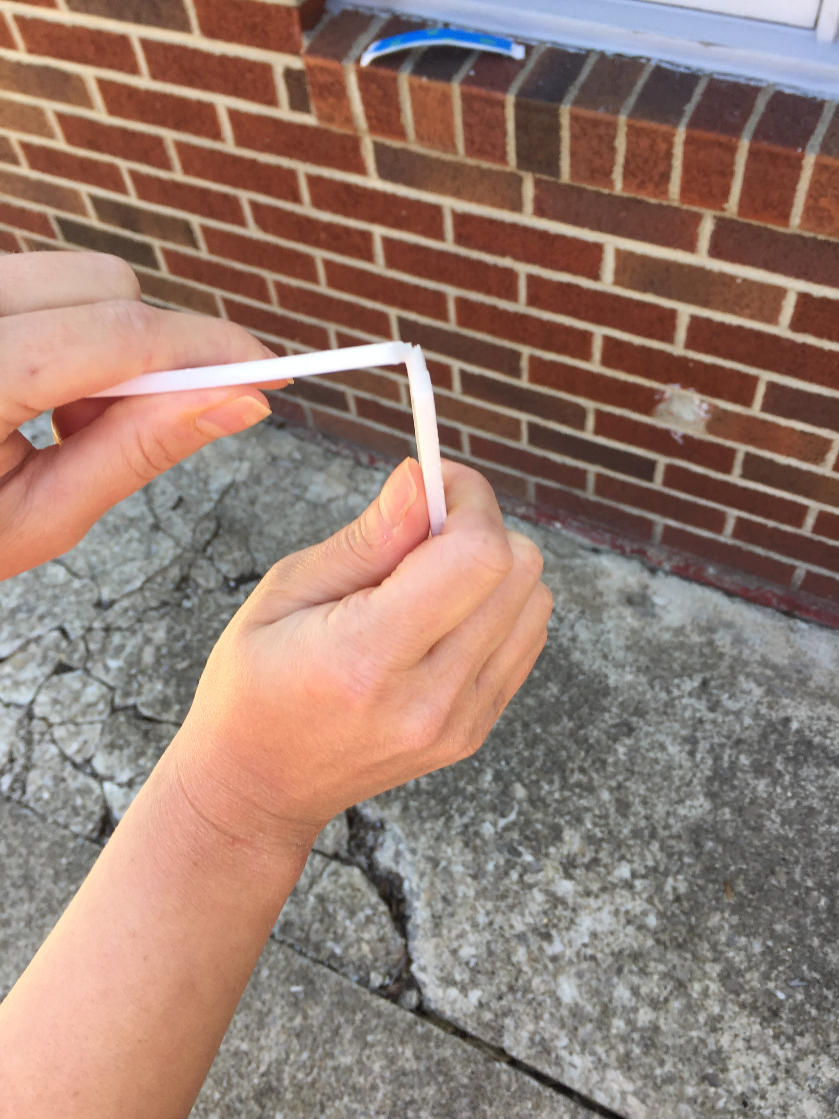
Extension--Laminating
Laminating materials may also allow them to be bent.
Take a ¾-inch wide piece of thin styrofoam and try to bend it.
What happens?
The Styrofoam tray broke as it was bent.

Slide 24
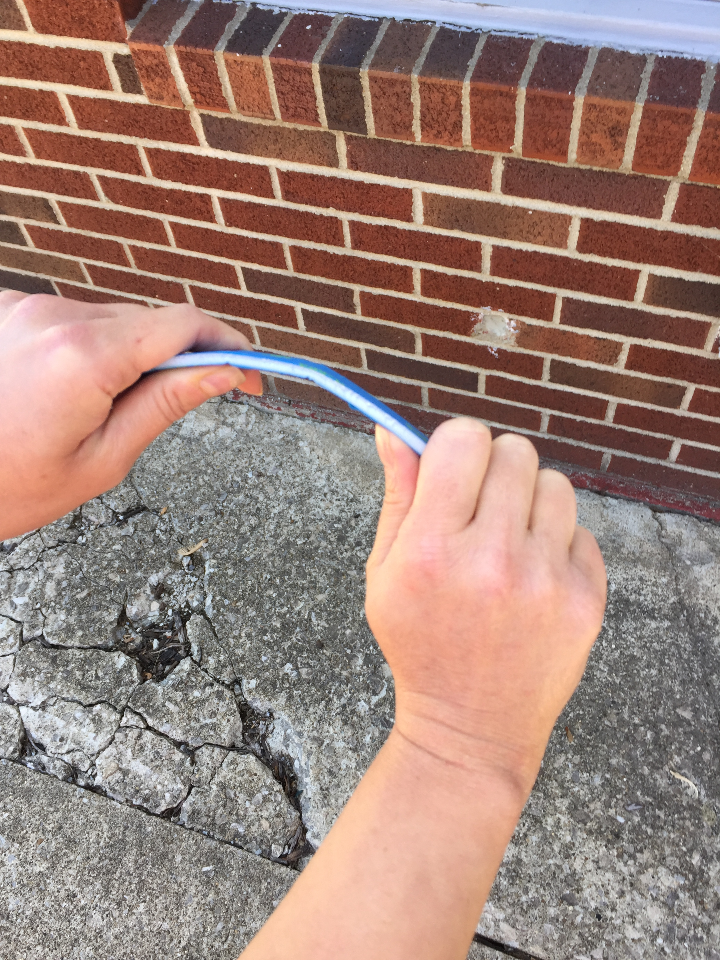
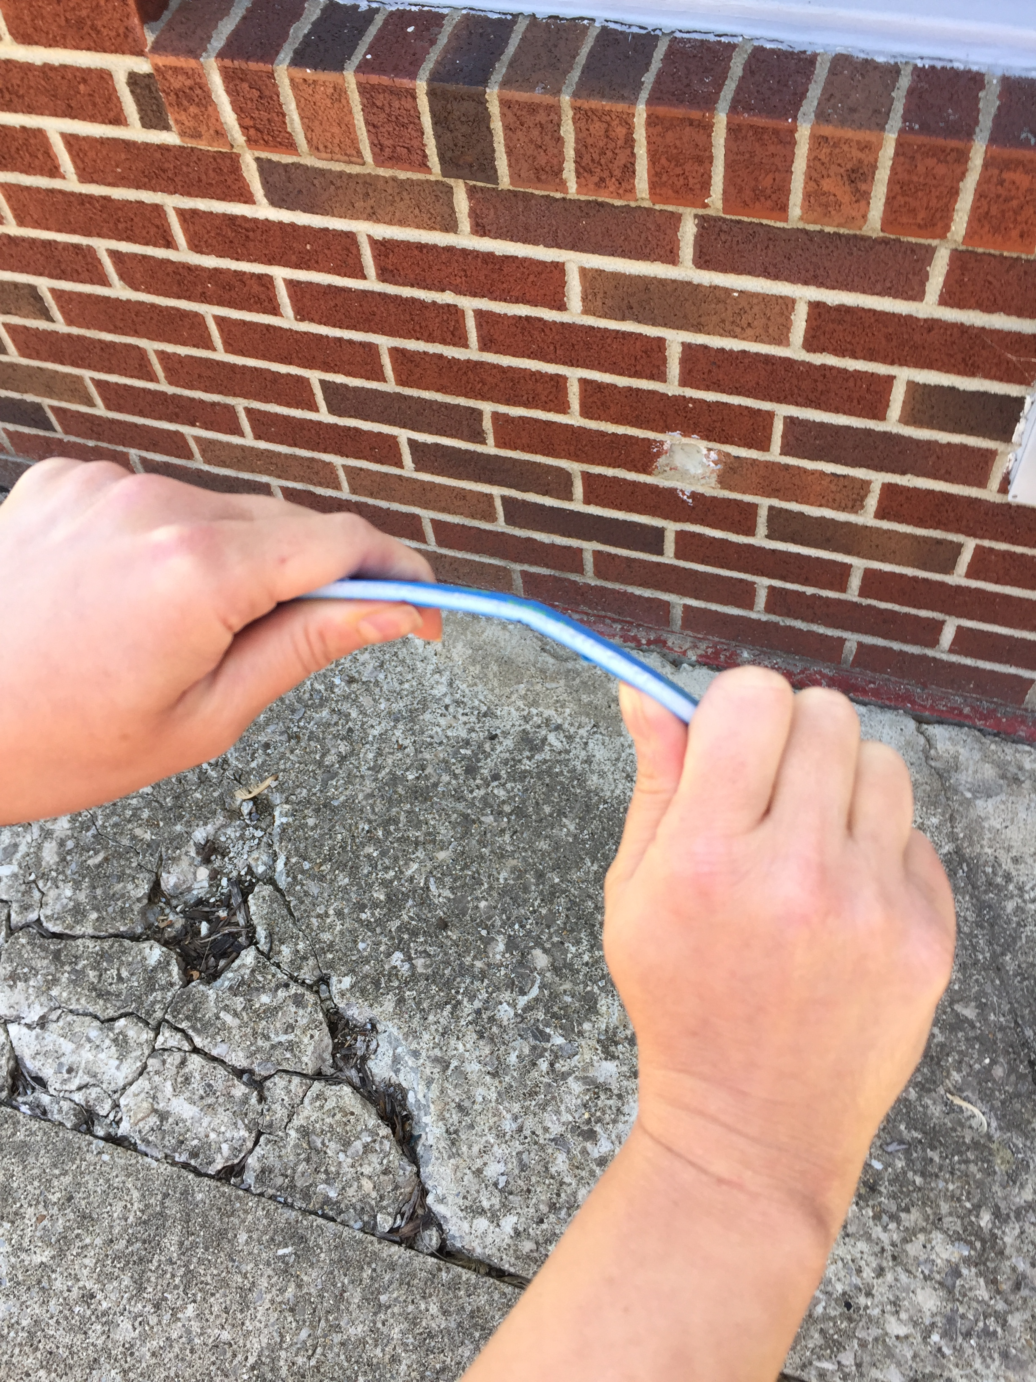
Laminating, Pt. 2
Now place masking tape or painters tape on both sides of another ¾”-inch wide strip of Styrofoam. And try to bend it. What happens?
The laminated pieces of Styrofoam did not break when bent.
Thin pieces of wood laminated together (in a few layers) will often bend more readily than a solid piece of wood.

