Slide 1
The Science and Art of Sharpening Edged Wood-Cutting Tools
A STEM Acoustic Guitar Modular Learning Activity

Slide 2
Use Policy
This presentation was developed by Timothy J. Wilhelm, P.E., Kankakee Community College, based on The STEM Guitar Project created at Sinclair Community College with funding from the National Science Foundation as part of ATE Grant No. 0903336; Tom Singer, Project PI.
All materials in this presentation are designed and intended for educational use, only. They may not be used for any publication or commercial purposes.

Slide 3
Author, Editors/Reviewers
Author: Timothy J. Wilhelm, P.E., Kankakee Community College
Editors/Reviewers:

Slide 4
Objectives
Student will be able to explain, in simple terms, the concept of material hardness;
Student will be able to explain, in simple terms, the related concepts of force and pressure;
Student will be able to explain, in simple terms, how the concept of hardness relates to sharpening edged cutting tools;

Slide 5
Objectives
Student will be able to explain, in simple terms, how the concepts of hardness and pressure relate to the ability of an edged cutting tool to efficiently cut, shape, and sculpt wood;
Student will be able to explain, in simple terms, the differences between common, sharpening-stone grits;

Slide 6
Objectives
Student will be able to explain, in simple terms, the basic steps and techniques involved in sharpening a common, beveled-edge chisel;
Student will be able to list and explain the safety hazards associated with the sharpening of edged cutting tools;
Student will be able to list and explain the safety precautions, PPE, and on-hand first aid supplies relevant to the sharpening of edged cutting tools;

Slide 7
Objectives
Student will be able to SAFELY demonstrate good, beginner-level technique in the sharpening of a beveled-edge chisel;
Student will be able to SAFELY demonstrate the good sharpness of the freshly sharpened, beveled-edge chisel, using the paper cutting method explained and illustrated in this lesson.

Slide 8
STEM – manufacturing, fabrication
Intro to Edged Cutting Tools, Their Function, Care, and Safety Concerns

Slide 9
Edged Wood-Cutting Tools -- Function
As this category name implies, these legacy hand tools cut into a target material made of wood. More specifically,
Shaping
  Such as changing a square spindle into a round rod or spoke
Contouring
  Such as forming the arm relief on a solid-body electric guitar
Carving Protruding Features
Carving Recessed Features
Scraping and Smoothing the Wood’s Surface

Slide 10
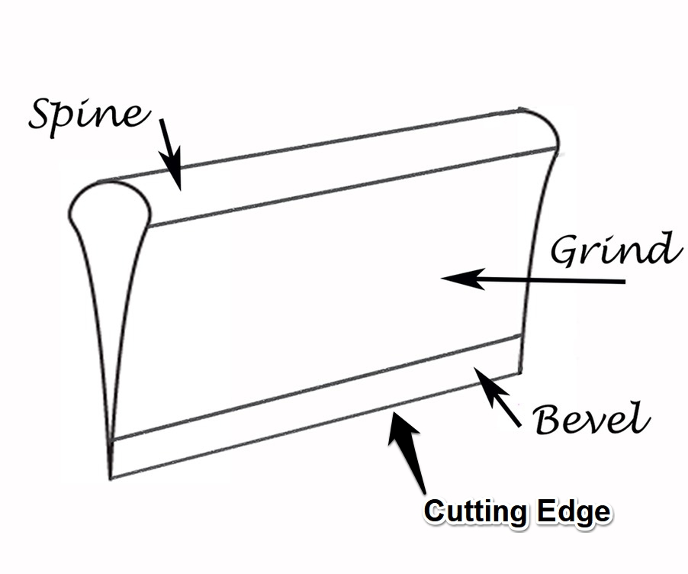
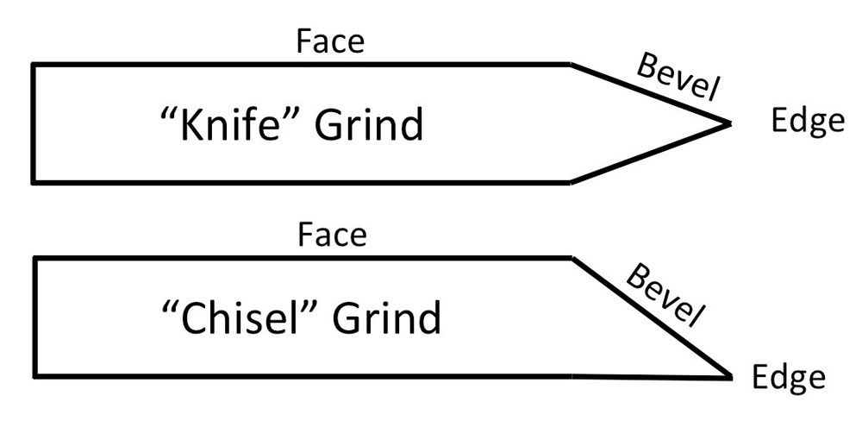
Edged Wood-Cutting Tools -- Vocabulary

Slide 11
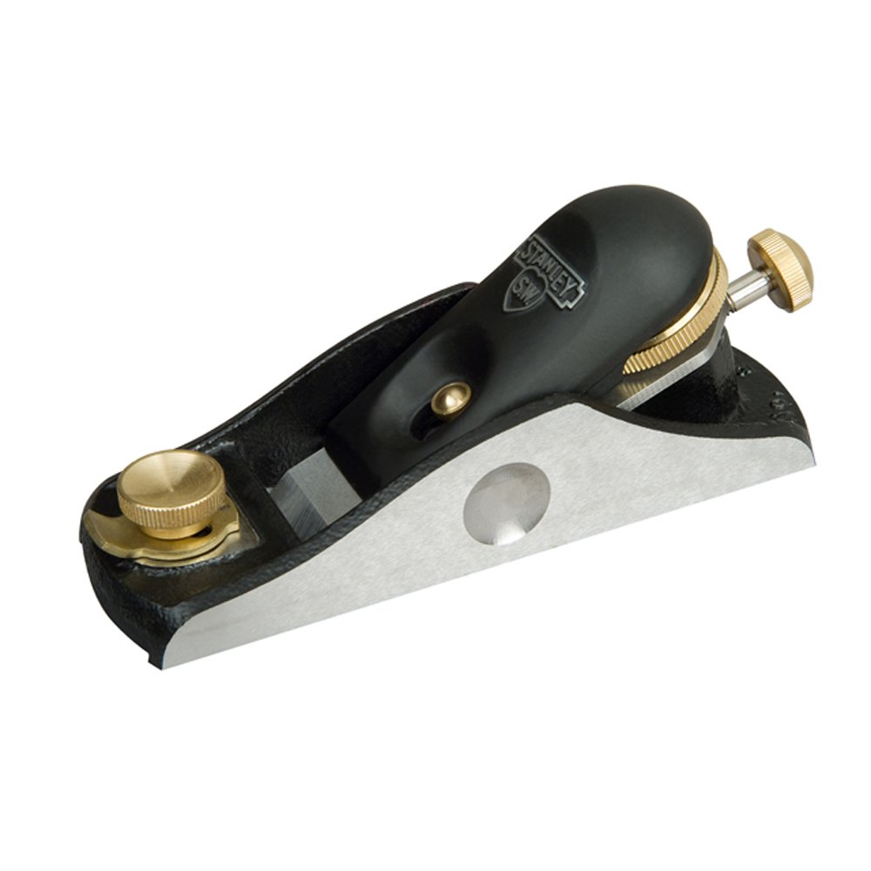
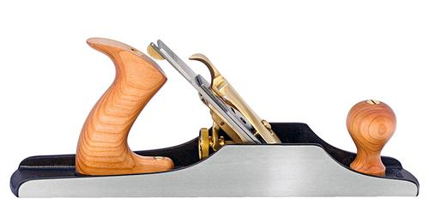
Block and Jack Planes

Slide 12
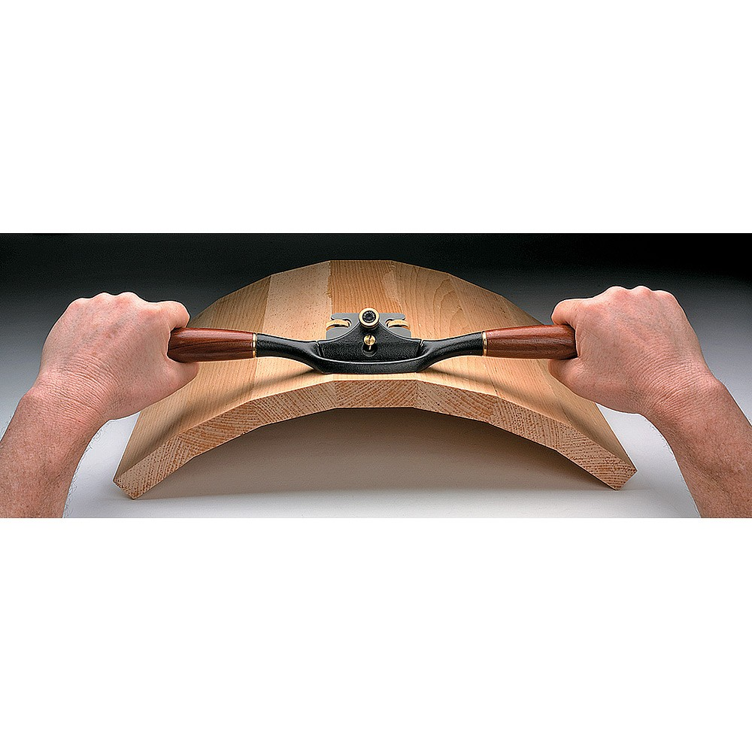
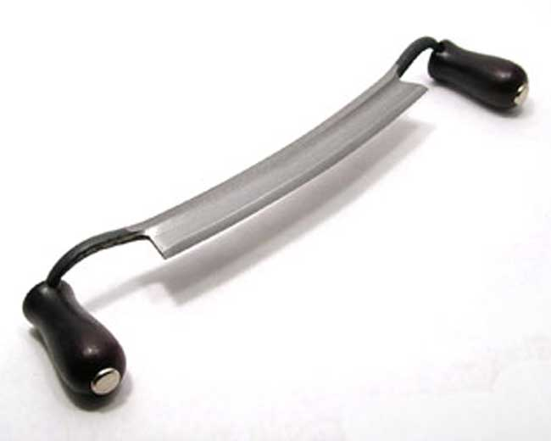
Drawknives and Spokeshaves

Slide 13
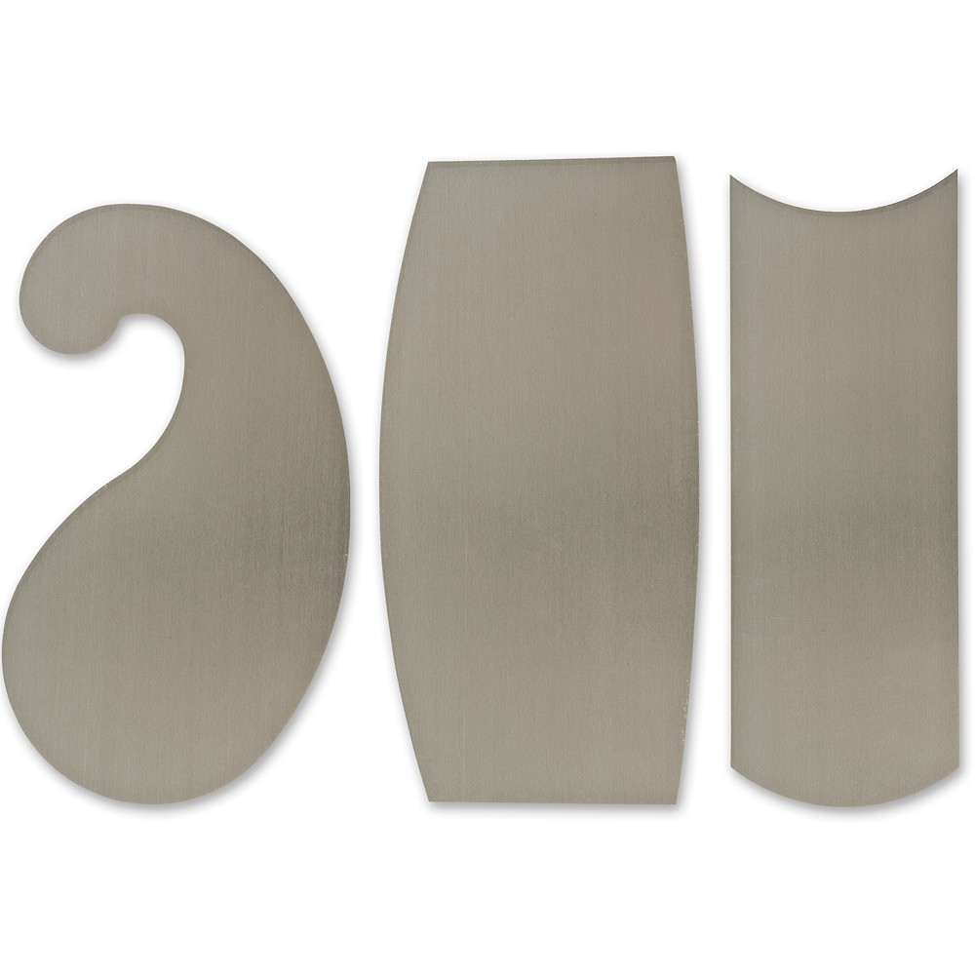
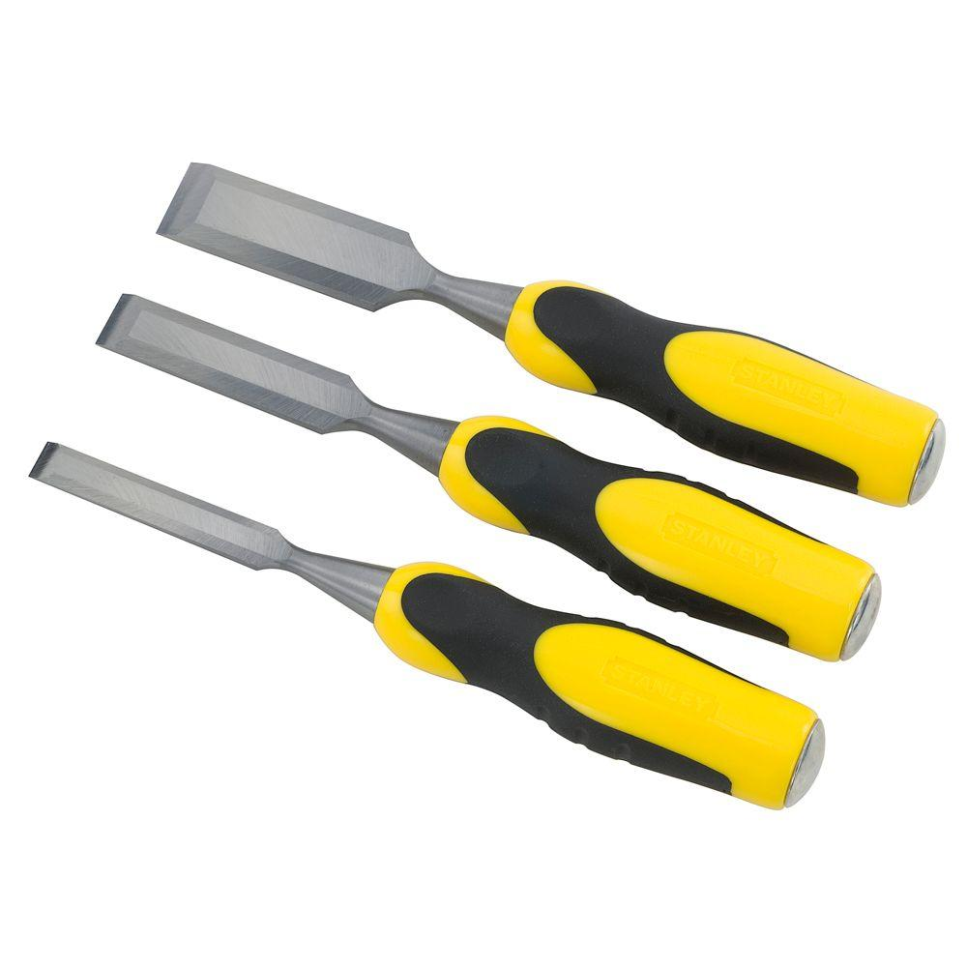
Chisels and Cabinet Scrapers

Slide 14
Edged Wood-Cutting Tools -- Sharpening
The primary tool for sharpening most (not cabinet scrapers) edged, wood-cutting tools is a “hone” (or whetstone, or sharpening stone). The surface of a hone is flat and abrasive, able to grind the bevels of the tool, forming a sharp edge. There are three, general types of hones:
Wet Stones
Oil Stones
Diamond Hones

Slide 15
Tool Sharpening -- Vocabulary
Hone (verb): to refine or perfect; to put an edge on; to sharpen
Whet (verb): to stimulate a focus on; to make more acute; to sharpen
Lap (verb): to smooth or polish to a high degree; to make flat; to create a very close fit
Grit (noun): abrasive granules of stone or sand; an ANSI-standard number indicating the relative roughness of an abrasive tool, i.e. sandpaper, grinders, hones, etc.
Swarf (noun): filings; file dust; fine chips or filings of metal resulting from grinding, filing, or abrasion

Slide 16
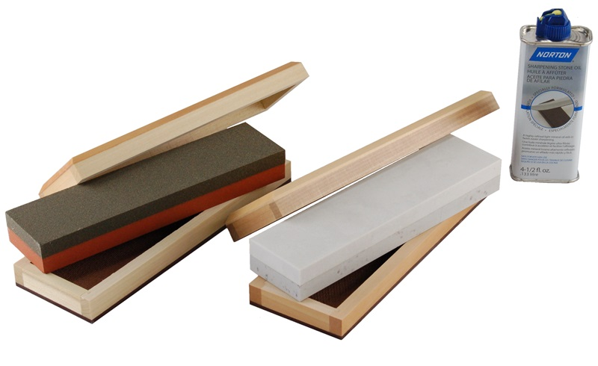
Oil Stones
Oil Stones are lubricated with honing oil prior to the sharpening process. They may be natural, quartz-based stones such as novaculite (a.k.a. Arkansas Stones); or, article stones of bonded, ceramic particles such as silicon carbide.

Slide 17
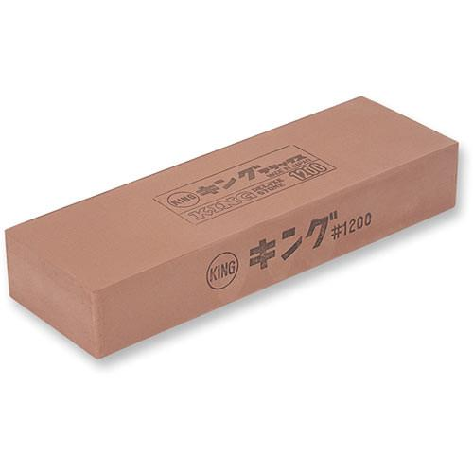
Water Stones
Water Stones (a.k.a. Japanese Water Stones) are lubricated with water (only!) prior to the sharpening process. They are natural, silicate-particle stones sourced primarily from Japan.

Slide 18
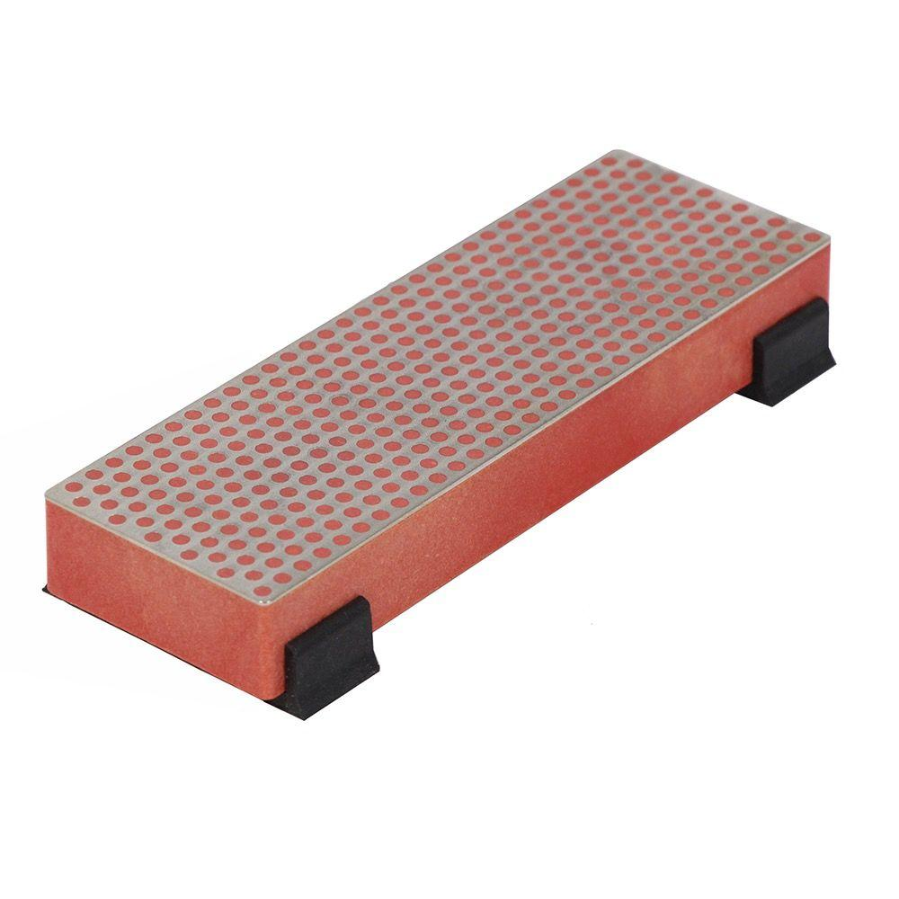
Diamond Hones
Diamond Hones (a.k.a. Diamond Plate) are made from flat pieces of steel coated with diamond grit. They are lubricated honing oil prior to the sharpening process.

Slide 19

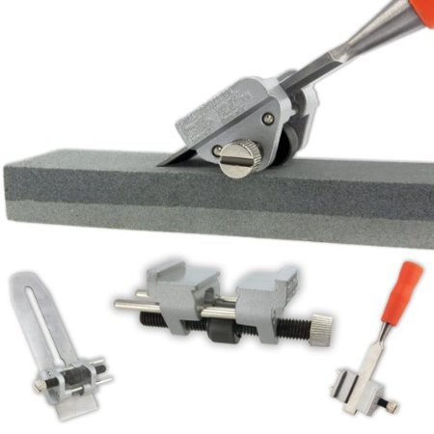
Honing Lubricants and Jigs
Honing lubricants are necessary to suspend the resulting swarf, preventing it from clogging the hone
Honing jigs hold the tool being honed at a precise, consistent angle against the hone on successive strokes

Slide 20
Hazards, Mitigation, and PPE
Flying wood and/or metal chips
  Awareness and Proper Technique
  Safety Glasses
Sharp edges
  Awareness and Proper Technique
  Mechanic’s Gloves
Proximity of other students
  Awareness and Communication

Slide 21
STEM – geology, physical science
Hardness, Force, and Pressure

Slide 22
Hardness
“Hardness” is a mechanical property of materials. It’s the ability of a material to resist being deformed, fractured, sheared, or abraded by a different material, via mechanical indentation or abrasion.
Rubbing a hard material against a softer material results in the softer material being scratched or abraded, with particles of the softer material being removed from it.

Slide 23
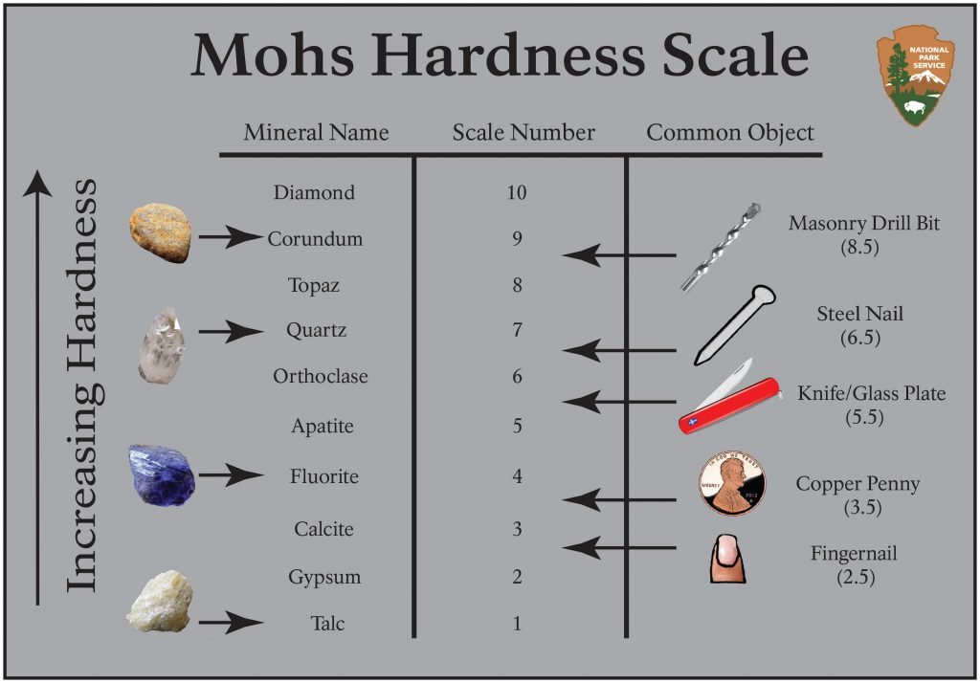
Hardness
In the realm of Geology, hardness of minerals is rated by the Mohs Scale:

Slide 24
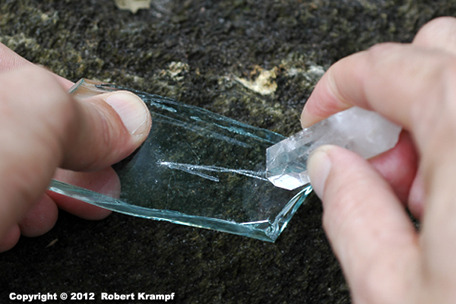
Hardness
Relative mineral hardness is determined via a “scratch test” of one unknown material against another

Slide 25
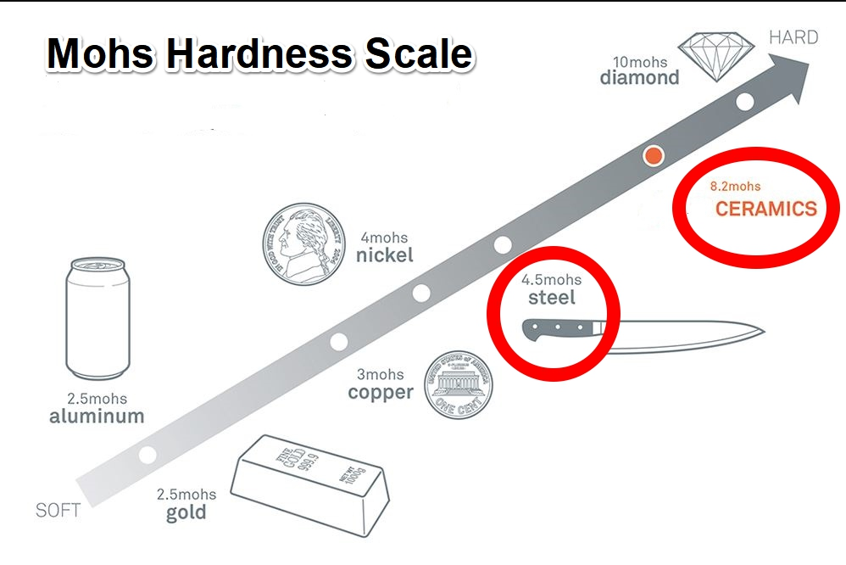
Hardness
In order to sharpen a steel chisel, the hone must be harder than chisel

Slide 26
Force
For the purposes of this lesson, “force” refers to the magnitude and direction of a mechanical push on and through an edged cutting tool, into its working end. When cutting, the force is pushing the tool into a softer material intending to cut the softer material; or, when sharpening the edge of the cutting tool, the force is pushing it into the harder material of the whetstone.

Slide 27
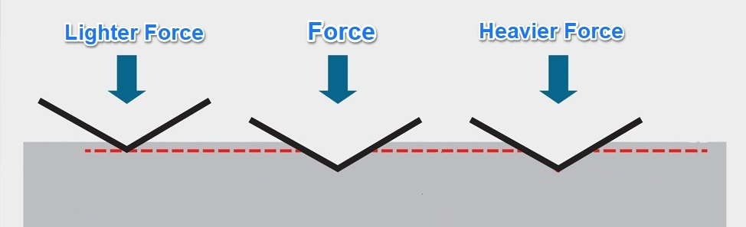
Force
When cutting wood, the greater the force applied to the chisel, the deeper it will penetrate the wood.
When sharpening a chisel, the greater the force applied to it, the more aggressively the hone will abrade the steel bevel of the chisel.

Slide 28
Pressure
“Pressure” is the magnitude of a force applied per the unit area through which the force is distributed on a surface. When cutting, the force pushing a dull, rounded-edge chisel applies less pressure into the wood than the same force pushing a sharp-edged chisel. When sharpening the edge of a chisel, because the bevel has a constant area, the force pushing the chisel into the hone must increase in order for the pressure on the hone to be increased.

Slide 29
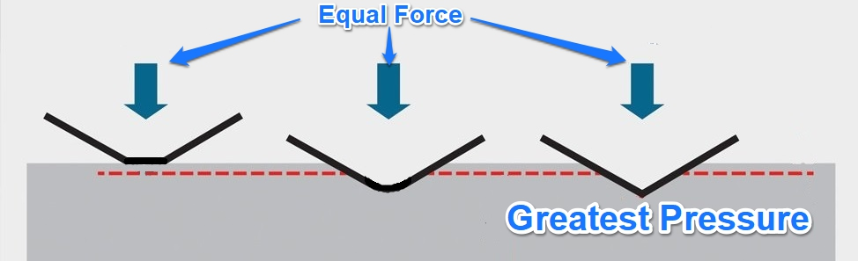
Pressure
Pressure exerted by a chisel cutting into wood can be increased in two ways: apply greater force to the tool (primarily for sharpening); or, make the contact area between the tool and the target material smaller by sharpening the cutting edge of the tool (for more effective cutting).

Slide 30
Pressure
When cutting wood with a chisel, because a sharp chisel translates force into a greater pressure than a dull chisel, sharp chisels are safer to use.
The extra hand-applied force required by a dull chisel makes the chisel more difficult to control, more prone to slipping and flying forward, creating a stabbing hazard.

Slide 31
Pressure
A coarse hone’s abrasive granules are spaced further than a fine hone. With fewer point-contacts per unit area, a coarse hone applies greater pressure to the chisel, providing an aggressive grind action. This results in faster honing, but leaves a scratched, serrated edge.
The tiny, tight granules of a fine hone decrease the aggressiveness of the grind (less pressure), but remove the larger scratches left by the coarse hone.

Slide 32
STEM – abrasion, grinding, sanding, etc.
Abrasive Grit

Slide 33
Abrasive Tools
Abrasive action is explained by the principles previously discussed: Hardness, Force, and Pressure.
The grit on the surface of an abrasive tool must be harder than the target material.
The greater the force applied to the abrasive tool, the more aggressively it will grind the target material.

Slide 34
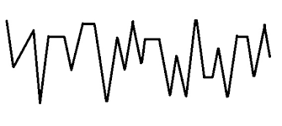

Abrasive Tools
With fewer contact-points per unit area, coarse-grit abrasive tools apply more pressure to the target material than fine-grit tools.
Coarse abrasives leave a rough edge on a chisel. Fine abrasives leave a smoother edge on a chisel. The finer the abrasive, the finer the edge.

Slide 35
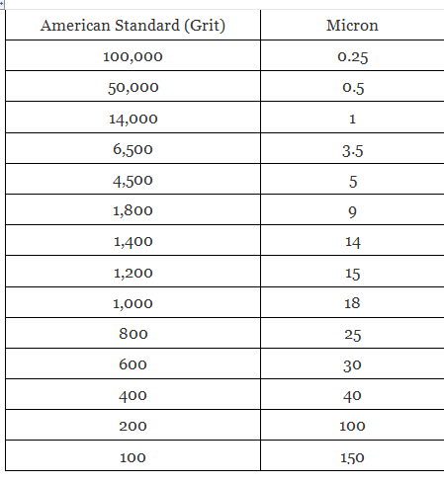
Abrasive Tools
The abrasive surface of an individual abrasive tool is fairly homogeneous. The grade of roughness on these abrasives is denoted by an ANSI-standard “grit” number – the number being inversely proportional to the degree of roughness.

Slide 36
STEM – sharpening edged cutting tools
Sharpening a Wood Chisel,
Step-by-Step

Slide 37
Chisel Sharpening – General Comments
If the chisel’s edge is nicked, or chipped, or very dull, begin honing with a coarse hone (100 to 300 grit). Then continue on with medium (800 to 1,200 grit) and fine (1,200 to 1,800 grit) stones.
If the chisel’s edge is not in bad shape, begin with the medium or fine hone.
Finish by stropping the edge with polishing compound (4,000 to 8,000 grit).

Slide 38
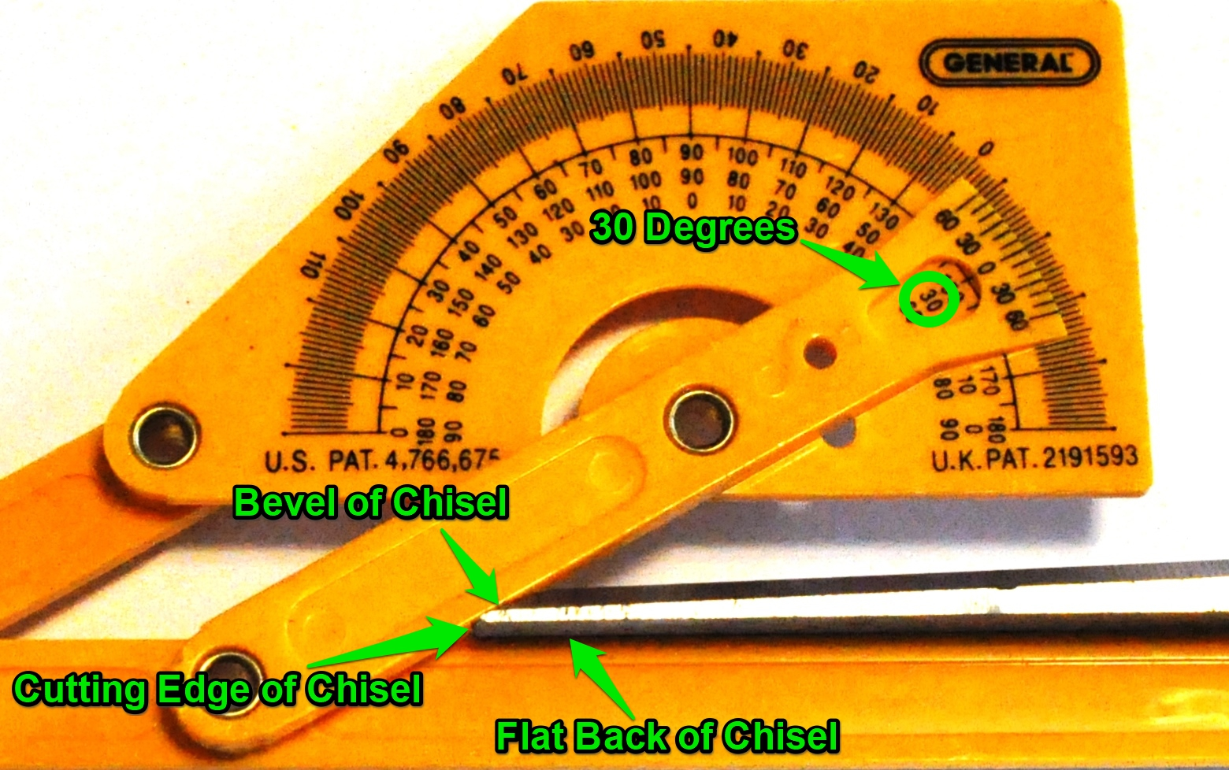
Chisel Sharpening -- Preparations
The bevels of most wood chisels we’ll use are ground at a 25º or 30º angle.
Check the manufacturer’s specifications for the chisel’s grind angle; or, measure it…

Slide 39
Chisel Sharpening -- Preparations
Gather the necessary materials:
  Hones of various grits, as needed;
  A leather strop with polishing compound;
  Appropriate hone lubricant;
  Appropriate chisel honing jig;
  Cleaning rags;
  Safety glasses;
  Mechanics gloves, if needed.

Slide 40
Chisel Sharpening – Step 1
Clean the chisel, well. Remove oil, grease, dirt, and loose rust.
Examine the condition of the edge to determine if honing needs to begin with a coarse stone, or if a medium or fine stone will be a suitable starting hone.
The photos in the next slide were taken with a 250x USB microscope. This chisel was never sharpened after purchase. Thus, in addition to wear and nicks on the edge, as well as some pitting and rust, the original grinding grooves are still visible from the original manufacturing…

Slide 41
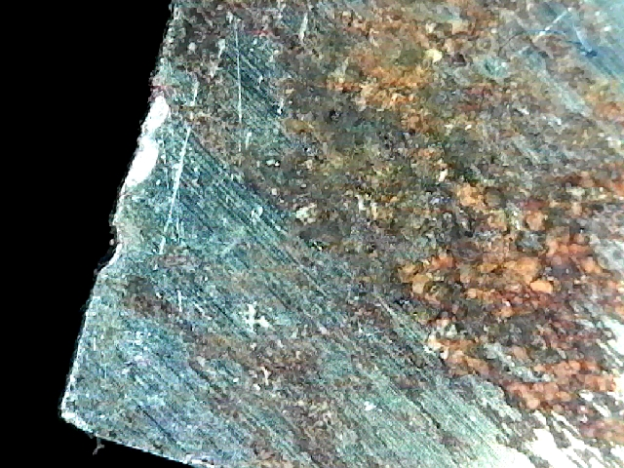
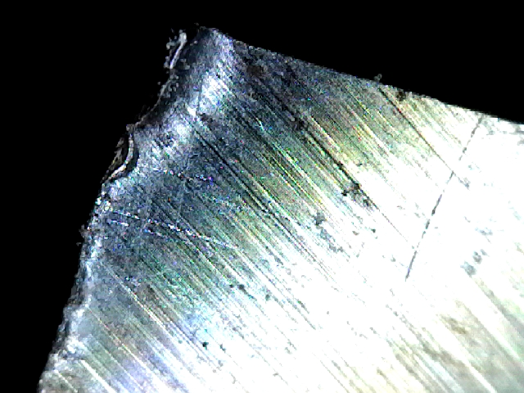
Chisel Sharpening – Step 1
The Back Flat Side -- Corners

Slide 42
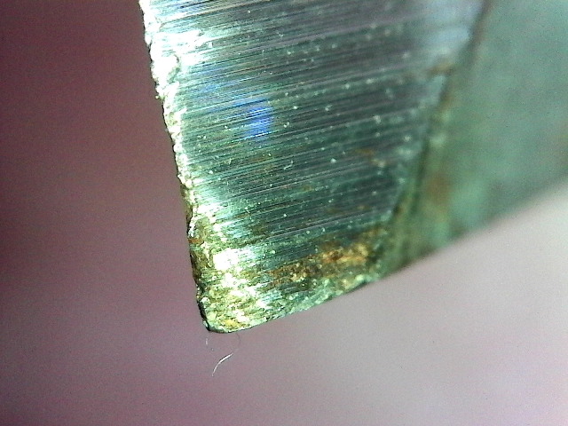
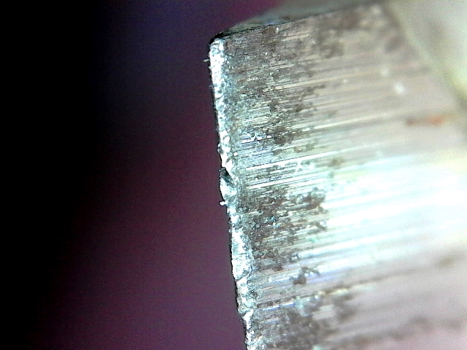
Chisel Sharpening – Step 1
The Front Bevel Side -- Corners

Slide 43
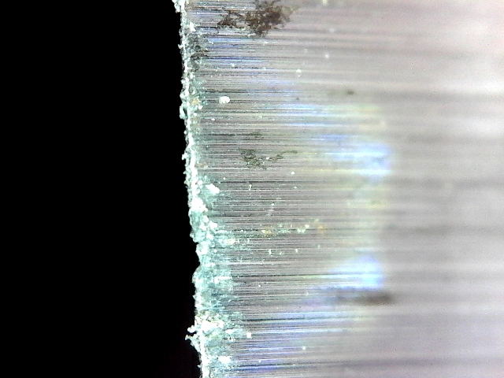
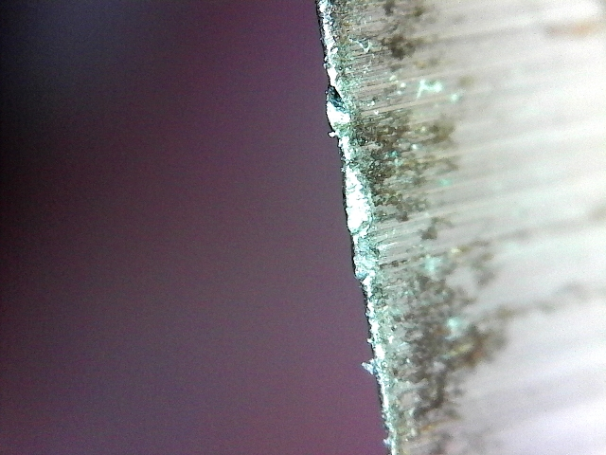
Chisel Sharpening – Step 1
The Front Bevel Side – Mid-Edge

Slide 44
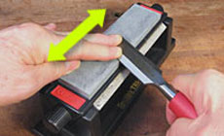
Chisel Sharpening – Step 2
Lap the Back/Flat Side of the Chisel
  Lay it flat on the lubricated hone and work it back and forth in a line perpendicular to the centerline of the chisel.
  Work through all the appropriate grits.

Slide 45
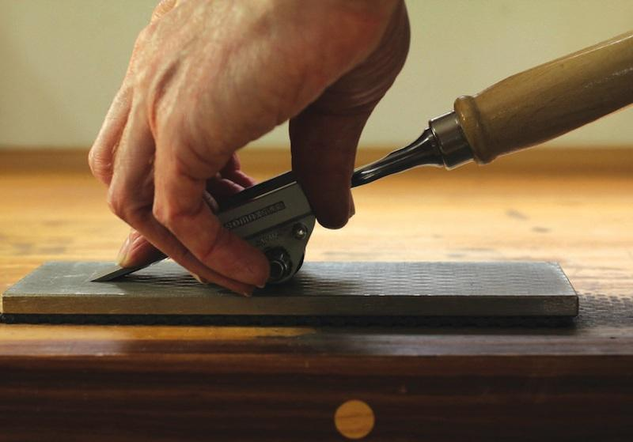
Chisel Sharpening – Step 3
Hone the Bevel
  Set the chisel in the jig, bevel down, so the bevel will lie flush on the hone’s lubricated surface.
  Push the edge forward along the hone as if trying to slice off a thin layer.
  Inspect often.
  Proceed grit-to-grit.

Slide 46
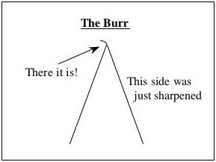
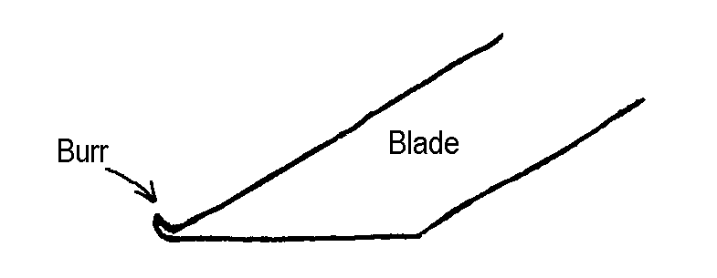
Chisel Sharpening -- Interlude
During the sharpening process, a very, very thin wafer of steel will develop along the length of the cutting end – the “burr.” It must be removed. Otherwise, upon use, it will immediately fold over and dull the edge.

Slide 47
Chisel Sharpening – Step 4
Remove the burr by stropping the chisel.
When honing, the edge is pushed along the stone’s surface.
When stropping, the edge is dragged backwards over a flat, smooth, leather strop, surface-impregnated with high-grit polishing compound.
Use alternating strokes, back-bevel-back-bevel, etc.
Hold the honed surface flat on the strop, lift the back end up, ever so slightly, and drag the edge back.

Slide 48
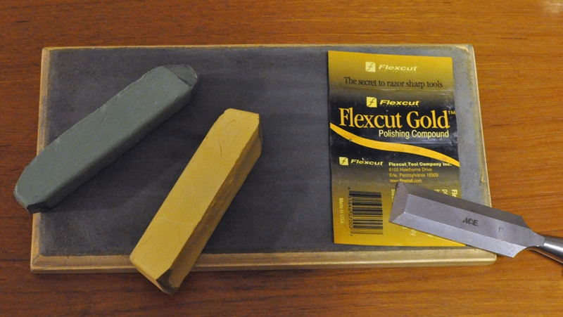
Chisel Sharpening – Step 4
Rub the polishing compound into the leather like coloring with a fat crayon.
Green = Chromium Oxide = about 10,000 grit
Gold = Aluminum & Titanium Oxides = about 8,000 grit

Slide 49
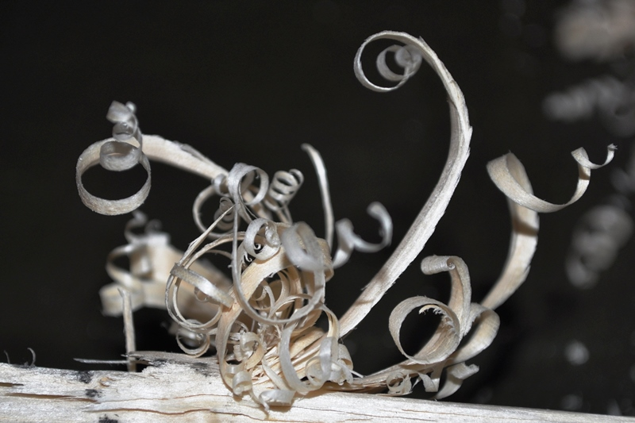
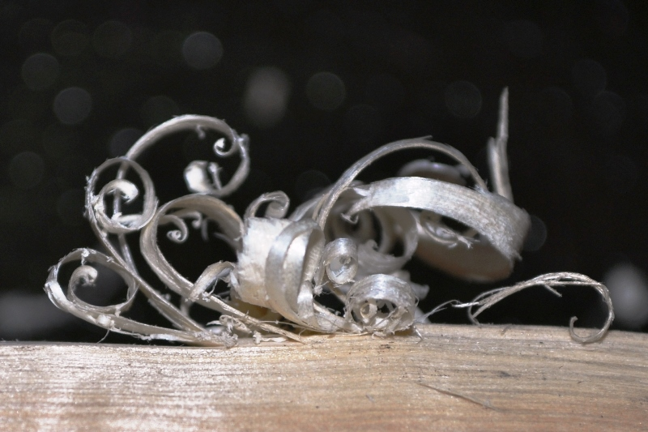
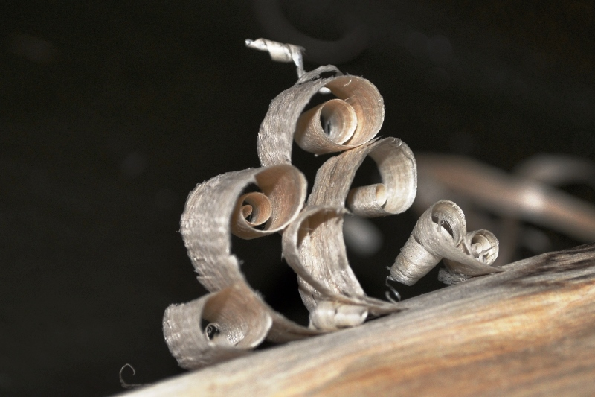
Chisel Sharpening – Step 5
Check the chisel for sharpness!
  Hold a sheet of paper, vertically. Attempt to shave thin slices off the edge of the hanging paper.
  Try to shave very thin wafers and curls off the surface of a piece of scrap wood.

Slide 50
Put Your Sharp Chisel to Work!
PROPERLY
CAREFULLY
SAFELY

