Slide 1
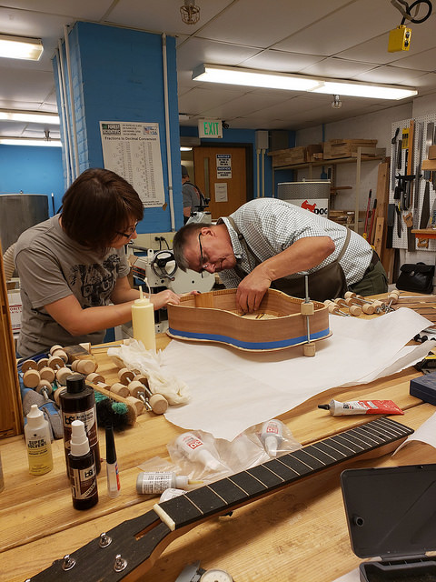
Exploring Factors that Affect Tree Growth
The STEM Guitar Grant
Debbie French, PhD

Slide 2
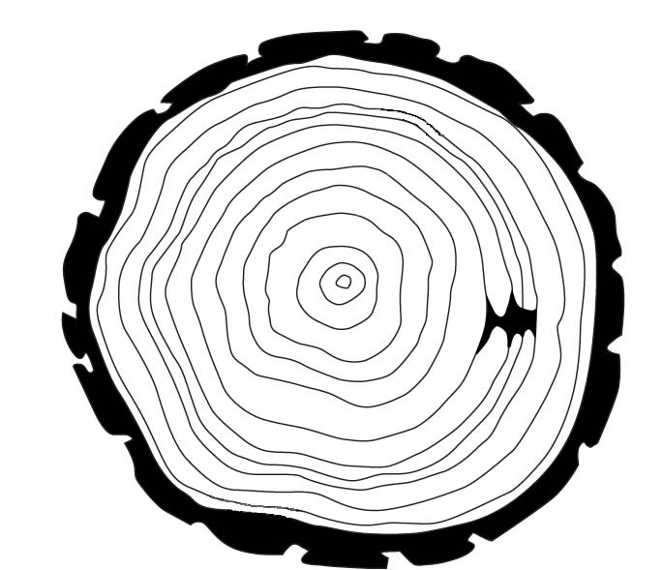
If you know when a tree was cut down, describe how you could determine the age of the tree?
Most trees add a ring each year they grow.
How old is this tree?
13 years old

Slide 3
Dendrochronology
Dendro-: Tree
-Chrono-: Time
-Ology: The study of
Dendrochronology is the study of tree growth over time.

Slide 4
What else do you notice about this tree cut-out?
Some rings are wide
Other rings are narrow

Slide 5
What factors could affect tree growth?
Some factors that affect tree growth are:
  Temperature
  Rainfall
  Forest fires
  Insects
  Landslides
In this lesson, we will explore how temperature and precipitation affect tree growth.

Slide 6
Below is a ”tree cookie”—A cross-cutting of a tree trunk:
Which letter represents good growing conditions?
Which letter represents poor growing conditions?
B
A
B
A

Slide 7
Dendroclimatology
Dendroclimatology is the study of the past climate as evidenced by the growth patterns in tree rings.

Slide 8
Image Source:
https://climate.nasa.gov/news/2540/tree-rings-provide-snapshots-of-earths-past-climate/

Slide 9
Caution!
Some tree species only grow one ring per every two years.
Other species may grow two rings per year.
However, most tree species grow one ring per year.

Slide 10
Tree Rings in Hard vs. Soft Woods
What differences do you notice between the red pine (soft wood) and the red oak (a hard wood)?
Image Source: https://careforwood.wordpress.com/wood-anatomy/

Slide 11
Factors that Affect Tree Growth
While there are other factors that affect tree growth, you will work through a simulation to determine the roles temperature and precipitation play in the growth of a tree.
https://scied.ucar.edu/tree-ring-interactive

Slide 12
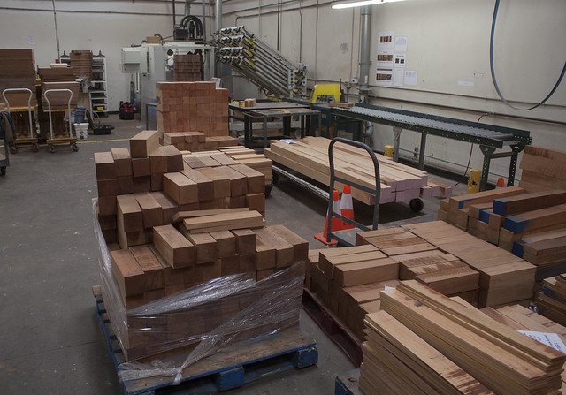
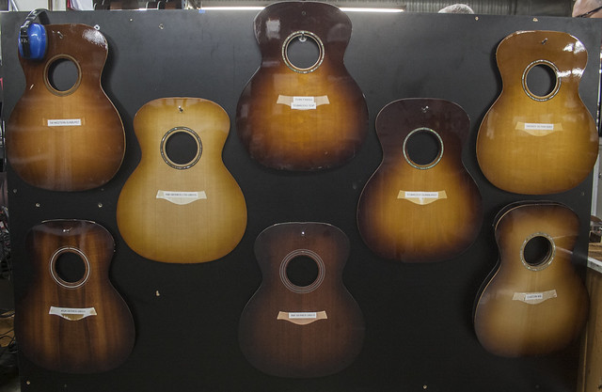
Tree Growth and Guitars
Later in this lesson you will explore:
  Why it is important as a luthier (guitar maker) to understand factors that influence tree growth.
  How Taylor Guitars is ensuring they have a sustainable supply of wood suitable for all aspects of guitar-making.
Photos at the Taylor Guitar Factory. Photos courtesy of James Huntington Schuelke
Notes:
Possible answers: In order to get

