Slide 1






Mentor-Connect
ATE Community Support – Addressing Questions on ATE Grants Management During Covid-19
June 10, 2020
1:00-2:00 p.m. Eastern

Slide 2

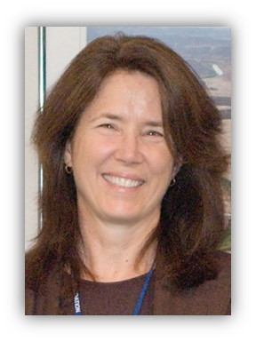
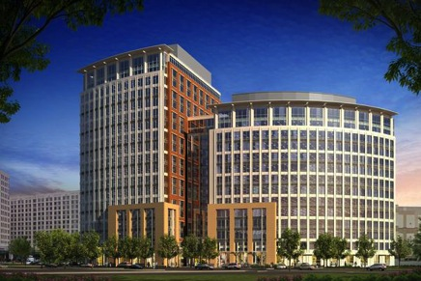
Welcome & Introductions
Dr. Celeste Carter, NSF Program Director
Co-Lead, ATE Program Officer
National Science Foundation

Slide 3
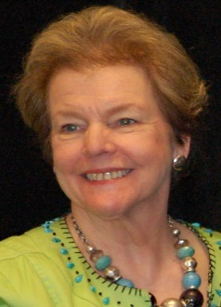

Agenda
Elaine Craft
Changes in Project
Annual Reports
No-cost Extensions
Budget Adjustments
Supplemental Funding Requests
Re-cap
Q & A with Dr. Carter

Slide 4
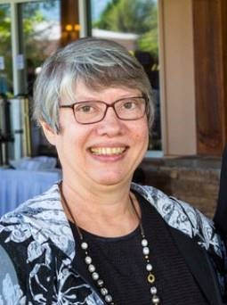
Changes in Project
Pamela Silvers
Communicating with your Program Officer
Preserving original Goals, Intellectual Merit & Broader Impacts
Revisiting Deliverables, Timeline, and Scope
Changes as needed to move forward

Slide 5

Changes in Project
Program officer
  E-mail
  They approve changes
  They want you to succeed

Slide 6

Changes in Project
Integrity of Proposal
    Goals
    Intellectual Merit
    Broader Impacts

Slide 7
Changes in Project
  Deliverables might include
    Workshops
    Presentations
    Course Modifications
Timeline Solutions
  Virtual
  No Cost Extension

Slide 8
Changes in Project
COVID
    Workshops
    Travel
  Non-COVID
    Change of courses
    PI/Co-PI Change

Slide 9
Annual Reports
Timeline
Sections – Information needed
How to address shortfalls & change in plans
Report pitfalls
Evaluator’s report

Slide 10

Annual Reports
E-mail - 90 days
Timing for submission
Annual Report

Slide 11
Annual Reports
Information Needed
What are the major goals of the project?
What was accomplished under these goals (you must provide information for at least one of the 4 categories)?
      Major activities
      Specific objectives
      Significant results
      Key outcomes or other achievements

Slide 12
Annual Reports
Information Needed (continued)
What opportunities for training and professional development has the project provided?
How have the results been disseminated to communities of interest?
What do you plan to do during the next reporting period to accomplish the goals?

Slide 13
Annual Reports
COVID Challenges & Changes
Activity completion
Training & travel
Faculty teleworking
Unexpected financial costs changes
Evaluator’s site visit

Slide 14
Annual Reports
Five Report Pitfalls
Recycling last year’s report without changes.
Including students’ names.
Not attaching your evaluator’s report.
Not using/responding to your evaluator’s report.
Only reporting the positive things and not the challenges/unforeseen obstacles.

Slide 15


Annual Reports
Five Common Mistakes
Evaluator
Communicate with evaluator
Discuss changes
Plan the timing for report submission
Attach external evaluator report

Slide 16
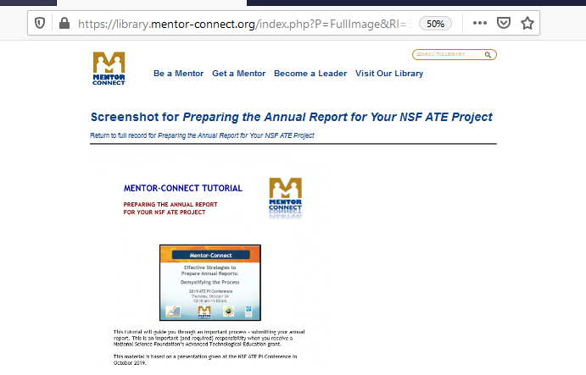
Annual Reports
Five Common Mistakes
Full copy of presentation entitled:
Effective Strategies for
Preparing Annual Reports:
Demystifying the Process

Slide 17
No-Cost Extensions
What?
More time to complete your project
Within same budget
When?
In final months of last year of a grant award
Submit notification (or request) 1-2 months before award anniversary
Restrictions?
May not have $0 remaining balance of grant funds at time of request
May not be just for using unliquidated balances

Slide 18
No-Cost Extensions
Length?
12 months
Can close out grant sooner if money is gone/work is done
Justification?
  Work plan must adhere to previously approved objectives of project
  Types?
    Grantee approved - 1st no-cost extension
    NSF Program Officer approved - subsequent no-cost extension(s)

Slide 19

No-Cost Extensions
When to Submit?
1st no-cost extension: at least 10 calendar days prior to anniversary date of award (sooner is advisable)
2nd no-cost extension: at least 45 days before scheduled grant end date
What information to supply?
  Each request must be justified – brief statement inserted in text box
  Plan for work must adhere to previously approved objectives of project
How to submit?
PI initiates in Research.gov
AOR must approve & submit to NSF

Slide 20
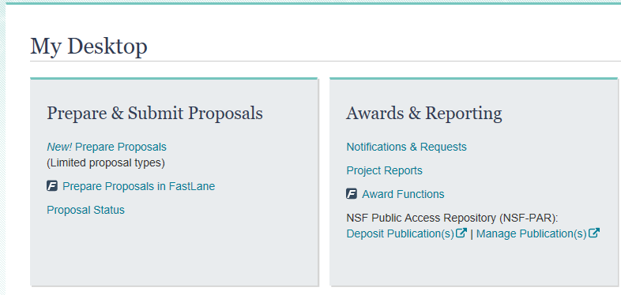
No-Cost Extensions
Log-in to Research.gov (same NSF # and password as FastLane)
Select “Notifications & Requests” under Awards & Reporting

Slide 21
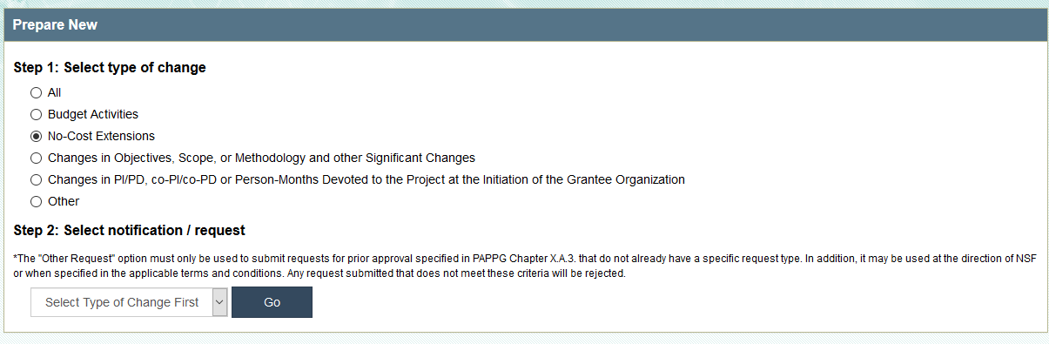
No-Cost Extensions

Slide 22
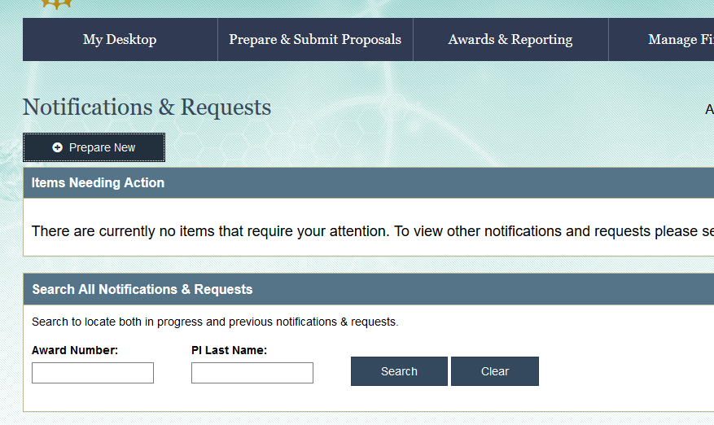
No-Cost Extensions
Enter your Grant #

Slide 23
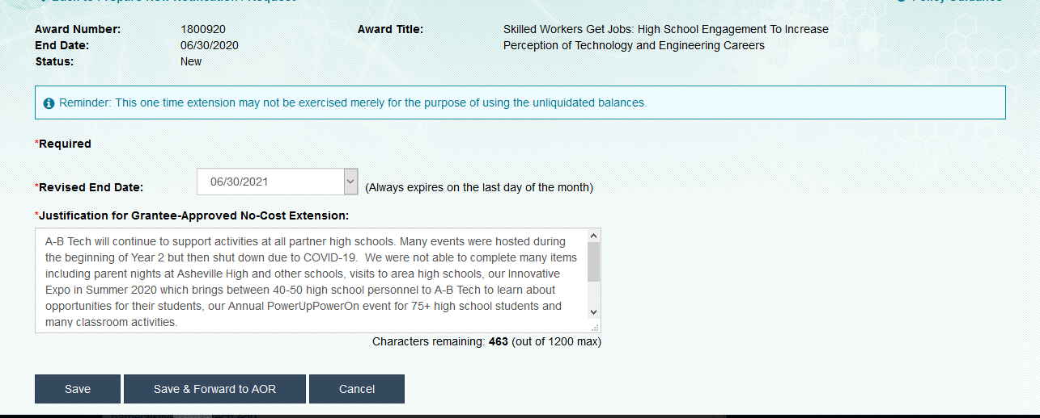
No-Cost Extensions
Select revised End Date from Drop Down
Type in Justification

Slide 24
No-Cost Extensions
More information about no-cost extensions:
PAPPG 20-1, Part II -Award Administration and monitoring of Grants and Cooperative Agreements,
Chapter VI: NSF Awards,
Subpart D: NSF Grant Periods,
Subpart 3, Change in Grant Period,
Subpart c, No-cost extensions.

Slide 25
Budget Adjustments
PI has authority to move money ….with one exception: Participant Support
Restrictions on Participant Support
Program Officer must approve:
$ moved out of Participant Support, or
$ moved between categories within Participant Support
However, PI has authority to move money into Participant Support
F. PARTICIPANT SUPPORT COSTS
STIPENDS $___________________
TRAVEL $___________________
SUBSISTENCE $___________________
OTHER $___________________

Slide 26

Budget Adjustments
Budget reallocation impact on indirect costs? A business office concern
College Policies & Procedures for expenditures must be followed

Slide 27
Supplemental Funding
PAPPG 20-1
“In unusual circumstances, small amounts of supplemental funding and up to six months of additional support may be requested to assure adequate completion of the original scope of work”
But, NSF Programs and Program Officers have additional flexibility …..

Slide 28
Supplemental Funding
What?
  Adds additional funding to an existing grant award
Why?
  Circumstances change or opportunities emerge that align with original project goals/objectives
      Types?
        Additional financial support for work within current goals/objectives
        Financial support for an additional scope of work that responds to a Dear Colleague Letter opportunity

Slide 29
Supplemental Funding
Dear Colleague Letters- ATE Funding Opportunities for Grantees
NSF 16-007
    Dear Colleague Letter: Advanced Technological Education (ATE) Program Support for Manufacturing Innovation Institutes (MIIs) and Investing in Manufacturing Communities Partnerships (IMCPs)
NSF 19-057
    Dear Colleague Letter: International Training and Education in Advanced Technologies (ATE-I)
NSF 20-054
    Dear Colleague Letter: Undergraduate Research Experiences in Advanced Technological Education (ATE-URE)

Slide 30
Supplemental Funding
When to consider?
  Circumstances change or opportunities emerge that align with original project goals/objectives
  Any project year, including no-cost extension year
  After communicating with your Program Officer
  When to submit request?
  2 months before money is needed
  Requests may be submitted within any project year

Slide 31
Supplemental Funding
    Length?
      Work to be completed by end date of grant award
  Restrictions?
    Amount of request in a given year is restricted (PAPPG)
    Limit applies to annual total if multiple requests are submitted
    Notification?
      Award amendment is issued via email

Slide 32
Supplemental Funding
How to Request?
Outline your idea/concept for a supplemental funding request
Send to your Program Officer and request feedback
Formally submit a Supplemental Funding request only if Program Officer has informally indicated that it is OK to do so
NOTE: This is not a new grant proposal

Slide 33
Supplemental Funding
How to submit online request?
Login to Research.gov
Under “Awards and Reporting,” select FastLane
Automatically transfers from Research.gov to FastLane
F
Award Functions

Slide 34
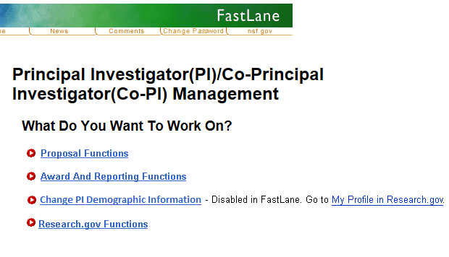
Supplemental Funding
In FastLane, Select Award & Reporting Functions

Slide 35
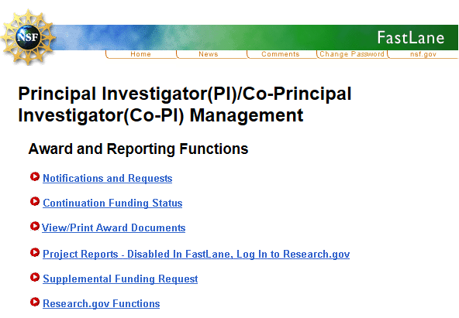
Supplemental Funding
Select Supplemental Funding Request
Next, select grant #

Slide 36
Supplemental Funding
Information required?
Summary of Proposed Work
Justification
Budget & Budget Justification
    If responding to Dear Colleague Letter, see the letter for additional specifications and funding limits.

Slide 37
Supplemental Funding
More information about Supplemental Funding:
PAPPG 20-1, Part II -Award Administration and monitoring of Grants and Cooperative Agreements,
Chapter VI: NSF Awards,
Subpart E: Additional Funding Support,
Subpart 4, Supplemental Support

Slide 38
Grant Management Strategies
Changes in Project
Annual Reports
No-cost Extensions
Budget Adjustments
Supplemental Funding Requests

Slide 39
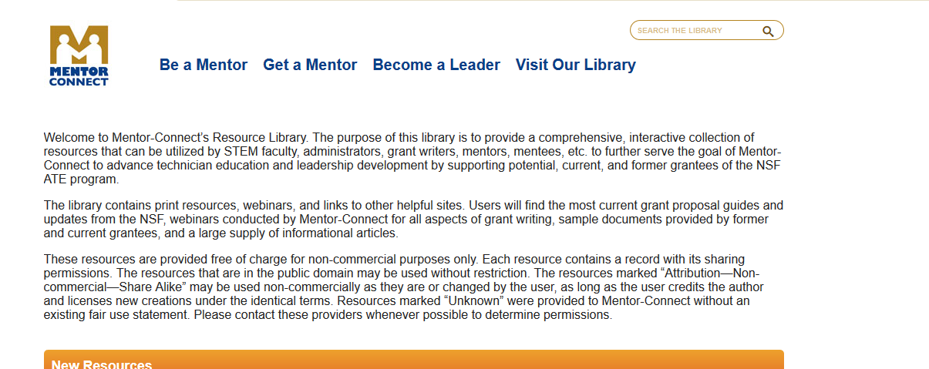
Additional Resources
https://library.mentor-connect.org/

Slide 40
Contact Us
Celeste Carter – vccarter@nsf.gov
Elaine Craft – Elaine.Craft@fdtc.edu
Pamela Silvers – pamelajsilvers@abtech.edu

Slide 41
Q & A
Dr. Celeste Carter, NSF Program Director
Co-Lead, ATE Program Officer

Slide 42



Mentor-Connect@fdtc.edu
Mentor-Connect: Leadership Development and Outreach for ATE
NSF DUE # 1501183 and #1840856
Elaine Craft, Principal Investigator
SC ATE Center of Excellence
Florence-Darlington Technical College - Florence, SC 29501
www.Mentor-Connect.org

