Slide 1
Properties of Reactor Plant Materials
ACADs (08-006) Covered
Keywords
Alloys, tempering, quench, radiation induced embrittlement, Hooke’s Law, Young’s Modulus, residual stress, structural stress, mass flow stress, brittle failure, galvanic corrosion, thermal shock, hot working, cold working, recrystallation temperature, vibration induced cracking,
Description
This PowerPoint presentation is an overview of the properties of metals and alloys used in reactor plant materials.
Supporting Material
1.1.7.1.1 | 1.1.7.1.2 | 1.1.7.1.3 | 1.1.7.1.4 | 1.1.7.1.5
1.1.7.1.6 | 1.1.7.1.9 | 1.1.7.2 | 1.1.7.3.1 | 1.1.7.3.1.2
1.1.7.3.1.5 | 1.1.7.3.1.6 | 1.1.7.3.4 | 1.1.7.3.5

Slide 2
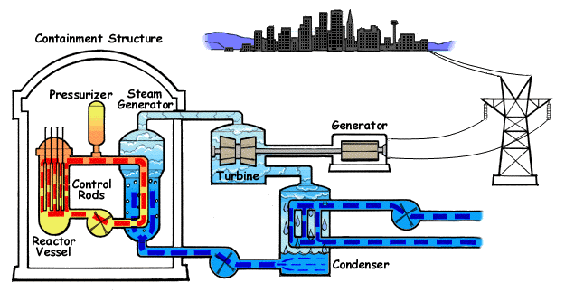
Power Plant Science
Power Plant Science

Slide 3
Properties of Reactor Plant Materials (1.1.7)
Objectives:
  Explain basic material properties
  Explain fracture mechanics
  Understand problems with planet materials

Slide 4
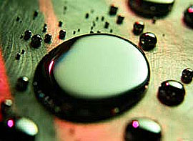
Properties of Metals and the Metallic Bond
The general physical properties of metals are:
  High metallic luster
  High electrical and thermal conductivity
  Malleability
  Ductility
  High density

Slide 5

Properties of Metals and the Metallic Bond
The general chemical properties of metals are:
Metals do not readily chemically combine with each other.
Metals combine readily with nonmetals, and are found in nature combined with elements such as oxygen or sulfur.

Slide 6
Properties of Metals and the Metallic Bond
The outermost (valance) electrons surrounding each metal atom are loosely held by the nucleus, and may readily enter the orbital continuum. The resulting structure is often described as a regular crystal lattice of positively charged nuclei surrounded by a sea of electrons. (Large circles are nuclei and small dots are electrons)

Slide 7
Alloys (1.1.7.1.1)
Definition: Substance having metallic properties and being composed of two or more chemical elements of which one is a metal.
Gives a combination of desired properties not found in pure metals.

Slide 8
Alloys
Metals cannot spontaneously combine with each other
Mixing is done by combining in a molten state
Two ways of combining
  Solid solution
  Mixture

Slide 9
Alloys (1.1.7.1.1)
Solid solution
  Solidified solution of mutually soluble constituents (e.g. metal and non-metal)
Mixture
  Components not mutually soluble (e.g. two metals)
  Physical separation of phases
  Phases are solid solutions of pure element components

Slide 10
Compressive Strength (1.1.7.1.2)
The capacity of a material or structure to withstand axially directed pushing forces. When the limit of compressive strength is reached, materials are crushed

Slide 11
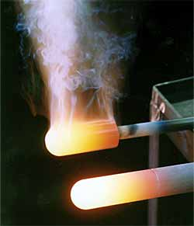
Thermal Stress (1.1.7.1.3)
Exists in materials having a temperature gradient across them when they are heated or cooled – the material attempts to expand or contract at different rates
Examples: RX vessel during a plant cooldown or Main Steam line on heat up

Slide 12
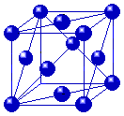
Heat Treatment (1.1.7.1.4)
When steel is heated to the critical temperature (about 1400 degrees F), the iron will change from body-centered to face-centered, and the carbon atoms will migrate into the central position formerly occupied by an iron atom (austentite).

Slide 13
Heat Treatment
If you cool (quench) the sample suddenly by immersing it in oil or water, the carbon atoms are trapped, and the result is a very hard, brittle steel. The structure is now a body centered tetragonal form (martensite).
If rather than quenching, you let the sample cool slowly, the iron atoms migrate back into the cube and force the carbon back out, resulting in soft steel (pearlite). If the sample was formerly hard, this softening process is called annealing.

Slide 14
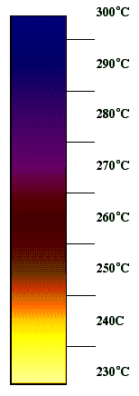
Tempering
After quenching, the steel is hard, brittle and internally stressed. Before use, it is usually necessary to reduce these stresses and increase toughness by 'tempering'.
There will also be a reduction in hardness and the selection of tempering temperature dictates the final properties.

Slide 15
Tempering
Color change indicates the temperature of the metal and is used to control the tempering process. Each stage of the color change indicates a percentage of the carbide compound remaining in the steel, and therefore its hardness.
The objective of tempering is to reduce the hardness to the point required and then stop the carbide breaking down any further by immediately quenching in cold water.

Slide 16
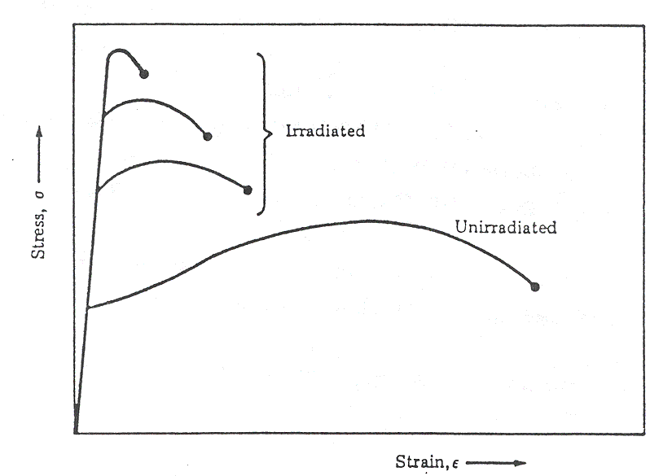
Radiation Induced Embrittlement (1.1.7.1.5)
Stress-Strain Curve for BCC Steel
Irradiated
Stress
Non-irradiated
Strain

Slide 17
Radiation Induced Embrittlement Effect on NDT Temperature

Slide 18
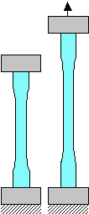
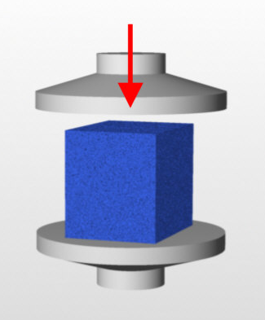
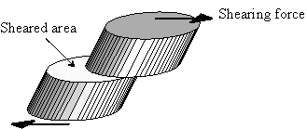
Types of Strength (1.1.7.1.6)
Strength is defined as the highest stress that a material can withstand before it completely fails to perform structurally.
Torsional
Tensile
Shear
Compressive

Slide 19
Stress (1.1.7.1.9)
The ratio of forces acting on an object to the cross sectional area where those forces are being applied.
Where:
σ = stress (psi or lb_{f}/in²)
F = applied force (lb_{f})
A = cross-sectional area (in²)

Slide 20
Strain
Total elongation per unit length.
Where:
ε = strain (inches per inch)
δ = total elongation (in)
L = original length (in)

Slide 21
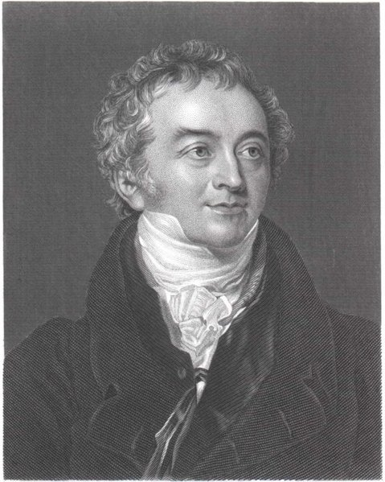
Young’s Modulus
Where:
E = Young’s Modulus or modulus of elasticity (psi or lb_{f} / in²)
σ = stress (psi or lb_{f} / in²)
ε = strain (inches per inch)
Thomas Young

Slide 22
Hooke’s Law
Where:
δ = total elongation of bar (in) (lower case Greek letter delta)
F = force producing extension of bar (lbf)
L = length of bar (in)
A = cross-sectional area of bar (in2)
E = elastic constant of the material, called the
Modulus of Elasticity, or Young’s Modulus (lbf/ in2)

Slide 23
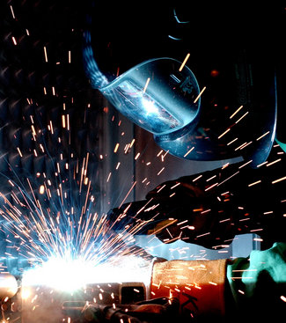
Residual Stress
Stresses exist in the metal from the manufacturing processes.
A crack, flaw, geometry change, etc., can tend to concentrate stress on a smaller area, since less area is available to carry the load.
Example: Welding induces several residual stresses.

Slide 24
Structural Stress
A result of components being in stress due to other components requiring support of the total weight.
σ
=
Force
Area
=
Weight
Area
W = weight of pipe and fluid

Slide 25
Pressure Stress
Results from containing a fluid under pressure
Examples: RCS during normal operation or Steam System Piping

Slide 26
Mass Flow Stress
Result from forces applied to vessels or piping systems by fluids in motion
Examples: Primary coolant flowing through the RX vessel or water hammer on start-up of a system
Force

Slide 27
Stress
F
F
Tensile Stress
F
F
Compressive Stress

Slide 28
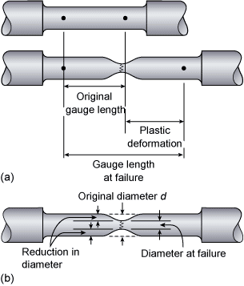
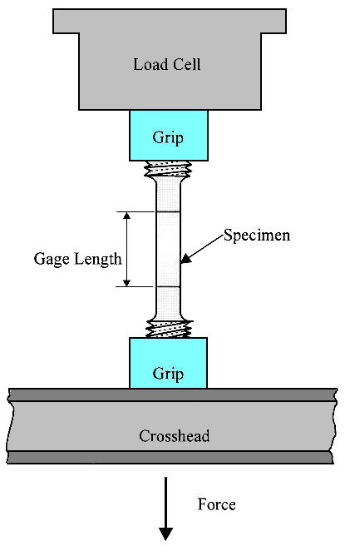
Tensile Test

Slide 29
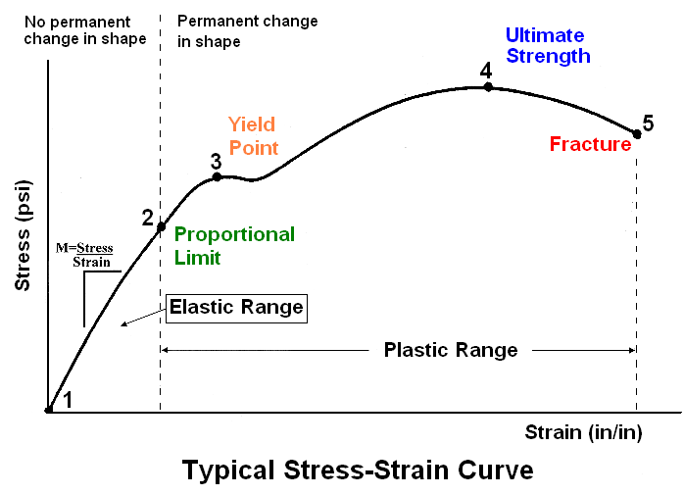
Stress vs. Strain

Slide 30
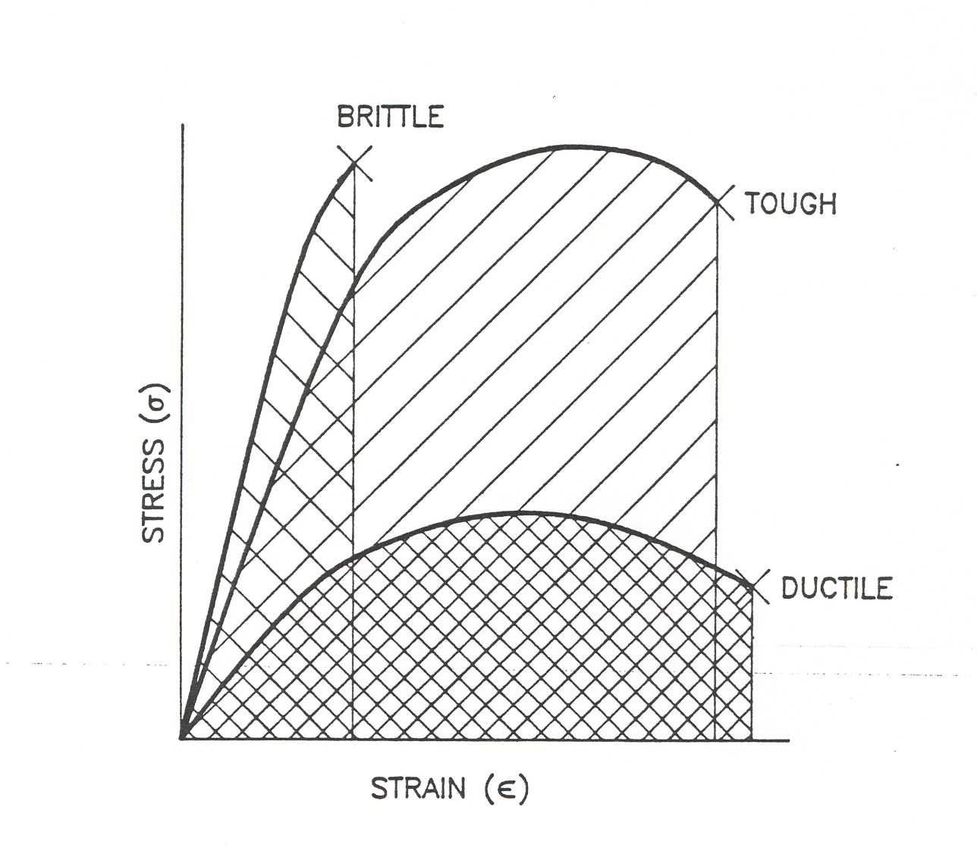
Stress vs. Strain
Stress-Strain Curve for:
  Brittle Material
  “Tough” Material
  Ductile Material
Area under the curve represents the total energy absorbed prior
to failure.

Slide 31
Stress vs. Strain

Slide 32
Brittle vs. Ductile
Toughness is measured as the combination of strength and ductility, or the total area under the stress-strain curve.
Therefore, alloys that are both high in strength and ductility should withstand high impact energy.

Slide 33
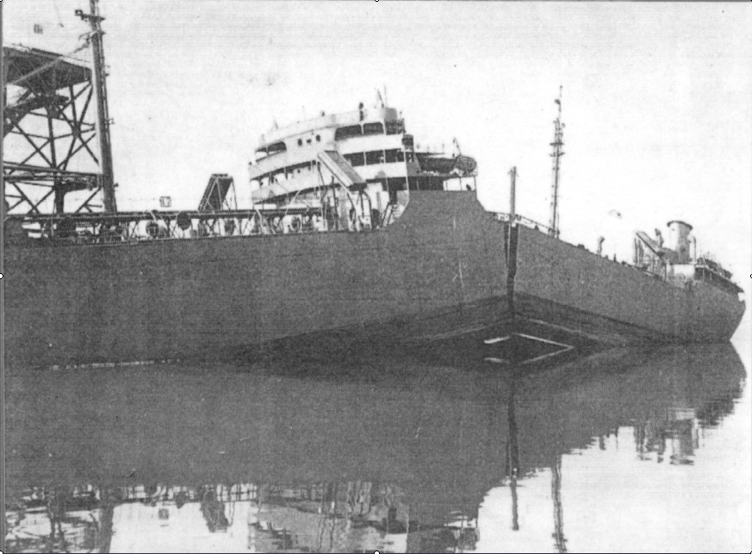
Brittle vs. Ductile

Slide 34
Brittle vs. Ductile
A
BRITTLE
FRACTURE
B
SHEARING
FRACTURE
C
COMPLETE
DUCTILE
FRACTURE
D
DUCTILE
FRACTURE
(CUP & CONE)

Slide 35
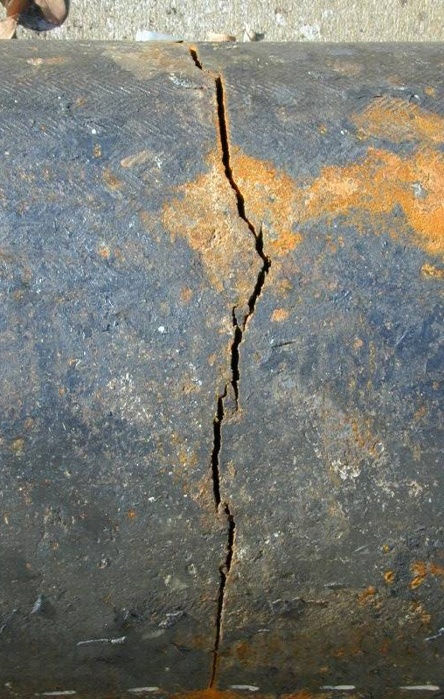
Brittle Failure (1.1.7.2)
Brittle fracture is defined as a sudden catastrophic failure with little or no plastic deformation.
Requires three conditions present to occur:
  Tensile stress
  Susceptible material (one with low fracture toughness)
  Pre-existing flaw

Slide 36
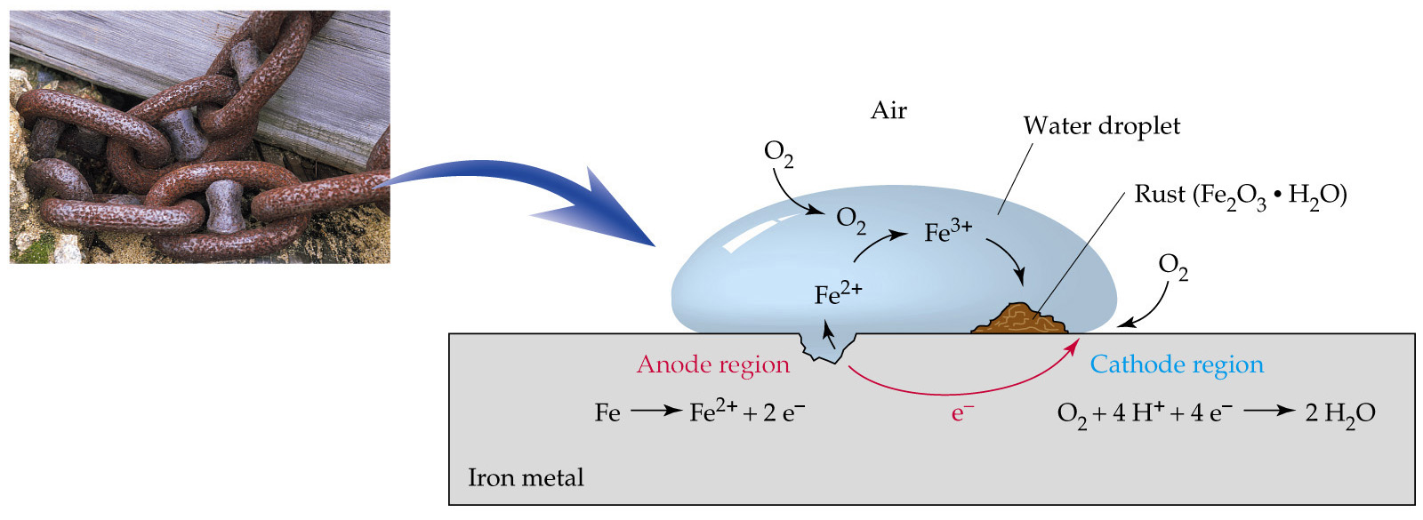
Corrosion (1.1.7.3.1)
Corrosion is the result of an anodic reaction, in which the metal dissolves in the electrolyte in the form of positively charged ions and a cathodic reaction, in which positively charged hydrogen ions build-up (“plate-out”) on the cathodic surface. The electrons released by the anodic reaction flow through the metallic circuit and neutralize an equivalent number of hydrogen ions in the cathode.

Slide 37
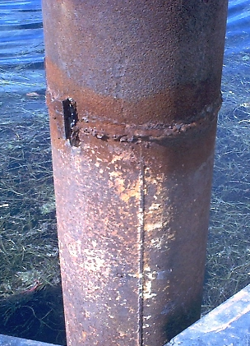
General Corrosion (1.1.7.3.1)
General Corrosion - corrosion that occurs over large areas of a metal surface.
This is the most common form of corrosion and it represents the greatest destruction of metal on a weight basis

Slide 38
There is an iron oxide film at the metal-water interface. Depending on a number of factors, including the amount of oxygen present and the pH, two types of films may develop.
  Hematite (Fe2O3) – The compound is red (red rust). It is a very soft and easily sloughed off of the surface allowing the cycle to repeat (undesirable).
  Magnetite (Fe3O4) – Called black rust. This is a harder, tightly adhering film that protects the surface from further deterioration (this is what we want).

Slide 39
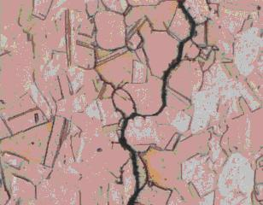
Localized Corrosion
Intergranular Corrosion - Localized attack at and adjacent to grain boundaries, with very little corrosion of the grains.

Slide 40
Localized Corrosion
The alloy disintegrates (grains fall out) and/or loses its strength. In a severe case of grain-boundary corrosion, entire grains are dislodged due to complete deterioration of their boundaries.
Intergranular corrosion can be caused by impurities at the grain boundaries, enrichment of one of the alloying elements, or depletion of one of these elements in the grain boundary areas.
Depletion of chromium in the grain-boundary regions results in intergranular corrosion of stainless steels.

Slide 41
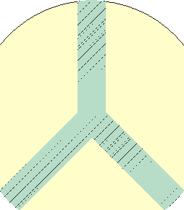
Chromium Carbide Precipitation
The most universally accepted theory for intergranular corrosion is based on depletion of chromium in the grain boundary areas.
Chromium Carbide
Precipitate
Grain
Carbide
Boundaries
Grain
Grain
}
Dissolved Metal
Chromium
Depleted Zone
Diagrammatic Representation of
Cross Section of Area Shown Above
a Grain Boundary in Sensitized Type
304 Stainless Steel

Slide 42
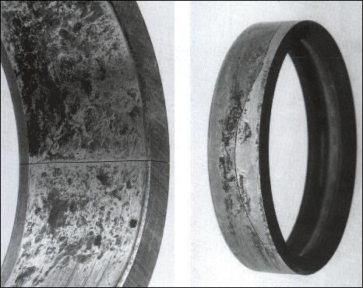
Localized Corrosion
Fretting corrosion occurs at contact areas between materials under load subject to vibration and slip.
Characterized by pits or grooves and oxide debris.
Common on ball bearings and other metal surfaces where metal to metal contact and motion occurs.

Slide 43
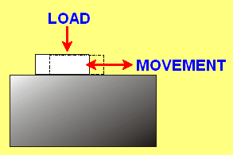
Localized Corrosion
The protective film on the metal surfaces is removed by the rubbing action and exposes fresh, active metal to the corrosive action of the atmosphere.
Also called friction oxidation, wear oxidation, chafing, and false brinelling.

Slide 44
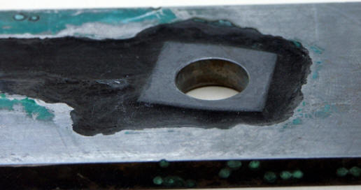
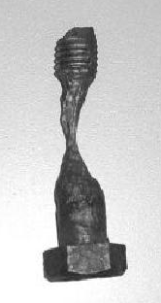
Localized Corrosion (1.1.7.3.1.1)
Crevice Corrosion - Intensive localized corrosion that frequently occurs within crevices and other shielded areas on metal surfaces exposed to a corrosive environment.

Slide 45
Localized Corrosion
Usually associated with small volumes of stagnant solution caused by holes, gasket surfaces, lap joints, surface deposits, and crevices under bolt and rivet heads.
To function as a corrosion site, a crevice must be wide enough to permit liquid entry but sufficiently narrow to maintain a stagnant zone.
This type of corrosion occurs in many mediums but it is most intense in chloride-containing solutions.

Slide 46
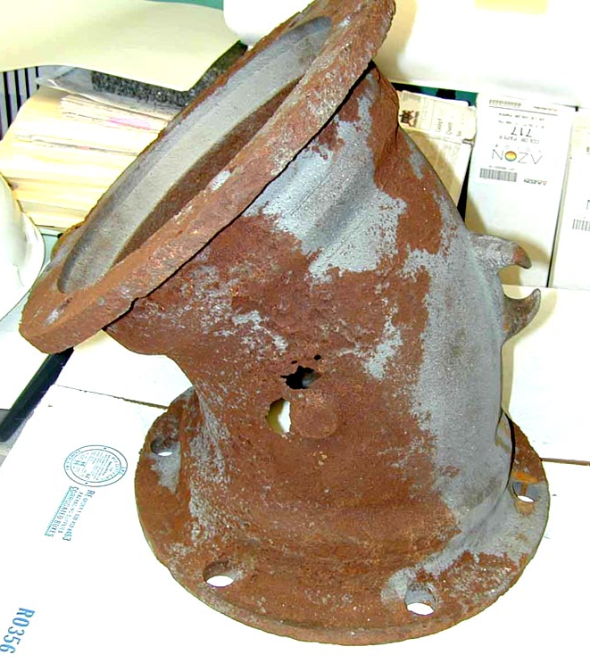
Localized Corrosion
Pitting is a form of extremely localized attack that results in holes in the metal.
It is often difficult to detect pits because of their small size and because the pits are often covered with corrosion products.

Slide 47
Localized Corrosion
An intense form of corrosion and failure can occur very quickly.
Many pitting failures are caused by chloride and chlorine-containing ions.
Often associated with stagnant conditions such as a liquid in a tank or liquid trapped in a low part of an inactive piping system.
Stainless steels are more susceptible to damage by pitting than any other class of alloy.

Slide 48
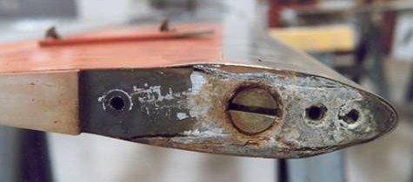
Galvanic Corrosion (1.1.7.3.1.2)
Galvanic corrosion tends to occur when dissimilar conducting materials are connected electrically and exposed to an electrolyte. The following fundamental requirements therefore have to be met for galvanic corrosion:

Slide 49
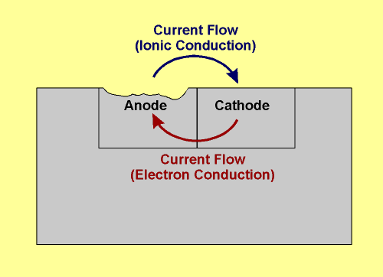
Galvanic Corrosion
  Dissimilar metals.
  Electrical contact between the dissimilar conducting materials
  (can be direct contact or a secondary connection such as a common grounding path).
  Electrolyte (the corrosive medium) in contact with the dissimilar conducting materials.

Slide 50
Galvanic Series
Anode End (Corroding Metal)
Magnesium
Zinc
Aluminum
Carbon Steel
Cast Iron
Stainless Steel (active)
Tin
Lead
Nickel (active)
Brasses
Copper
Bronzes
Nickel-copper alloy
Nickel (passive)
Stainless Steel (passive)
Silver solder
Titanium
Graphite
Gold
Platinum
Increasing Nobility
Cathode End (Protected Metal)

Slide 51
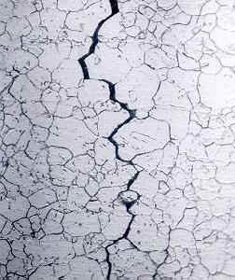
Localized Corrosion (1.1.7.3.1.5)
Stress Corrosion Cracking (SCC) refers to cracking caused by the simultaneous presence of tensile stress and a specific corrosive medium.

Slide 52
Localized Corrosion
Has serious consequences since it can occur at stresses within the range of typical design stress.
Intergranular stress corrosion cracking (IGSCC) requires three components to occur:
  tensile stress
  susceptible (sensitized) material
  corrosive environment

Slide 53
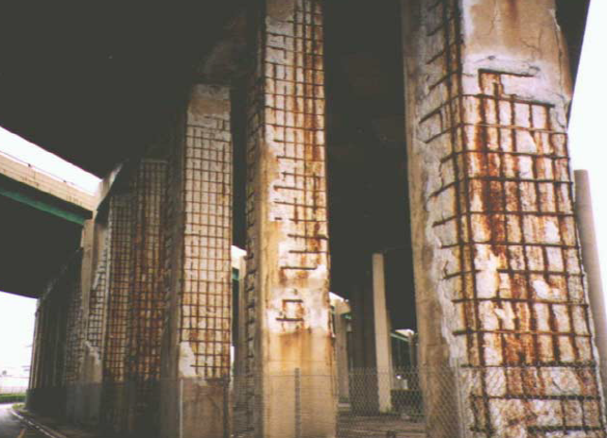
Chloride Stress Corrosion
Chloride Stress is caused by chlorides breaking up passive oxide
Layer on materials
Sources of chlorides:
– Marine Environments
– De-icing Salts (NaCl, CaCl2)
– Chemical Plant Environment
Vicious Circle: Chlorides are never consumed

Slide 54
Microbiologically Induced Corrosion (1.1.7.3.1.6)
Bacteria in water
. Can be in presence of oxygen or not
. Bacteria form a nodule
. Similar to pitting corrosion.
Control:
Biocide introduced into system medium
Applied Cathodic Currents
.

Slide 55
Corrosion Prevention
Galvanic corrosion can be reduced or prevented by using proper practice to minimize galvanic effects.
Select combinations of metals as close together as possible in the galvanic series.
Avoid unfavorable area effects of small anodes and large cathodes.
Insulate dissimilar metals completely.
Apply coatings with caution. Coat the cathode if only one material is to be coated.
Add inhibitors to decrease the aggressiveness of the environment.
Avoid threaded joints for materials far apart in the series. Welded or brazed joints should be used
Design for the use of readily replaceable anodic parts or make them thicker for longer life.
Install a third metal that is anodic to both metals in the galvanic contact.
.

Slide 56
Corrosion Prevention
Three major factors affect the rates or likelihood of corrosion:
  pH – May determine the type of corrosion that takes place and can directly affect passive protective layers.
  Oxygen content – Oxygen is added to condensate to maintain a tight corrosion layer in condensate and feedwater piping, however, hydrogen is added to scavenge oxygen in the reactor. This is to prevent intergranular stress corrosion cracking (IGSCC).
  Impurities – Could be any number of chemicals or elements that would adversely affect chemistry and promote corrosion. One in particular that must be avoided is anything containing chlorides.

Slide 57
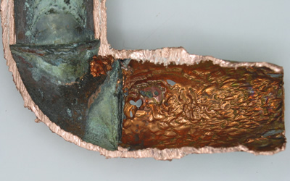
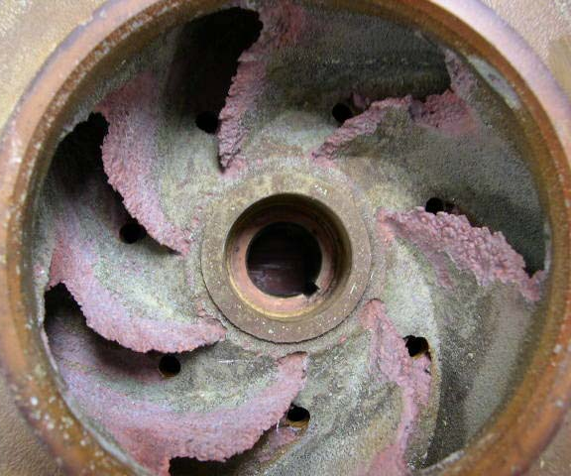
Erosion (1.1.7.3.4)
Abrasive action erosion - caused by the presence of solids in a fluid.
Droplet impingement - highly accelerated liquid droplet that causes a plastic deformation in the metal surface.
Cavitation erosion - damage to material surfaces caused by the formation and subsequent collapse of bubbles caused by local pressure fluctuations.
Liquid impact-induced erosion - a two-phase flow phenomenon that is caused by liquid droplets that are suspended in a flowing gas/vapor.
Flashing induced erosion - caused by the spontaneous vaporization caused by a sudden pressure change.

Slide 58
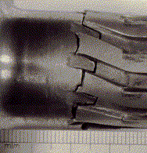
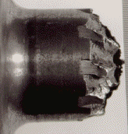
Fatigue Failure (1.1.7.3.5)
Many applications involve cyclical loading.
Fatigue failure may occur in steel, for example, after several cycles of loading to a stress level at 80% of the yield strength.
Torsional fatigue failure of a splined shaft
No elongation is generally evident at the site of a fatigue failure.
Repeated stress applications can create localized plastic deformation at the metal surface resulting in cold working (lower ductility and higher hardness) at these sites, resulting in cracking over time .

Slide 59
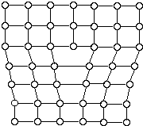
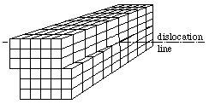
Cold Working/Work Hardening (1.1.7.3.5)
A dislocation may be defined as a disturbed region between two substantially perfect parts of a crystal. A dislocation is a linear defect around which some of the atoms are misaligned. Two simple types of dislocation are:
  Edge dislocation
  Screw dislocation
Screw
Dislocation
Edge
Dislocation

Slide 60
Cold Working/Work Hardening
Dislocations can be observed in crystalline materials using an electron-microscopic. Virtually all metals contain some dislocations that were introduced during solidification, during plastic deformation, and as consequence of thermal stresses that result from rapid cooling.
The importance of dislocations to the metal user is that dislocation interactions within a metal are a primary means by which metals are deformed and strengthened. When metals deform by dislocation motion, the more barriers the dislocations meet, the stronger the metal.

Slide 61
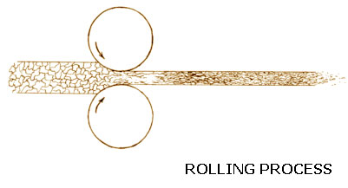
Cold Working/Work Hardening
Work hardening takes place when a metal has been deformed (by hammering, bending, pressing or rolling for instance).
As mentioned, during deformation the dislocations run into each other, thus increasing the material’s strength.
The deformation also increases the number of dislocations, which increases the strength too.

Slide 62
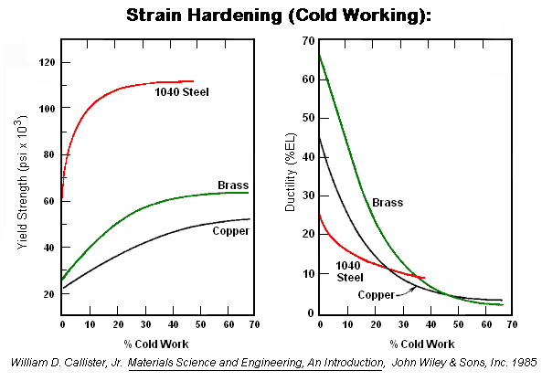
Cold Working/Work Hardening
As a result of this process, the material’s Yield and Tensile Strength go up while its Ductility goes down (it becomes brittle)

Slide 63
Cold Working/Work Hardening
The metal must have some ductility to begin with. Since HCP metals are already brittle, little work hardening is possible. Some work hardening is possible with BCC metals while FCC metals are ductile and easily work hardened.
There is only a certain amount you can deform a material before it breaks.
Cold work is measured in % (the percent change in cross-section of the material)
Different materials have varying % allowable cold work.

Slide 64
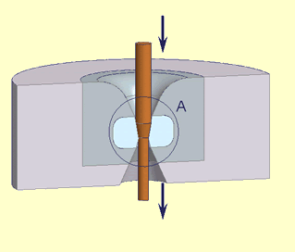
Cold Working/Work Hardening
What if you want or need to deform a sample more than is “possible”? For example, what if you want to draw a piece of wire from a rod of copper?
You can anneal the material, and “undo” the strain hardening.
The maximum cold work allowable for copper is 85%. You will have to draw the copper, then anneal it several times.

Slide 65
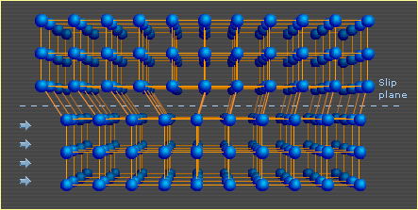
Cold Working/Work Hardening
When you deform a piece of metal, you elongate the grains. Slip only occurs in the favored direction.
You strengthen the material in the direction it is deformed, but properties in the other directions do not change as much.
When you draw wire, you strengthen in the longitudinal direction. It is not strengthened axially.
This makes it easy to cut, but hard to break by pulling on it.

Slide 66
Hot Working
Hot Working – is the working of metals above their recrystallation temperature and no strain hardening occurs.
Recrystallation temperature is the where deformed grains are replaced with new undeformed grains until all existing grains are replaced.

Slide 67
Thermal Shock
Thermal shock occurs when a thermal gradient causes different parts of an object to expand at different rates.
This causes stress to be put on the material that eventually exceeds the strength of the material with causes it to crack. nothing stops this crack from propagating through the material, it will cause the object's structure to fail.

Slide 68
Vibration Induced Cracking
Excess vibrations & resultant stresses in the effected parts cause excessive fatigue & hence failure of that part. Vibrations from any one source may induce more vibrations on other sources & the net effect may be more severe & cascading in nature.
Excess vibrations may also effect foundations of machines or part of building, if their resonant frequency coincides with one of the exciting machine frequencies & causes excess vibrations. If the value of vibration & pulsation are within limits, than these do not affect machine life by themselves.

Slide 69

Questions???
Students: Now is your chance to have unclear concepts clarified. Please take advantage of this time to ask any questions pertaining to this material or material previously covered!

