Slide 1
Project COMPETE Instrumentation & Control Units (Dual Enrollment: LDCC INST1010 and INST1000)
1 | 2 | 3 | 4a | 4b | 5
Intro to Electrical Circuits | Basic Circuits | Working with Arduino | Programming and Data Collection | Control System Elements / Project | Industrial Inst. & Control Elements and Documentation
Intro to Electricity, Conductors & Insulators Voltage, Current and Resistance How to use a Multimeter Ohm’s Law Breadboards Power (P = VI) | Series and Parallel Circuits Equivalent Resistance KVL & KCL Solve Circuits | Arduino Control LEDs Circuit FOR Statements LEDs Switches Bridge Circuits Photoresistors | Analog & Digital I/O. Intro to Excel Spreadsheets Linear Regression Thermistors Programming Fundamentals | Transistors Relays Cascading Switches Potentiometers Sous Vide Project Capacitors & RC Circuits | Industrial Instrumentation Industry Organizations Industry Standards Process Variables Control Loops Piping & Inst. Drawings
NCCER Electrical Level 1 Modules [Helper IBC]
1 | 2 | 3 | 4 | 5 | 6 | 7 | 8 | 9 | 10 | 11 | 12
Orient. To Electrical Trade | Electrical Safety | Intro to Circuits | Electrical Theory | Intro to the NEC | Device Boxes | Hand Bending | Raceways & Fittings | Conduct. & Cables | Basic Electrical Drawings | Resid. Electrical Services | Electrical Test Equip.
Sectors Apprentice/Training Employ. Responsible Key Ind. Standards | Hazards PPE Standards Tool Safety | Charge Conductors Voltage… Ohm’s Law Power Multimeter | Series / Parallel Equivalent Resistance Multimeter KVL & KCL | Chapters Definitions Articles Tables Specific Reqts. | Types of boxes Installation Sizing | 90⁰ Bends Offset Saddle Cut, Ream, Thread | Select & install Fasteners & anchors Wireways.. Cable Trays | Types Sizes Materials Ampacities Install conductors | Construct. Drawings Symbols Material Takeoff | Sizing Grounding Installation Panel Bd Branch Ct Devices | Voltmeter Ohmmeter Ammeter
*Shaded modules overlap significantly.

Slide 2
Electrical Technology (& Engineering) Tracks
NCCER CORE
Maintenance
(IBC)
Electrical 2
(NCCER Electrical Level 1)
(& Complete Interim Credentials)
(IBC)
120’ Prereq: Geom., Core*
Hand’s on performance tasks plus additional classroom instruction.
Student may choose to complete Interim Credentials in parallel
Students may compete in Skills USA.
Strong in Math
Want to be an Electrician
Electrical 1
Intro to Electrical Trades
(IBEW/etA
Interim Credentials - Online)
(IBC)
?
Levels 1-3: IBC#: 545
Level 4: IBC#: 546
Level 5: IBC#: 547
NCCER Helper: IBC#: 199
NCCER Level 1: IBC#: 031
(Optional) Interim Credentials: 545, 546, 547
Strong in Math
Want to be an Instrumentation Tech
Students interested in Electrician and/or Instrumentation may choose to begin Interim Credentials
Instructor facilitates online learning.
Can complete remaining IBC(s) in a follow-on semester(s).
Project-Based course using Arduino microcontrollers and circuit boards.
Students review/complete NCCER Electrical Orientation, Safety and Circuit Theory modules.
Electrical students with interest & aptitude can take as lead-in to Technical College programs.
Intro. to Electrical & Instrumentation Technologies
(IEIT)
(IBC & Dual Enrollment)
120’ Prereq: Algebra 2
PLTW Intro. to Engineering
(IED)
60’ + Geometry
Interested in electrical technology.
Want to be an Engineer or Electrical Technologist
Strong in Math
NCCER Helper: IBC#: 199 (begin)
Dual Enrollment: LDCC + articulation
?
Computer Programming 1
(AFE – Python)
120’ Coreq: Algebra 2
All courses are “drop in.” Students do not have to take prior technology/ trades course(s).
PLTW Principles of Engineering
(POE)
60’ + Algebra 2
Interested in Computer Science / Engineering.
Strong in Math

Slide 3
Options / Recommendations for Pursuing a
Career in Applied Science / Technology
Engineering / Computer Science
  Continue to take math through AP Calculus if you can; or at least MASTER Algebra 2 and Advanced Math – Trig.
  Consider Intro. to Electrical & Instrumentation Technologies (IEIT). We use the Arduino microcontroller in this course; which is what Tech uses for the its first 3 engineering courses.
  If you are interested in programming, take Computer Programming 1 (Amazon Future Engineers Curriculum – Python)
Technology with Good Pay and Less Math
  Continue to take math through Algebra 2 (and Advanced Math – Trig if you want to go the Instrumentation & Control route).
  Electrical & Instrumentation Technologies (IEIT) will prepare you for a program like Tech’s Instrumentation and Control Systems Engineering Technology degree, or a 2 year program at BPCC…
  Electricians make really good money and spend more time doing hands-on work. At BPSTIL you can start with Core Maintenance paired with an Electrical 1 and/or take Electrical 2. Both will earn you Industry Based Certifications.
  Also, take a look at the programs offered at our local Community Colleges and Technical Schools.

Slide 4
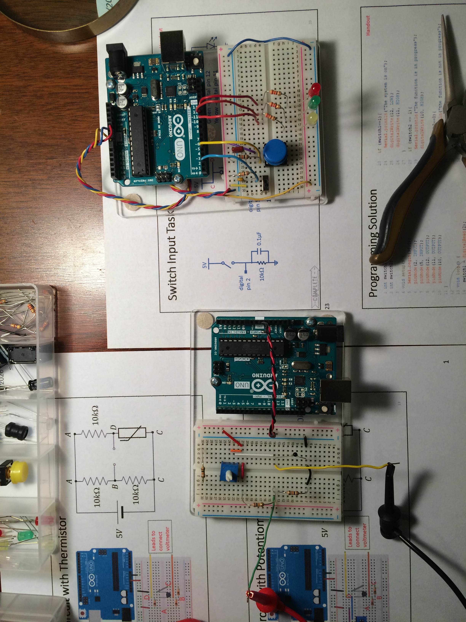
Intro. to Electrical & Instrumentation Technologies (IEIT) (Dual Enrollment: LDCC INST1010 and INST1000)
Intro to Electricity | Building Circuits* | Power | Working with Logic Controllers | Basic Circuits & Switches |  | Analog & Digital Inputs Excel Spread-sheets Linear Regression/ Calibration |  |  | Process Control Systems | P&ID & Industry Standards
Elec. Charge Conductors Insulators Voltage… Multimeter | Ohm’s Law Breadboards Resistors | P = VI Solve problems | Arduino Control LEDs Circuit FOR Statements | Series, // Eq. Resist. KVL & KCL Solve Circuit | Maintained Momentary Switch Input If statements | Bridge Circuits Photoresist. Analog & Digital I/O. | Record Data Format Statistical Functions Charts | Linear Trendline Calibration Data Types Programming | Transistors Relays Potentiom. Control Sys Project RC Circuits | Piping & Inst. Drawings Common Ind. Standards Indust. Orgs. Final Exam
Inst. Course also provides Dual-Enrollment credit and/or pathway to Inst. Technician programs.
  LA Tech ICET Program
    Arduino wiring and programming
  BPCC Industrial Technology Programs
  …

Slide 5




Local Tech School Programs Targeted
Engineering (AS)
Industrial Technology (Advanced Manufacturing and Mechatronics)
Industrial Technology (Automation and Controls)
Oil and Gas Production Technology
Industrial Technology (Industrial Maintenance)
Oil and Gas Production Technology
Oil and Gas Technology (Process Technology)
Industrial Instrumentation Technology
Industrial Manufacturing Technology
Air Conditioning and Refrigeration
Automotive Technology
Electrician – Commercial Wiring II
Electrician- Industrial Electrician
Industrial Instrumentation Technology
Process Technology
AC & Refrigeration Technology
Automotive Technology
Electrician
Industrial Maintenance Technology
Inst. and Control Systems
Engineering Technology
Construction Engr. Tech.
Mechanical Engr.
Electrical Engr.
Industrial Engr.
Computer Science
Biomedical Engr.
Civil Engr.
Nanosystems Engr.
Cyber Engr.
Chemical Engr.
IBEW/etA Apprenticeship Program
Beneteler Steel Apprenticeship Program
…

Slide 6
Earlier Charts Used for Planning
M. Nelson, BPSTIL

Slide 7
Instrumentation & Control (Dual Enrollment: LDCC INST1010 and INST1000) [48 – 100 min. days ≈ 10 weeks]
1 (01a – 03a) |  |  | 2 (04a - 4e) | 3 (05a – 06c) |  | 4 (07a – 09d) |  |  | 5 (10a-13b) | 6
Intro to Electricity | Building Circuits | Power | Working with Logic Controllers | Basic Circuits & Switches |  | Analog & Digital Inputs Excel Spread-sheets Linear Regression/ Calibration |  |  | Process Control Systems | P&ID & Industry Standards
Elec. Charge Conductors Insulators Voltage… Multimeter | Ohm’s Law Breadboards Resistors | P = VI Solve problems M3 Exam | Arduino Control LEDs Circuit FOR Statements | Series, // Eq. Resist. KVL & KCL Solve Circuits M4/M12 Exam M12 Perf Tsk | Maintained Momentary Switch Input If statements | Bridge Circuits Photoresist. Analog & Digital I/O. | Record Data Format Statistical Functions Charts | Linear Trendline Calibration Data Types Programming | Transistors Relays Potentiom. Control Sys Project RC Circuits | Piping & Inst. Drawings Common Ind. Standards Indust. Orgs. Final Exam
2 | 2 | 2 | 5 | 5 | 2 | 3 | 2 | 5 | 10 | 8
3
4
5
6
7
8
9
10
*Shaded modules overlap significantly.
NCCER Electrical Level 1 [26 – 100 min. days ≈ 5 weeks (excluding overlap modules) to complete Helper IBC]
1 | 2 | 3 | 4 | 5 | 6 | 7 | 8 | 9 | 10 | 11 | 12
Orient. To Electrical Trade | Electrical Safety | Intro to Circuits | Electrical Theory | Intro to the NEC | Device Boxes | Hand Bending | Raceways & Fittings | Conduct. & Cables | Basic Electrical Drawings | Resid. Electrical Services | Electrical Test Equip.
Sectors Apprentice/Training Employ. Responsible Key Ind. Standards M1 Exam | Hazards PPE Standards Tool Safety M2 Perf Task M2 Exam | Charge Conductors Voltage… Ohm’s Law Power Multimeter | Series / Parallel Equivalent Resistance Multimeter KVL & KCL | Chapters Definitions Articles Tables Specific Reqts. M5 Perf Task M5 Exam | Types of boxes Installation Sizing M6 Perf Task M6 Exam | 90⁰ Bends Offset Saddle Cut, Ream, Thread M7 Perf Task M7 Exam | Select & install Fasteners & anchors Wireways.. Cable Trays M8 Perf Task M8 Exam | Types Sizes Materials Ampacities Install conductors M9 Perf Task M9 Exam | Construct. Drawings Symbols Material Takeoff M10 Perf Tsk M10 Exam | Sizing Grounding Installation Panel Bd Branch Ct Devices M11 Perf Tsk M11 Exam | Voltmeter Ohmmeter Ammeter
3 | 5 | * | * | 3 | 5 | 5 | 10 | 5 | 4 | 8 | *
1
2
11
12
13
22 days ~ 4.5 weeks to finish Level 1

Slide 8
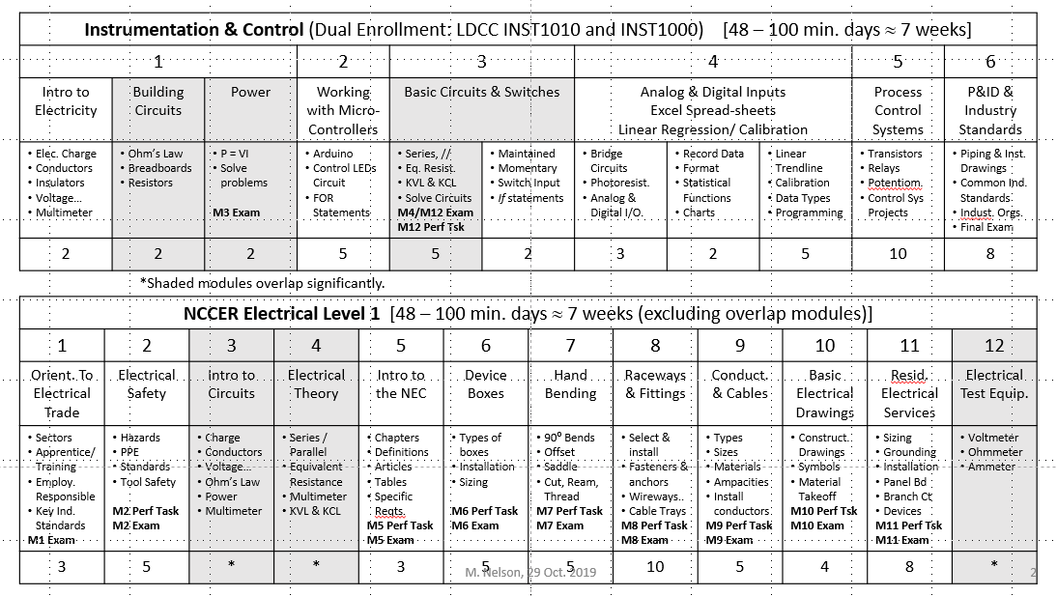
Spring 2020 Electrical Tech Plan
Implement original plan, combining Instrumentation and NCCER Electrical Level 1
  With overlapping modules in DC circuit theory (shaded)
Enroll all students in Instrumentation & Control course (dual-enrollment)
  Pilot this course fully
Enroll all students in NCCER Electrical Level 1*
  Pilot this course to the extent possible
  Enroll eligible students in NCCER database and submit test scores / performance task completions (*with CORE)
  Modules 3,4 & 12 overlap with Inst.
  Try to get Helper IBC #199: Modules 1-3, 6-8, and 12.
Students without Core
  Cover same material
  Not eligible to receive NCCER credit.
  Might do some CORE lessons when others are in the shop. (or work on etA - below)
If instructor completes etA certification
  Possibly enroll students interested in starting work on etA Interim Credentials
  Would have to complete mostly on their own time and/or finish over the summer, or next year, under BPSTIL instructor.

