Slide 1
NanoDemos
Train the NanoTeacher Workshop
July 16, 2014
1

Slide 2

Nanotechnology
The understanding and control of matter between approximately 1 and 100 nanometers
Gold atom is about .33 nanometers
Unusual physical, chemical, and biological properties can emerge at the nanoscale
2

Slide 3
Property Changes
Short demonstrations that show nanoscale properties
  Different forces are stronger
    F = m * a
  More reactive
  Absorb/Reflect light differently (color change)
  Increase in
    Perform under extreme temperatures
    Insulation
    Strength
    Conductivity
3

Slide 4
Increased Surface Area
=
1cm .5cm .5cm
4

Slide 5
Ferrofluid
Nanoparticles of magnetite
Colloid Solution
  Evenly suspended particles in the carrier fluid
Superparamagnetic
  Only Magnetic is presence of a magnet
5

Slide 6
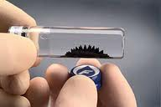
Magnetic Field
Visible reaction to the magnetic field
Does not spike with the side of the magnet
Source: Ferrotec
6
Notes:
http://www.interactivearchitecture.org/ferrofluid-sculptures-by-sachiko-kodama.html

Slide 7
Ferrofluid Applications
Dampen vibrations in loud speakers
Heat sink
Seals of rotating shafts and computers
MRI and cancer detection
Experimentation in targeted drug delivery
7

Slide 8
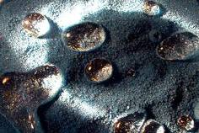
Magic Sand
Hydrophobic properties found in nature
  Nasturtium, kale, and lotus leaves
Extended to a number of products
  Car Wax
  Clothing
  Paint
Source: Wikimedia
8
Notes:
http://commons.wikimedia.org/wiki/File:Hydrophobic_Sand.jpg

Slide 9
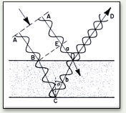
Thin Films
Demonstrate how changing the scale changes properties
Interfering wave lengths produce different colors
Source: Causes of Color
9
Notes:
http://www.webexhibits.org/causesofcolor/15.html

Slide 10
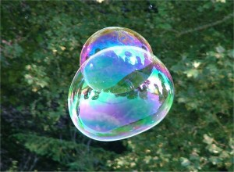

Thin Films
Butterfly, beetles, and other insects
Oil Slicks
Bubbles
Two way mirrors
Source: Brooklyn Children's Museum
Source: SciTech Daily
10
Notes:
http://www.freerepublic.com/focus/f-chat/2372704/posts

Slide 11
Memory Wire
Alloys and polymers
Bend the materials
  Change crystal structure
Materials return to original shape or crystal structure under the right conditions
  Temperature
  Wavelengths of Light
11

Slide 12
Shape Memory Applications
Medical devices such as self stitching stitches and braces
Airplanes – helps reduce turbulence
Glasses frames
Silly Bands
12

Slide 13
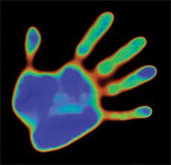
Liquid Crystals
Behave like a liquid and a crystal
  Flow like a liquid
  Can align like a solid crystal
Thermotropic
  Heat causes the liquid crystals to align differently
  Birefringence – light waves are out of sink similar to the thin films
Source: H.W. Sands Corp
13
Notes:
http://www.goodlifeinnovations.com/index.php?comp=content&op=view&id=84

Slide 14
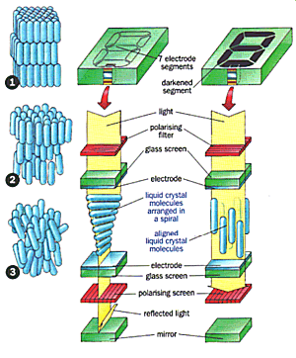
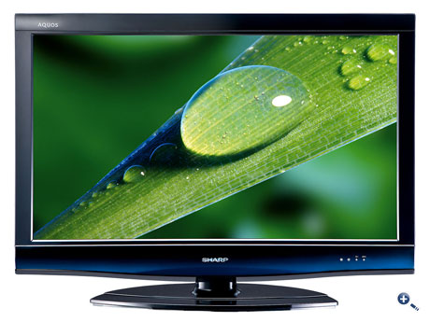
Liquid Crystals
Liquid Crystal Displays
  TV, cell phone screens, computers, clocks
Optical Imaging
Thermometers
Source: Televisions.com
Source: Nanodic.com
14
Notes:
http://www.ixsuns.com/matrix_pixel.htm

Slide 15
References
Slide 6 | Ferrofluid Display Cell. [Online image]. 10 July. 2013. <<http://www.ferrotec.com/technology/ferrofluid/>.
Slide 8 | Hydrophobic sand. [Online image]. 10 July. 2013. <http://commons.wikimedia.org/wiki/File:Hydrophobic_Sand.jpg>.
Slide 9 | Interference of Light Beams. [Online image]. 10 July. 2013. <http://www.webexhibits.org/causesofcolor/images/content/35.jpg>.
Slide 10 | Bubbles. [Online image]. 10 July. 2013. <http://www.bcmgreenthreads.org/wp-content/uploads/2012/08/800px-Soap_Bubble_-_foliage_background_-_iridescent_colours_-_Traquair_0408011-300x220.jpg.>.
Slide 10 | Butterfly. [Online image]. 10 July. 2013. <http://scitechdaily.com/images/iridescent-butterfly-wings.jpg.>.
Slide 13 | Liquid Crystal Handprint. [Online image]. 10 July. 2013. <http://www.hwsands.com/images/sce/thermochromic.jpg>.
Slide 14 | Liquid Crystal Display TV. [Online image]. 10 July. 2013. <http://www.televisions.com/Images/Previews/2009/Philips/P1017/white/460mag/LCD_TV_Sharp_LC-32_DH_77_E_Front.jpg>.
Slide 14 | Liquid Crystal Alignment. [Online image]. 10 July. 2013. <http://www.nanodic.com/nanoelectronic/Liquid_Crystal_Display/7_resize.jpg>.
15
Notes:
http://www.webexhibits.org/causesofcolor/images/content/35.jpg

