Slide 1

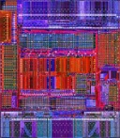
Role of Modeling and Simulation
Systems have many features that make them difficult to study:
Too big to see everything
Too expensive to change
Proprietary
Multi-disciplinary
Obscure documentation
etc
14 mm
These problems are particularly acute when we try to grasp what’s on a chip.
16 mm
If we create a model that is 1000 X larger than the chip, a number of features become clearer.
Feature | Size on chip | Scale up 1000 X
Die side (average) | 15 mm | 15 m
Wafer | 300 mm | 300 m
Transistor side | 100 nm | 0.1 mm
Size tolerance (±) | 3 nm | 3 μm
Cost ($) | 45.00 | ??
Now translate these numbers into what’s around us

Slide 2
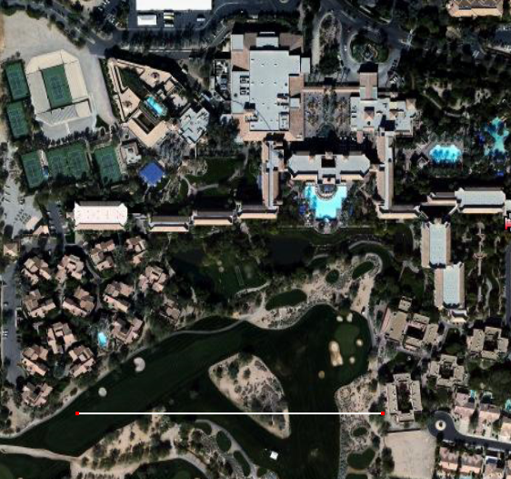
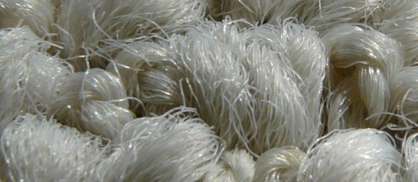

Scottsdale Princess Resort
The wafer is now the size of the hotel complex
It is just under 1 m thick
The surface is VERY clean
20 dust particles on the wafer
puts you out of business.
The chip is the size of the room
The I/O contacts are equivalent to 2000 tennis balls.
All the devices are in a surface layer 2 mm thick
about the carpet base layer.
Can you see the fibers in the carpet?
Their diameter is the size
of a transistor (at 1000 X).
The chip surface (ie the floor) is flat to half a fiber thickness across the room.
The smallest line on a transistor is half a fiber diameter.
Its width is controlled to a tenth of that.
There are 20 B carpet fibers in the room (we counted every one).
They cost $ 200 n each.
There are 2 B transistors on the die (memory is > 10 X).
They cost $ 50 n each for logic.
$ 0.1 n for flash memory.
That’s why it’s important.
300 m
For more information go to: www.esyst.org
Or contact: tom.mcglew@domail.maricopa.edu

