Slide 1
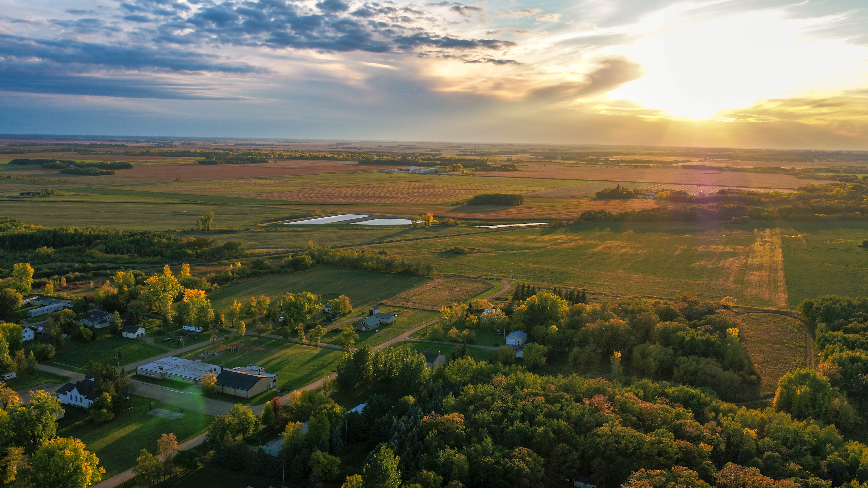
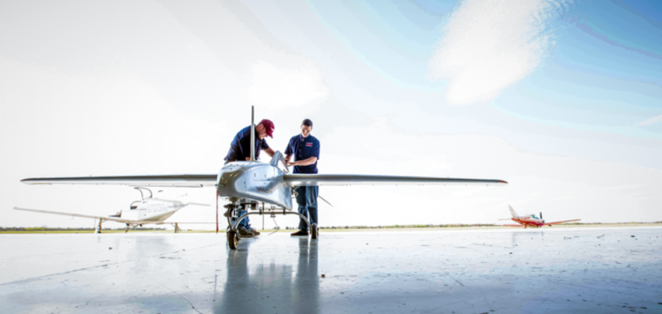
Part 107 and What it Means to You
Zack Nicklin
UAS Program Manager NCTC
UAS Director/Co-PI NCAT
Zackary.Nicklin@northlandcollege.edu

Slide 2
Drones are Regulated!
14 CFR Part 107 is the regulation governing commercial drone flights in the National Airspace System.
All flights that are not recreational in nature are considered commercial by the FAA
Recreational flights are guided by Advisory Circular 91-57B (AC91-57B)
There are statutory provisions that allow some operations by higher education institutions to be classified as recreational in the 2018 FMRA (PL 115-254, Section 350

Slide 3



Part 107
Each aircraft must be registered and marked on the outside.
Under 55lbs
<100 mph
VLOS
Moving cars or over people
-
Yield to
Hazmat (batteries don’t count)
Below 400ft AGL
Permission needed for other than “G” https://www.youtube.com/watch?v=tX2_G9jzeuc
1 aircraft = 1 RPIC

Slide 4
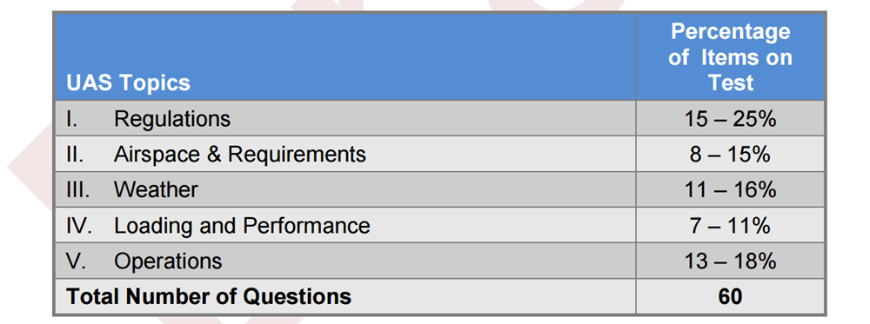
What is on the Test?

Slide 5
Steps to be Eligible to Certify
  1. To be eligible to get your Remote Pilot Certificate, you must be:
    At least 16 years old
    Able to read, write, speak, and understand English
    Be in a physical and mental condition to safely fly a UAS
Review the full process to get your Remote Pilot Certificate.
Study for the Knowledge Test by reviewing the Test Prep materials provided by the FAA.
Obtain an FAA Tracking Number (FTN) by creating an Integrated Airman Certification and Rating Application (IACRA) profile prior to registering for a knowledge test.
Schedule an appointment to take the Knowledge Test at an FAA-approved Knowledge Testing Center.
Once you've passed your test, complete FAA Form 8710-13 for a remote pilot certificate (FAA Airman Certificate and/or Rating Application) using the electronic FAA Integrated Airman Certificate and/or Rating Application system (IACRA)*

Slide 6
Waivers
Operation from a moving vehicle or aircraft (§ 107.25)
Daylight operation (§ 107.29)
Visual line of sight aircraft operation (§ 107.31)
Visual observer (§ 107.33)
Operation of multiple small unmanned aircraft systems (§ 107.35)
Yielding the right of way (§ 107.37(a))
Operation over people (§ 107.39)
Operation in certain airspace (§ 107.41)
Operating limitations for small unmanned aircraft (§ 107.51)

Slide 7


Recreational Flight in the NAS
Must be purely for fun (with limited exceptions)
Under 400ft
VLOS
Permission for other than “G”
Required lighting
Yield to
No moving cars or over people
Aeronautical Knowledge Test

Slide 8
Educational Exemption
INSTITUTION OF HIGHER EDUCATION.—The term ‘‘institution of higher education’’ has the meaning given to that term by section 101(a) of the Higher Education Act of 1965 (20 U.S.C. 1001(a)). (2) EDUCATIONAL OR RESEARCH PURPOSES.—The term ‘‘education or research purposes’’, with respect to the operation of an unmanned aircraft system by an institution of higher education, includes—
(A) instruction of students at the institution;
(B) academic or research related uses of unmanned aircraft systems that have been approved by the institution, including Federal research;
(C) activities undertaken by the institution as part of research projects, including research projects sponsored by the Federal Government; and (D) other academic activities approved by the institution.

Slide 9

Educational Exemption Cont.
Administration and especially insurance providers =

Slide 10
Overwhelmed Yet?

Slide 11


Slide 12
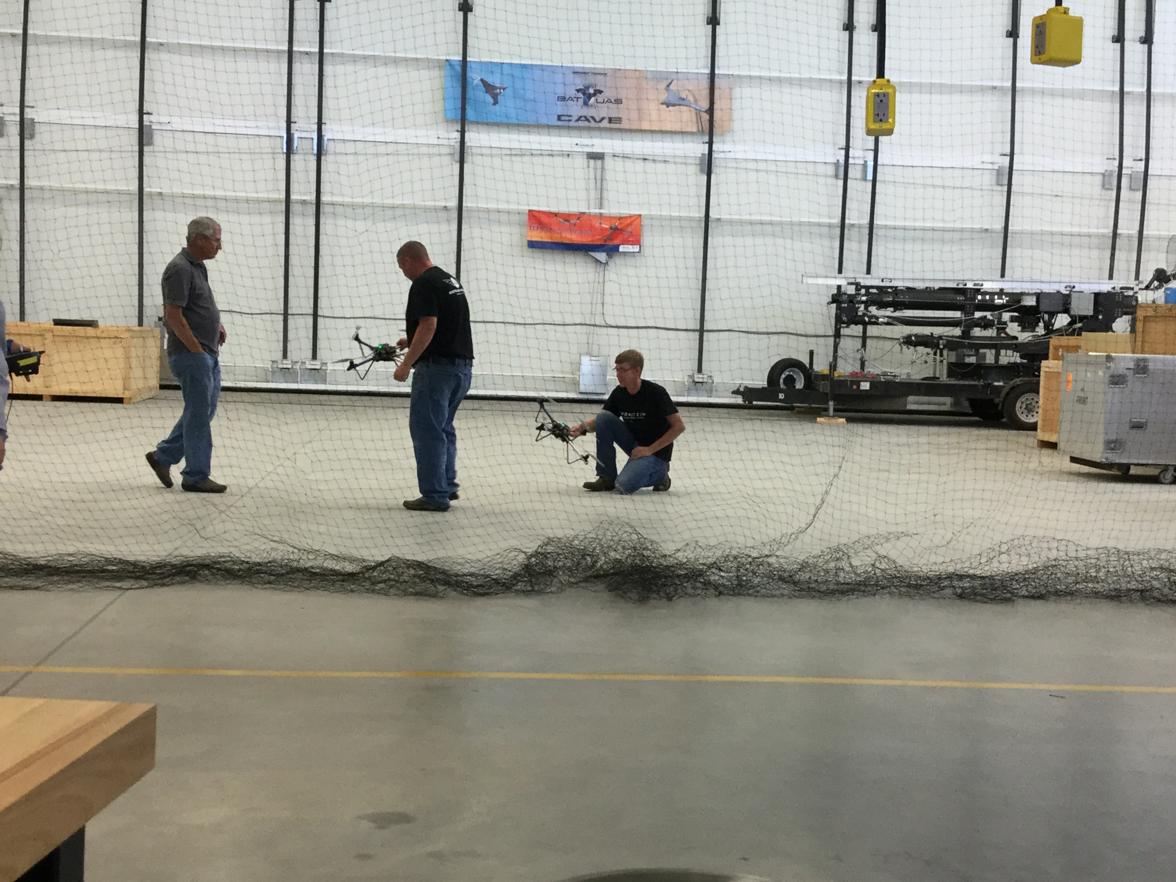
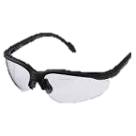
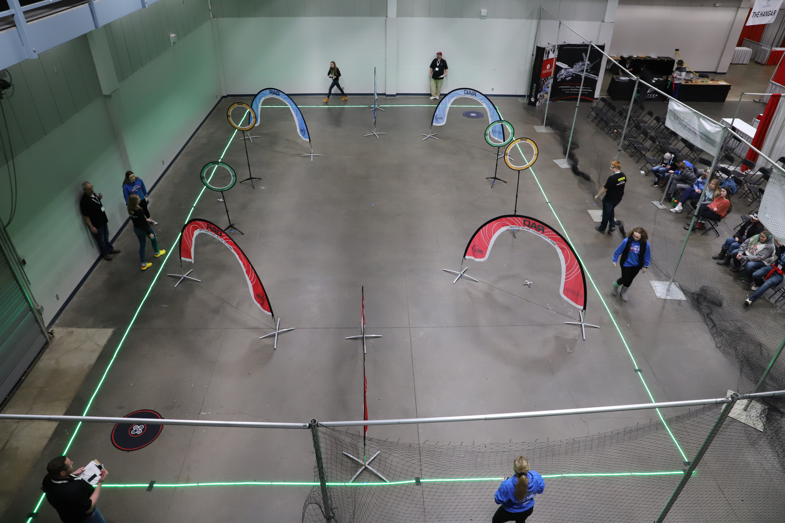
Safety is still important
Use nets or gym dividers
Keep it to participants
Use geofencing
Prop guards

Slide 13
Additional Factors
Drone Policy
Who is in charge?
Maintaining the equipment
IT help (installs, upgrades)
What is the goal of using drones in your program?
Funding sources (budget)
Know your modes (RTH, Atti, geofencing,etc)
Local ordinances
System Limitations

Slide 14
