Slide 1


Dr. Tara N. Lewis
Career Coach, DOL FLEXTech Grant
July 10, 2022

Slide 2
What is Career Readiness?
Career readiness is a foundation from which to demonstrate requisite core competencies that broadly prepare the college educated for success in the workplace and lifelong career management.
Career Ready
Faculty
Career Coaches
Mentors

Slide 3

NACE is the leading source of information on the employment of the college educated, and forecasts hiring and trends in the job market; tracks starting salaries, recruiting and hiring practices, and student attitudes and outcomes; and identifies best practices and benchmarks.

Slide 7
Why is career readiness important for students?
https://cla.umn.edu/career-readiness/curriculum-integration

Slide 8
Career Readiness Competencies:
How to integrate them into your classroom
You are already doing it – Career Services can help to translate!
Action: Provide Mentoring Moments
  Promote early career exploration and connect them to the career center
  Share Your Career Story
  Recommend a Career Resource
  Engage in Career Conversation with students (informational interview questions)
Effect:
  Students become more engaged
  Students are better informed to make career decisions
  Perceive faculty as more interested in their academic and career success

Slide 9
Career Readiness Competencies:
Connect it with your syllabus
Resources
Assignments
Student Learning Outcomes
Additional Support/Items
Connect the dots for them!

Slide 10
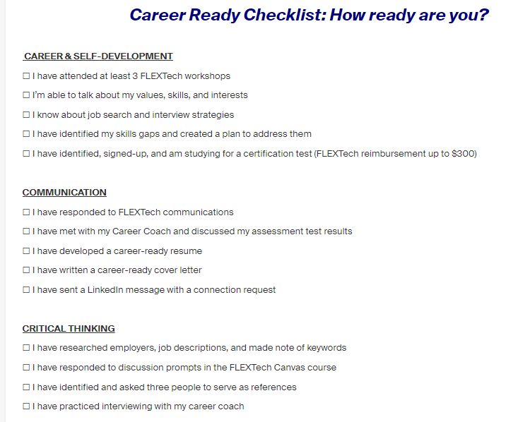

Slide 11
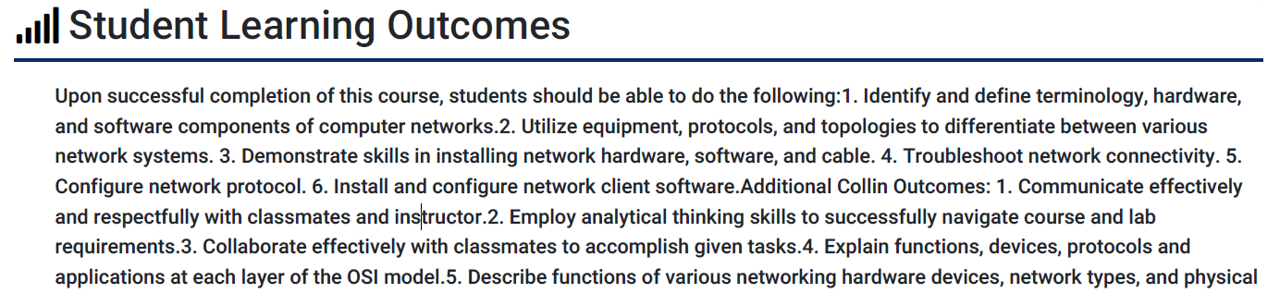
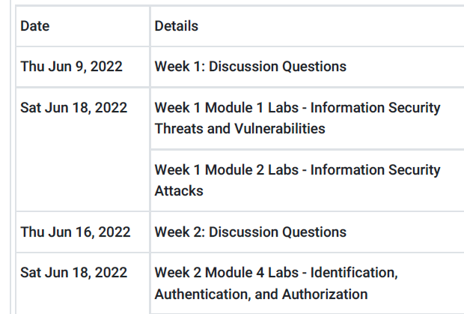

Slide 12
Resources
https://cla.umn.edu/career-readiness/curriculum-integration
https://www.naceweb.org/career-readiness/competencies/career-readiness-defined/
https://www.creighton.edu/sites/default/files/2022-01/Career-Conversation-Guide.pdf

