Slide 1


DNA Automation with
Nano-Structured Ceramics
Mario Blanco, PhD
Nanopec CEO
October 20, 2022

Slide 2


This webinar is hosted by:
The Nanotechnology Application and Career Knowledge (NACK) Resource Center is a National Science Foundation (NSF) Advanced Technology Education (ATE) Regional Center for Nanofabrication Manufacturing Education. NACK is a subsidiary of the Center for Nanotechnology Education and Utilization (CNEU) in the Penn State College of Engineering’s department of Engineering Science and Mechanics.
DUE 2000725

Slide 3


This webinar is being recorded and links will be available at:
  https://www.cneu.psu.edu/webinars/
  NACK Center YouTube channel
Please use the Q&A module for questions related to the webinar topic.
Zoom related questions (i.e. issues with the webinar controls, etc.) may be put in the chat window.

Slide 4
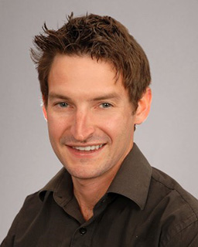
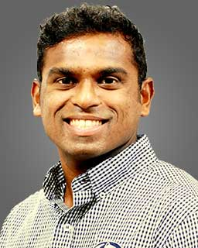
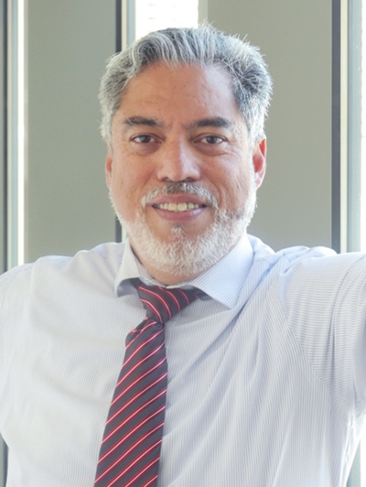
Host
Co-host
Presenter
Zac Gray
Managing Director
NACK Center / CNEU
Vishal Saravade
Assistant Teaching Professor
CNEU
Mario Blanco
President & CEO
Nanopec

Slide 5
DNA Automation with
Nano-Structured Ceramics
Mario Blanco, PhD
Nanopec CEO
October 20, 2022

Slide 6

DNA Synthesis Automation Goals
Realize the full potential of
Synthetic Biology
to protect
to heal
to improve
the quality of our lives
Synthesize genes that are difficult to clone
Synthesize vaccine and therapeutic candidates without animal products or bacterial fermentation
Generate humanized or recombinant antibodies
CRISPR CAS9 edited genes and gene variants
Provide large scale gene synthesis for DNA Banking/archiving
Optimize codon use to boost target protein expression

Slide 7
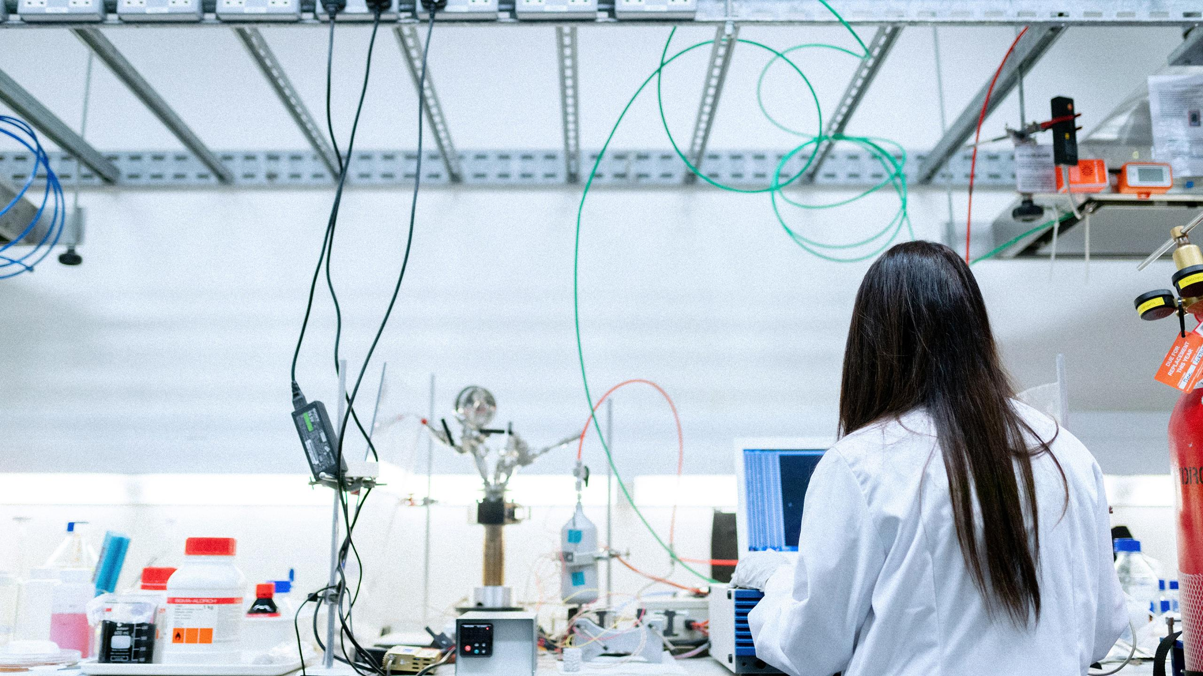
The fundamentals
The applications
Comparative advantage
How it works
Next level automation
Nanopec

Slide 8

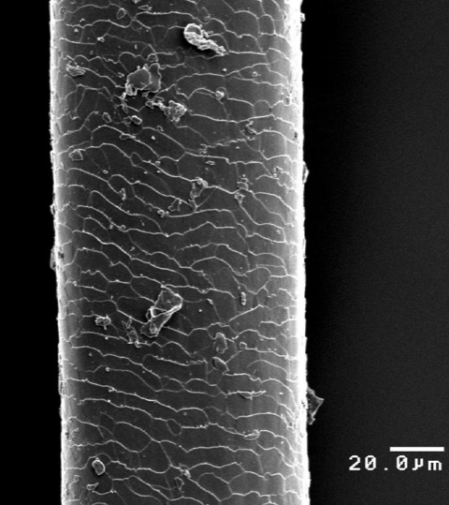
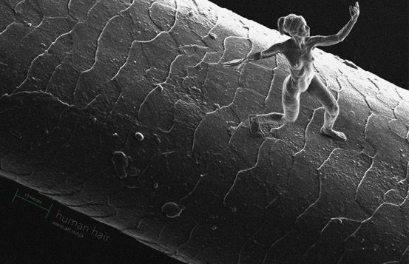
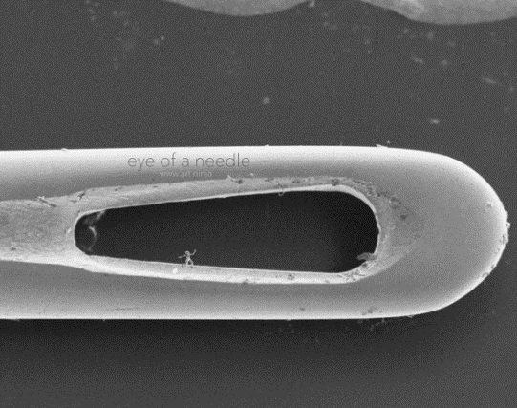

What is a nanometer ?
1 nm =0.000000001 meters
50 nm
80,000 nm
Nano-structured
ceramic pores
500 nm
10,000 nm
2,000 nm

Slide 9
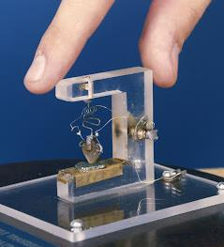
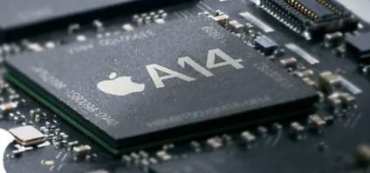
Small means fast: electronic chips automation analogy
1 transistor
1 bit: (0 , 1)
11.8 billion transistors
4 full human genomes/s
1 inch
1/4 inch
1947
2020

Slide 10
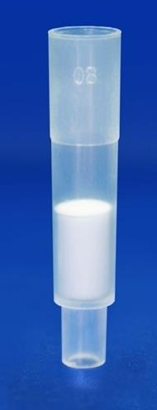
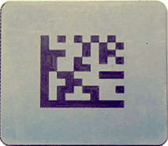

Scale of DNA Automation: Present and Future
1/16 inch
1 inch
Controlled Pore Glass 1934
column: 1 oligo
microplate: 726 oligos
scale: 1 micro mole
DNAReaxTM 2021
chip: 1 oligo
plate: 180,000 oligos
scale: 1.8 micro mole
Notes:
2 mm 2000 microns, 4 million square microns, half give 2 million locations (133 pores on each)

Slide 11
Notes:
Numerous studies point to a

Slide 12
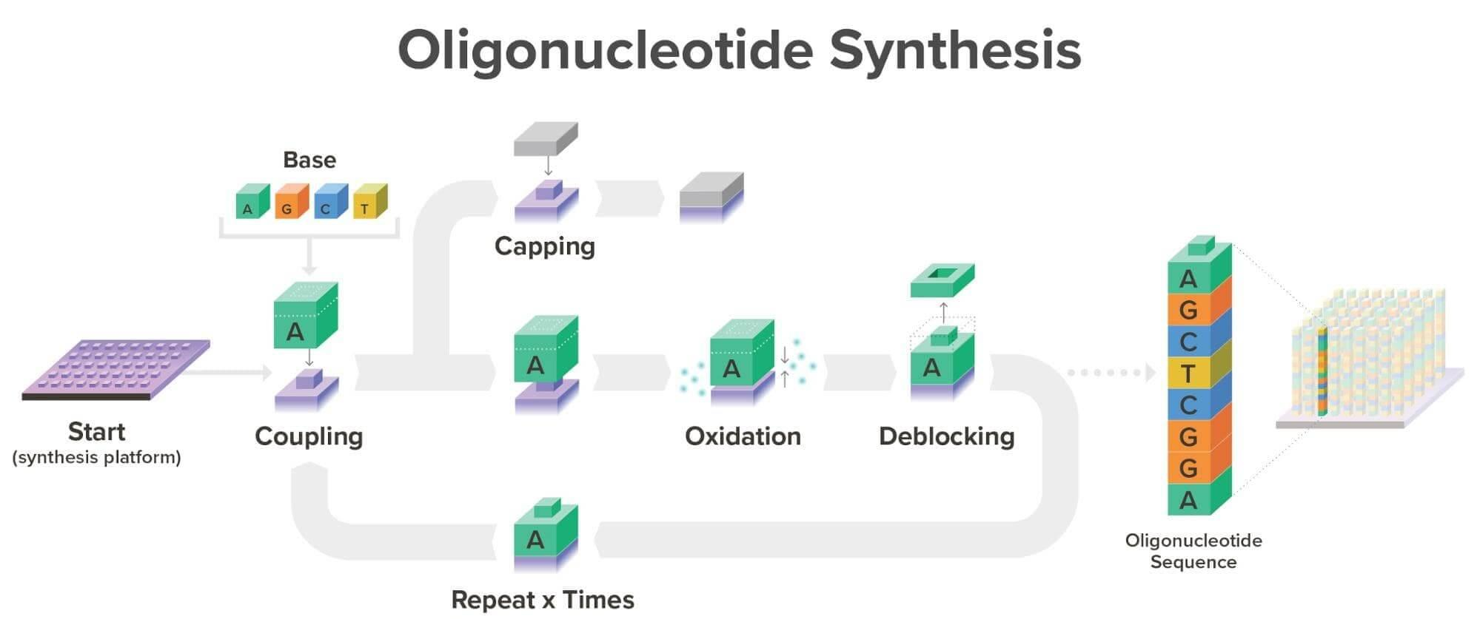
Simplified Workflow
platform customer
nanopec
customer
Notes:
Numerous studies point to a

Slide 13
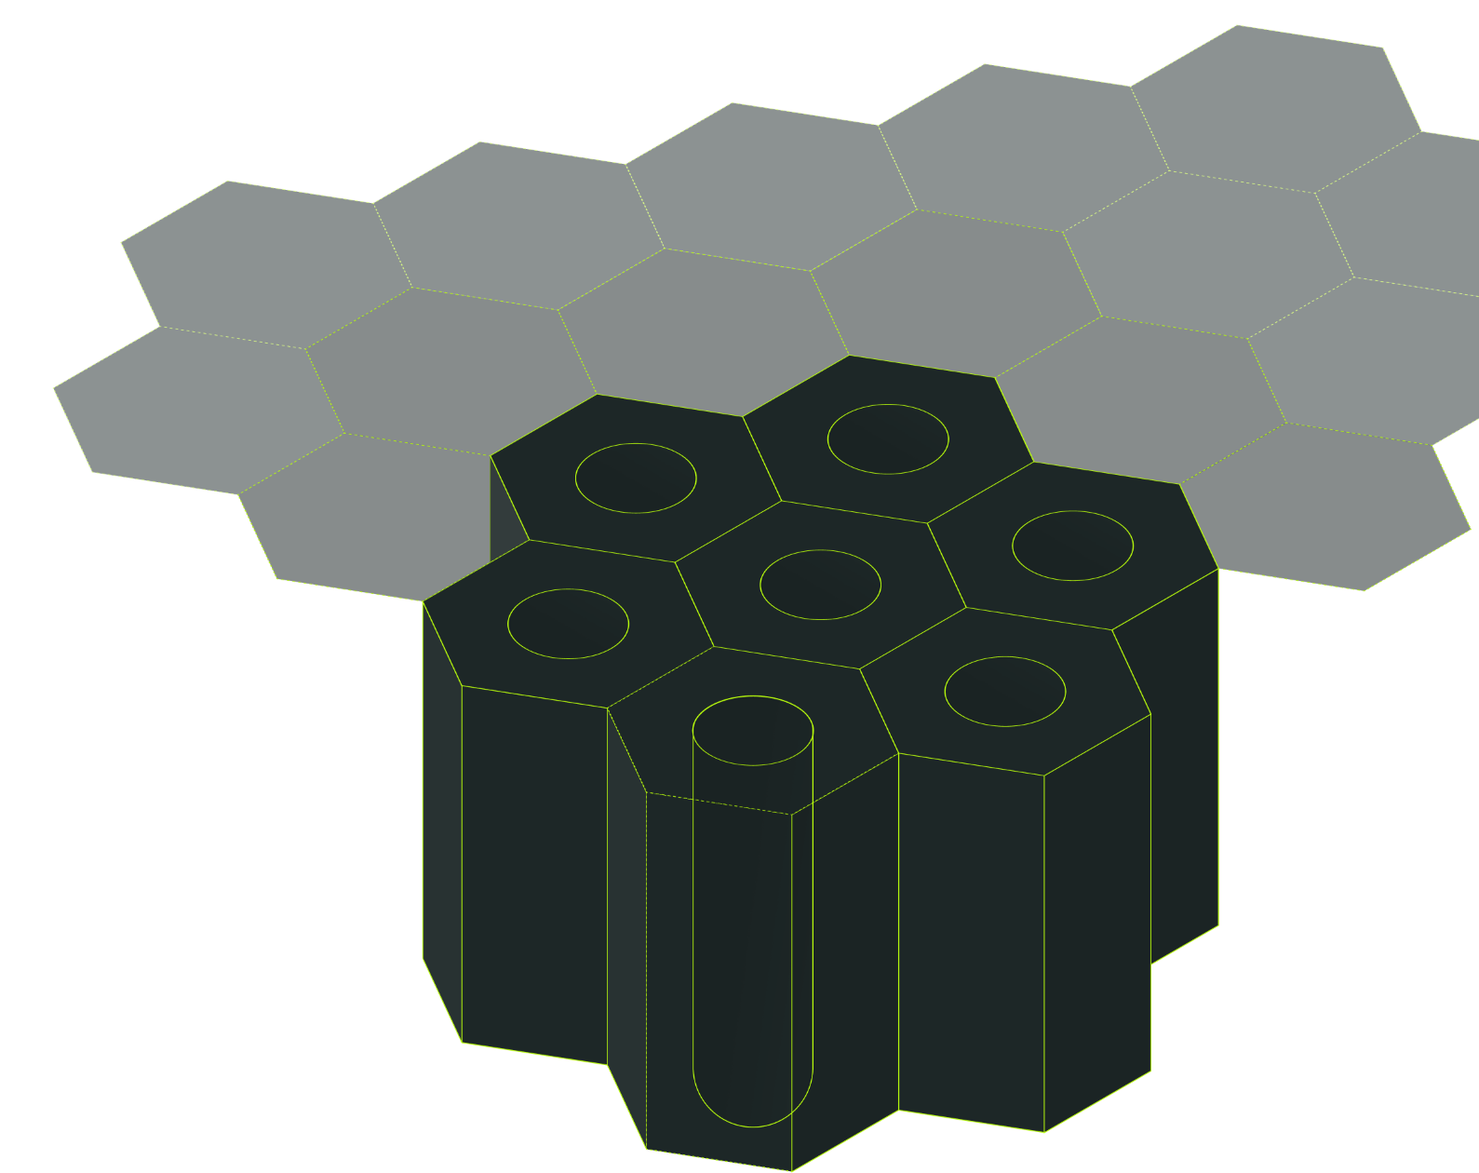
The core of the technology is a patented nanoporous ceramic enabling precise DNA and RNA synthesis through pore size control
Nanopec
Diameter
60-300 nm
Pore diameter
Pore length
Controlled surface spacing
Patented DNA automation platform
Inter-distance
20-500 nm
Pore length
10-250 microns

Slide 14
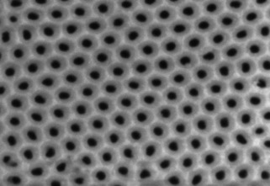
DNAReax™ can transform the synthetic biology market
Market ready technology
Customer tested with high performance
Low cost and scalable in-house production
Patented DNA automation platform
200 nm

Slide 15
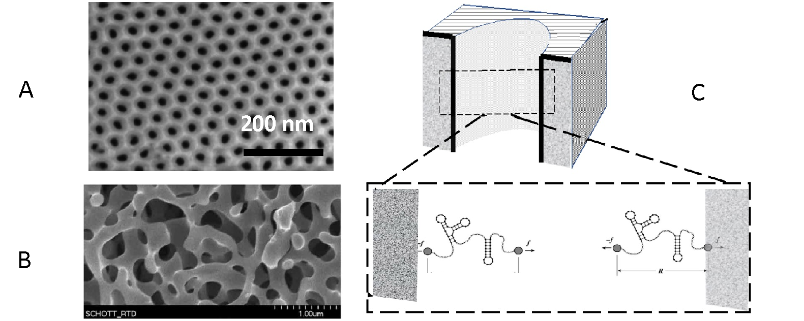
Nanostructured Ceramic vs CPG

Slide 16


Slide 17
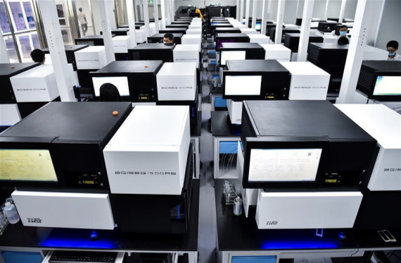
One of the world’s largest gene banks is already using DNAReax™
nanopec
Customer case: DNA banking
Synthesizers handling 8000 chips
Making 200 gene variants overnight
LOI signed, first orders placed
“We get 460 times the yield compared to silicon*”
*Only by changing consumables, i.e. no CAPEX

Slide 18
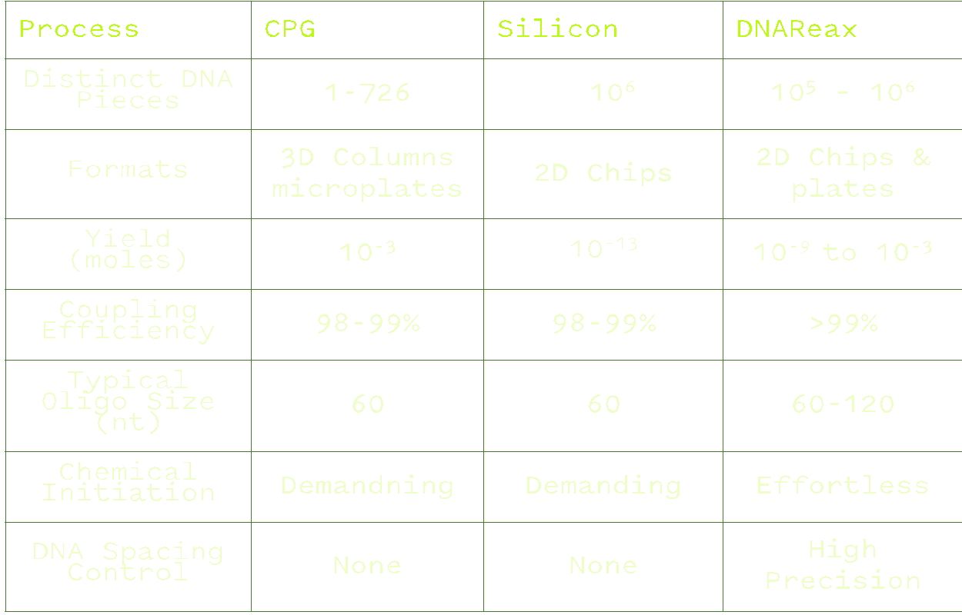
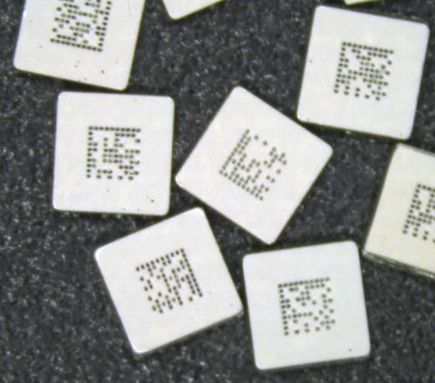

Competitive analysis: automation outperforms current technologies
* All Data provided by paying customers, independent laboratories
** Experimentally validated data, over 50 tests, available under NDA
*** Proprietary controlled surface silanization
Notes:
Numerous studies point to a

Slide 19
Current focus is on early adaptors and applications in biological therapeutics
Nanopec
DNA banking
DNA Probes
Vaccines, DNA and RNA based therapeutics

Slide 20

Platform is unique in being able to create pre-clinical amounts of cell free, animal free DNA overnight
nanopec
Yield
No bovine serum, e-coli or mammalian cells
No risk of cell/DNA contaminants leading to undesired immunological reactions
Sufficient yields to run pre-clinical and clinical tests directly from synthesis, no fermentation or amplification needed
Cell free
Animal free

Slide 21
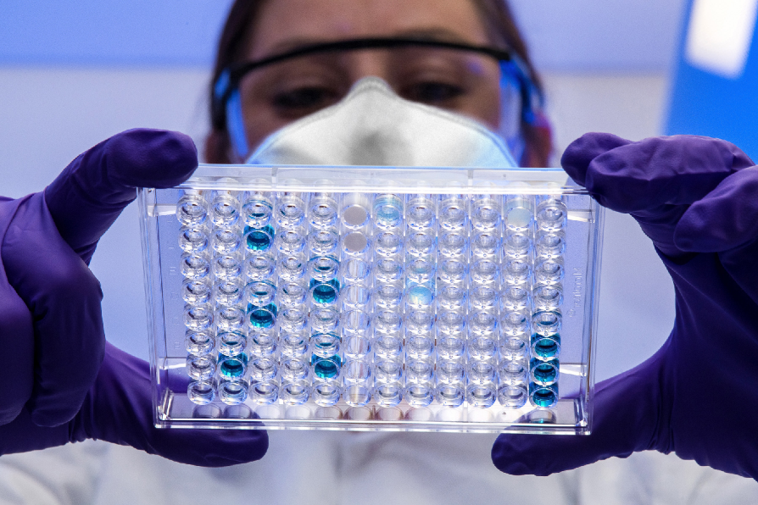
Collaboration with pharma client developing DNA based therapeutics
COLLABORATIONS
Synthesis supply chain and timing is the number one issue for progress
Standard lead time from external supplier is 6-8 weeks for one gene
Sufficient yields for required gene libraries and animal tests can be created on one 10x10 cm DNAReax™ substrate in one day

Slide 22
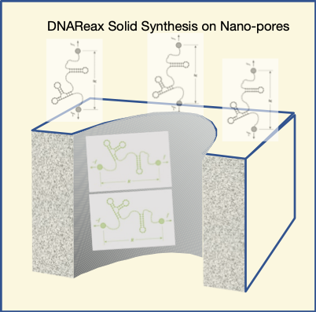
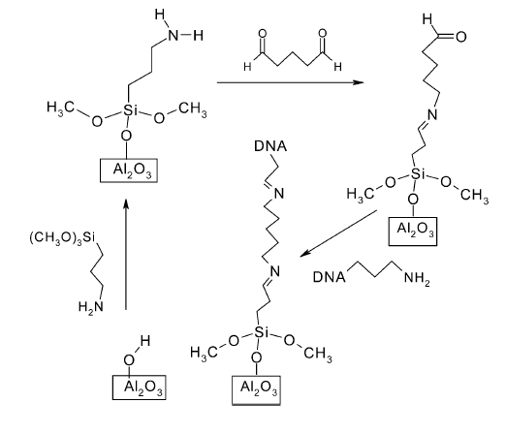
Proprietary DNA Spacing on Nano-porous Substrate
Notes:
Numerous studies point to a

Slide 23
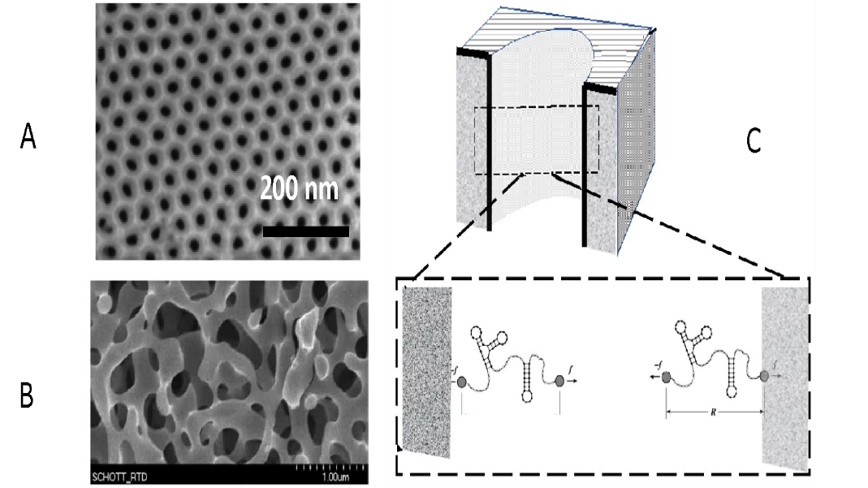
nanopec protects IP: combination of patents and trade secrets
Blanco, M.; “Nano-porous anodic aluminum oxide membrane for healthcare and biotechnology”, US20200392639A1, WO/2020/257092 (Granted)
Blanco, M.; “Controlled Doping of Anodic Aluminum Oxide For Enhanced Fluorescence and Methods of Preparation”, US16799169 Application
Blanco, M.; “Enhanced signal to noise ratios for PCR testing within a FRET doped nano-structured ceramic film”, US63010268 Application
“Nano-structured Aluminum Oxide Ceramic Chips for the Automation of Solid-State Oligonucleotide Synthesis”, PCT 63183723 Application
Blanco, M.; “Doped Nano-porous ceramic films for high density bioassays”, PCT 63040245
Blanco, M.; Oppelstrup, N.; Apparatus And Processes For High Throughput Automation Of Synthetic DNA And RNA on Nanostructured Ceramic Films, U.S. Provisional Application No. 63354727
Patent: All inventions that can be reversed engineered are patented
Trade Secret: Otherwise kept undisclosed
Notes:
Here we should outline how to protect the IP in a broad sense as well (Patents, IT, Physically)

Slide 24

Thank you!
Nanopec

Slide 25


Slide 26
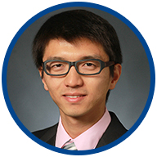
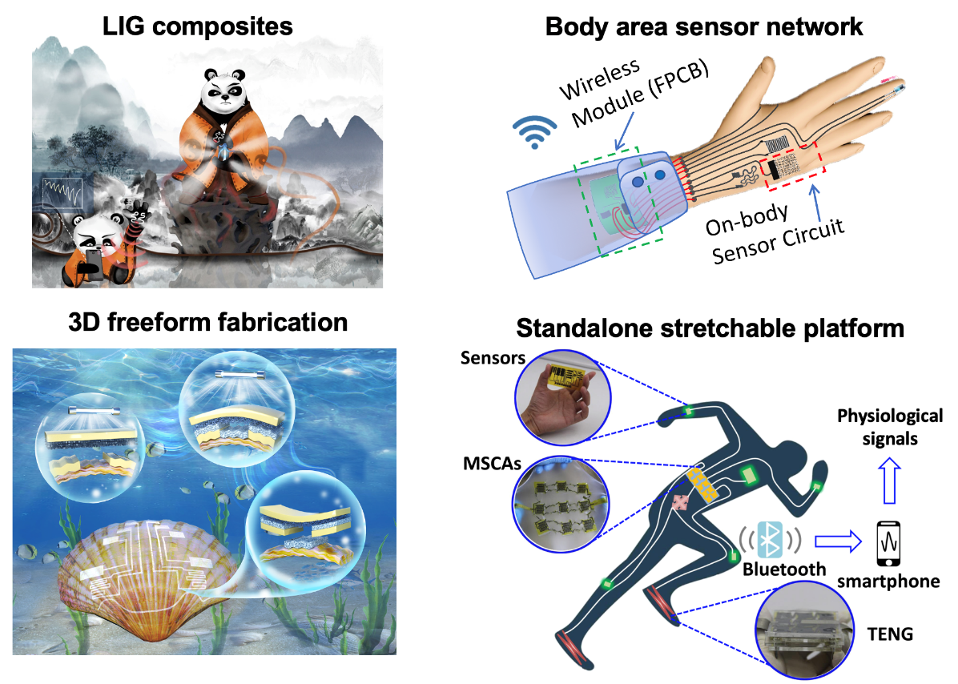
Upcoming Webinar:
November 16, 2022 at 1 pm ET
“Standalone Stretchable Device Platform for Human Health Monitoring"
Dr. Huanyu Cheng
James L. Henderson, Jr. Memorial Associate Professor of Engineering Science and Mechanics
Visit https://www.cneu.psu.edu/webinars/ for more details

Slide 27

Thank you for attending!
We would love your feedback

