Slide 1
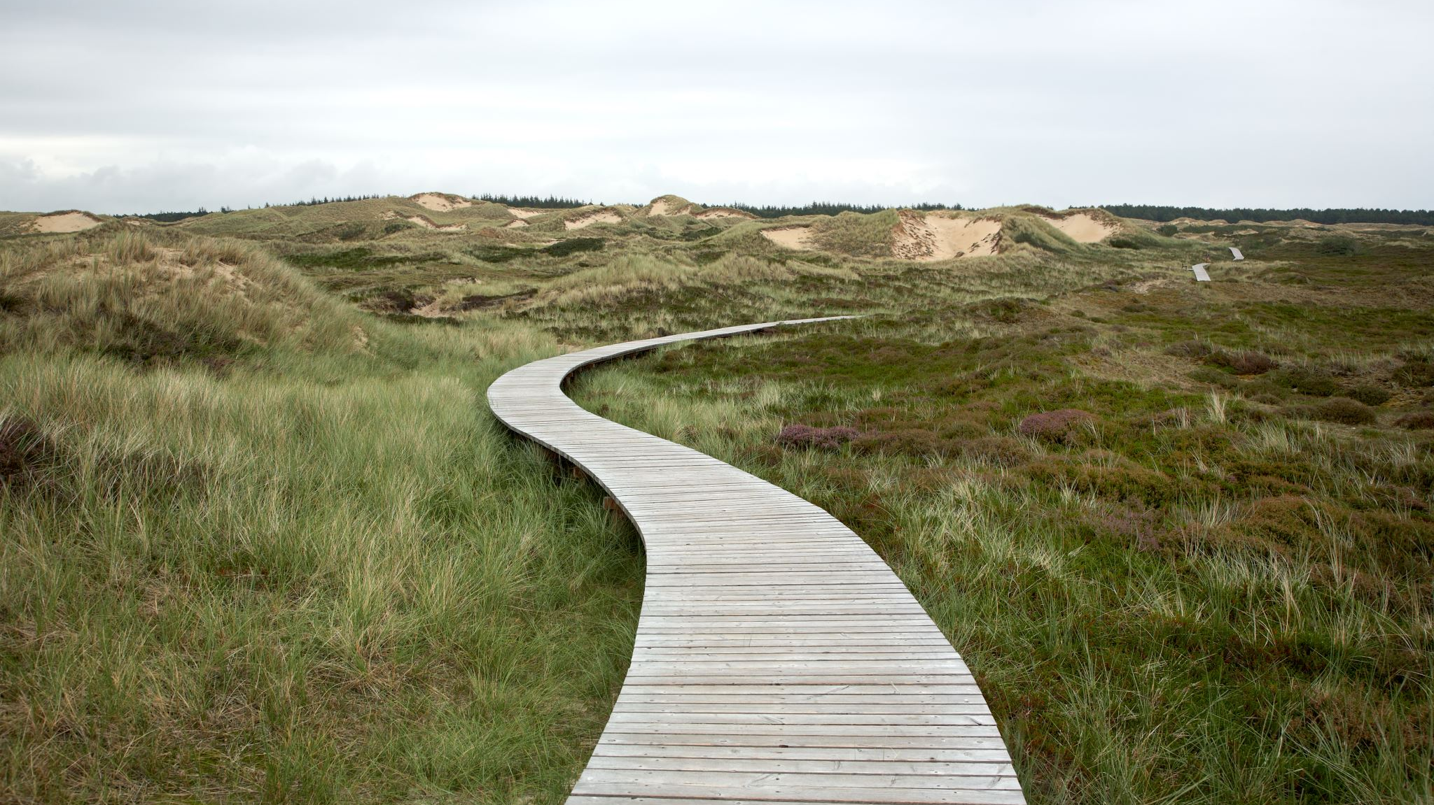
Grant Award #2055411 Expanding the Data Analytics Technician Pipeline from High School into College and High Demand Jobs in Southwest Ohio Course Building and Next Steps
By Paul Hansford

Slide 2
Guiding Design Principles
Targeting h/s and grant work course building
1. Open Source (OER) materials / Alternative
MS Excel and/or Google Sheets
2. Low cost or no cost textbooks
3. No Prerequisites (as much as possible)
4. Service Learning
5. Multi modality
6. Shareable (NSF funded courses)
7. Doing good with data
8. Industry guided

Slide 3
OER
1. Open Source (OER) materials / Alternative
MS Excel (if they have a subscription) and/or Google Sheets (free resource)
Why:
Making sure that high schools (CCP and TechPrep) that are resource/budget challenged do not have an extra budget burden.

Slide 4
Textbooks
2. Low cost or no cost textbooks
Why:
Making sure that high schools (CCP and TechPrep) that are resource/budget challenged. But some schools will choose not to adopt a course if the textbooks are pricey and are changed too often.
At some point, ODE will impose $300 cap (either by course or maybe by semester)
Either way, the trend forward is more digital and lower textbook cost.

Slide 5
No Prerequisites (low) as much as possible
3. Create Gateway opportunities
Making sure that the courses for high schools (CCP and TechPrep) that are available to as many students as possible:
High school students
Traditional students
Retooling / upskilling workers
*It is understandable that an advanced course like next course of Python would have a (or the PLA) prerequisite.

Slide 6
Project work (PBL)
4. Honors / Service Learning etc
The project work is designed to demonstrate the knowledge acquired (Theory + Practice) in the first half of the course and apply it to a real world solution. The project work can be used to do something great and exhance your experience as a Sinclair student. Here are a range of options to think about for your project work. Honors, Service Learning, and HPAC can be stacked (combined) without much extra effort.
Honors
The Sinclair Honors Program is designed to meet the needs of students who seek intellectual challenges and are willing to assume more responsibility for their learning experience. Realizing every student is different, the Honors Program has several options available to allow students to reach their academic goals. Completing the course project for honors requires making a commitment within the first week (7 days) and filling out the proper forms.
https://www.sinclair.edu/academics/honors-program/
There are lots of options within the honors program, but we are talking about just taking the course for honors in context of the project work. It is about a 10% more work commitment for the course but easily doable.
Service Learning
Service Learning at Sinclair is an educational strategy intentionally designed by faculty to engage students in course related learning while meeting community needs.
https://www.sinclair.edu/about/offices/provost/assessment-of-student-learning/service-learning/
The committment means filling out a form and working with a community organization needs, (could be internal Sinclair or another organization), while completing the project work.
It is about 5 to 10 percent more than a regular project. This is a best effort commitment. Both parties realize that you are a learning student trying your best.

Slide 7
Project work (PBL)
4. CRUSH / Regular / Hall of Fame (Top 10 project)
HPAC (now CRUSH)
Health Professions Affinity Community (HPAC) introduces students to health-related careers while empowering them to address their community's most pressing health disparities.
You will work either solo or in teams to solve a problem, using the project framework, for a community non-profit working with an AmeriCorp coach. It is similar to the options above, but you will will be working with a student (coach) to help solve healthcare problems. There are many companies that need help. This will be like a consulting role to gather their requirements and turn it into a database for them to use.
https://www.myhealthycitizen.com/americorps/
There are small grants (written requests) available that can be used to acquire extra funds, there are regional and national contests as paid for trips, and a win-win for the community. Students make connections that usually turn into references etc.
Regular Project
Nothing out of the ordinary, but maybe so. You don't have to have a structured project to do great work. It will not involve the extra rewards and leadway that comes with the added responsibility.
HOF (from database course)
Lastly, there is a Hall of Fame for the database project. If you want to design a project that is really outstanding, you can easily do that. There are hundreds of projects that have been graded over the years. I have marked a few of them, with permission of the designer, to be a top 10. If your project is excellent, you can knock off one of the HOF projects. Your project will be showcased to future classes as an example of good work. There is lots of opportunity to be one of the top projects. Excellent design, Lots of data, really complex queries or calculations, very excellent user interface, beautiful reports etc. doing extra like switchboards, vba, and dashboards etc (above the normal scope of the course by self learning).
You get out of something what you put into it. Please read about the project work instructions in the appropriate week.

Slide 8
Multi modality where possible
5. More Options the more ways students can complete
* PLA – Proficiency (Testing out)
* Face to Face – Traditional class
* Online – Asynchronous course
Virtual - Remote Instruction – Synchronous, but by online meetings
Blended – A – half online and half face to face - 2 meetings
- B – half of the class online, half face to face – Same meetings (“live”
CBE – Flex pace (rolling starts, self paced, success coaches, same ending)
Competency Based Education (CBE) Courses
AJT - Correctional education (nothing external to course, but elearn)
https://www.sinclair.edu/services/support/citizens-re-entering-the-workforce/
** Tech Prep shells (proficiency) and *** CCP shells (OTM / credit)
Sinclair modality definitions: https://www.sinclair.edu/locations/online/

Slide 9
Math for high school
Models for data science math
IDS
https://www.introdatascience.org/
Bootstrap
https://bootstrapworld.org/materials/data-science/
You cubed
https://www.youcubed.org/
Data 6 , data 8
https://data6.org/
http://data8.org/
A Powerful Platform for Statistics Education
https://www.stats4stem.org/
Other NSF courses out there. Evaluate site and other NSF sites.

Slide 10
Python for high school
Models for data analytics / science Python
Add here

Slide 11
Intro to Data literacy
Models for data literacy
https://www.tableau.com/learn/data-literacy
https://dataliteracy.com/
https://www.thedatalodge.com/basecamp <- Most expensive
https://thedataliteracyproject.org/ < data literacy free course

Slide 12
Shareable Materials
NSF requires that we share our work to help grow other like program across the united states.
We are considered a leader and an innovative pioneer.
There are COP (community of practice sites where community colleges are sharing and top tier universities).
We (other Grant resources) will also be building shareable course modules.
(In addition to new courses and cert)

Slide 13
Doing good with Data or data for social good
Not all students are driven by high demand jobs with high salaries
Some students are driven by the ability to help others
https://www.datakind.org/do-good-with-data
https://magazine.amstat.org/blog/2020/09/01/getting-started-in-data-for-good/
https://data.org/news/charting-the-data-for-good-landscape/
https://online.maryville.edu/blog/data-science-for-social-good/
https://escience.washington.edu/dssg/
https://www.datascienceforsocialgood.org/

