Slide 1
General Laboratory Practices
ACADs (08-006) Covered
Keywords
Lab ware, glassware, balances, heating apparatus, separation apparatus, hydrometers, viscometers, pipettes, titrators, desiccators, acids and bases, compressed gases, chemical shelf-life, laboratory equipment, laboratory methods
Description
Explain and apply the concepts related to sample collection equipment
Supporting Material
4.21.1.1 | 4.21.1.2 | 4.21.1.3 | 4.21.1.4 | 4.21.1.5 | 4.21.1.6 | 4.21.1.7 | 4.21.1.8
4.21.1.9 | 4.21.2 | 4.21.3 | 4.21.4 | 4.21.5.2 | 4.21.5.3 | 4.21.6

Slide 2
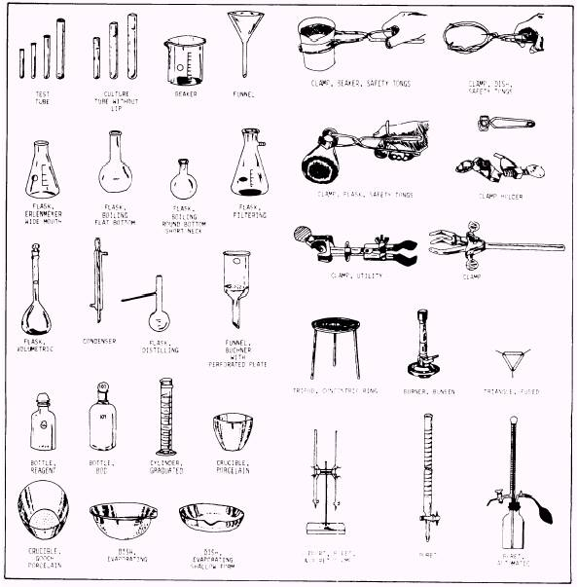
lab ware
Each piece of lab equipment is designed to do a different job.
Notes:
It is important to know the names and functions of different kinds of laboratory equipment, so that…
…experiments are done safely.
….experiments are completed successfully.
http://www.wisc-online.com/Objects/ViewObject.aspx?ID=sci302

Slide 3
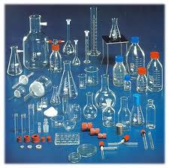
glassware
Function: volumetric measuring, holding or storing chemicals or samples, mixing or preparing solutions, containing lab processes
Notes:
There are many different kinds of laboratory glassware items, the majority are covered in separate articles of their own; see the list further below. Such glassware is used for a wide variety of functions which include volumetric measuring, holding or storing chemicals or samples, mixing or preparing solutions or other mixtures, containing lab processes like chemical reactions, heating, cooling, distillation, separations including chromatography, synthesis, growing biological organisms, spectrophotometry, and containing a full or partial vacuum, and pressure, like pressure reactor. When in use, laboratory glassware is often held in place with clamps made for that purpose, which are likewise attached and held in place by stands or racks. This article covers aspects of laboratory glassware which may be common to several kinds of glassware and may briefly describe a few glassware items not covered in other articles.
http://en.wikipedia.org/wiki/Laboratory_glassware

Slide 4
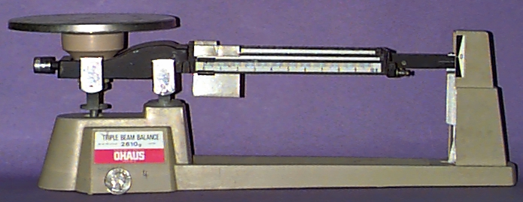
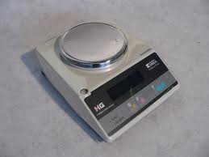
balances
Function: determine an object’s mass
Notes:
The function of a balance is to mass objects. [NOTE: If the device is measuring an object using springs against gravity, the devise is correctly referred to as a scale and it's measurements are described as weight not mass.] A balance uses a comparison of a known substance or calibration with the unknown object to determine the unknown object's mass.
http://www.newton.dep.anl.gov/teachers/resources/basiclab/balance.html

Slide 5
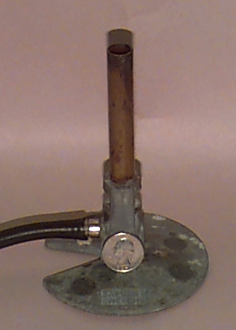
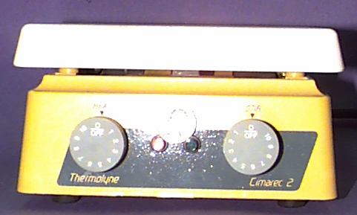
heating apparatus
Function: to heat substances
Notes:
The function of a bunsen burner (right) is to heat substances. The burner can be regulated by changing the air and gas mixture.
The function of a hotplate is obvious. Hotplates are often used as an alternative to the bunsen burner. Some hotplates have a stirring mechanism as part of their design and allows for faster dissolving of some solids by heating and stirring at the same time.
http://www.newton.dep.anl.gov/teachers/resources/basiclab/hotplate.html

Slide 6
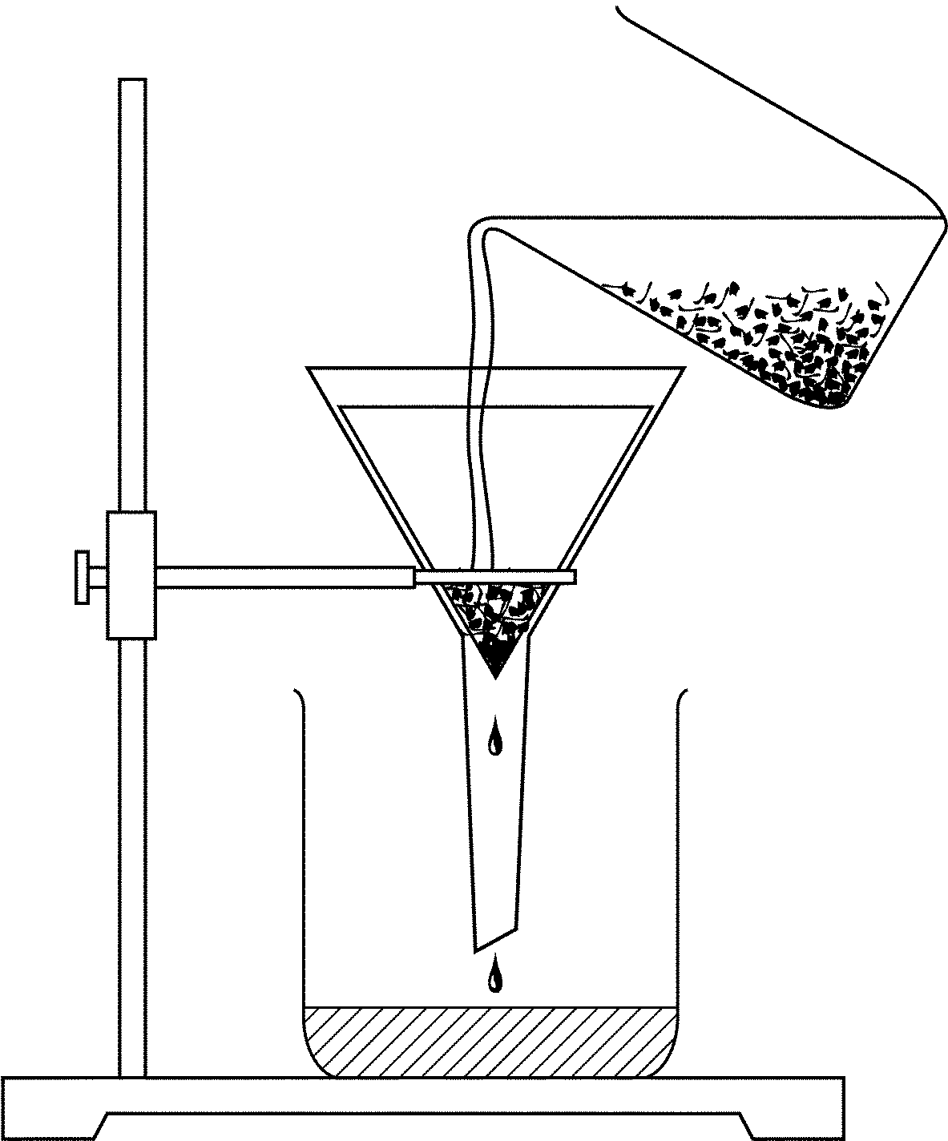
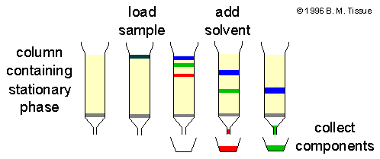
separation apparatus
Function: Separates components so they may be analyzed.
Notes:
http://chemwiki.ucdavis.edu/VV_Lab_Techniques/Thin_Layer_Chromatography#Plates
If you know that one component of a mixture is insoluble in a given solvent, but another component is freely soluble in it, it often gives good separations.
http://www.files.chem.vt.edu/chem-ed/sep/sepintro.html
Separations
Introduction
A sample that requires analysis is often a mixture of many components in a complex matrix. For samples containing unknown compounds, the components must be separated from each other so that each individual component can be identified by other analytical methods. The separation properties of the components in a mixture are constant under constant conditions, and therefore once determined they can be used to identify and quantify each of the components. Such procedures are typical in chromatographic and electrophoretic analytical separations.
A mixture can be separated using the the differences in physical or chemical properties of the individual components. As an example, dumping spaghetti and water in a colander separates the two components because the liquid water can run through the colander but the solid spaghetti cannot (assuming that it is not grossly overcooked as prepared in some university dining halls). Some water will stick to the spaghetti and some spaghetti may go down the drain because the colander is not 100% efficient. An analagous example is the filtering of a solid precipitate to separate it from a solution. These separations are based on the states of matter of the two components, other physical properties that are useful for separations are density and size. Some useful chemical properties by which compounds can be separated are solubility, boiling point, and vapor pressure.
SEPARATIONS
Introduction
Chromatography
chromatography introduction
chromatography theory
gas chromatography (GC)
gas chromatography columns
gas chromatography detectors
gas chromatography injectors
high-performance liquid chromatography (HPLC)
ion chromatography
liquid chromatography (LC)
size-exclusion chromatography (SEC)
supercritical-fluid chromatography (SFC)
thin-layer chromatography (TLC)
Electrophoresis
introduction and principles
capillary electrophoresis
discontinuous electrophoresis
gel electrophoresis (SDS-PAGE)
Extraction
introduction and principles
solid-phase extraction (SFE)
supercritical-fluid extraction (SFE)

Slide 7
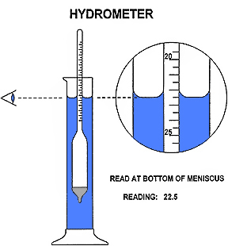
hydrometers
Function: measures the specific gravity (or relative density) of liquids
Notes:
A hydrometer is an instrument used to measure the specific gravity (or relative density) of liquids; that is, the ratio of the density of the liquid to the density of water.
A hydrometer is usually made of glass and consists of a cylindrical stem and a bulb weighted with mercury or lead shot to make it float upright. The liquid to be tested is poured into a tall container, often a graduated cylinder, and the hydrometer is gently lowered into the liquid until it floats freely. The point at which the surface of the liquid touches the stem of the hydrometer is noted. Hydrometers usually contain a scale inside the stem, so that the specific gravity can be read directly. A variety of scales exist, and are used depending on the context.
Hydrometers may be calibrated for different uses, such as a lactometer for measuring the density (creaminess) of milk, a saccharometer for measuring the density of sugar in a liquid, or an alcoholometer for measuring higher levels of alcohol in spirits.
Principle
Operation of the hydrometer is based on Archimedes' principle that a solid suspended in a fluid will be buoyed up by a force equal to the weight of the fluid displaced by the submerged part of the suspended solid. Thus, the lower the density of the substance, the farther the hydrometer will sink. (See also Relative density and hydrometers.)
http://en.wikipedia.org/wiki/Hydrometer

Slide 8
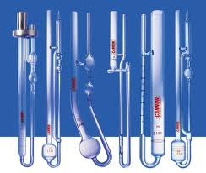
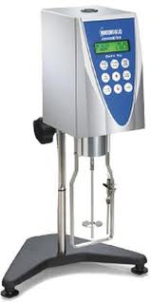
viscometers
Function: measures the viscosity of a fluid
Notes:
A viscometer (also called viscosimeter) is an instrument used to measure the viscosity of a fluid. For liquids with viscosities which vary with flow conditions, an instrument called a rheometer is used. Viscometers only measure under one flow condition.
In general, either the fluid remains stationary and an object moves through it, or the object is stationary and the fluid moves past it. The drag caused by relative motion of the fluid and a surface is a measure of the viscosity. The flow conditions must have a sufficiently small value of Reynolds number for there to be laminar flow.
At 20.00 degrees Celsius the viscosity of water is 1.002 mPa·s and its kinematic viscosity (ratio of viscosity to density) is 1.0038 mm²/s. These values are used for calibrating certain types of viscometer.
“trueness”). In the context of the method validation here, the terms random error, systematic error, and total error are generally used to clarify the intent and meaning.
http://en.wikipedia.org/wiki/Viscometer

Slide 9
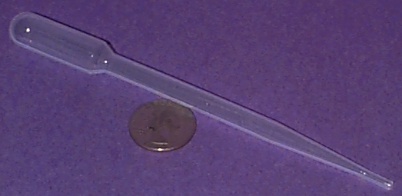
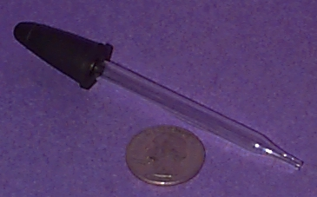
pipettes
Function: precisely measures volumes of liquids
Notes:
Pipettes are devices that allow the users to extract or deliver small amounts of a liquid. Pipettes come in a variety of designs with only two shown. Some are graduated to deliver exact quantities, but most allow for a "drop at a time" delivery.
http://www.newton.dep.anl.gov/teachers/resources/basiclab/pipette.html

Slide 10
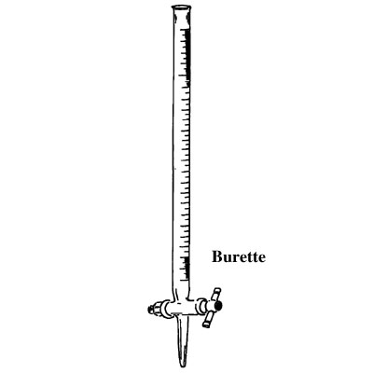
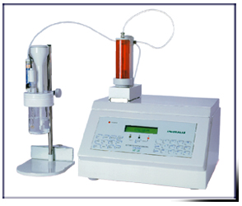
titrators
Function:
Titration is the quantitative measurement of an analyte in solution by completely reacting it with a reagent solution.
Notes:
Manual titration is done with a buret.
For repetitive titrations, autotitrators with microprocessors are available that deliver the titrant, stop at the endpoint, and calculate the concentration of the analyte.
http://www.files.chem.vt.edu/chem-ed/titration/titratn.html
Titration
Introduction
Titration is the quantitative measurement of an analyte in solution by completely reacting it with a reagent solution. The reagent is called the titrant and must either be prepared from a primary standard or be standardized versus a primary standard to know its exact concentration.
The point at which all of the analyte is consumed is the equivalence point. The number of moles of analyte is calculated from the volume of reagent that is required to react with all of the analyte, the titrant concentration, and the reaction stoichiometry.
The equivalence point is often determined by visual indicators are available for titrations based on acid-base neutralization, complexation, and redox reactions. and is determined by some type of indicator that is also present in the solution. For acid-base titrations, indicators are available that change color when the pH changes. When all of the analyte is neutralized, further addition of the titrant causes the pH of the solution to change causing the color of the indicator to change.
Instrumentation
Manual titration is done with a buret, which is a long graduated tube to accurately deliver amounts of titrant. The amount of titrant used in the titration is found by reading the volume of titrant in the buret before beginning the titration and after reaching the endpoint. The difference in these readings is the volume of titrant to reach the endpoint. The most important factor for making accurate titrations is to read the buret volumes reproducibly. The figure shows how to do so by using the bottom of the meniscus to read the reagent volume in the buret.
The end point can be determined by an indicator as described above or by an instrumental method. The most common instrumental detection method is potentiometricdetection. The equivalence point of an acid-base titration can be detected with a pH electrode. Titrations, such as complexation or precipitation, involving other ions can use an ion-selective electrode (ISE). UV-vis absorption spectroscopy is also common, especially for complexometric titrations where a subtle color change occurs.
For repetitive titrations, autotitrators with microprocessors are available that deliver the titrant, stop at the endpoint, and calculate the concentration of the analyte. The endpoint is usually detected by some type of electrochemical measurement. Some examples of titrations for which autotitrators are available include:
Acid or base determination by pH measurement with potentiometric detection.
Determination of water by Karl Fischer reagent (I₂ and SO₂ in methyl alcohol and pyridine) with coulometric detection.
Determination of Cl in aqueous solution with phenylarsene oxide using amperometric detection.

Slide 11
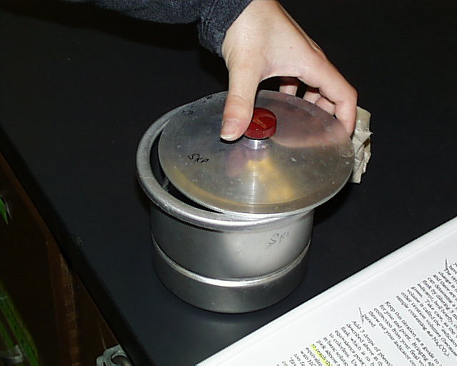
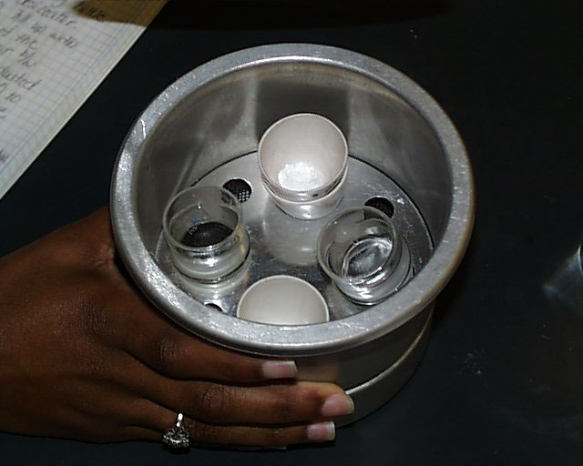
desiccators
Function: 1) cooling of heated objects
2) storage of dry objects
Notes:
http://www.csudh.edu/oliver/che230/labmanual/desiccat.htm
A desiccator is an airtight container which maintains an atmosphere of low humidity through the use of a suitable drying agent which occupies the bottom part of the desiccator. It is used both for the cooling of heated objects and for the storage of dry objects that must not be exposed to the moisture normally present in the atmosphere.

Slide 12
cleanliness of
laboratory equipment
_{Importance: safety, accuracy}
Standards: Good Laboratory Practice (GLP) is a quality system under which studies are planned, performed, monitored, recorded, archived, and reported.
Notes:
GLP: Good Laboratory Practice
2.1.4 Definition of GLP
The quality is the capability to systematically produce the same product to meet the same
specifications time after time. GLP was altered to protect the integrity and quality of
laboratory data used to back up a product application. The definition of the term “Good
Laboratory Practice” itself, which identifies GLP as “a quality system related with the
organisational process and the conditions under which non-clinical health and
environmental safety studies are planned, performed, monitored, recorded, archived and
reported.” can be considered as an example of a brief and accurate definition. GLP describes
good practices for non-clinical lab studies that support research or marketing approvals for
FDA-regulated products( Seiler, 2005).
2.1.5 Purpose of GLP
Everyone makes mistakes that’s why GLP is needed. GLP principles are a good idea even if
you are not required to follow the standards. There are some simple rules such as: Say What
You Do (with written standard operating procedures), do what you say (follow the
procedures), be able to prove it (with good record keeping) (Jean Cobb, 2007).
2.1.6 The principles of good laboratory practice (GLP) is to support the development of
quality and validity of test data used for determining the safety of chemicals and chemicals
product (Clasby, 2005).
6.1.4 The GLP Principles do not suggest or require any specific time intervals for such
activities. Cleaning and maintenance intervals may be different from one type of equipment
to the other, and such intervals may as well depend on the frequency of use or the workload
imposed on the respective equipment. On the other hand the question of the correct
frequency of such activities should be considered as a scientific one, calling for the expert
judgement of the responsible scientists.
6.1.5 Generally the manufacturer's manuals provide useful signs or suggestions for cleaning
and maintenance intervals. These same aspects are valid also for calibration frequencies,
where in some cases calibration is routinely performed before each measurement, while in
other cases the respective frequencies may be set in an arbitrary manner. The key point in
the consideration of maintenance and calibration frequencies is the necessary assurance of
data validity.

Slide 13
laboratory equipment cleaning methods
Wear appropriate personal protective equipment
Allow disinfectant to remain on the equipment for the appropriate contact time
Completely remove the disinfectant from the equipment
Store equipment and complete cleaning certification
Notes:
Decontamination of Laboratory Equipment
http://www.tamhsc.edu/ehsm/laboratory-safety/hsc-equipment-decontamination-policy.pdf

Slide 14
handling acids and bases
Wear correct personal protective equipment (PPE):
  eyewear, face shields, hand and respiratory protection
Always use secondary containment devices if/when transporting acids or bases.
If you are using hazardous chemicals, make sure your work is always done inside a fume laboratory hood.
Always document Standard Operating Procedures (SOP), and incorporate Safe Work Practices (SWP).
Notes:
Introduction to Medical Laboratory Technology
Precaution:
When diluting concentrated acids, thin walled glassware
should be used since the heat evolved by the procedure
often cracks thick glasswares. Examples:- hydrochloric
and sulfuric acid.

Slide 15
handling acids and bases
_{ALWAYS}
• Obtain and read the most current Materials Safety Data Sheet (MSDS) for the specific acids and other chemicals that you will be using.
• Implement the controls and SWP’s specified in the MSDS.
• Check for incompatibilities in materials, processes and products of your method(s).
• Follow the documented SOP for the planned task.
• Keep a detailed laboratory notebook, documenting your work.
• Stop Work — your work, or that of your colleagues — when you are concerned or suspicious of danger or unnecessary risk.
Notes:
Texas A& M Engineering
Guideline for the Safe Handling of Acids and Bases

Slide 16
using compressed gases
General Use SOP for Compressed Gases
1.) Process or Experiment Description
2.) Hazardous Chemicals/ Class of Hazadous Chemicals
3a.) Control of Hazards – General
3b.) Engineering/ Ventilation Controls
4.) Special Handling Procedures and Storage Requirements
Notes:
http://chemtoolkit.stanford.edu/node/59
Stanford University. Laboratory Chemical Safety Toolkit
General Use SOP for Compressed Gases
#1Process or Experiment DescriptionThis standard operating procedure (SOP) is intended to provide general guidance on how to safely work with compressed gases. This general use SOP only addresses safety issues specific to compressed gases. In some instances, several general use SOPs may be applicable for a specific chemical (i.e., for flammable gases, both this general use SOP and the general use SOP for flammables would apply). If you have questions concerning the applicability of any item listed in this procedure contact the Principal Investigator/Laboratory Supervisor of your laboratory or Environmental Health and Safety (x3-0448).
#2Hazardous Chemicals/Class of Hazardous ChemicalsCompressed gases have inherent pressure hazards and can also create health hazardous and/ or flammable atmospheres. Common hazard characteristics of gases include flammability, toxicity, and corrosivity. A few gases (i.e., silane, diborane, phosphine) are considered pyrophoric (will ignite spontaneously in air).
One additional hazard property common to all compressed gases is the substantial volume expansion when released to air. Gas release in an inadequately ventilated room can create an oxygen-deficient environment.
#3Control of Hazards- GeneralCheck connections and hoses regularly for leaks using a specific monitoring instrument or soapy water (or equivalent).
When using highly flammable or toxic gas, check the delivery system using an inert gas prior to introducing the hazardous gas.
When using compressed acetylene: (i) do not exceed a working pressure of 15 psig, and (ii) do not use vessels, piping, or other materials that contain a significant amount of copper (usually considered to be more than 50% copper).
Replace valve caps when cylinders are not in use or before moving.
Remove damaged or defective cylinders from service (contact the cylinder vendor for assistance).
#3aEngineering/Ventilation ControlsIf the process does not permit gas use and/or storage in well-ventilated areas (i.e., lab ventilation having a minimum of 6 air changes per hour), contact Environmental Health and Safety at x3-0448 to determine necessity of an oxygen-deficiency monitor or other alarm devices.
#3bPersonal Protective EquipmentAt minimum, lab coats, safety glasses, and closed toed shoes should be worn when handling compressed gases. Depending on the hazard characteristics, additional protective equipment may be necessary.
#4Special Handling Procedures and Storage RequirementsSafe Handling:
Compressed gas cylinders must be transported using hand-trucks or other appropriate means. NEVER TRANSPORT UNSECURED COMPRESSED GAS CYLINDERS!
Cylinders should be transported upright whenever possible (always transport acetylene in an upright (vertical) position).
Elevators can be a confined space – NEVER ride in an elevator with compressed gas cylinders. Have one person send the elevator and another person receive the elevator.
Safe Storage:
Secure compressed gas cylinders (>26" tall) to an anchored rack using two metal chains (at 1/3 and 2/3 cylinder height).
No more than two cylinders may be secured with one pair of chains.
Segregate and clearly mark full and empty ("MT") cylinders.
Store compressed gas cylinders away from heat sources, and flammable and highly combustible materials (such as oil and greases).
Segregate according to hazard class and chemical compatibility. Ensure to separate flammable and oxidizing gases.
Store flammable gases away from flammable solvents, combustible material, ignition sources (including unprotected electrical connections), and oxygen gas cylinders and liquid oxygen (at least 20 feet if possible).
Additionally, follow all substance-specific storage guidance provided in MSDS documentation.

Slide 17
using compressed gases
General Use SOP for Compressed Gases
5.) Spill and Accident Procedures
6.) Waste Disposal
7.) Minimum Training Requirements
8.) Approval Required
9.) Decontamination Procedures
10.) Designated Area
Notes:
http://chemtoolkit.stanford.edu/node/59
Stanford University. Laboratory Chemical Safety Toolkit
General Use SOP for Compressed Gases
#5Spill and Accident ProceduresPrompt response to chemical spills is critical to protect worker health & safety and to mitigate adverse affects to the environment. For further guidance, refer to "Response to Chemical Spills and Exposures".
Laboratory personnel who work with hazardous chemicals are to be provided the opportunity to receive medical attention/consultation when:
A spill, leak, explosion or other occurrence results in a hazardous exposure (potential overexposure).
Symptoms or signs of exposure to a hazardous chemical develop.
#6Waste DisposalCoordinate with vendor for return of cylinders.
#7Minimum Training RequirementsGeneral Safety & Emergency Preparedness (EHS-4200)
Chemical Safety for Laboratories (EHS-1900)
Compressed Gas Safety (EHS-2200)
Laboratory-specific training
#8Approval RequiredConsult with PI regarding need for prior approval. Laboratory personnel shall seek and the PI must provide prior approval of any chemical usage involving the following list of restricted chemicals.
#9Decontamination ProceduresNot applicable
#10Designated AreaFor compressed gases that are also considered particularly hazardous chemicals, a designated area shall be established per the other applicable SOP(s).

Slide 18
chemical shelf-life:
_{Responsibilities}
_{Coding}
_{Storage}
_{Testing}
_{Shipping}
Excess, Disposal and Reutilization of Shelf Life Assets
Notes:
Shelf Life Policy and Procedures
https://www.shelflife.hq.dla.mil/policy_DoD4140_27.aspx
http://www.af.mil/shared/media/epubs/PUBS/AF/23/23011007/070301/070301.pdf

