Slide 1
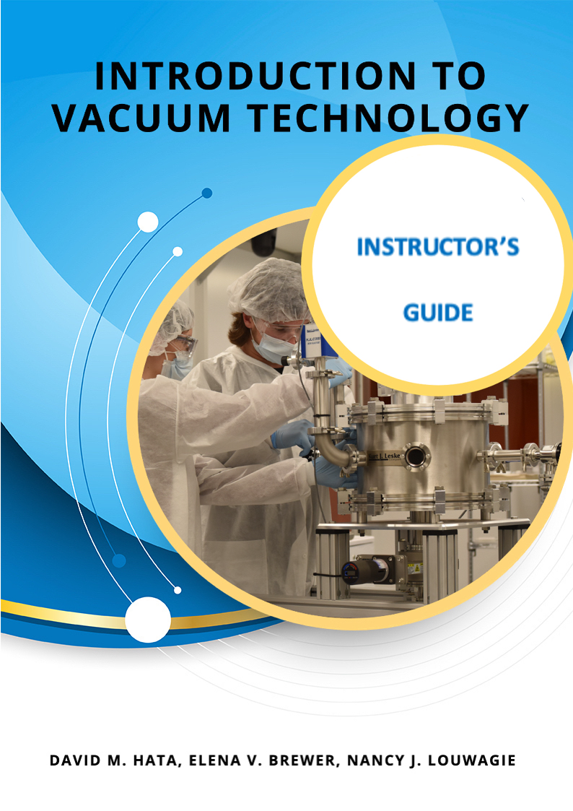




E-Book Development for Technician Laboratory Experiments and Learning Activities
Elena Brewer, SUNY Erie Community College
Nancy Louwagie, Normandale Community College

Slide 2

Developing an E-book and Other Interactive Instructional Materials for Technician Education in Vacuum Technology
NSF New-to-ATE Project #2000454, $300K Budget
PI – Elena Brewer, Professor, Electrical Engineering Technology and Nanotechnology, SUNY Erie Community College, Williamsville, NY
brewer@ecc.edu
Co-PI – Nancy Louwagie, Instructor, Engineering Technology Programs, Vacuum Technology Department, Normandale Community College, Bloomington, MN
Nancy.Louwagie@normandale.edu
Consultant - David Hata, Author of Introduction to Vacuum Technology textbook, Portland, OR
External Evaluator - Bob Bailey, Outcomes Consulting Services, Lynchburg, VA

Slide 3
Outline
Project background and motivation
Step 1: Components required for your educational materials
Step 2: Choosing E-Publishing platform
Step 3: Producing visual materials
Step 4: Licensing your work
Learning more using existing OER courses

Slide 4
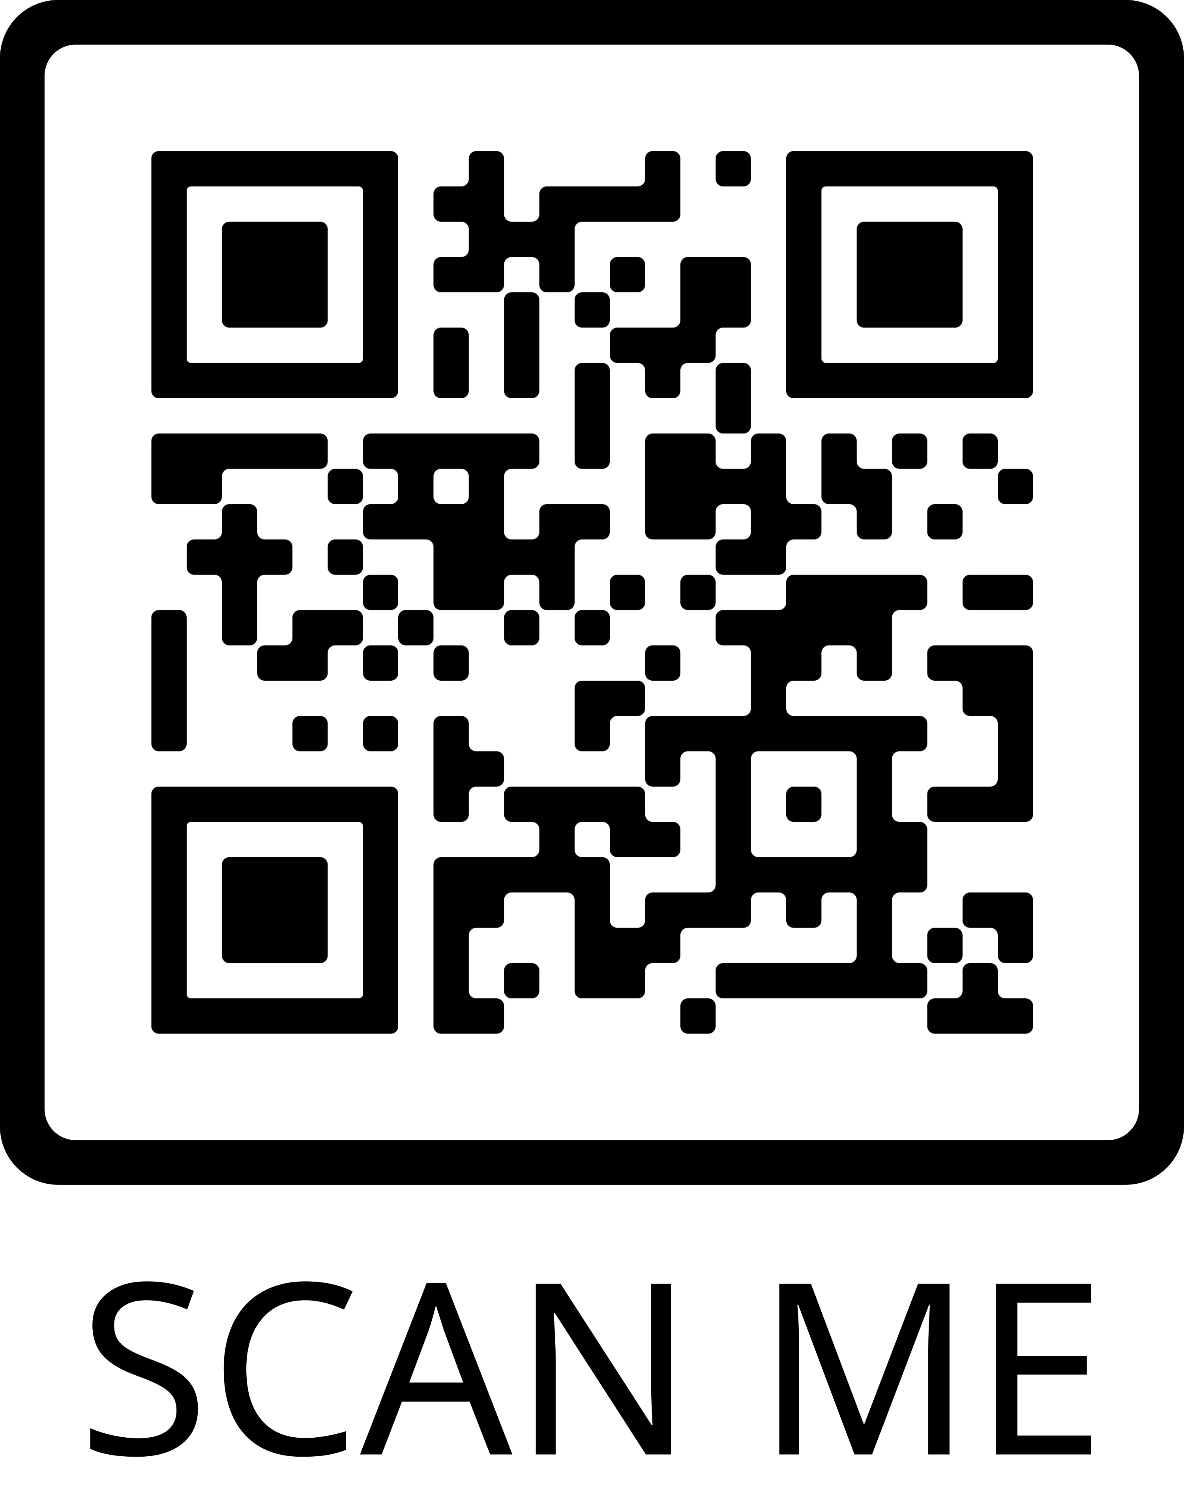
What is Your Background?
Q1: Which one of the following options best describes
your affiliation?
Q2: What is your experience with e-learning? Examples
includes creating and/or publishing e-books; creating
video content; creating content for use on LMS;
creating animations
Q3: Briefly list or describe the primary technology area
of interest to you.

Slide 5

Project Background: The Need
The semiconductor companies need technicians and other personnel to work in their factories as:
- maintenance technicians
- process technicians
- equipment managers who understand vacuum systems, what
each system includes and what process does it support
Legislation to grow the semiconductor industry
is introduced:
- CHIPS for America Act
- FABS Act
New factories are being built:
Example: Intel Corporation building new
factories in Columbus, OH
(Image Credit: Intel Corporation)

Slide 6
Project Background: The Need (Continued)
A key part of a semiconductor maintenance technician’s skill set is a working knowledge of vacuum technology.
A curriculum for training technicians in vacuum technology requires:
- instructional materials, such as textbooks and laboratory instruction
manuals,
- training facilities, such as teaching laboratories with industry-standard
vacuum equipment,
- qualified instructors with working knowledge of vacuum systems.

Slide 7
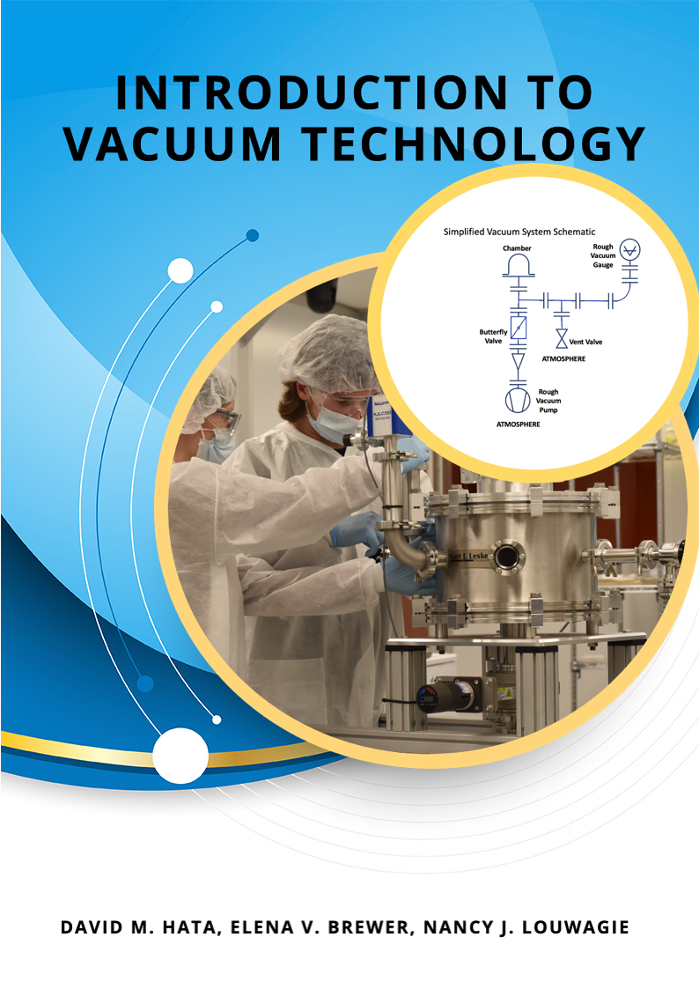

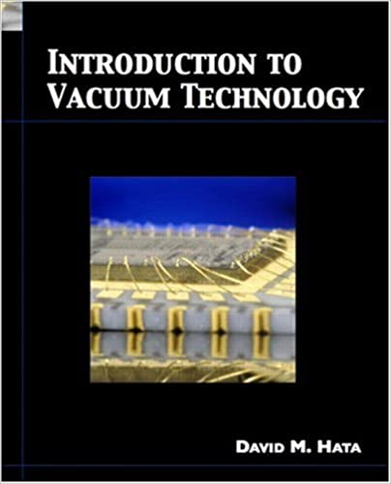
Project Background:
Scope
E-Book
Student Lab Manual
Instructor’s Guide

Slide 8
Step 1: What components are required for your educational material?
Self-generated table of contents
Mathematical formulas engine
Embedded videos
Embedded animations/simulations
Interactive pre-lab assignments
Availability in different formats: EPUB, Web, PDF, etc.
Support for different learning formats: hands-on, remote hands-on, utilization of video materials
TOC and Learning Objectives
Video Example: Equipment Operation
Video Example: Demonstrations of physical phenomena

Slide 9
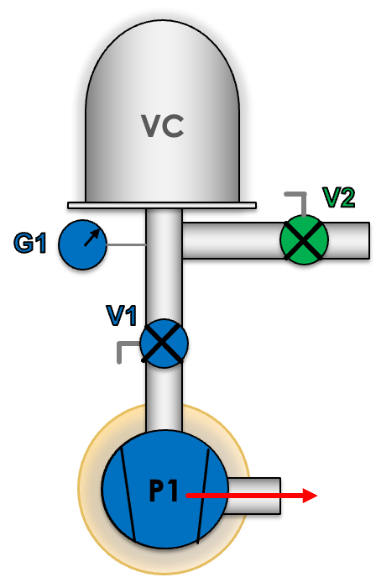
Step 1: What components are required by your project?
Rough Vacuum System: Remote Pump Down demonstration
Self-generated table of contents
Mathematical formulas engine
Embedded videos
Embedded animations/simulations
Interactive pre-lab assignments
Availability in different formats: EPUB, Web, PDF, etc.
Support of different learning formats:
-hands-on,
-remote hands-on,
-utilization of video materials

Slide 10
Step 1: What components are required by your project?
Rough Vacuum System: Remote Pump Down demonstration
Self-generated table of contents
Mathematical formulas engine
Embedded videos
Embedded animations/simulations
Interactive pre-lab assignments
Availability in different formats: EPUB, Web, PDF, etc.
Support of different learning formats:
-hands-on,
-remote hands-on,
-utilization of video materials

Slide 11
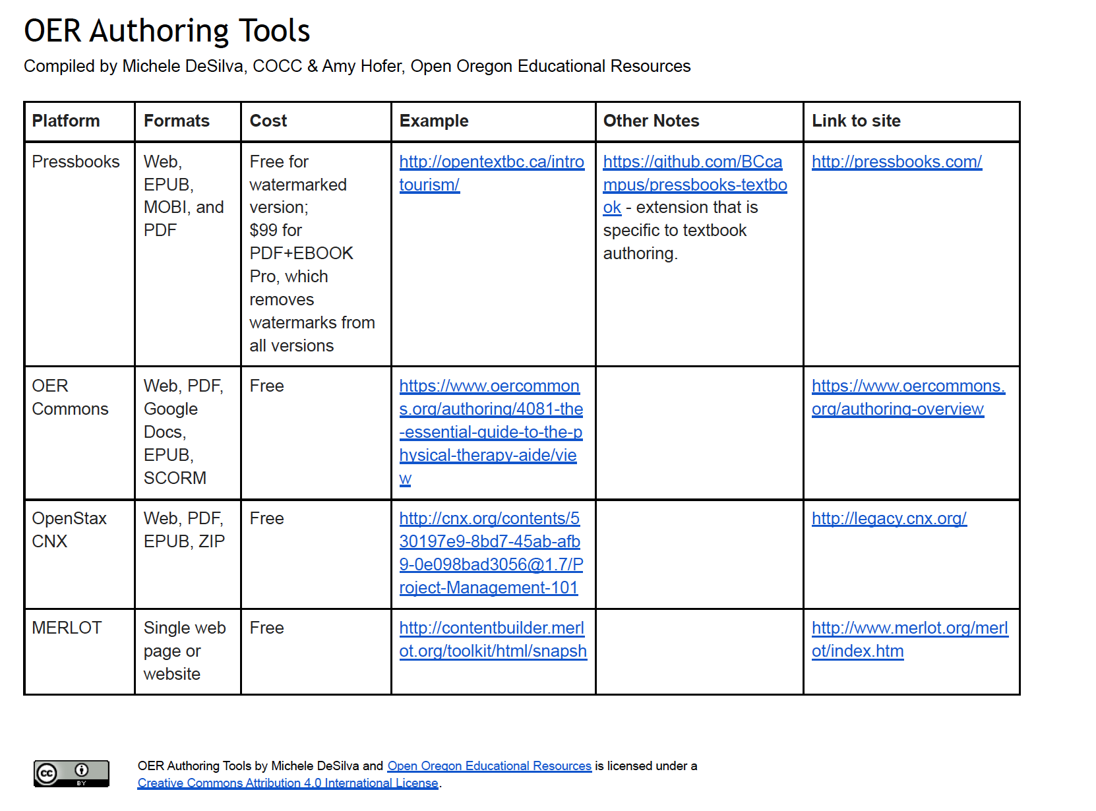
Step 2: Choosing E-Publishing Platform

Slide 12
Step 2: Choosing E-Publishing Platform
Other considerations:
Sustainability requirement: free or low-cost housing of the resource after grant ends. Milne Publishing (based on PressBooks) offers free and indefinite housing of the e-book and related ancillary materials on their platform.
Learning curve for the team that is does not have prior e-publishing experience.

Slide 13

Step 3: Production of Visual Materials (Figures, Videos, Animations)
Screencast-o-Matic: Web-based screen capture tool. Recordings may be up to 15- minutes long using the free version.
Jing: A free screen capture tool that allows you to make videos that are up to 5 minutes in duration.
Windows Movie Maker: Program for Windows computers that allows you to create video.
iMovie: Program for Macs that allows you to create, edit, and share video.
Camtasia: A video capture and editing tool.
This work is licensed by SUNY Buffalo State under a Creative Commons Attribution-ShareAlike 3.0 Unported License.

Slide 14
Step 3: Production of Visual Materials (Figures, Videos, Animations)
Words of Wisdom about developing visual materials on a small budget:
Utilize students for creation of figures and simple animations/simulations.
Ask vendors of editing software for educational pricing or discounts
(example – Vegas Pro).

Slide 15

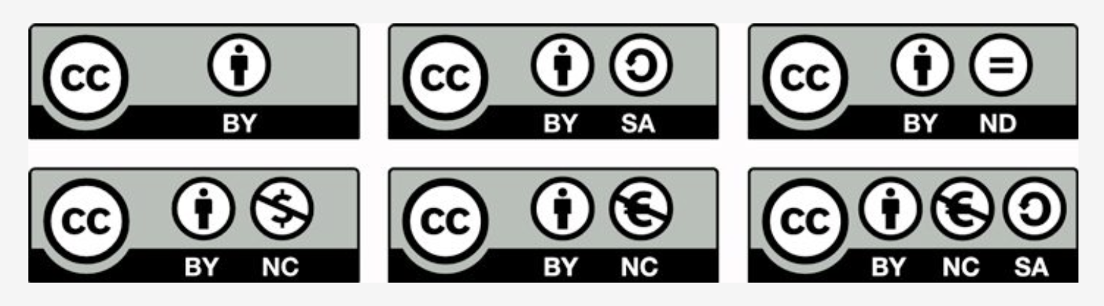
Step 4: Licensing your work with Creative Commons License
Creative Commons Licensing :
- Attribution (CC BY),
- Attribution Non-Commercial (CC BY-NC),
- Attribution No Derivatives (CC BY-ND), Guide to CC Resources:
- Attribution Share Alike (CC BY-SA),
- Attribution Non-Commercial Share Alike (CC BY-NC-SA),
- Attribution Non-Commercial No Derivatives (CC BY-NC-ND).

Slide 16
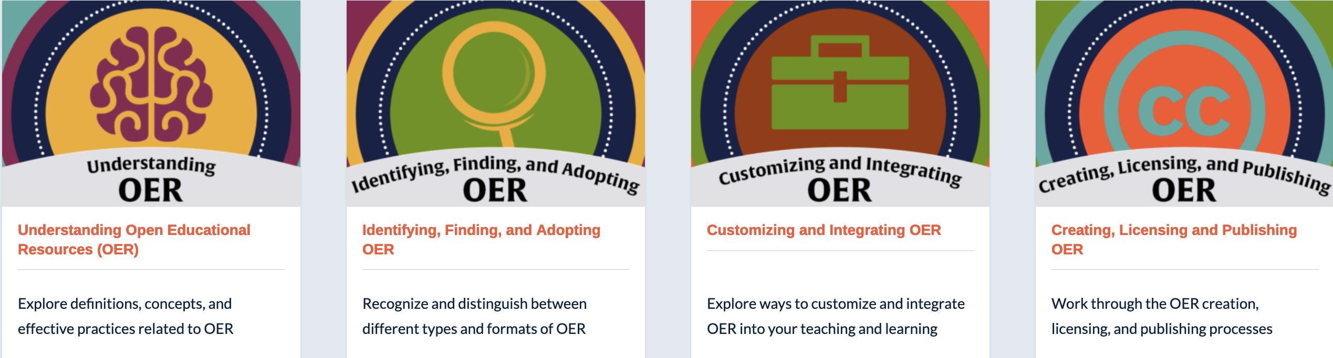


Step 5: Learn more using existing OER Courses
https://online.suny.edu/sunyoercommunitycourse/

Slide 17
Conclusion
This short guide is designed to give you a jump-start in starting producing your own e-pub materials.
Do not forget to pick up USB drive: it contains more e-publishing resources.
Good luck!

