Slide 1
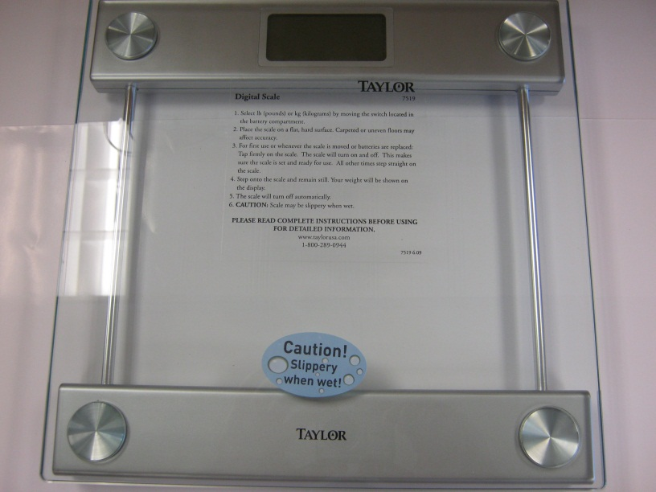
DIGITAL SCALE
Taylor Model 7519

Slide 2
Components
Control Board
Back of LCD Display
Battery Holder
Load Cell under foot

Slide 3
Control Board
Electrolytic Capacitors
Strain Gauge Connections
Control Logic
Surface Mount Components
Mode Switch

Slide 4
LCD Display
7-Segment Numeral
f a b
g (segment is off)
e d c

Slide 5
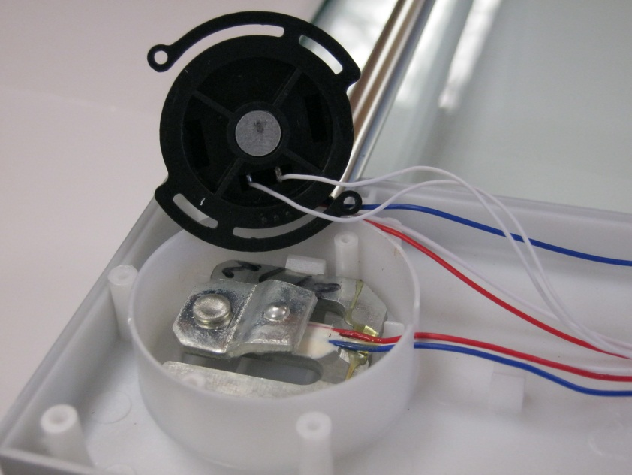
Load Cell
Foot Covering Load Cell
Load Cell Uncovered

Slide 6
Load Cell
Metal Frame
Strain Gauge (under epoxy)

Slide 7
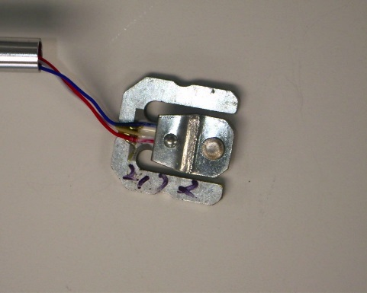
SEN-10245 50kg Load Cell Specifications
Capacity kg 40-50 Comprehensive Error mv/v 0.05 Output Sensitivity mv/v 1.0±0.1 Nonlinearity %FS 0.03 Repeatability %FS 0.03 Hysteresis %FS 0.03 Creep (3min)%FS 0.03 Zero Drift (1min)%FS 0.03 Temp. Effect on Zero %FS/10℃ 1 Temp. Effect on | Output %FS/10℃ 0.05 Zero Output mV/V ±0.1 Input Resistance Ω 1000±20 Output Resistance Ω 1000±20 Insulation Resistance MΩ ≥5000 Excitation Voltage V ≤10 Operation Temp. Range ℃ 0--+50 Overload Capacity %FS 150

Slide 8
Strain Gauge
Flexible Resistive Material
Resistance of Material Changes when Stressed
Sample Strain Gauges

