Slide 1
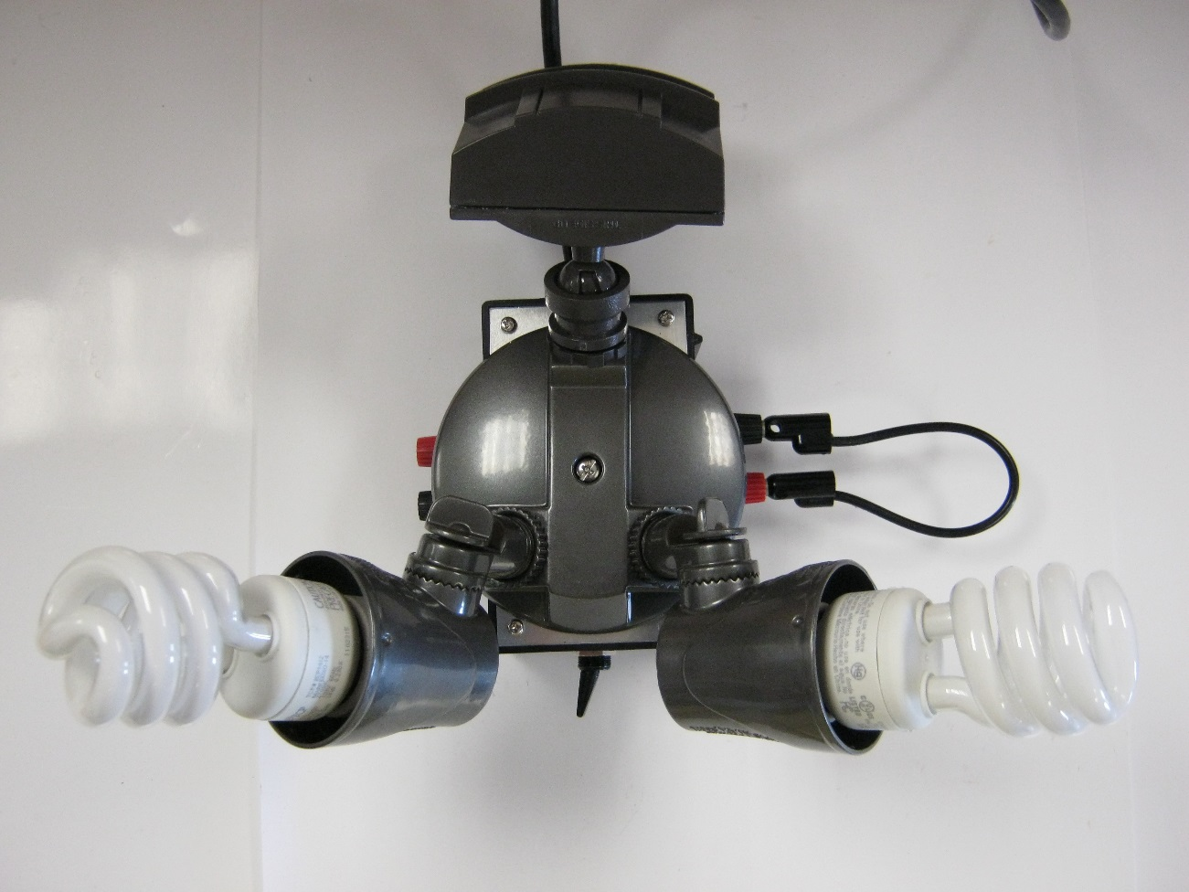

Motion SensinG Light Teardown

Slide 2
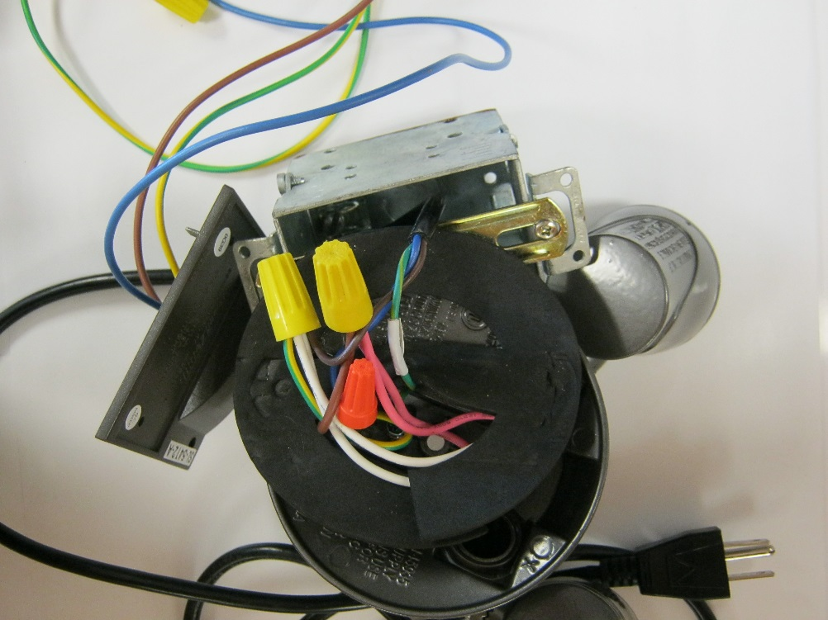
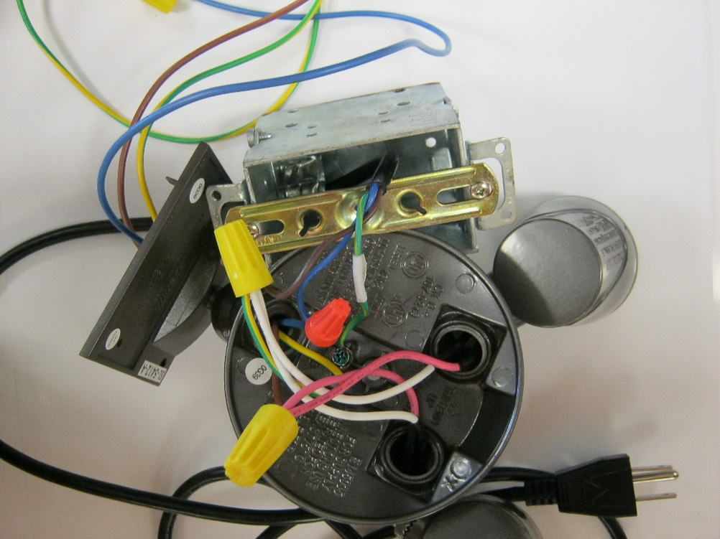
Wiring
We opened the back end of the fixture to expose the AC wiring.
Power to circuit board
Ground
Positive
Neutral

Slide 3
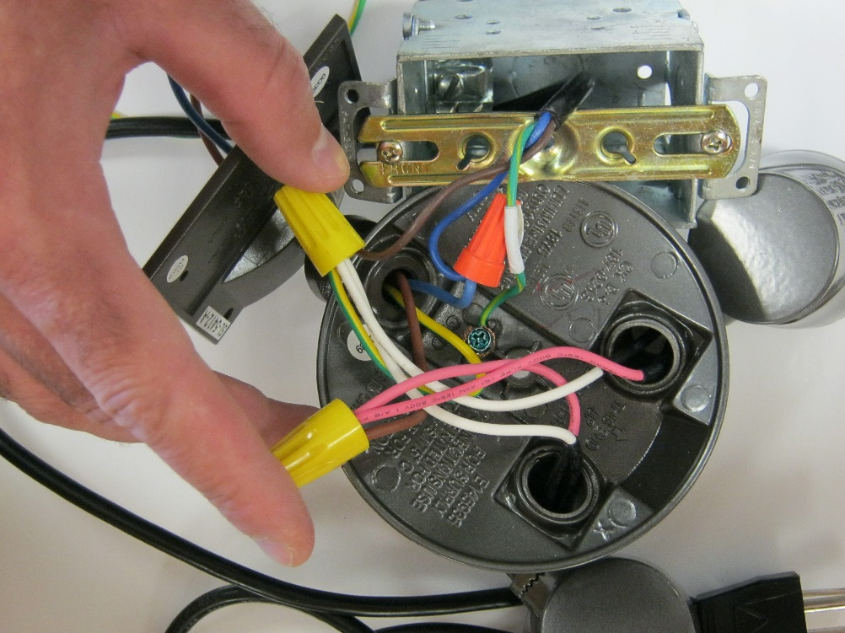
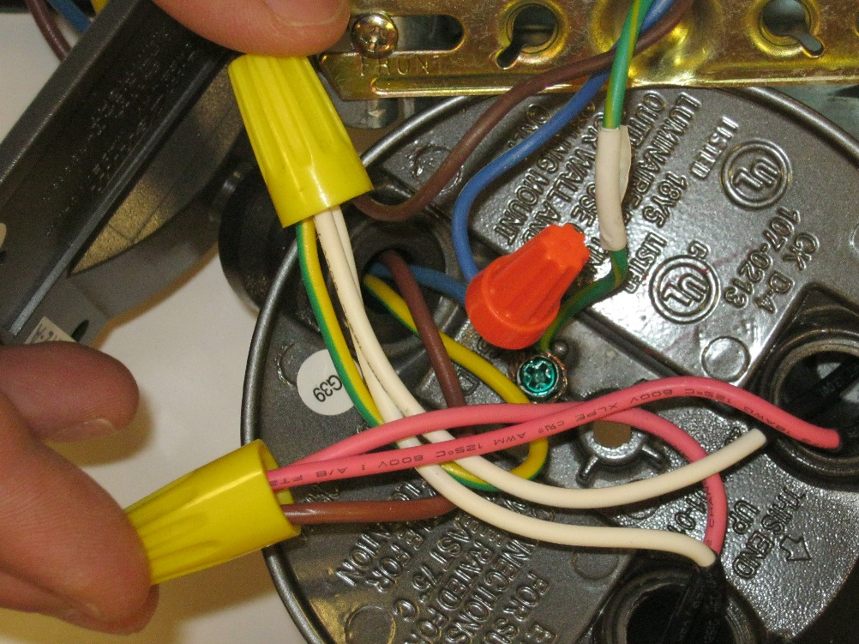
Close up view of wiring

Slide 4
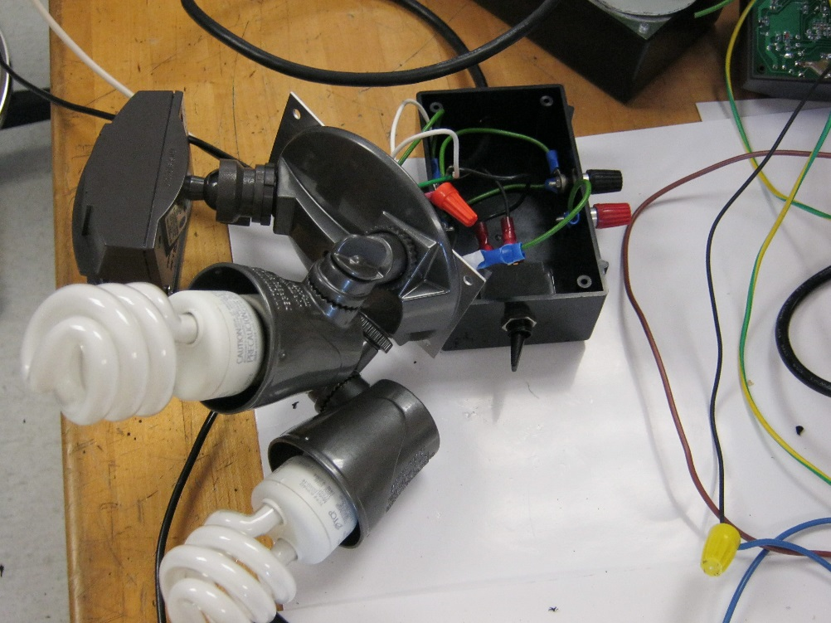
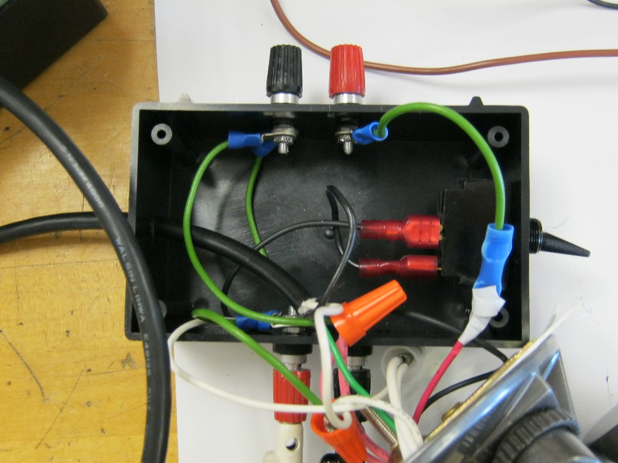
Adding manual toggle switch
Positive
Ground
Neutral
On/Off switch
For our experimentation purposes we broke out the wiring in order to measure voltage and current.

Slide 5
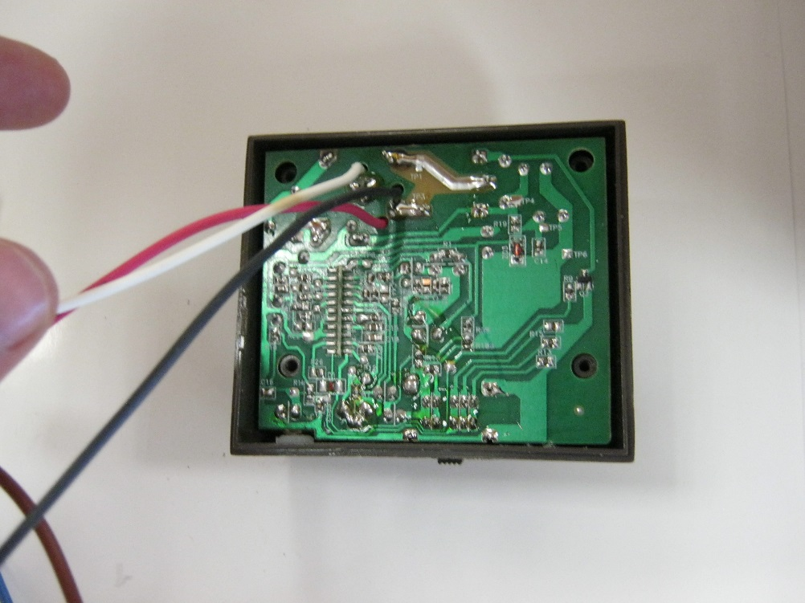
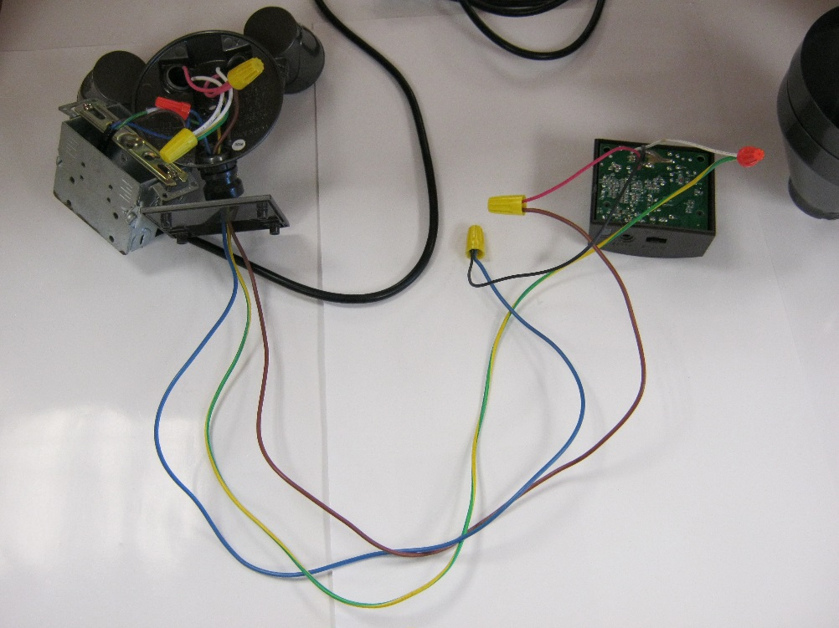
Positive, neutral and ground wiring for lights
120V, 60Hz, 4.2A UL listing
Neutral to lights
Power to circuit board
Positive to lights
Added wiring from power supply on back of circuit board to manual toggle switch
This is the sensor circuit board.

Slide 6
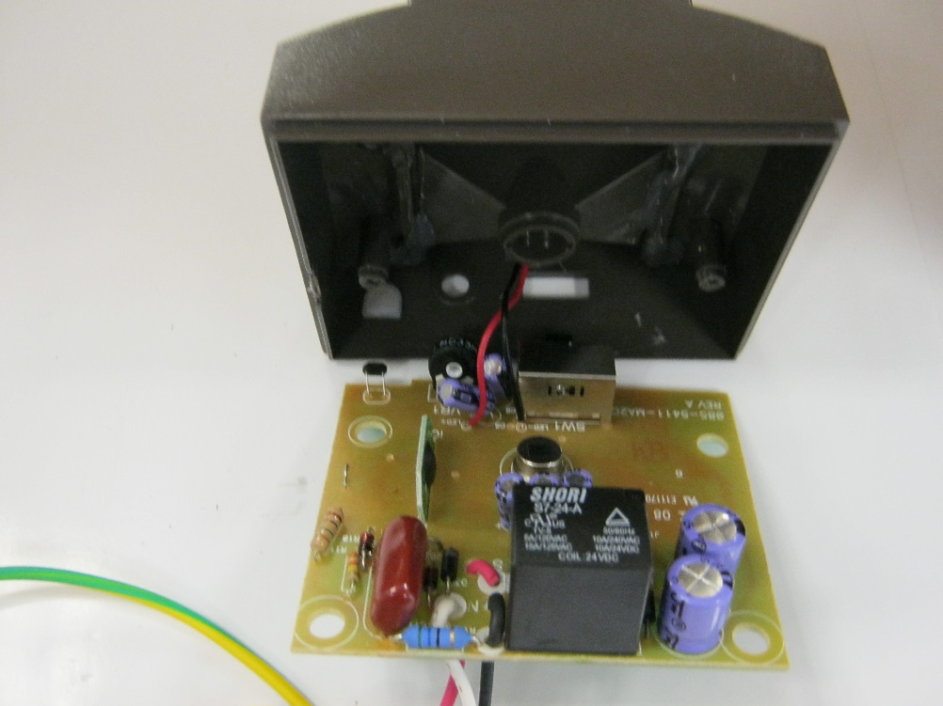
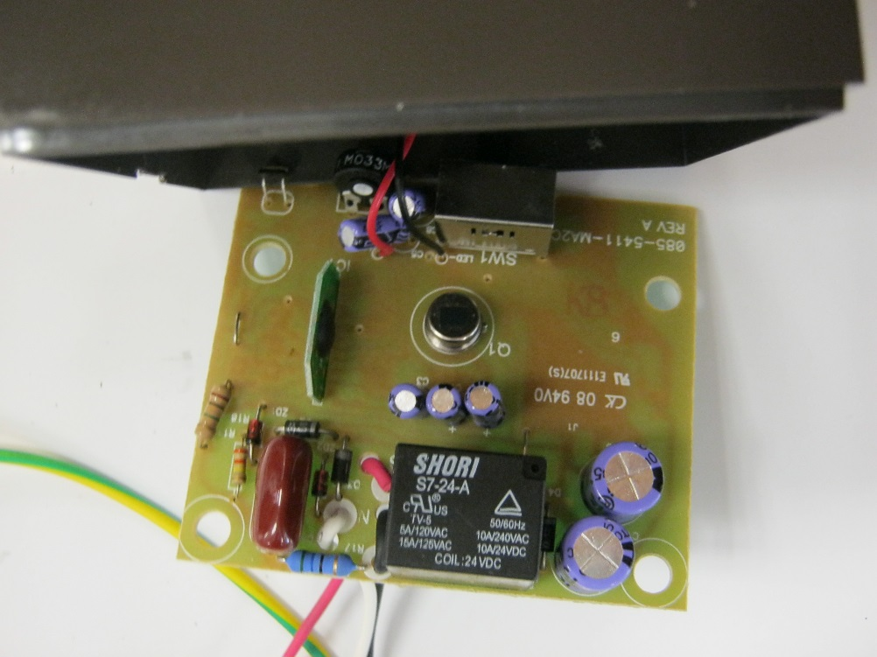
FRONT of Circuit board
Infrared light impinges the sensor through a diffuser lens. Changes are interpreted as motion.
Timer circuitry
Infrared motion sensor
Controller
Photo resistor
Wiring added to power supply for on/off toggle
Capacitors
Relay

Slide 7
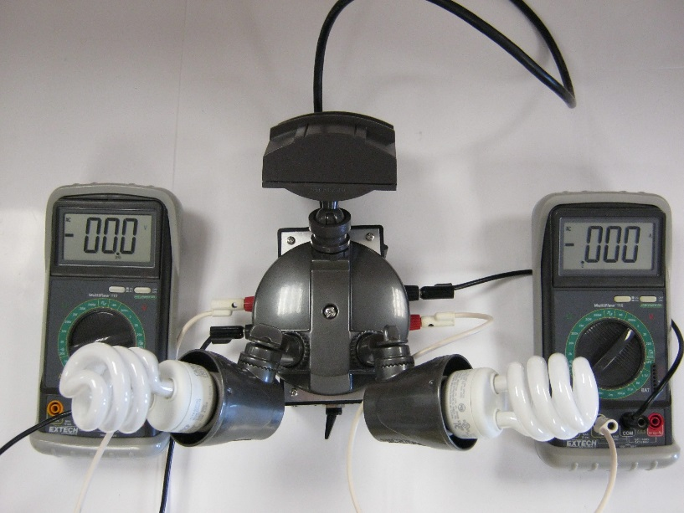
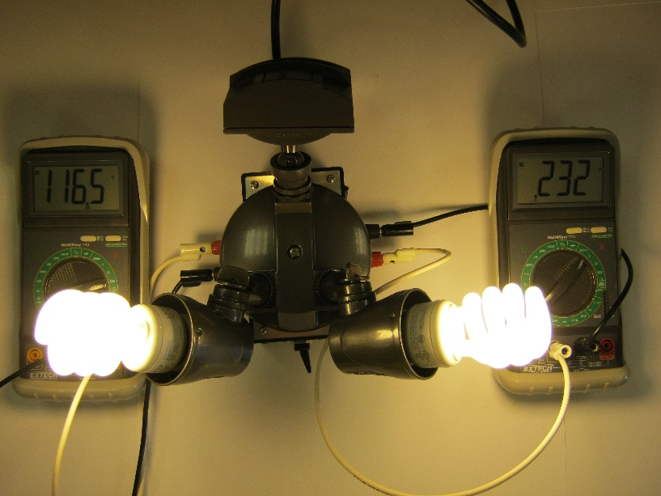
Measuring voltage and current on cfl
Manual toggle in off position
Manual toggle on position
With our breakout box we can measure differences between incandescent, CFL and LED bulb performance.
116.5 volts
232 mA current
14W - .23A (listed on bulb)

