Slide 1
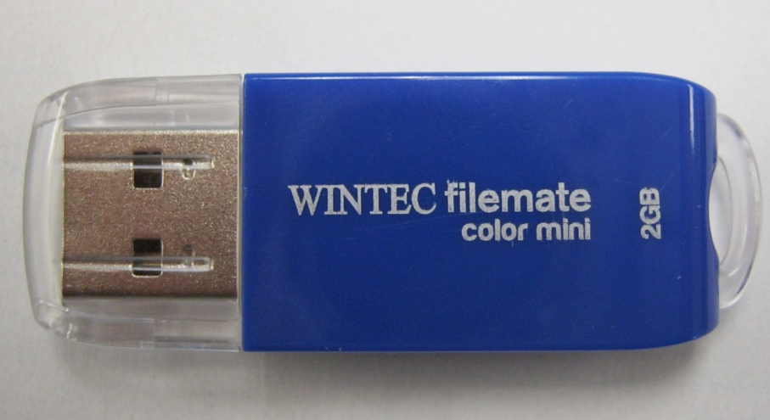
The USB Flash Drive
Wintec filemate 2GB

Slide 2
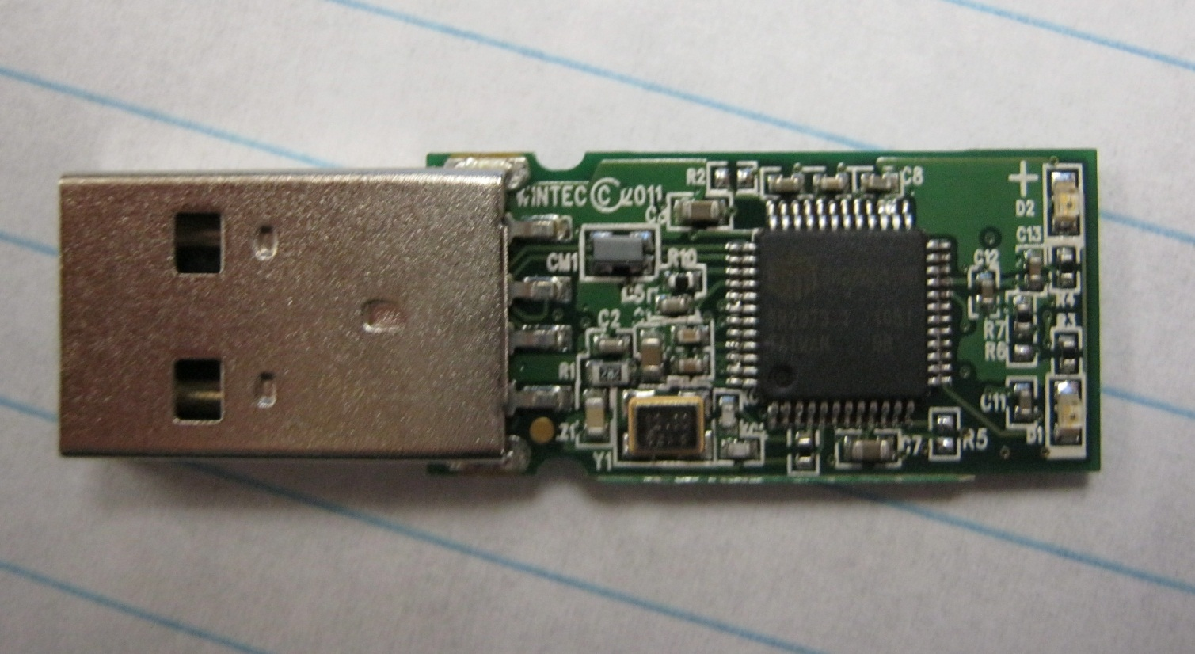
Components
USB male connector
USB mass storage controller
LED’s
Crystal Oscillator

Slide 3
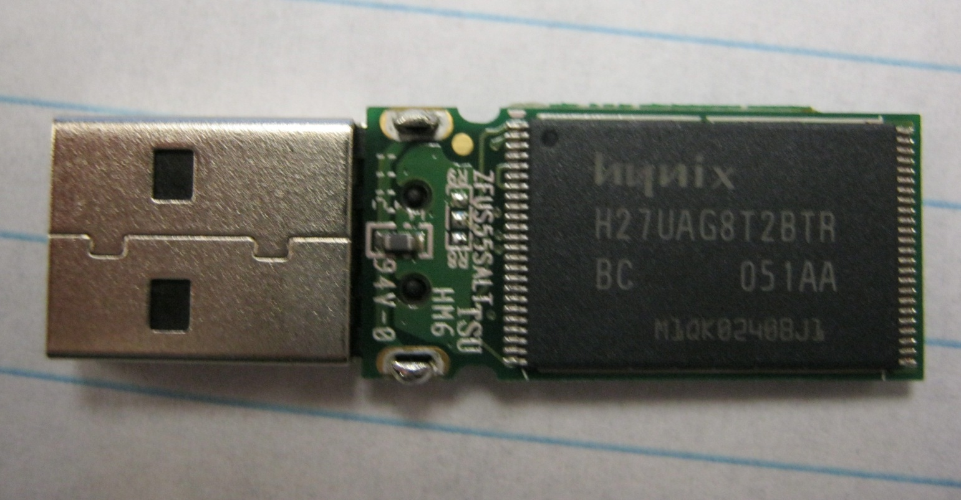
Components cont’d
USB male connector
NAND flash memory chip

Slide 4
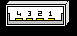
USB Connector
Pin | Name | Description
1 | VCC | +5 VDC
2 | D- | Data -
3 | D+ | Data +
4 | GND | Ground
Serial bus
Sequential read 14.8 MB/sec
Sequential write 4.3MB/sec
Data I/O

Slide 5
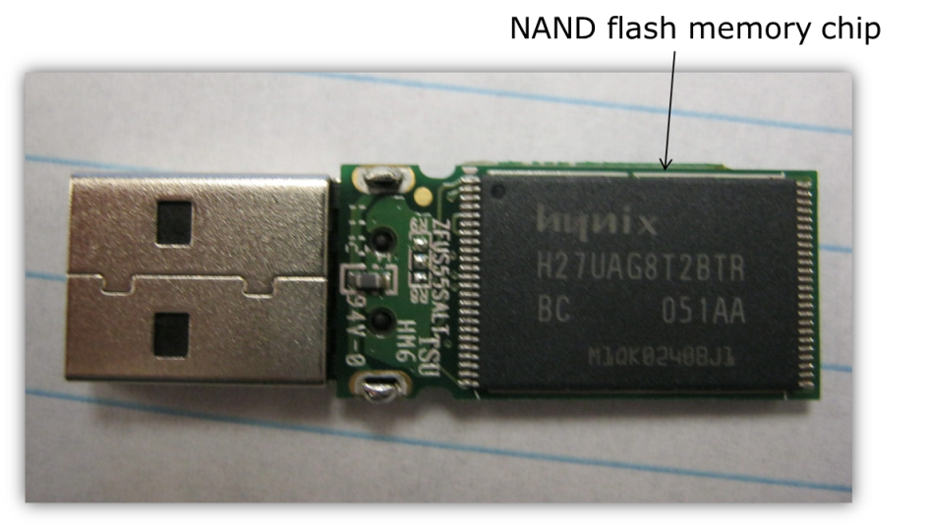
NAND flash memory chip
Hynix (H27UAG8T2BTR)
2GB storage
Operates at 3.3V VCC
TSOP surface mount

Slide 6
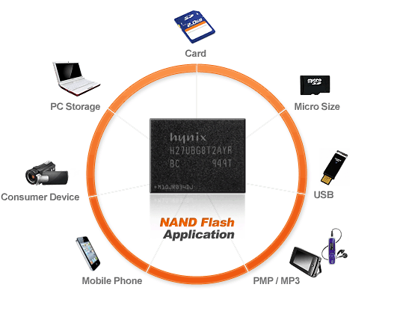
Other NAND flash memory applications

Slide 7
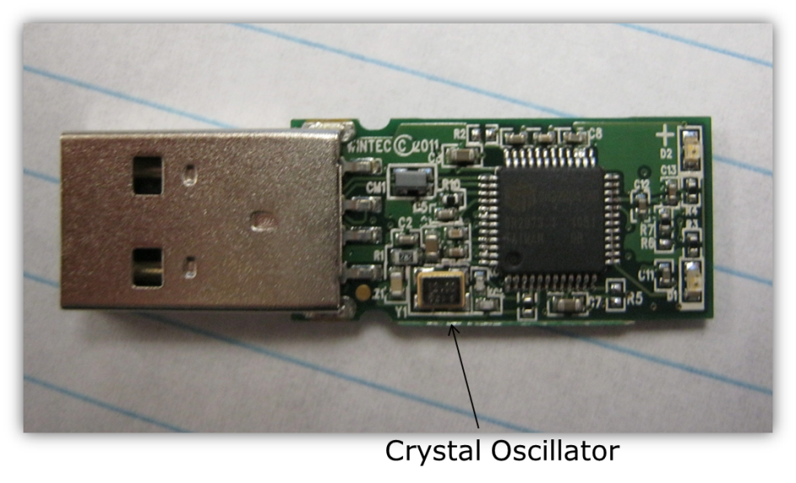
Crystal Oscillator
Common in many electrical devices.
Produces a clocking signal of 12MHz
Controls the devices data output

