Slide 1
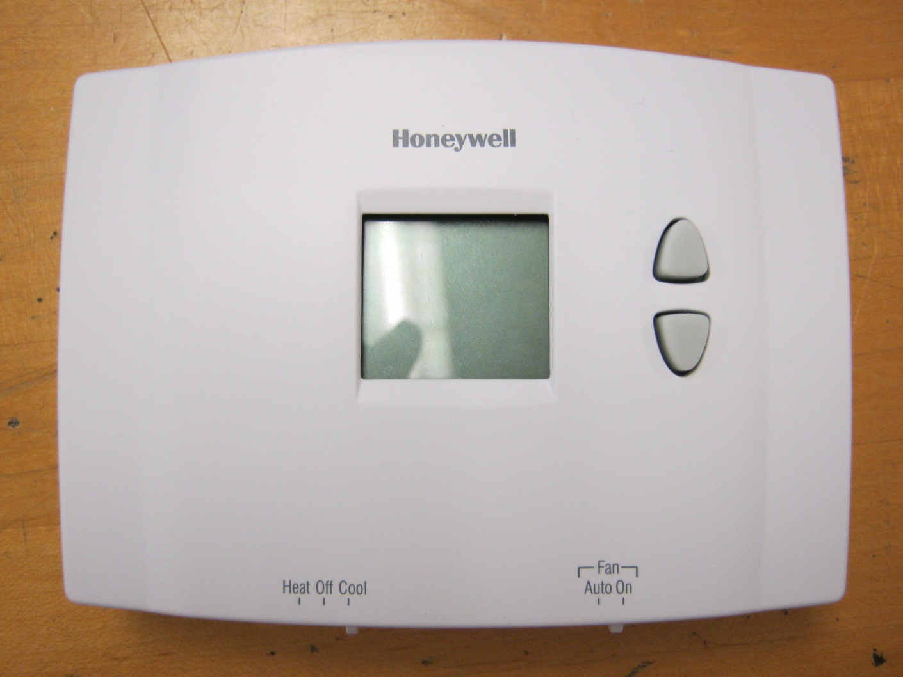
Digital Non-Programmable Thermostat

Slide 2
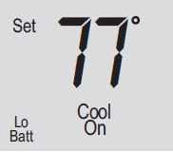
Digital screen
Setpoint indicator-
Appears when the Setpoint temperature is displayed
Temperature
The ambient temperature is normally displayed. The setpoint temperature will appear 5 seconds after the Up or Down button is pressed once.
Low battery warning
System status
Cool on: Cooling system is on.
Heat on: Heating system is on.

Slide 3
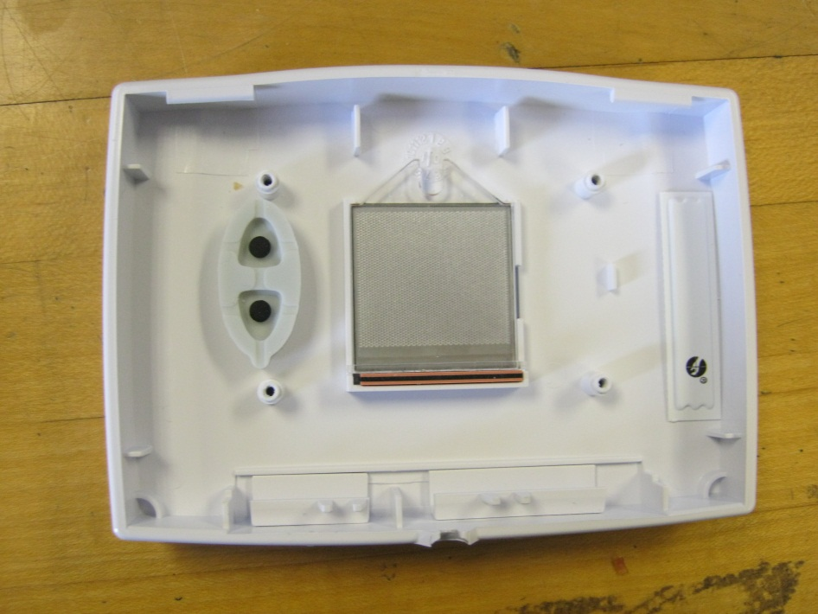
Back of front cover
Two rubber buttons
Back of screen
Sliders heating/cooling and fan auto/off

Slide 4
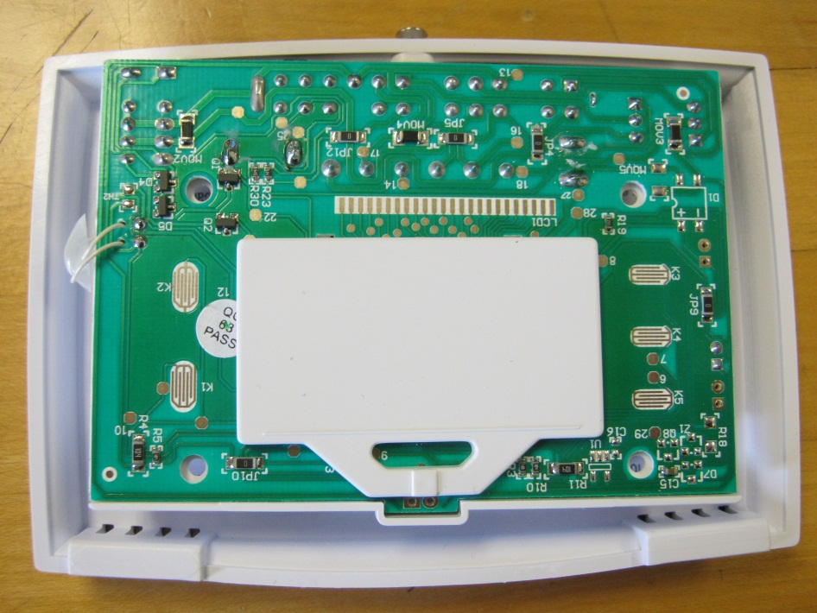
1st glance at circuit board
Buttons make contact on these terminals
Terminals for the screen
Plastic plate to protect processor, also keeps screen in place.

Slide 5
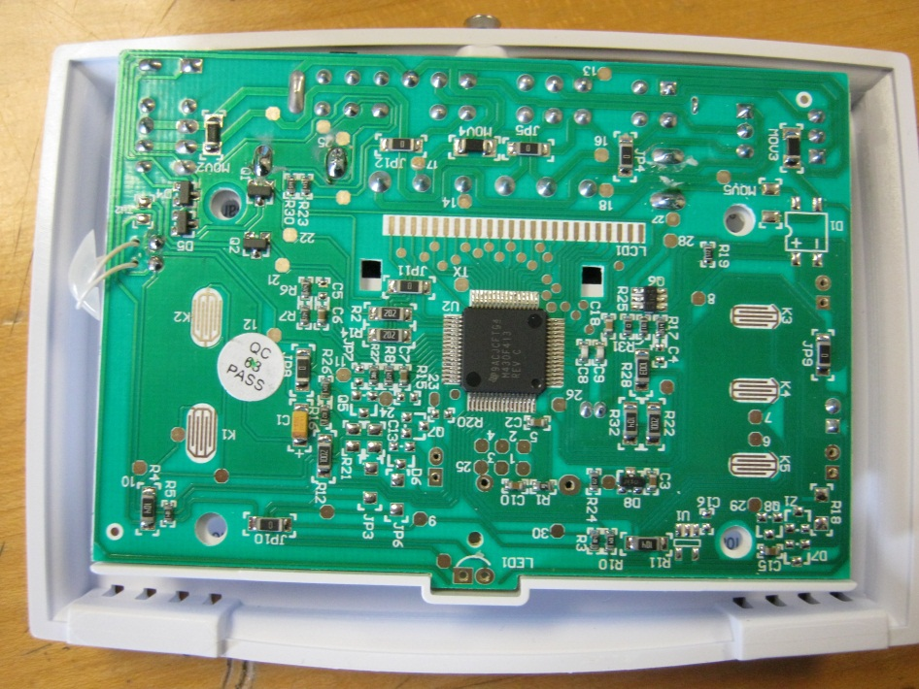
Underneath the plastic protection
Micro-controller
64 pin chip
Must have non-volatile memory because it keeps the set temperature even after power loss.

Slide 6
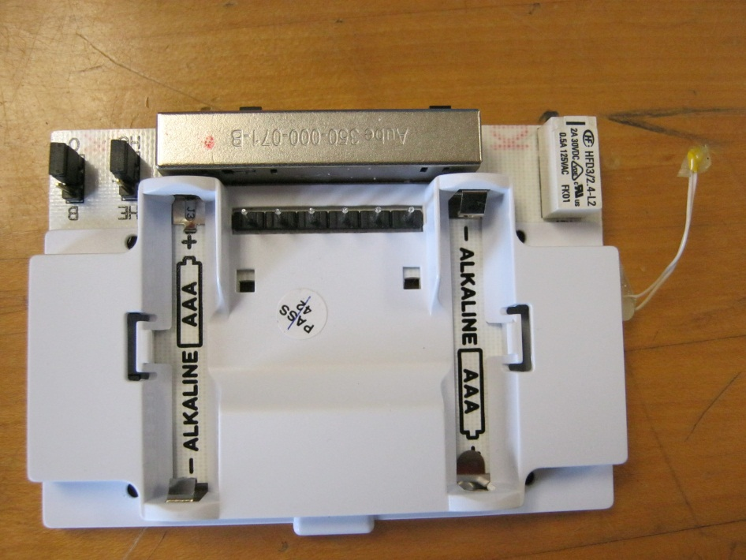
Back with Thermister
Sliders for heat/cool and fan auto/on
Temperature sensor
Thermistor changes resistance depending on the temperature
At room temperature the resistance is around 12k ohms. With someone holding it the resistance goes down to 9k ohms (assuming about 90-98 degrees F). Holding it outside on a cold day (about 20 degrees F) it reads 26k ohms.
When the thermostat is on a signal is only sent to the thermistor every few seconds. The signal is a very short square wave that will change voltage when the thermistor is a different resistance. This means it only takes a temperature reading once every few seconds.
Battery goes here

Slide 7
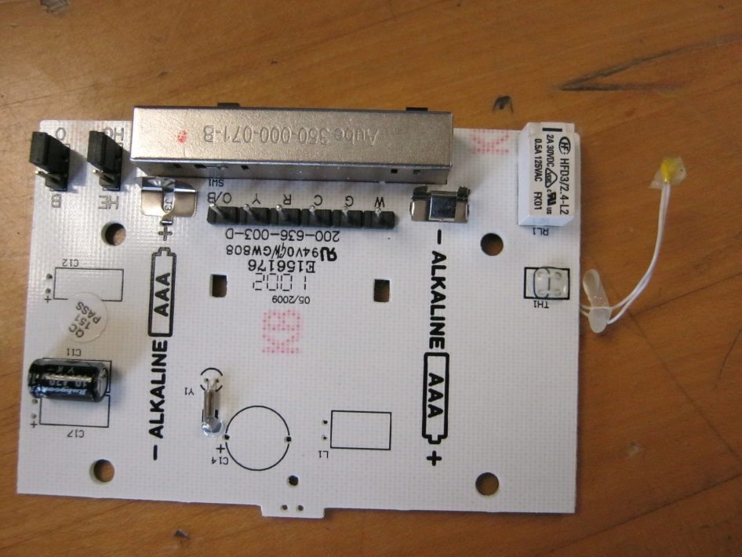
Back without cover
Battery terminals
Capacitor

Slide 8
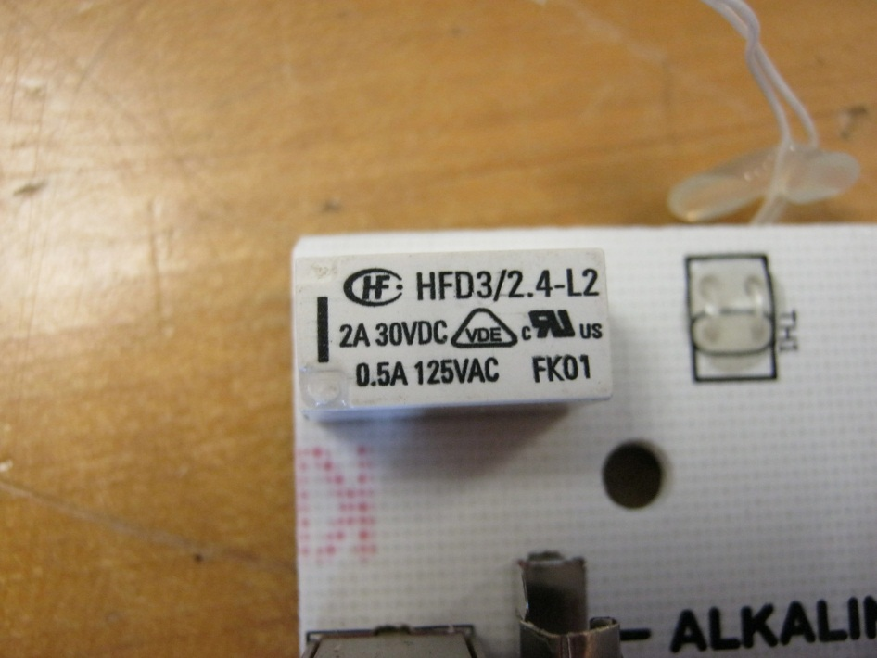
Relay
Relay for switching on heater/cooler, allows the high voltage Heater or A/C unit to be controlled by the 3V control system.
Contacts for the temperature sensor

Slide 9
