Slide 1
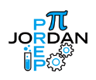
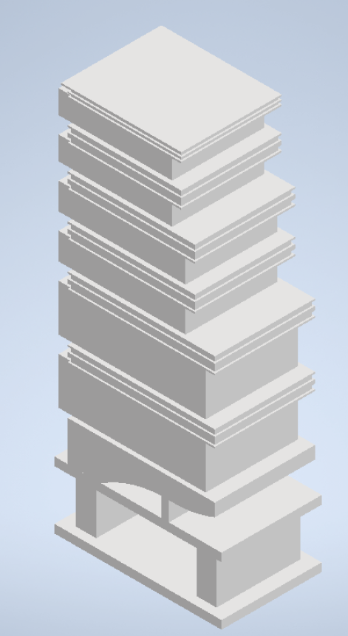
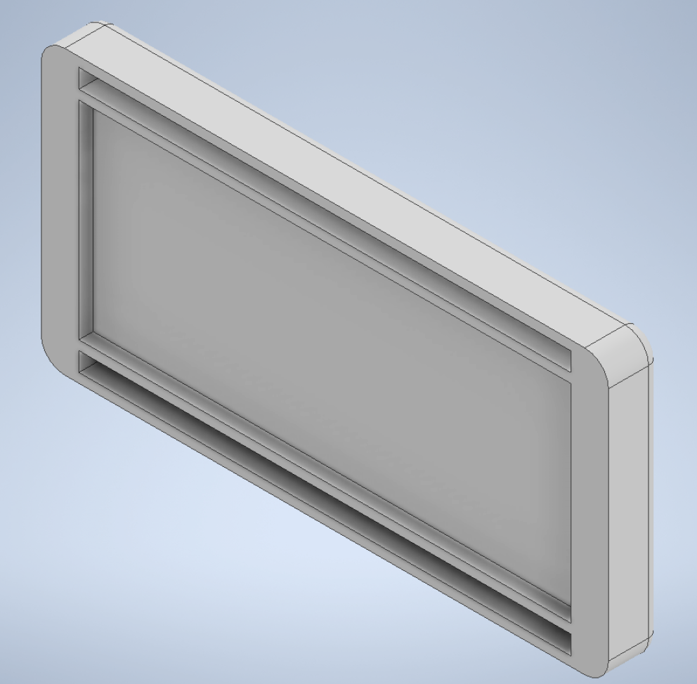
PREP+ At Westpointe Campus
What is PREP+?
Examples of applied course work: 3D renderings and shop drawings
Seniors at West Jordan and Bingham High Schools, started their college engineering technology degrees at SLCC Westpointe Campus last year via an NSF Grant. As juniors they completed EDDT 1010/Intro to Eng and Design, STEM 1010/Math and Technology, MCCT 1500/Machine Shop and EDDT 1040/Intro to AutoCAD coursework. Currently, there is a class of seniors and a class of juniors on campus. The goal is to graduate from high school with a one-year Engineering Technology degree. This path is excellent for preparing PREP students for careers in STEM, while also providing higher paying employment opportunities to help students pay for continuing their education. Shown are designs from EDDT 1010 (Junior class) and EDDT 1050 (Seniors).
Top left: Scale of a building Middle: Mechanical Bandage Applicator Right: Fidget toy.
Bottom: Key design for CNC Machine
This material is based upon work supported by the National Science Foundation under Grant No. 2000862. Any opinions, findings, and conclusions or recommendations expressed in this material are those of the author(s) and do not necessarily reflect the views of the National Science Foundation.

