Slide 1


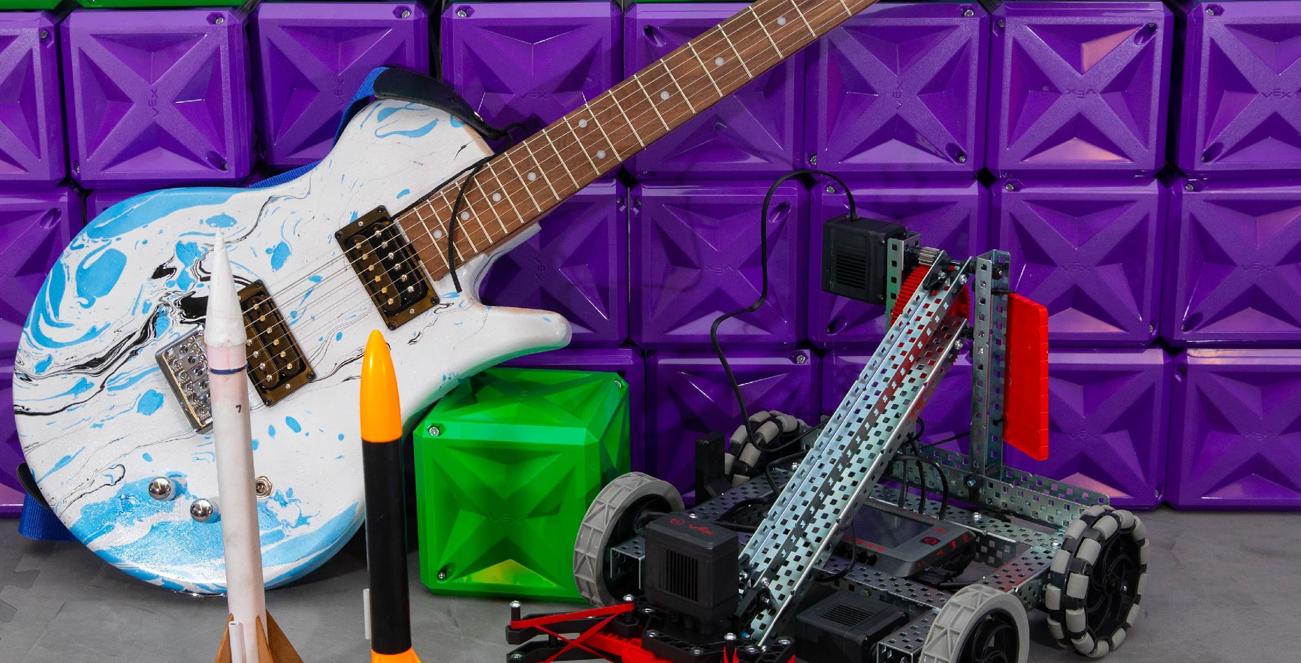

LaToya Chandler, M.Ed.
GRRATE Faculty
Santa Fe College
Gainesville, Florida
Toya-Tech
Notes:
The goal of the GRRATE project is to provide high school dual enrollment and college students with an early STEM intervention in the form of a self-efficacy experience that is in alignment with STEM technician skills and career awareness.

Slide 2



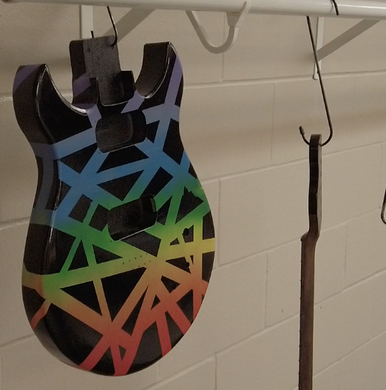
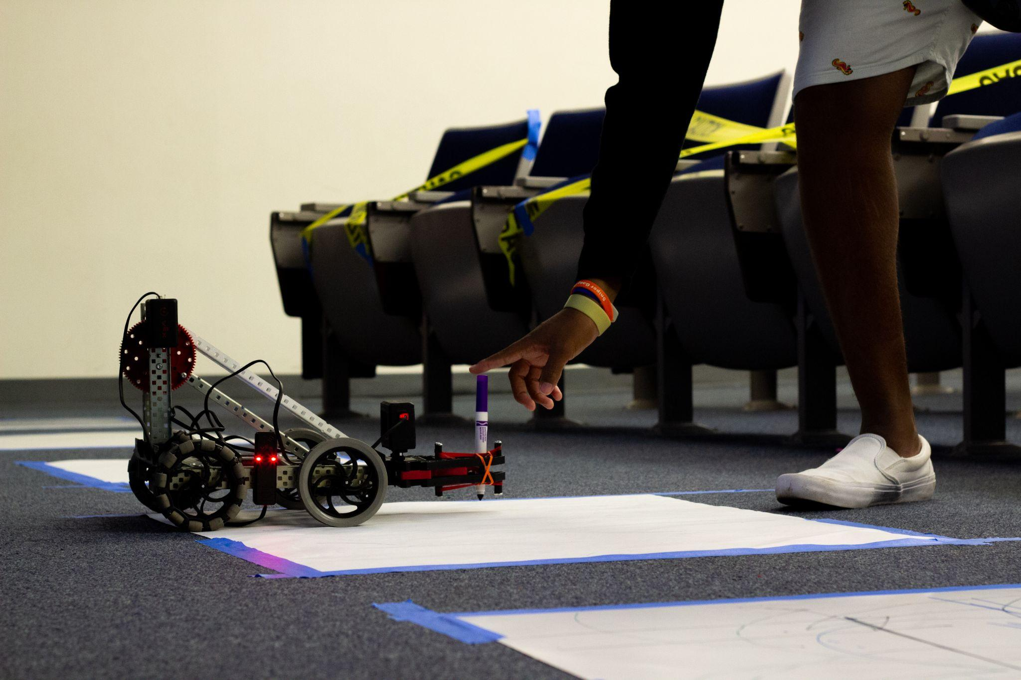
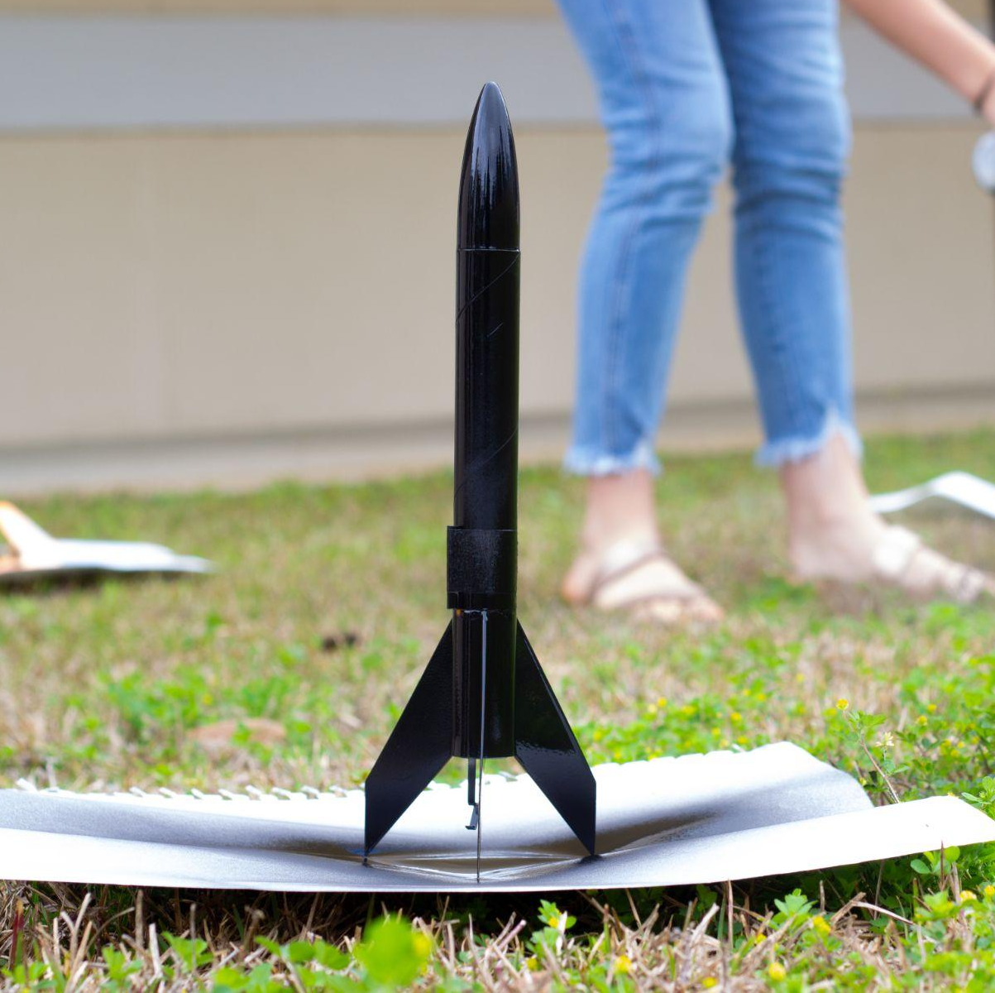
Wide World of Science
LaToya Chandler, M.Ed.
GRRATE Faculty
Santa Fe College
Gainesville, Florida
latoya.chandler@sfcollege.edu
Notes:
A major emphasis of this project is focused on the future skills of a STEM technician. We accomplish this by situating students to participate in firsthand experiences applying tasks related to technicians in the form of a project.

Slide 3
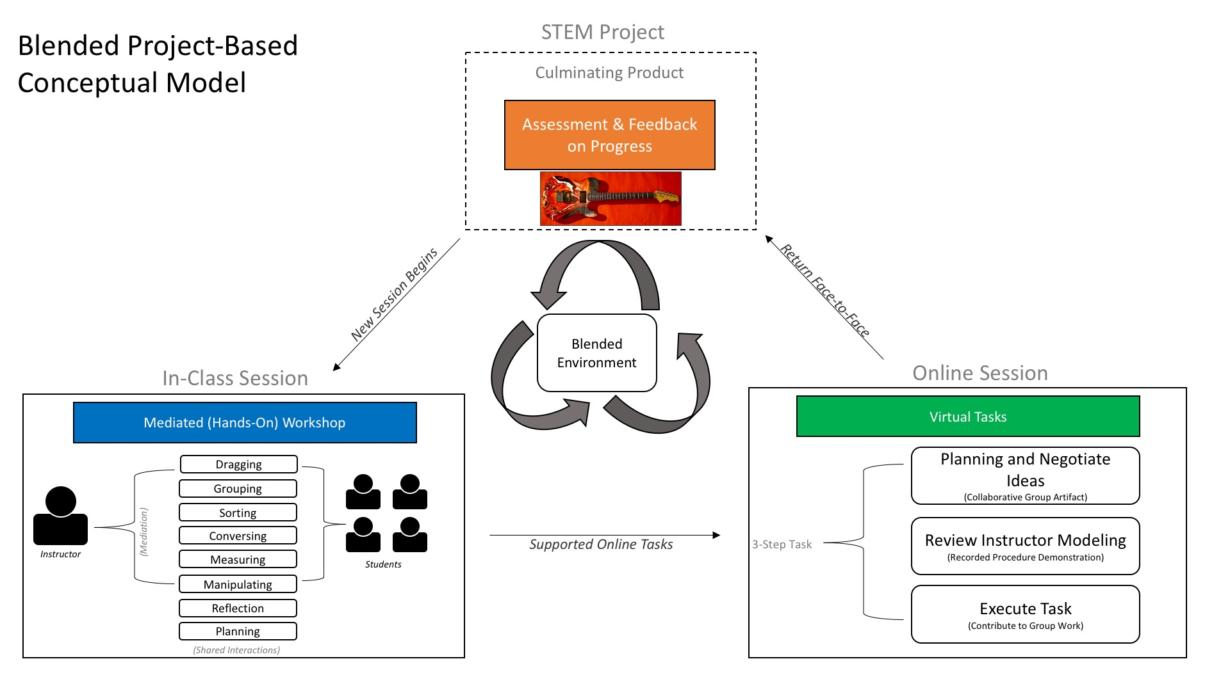
Project-Based Learning Blended
Notes:
We use a Flipped Learning Model with classroom tasks, social interaction and online activities that are in alignment to our classroom work. In the online environment, students can view short video lectures, engage in collaboration boards and threaded discussions online to prepare for our work in the face-to-face classroom session.

Slide 4

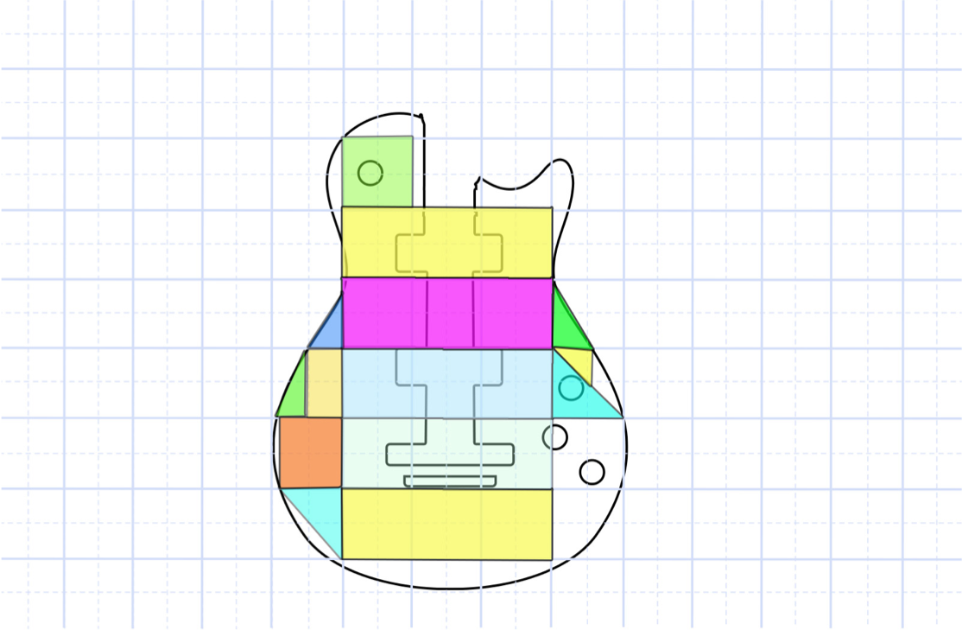
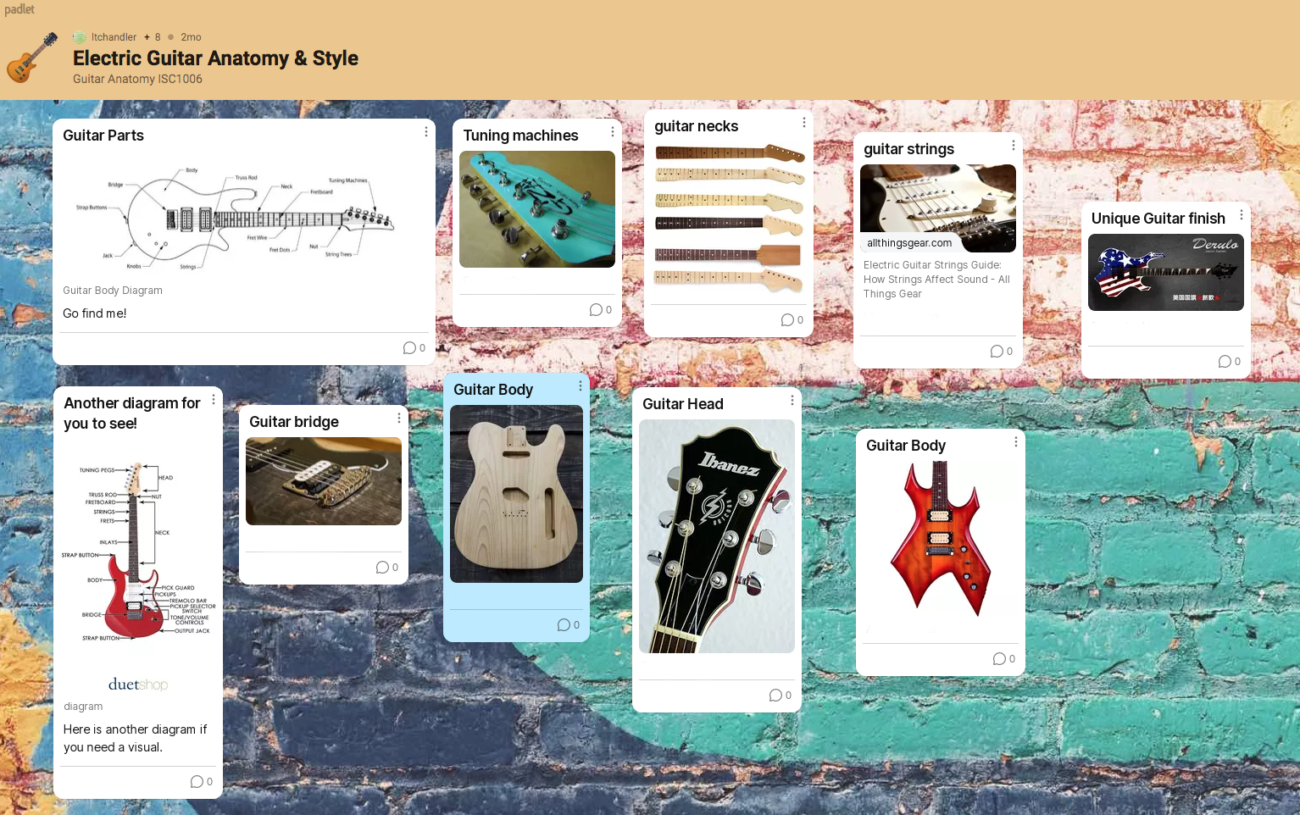
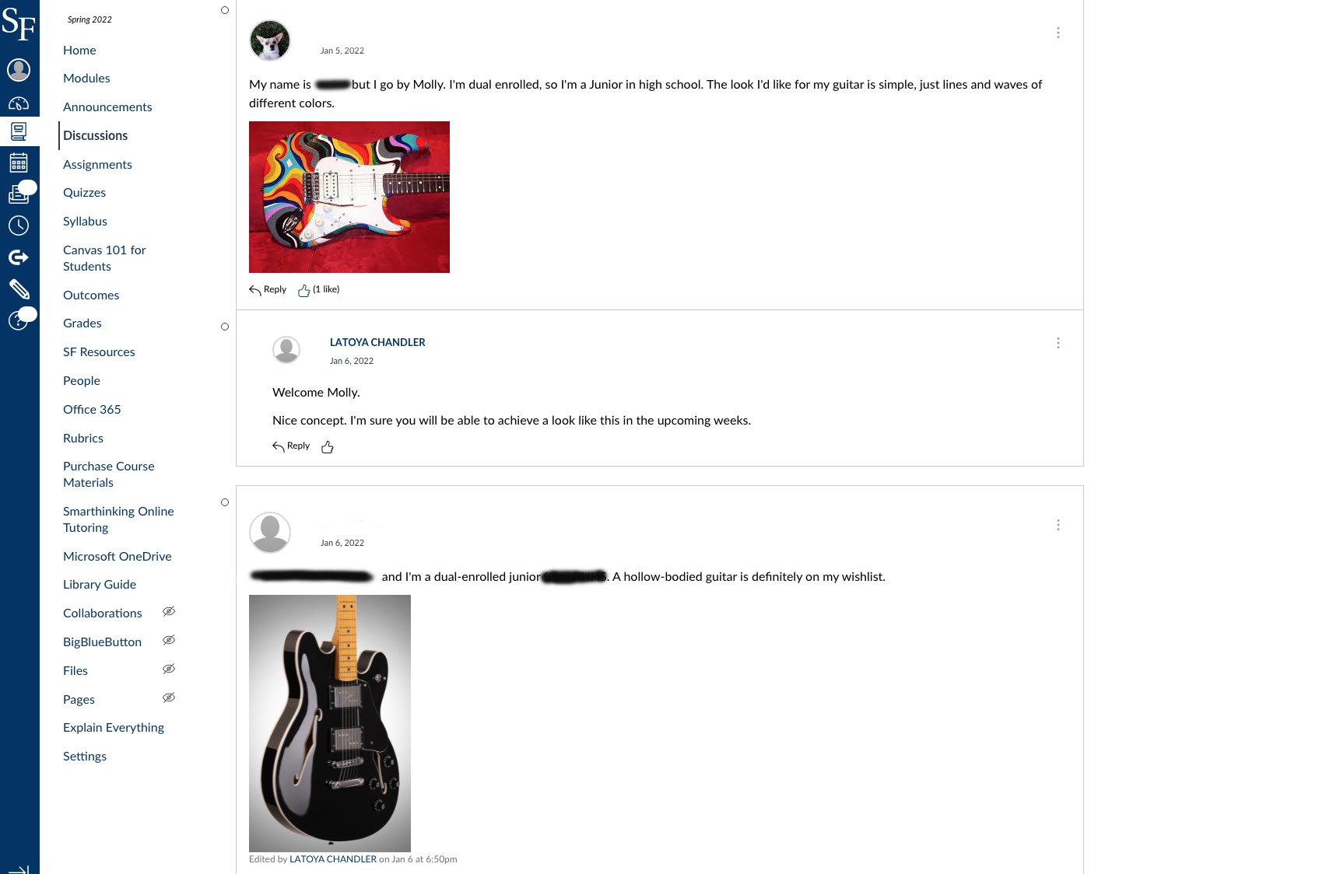
Situated Online Tasks
Supporting Online Tasks
Digital Artifacts
Homework Submissions
LaToya Chandler, M.Ed.
GRRATE Faculty
Santa Fe College
Gainesville, Florida
latoya.chandler@sfcollege.edu
Online Discussions
Group Collaboration
Notes:
Tasks in the online environment are situated to align with our face-to-face classroom work. Our goal is to minimize the gap between the online learning tasks and the face-to-face classroom learning environment. We want students to be able to transfer their conceptual ideas developed in the online environment and apply them to “in-class” activity. We do this by designing collaborative activities that promote students to plan our their ideas before entering class.

Slide 5
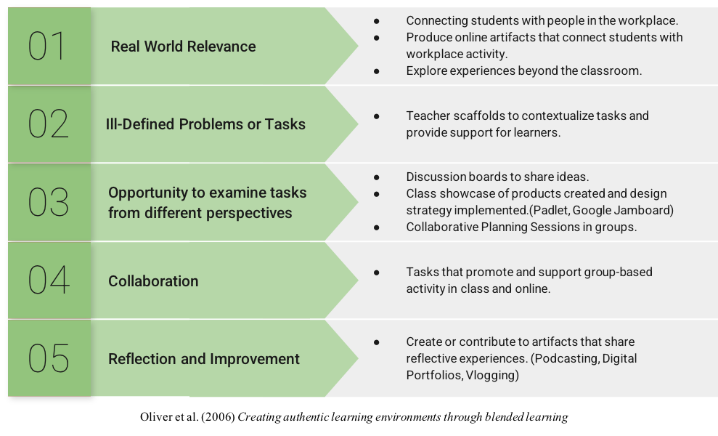
Hybrid Authentic Environment
LaToya Chandler, M.Ed.
GRRATE Faculty
Santa Fe College
Gainesville, Florida
latoya.chandler@sfcollege.edu
Oliver et al. (2006) Creating Authentic Learning Environments Through Blended Learning.
Notes:
The hybrid environment (Table 1) was adapted from authentic learning principles for blended environments, where students are immersed in characterizing the actions, skills and discussions for building guitars, rockets or robots. The online environment is used as a tool to support concept development and transfer online tasks into the physical workplace. We collaborate our design ideas, plan, share reflective experiences and we showcase our products.

Slide 6
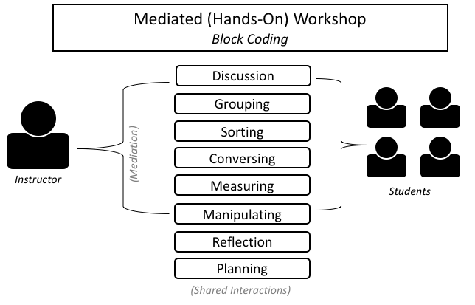
Blended Learning Environment
Facilitate
Coach
Model
Manage Interactions
LaToya Chandler, M.Ed.
GRRATE Faculty
Santa Fe College
Gainesville, Florida
latoya.chandler@sfcollege.edu
Assess & Provide Feedback
Build the Culture
Scaffold the Inquiry
Plan the Learning Design
Notes:
As an instructor in this environment, my role is shifted to facilitating and guiding students in a community of practice experience. The instructor is engaged in designing, building and programming along with the students to provide an opportunity for them to visualize, practice and participate in community discourse. Task support is provided by modeling, coaching and fading that support as students begin to build their own conceptual pathway to thinking and doing the work tasks independently.

Slide 7




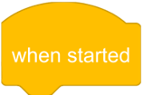





Participatory Learning Community
Learning in a Community
“Engagement within the Practice”
Notes:
We give the learner many opportunities to engage in the practice by drawing from the instructor’s demonstrations with their own laptops/devices. Students can plan and manipulate robots while the instructor elicits guided action on a large display screen.
The main focus is to give students the opportunity to collaborate and plan out robot behaviors in the online environment before engaging in hands-on work. In a “Planning Space” a student would be able to drag and manipulate the parameters of the code blocks to develop a planned algorithm that tells our robot “what to do”.
For conceptual support, It's my job to support you with guiding questions that will orient your attention towards salient concepts and help you recognize “what is happening” within your planned procedure steps (Weick et al., 2005).

Slide 8
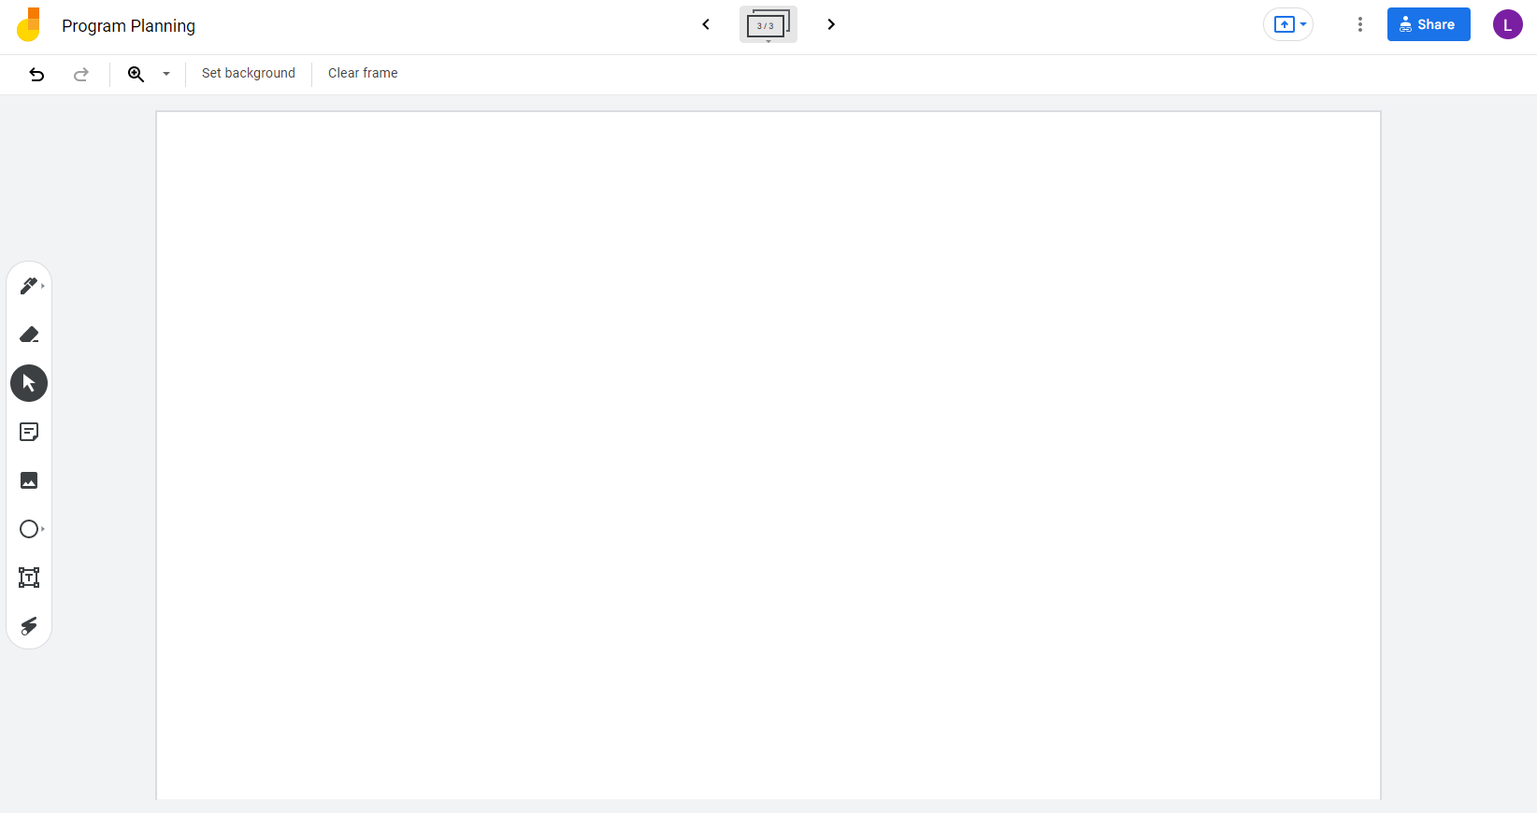


Google Jamboard for Supporting Online Collaborative Planning
Learning in a Community
Share Board with Others
Pen Tool
Eraser
Posted Note Tool
Image Uploads
Shape Tools
Text Tool
Up to 50 Users
Laser Pen
Go to Jamboard
https://jamboard.google.com/d/1Xs2R3u_ArCIX30Usqk8hezOU6Pl2-SzTXjR5C1eOQFs/edit?usp=sharing
Notes:
A jamboard is a digital whiteboard that lets you collaborate in real-time. You can use a jamboard device, a standard web browser or a mobile app.
Working together in real-time or asynchronously is possible. But in real-time the app will support up to 50 users. Lets take a tour of the tools.

Slide 9
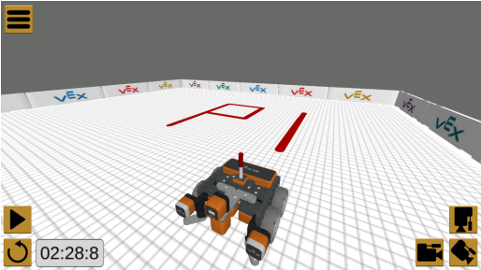
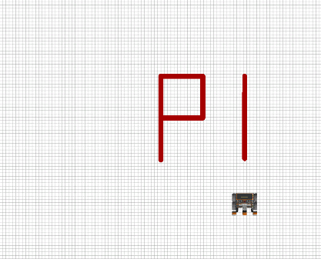
Jamboard Purpose in Robotics
LaToya Chandler, M.Ed.
GRRATE Faculty
Santa Fe College
Gainesville, Florida
latoya.chandler@sfcollege.edu
Go to Jamboard
Notes:
In robotics class, we use the jamboard to begin thinking about and planning the behaviors we want our robot to execute in an assigned task. In most cases, in order for a student to be cleared to run the robotics course in class, they must submit proof that they have engaged in a planning process which is the Jamboard. The jamboard is started in class under a teacher-led discussion and developed over time out of class.

Slide 10
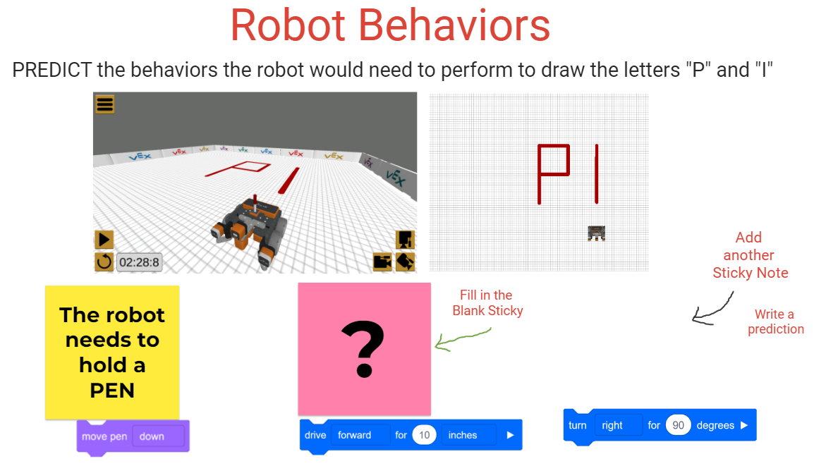
LaToya Chandler, M.Ed.
GRRATE Faculty
Santa Fe College
Gainesville, Florida
latoya.chandler@sfcollege.edu
Notes:
I never start with an empty Jamboard. We want to avoid this being an open-ended activity, we need a structured scaffold to contextualize the student’s work tasks.
So my jamboards are always pre-set with text, images, notes and guided questions used to elicit the students to engage in specific actions on the board.

Slide 11
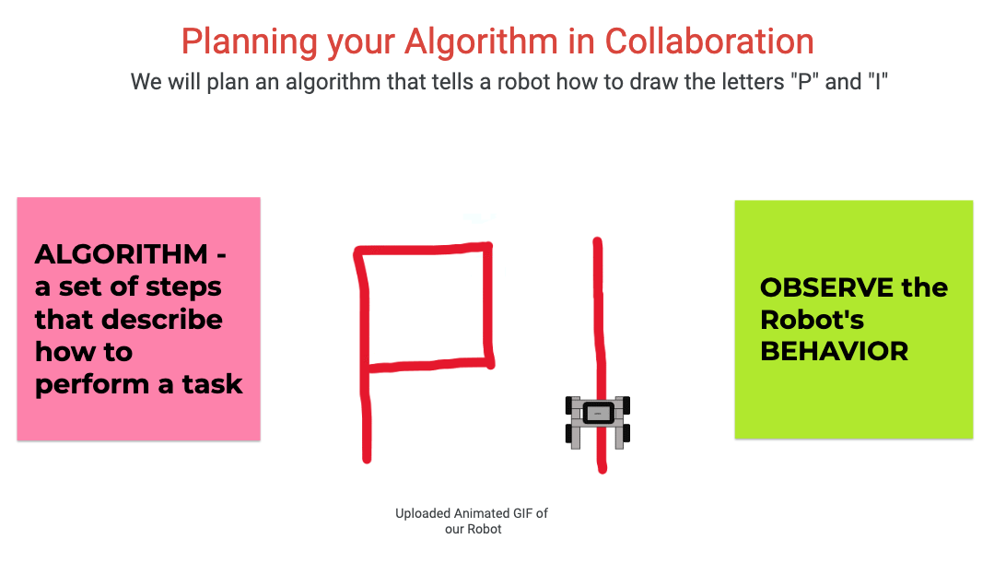
LaToya Chandler, M.Ed.
GRRATE Faculty
Santa Fe College
Gainesville, Florida
latoya.chandler@sfcollege.edu
Notes:
A scaffold can help simplify the coding processes and highlight behaviors of the robot. A scaffold provides the appropriate level of support in a just-in-time fashion. In a community of practice, we are using a combination of a teacher-enabled scaffold and the jamboard itself as a technology-enabled scaffold. The scripted prompts that you see, are set up to lead the student into engaging in activity with guided questions, cues and prompts. Prompting includes circling, highlighting and annotated notes and sentence starters. The social script prompts in this Jamboard mostly include sentence starters and guiding questions for collaborative conversation.
The first highlighted feature is the image upload. We use animations to help students conceptualize the simulation behaviors of our robot. Video uploads are not supported but still images and documents are.

Slide 12
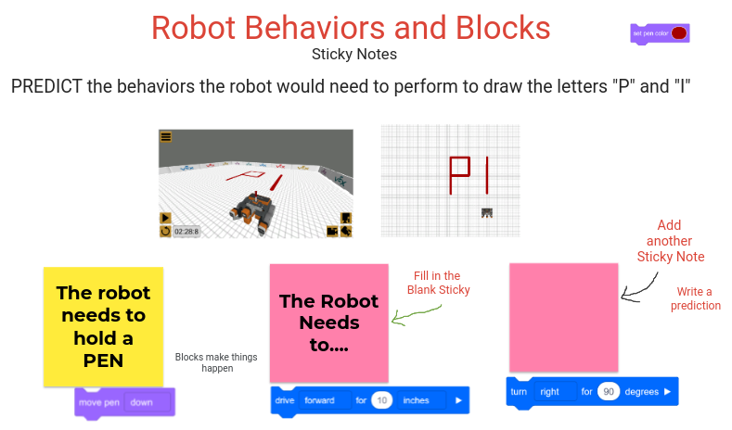
LaToya Chandler, M.Ed.
GRRATE Faculty
Santa Fe College
Gainesville, Florida
latoya.chandler@sfcollege.edu
Notes:
The next highlighted tool is the sticky notes. Sentence starters are used to lead students to engage in predicting the behavior of their robot.

Slide 13
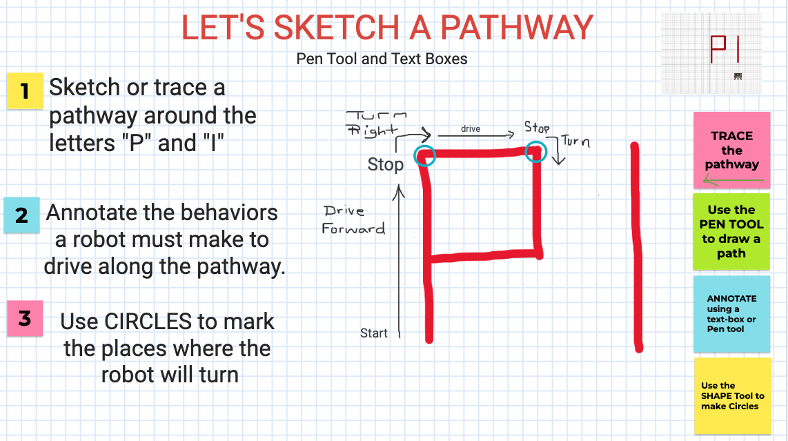
LaToya Chandler, M.Ed.
GRRATE Faculty
Santa Fe College
Gainesville, Florida
latoya.chandler@sfcollege.edu
Notes:
Scaffolding can simplify next-step procedures and highlight important behaviors of robots. The scaffold supports learning in moments when students may be working together synchronously without a teacher present.

Slide 14
SWOT Survey
Go to www.menti.com and use the code
LaToya Chandler, M.Ed.
GRRATE Faculty
Santa Fe College
Gainesville, Florida
latoya.chandler@sfcollege.edu
6795 7645
https://www.menti.com/al4ohyxk7ouo

Slide 15
Strength
Low Floor
Easy to Use
Real-Time Asynchronous Interaction
Supports GIF animation
LaToya Chandler, M.Ed.
GRRATE Faculty
Santa Fe College
Gainesville, Florida
latoya.chandler@sfcollege.edu
https://www.menti.com/al4ohyxk7ouo

Slide 16
Weakness
No Video Support
Web 2.0 Capability
No integration in Canvas LMS (no plug-in)
No Threaded Discussion Board
No Voice Recording
Can’t Embed Links to URLs
LaToya Chandler, M.Ed.
GRRATE Faculty
Santa Fe College
Gainesville, Florida
latoya.chandler@sfcollege.edu
https://www.menti.com/al4ohyxk7ouo

Slide 17
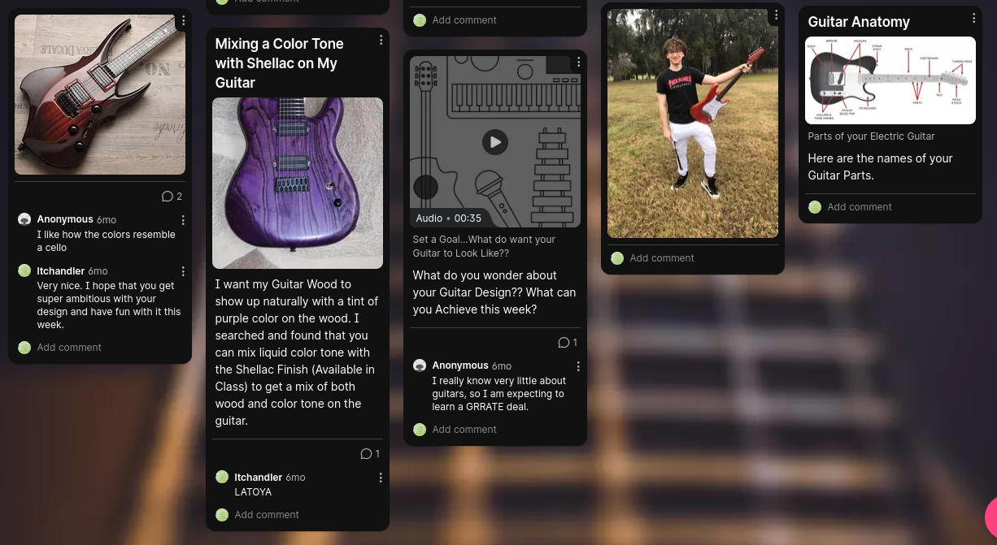
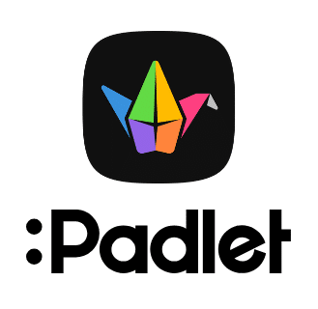
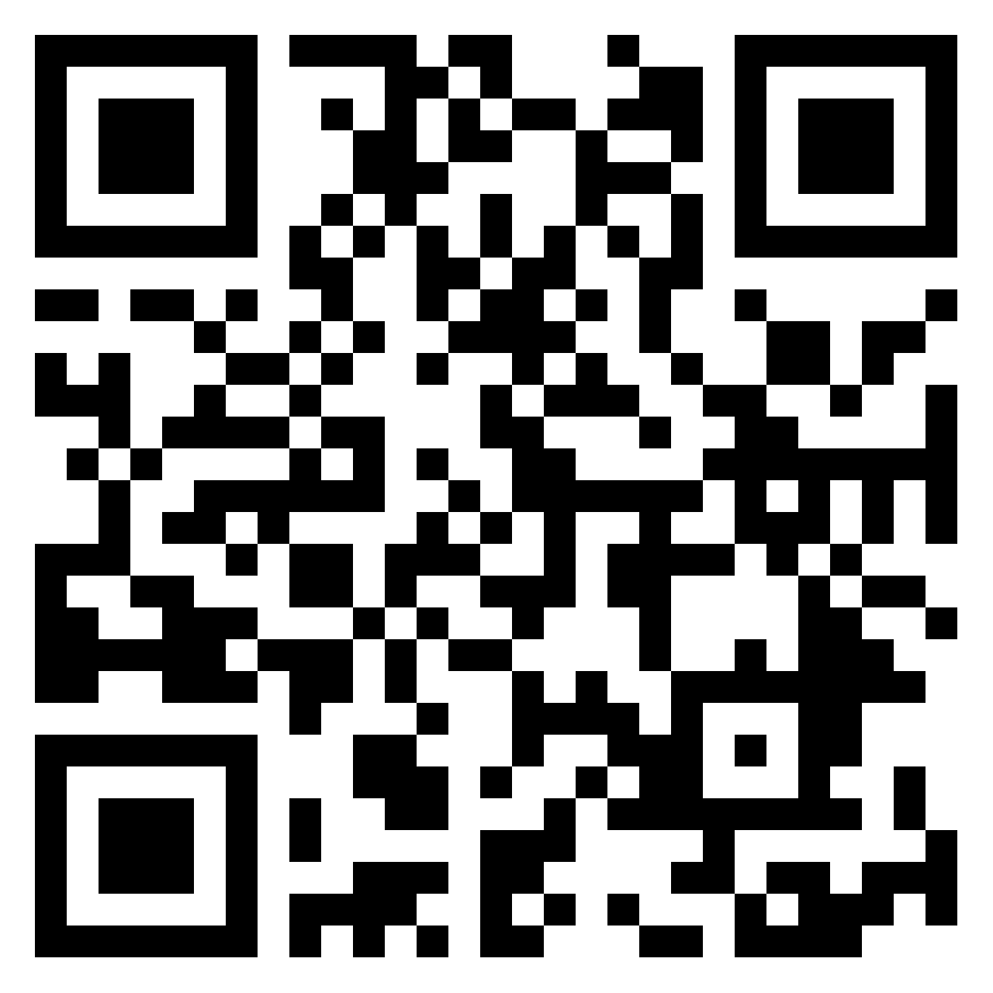
Other Collaboration Tools
Padlet Walls Support Video and Threaded discussion
LaToya Chandler, M.Ed.
GRRATE Faculty
Santa Fe College
Gainesville, Florida
latoya.chandler@sfcollege.edu
Go to Padlet Wall
www.padlet.com

Slide 18

Explain Everything
Interactive Whiteboard embeds directly into Canvas LMS
More integration features available in Canvas LMS
One configuration
Real-time asynchronous collaboration
Voice Chat
Recording, animation and video editing
Sharable recordings with URL links
LaToya Chandler, M.Ed.
GRRATE Faculty
Santa Fe College
Gainesville, Florida
latoya.chandler@sfcollege.edu
https://explaineverything.com/
Notes:
Explain everything is an interactive white board that offers more features for our community of practice. However, before adopting any technology into a course, it is important to conduct proper technological, pedagogical, and content knowledge (TPACK) framework. Successful education technology integration requires TPACK.

Slide 19


Self-Efficacy
College Credit
I CAN
LaToya Chandler, M.Ed.
GRRATE Faculty
Santa Fe College
Gainesville, Florida
latoya.chandler@sfcollege.edu
I’LL TRY
I WANT TO
I CAN’T
STEM Attitudes
Notes:
Collaboration boards implemented in a Community of Practice support our intervention in the form of self-efficacy building in technician skills.

Slide 20


THANK YOU
Latoya Chandler
Santa Fe College
GRRATE Interdisciplinary Science
latoya.chandler@sfcollege.edu
Toya-Tech

