Slide 1

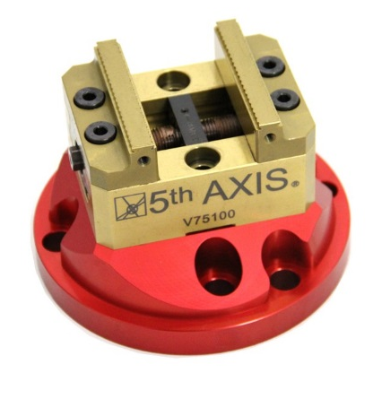



CNC
Advanced
Multi-Axis Programming
CAMP

Slide 2


1. Train Georgia Technical College and University Faculty in Multi-Axis Machining and Programming.
2. Develop Projects for Multi-Axis Machining.
3. Promote Career Pathway: Bachelor of Applied Science in Manufacturing Operations.
CNC Advanced Multi-Axis Programming CAMP

Slide 3
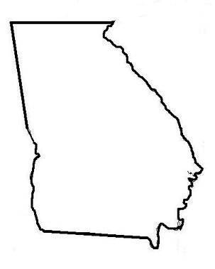
Multi-Axis Trained Faculty in
Georgia
(1) Georgia Northwestern Tech College
(1) North Georgia Technical College
(1) West Georgia Technical College
(1) Kennesaw State University
(3) Athens Technical College
(1) Oconee Fall Line Tech College
(1) Savannah Tech College
(1) Coastal Pines Tech College
CNC Advanced Multi-Axis Programming CAMP

Slide 4
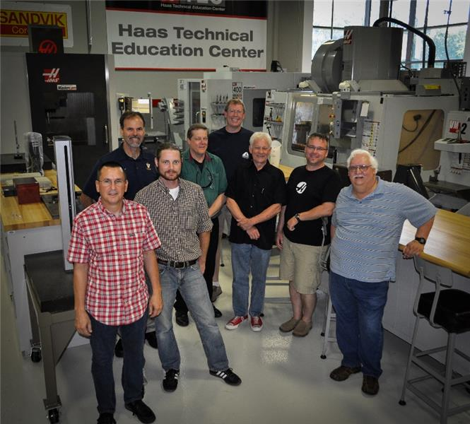

Multi-Axis Faculty Trained
CNC Advanced Multi-Axis Programming CAMP

Slide 5

Multi-Axis Projects
CNC Advanced Multi-Axis Programming CAMP

Slide 6
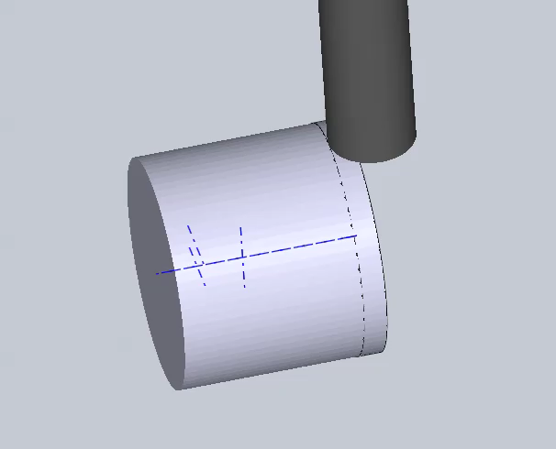
Multi-Axis Projects
CNC Advanced Multi-Axis Programming CAMP

Slide 7
Broader Impacts
1. STEM Guitar Institute
2. Haas Foundation Grants
CNC Advanced Multi-Axis Programming CAMP

Slide 8

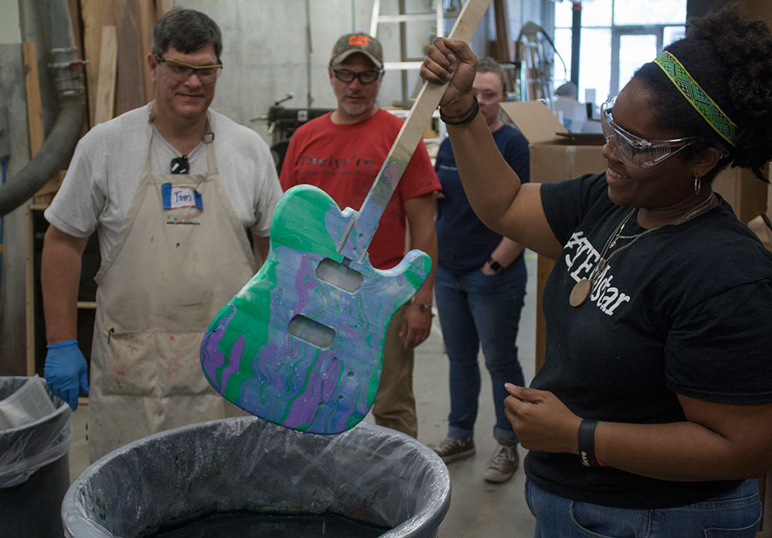
STEM Guitar Institute
Stimulates interest in manufacturing
Career Pathway for Machining
(6) Technical College Faculty trained
CNC Advanced Multi-Axis Programming CAMP

Slide 9
Haas Foundation Grant
Athens Technical College $ 7,500
Georgia Northwestern Technical College $17,500
Oconee Fall Line Technical College $10,000
Lanier Technical College $15,000
Georgia Southern University $15,000
Kennesaw State University $15,000
CNC Advanced Multi-Axis Programming CAMP

Slide 10
1. Train Georgia Technical College and University Faculty in Multi-Axis Machining and Programming.
2. Promote Career Pathway: Bachelor of Applied Science in Manufacturing Operations.
CNC Advanced Multi-Axis Programming CAMP

