Slide 1
career pathway

Slide 2
Welcome !
Stuart Rolf
Program Chair
Machine Tool Technology
Athens Technical College
Randy Emert
Assistant Professor
Mechanical Engineering Technology
Kennesaw State University
Ed Kiszka
Instructor
Machine Tool Technology
Athens Technical College

Slide 3
CNC Advanced Multi-Axis Programming
CAMP

Slide 4
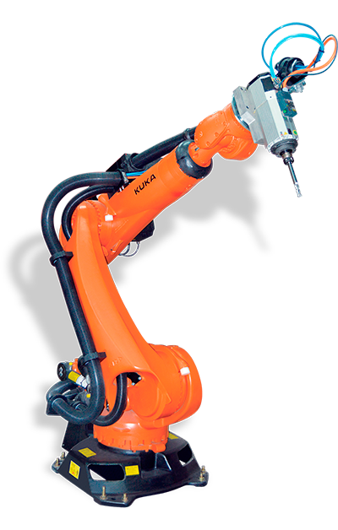
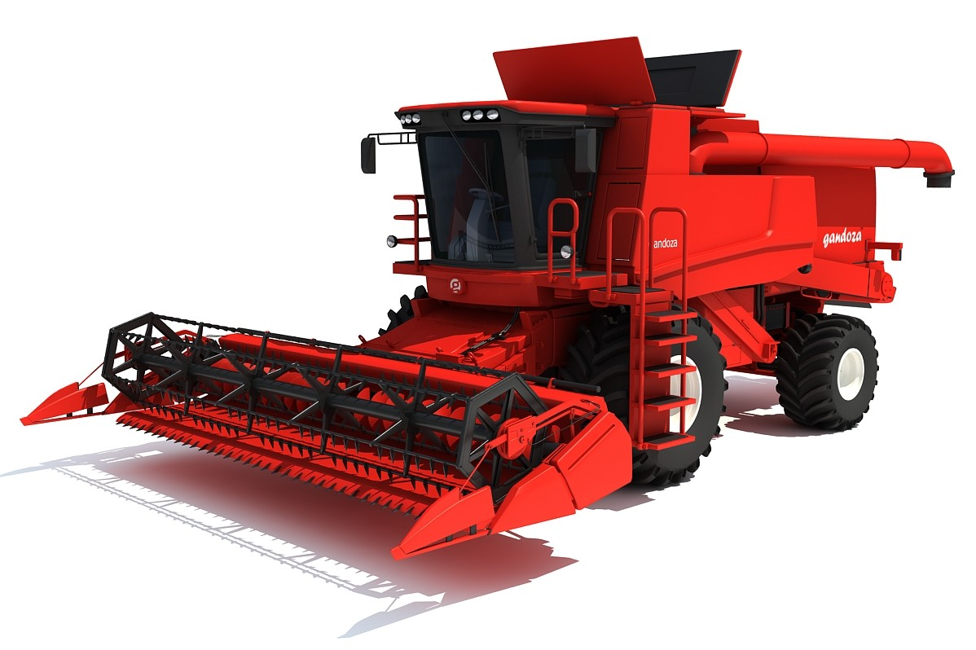
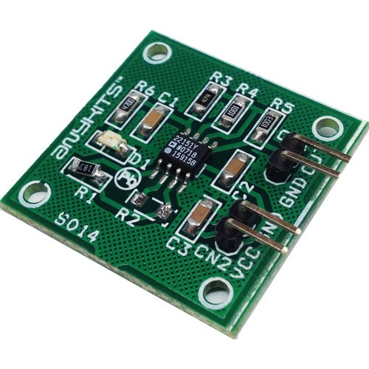
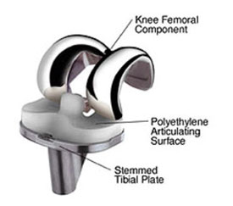
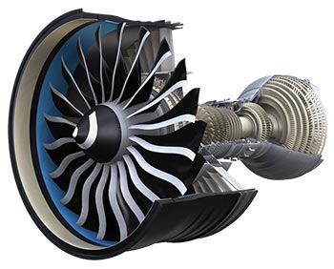
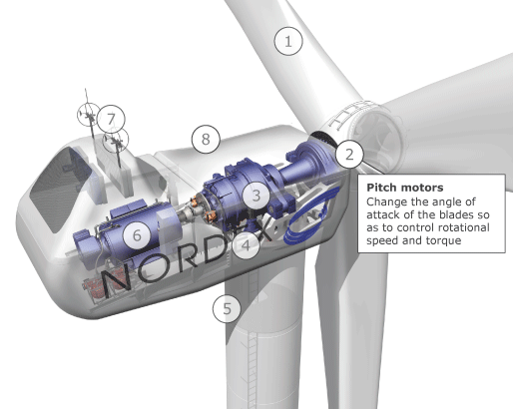
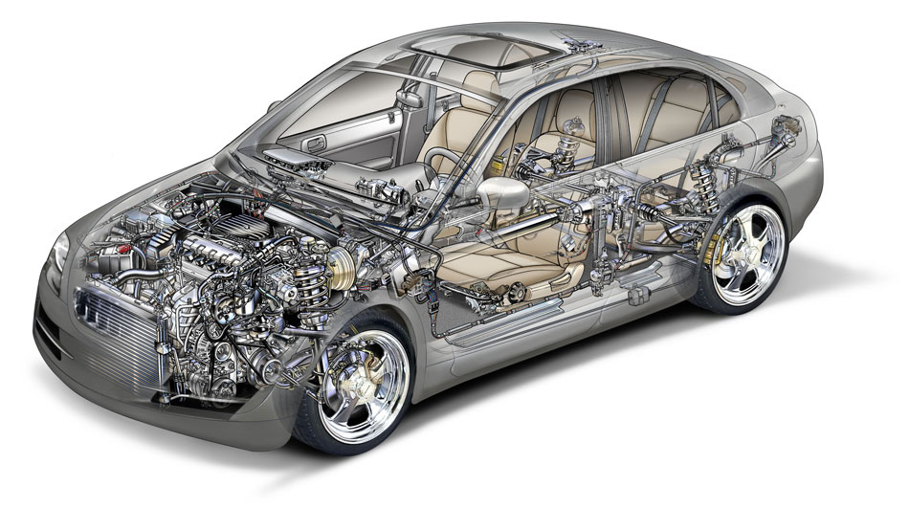
Machining
The Foundation for every industry!

Slide 5
The Need for Society
Boeing, where about 35 percent of the 29,645 machinists in the company's Seattle industrial hub are 55 or older.
We have a shortage of machinists in this country not because we are going to explode again as a manufacturing powerhouse and not because our aerospace and defense industry will keep us alive for another century. We need more machinists today because there are nearly NONE coming up to replace this country's core needs.
Almost 3.5 million manufacturing positions will need to be filled over the next decade as baby boomers retire, and 2 million of those jobs could remain vacant because of manufacturing's fading appeal to millennials, according to a 2015 study by Deloitte and the Manufacturing Institute.

Slide 6
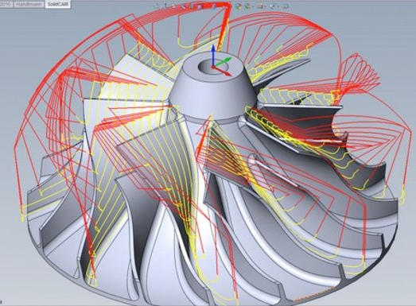
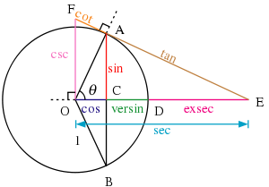
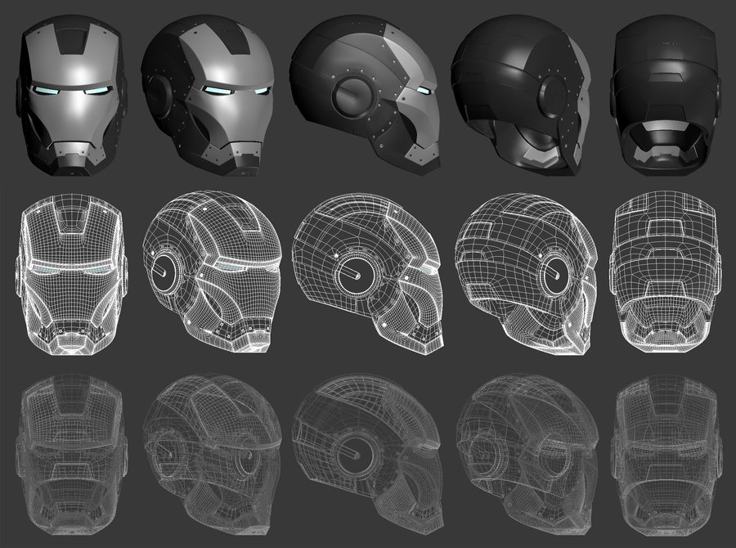
Seeking the Technically Savvy
Logical Reasoning
Problem Solving
3D Puzzles

Slide 7
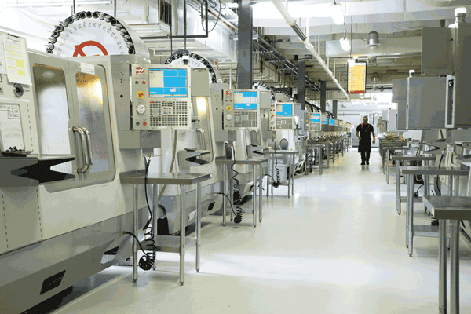
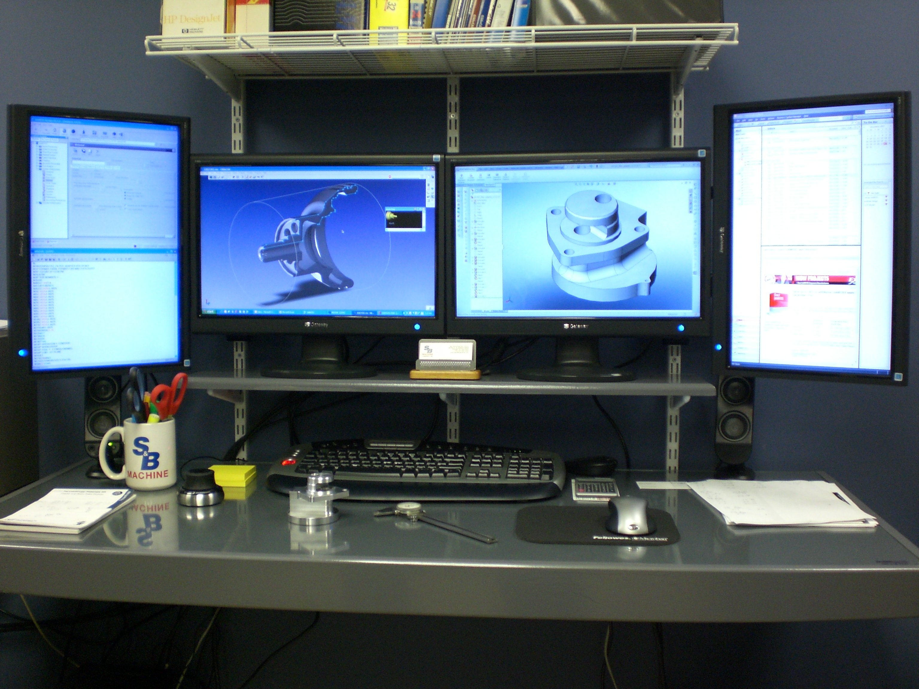
Working Environment

Slide 8
career pathway
Machine Tool Technology
Manufacturing Operations
Quality Assurance
Associate of Science
Master of Science
Bachelor of Applied Science

Slide 9
MACHINE TOOL TECHNOLOGY
Athens Technical College Machine Tool Technology offers a wide variety of courses, certificates, diplomas and a degree tailored to help you meet the requirements of local employers
Machining could be the right career for you if:
You like working with your hands
You have the ability to think three-dimensionally
You want great pay to support yourself and your family
You enjoy creating things
You like solving problems
AthensTech.edu/TEM
Georgia companies have more high-salaried jobs for qualified machinists than they can readily fill

Slide 10
Bachelor of Applied Science Manufacturing Operations
Where does that put you in the great scheme of manufacturing things?
Industrial Engineering
Statistical Process Control
Better theoretical understanding of the process
Better practical understanding of the process
You are now in huge demand

