Slide 1
Urban Agriculture 101

Slide 2
Agenda
Define three different areas of Agriculture related to the plant sciences
Describe the Urban Ag curriculum at Northeast Community College
List some careers that fall under each area of Agriculture in this presentation

Slide 3
What is Agronomy?

Slide 4
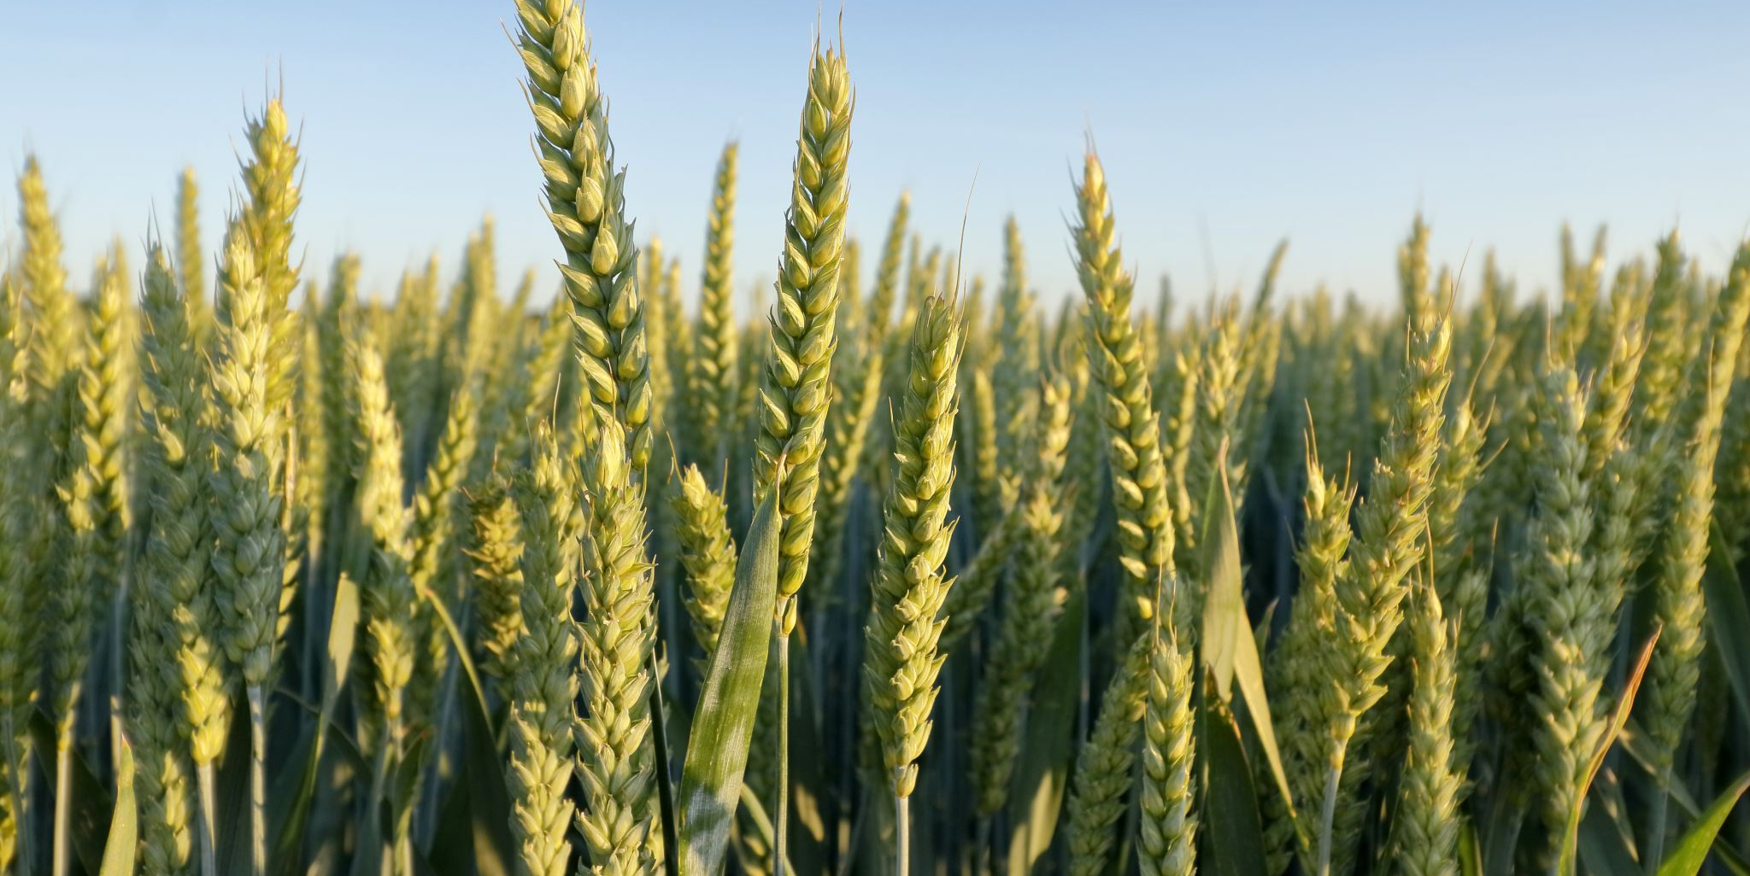
Agronomy
The study and production of growing grains and grasses in large-scale
Sold by the bushel or the ctw
Examples:
Corn, Sorghum, Millet, Soybeans

Slide 5
What is horticulture?

Slide 6
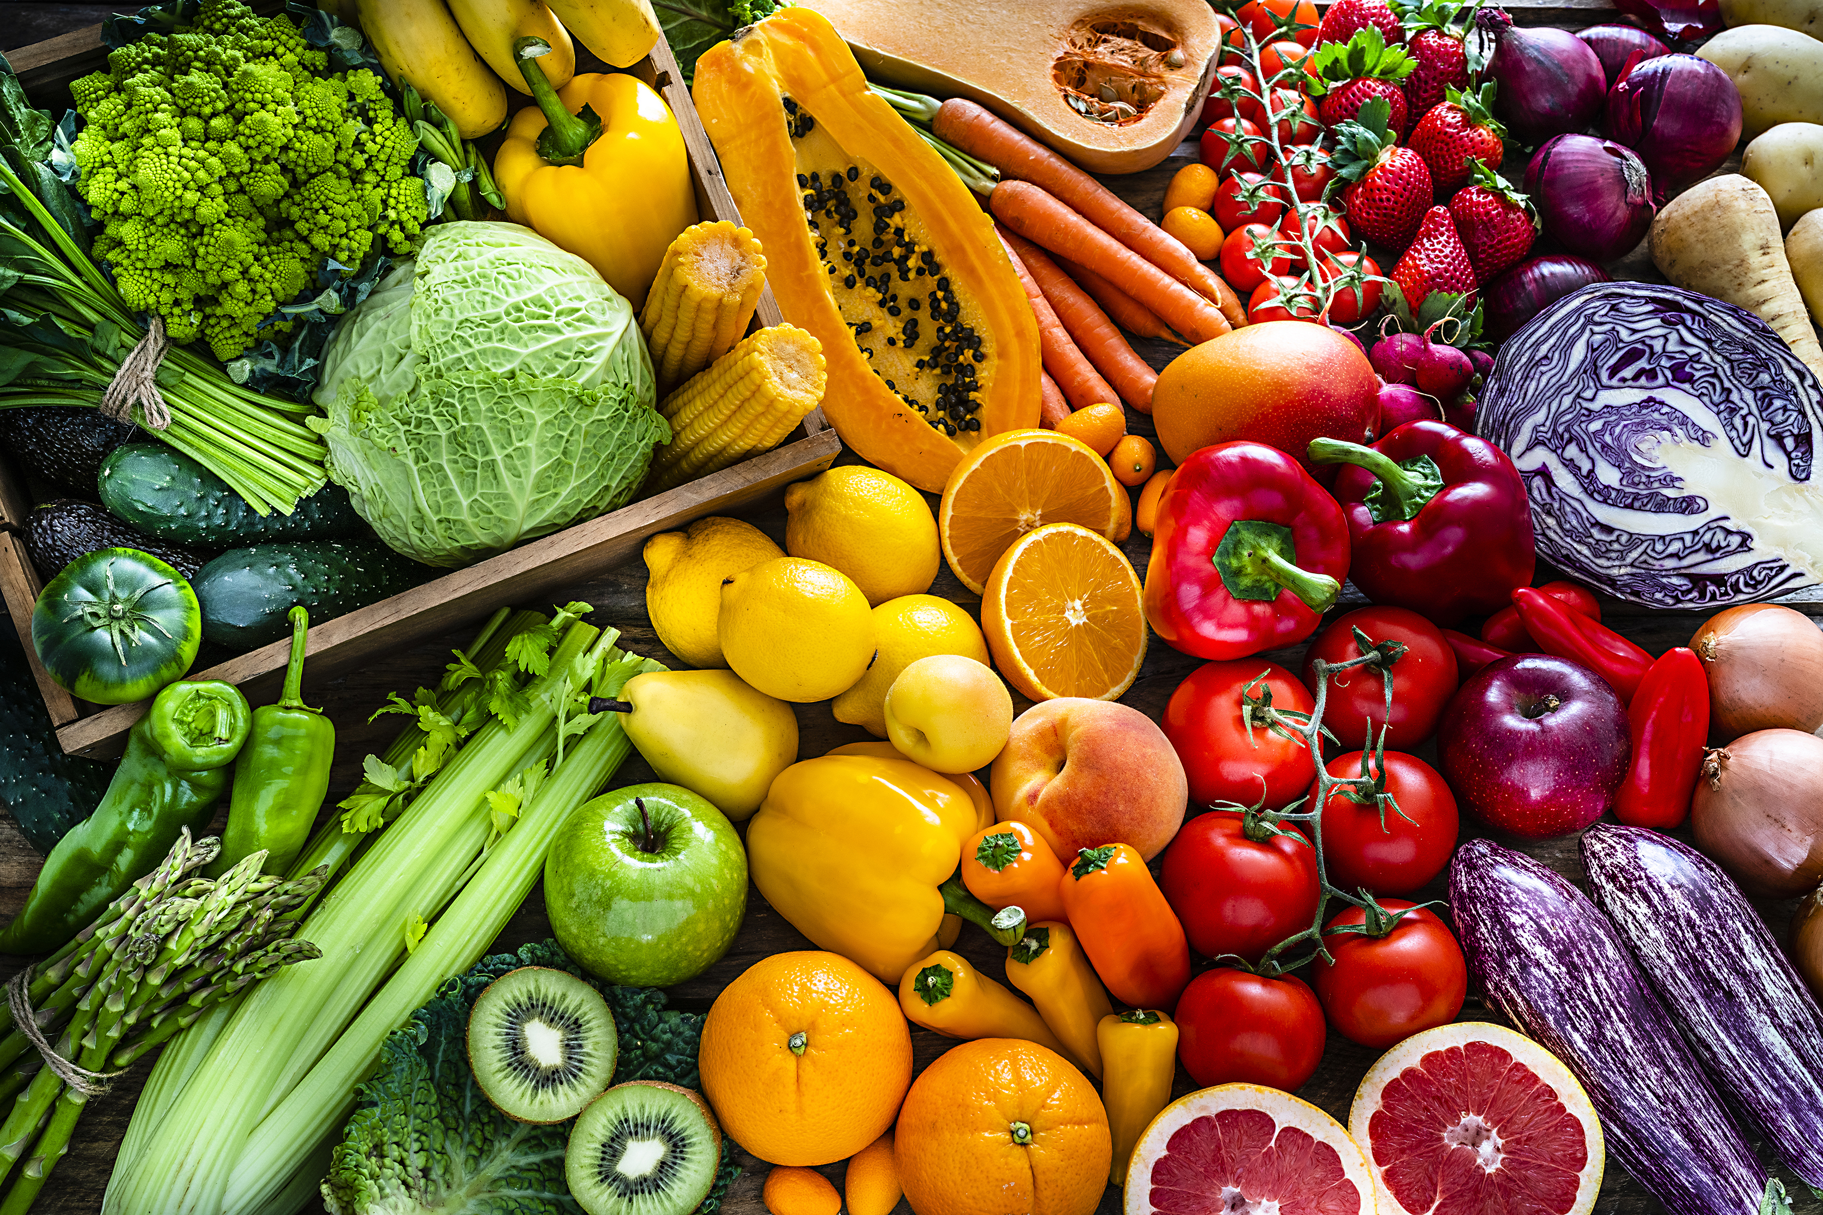
Horticulture
The study and production of high-value and ornamental crops, generally in small-scale
Sold individually or by the pound/kilo
Examples:
Turfgrass, Trees, Vegetable Production, Fruit Production

Slide 7
Quiz!
Which category of plant science would the following commodities be produced under?
Lentils
Grapefruit
Potatoes
Walnuts
Sunflowers
Cut Flowers
Lettuce
Quinoa
Agronomy
Horticulture
Both
Horticulture
Agronomy
Horticulture
Both
Agronomy

Slide 8
What is urban agriculture?

Slide 9
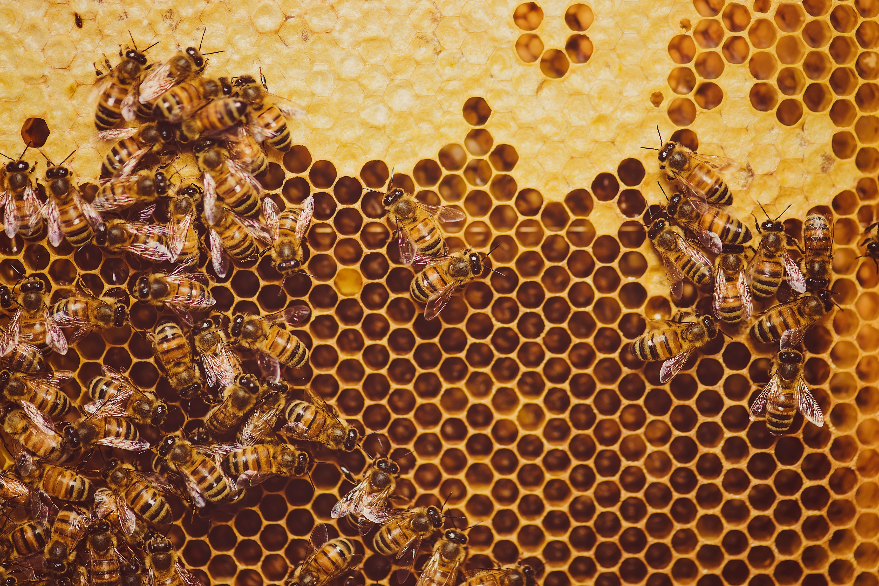
Urban Agriculture
Diversified ag production with value-added components, typically more horticulture and small production animal
Typically found in urban environments or at the margins of urban environments where lots or small acreages are common
Sold in specialty markets such as CSAs, Farmers Markets, and contracted vendors
Examples:
Honey Production, Hydroponics, Egg Production, Preserved Foods, Baked Goods

Slide 10
Urban Agriculture
Northeast Community College offers a degree in Urban Ag
This is a combination of Ag and Hort classes that can be tailored to your interests
The 10-acre Urban Farm on the Northeast Campus serves as an outdoor learning classroom with unlimited potential

Slide 11
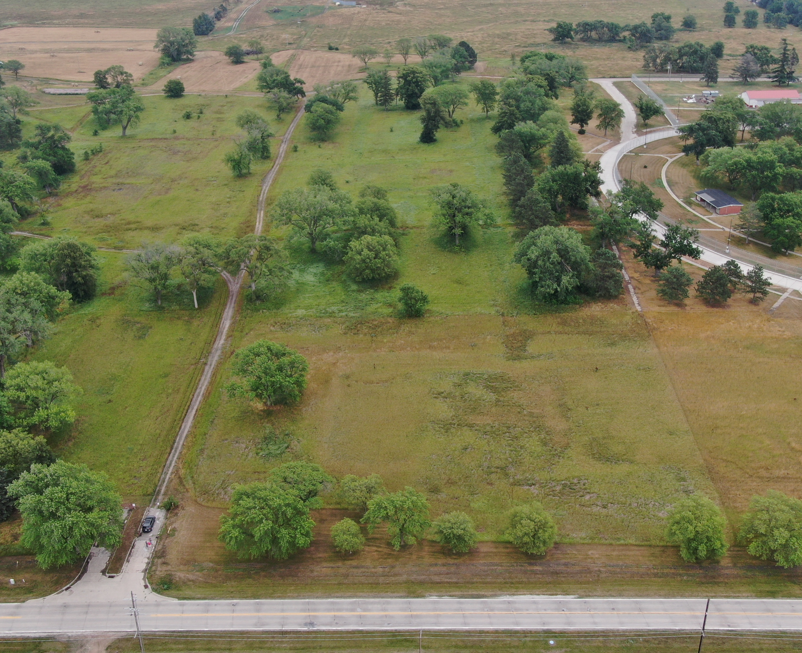
Urban Agriculture
Urban Farm – Current Projects
  Bees
  Native fruit and nut orchard
  Compost
  Biological surveys
  Bat boxes
  Raised beds
  Permeable pavers
  Soil testing
  Water sensing technology
  Drone flights

Slide 12
Careers - Agronomy
Crop Scout
Chemical applicator
Agronomist
Extension Educator
Seed Sales
Agriculture Producer/Farmer

Slide 13
Careers - Horticulture
Nursery/Greenhouse Owner
Turfgrass specialist
Golf Course Superintendent
Horticulturalist
Professional Landscaper
Extension Educator

Slide 14
Careers – Urban Ag
Entrepreneur
Extension Educator
Urban Forest Specialist
Parks and Recreation Specialist
Specialty Grower
Community Garden/Farmers Market/CSA Coordinator

Slide 15
THANK YOU

