Slide 1
Soil Variability

Slide 2
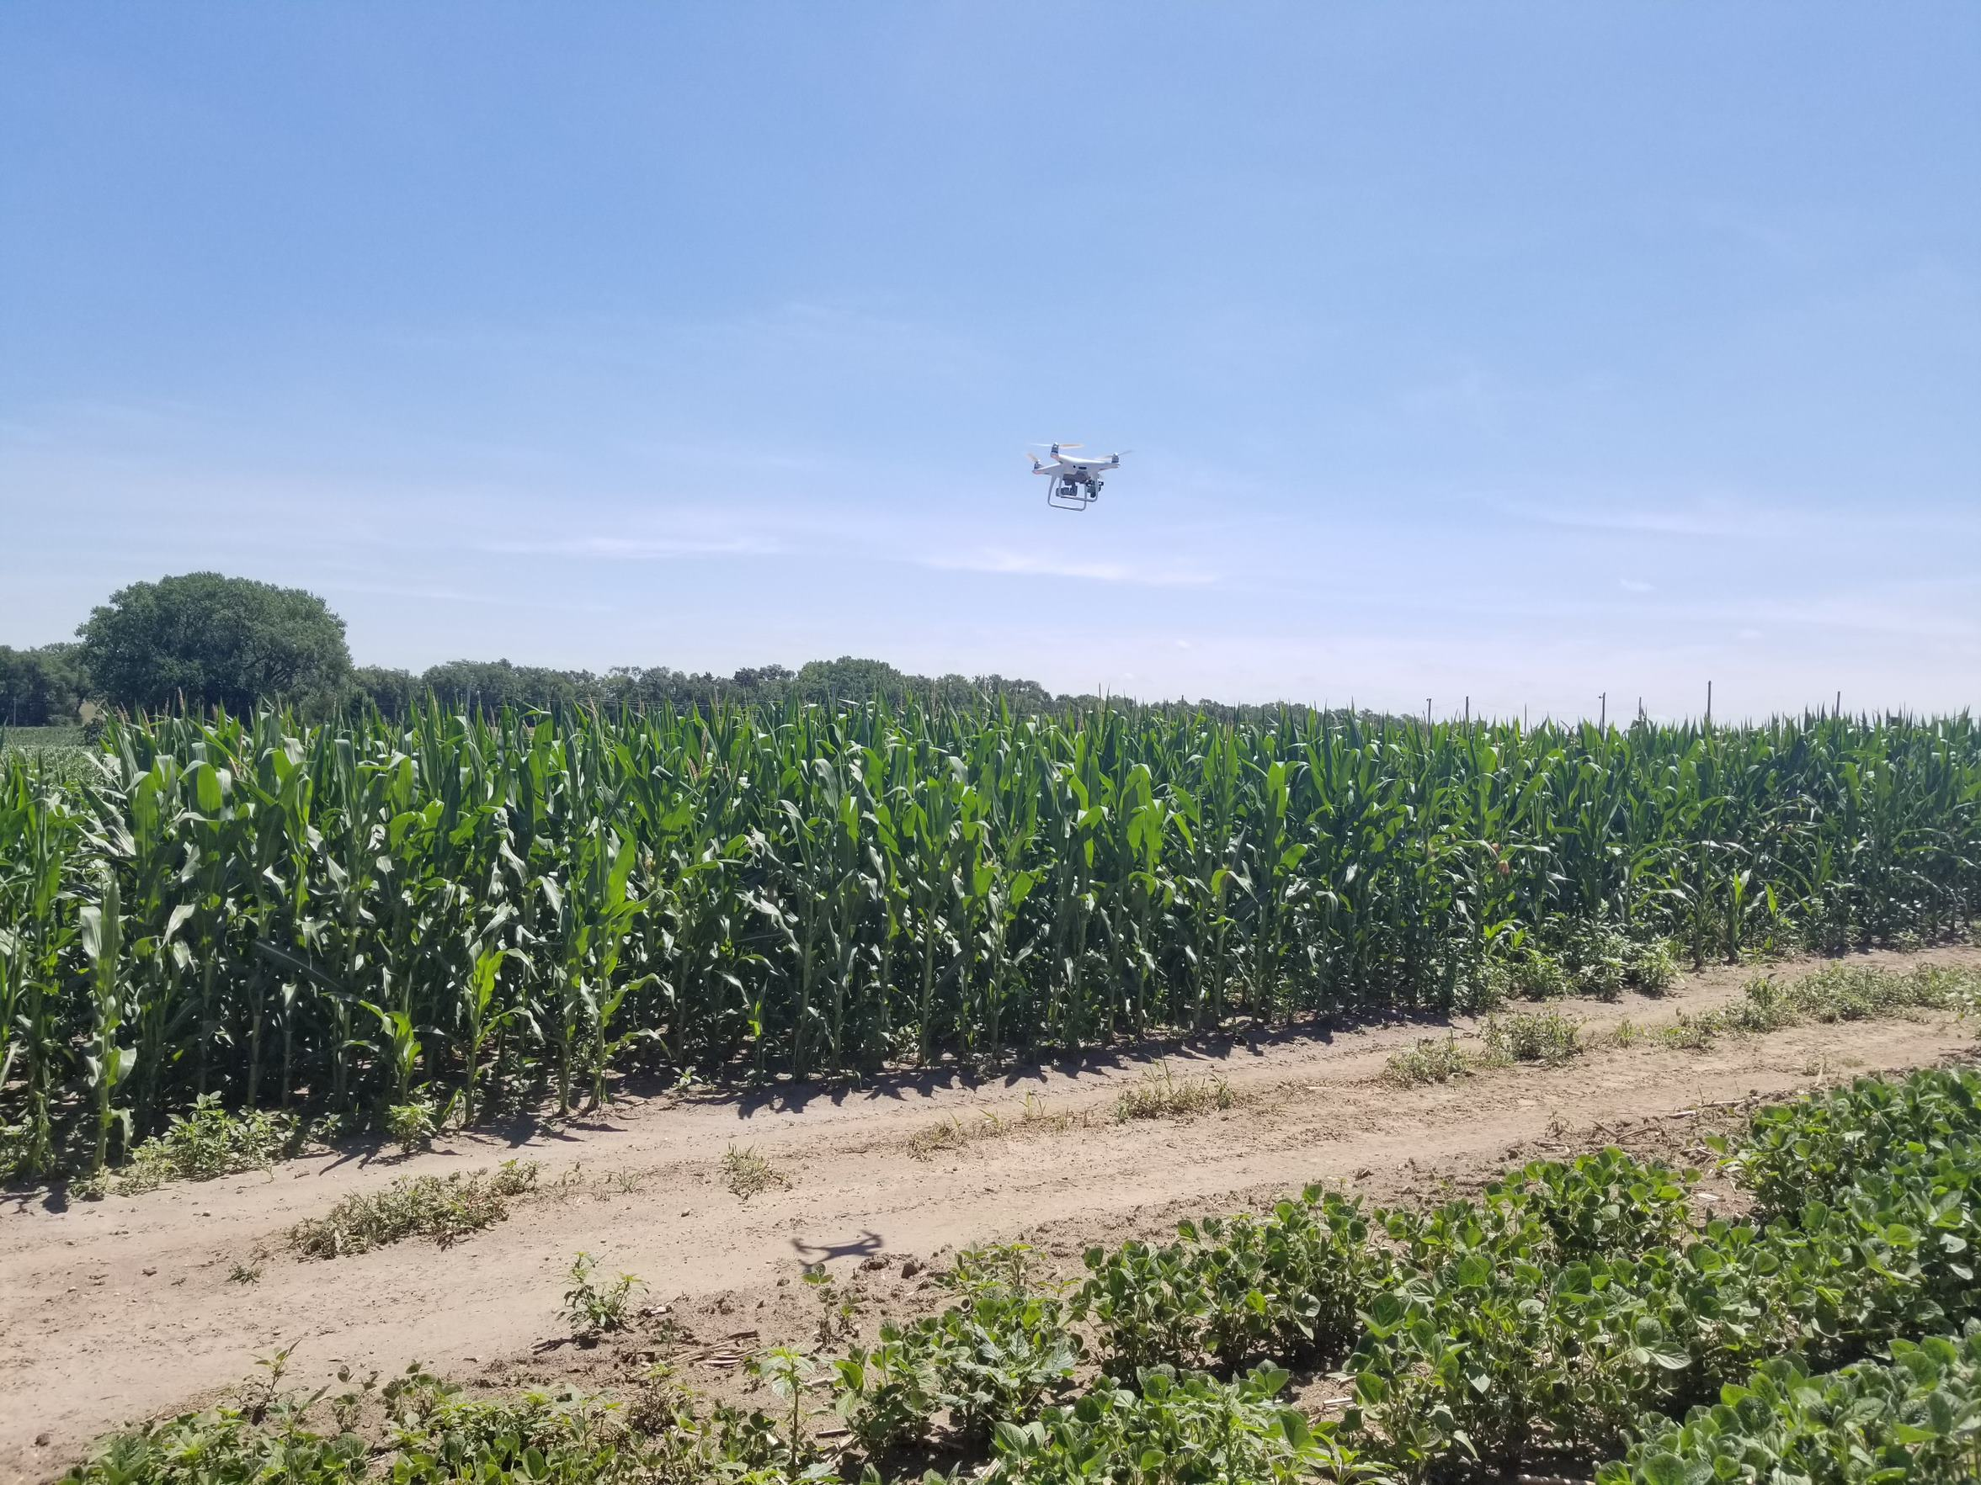
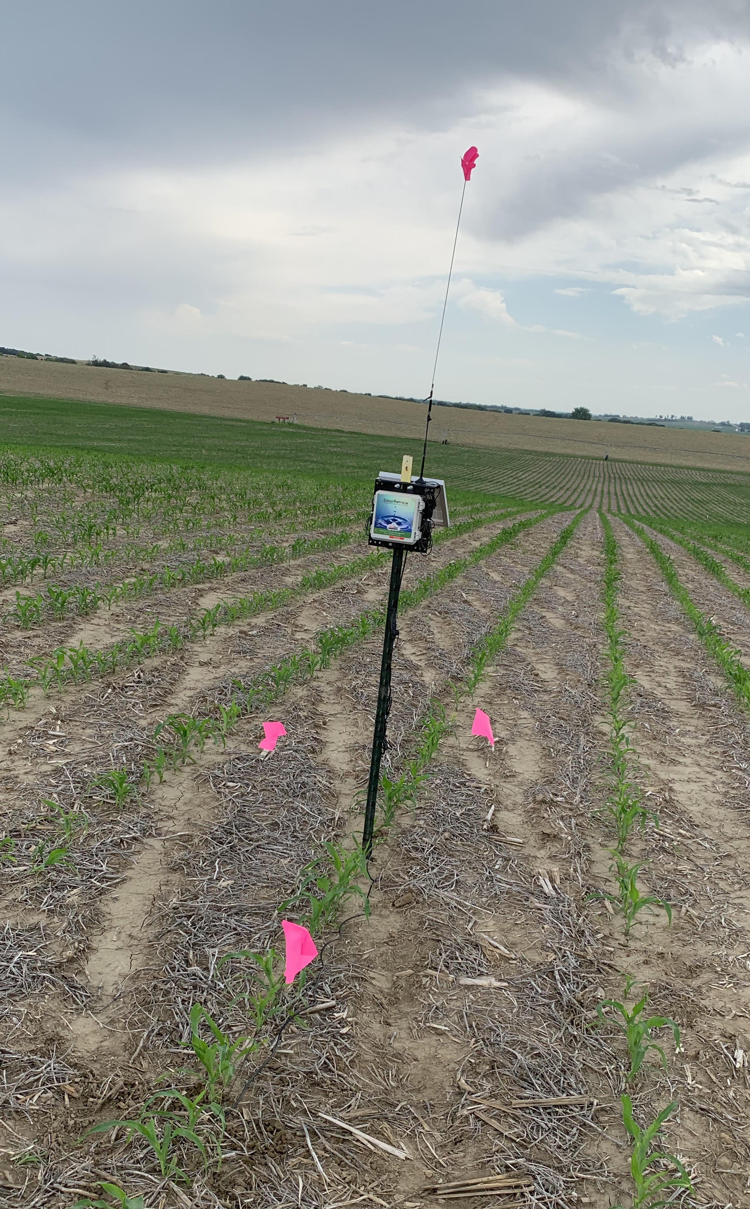
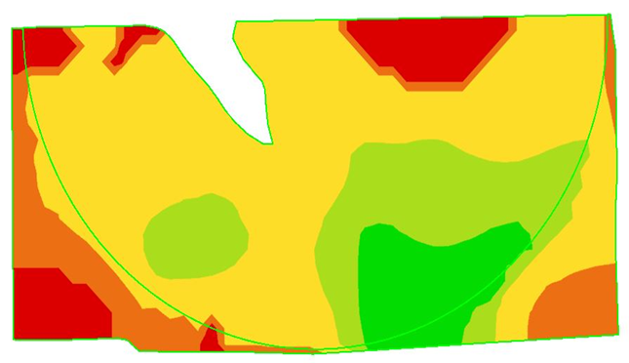
When you hear the words, “precision agriculture”, what do you think of?
Photos courtesy of Courtney Nelson and Rob Thomas
Notes:
Pose this question to your students and see what sort of responses you get. You can use this question for their journal question/question of the day/etc. I have these pictures all staggered on transitions, so the drone photo comes first, then the soil moisture probe, then the “pretty map”. Those are some of the first things that my mind wanders to. You can share your own thoughts with the class. This rolls into the next slide sharing what precision ag really is.

Slide 3

What is Precision Ag?
Is a method of farm management
Technology is a tool in our toolbox to enhance our decision making
Optimizing results with less inputs
Stock photos, royalty-free images, graphics, vectors & videos | Adobe Stock
Notes:
While all the things on the last slide are precision ag tools, I want to encourage you to think of precision ag as not just the technology. I challenge you to think about it as a method of farm management. We will dive deeper in further units about the differences in traditional and precision ag practices, but you can explain now that this is us being intentional with our decisions. Saying that we are going to make a specific recipe of a feed ration rather than just throwing in a touch a silage, some hay, maybe some soybean meal today because I’m feeling adventurous. This is also not us going to one area of the field to sample then doing things for the field based on that one spot. This is us working to collect data and going one step further to make sense of the data. Technology is that tool to help us enhance our decision making. “optimizing results with less inputs”. Break down words as needed. I connect optimization to something that they have done or will soon do in math for example. I will have an example where I say, if you are making Chex Mix, you want to have the right mix. Don’t want it too heavy on the Chex, or the M&M’s. Want to find that sweet spot in the middle where you have the mix of sweet and salty. That’s a fun example, and I’d encourage you to share another one if you have one.

Slide 4
How does Precision Ag Help?
Technology
Data/Information
Interpretation/Decision-making
Technology reveals Variability
  Differences
Managers interpret information
Managers make intentional management decisions for specific areas of the field or herd
  Put fewer inputs in less productive areas of the field and vice versa
Photo courtesy of Microsoft Stock Images
Notes:
How does precision ag help solve these issues and more?
There are three main components to precision ag: Information, technology, and management. They all three rely on one another, like a three-legged stool. Precision ag technologies help reveal variability in your field, herd, pasture, landscape, etc. We can then interpret the information we are receiving from these tools to help us make more intentional decisions for the specific areas of the field or herd that we see. This can involve putting more inputs in an area of field that can produce better than areas that consistently get flooded out as an example.

Slide 5
Soil Sampling
Identifies
  Soil pH
  Soil’s ability to hold water
  Soil’s ability to release water
  Fertility availability
  Fertility needs

Slide 6
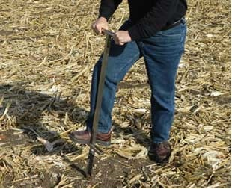
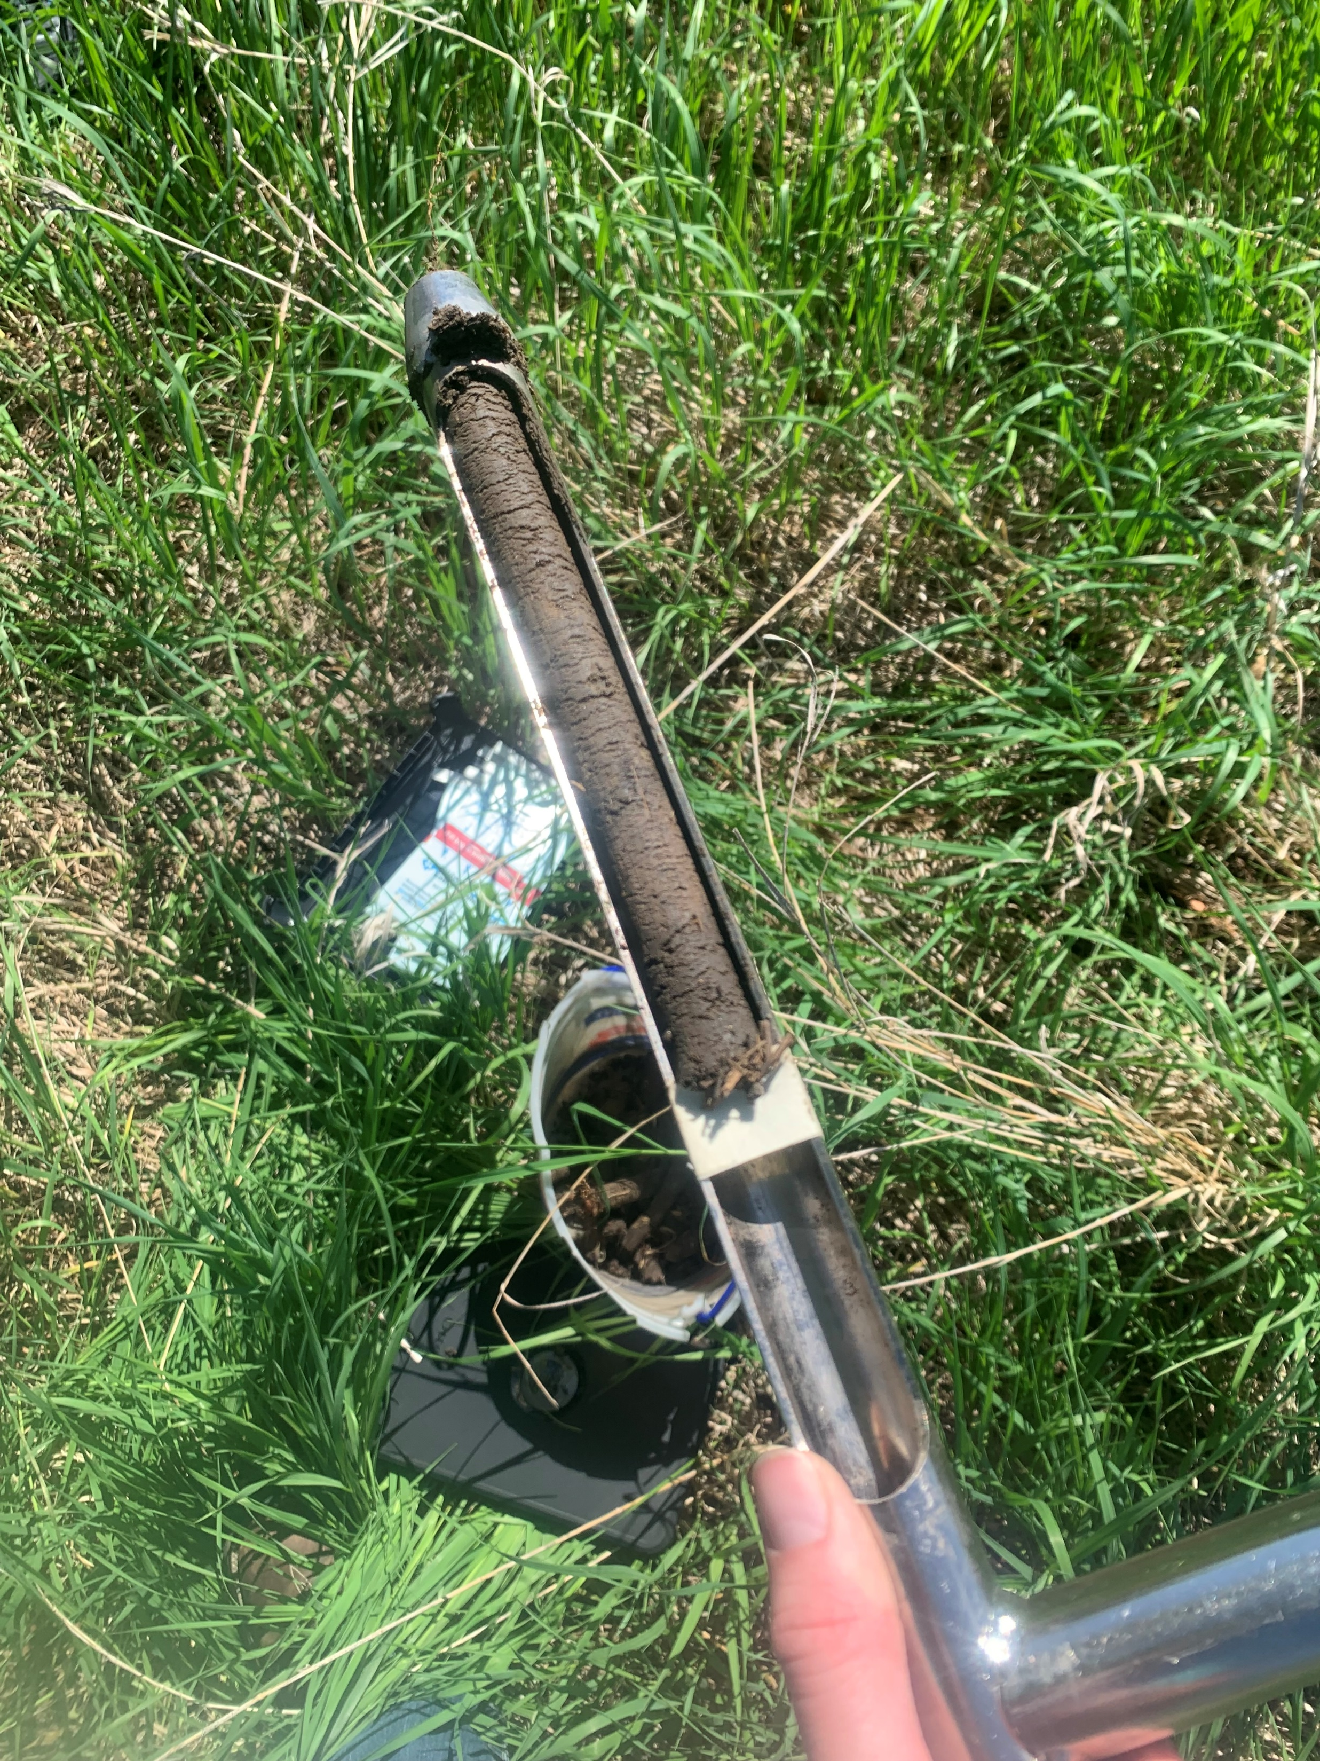
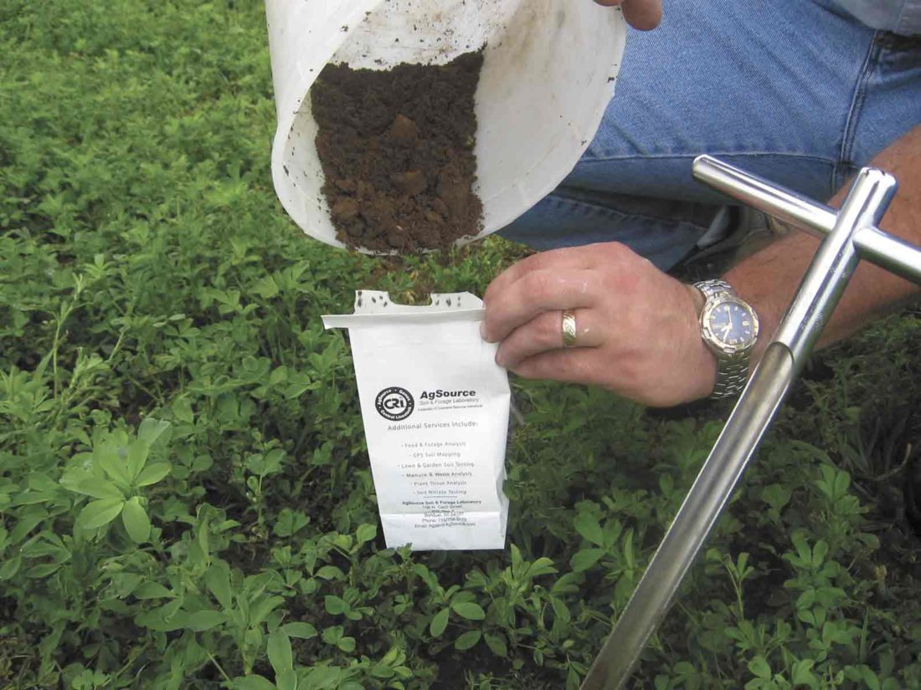
Using a soil probe to collect a soil sample.
Preparing soil for shipment to the lab for analysis.
Eight-inch core sample with diameter about the size of a quarter is a quality sample to test
Notes:
Drive to the field to be sampled
Use a soil probe to remove a sample of soil from the ground. You want to collect the top eight inches of soil to have a good sample.
Ten to fifteen samples are taken within a zone of a ten-foot radius from the point where you are sampling
All soil samples within the zone are mixed to get an average of that ten-foot area.
Soil samples are sent to a lab for analysis.
The top left photo showcases the soil probe used to collect samples. The middle photo is an example of a good core sample. You dump these samples into a bucket, mix 10-15 of them together in a bucket, as you can see in the bottom right photo. In this photo, we see them dumping the prepared sample into a lab bag to be sent into the lab for testing.

Slide 7
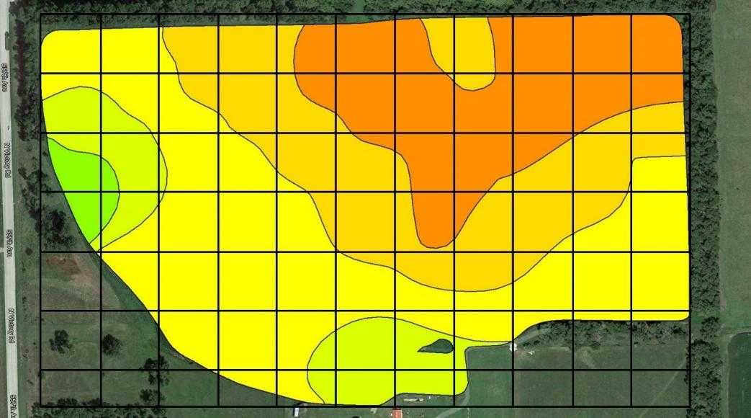
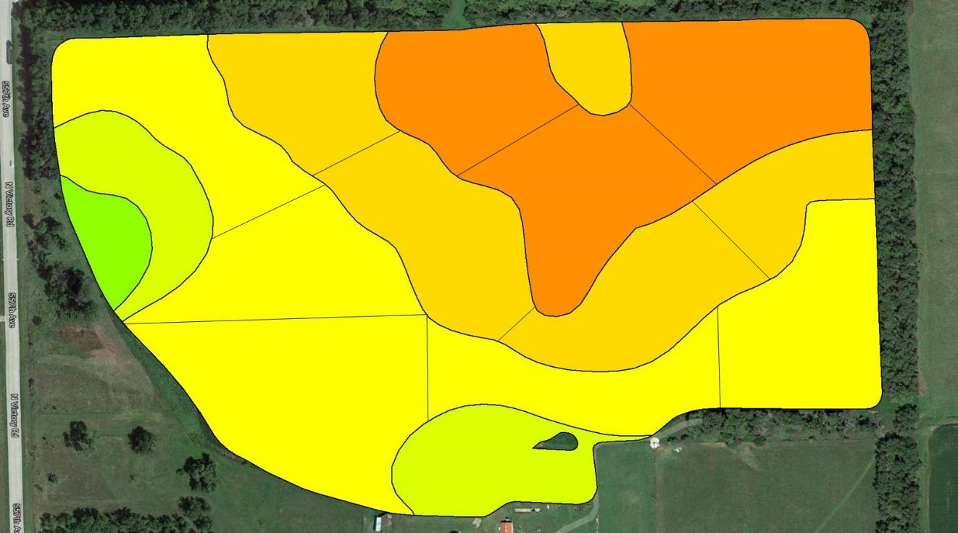
Grid Sampling - a soil sample is taken within each square across the field map. Very time consuming and expensive.
Zone Sampling - fewer soil samples are taken and less costly for lab testing. Lose some of the detail.

Slide 8
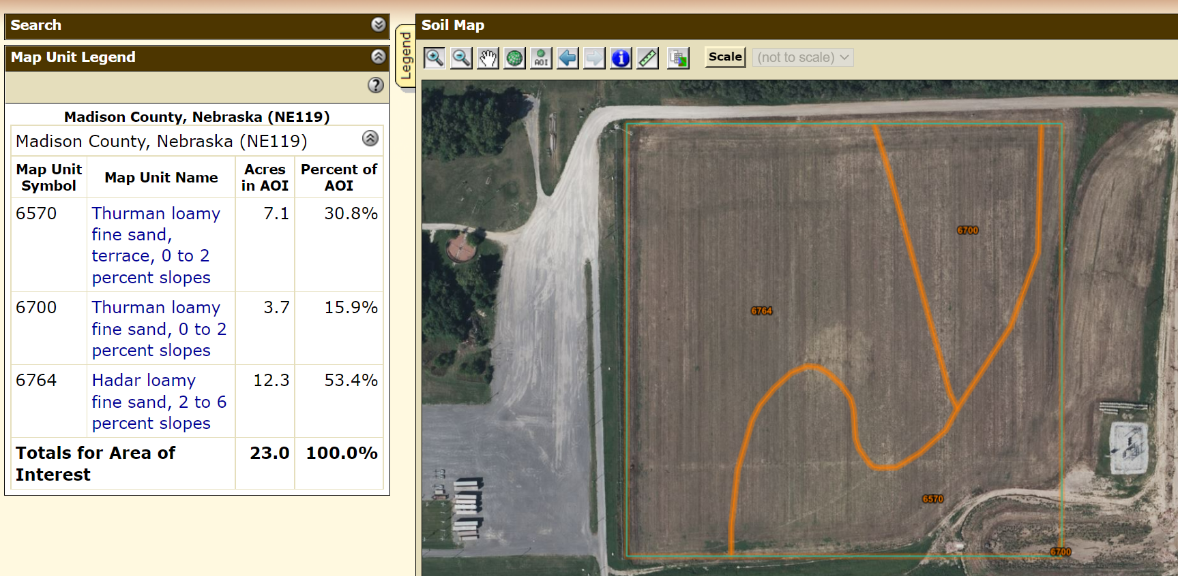

Slide 9
Once you have your data collected:
Tell me what percent of the field was each color in our data set (e.g. what percent of the data collected is red, orange, yellow, etc.)
AND
Answer the questions on your worksheet

Slide 10
Review
What could the different colors in this map above represent?
  Any value on our soil test report: soil pH, nutrient levels, electrical conductivity, organic matter, cation exchange capacity, etc.
Why is variability important for people to understand?
  It allows us to make more informed and intentional decisions. In the long run, it has the capability to save growers money and help protect the environment.

Slide 11
Review
What are some examples of decisions you can make from this data?
  Adjust variable-rate planting or fertilizer decisions
How often should you fully grid sample?
  Every 3-5 years depending on your soil’s health and goals

Slide 12
Grant Acknowledgements
This material is based upon work supported by the National Science Foundation under Grant No. 2202151. Any opinions, findings, and conclusions or recommendations expressed in this material are those of the author(s) and do not necessarily reflect the views of the National Science Foundation.

