Slide 1

Luminescent Nanoparticles of Metal Oxides
Yuanbing Mao, Ph.D.
Multifunctional Applications of Oxides (MAO) Laboratory
Department of Chemistry
Illinois Institute of Technology
May 14, 2020
1 PM Eastern

Slide 2

This Webinar Is Hosted By
ATE Central acts as an information Hub for the National Science Foundation ATE Grantee Community
atecentral.net/webinars

Slide 3
This Webinar Is Brought To You By

Slide 4


Introductions: Host and Moderators
Mike
Lesiecki, host
Atilla Ozgur Cakmak
Assistant Professor
Penn State University
NACK Network
Trevor Thornton
Professor
Arizona State University
Notes:
I’m Mike Lesiecki, with Luka Partners. I’ll be the moderator for the webinar today and I also serve on EvaluATE’s community college liaison panel. Lori Wingate will is the main presenter for the webinar. She is director of EvaluATE, which is located at The Evaluation Center at Western Michigan University.

Slide 5

Introductions
Presenter
Yuanbing Mao, PhD
Professor and Chair
Department of Chemistry
Illinois Tech

Slide 6
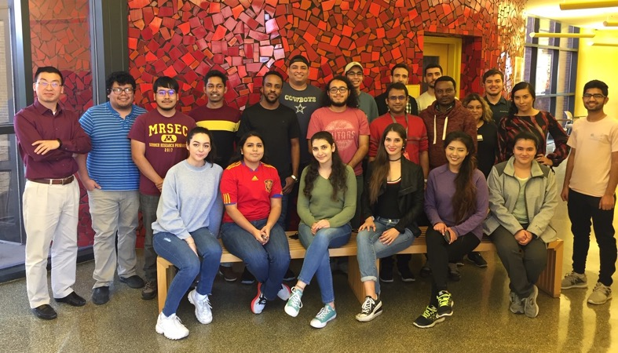
Acknowledgements (2010 – present)
Visiting Scholars:
Dr. H Liu
Dr. W. Luo
Dr. L. Mao
Dr. L. Yi
Dr. L. Tian
Postdoctoral Fellows:
Dr. J. Ahmed
Dr. S. Gupta (Fulbright)
Dr. M. Pokhrel
Dr. B. Srivastava
Dr. Y. Tian
Dr. J. Zhao
Graduate Students:
Mr. S. Alaparthi (WV State U)
Ms. P. Kukkapalli (Guardian Drug Co.)
Mr. Q. Li (TAMU → Purdue U)
Ms. W. Lin (Iowa State U)
Ms. X. Sun (TAMU → Purdue U)
Ms. Christina Figueroa (UTRGV)
Mr. M. Hakim Marjuban (UTRGV)
Mr. O. Oriretan (UTRGV)
Ms. M. Penilla (UTRGV)
Mr. J. Zuniga (Moltex Energy, Canada)
Ms. F. Jahanbazi (Current)
Mr. T. Abeywickrama (Current)
Undergraduates (> 60):
Mr. A. Altecor (Rice U → DuPont)
Mr. A. Arguelles (TAMU)
Ms. J. Bravo (Iowa State U)
Ms. Y. Cantu (Texas State U)
Mr. H. Chirino (UTRGV)
Ms. D. Concha (Baylor C)
Mr. K. Diab (UT Medical School)
Ms. E. Garcia (Great Mills Co.)
Ms. B. Gonzalez (UTRGV)
Ms. A. Lopez (UTRGV)
Ms. Q. Lu (Sharyland ISD)
Mr. L. Lu (UTRGV)
Ms. D. Owens (McAllen ISD)
Ms. M. Palacios (UT Medical School)
Mr. J. Shaikh (Medical School)
Ms. M. Valdez (UTRGV)
Mr. E. Villarreal (Rice U, NSF GF)
Mr. K. Wahid (UT Medical School)
etc.
High School Interns (> 18):
P. Aguirre (UTRGV), A. Flores, M. Gorena, S. Maldonado, A. Ramos, A. Rocha, M. Trejo, H. De Santiago (UTRGV), M. Valdez (UTRGV), C. Waters (TAMU), etc.
Jan. 18, 2019

Slide 7








Acknowledgements (2010 – present)
$$:
IIT Startup
UTPA Startup UTPA FRC
UTPA FDFP
UTPA URI
UTRGV FRC
Collaborators:
Dr. S. Banerjee (TAMU)
Dr. J. Borchers (NIST)
Dr. A. Burger (Fisk U)
Dr. X. Chen (Columbia U)
Dr. J. Dorman (LSU)
Dr. Z. Feng (OSU)
Dr. B. Guiton (UKentucky)
Dr. E. Kelley (NIST)
Dr. K. Lozano (UTRGV)
Dr. K. Martirosyan (UTRGV)
Dr. J. Neuefeind (ORNL)
Dr. A. Puretzky (ORNL)
Dr. L. Sun (UConn)
Dr. M. Therien (Duke U)
Dr. D. Wall (WSU)

Slide 8
Outline
Intro
PL and RL
PerL
UC
Summary

Slide 9
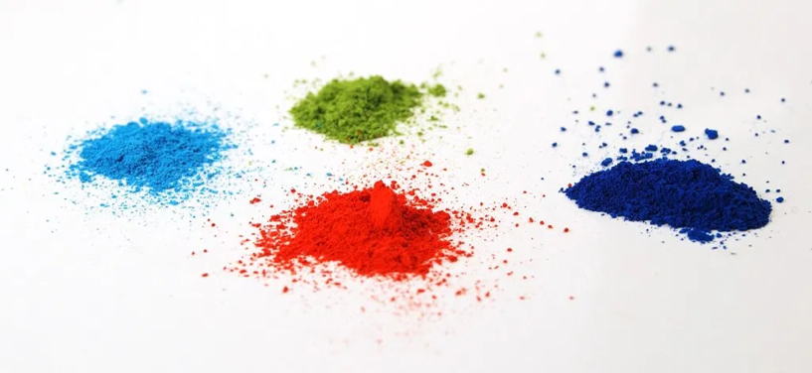
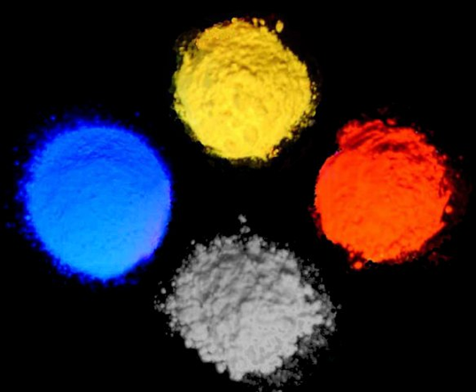
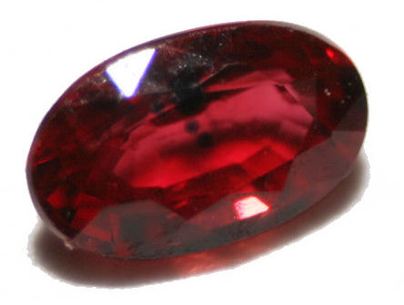
Metal Oxides
Chemical compounds containing at least one oxygen atom as well as at least one metallic element.
Cr3+:Al₂O₃
https://www.sigmaaldrich.com/materials-science/material-science-products.html?TablePage=112202335

Slide 10
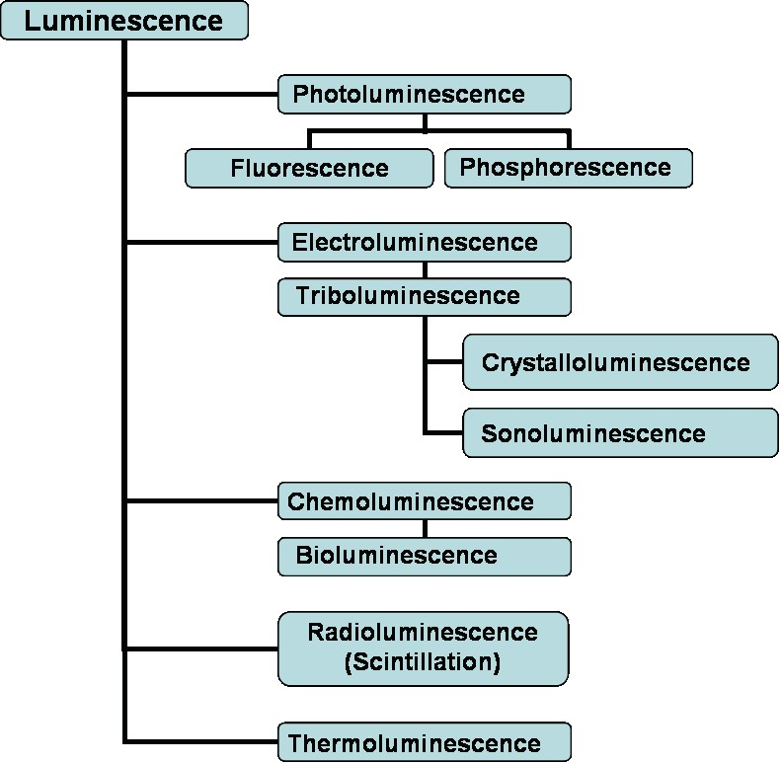
Luminescence
A light emission which represents an excess over the thermal radiation and lasts for a time exceeding the period of electromagnetic oscillation.
A form of cold-body radiation vs. incandescent light.
Loses correlation between phases of absorbed and emitted light vs. reflected and stray light.
Brief history:
‘Afterglow’ traced back to ~1000 years
First observed fluorescence from quinine by Sir J.F.W. Herschel in 1845
G.G. Stokes coined the term ‘fluorescence’ in 1853
E. Wiedemann used the term ‘luminescence’ in 1888
Basic principles of fluorescence were mostly developed during the 1020’s and 1930’s:
Excited state lifetime (Gaviola)
Quantum yield (Wavilov)
Polarization of fluorescence (Weigert, F. Perrin)
Jablonski diagram (A. Jablonski)
Fluorescence resonance energy transfer by T. Förster in the 1950’s
Upconversion by F. Auzel in the 1960’s
https://www.phenix.bnl.gov/phenix/WWW/publish/barish/publish/wasiko/Copy/Solar/Luminescence%20and%20Fluorescence%20Spectroscopy.htm

Slide 11
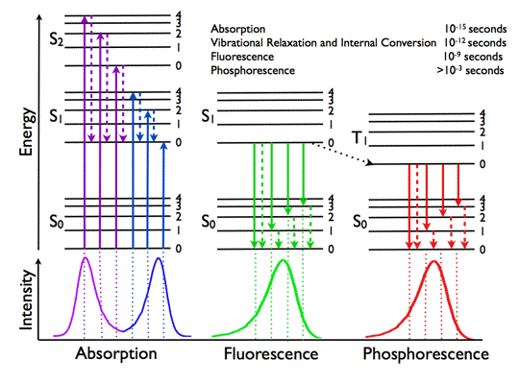
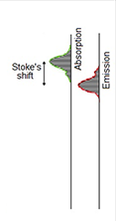
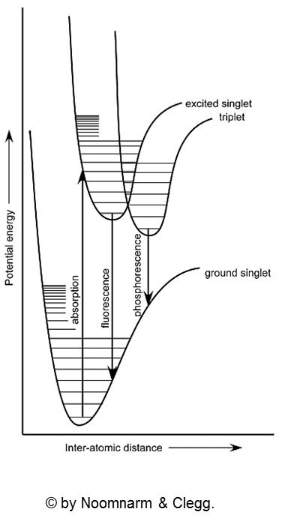
Luminescence
Jablonski diagram and spectra showing the fundamental photophysical processes in organic molecules:
Absorption of a photon: S₀ → S₁,S₂
Internal conversion: S₂ → S₁ (non-radiative)
Fluorescence: S₁ → S₀
Intersystem crossing: S₁ → T₁
Phosphorescence: T₁ → S₀
https://www.lambertinstruments.com/technologies-1/2014/12/4/frequency-domain-flim-basic-equations

Slide 12

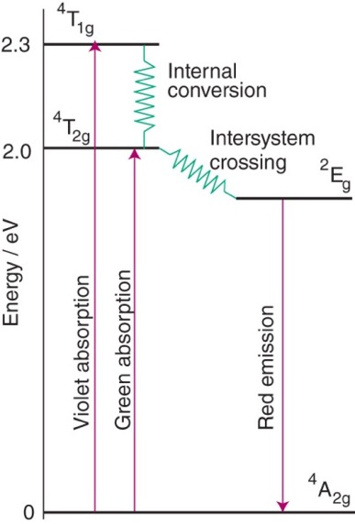
Luminescence
Cr3+:Al₂O₃
Luminescence Characterization:
Excitation spectroscopy
Emission spectroscopy
Quantum yield
Lifetime
……

Slide 13
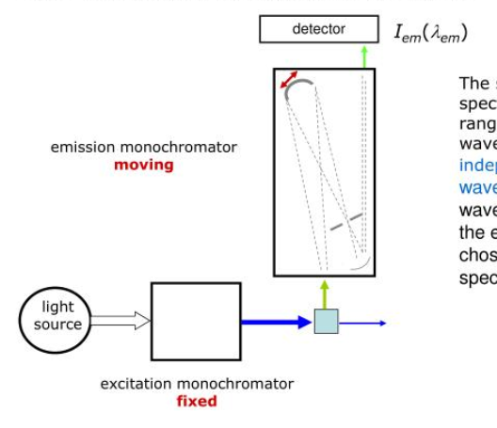
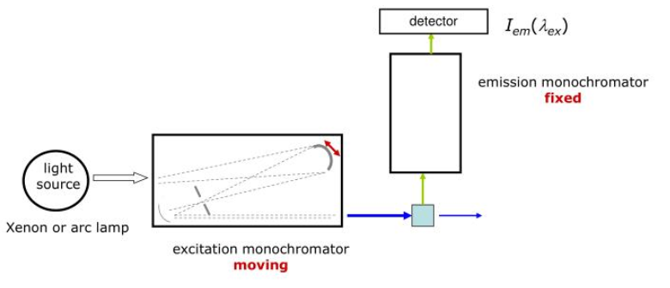
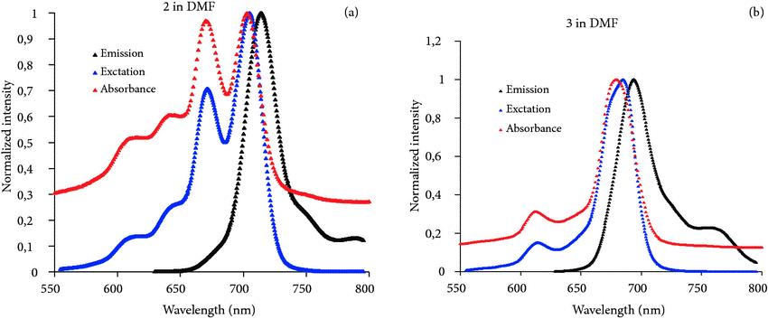
Excitation and Emission Spectra
Turk. J. Chem. 38(6):1083-1093 (2014).

Slide 14
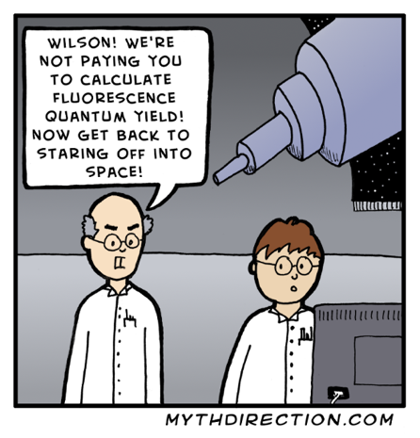
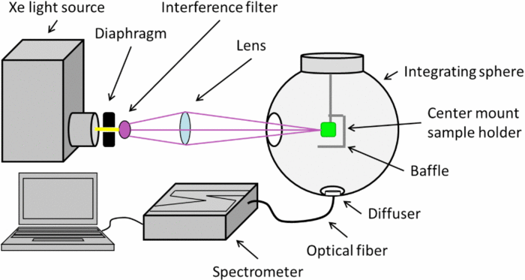
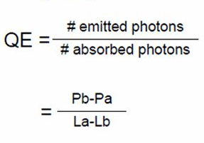
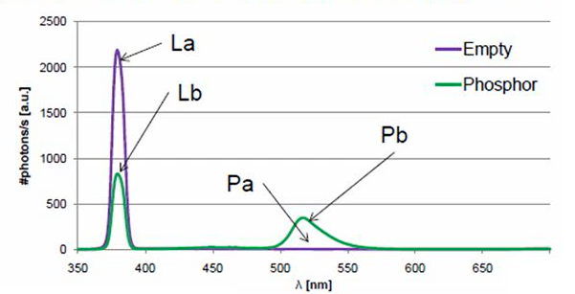
Luminescence Quantum Yield
Review of Scientific Instruments 85, 123115 (2014)
L_{a}: total # of incident photons
L_{b}: total # of photons not absorbed by the phosphor
P_{a}: dark signal in the emission wavelength area
P_{b}: total # of photons emitted in emission wavelength area

Slide 15
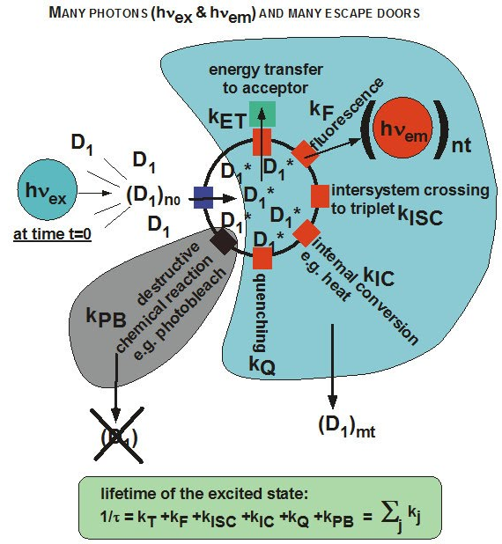
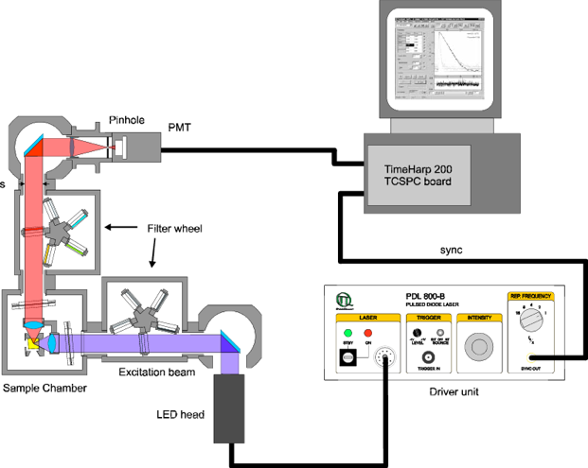
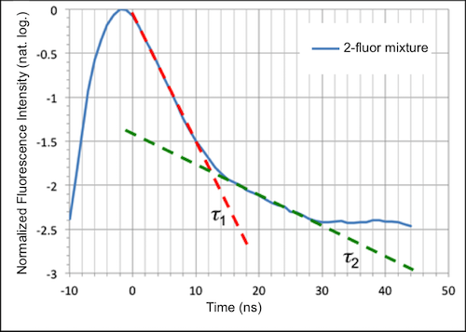
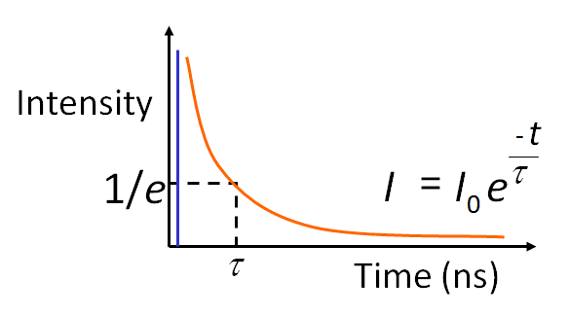
Luminescence Lifetime
Proceedings of SPIE, 4648, April 2002. DOI: 10.1117/12.462651
https://sites.google.com/site/yichunchen52/research
https://www.lambertinstruments.com/technologies-1/2014/12/4/fluorescence-lifetime-imaging-microscopy
https://www.kineticriver.com/danube/

Slide 16
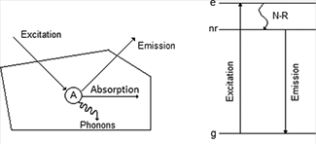
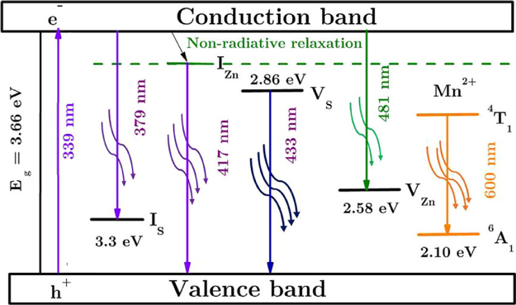
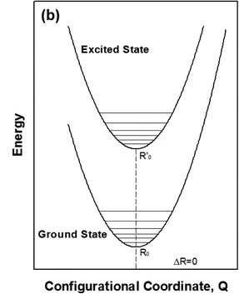
Luminescing Materials
Optik, 2018, 153, 31-42
Objectives:
To search new host materials
To develop nanoscopic light emitters
To explore strategies to enhance luminescence
To understand structured-related mechanisms
Tian, J Solid State Lighting, 2014, 1, 11

Slide 17
Luminescing Nanoparticles
In general and potentially:
High quantum efficiencies, sharp emission peaks, high photostability, emission wavelength tunability, and may emit light when irradiated by ionizing radiation
Bioimaging:
Organic dyes: suffer from photobleaching and broad emission
Quantum dots: exhibit toxicity
Lanthanide-doped NPs:
(1) wide excitation range: UV to NIR
(2) broad emission wavelengths
(3) enhanced photostability
(4) large Stoke’s shift
(5) increased lifetimes (milliseconds)
(6) upconversion emission, and
(7) high water dispersibility, biocompatibility, stealthy nature and preferably targeting ability
minimizes the autofluorescence and scattering of light
due to parity forbidden transitions occurring within 4f shell shielded by 5s and 5p orbitals,

Slide 18
Outline
Intro
PL and RL
PerL
UC
Summary

Slide 19
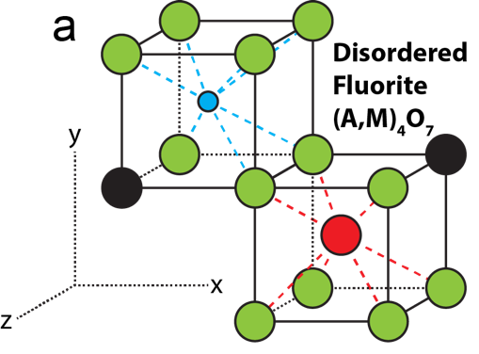
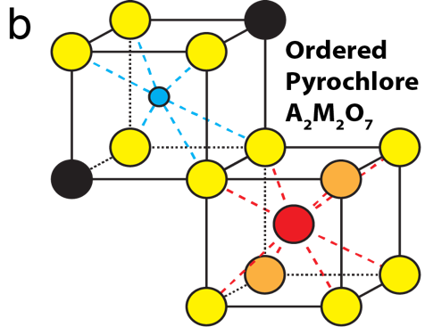
AIII₂MIV₂O₇ Compounds
Dis/ordering of cations and oxygen vacancies
La₂Zr₂O₇: ~1000ºC
fluorite < r_{A}/r_{M} = 1.46 < pyrochlore
One Raman peak
Six Raman peaks
Refractory with m.p. > 2500ºC
Challenge to synthesize, especially @ nanodomain
To make metastable phase if synthesis temp. is lower than phase transition temp.

Slide 20
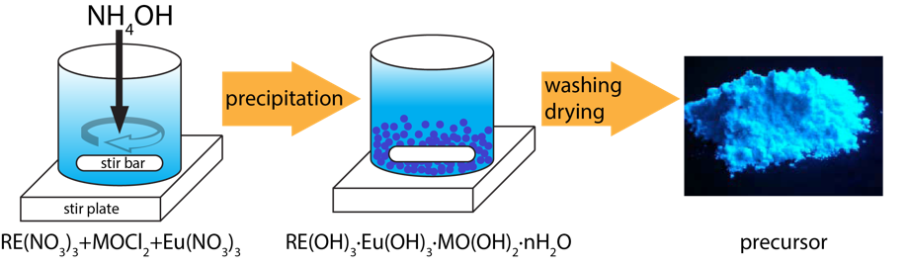
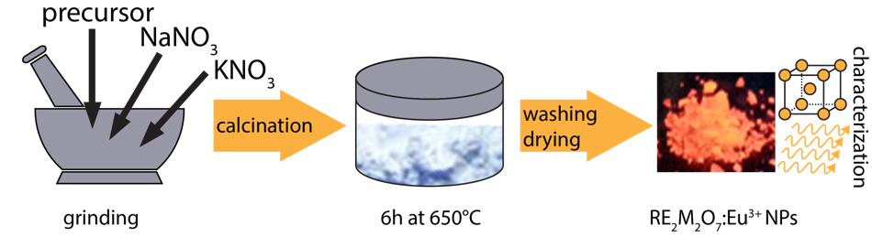
Molten Salt Synthesis of A₂M₂O₇ NPs
Benefits of the MSS Process
Lower temp. + evener distribution: Solid-state synthesis vs. MSS
Soft aggregates: sol-gel method vs. MSS
Particle size reduction: flux method vs. MSS
No milling or surface dead layer
Yuanbing Mao, Xia Guo, Jian Y. Huang, Kang L. Wang, and Jane P. Chang, Luminescent nanocrystals with A₂B₂O₇ composition synthesized by kinetically modified molten salt synthesis, Journal of Physical Chemistry C, 2009, 113(4), 1204-1208.

Slide 21
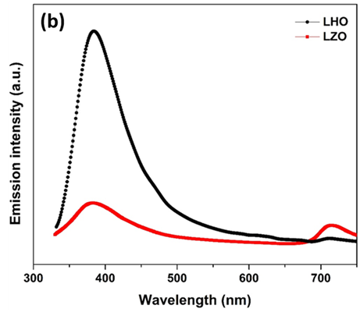
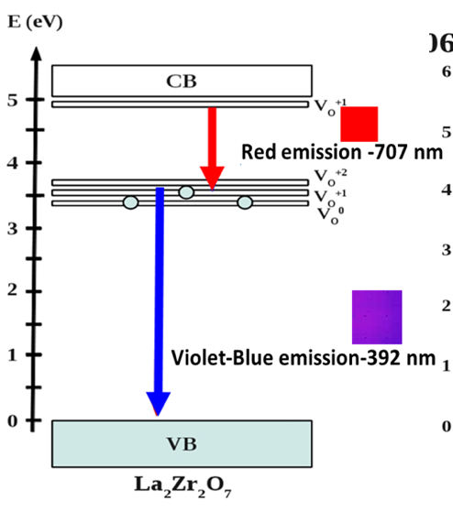
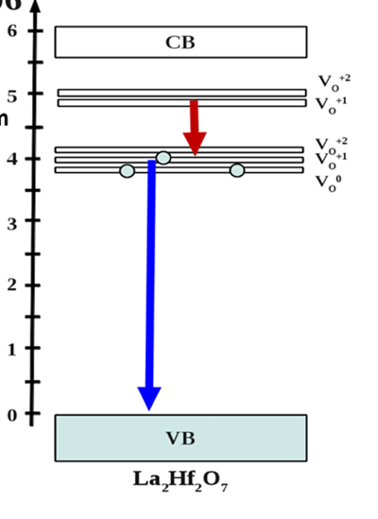
Cationic Variation: La₂Zr₂O₇ vs La₂Hf₂O₇ NPs
λ_{ex} = 306 nm

Slide 22
Cationic Variation: Eu3+:La₂Zr₂O₇ vs Eu3+:La₂Hf₂O₇
PL: peak at ~5% Eu3+.
QY: La₂Hf₂O₇ > La₂Zr₂O₇.
CN | 6
⁴⁰Zr: [Kr]4d²5s² | 0.72
⁷²Hf: [Xe]4f¹⁴5d²6s² | 0.71
Change of M4+ cations in ionic A₂M₂O₇ compounds:
→ Affects crystal field splitting (CFS) of Eu3+ ions
→ Changes the charge cloud of Eu3+ ions
→ Varies QY
Kareen Wahid, Madhab Pokhrel, and Yuanbing Mao, Structural, Photoluminescence and Radioluminescence Properties of Eu3+ Doped La₂Hf₂O₇ Nanoparticles, Journal of Solid State Chemistry, 2017, 245, 89-97.

Slide 23
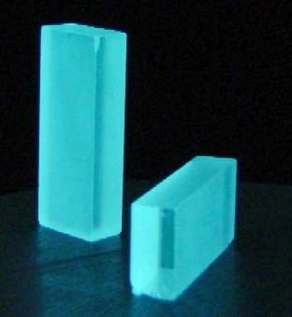
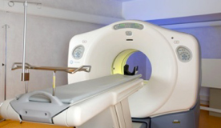
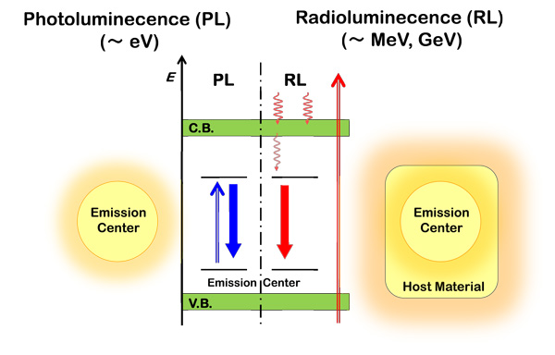

Photoluminescence vs. Radioluminescence
Medicine
Security
Expanding applications of ionizing radiation scintillation detectors
The progress on new scintillators is slow
The use of high quality single crystals is not the only way to achieve better scintillation properties
http://research.kyoto-u.ac.jp/service/topic/spirits/lists/h25list_e/sprits_h25en_68_masai/

Slide 24
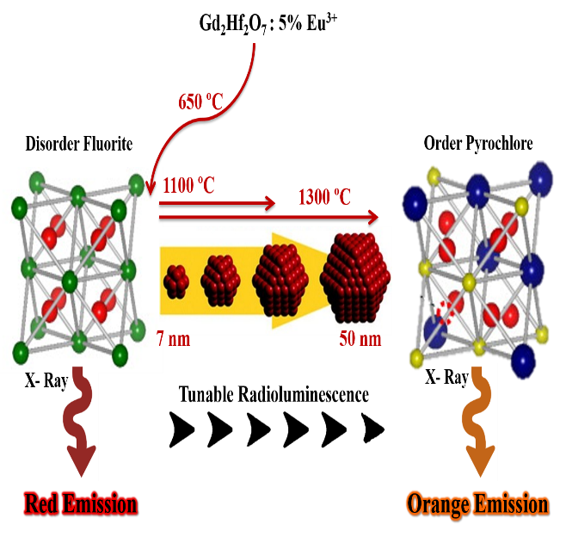
Particle Size & Crystal Structure Engineering
Tunability of RL color: red → orange
Strategy for designing advanced optoelectronic materials
Santosh K. Gupta, Maya Abdou, Partha Sarathi Ghosh, Jose P. Zuniga, and Yuanbing Mao, Thermally Induced Disorder-Order Phase Transition of Gd₂Hf₂O₇:Eu3+ Nanoparticles and its Implication on Photo- and Radio-Luminescence, ACS Omega, 2019, 4, 2779-2791.

Slide 25
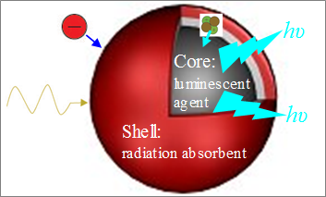
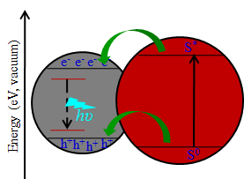
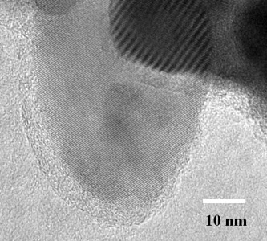
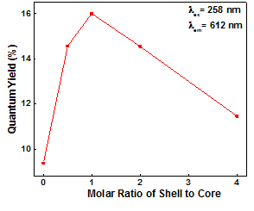
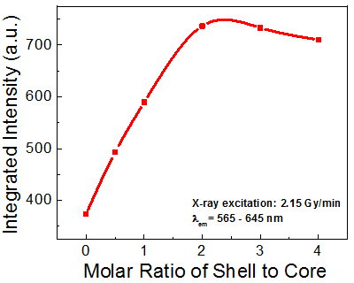
Core@Shell Strategy
Shell: eliminates surface defects
Charge carriers: transfer from shell to core
PL & RL: increased ~2 times
Eu:La₂Zr₂O₇@YBO₃ NPs

Slide 26
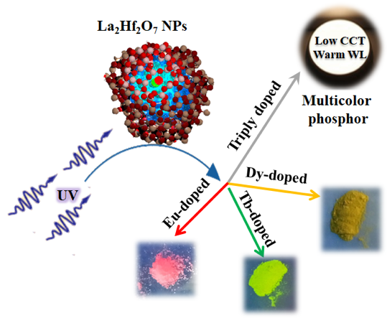


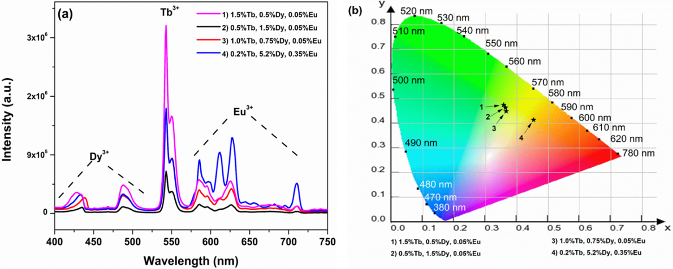
Warm White Lighting
DOE: WLEDs will save >20% electricity (2010-30)
Deficiency of the red light component in commercial phosphors
Dy,Tb,Eu:La₂Hf₂O₇ NPs

Slide 27
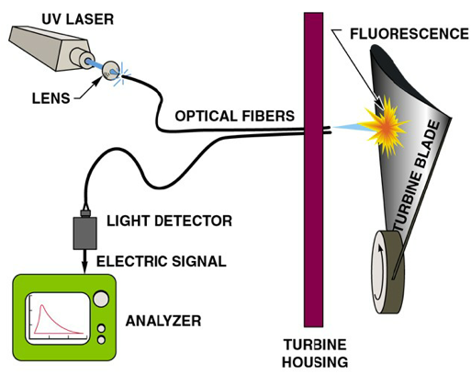
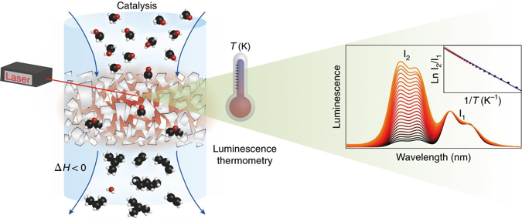
Luminescence Thermometry
For harsh environments
High spatial resolution
Rapid response
Non-invasive operation
To reduced areas
Offering sub-​micrometric resolution
High accuracy
Current thermographic phosphors are restricted to bulk samples with moderate sensitivity and intermediate temperature range

Slide 28
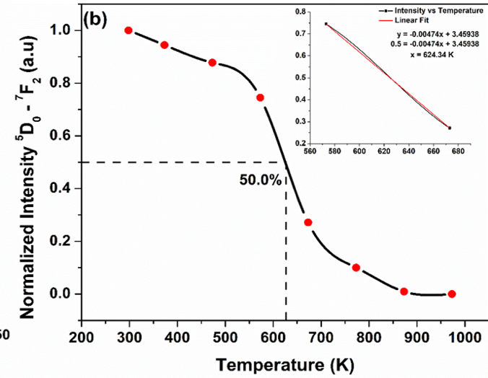
Luminescence Thermometer
La₂Hf₂O₇:5%Eu NPs
Materials | Maximum S_{r} (%K⁻¹) | Temp. range (K)
Gd₂O₃:Er³⁺ /Yb³⁺ | 0.39 | 300-900
NaLuF₄:Ho³⁺/Yb³⁺ | 0.12 | 350-750
Yb₃Al₅O₁₂:Er³⁺ | 0.48 | 295-973
NaLuF₄:Gd³⁺ | 0.29 | 298-523
Y₂MgTiO₆:Mn⁴⁺ | 0.14 | 10-513
GdVO₄:Sm³⁺ | 1.41 | 393-603
La₂Hf₂O₇:Eu³⁺ | 3.53 | 298-973
High activation energy: 0.425 eV
Highest relative temperature sensitivity (S_{r})
Contributions: high QY, good PL and RL properties, high lifetime, and excellent thermal stability.
Collaborative work with Dr. Alex Puretzky at ORNL
Santosh K. Gupta, Jose Zuniga, P.S. Ghosh, Maya Abdou, and Yuanbing Mao, Correlating Structure and Luminescence Properties of Undoped and Eu3+ doped La₂Hf₂O₇ Nanoparticles Prepared with Different Co-Precipitating pH Values through Experimental and Theoretical Studies, Inorganic Chemistry, 2018, 57(18), 11815-11830.

Slide 29
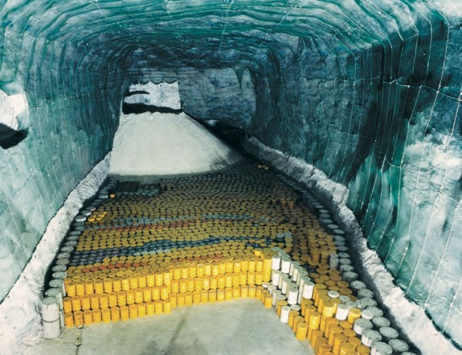
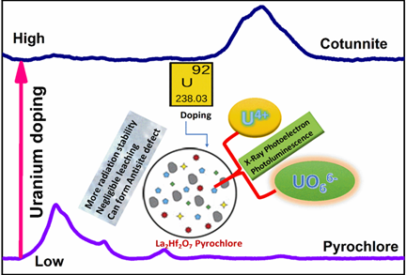
Nuclear Waste Immobilization
Suitable properties of nuclear waste hosts:
large containing capability
high thermal stability
good radiation stability
high chemical stability
resistance to radiation-induced amorphization
negligible leaching
etc.
Uranium and its radioactive isotopes: a high-level of nuclear waste
La₂Hf₂O₇ NPs: U-doping induced phase transformation
Speciation studies of uranium ion in A₂M₂O₇ compounds: uncharted and vague
Maya Abdou, Santosh K. Gupta, Jose Zuniga, and Yuanbing Mao, On Structure and Phase Transformation of Uranium Doped La₂Hf₂O₇ Nanoparticles as an Efficient Nuclear Waste Host, Materials Chemistry Frontiers, 2018, 2, 2201 - 2211 (cover).

Slide 30
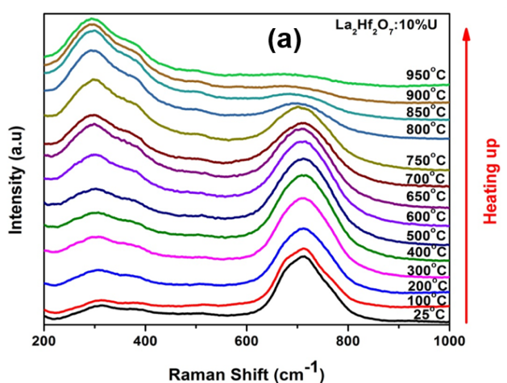
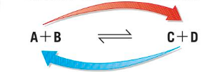
Nuclear Waste Immobilization
Structural Evolution of La₂Hf₂O₇:10%U NPs
La₂Hf₂O₇ NPs as nuclear waste host: reversible phase transition – observed for the 1st time
Pyrochlore
Cotunnite
Collaborative work with Dr. Alex Puretzky at ORNL

Slide 31
Nuclear Waste Immobilization
γ-ray irradiation impact on A₂Hf₂O₇:5%Eu NPs
Fascinating behavior from lanthanum (f0) hafnate and lutetium (f14) hafnate
Two extreme compositions with the maximum and minimum ionic radius ratio r_{RE}/r_{Hf} of the studied RE₂Hf₂O₇:5%Eu NPs
Beneficial for fundamental U chemistry and nuclear industry
Collaborative work with Dr. Don Wall group at WSU
Victoria Trummel, Santosh K. Gupta, Madhab Pokhrel, Donald Wall, and Yuanbing Mao, Investigating the impact of gamma radiation on structural and optical properties of Eu3+ doped rare-earth hafnate pyrochlore nanocrystals, Journal of Luminescence, 2019, 207, 1-13.

Slide 32


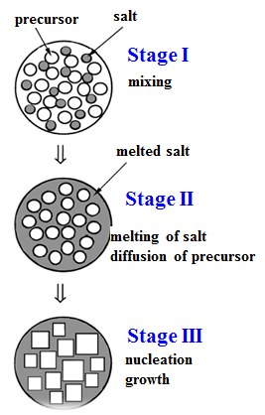
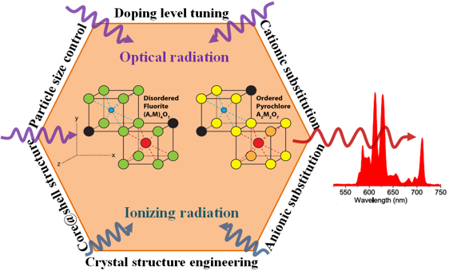

Summary on Luminescence Studies of A₂M₂O₇ NPs
Molten-salt synthesis method for A₂M₂O₇ NPs with different doping levels, compositions and crystal structures
Several strategies to tune the spectral features of these NPs
Explored both PL and RL of these phosphors and scintillators
Have great potentials for broad optical applications

Slide 33
Outline
Intro
PL and RL
PerL
UC
Summary

Slide 34



Persistent Luminescent Materials
Materials which emit in the UV, VIS and/or NIR spectral regions for minutes, hours or even days after ceasing the excitation irradiation
New applications spontaneously set more requirements on design methodology, morphology, and functionalization of PLMs
New applications also promote the development of new PLMs
Bioimaging/Diagnostics
Need to avoid tissue autofluorescence and weak tissue penetration
Urgent need for PLM NPs with bright luminescence and long afterglow
To understand their biodistribution in vivo

Slide 35

Red Long-Lasting Phosphor Cr:ZnGa₂O₄
Conveniently excited through its bandgap by UV light
Emit s around 695 nm via the 2E → 4A₂ transition of Cr3+
Matches the optical window of biological tissues
Use of a small dopant concentration (0.5%) and similar dopant size (Cr3+ vs Ga3+) → reduce the occurrence of defects and avoid potential loss centers
AB₂O₄ compound, spinel structure
Zn2+ and Ga3+ ions occupy tetrahedral A and octahedral B sites, respectively
The currently synthesized Cr:ZnGa₂O₄ NPs: 40–150 nm, polydisperse
No sub-10-nm persistent nanophosphors synthesized yet
T. Maldiney, et al., Nat. Mater., 2014, 13, 418. A. Abdukayum, et al. JACS, 2013, 135, 14125.

Slide 36
PerL Cr:ZnGa₂O₄ NPs by Bi-Phasic Synthesis

Slide 37

Enhancing PerL of Cr3+:ZnGa₂O₄ NPs
Hydrothermal Synthesis
Urea
Urea + NH₄NO₃

Slide 38
Outline
Intro
PL and RL
PerL
UC
Summary

Slide 39


Upconversion Luminescence
An optical process that emits high-energy photons by absorbing two or more low-energy photons, which is caused by anti-Stokes luminescence
Energy level
diagram
Analogy from
everyday life
http://dcbwww.unibe.ch/groups/guedel/images/res/upc.GIF

Slide 40
Enhanced Upconversion
Er,Yb:La₂Zr₂O₇ NPs
Li+ co-doping induced phase transition
4F_{9/2}→4I_{15/2}
18-fold
λ_{ex} = 980 nm
4S_{3/2}→4I_{15/2}
14-fold
Er3+ ions
2H_{11/2}→4I_{15/2}

Slide 41


Upconverting Singular Red Emission

Slide 42



Summary
Upconversion
Er,Yb:La₂Zr₂O₇ NPs:
Li+-co-doping
Phase-transition induced UC enhancement
Cr,Er,Yb:ZnGa₂O₄ NPs:
Thermal-treatment induced even distribution
Singular red emission
Photo- & Radio-Luminescence
A₂M₂O₇ NPs:
Molten-salt synthesis
6 Spectral tuning strategies
Warm white light
Luminescence thermometry
Actinide Immobilization
Luminescent NPs of Metal Oxides
Persistent Luminescence
Cr:ZnGa₂O₄ NPs:
Bi-phasic synthesis
Hydrothermal synthesis
Smallest particles
Red persistent PL
Bioimaging

Slide 43
Thank you for your attention!
Any questions/comments?

