Slide 1


Nanoengineering Cellulose for
Environmental & Biomedical Applications
Amir Sheikhi, Ph.D.
Assistant Professor
Chemical Engineering
Biomedical Engineering (Courtesy)
The Pennsylvania State University
sheikhi@psu.edu
Bio-Soft Materials Laboratory (B-SMaL): www.sheikhilab.com
NACK Network and NCI-SW
Pennsylvania State University
University Park, PA, USA, April 16, 2020

Slide 2

This Webinar Is Hosted By
ATE Central acts as an information Hub for the National Science Foundation ATE Grantee Community
atecentral.net/webinars

Slide 3
This Webinar Is Brought To You By

Slide 4
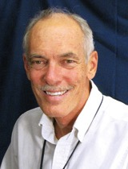

Introductions
Mike
Lesiecki, host
Robert Ehrmann
NACK Network
Trevor Thornton Professor
Notes:
I’m Mike Lesiecki, with Luka Partners. I’ll be the moderator for the webinar today and I also serve on EvaluATE’s community college liaison panel. Lori Wingate will is the main presenter for the webinar. She is director of EvaluATE, which is located at The Evaluation Center at Western Michigan University.

Slide 5
Introductions
Presenter
Amir Sheikhi
Assistant Professor
Chemical Engineering

Slide 6


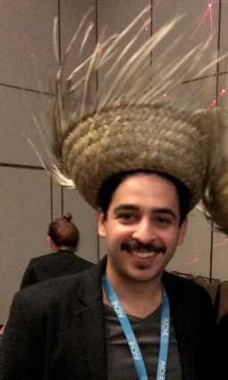

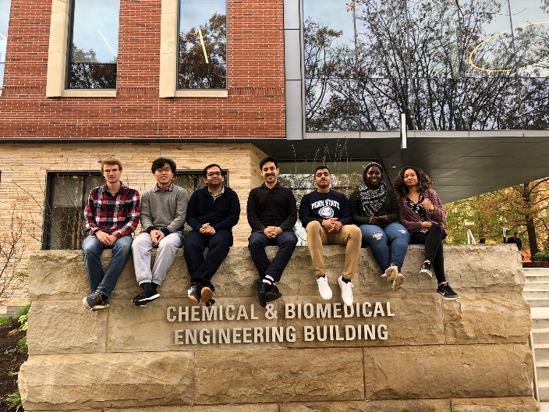


Amir Sheikhi
Me!
EDUCATION
Research Keywords
BS: University of Tehran, Chemical Engineering
MS: University of Tehran, Chemical Engineering
PhD: McGill University, Chemical Engineering
PDF: McGill University, Chemistry
PDF: Harvard-MIT Health Sciences and Technologies, Engineering in Medicine
PDF: UCLA, Bioengineering
Experimental Soft Materials
Biomaterials
Living Materials
Environment
Tissue Engineering and Regeneration
Bioseparation
FUN FACT(S) about ME
-I was born in Tehran, the capital city of Iran.
-When I was a kid, I really wanted to become an astronaut! I was kind of addicted to collecting space-related magazines that my parents got worried about me!
-DID YOU KNOW: During the launch phase, an astronaut has to endure a force of up to four times their own body weight. Ill-fitting dental fillings could become loose or fall out → So, I took a good care of my teeth and never had any problem with them…but never became an astronaut!!
Many years later, I became a Chemical Engineering faculty!!
-Hobbies (Swimming), favorite food (Barberry rice w/ saffron chicken)

Slide 7
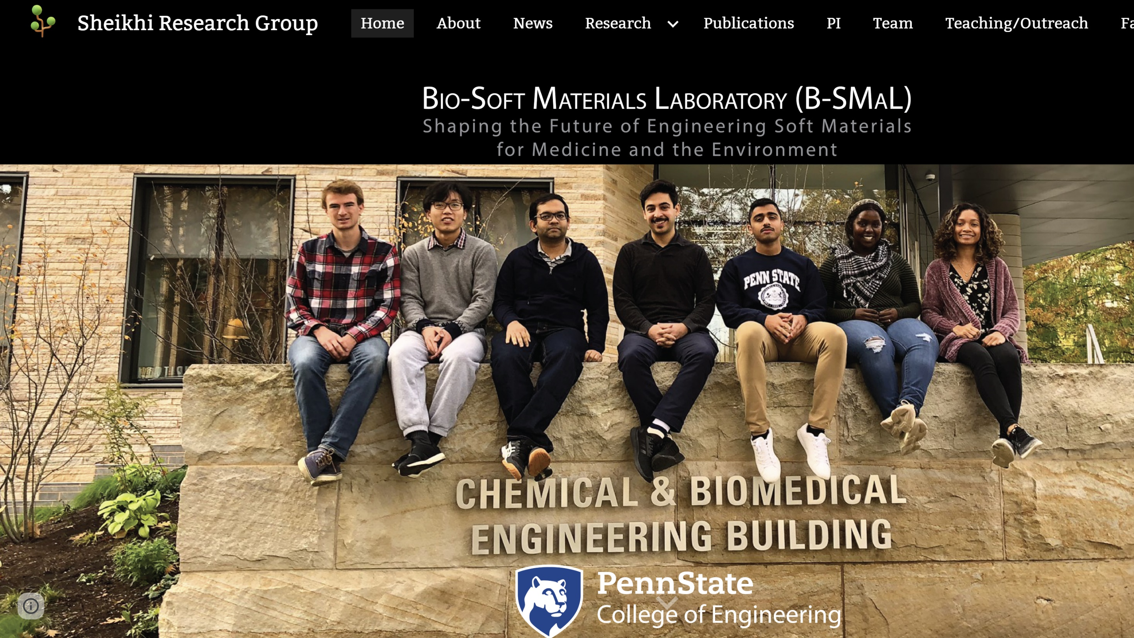

Slide 8
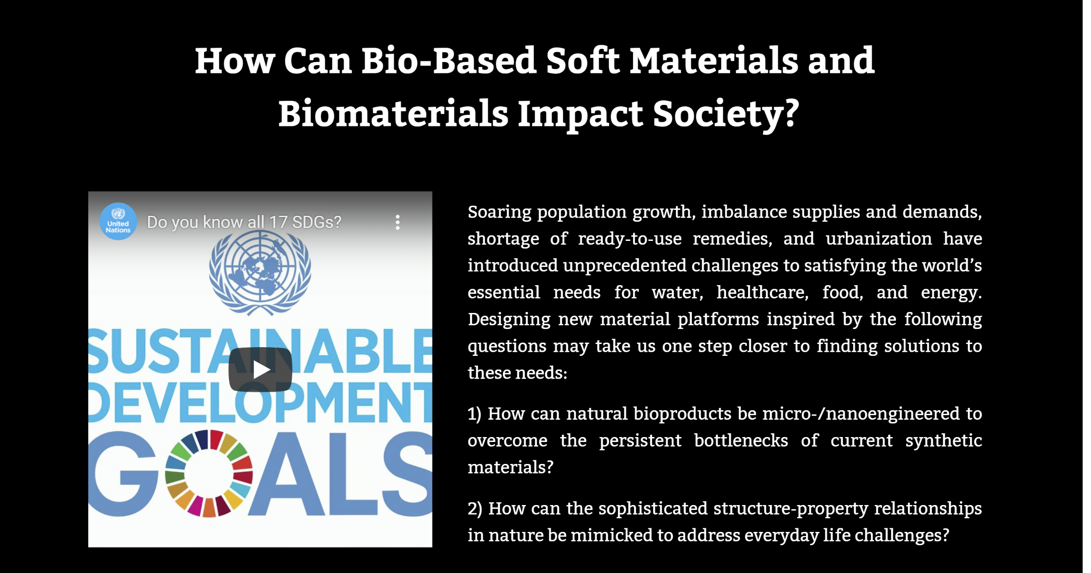

Slide 9
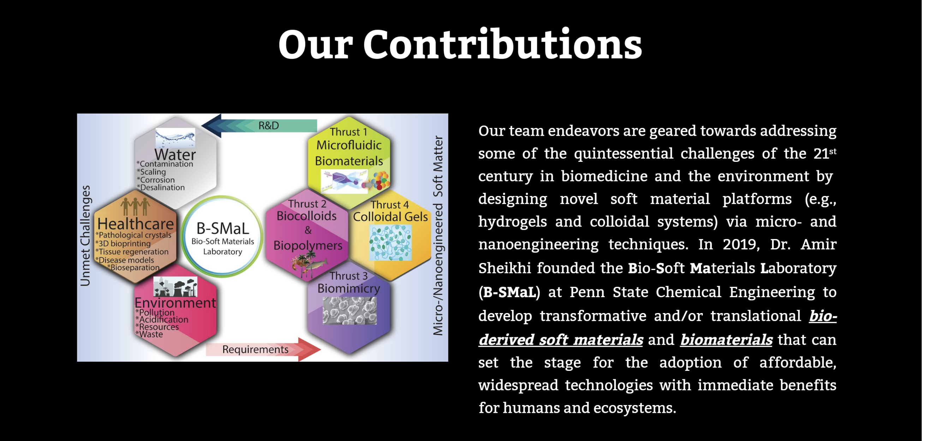

Slide 10
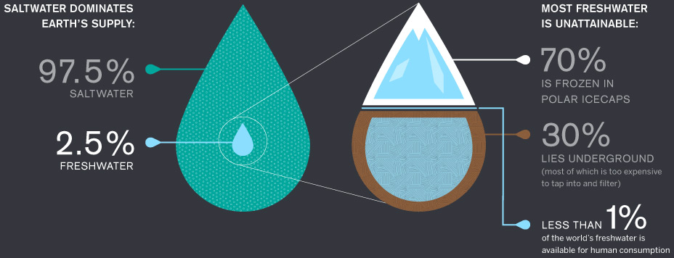

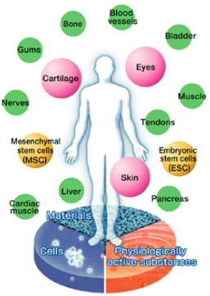
Every 20 seconds, a child dies…
from not having access to clean water
More than 38% of men and women
will be diagnosed with cancer at some point during their lifetimes (American Cancer Society, 2013-2015)
0
14%
1-3
>6
side effects
4-5

Slide 11




The most abundant…
…biopolymer
in the world
Cellulose
Hairy Nanocelluloses
Layered Minerals
…mineral
in the soil
Micro-/Nanoengineered
Soft Materials
Silicon (Si)
…protein
in the body
Beaded Gelatin Hydrogels
Collagen
Notes:
What if we could use natural materials to overcome the biggest challenges in environment and medicine?
These materials are the most abundant
They are, biodegrdable, and they are always renewed by nature (there for us),
Outline in the left

Slide 12
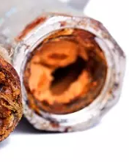
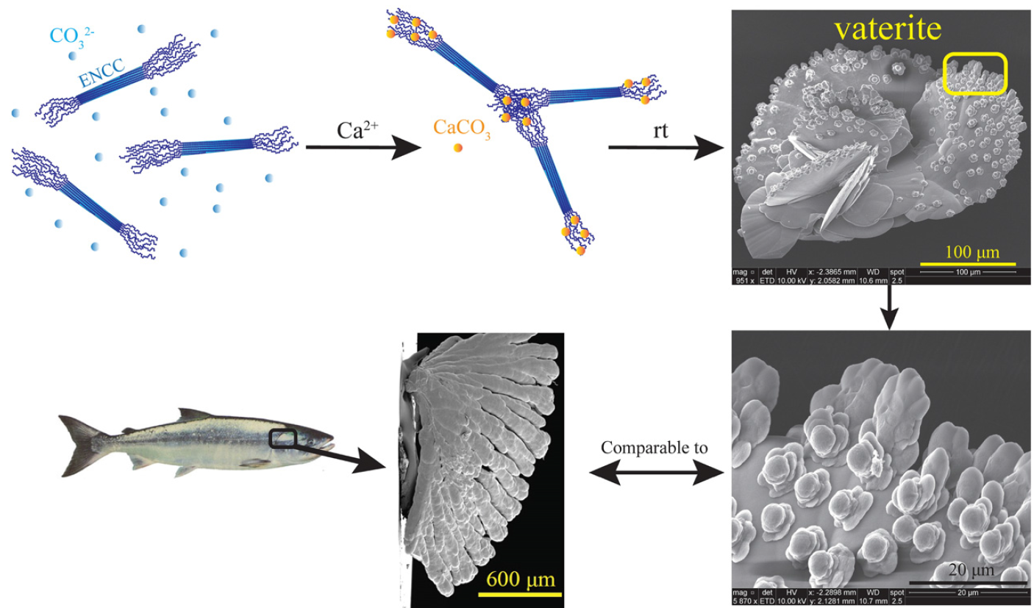

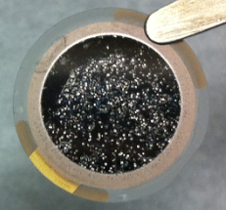
Outline
Hairy nanocelluloses
Part II: Biomimetic mineralization
Part I:
Scale inhibition
Part IV:
Water remediation
Part III:
Scale-resistant interfaces
Part V: Other applications
Nanocomposites
Bactericides
Humidity switches
Rheology modifiers
Notes:
Remove the materials (images of NCC etc)
Highlight the keywords

Slide 13
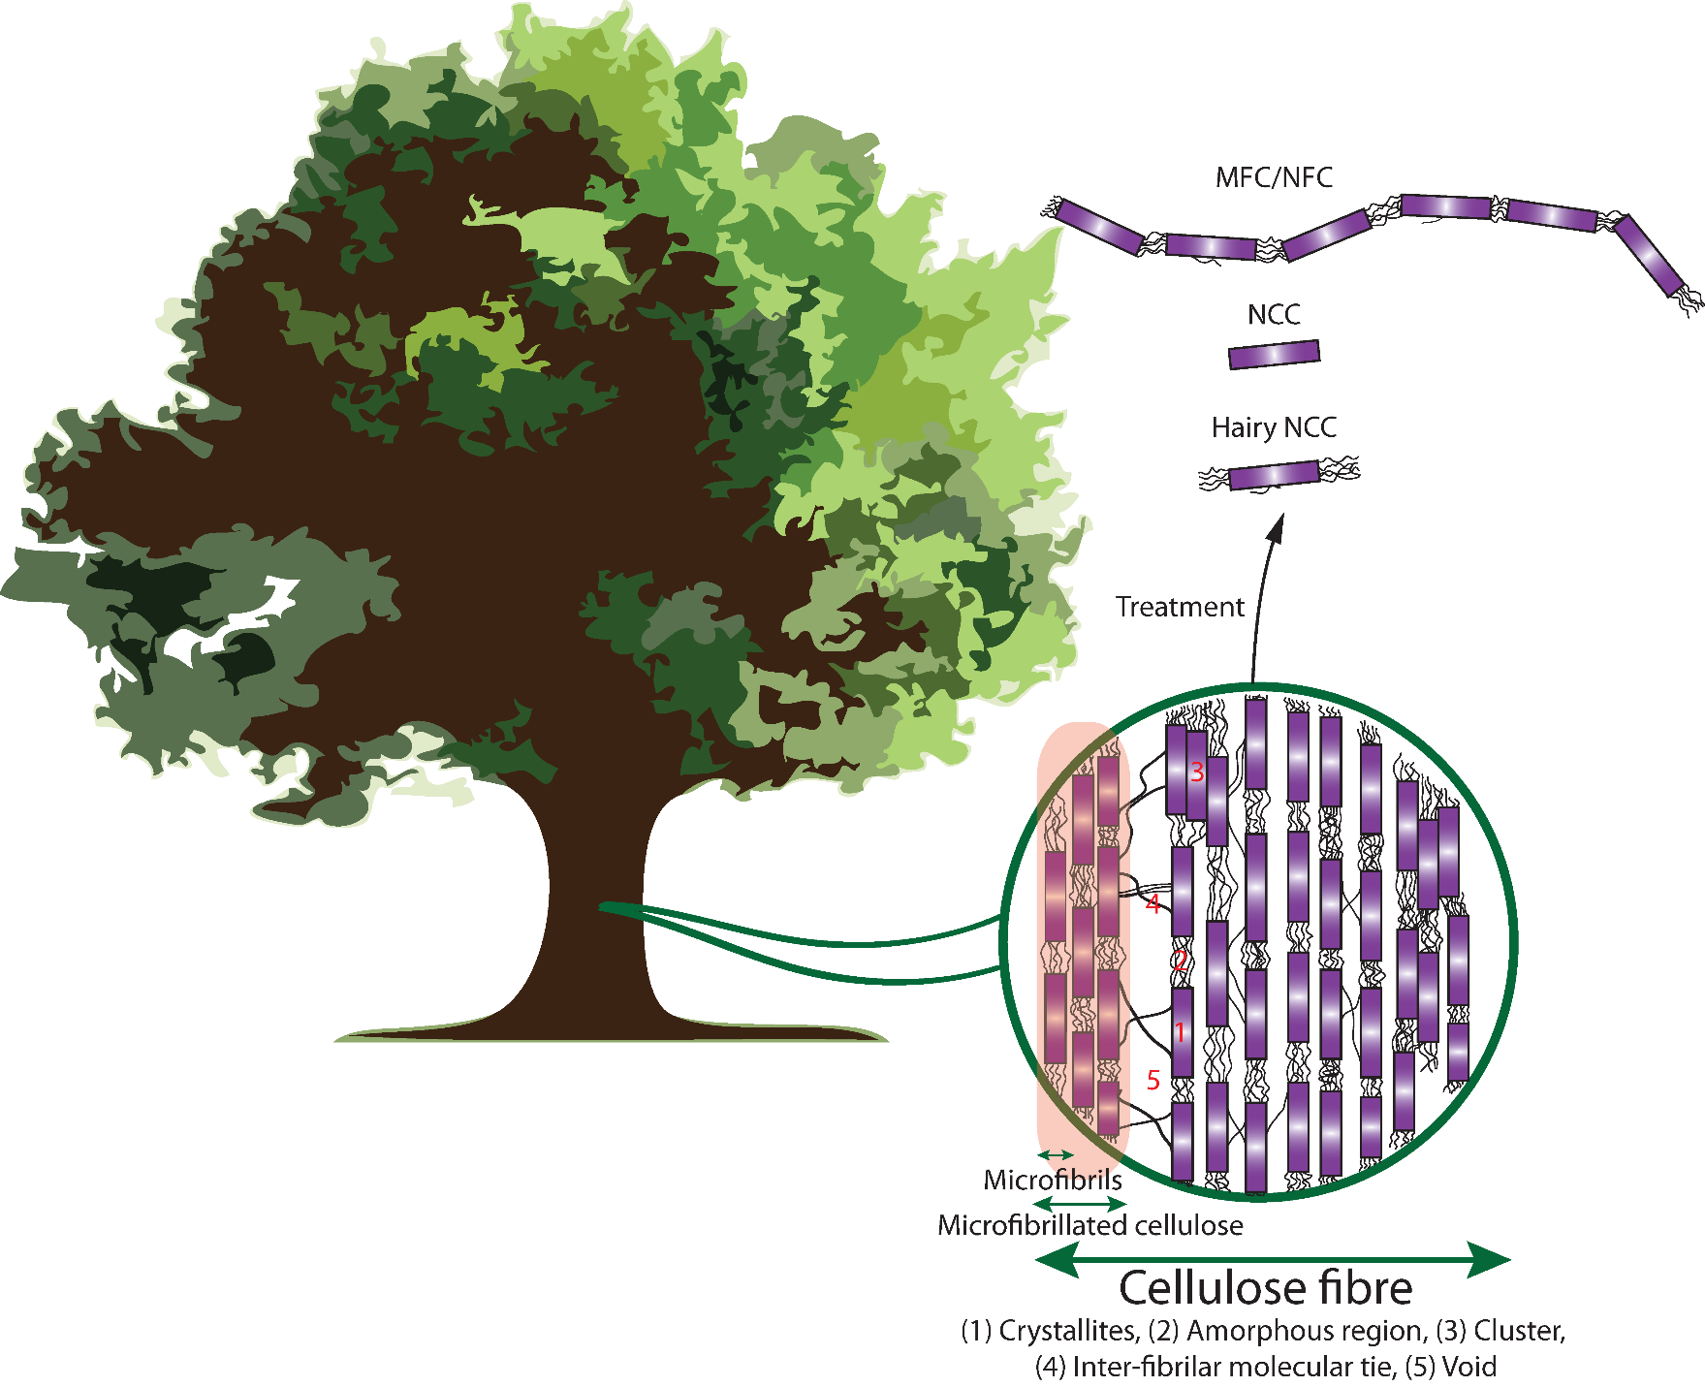
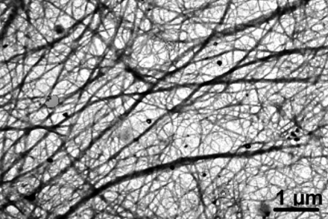
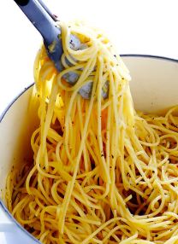
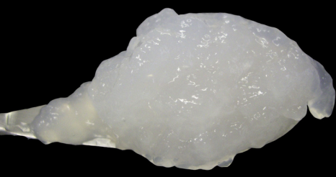

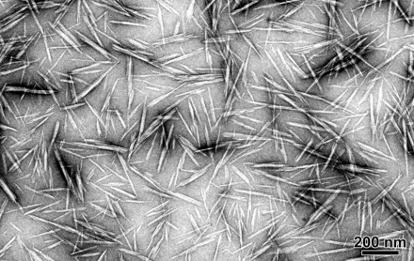
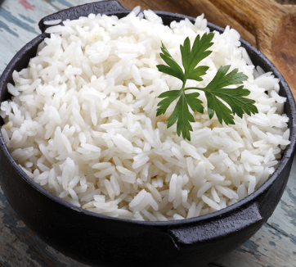
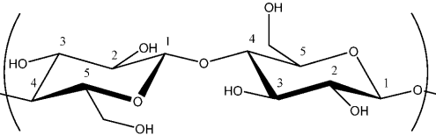
Conventional nanocelluloses
MFC/NFC
Late 1970s ITT Rayonier labs
Whippany, NJ
1 µm
CNC
200 nm
Biorenewable
Biodegradable
Cost effective
Environmentally friendly
Large surface area (>100 m²/g)
Kontturi et al., Advanced Materials (2018)
Dufresene, Materials Today (2017)
Habibi et al., Journal of Materials Chemistry (2008)
Malainine et al., Carbohydrate Polymers (2003)

Slide 14
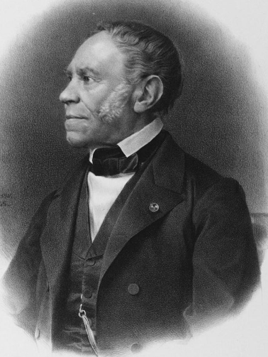

Introduction to conventional nanocelluloses
Conventional nanocelluloses
Applications
Anselme Payen
1795-1871
Bengt Rånby
1920-2000
Nanocomposites (1100 articles)
Films (500)
Hydrogels (240)
Rheology (190)
Coating (160)
Aerogels (145)
Fillers (145)
Optical (140)
Self-assembly (120)

Slide 15
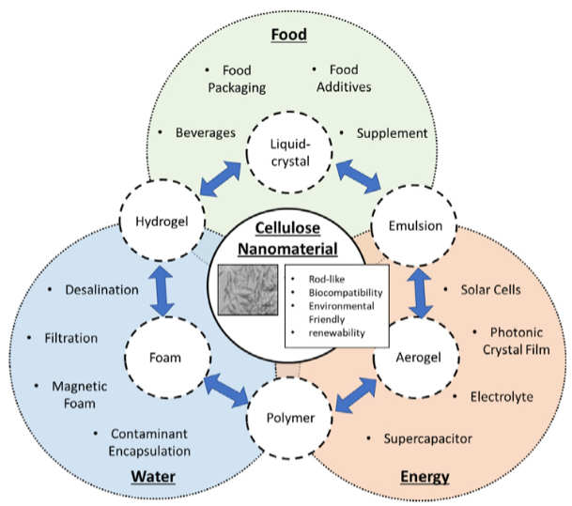
Introduction to conventional nanocelluloses
Conventional nanocelluloses
Applications
Tan et al., Science of The Total Environment (2019)

Slide 16
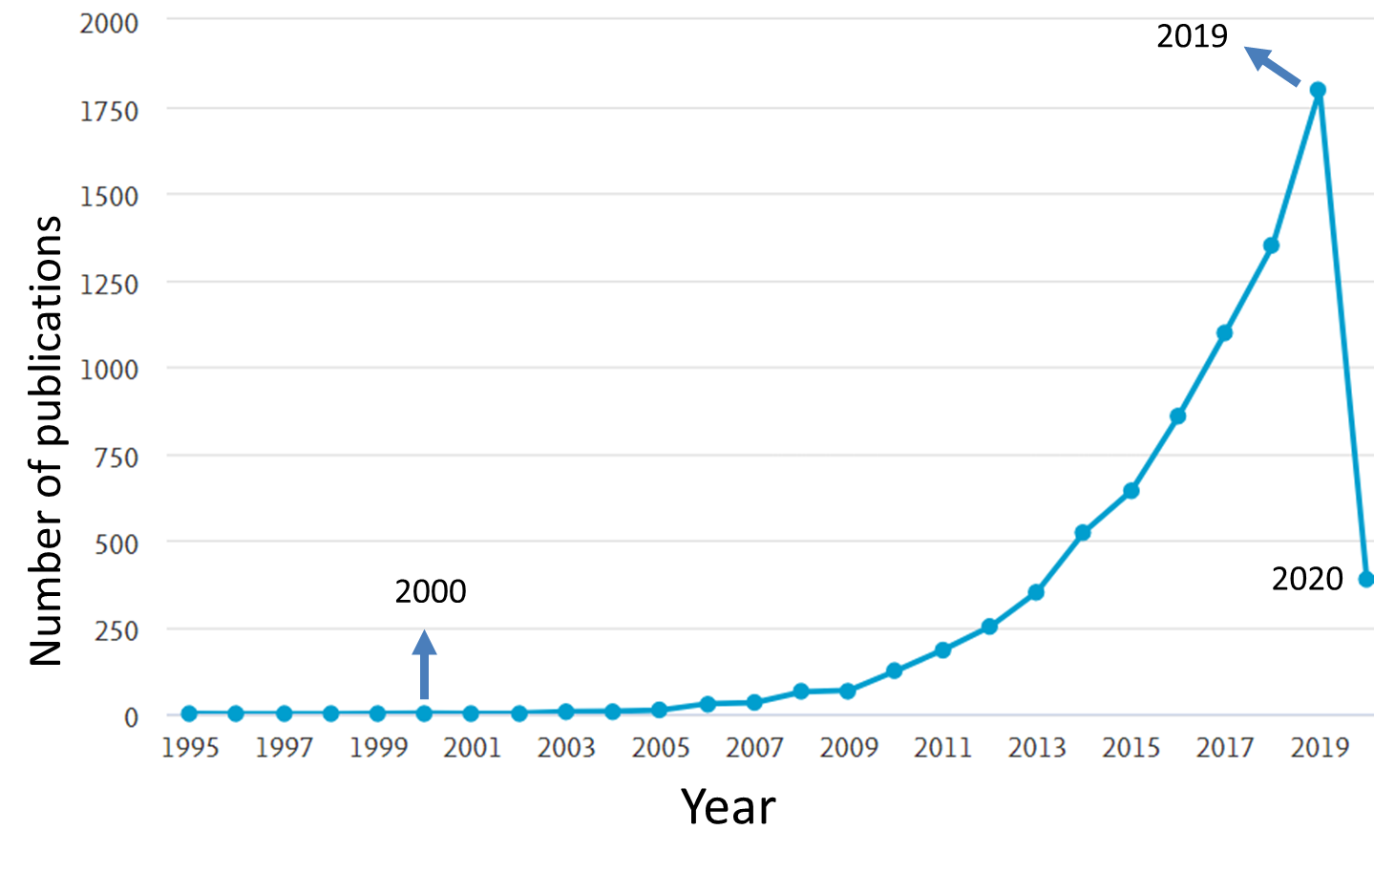
Introduction to conventional nanocelluloses
Conventional nanocelluloses

Slide 17
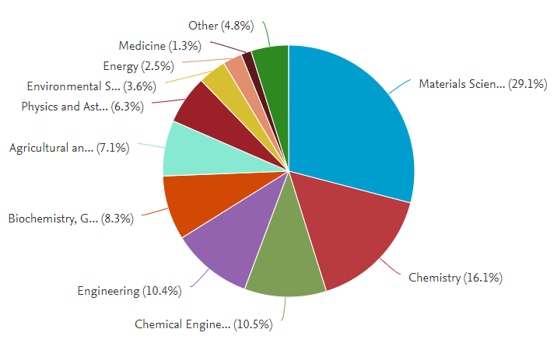
Introduction to conventional nanocelluloses
Conventional nanocelluloses
Applications

Slide 18
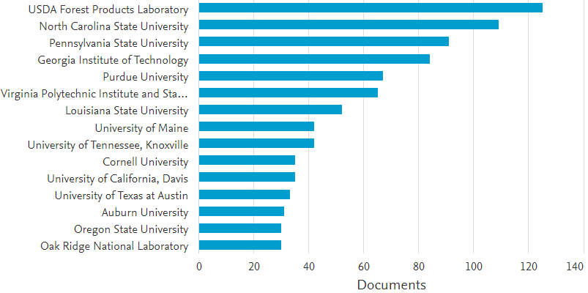
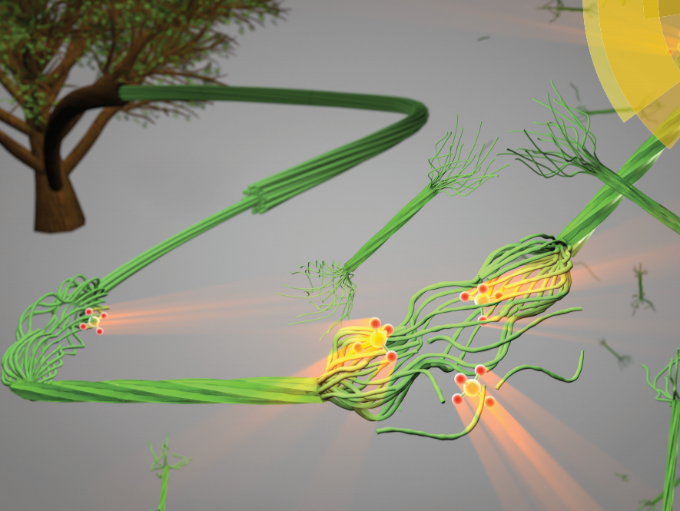
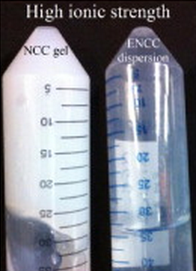
Introduction to Hairy Nanocelluloses
Conventional nanocelluloses
Hairy nanocelluloses
Unique properties
Cellulose Nanotechnology
Research Consortium
Colloidal structure
Functional groups
Charge density
Colloidal stability
Facile production
Biodegradation/ hemocompatibility

Slide 19
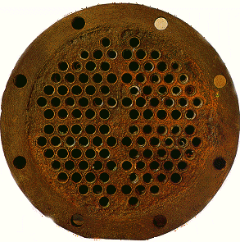
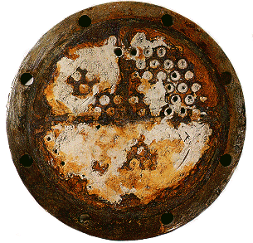
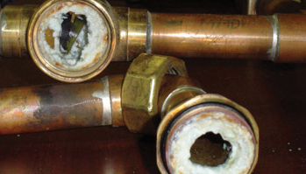
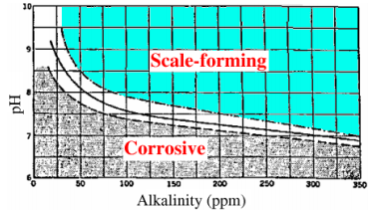
Part I: Scale inhibition
Sparingly soluble salts
  Anions: CO₃²⁻, SO₄²⁻, …
  Cations: Ca²⁺, Mg²⁺, Ba²⁺, …
Examples of affected operating units
  Cooling towers, digesters, evaporators, and heaters
Problems: Fluid mechanics, heat and mass transfer
Inhibition methods
  Acid treatment, ion exchange, macromolecular additives

Slide 20
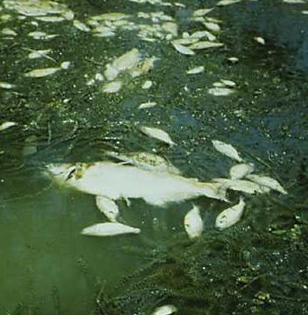
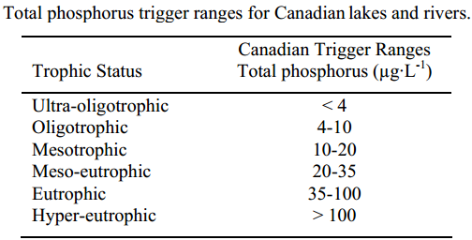
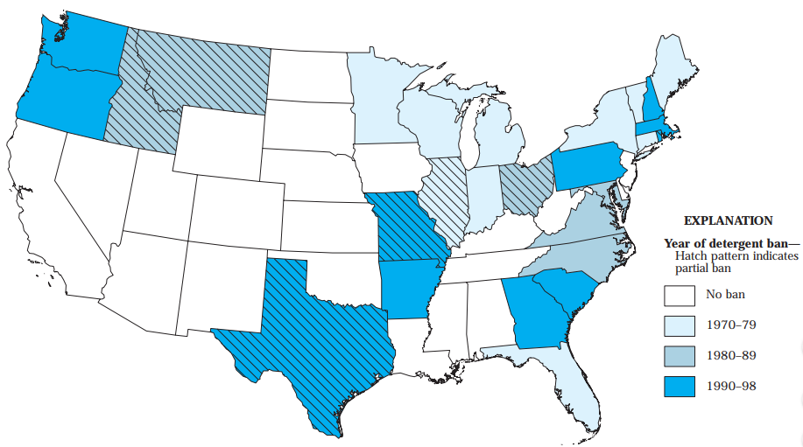
Drawbacks of current macromolecular antiscalants
Most of the antiscalants are not biodegradable
Their backbone is toxic
They comprise phosphorus and nitrogen
Their functional groups result in eutrophication
= 0.1 ppm
Canadian Water Quality Guidelines for the Protection of Aquatic Life, Canadian Council of Ministers of the Environment, 2004.

Slide 21
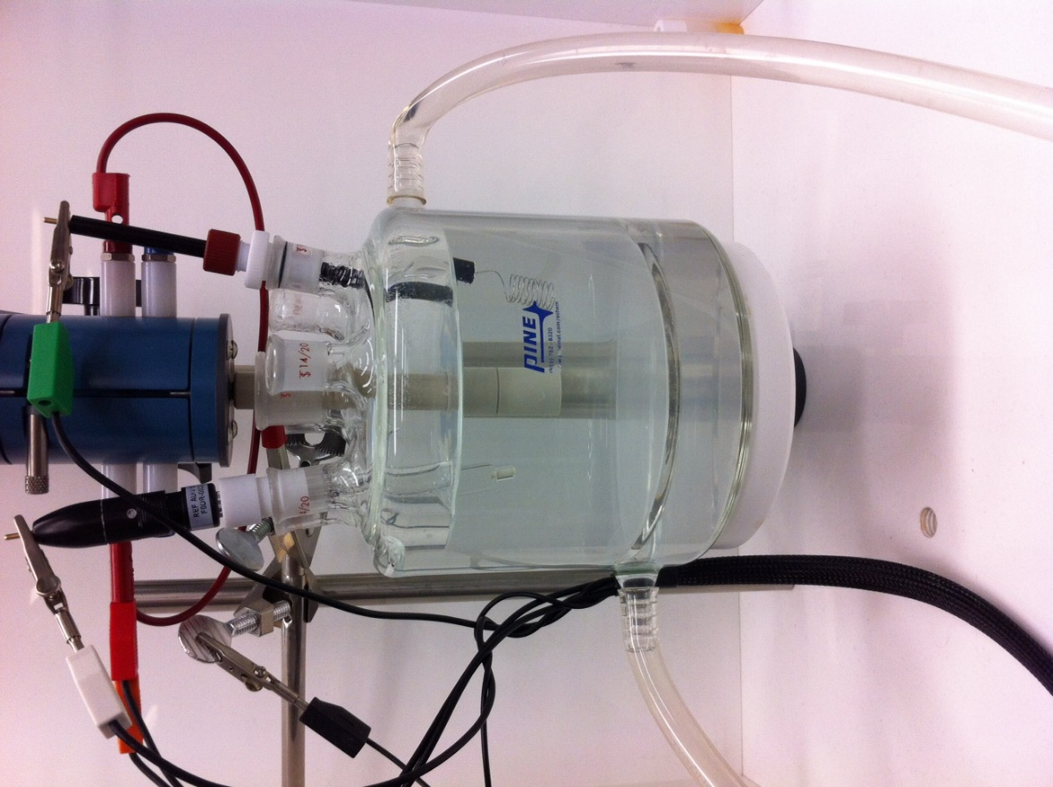
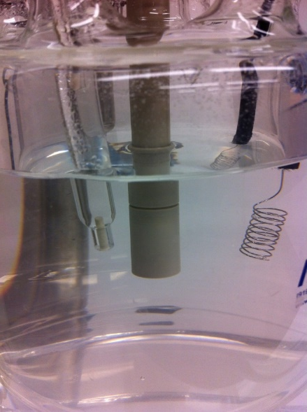

Simulated industrial scale formation
Highly phosphonated
Flexible
Clean
electrode
Ideal scale inhibition!
Industrial antiscalant
concentration = 10 ppm
No additive
Scaled
electrode
Ca²⁺, Cl⁻
Na⁺, HCO₃⁻
Chronoamperometry
Sheikhi et al., Environmental Science: Water Research & Technology (2015)

Slide 22

Nanocelluloses as antiscalants
CNC (66.6 ppm)
TEMPO-CNC (66.6 ppm)
NFC (66.6 ppm)
COOH = 4.6 mmol g⁻¹
CMC (16.6 ppm)
CMC (166 ppm)
Not enough charge content
Not enough flexibility
Sheikhi et al., Materials Horizons (2018)
https://www.tomorrowsuccess.com/dare-dont-fear.html, Accessed on Jan 11, 2019

Slide 23
Hairy nanocelluloses
van de Ven and Sheikhi, Nanoscale (2017)

Slide 24
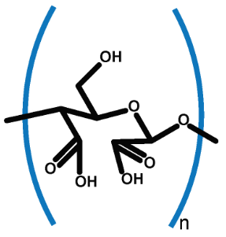
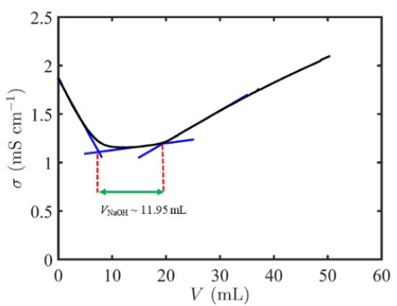
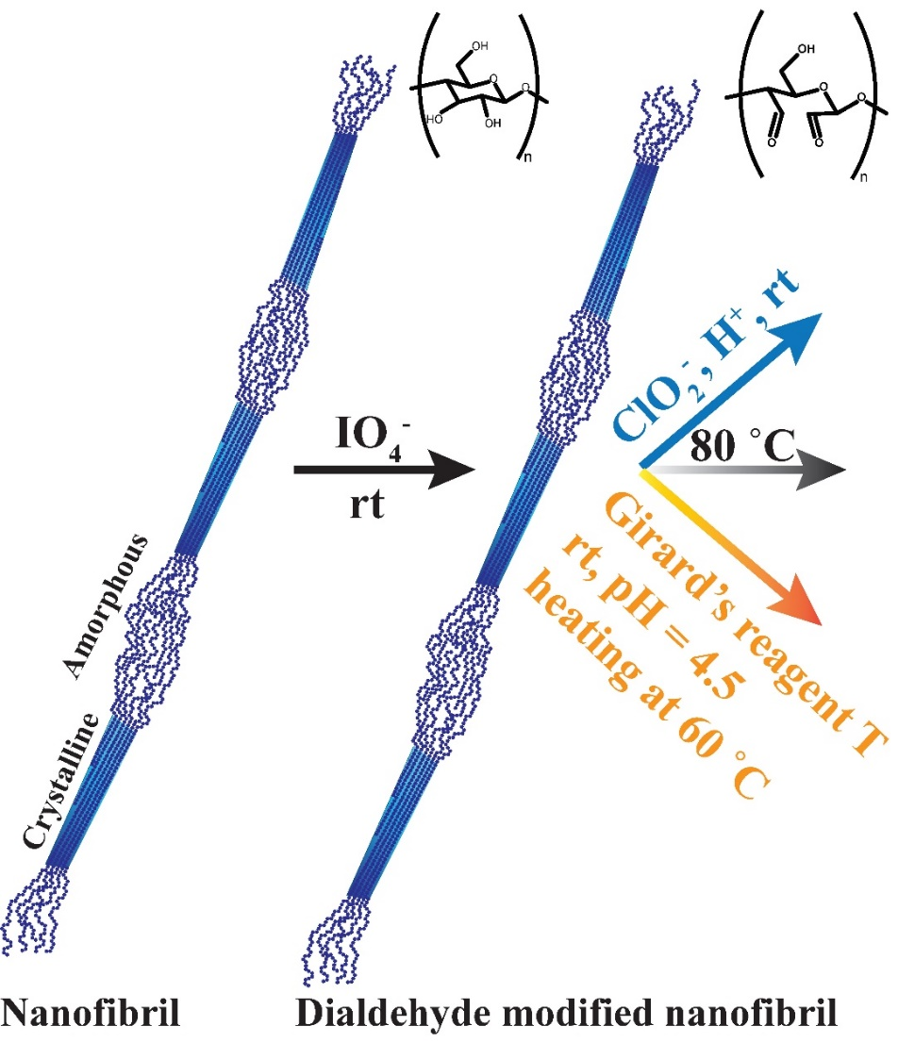
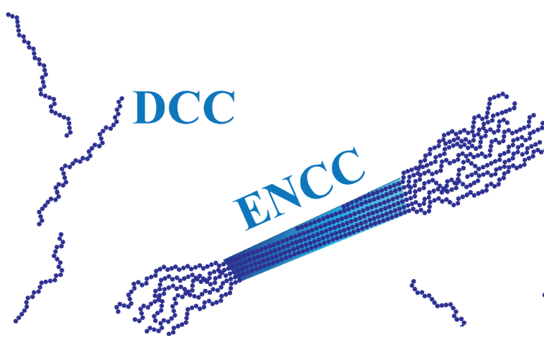
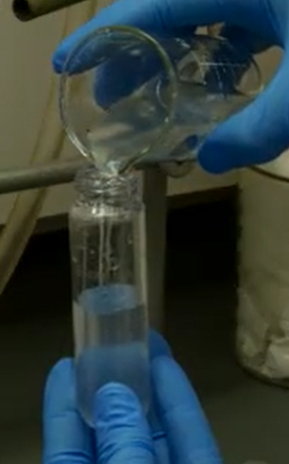
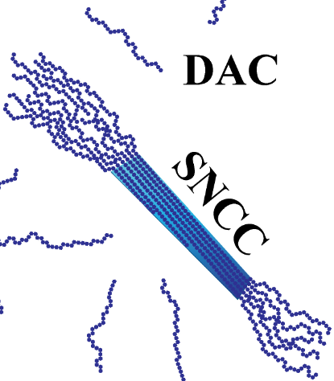
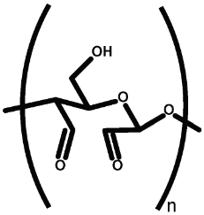
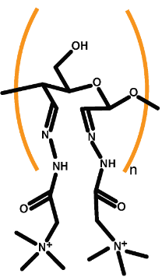
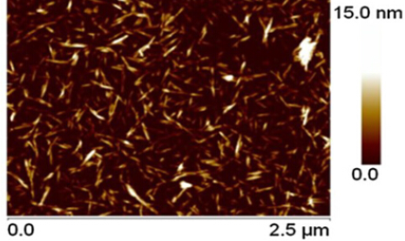
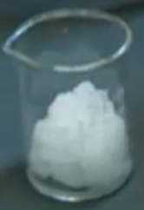
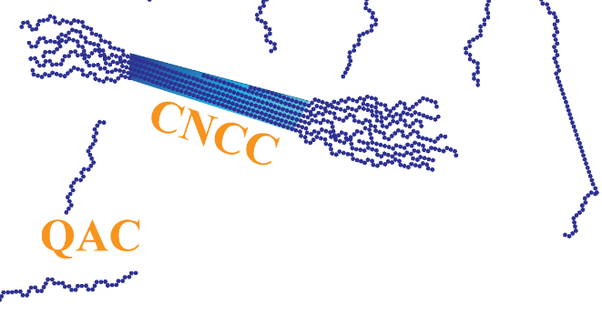
Hairy nanocelluloses
COOH concentration = 0.01195 (V_{NaOH}) × 10 mM (NaOH concentration) / 0.02 g (initial ENCC) ~ 5.98 mmol/g
Sheikhi and van de Ven, Current Opinion in Colloid & Interface Science (2017)
Sheikhi et al., Journal of Visualized Experiments: JoVE (2016)
Yang et al., Langmuir (2012)

Slide 25
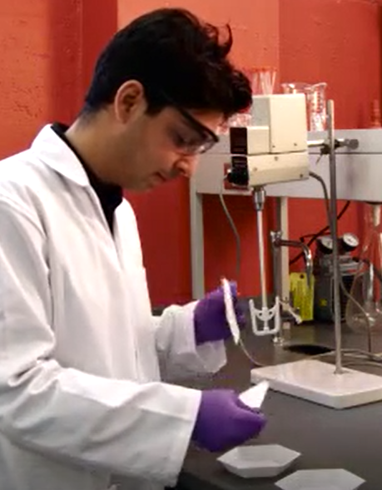
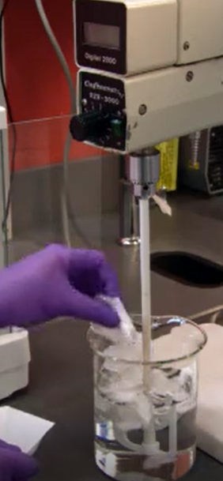
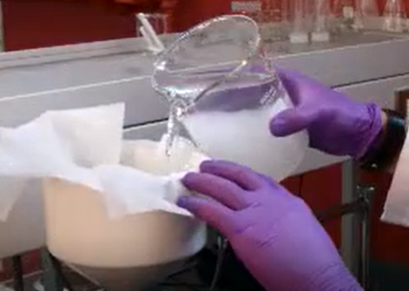
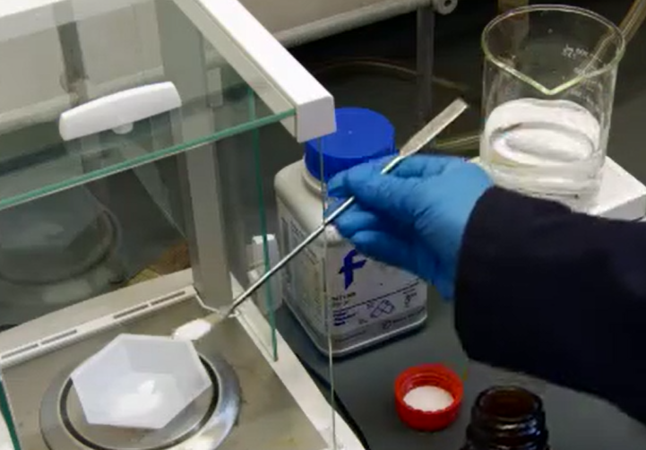
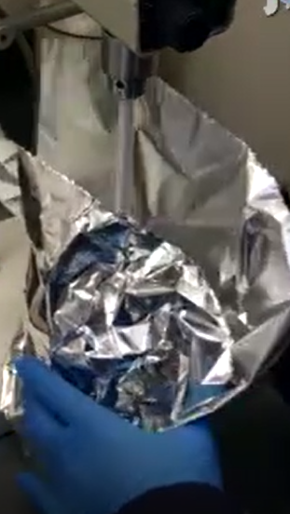




Hairy nanocellulose synthesis
Preparing partially oxidized fibers
1
2
3
4
5
6
7
8
9
10
11
Preparing electrosterically stabilized nanocrystalline celluloses (ENCC)

Slide 26





NCC versus ENCC
NCC
ENCC
ζ (mV)
Hydrodynamic d (µm)
Sheikhi et al., Journal of Colloid and Interface Science (2014)
[KCl] (mM)
[KCl] (mM)
Notes:
Write in color for CNC and HCNC

Slide 27
ENCC assembly
Yang et al., Biomacromolecules (2016)
Notes:
Write in color for CNC and HCNC

Slide 28


ENCC assembly
Tavakolian et al., Journal of Colloid and Interface Science (2019)
Notes:
Write in color for CNC and HCNC

Slide 29
Hairy nanocelluloses as antiscalants
High functional group density
Structural flexibility
Sheikhi et al., Materials Horizons (2018)

Slide 30
Hairy nanocelluloses as antiscalants
Additive | C (ppm) | COO⁻/Ca²⁺ (mol/mol)
ENCC | 12.5 | 0.037
DCC | 8.3 | 0.026
ENCC (8.3 ppm)
ENCC (16.6 ppm)
Sheikhi et al., Materials Horizons (2018)
Notes:
Legend for half scale

Slide 31

Hairy nanocelluloses as an antiscalant
Sheikhi et al., Materials Horizons (2018)

Slide 32








Slide 33





Part II: Biomimetic mineralization
http://www.123rf.com
Accessed on 12/08/2015
http://www.snail-world.com
Accessed on 12/08/2015
http://www.toonpool.com
Accessed on 12/08/2015
http://biologyencore.tumblr.com/
Accessed on 12/08/2015

Slide 34

Biomimetic mineralization of CaCO₃ using ENCC
Anionic hairy nanocelluloses (ENCC)
Sheikhi et al., Crystal Growth & Design (2016)

Slide 35


Biomimetic mineralization of CaCO₃ using ENCC
50 μm
30 μm
2 μm
2 μm

Slide 36

Biomimetic mineralization of CaCO₃ using ENCC
10 μm
50 μm
Sheikhi et al., Crystal Growth & Design (2016)

Slide 37





Part III: Scale-resistant interfaces
Uncoated
ENCC coated
Sheikhi et al., Journal of Materials Chemistry A (2018)
Sheikhi et al., ACS Applied Materials & Interfaces (2018)

Slide 38







Part IV: Water remediation
Lead
Copper
Mercury
O (100 nm)
Arsenic
Cadmium
Additive | q_{e} (mg/g)
ENCC | 185
CM-BNCC | 9.7
O (1 µm)
Activated C | 4.4
Sheikhi et al., ACS Applied Materials & Interfaces (2015)

Slide 39



Dye removal using hairy nanocellulose-based foams
Yang et al., Langmuir (2016)

Slide 40

Part V: Reinforcing papers
Sheikhi et al., ACS Applied Nano Materials (2018)

Slide 41

Part V: Antibacterial nanocrystalline cellulose
Tavakolian et al., ACS Applied Materials & Interfaces (2018)

Slide 42


Part V: Nanocellulose-based humidity switch
Safari et al., ACS Applied Materials & Interfaces (2016)

Slide 43


Part V: Colloidal nano-toolbox for molecularly regulated polymerization
Sheikhi et al., Materials Horizons (2017)

Slide 44


Concluding remarks
Hairy nanocelluloses (HNCs)
Nanoengineering cellulose fibers via facile chemistry yields HNCs.
HNCs overcome the structural limitations of conventional nanocelluloses.
HNCs can provide reliable, green scale inhibitors.
Cellulose-based scale-resistant membranes are now feasible.
HNCs are promising candidates for water remediation, reinforced nanocomposites, bactericides, humidity switches, and
rheology modifiers.

Slide 45











Acknowledgments
Prof. Theo van de Ven
Prof. Ali Khademhosseini
Prof. Dino Di Carlo
Prof. Ashok Kakkar
Prof. Pierre Carreau
Prof. Samanvaya Srivastava
Dr. Rahmi Oklu
Dr. Han Yang
Dr. Salman Safari
Dr. Na Li
Dr. Søren Leth Mejlsøe
Dr. Md. Nur Alam
Dr. Reihaneh Haghniaz
Ms. Nicole Kuntjoro
Mr. Joseph de Rutte
Mr. Enzo Bomal
Mr. Outman Akouissi
Mr. Alireza Sohrabi
2

Slide 46








Funding sources
Notes:
Group and PI with the flight at the corner

Slide 47


Slide 48

Join Us
Webinar on May 14, 2020
1 PM Eastern
Luminescent Nanoparticles of Metal Oxides
Yuanbing Mao, PhD
Professor and Chair
Department of Chemistry
Illinois Tech

