Slide 1
Re-Visiting Sustainability goals: in a post-grant world
Rachael Bower, ATE Central
Nancy Maron, BlueSky to BluePrint
Dr. Ann Beheler, National Convergence Technology Center
March 6, 2018

Slide 2
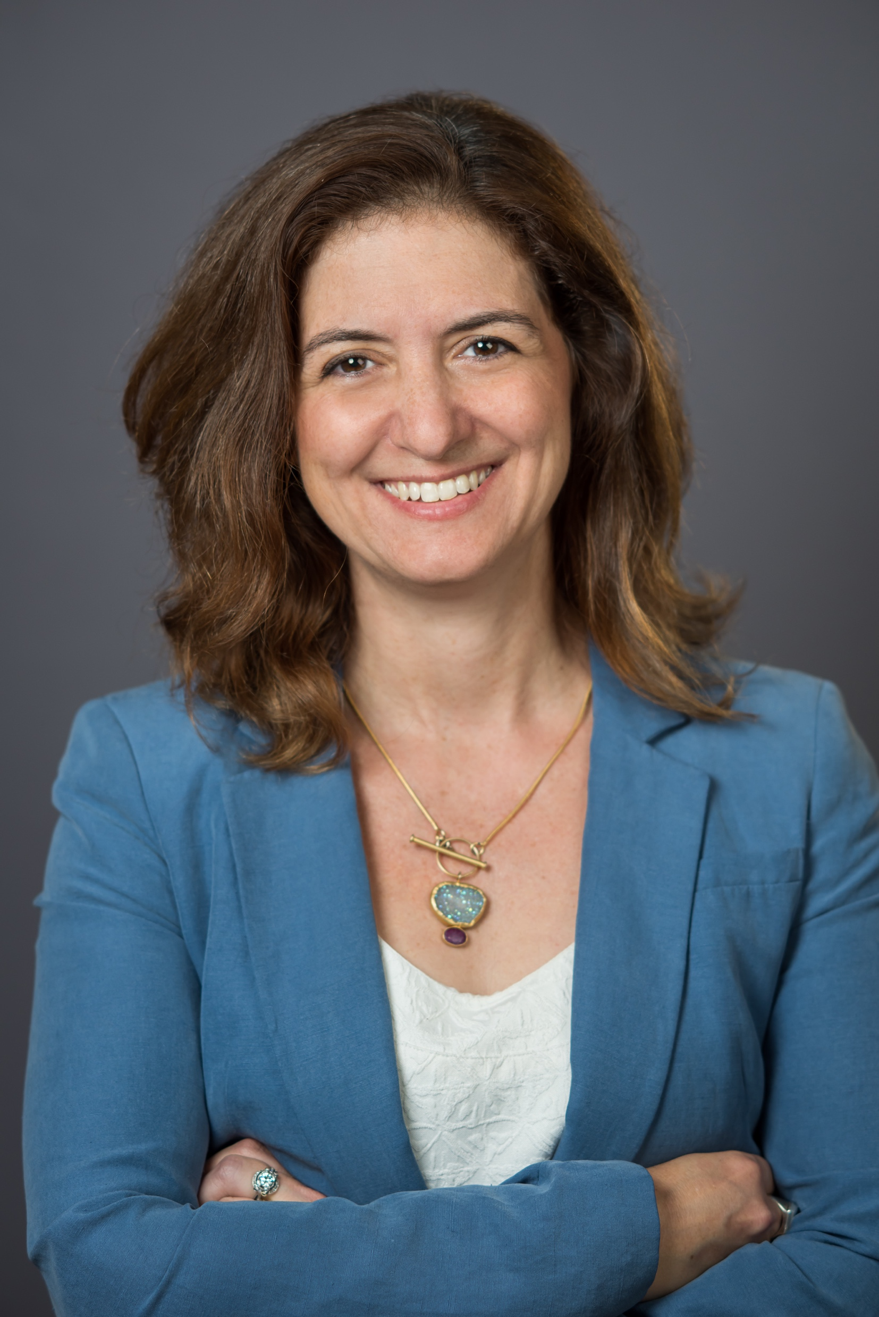
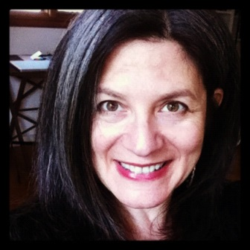
Today’s Presenters
Nancy L. Maron
Founder, BlueSky to BluePrint, LLC
Rachael Bower
University of Wisconsin-Madison
PI, ATE Central

Slide 3
TODAY’S GUEST SPEAKER
Dr. Ann Beheler

Slide 4
Poll Question #1
I would describe myself as:
Affiliated with an ATE grant
Affiliated with a different NSF granting program
Not currently funded, but writing an ATE grant
Other

Slide 5
ATE: Advanced Technological Education
NSF Funding – focus on technician education; professional development; community colleges
Approximately 306 projects & centers currently funded
Not just a funding program; a real community
Variety of cross-cutting support for community members

Slide 6
Primary Purpose: Amplify the Impact of ATE
Information Hub and Portal
Resource Collection
Services and Tools
Outreach and Dissemination

Slide 7
Sustainability Support
ATE Central: community driven
ATE Community Needs Survey (annual)
Significant need: sustainability support
Workshops + webinars

Slide 8
ITHAKA is a not-for-profit organization that helps the academic
community use digital technologies to preserve the scholarly record
and to advance research and teaching in sustainable ways.
JSTOR is a not-for-profit digital library of academic journals, books, and primary sources.
Ithaka S+R is a not-for-profit research and consulting service that helps academic, cultural, and publishing communities thrive in the digital environment.
Portico is a not-for-profit preservation service for digital publications, including electronic journals, books, and historical collections.

Slide 9
http://blueskytoblueprint.com/
Strategy, consulting, research and training
Applying strategy to innovative initiatives in academic and cultural organizations
Case studies, reports and tools freely available at blueskytoblueprint.com

Slide 10
Sustainability Health Check: Sustainability Strategies for Leaders
of ATE projects and Centers
WEBINAR SERIES
FEBRUARY – APRIL 2018
This season, our webinar series on Sustainability focuses on topics useful to Centers and Projects at all stages of growth. It is never too soon to be thinking about life “post-grant,” whether you are planning for independence or preparing for a time when grants may not be forthcoming.

Slide 11
Sustainability health check Sustainability Strategies for ATE Projects and Centers
FEBRUARY 6: Taking Stock and Planning for Success
GUEST SPEAKER: Lori Wingate
MARCH 6: Re-visiting your sustainability goals in a post-grant world
GUEST SPEAKER: Ann Beheler
APRIL 10: Succession Planning: How to build a plan so that your work continues without you
GUEST SPEAKER: Kathy Alfano
TODAY!

Slide 12
TODAY’S GUEST SPEAKER
Dr. Ann Beheler
PI, National Convergence Technology Center
Executive Director of Emerging Technology Grants, Collin College

Slide 13
Current Work
Principal Investigator, National Convergence Technology Center (IT and Communications)
Located at Collin College, Frisco, TX with 8 partners nationally
Foundation is the Business & Industry Leadership Team (BILT) Model, refined and scaled since 2004 for CTC on a regional/national basis
Work with a consortium of 64+ college and university partners, the Convergence College Network (CCN)
Provide significant professional development for faculty nationwide
Lead for the Centers Collaborative for Technical Assistance NSF grant to assist other colleges with best practices in a variety of areas
Also assist numerous colleges nationally with their programs and proposals

Slide 14
Background
Education
Mathematics
Computer science
Leadership
Work Experience Highlights
Have led several NSF ATE grants since 2001
Led a 7-college, 6-state DOL TAACCCT Round 1 grant ~$20 M focusing on several aspects of IT
Faculty for many years, Dean in 2 states and VPAA in one
Corporate positions at Rockwell International, Raytheon, and Novell
Entrepreneurial consulting business

Slide 15
GOALS OF TODAY’S WEBINAR
Introduce broad definition of “sustainability”
Consider how this can be applied to your work, or to different elements of your work
Share the “prioritization” method, as a way to determine where to strategically invest
Offer the perspective of an experienced practitioner on best practices

Slide 16
Poll Question #2
If you had to choose which elements of your current project or center to keep supporting, would you
Keep the ones having the most impact
Keep the ones bringing in continuing funding
I am struggling to choose; they are all important!
Other

Slide 17
Sustainability is…

Slide 18
Sustainability is
the ability to generate or gain access to the resources—financial or otherwise—needed to protect and increase the value of the content or service for those who use it.
A sustainability plan is an evidence-based strategy for identifying and securing these ongoing sources of support for your project or center, over time.
Notes:
This is a sound logic for thinking of your entire enterprise –
You have activities, people, skills and outputs you have created; and you need to think about all the sources of support they will require, and how you can keep them coming, over time.
But, at the same time, we know that it may not always be possible – or even desirable – to keep the exact same footprint over a decade… things change!
SO, how can we also look at “sustainability” with a more nuanced approach?

Slide 19
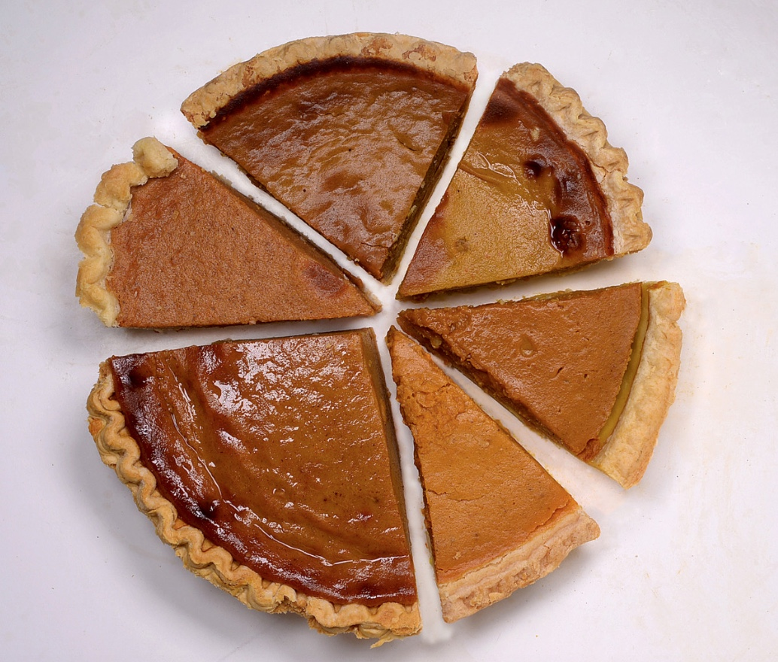
Do we need to sustain the WHOLE pie.. Or just some pieces?
Notes:
When we think about “sustaining” something… do we mean we need to keep everything going exactly as it was, the day it was funded?
Certainly not.
There may be elements that have been resounding successes, and others.. Less so.
There’s nothing wrong with that – but it’s important to take a good look at it all, to find which pieces need -- require, deserve – your ongoing (or even increased) attention and investment, and which may have had a good run, but could be handled in a different way.
QUESTION FOR ANN _

Slide 20
Step #1… Take Inventory
Notes:
The first step is literally to ask yourself _ what have we got! You probably know the answer, but it is worth taking a moment to think about it…

Slide 21
So, what are some of the things of value your project or center has created?
Notes:
Some of the things you may have created over time include.. Curriculm… textbooks … planning around events… what else?
(TAKE FEEDBACK FROM AUDIENCE)

Slide 22
Step #1… Take Inventory
Notes:
How about these other things?
Don’t forget to add to the list…

Slide 23
Step #1… Take Inventory

Slide 24
Step #2… Evaluation (or… “How’s it going?”)
Notes:
The next step is to take a honest look at how things are going.
When I looked for images to illustrate this slide, I searched for “Evaluation” and you will never guess… any slide that showed a checklist like this, had the same box checked – Whatever was at the top! That made me smile – and is perfectly normal – just as it would be normal for many PIs to give many of their projects high marks. But this is not the time to tread lightly! This process – when you undertake it – is not for the benefit for funders, is not meant to be publicly shared, but is meant to inform your future decision making. So be brutally honest!

Slide 25
Step #2… Evaluation (or… “How’s it going?”)
Concerning evaluation, when to get started?
Are there specific sorts of questions to ask, or things to evaluate, with an eye to future sustainability?
Notes:
QUESTIONS FOR ANN…

Slide 26
What are important criteria?
Notes:
QUESTIONS FOR ANN _ What are other things you might want to keep an eye open for?

Slide 27
Questions?

Slide 28
PLANNING FOR POSt-grant scenarios

Slide 29
Step #3… Choose your path(s)
The maze of Longleat House By Rurik via Wikimedia Commons from Wikimedia Commons
Notes:
So… with that n mind… you have some choices about how to proceed…

Slide 30
Step #3… Choose your path(s)
Notes:
Each of these types of outputs/activities may lend itself to a differnet sort of path…
Discuss & illustrate ”paths” for sustainability…
- Difference between
hosting/storing something somewhere
handing it off to someone to handle it
finding a way to keep doing it yourself

Slide 31
Step #3… Choose your path(s)
Notes:
Discuss & illustrate ”paths” for sustainability…
- Difference between
hosting/storing something somewhere
handing it off to someone to handle it
finding a way to keep doing it yourself

Slide 32
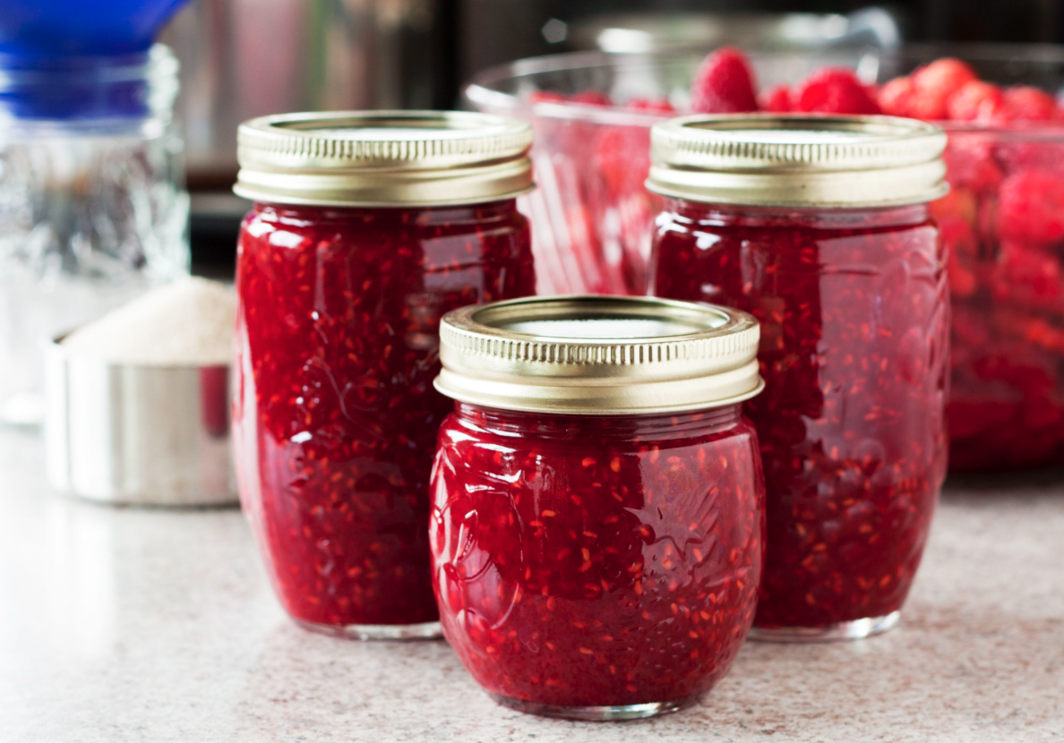
The “preservation” or “archiving” path
Notes:
QUESTIONS FOR ANN _
Preservation…

Slide 33
The “preservation” or “archiving” path
Notes:
QUESTIONS FOR ANN _
Preservation…

Slide 34
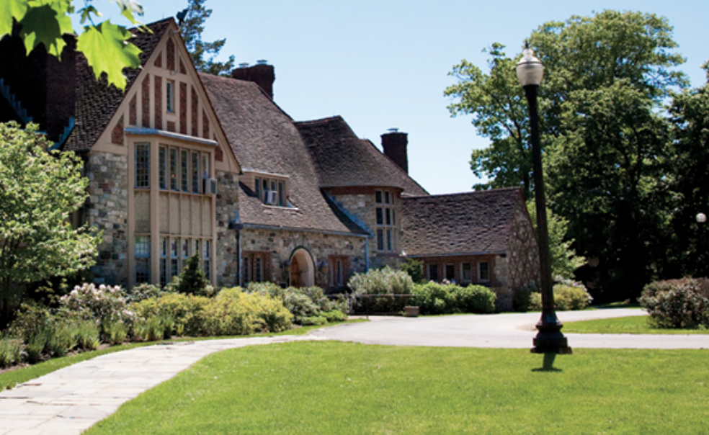
The “institutionalization” path
Notes:
QUESTIONS FOR ANN _
Examples of Institutionalization
WESTCHSETER COMMUNITY COLLEGE

Slide 35
The “institutionalization” path
Notes:
QUESTIONS FOR ANN _
Examples of Institutionalization
WESTCHSETER COMMUNITY COLLEGE

Slide 36
The “keep it growing” path
Notes:
QUESTIONS FOR ANN _
Examples of Institutionalization

Slide 37
The “keep it growing” path
Notes:
QUESTIONS FOR ANN _
Examples of business models for ATE centers…

Slide 38
Questions?

Slide 39
PRIORITIZING
Notes:
Of all the activities you do… which are most critical to take forward?
This activity can help you to assess this and to make choices/

Slide 40
What are important criteria?

Slide 41
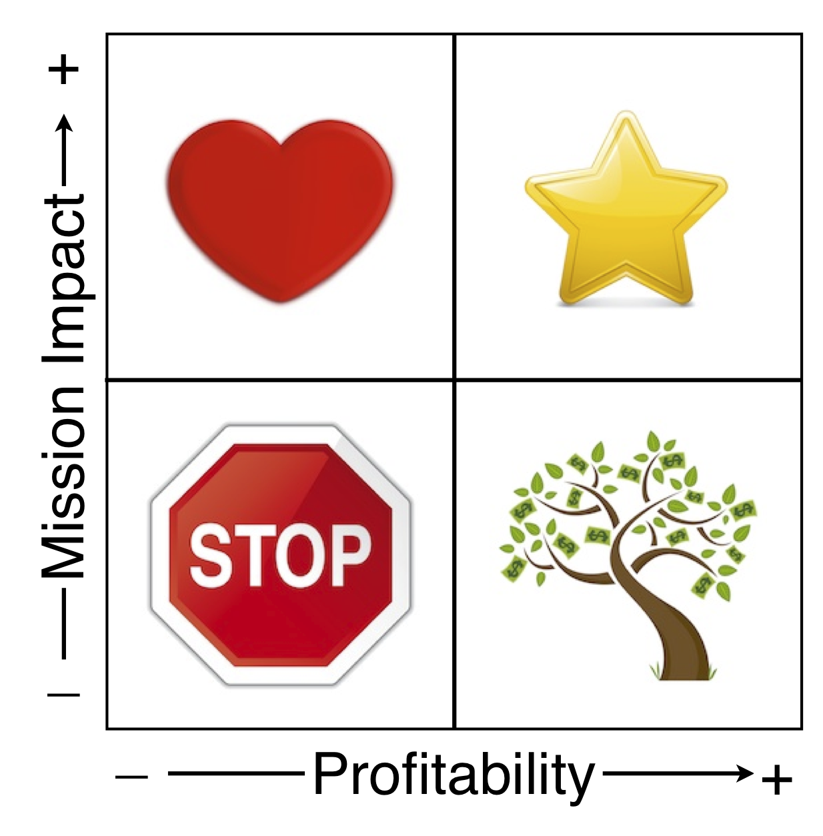
Tools for prioritizing your activities
Contribution to sustainability
Adapted from Nonprofit Sustainability: Making Strategic Decisions for Financial Viability by Jeanne Bell, Jan Masaoka & Steve Zimmerman

Slide 42
How would you categorize:
Hosting a national competition that results in student job offers and gets with major industry sponsors
Semi-annual industry brunch with students that is poorly attended
Profitability
Contribution to sustainability
Value to users

Slide 43
How would you categorize:
Hosting a national competition that results in student job offers and gets with major industry sponsors
Semi-annual industry brunch with students that is poorly attended
Nat’l competition, with great results and $$ support
Poorly attended industry brunch with students
Profitability
Contribution to sustainability

Slide 44
Is this approach applicable for any of your projects?
What challenges do you face in prioritizing among opportunities? What factors will influence your choice?
What do you need to know in order to move forward?
Notes:
?

Slide 45
Questions?

Slide 46
YOUR NEXT STEPS

Slide 47
Poll Question #3
When thinking about sustaining the impact of our work…
We still want to do it all
We are going to make strategic choices about which areas to invest in and which to stop
We know budgetary issues will force us to make some choices
All of the above

Slide 48
TAKING ACTION
Develop your inventory
Review existing evaluation results… or take a fresh look
Map out which “paths” suit which elements best
If you want to keep doing it all, map out some new scenarios for support

Slide 49
WEBINAR SERIES 2018
Coming soon…
APRIL 10: Succession Planning:
How to build a plan so that your work continues without you
GUEST SPEAKER: Kathy Alfano
Please visit
https://atecentral.net/sustainability
to sign up for the spring webinars!

Slide 50
PLEASE TAKE A MOMENT TO COMPLETE OUR SURVEY…

Slide 51
Thank you
Nancy Maron nancy@blueskytoblueprint.com
Rachael Bower bower@scout.wisc.edu
Ann Beheler abeheler@collin.edu

Slide 52
[END]

