Slide 1
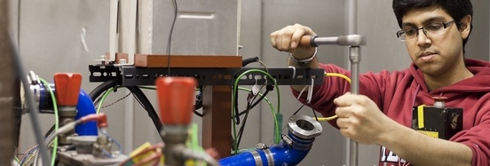
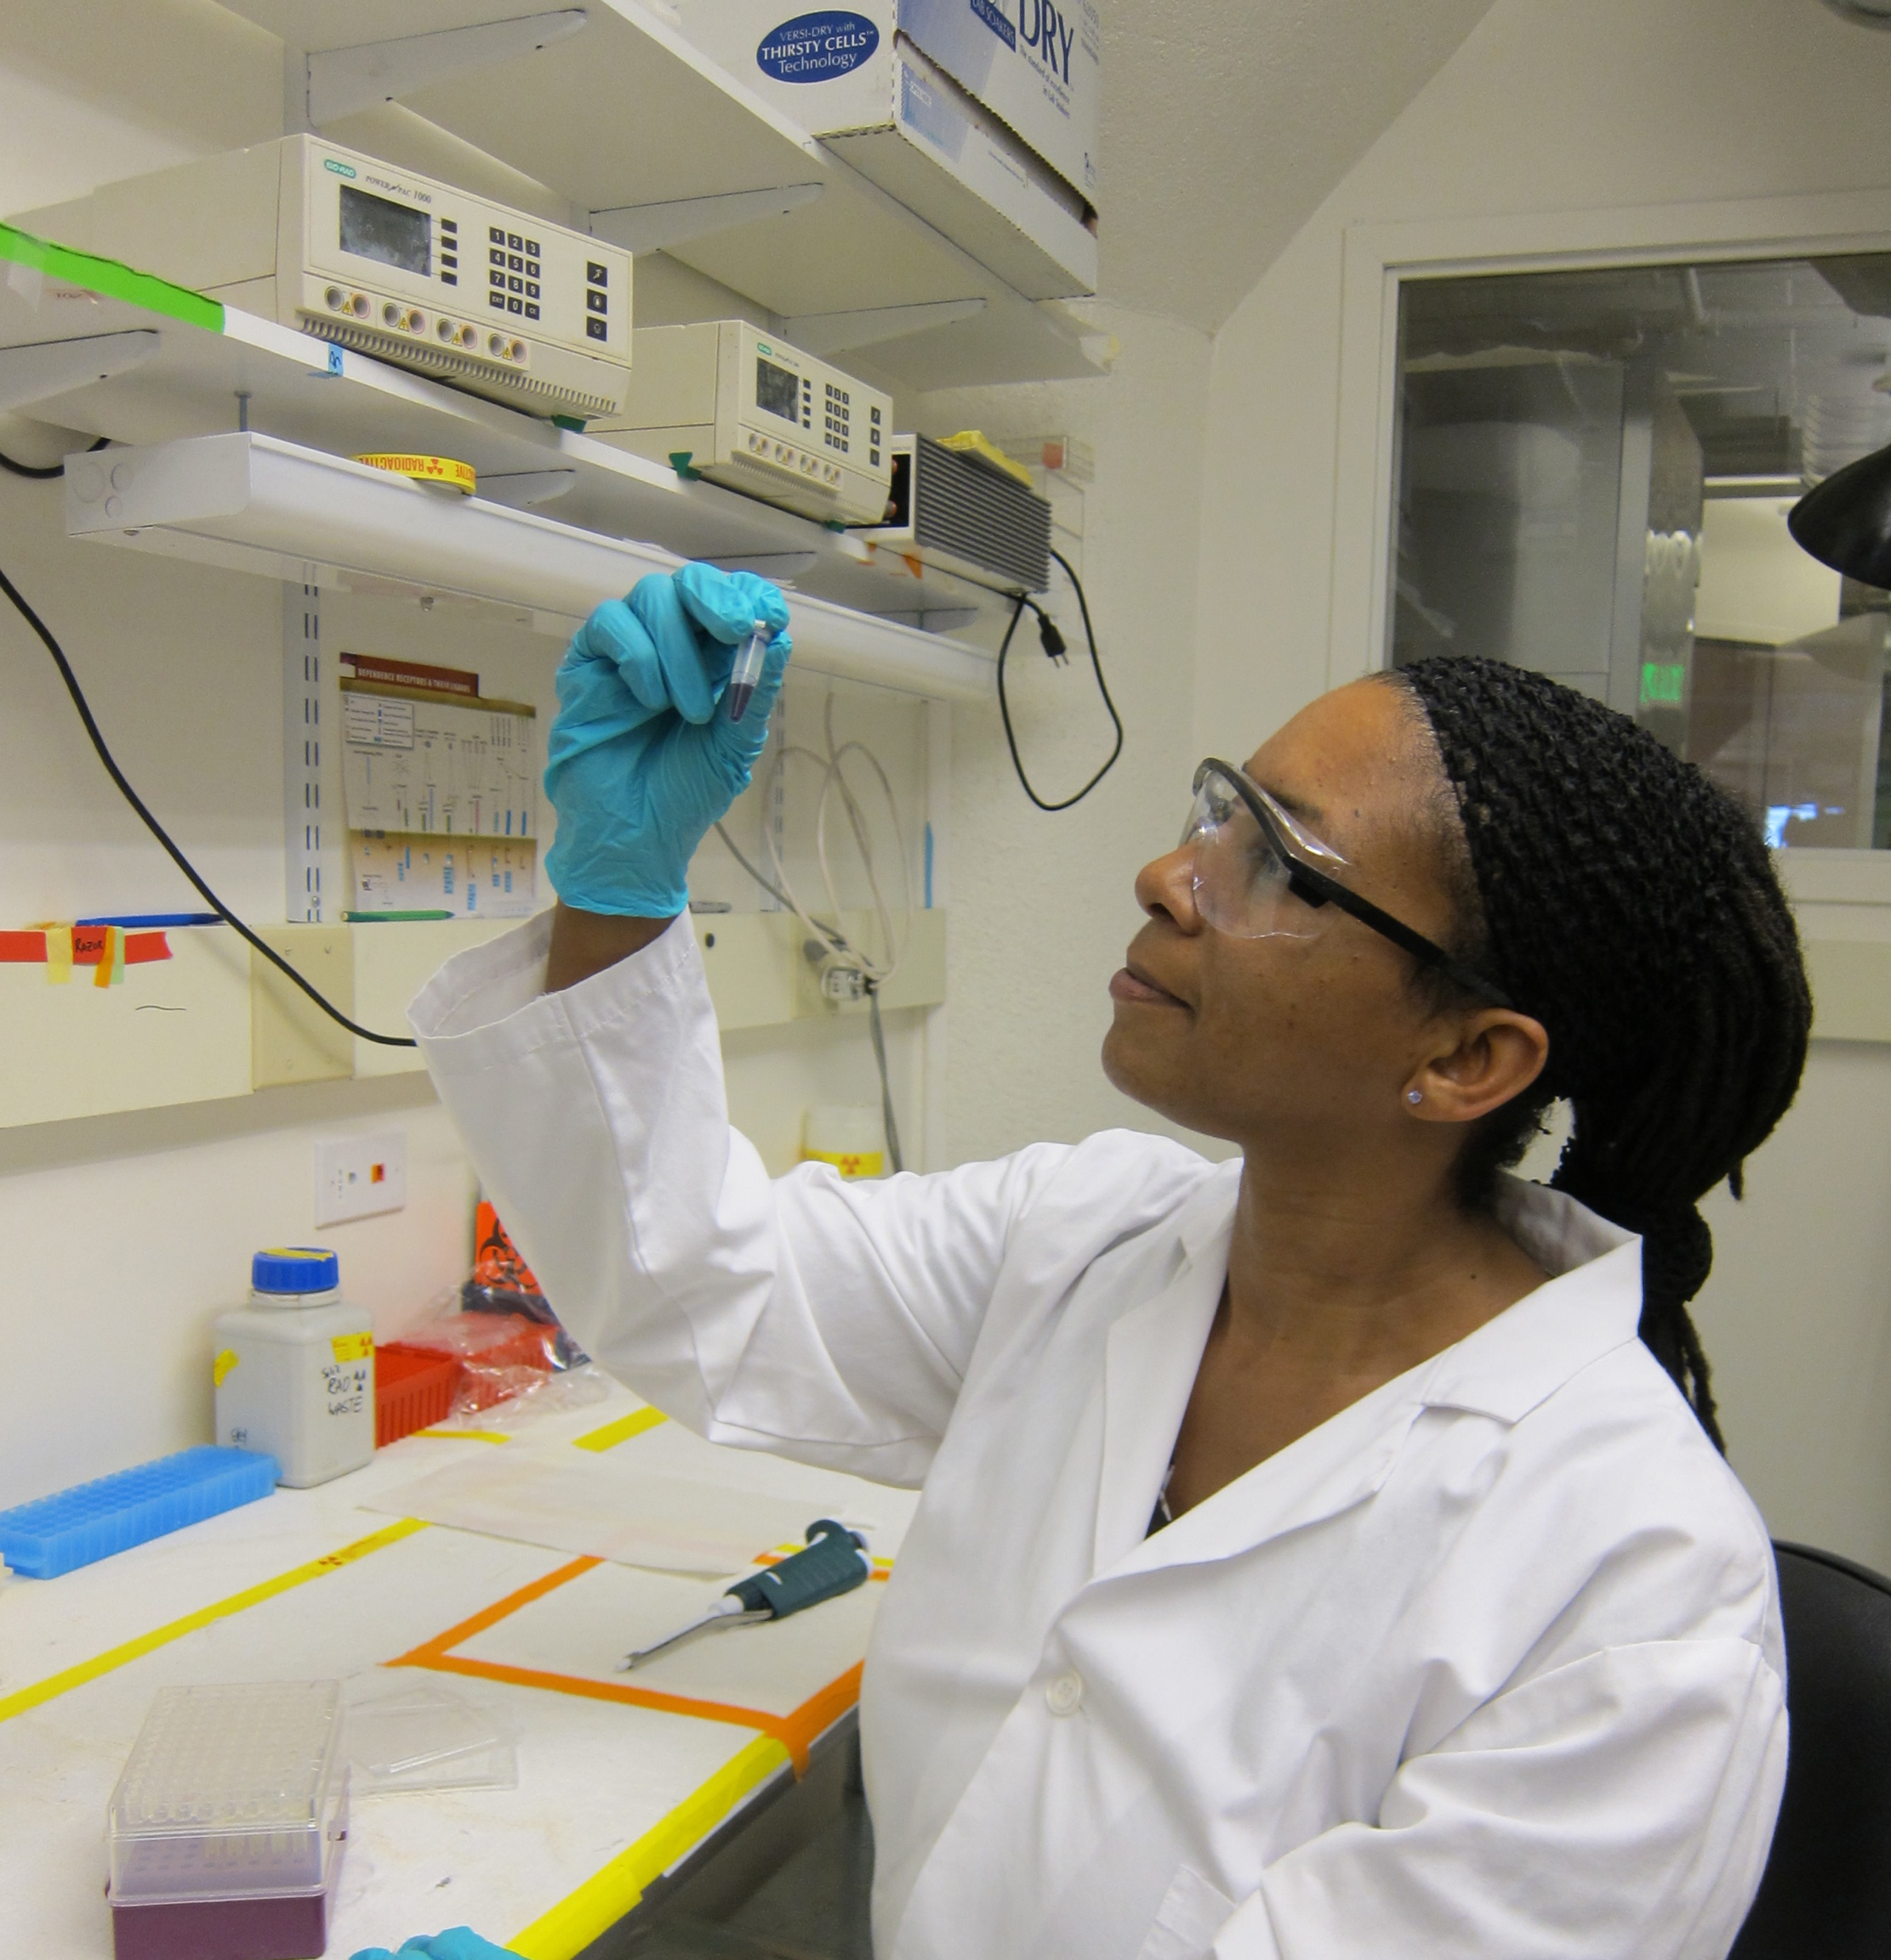
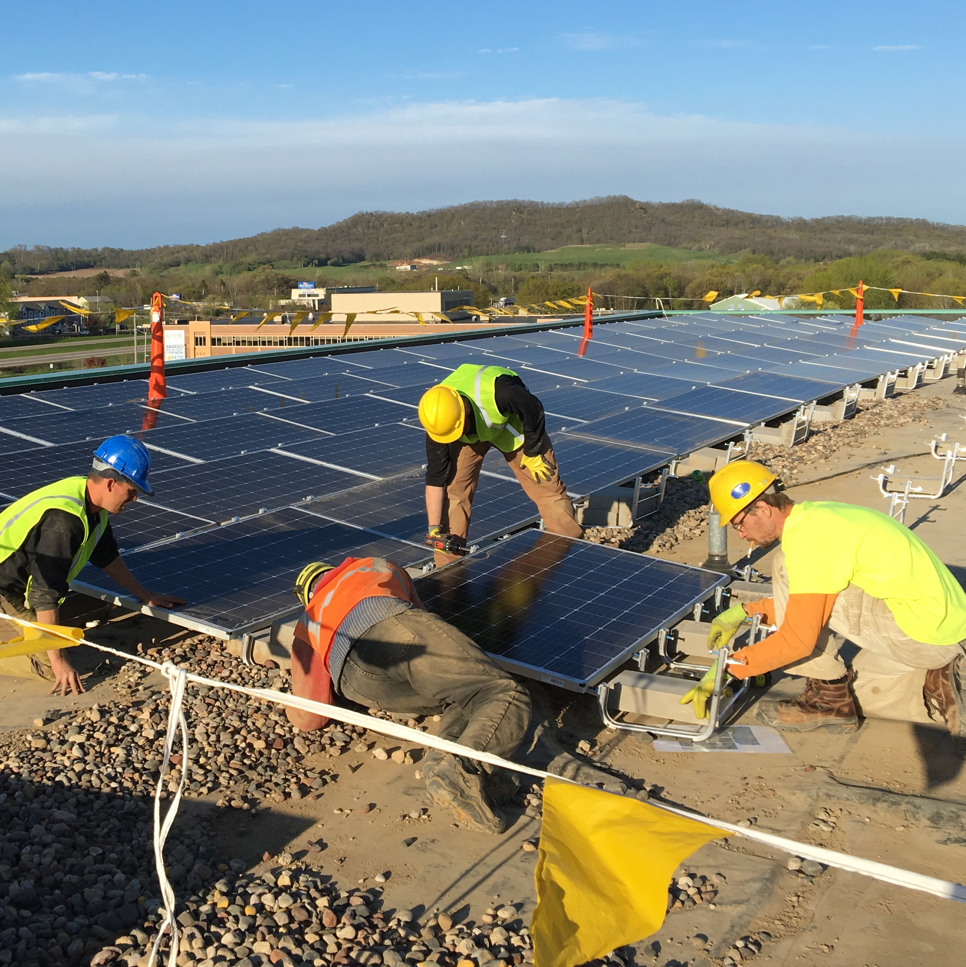
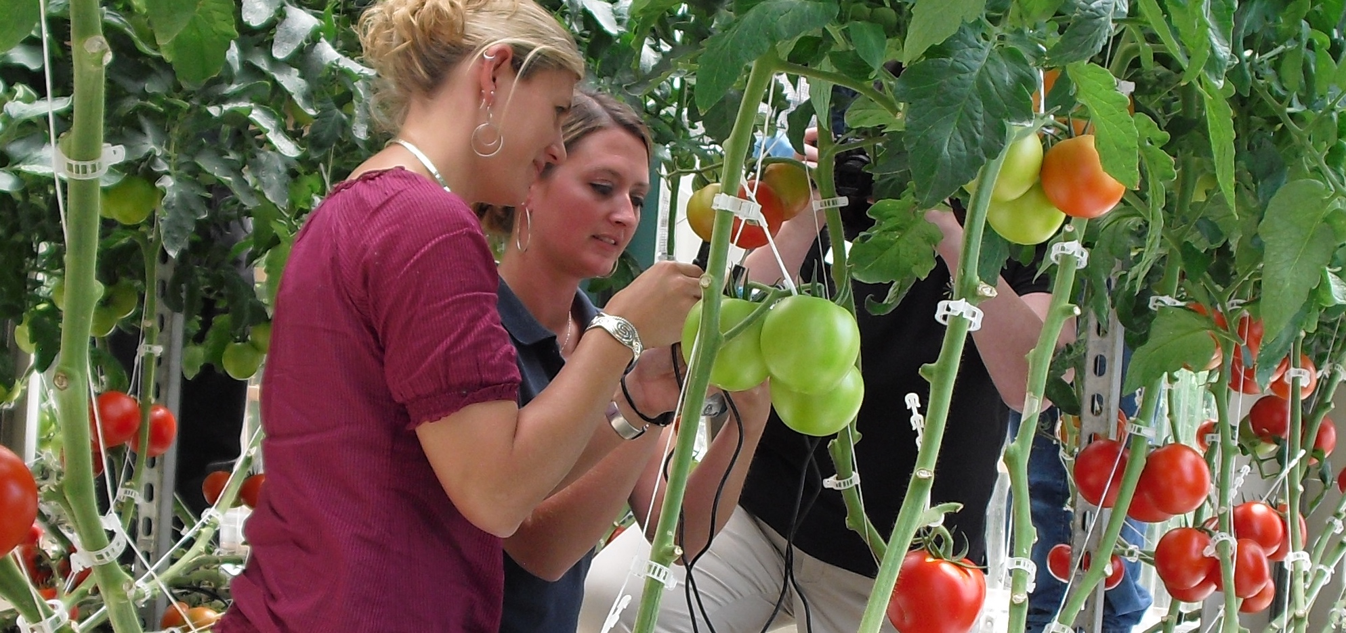


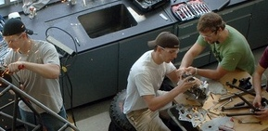
ATE Survey
2020
Findings from the Annual Survey of Principal Investigators in the National Science Foundation’s Advanced Technological Education Program
www.evalu-ate.org/annual_survey

Slide 2
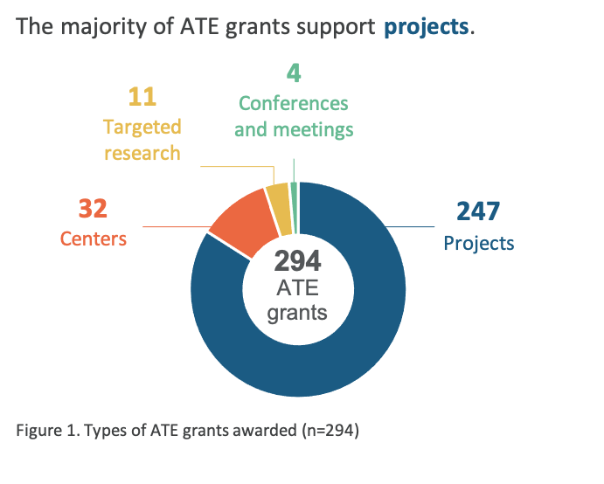
ATE GRANT TYPES AND INSTITUTIONS
Most ATE grants support projects, and most PIs are located at two-year colleges.
ATE Annual Survey: 2020 Report

Slide 3
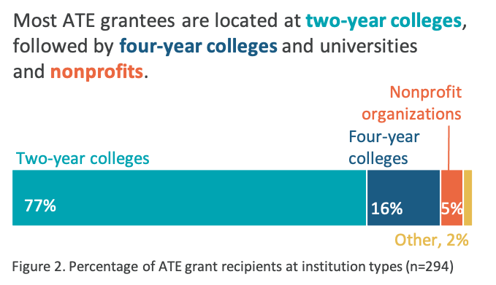
ATE GRANT TYPES AND INSTITUTIONS
Most ATE grants support projects, and most PIs are located at two-year colleges.
ATE Annual Survey: 2020 Report

Slide 4
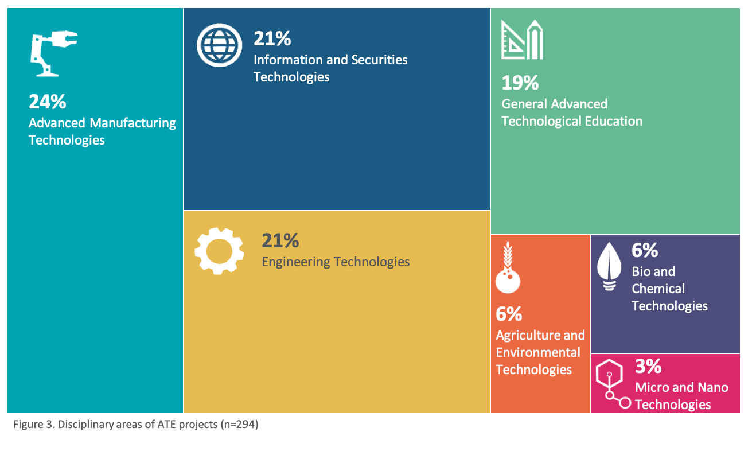
ATE PROJECT DISCIPLINES
The majority of ATE projects are in the areas of advanced manufacturing technologies, information and securities technologies, and engineering technologies.
ATE Annual Survey: 2020 Report

Slide 5
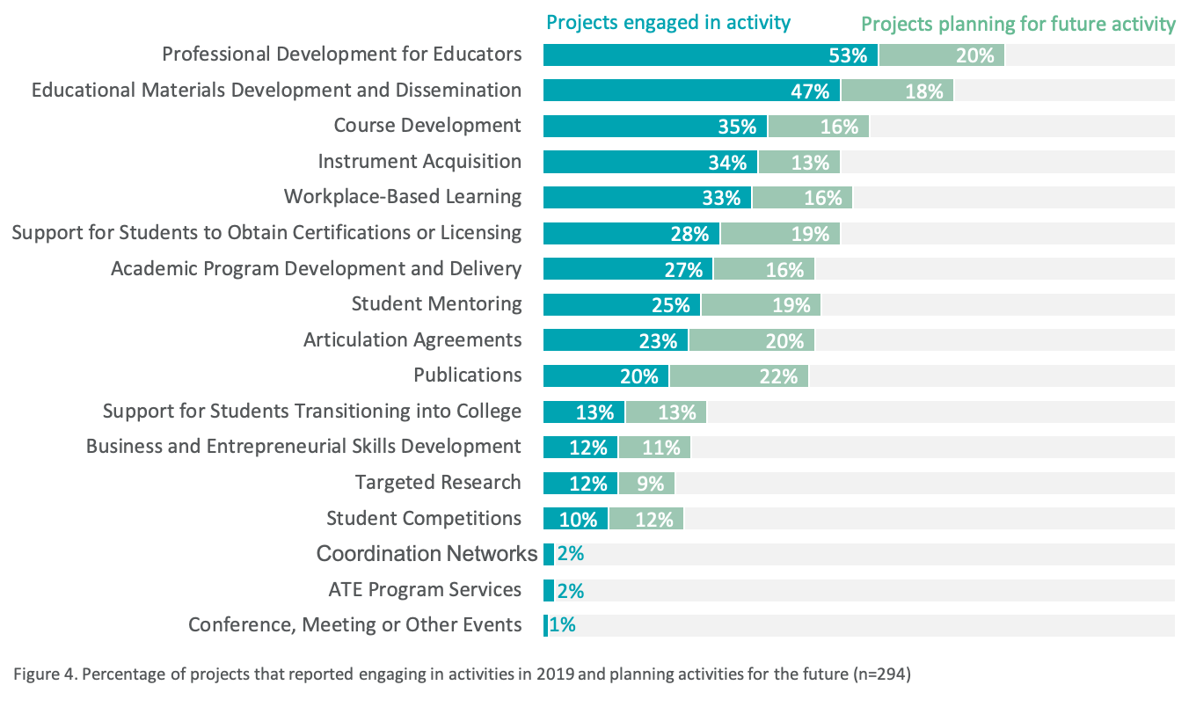
ATE PROJECT ACTIVITIES
ATE projects engaged in a variety of activities in 2019 to improve the education of science and engineering technicians.
ATE Annual Survey: 2020 Report

Slide 6
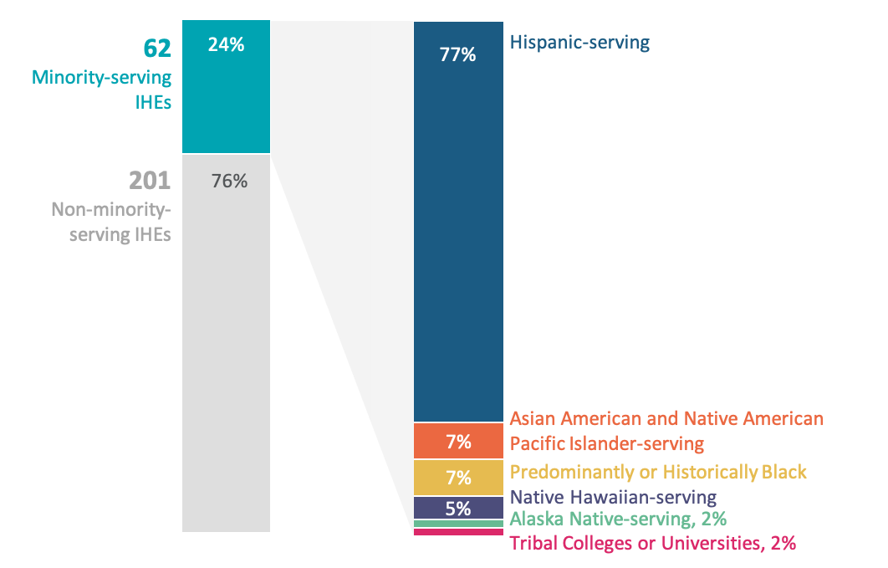
ATE PROJECTS AT MINORITY-SERVING INSTITUTIONS
Twenty-four percent of ATE projects are located at minority-serving institutions.
Figure 5. ATE projects at minority-serving institutions (n=62)
ATE Annual Survey: 2020 Report

Slide 7
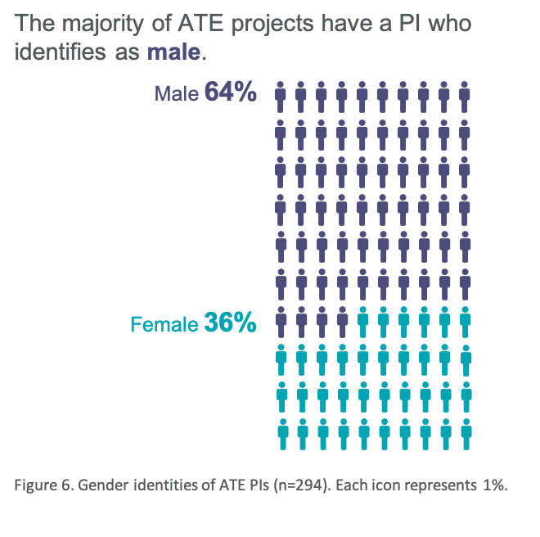
ATE PRINCIPAL INVESTIGATORS
Thirteen percent of ATE projects have PIs from racial and ethnic groups historically underrepresented in STEM.
ATE Annual Survey: 2020 Report

Slide 8
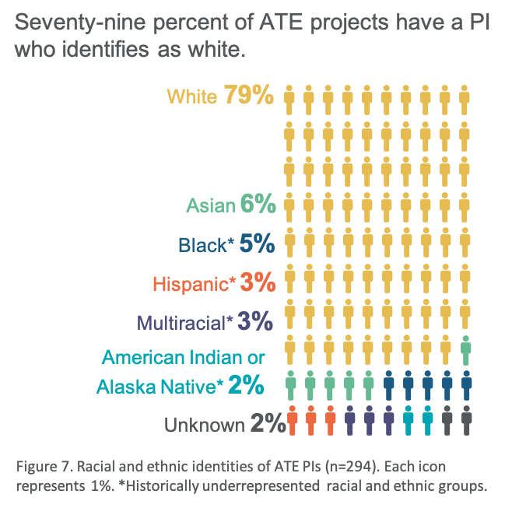
ATE PRINCIPAL INVESTIGATORS
Thirteen percent of ATE projects have PIs from racial and ethnic groups historically underrepresented in STEM.
ATE Annual Survey: 2020 Report

Slide 9
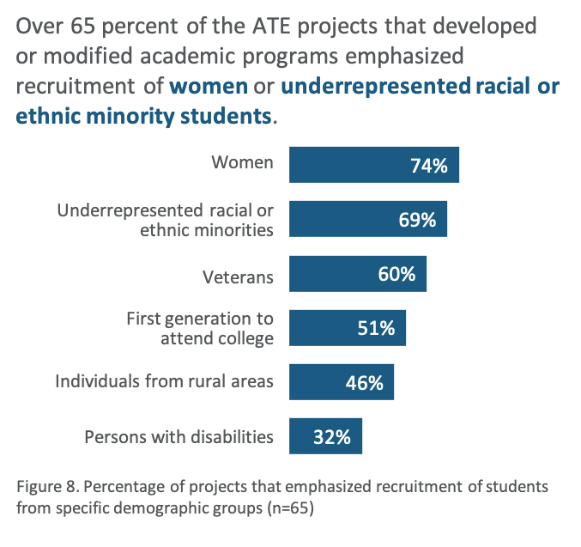
ACADEMIC PROGRAM DEVELOPMENT
Twenty-seven percent of ATE projects created or substantially modified an academic program.
ATE Annual Survey: 2020 Report

Slide 10
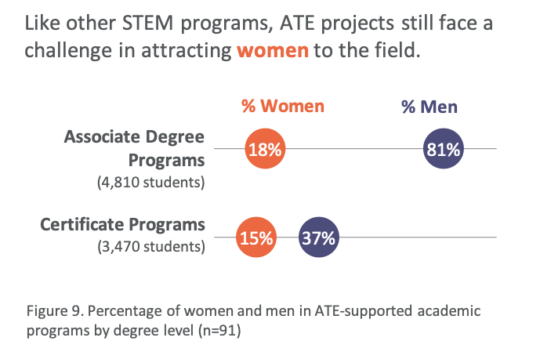
STUDENTS SERVED BY ATE ACADEMIC PROGRAMS
Students from groups that have been historically underrepresented in STEM have similar rates of participation in the ATE program.
ATE Annual Survey: 2020 Report

Slide 11
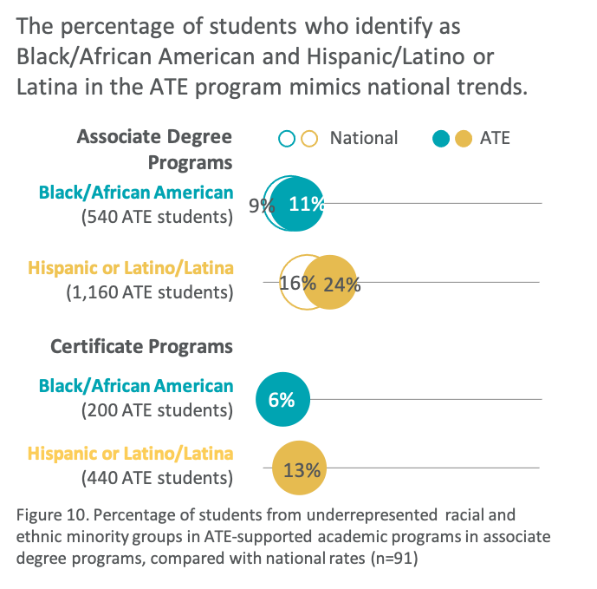
STUDENTS SERVED BY ATE ACADEMIC PROGRAMS
Students from groups that have been historically underrepresented in STEM have similar rates of participation in the ATE program.
ATE Annual Survey: 2020 Report

Slide 12
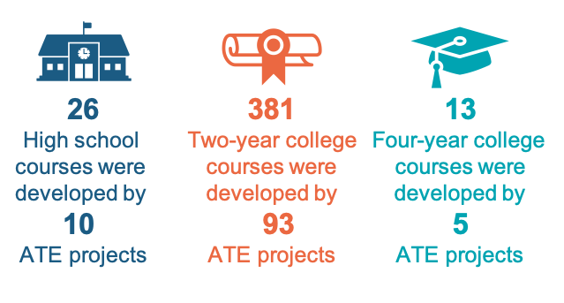
COURSE DEVELOPMENT
Thirty-five percent of ATE projects created or modified at least one academic course.
ATE Annual Survey: 2020 Report

Slide 13
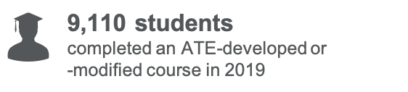
COURSE DEVELOPMENT
Thirty-five percent of ATE projects created or modified at least one academic course.
ATE Annual Survey: 2020 Report

Slide 14
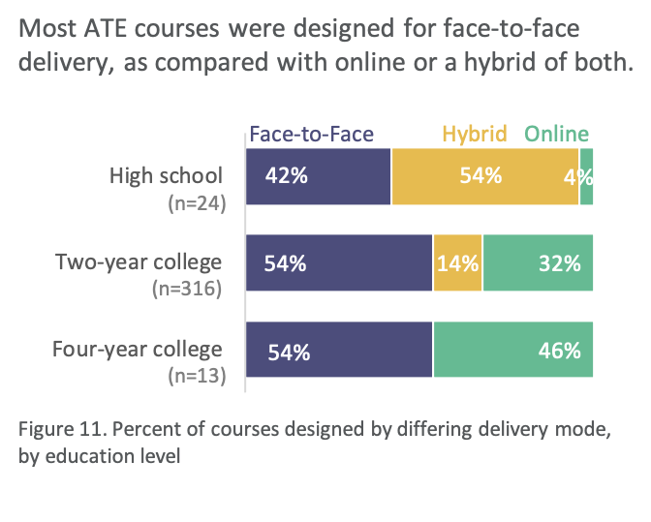
COURSE DEVELOPMENT
Thirty-five percent of ATE projects created or modified at least one academic course.
ATE Annual Survey: 2020 Report

Slide 15
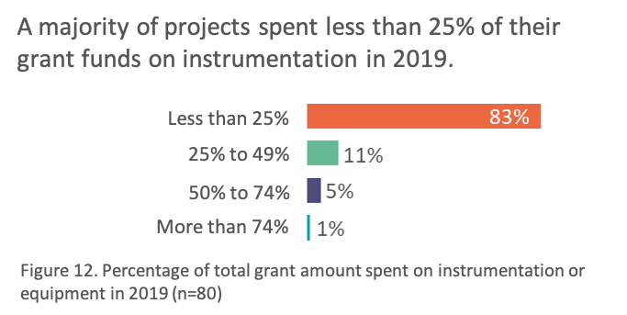
INSTRUMENT ACQUISITION
Thirty-two percent of ATE projects acquired instruments or equipment to prepare students for work in business and industry.
ATE Annual Survey: 2020 Report

Slide 16
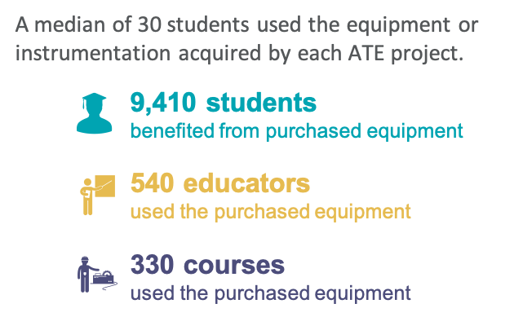
INSTRUMENT ACQUISITION
Thirty-two percent of ATE projects acquired instruments or equipment to prepare students for work in business and industry.
ATE Annual Survey: 2020 Report

Slide 17
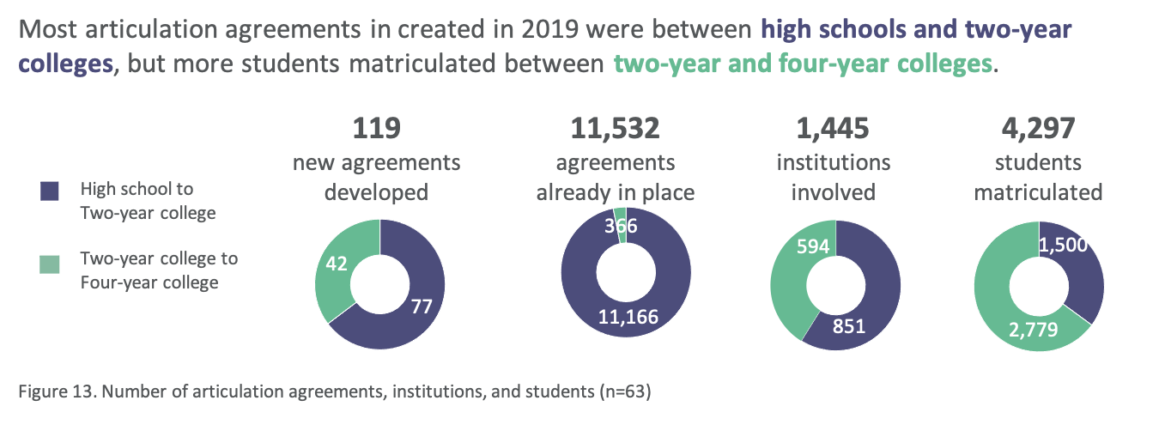
ARTICULATION AGREEMENTS
Twenty-one percent of ATE projects created or maintained articulation agreements.
ATE Annual Survey: 2020 Report

Slide 18
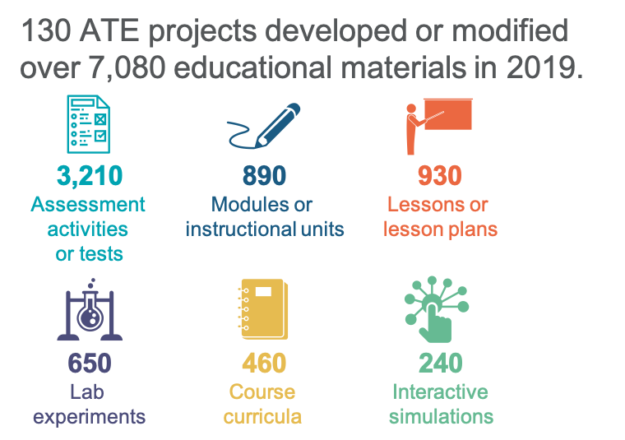
EDUCATIONAL MATERIAL DEVELOPMENT
Forty-four percent of ATE projects created or substantially modified educational materials.
ATE Annual Survey: 2020 Report

Slide 19
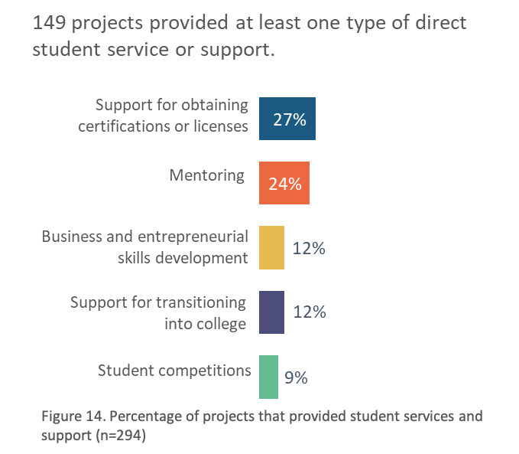
STUDENT SERVICE AND SUPPORT
Fifty-one percent of projects provided at least one type of student service or support.
ATE Annual Survey: 2020 Report

Slide 20
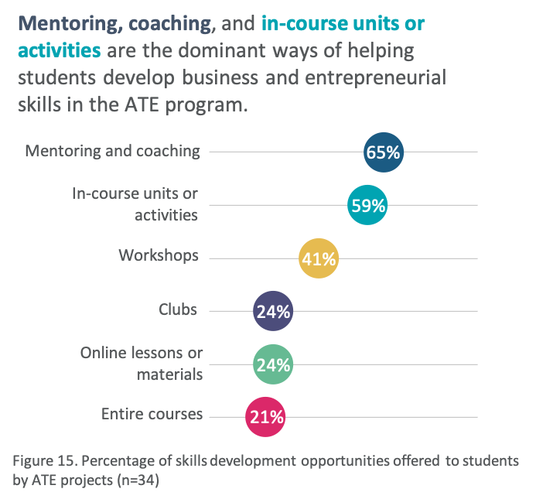
STUDENT SERVICE AND SUPPORT
Fifty-one percent of projects provided at least one type of student service or support.
ATE Annual Survey: 2020 Report

Slide 21
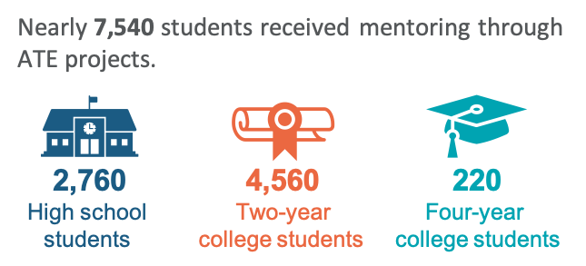
STUDENT SERVICE AND SUPPORT (continued)
Twenty-four percent of ATE projects provided students with mentoring or coaching, and
9% hosted or organized a student competition.
ATE Annual Survey: 2020 Report

Slide 22
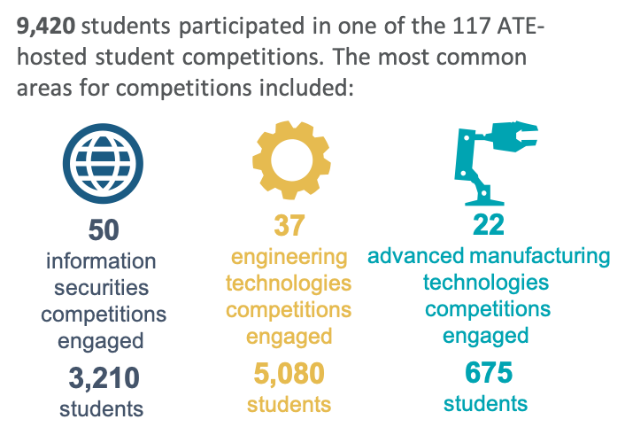
STUDENT SERVICE AND SUPPORT (continued)
Twenty-four percent of ATE projects provided students with mentoring or coaching, and
9% hosted or organized a student competition.
ATE Annual Survey: 2020 Report

Slide 23
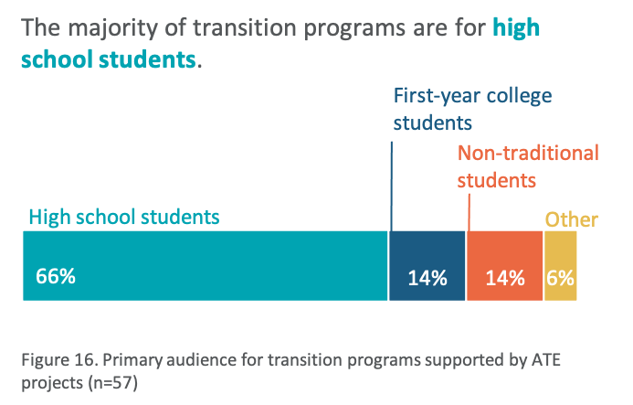
STUDENT SERVICE AND SUPPORT (continued)
Twelve percent of ATE projects provided extra support for students transitioning into college, and 27% helped students prepare for certification or licensure.
ATE Annual Survey: 2020 Report

Slide 24
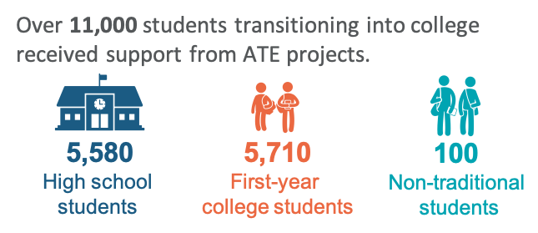
STUDENT SERVICE AND SUPPORT (continued)
Twelve percent of ATE projects provided extra support for students transitioning into college, and 27% helped students prepare for certification or licensure.
ATE Annual Survey: 2020 Report

Slide 25
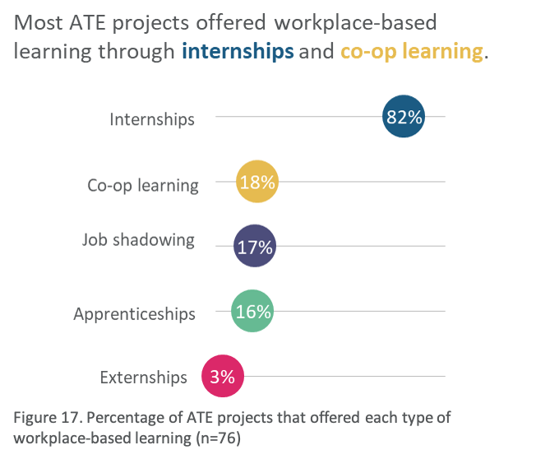
WORKPLACE-BASED LEARNING
27 percent of ATE projects provided workplace-based learning opportunities
for students.
ATE Annual Survey: 2020 Report

Slide 26
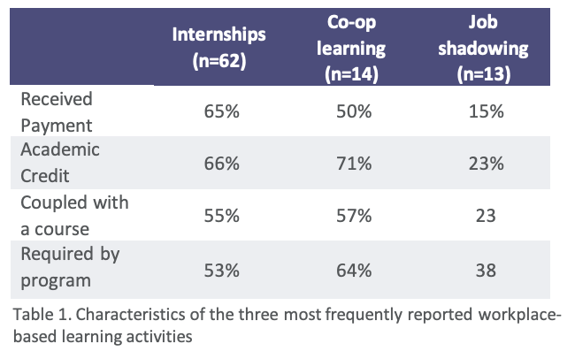
WORKPLACE-BASED LEARNING
27 percent of ATE projects provided workplace-based learning opportunities
for students.
ATE Annual Survey: 2020 Report

Slide 27
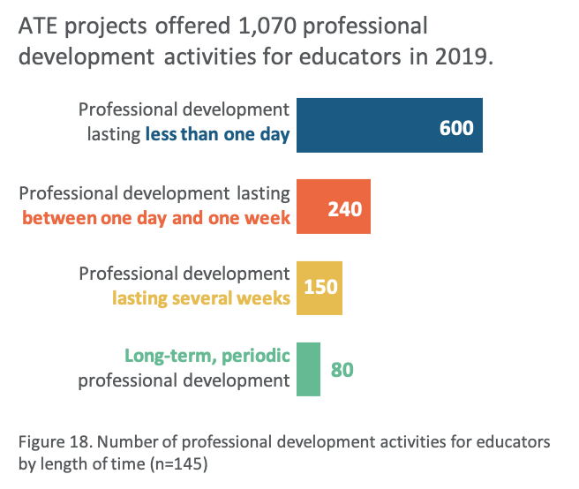
PROFESSIONAL DEVELOPMENT FOR EDUCATORS
Fifty percent of ATE projects provided training or professional development to current or future educators.
ATE Annual Survey: 2020 Report

Slide 28
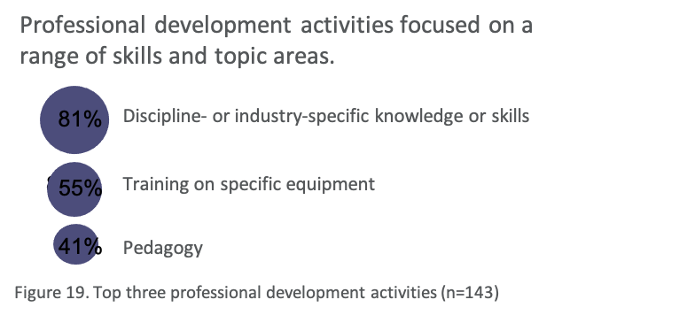
PROFESSIONAL DEVELOPMENT FOR EDUCATORS
Fifty percent of ATE projects provided training or professional development to current or future educators.
Professional development activities focused on a range of skills and topic areas.
81%
Discipline- or industry-specific knowledge or skills
81%
81%
Training on specific equipment
55%
41%
Pedagogy
Figure 19. Top three professional development activities (n=143)
ATE Annual Survey: 2020 Report

Slide 29
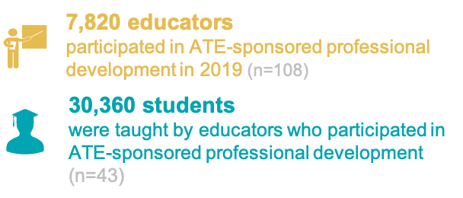
PROFESSIONAL DEVELOPMENT FOR EDUCATORS
Fifty percent of ATE projects provided training or professional development to current or future educators.
ATE Annual Survey: 2020 Report

Slide 30
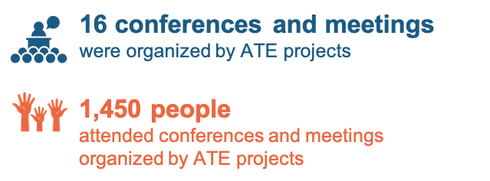
COORDINATION NETWORKS AND CONFERENCES
Only a few ATE projects are funded specifically to organize coordination networks and conferences, but many projects are actively engaged in professional exchange.
ATE Annual Survey: 2020 Report

Slide 31
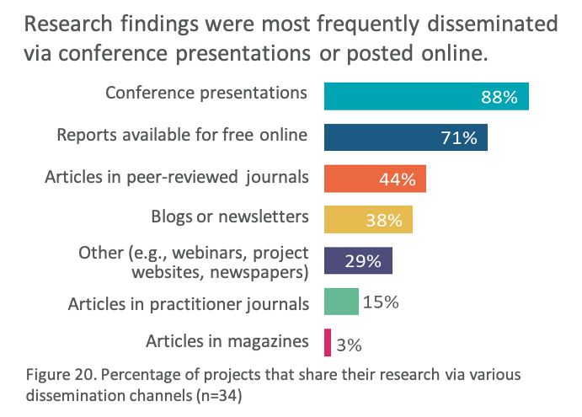
ATE TARGETED RESEARCH AND PUBLICATIONS
Twelve percent of ATE projects conducted some type of research, and
19% developed materials intended for publication.
ATE Annual Survey: 2020 Report

Slide 32
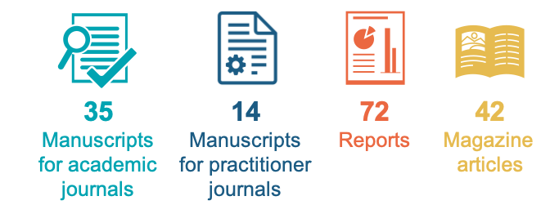
ATE TARGETED RESEARCH AND PUBLICATIONS
Twelve percent of ATE projects conducted some type of research, and
19% developed materials intended for publication.
ATE Annual Survey: 2020 Report

Slide 33
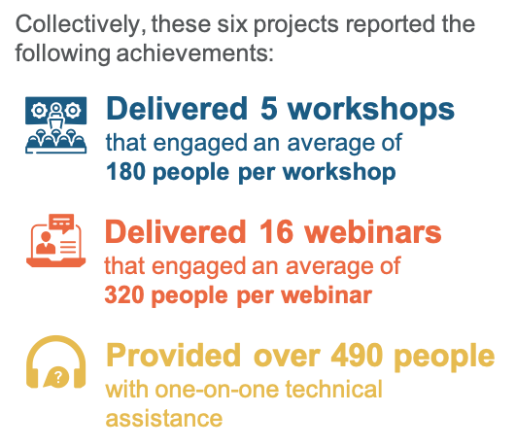
ATE PROGRAM SERVICES
Two percent of projects were funded specifically to serve the ATE program.
ATE Annual Survey: 2020 Report

Slide 34
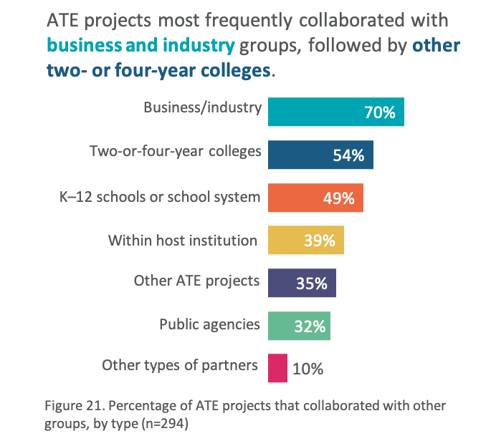
COLLABORATION
ATE projects collaborated with over 8,500 other organizations and institutions.
ATE Annual Survey: 2020 Report

Slide 35
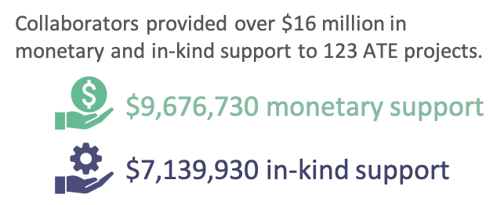
COLLABORATION
ATE projects collaborated with over 8,500 other organizations and institutions.
ATE Annual Survey: 2020 Report

Slide 36
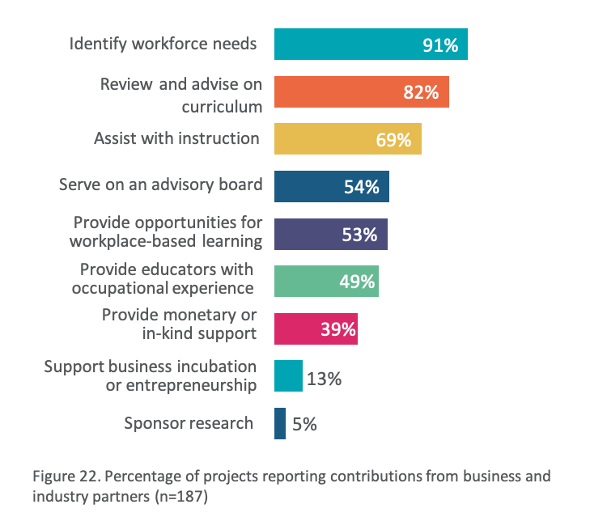
COLLABORATION WITH BUSINESS AND INDUSTRY
Sixty-four percent of ATE projects collaborated with business and industry partners.
ATE Annual Survey: 2020 Report

Slide 37
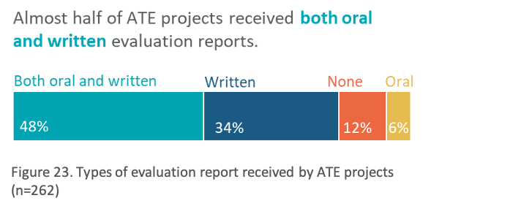
EVALUATION
Eighty-nine percent of ATE projects engaged an evaluator.
ATE Annual Survey: 2020 Report

Slide 38
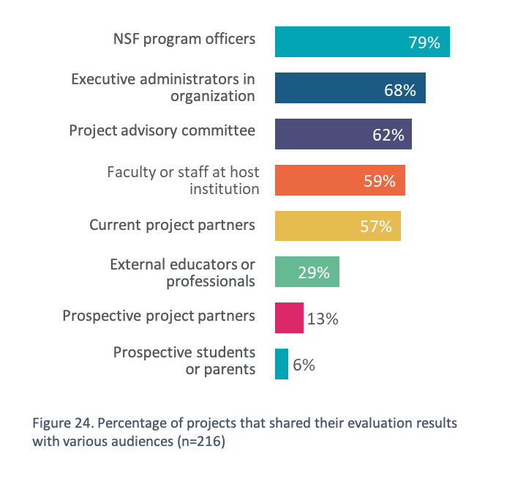
EVALUATION
Eighty-nine percent of ATE projects engaged an evaluator.
ATE Annual Survey: 2020 Report

Slide 39



ATE ANNUAL SURVEY
2020 HIGHLIGHTS
This summary of activities and achievements of the Advanced Technology Education (ATE) program is based on the 2020 ATE survey. Principal investigators for 91% (n=294) of ATE grants completed the survey, out of a total of 325 ATE grants. This included 247 projects, 32 centers, 4 conference grants, and 11 targeted research projects.
153 DEGREE PROGRAMS AND 454 COURSES
were developed by 125 ATE projects.
Almost half (49%) of all academic degree programs developed were certificate programs, and a majority (84%) of courses developed were at the associate degree level.
7,820 EDUCATORS
participated in 1,070 professional development activities.¹
The main audiences for ATE professional development activities were educators at secondary schools and two-year colleges.
65,000+ STUDENTS
were served by ATE projects.
ATE projects served over 65,000 students through a variety of activities.¹
68
Associate degree
programs served
5,790 students
75
Certificate
programs served
3,760 students
Received business and entrepreneurial skills development
Participated in a
transition program
Attended academic programs
Participated in student
competitions
Enrolled in courses
Received mentoring
At secondary schools
At two-year colleges
At other
Engaged in workplace-based
learning
2,400
4,300
580
At four-year colleges, 500
¹ Due to the structure of the survey questions, educator and student counts cannot be combined because of the the high probability of double-counting individual students.
ATE Annual Survey: 2020 Report

Slide 40




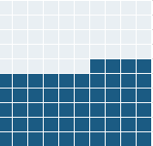





ATE ANNUAL SURVEY
2020 HIGHLIGHTS (continued)
7,110 EDUCATIONAL MATERIALS
were developed by 126 ATE projects.
Educational materials developed included assessment activities, modules or instructional units, lessons, lab experiments, curricula, case studies, instructor guides, and textbooks.
11,651 ARTICULATION AGREEMENTS
were developed or maintained by 62 ATE projects.
4,300 students matriculated to a higher-level education institution with the aid of an ATE-supported articulation agreement.
8,500 COLLABORATORS
were engaged by ATE projects.
ATE projects most frequently collaborated with business and industry groups and other colleges and universities.
OTHER ACTIVITIES were conducted by ATE projects in 2019 in support of advanced technological education.
ATE projects engaged in a wide range of activities. More information about those listed below and others can be found in the full report.
70%
collaborated with
business and industry groups
54%
collaborated with
other two- and
four-year colleges
3,310
Assessment
activities or tests
1,160
Modules or
instructional units
1,010
Lessons or
lesson plans
High school
to two-year college
Two-year college
to four-year college
operated
5 coordination networks
conducted
11 research studies
Agreements
Maintained
(n=11,532)
97%
3%
Agreements
Developed (n=119)
65%
35%
hosted
16 conferences
developed
163 publications
This material is based upon work supported by the National Science Foundation under grant number 1600992. Any opinions, findings, and conclusions or recommendations expressed in this material are those of the author(s) and do not necessarily reflect the views of the National Science Foundation.
ATE Annual Survey Report 2020

Slide 41

ATE Annual Survey
2020 Report
December 2020
Valerie A. Marshall
Lyssa Wilson Becho
Lori A. Wingate
Arlen Gullickson
Suggested citation:
Marshall, V. A., Becho, L. W., Wingate, L. A., & Gullickson, A. (2020). ATE annual survey: 2020 report. Kalamazoo, MI:
The Evaluation Center, Western Michigan University. Retrieved from http://www.evalu-ate.org/annual_survey/
This material is based upon work supported by the National Science Foundation under grant number 1600992. Any opinions, findings, and conclusions or recommendations expressed in this material are those of the author(s) and do not necessarily reflect the views of the National Science Foundation.

