Slide 1
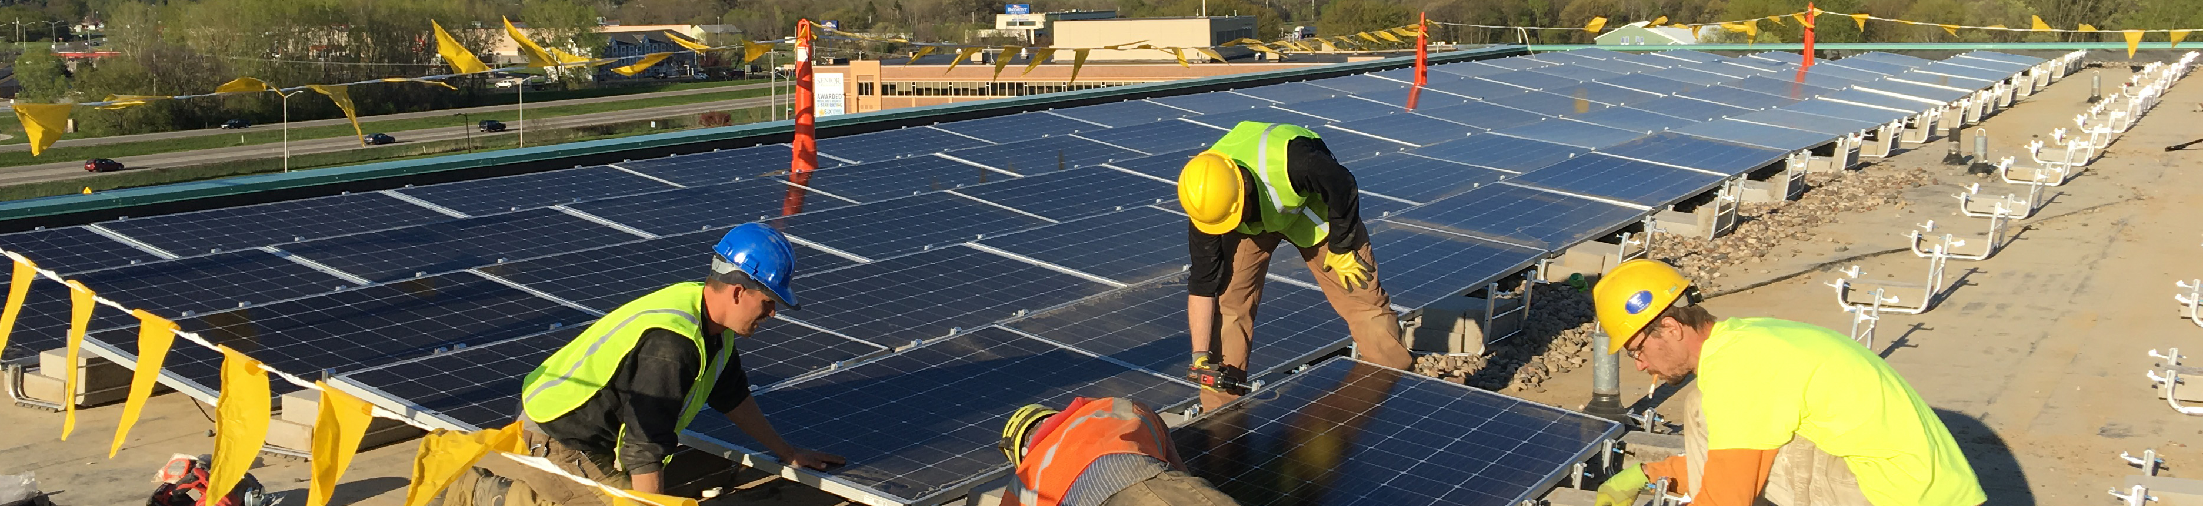
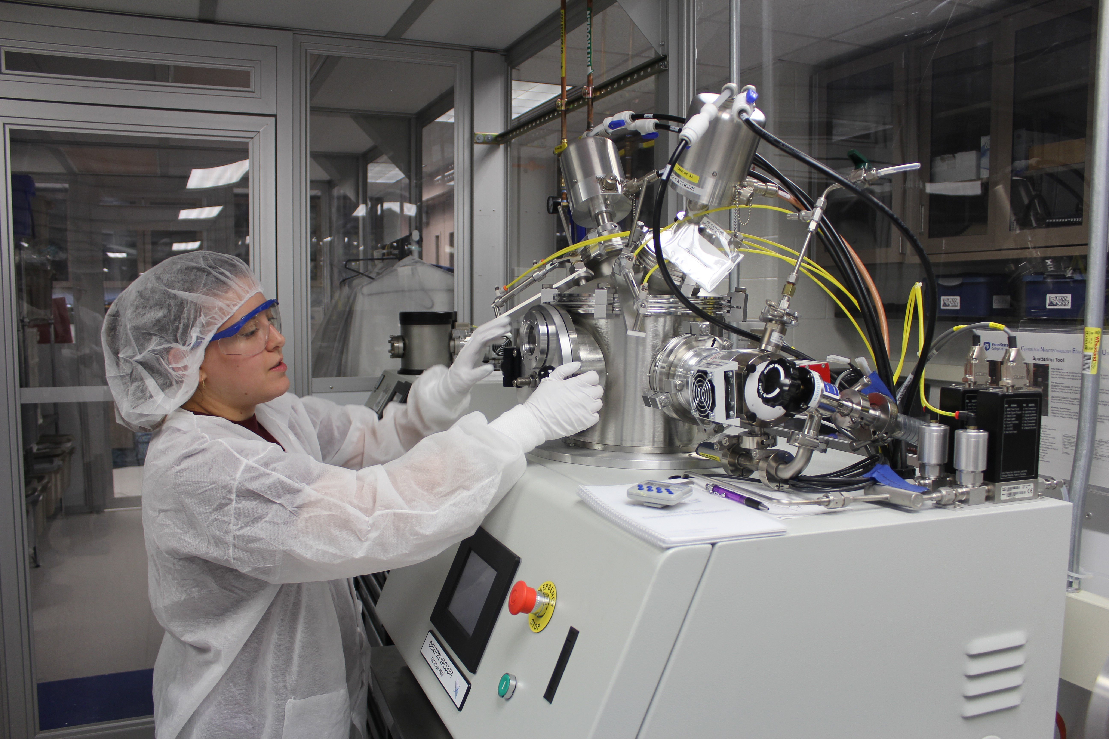


ATE Survey 2019
Findings from the Annual Survey of Principal Investigators in the National Science Foundation’s Advanced Technological Education Program
ATE Annual Survey Report Graphs 2019 Full report at www.evalu-ate.org/annual_survey

Slide 2
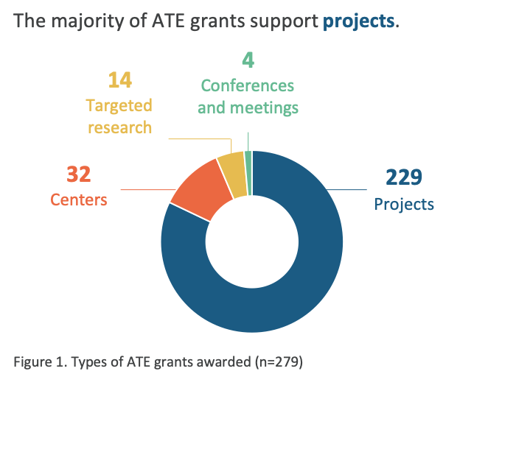
ATE Annual Survey Report Graphs 2019 Full report at www.evalu-ate.org/annual_survey

Slide 3
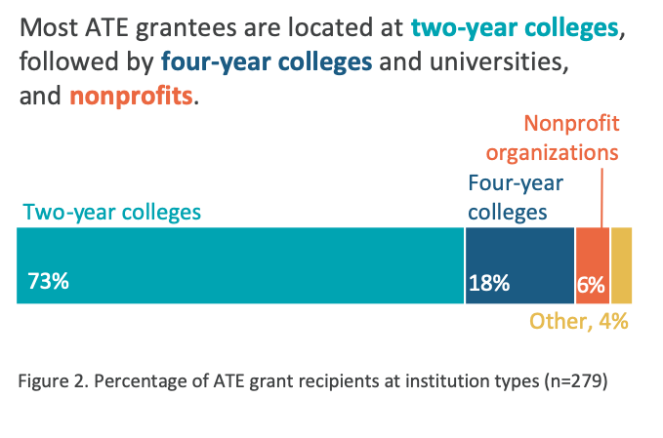
ATE Annual Survey Report Graphs 2019 Full report at www.evalu-ate.org/annual_survey

Slide 4
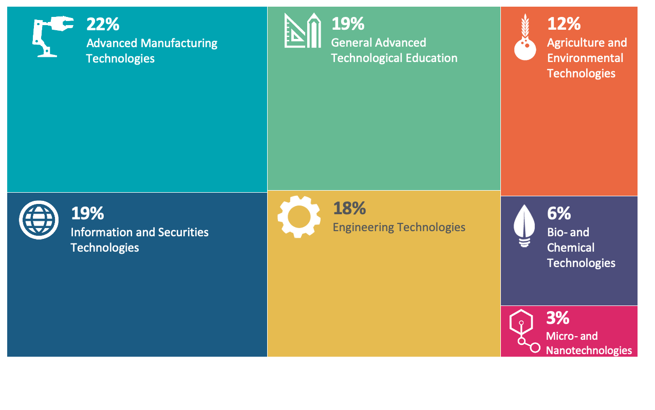
Figure 3. Disciplinary areas of ATE projects (n=279)
ATE Annual Survey Report Graphs 2019 Full report at www.evalu-ate.org/annual_survey

Slide 5
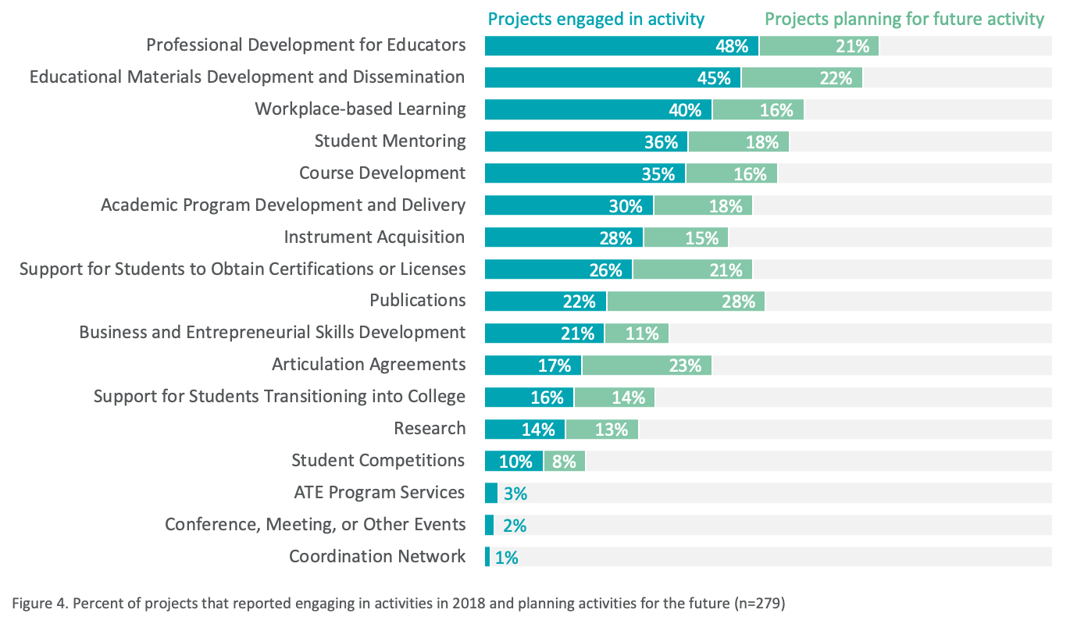
ATE Annual Survey Report Graphs 2019 Full report at www.evalu-ate.org/annual_survey

Slide 6
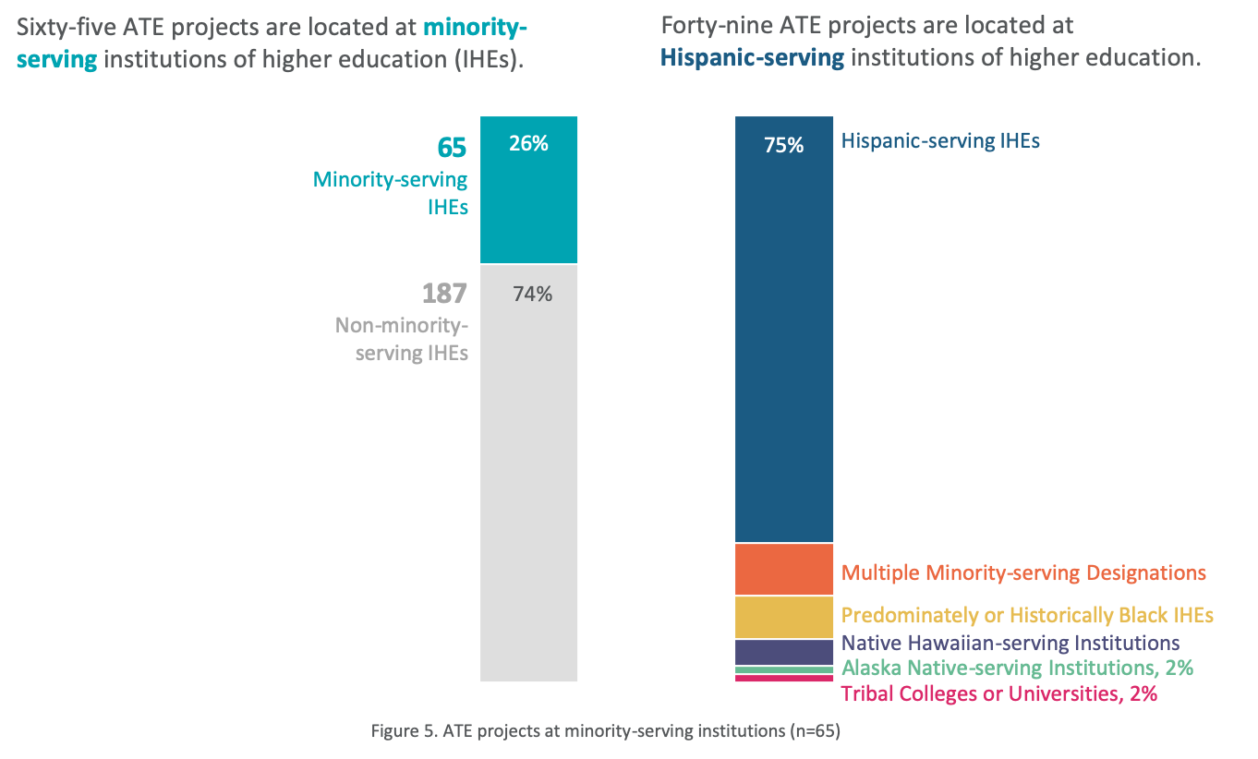
ATE Annual Survey Report Graphs 2019 Full report at www.evalu-ate.org/annual_survey

Slide 7
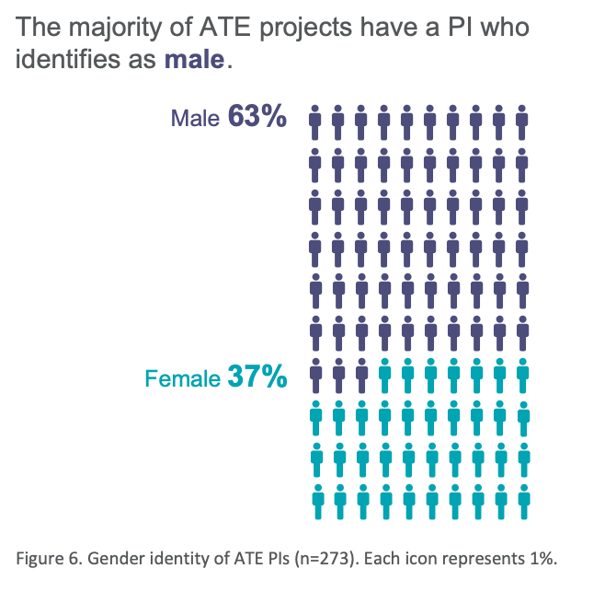
ATE Annual Survey Report Graphs 2019 Full report at www.evalu-ate.org/annual_survey

Slide 8
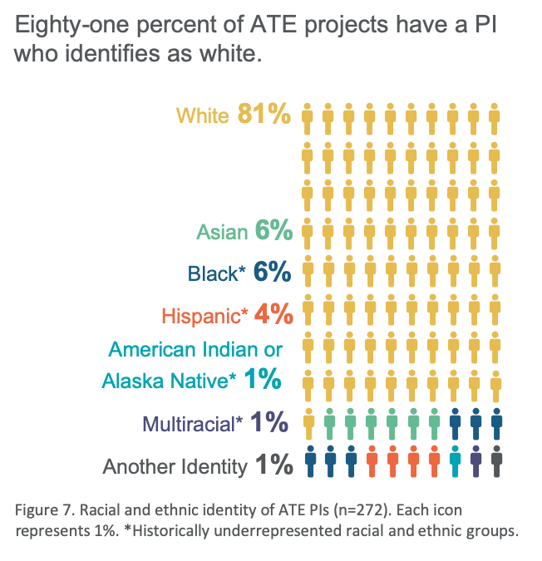
ATE Annual Survey Report Graphs 2019 Full report at www.evalu-ate.org/annual_survey

Slide 9
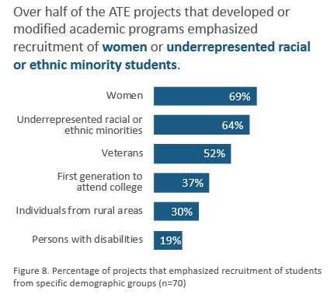
ATE Annual Survey Report Graphs 2019 Full report at www.evalu-ate.org/annual_survey

Slide 10
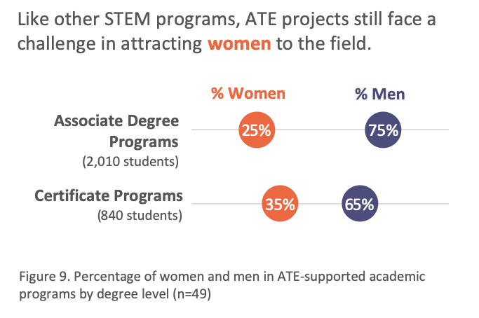
ATE Annual Survey Report Graphs 2019 Full report at www.evalu-ate.org/annual_survey

Slide 11
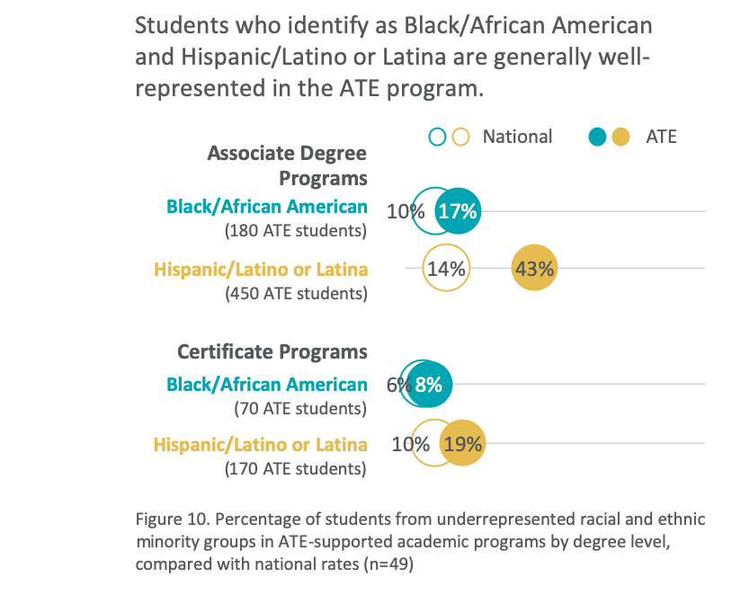
ATE Annual Survey Report Graphs 2019 Full report at www.evalu-ate.org/annual_survey

Slide 12
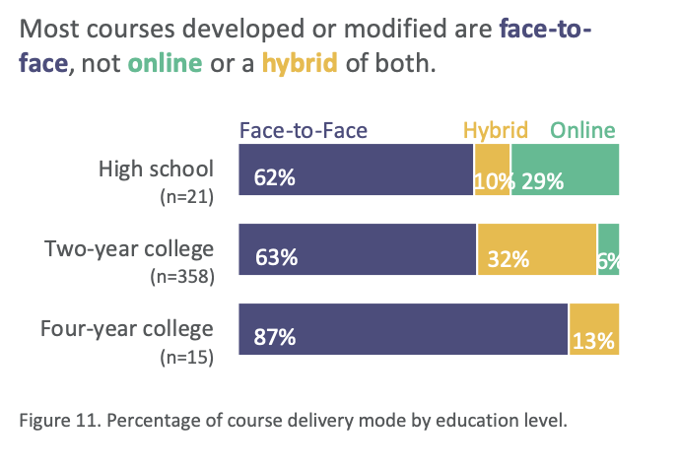
ATE Annual Survey Report Graphs 2019 Full report at www.evalu-ate.org/annual_survey

Slide 13
ATE Annual Survey Report Graphs 2019 Full report at www.evalu-ate.org/annual_survey

Slide 14
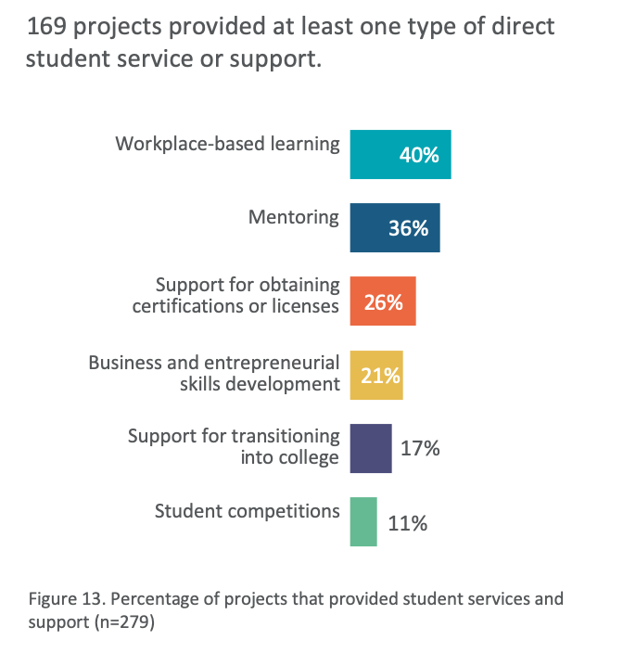
ATE Annual Survey Report Graphs 2019 Full report at www.evalu-ate.org/annual_survey

Slide 15
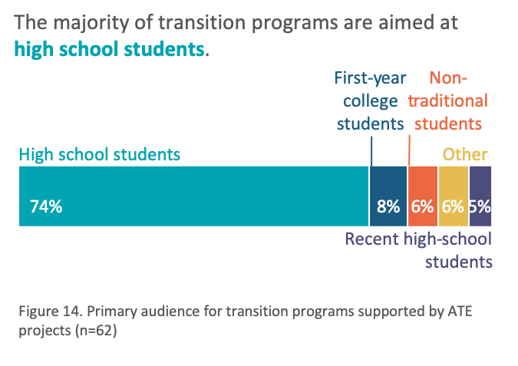
ATE Annual Survey Report Graphs 2019 Full report at www.evalu-ate.org/annual_survey

Slide 16
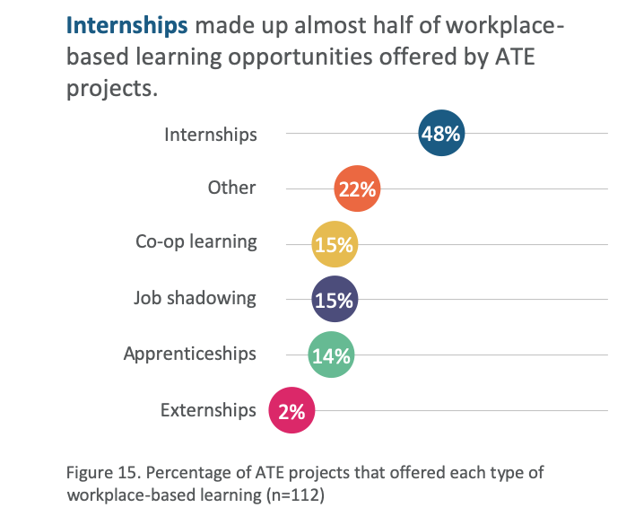
ATE Annual Survey Report Graphs 2019 Full report at www.evalu-ate.org/annual_survey

Slide 17
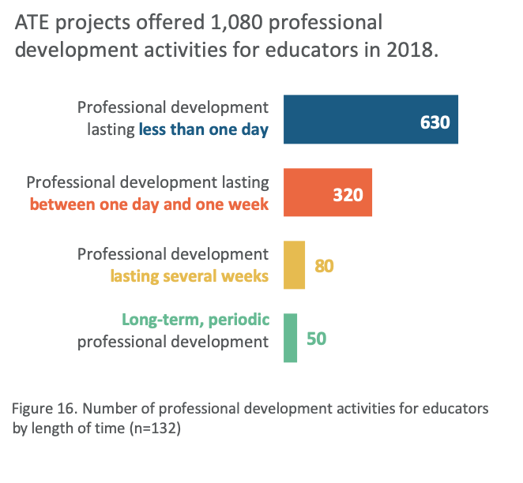
ATE Annual Survey Report Graphs 2019 Full report at www.evalu-ate.org/annual_survey

Slide 18
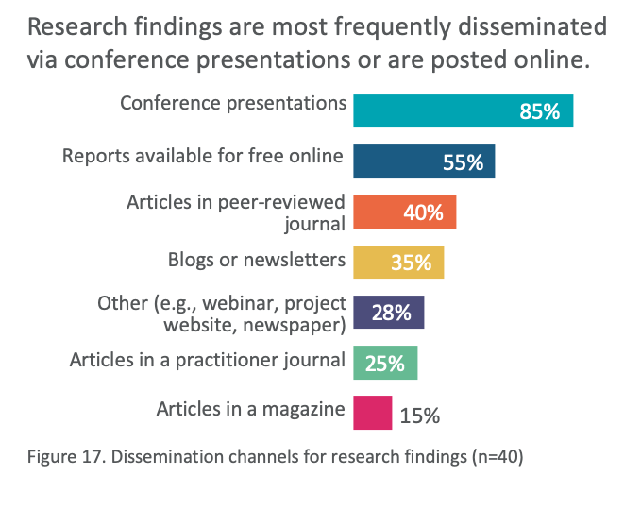
ATE Annual Survey Report Graphs 2019 Full report at www.evalu-ate.org/annual_survey

Slide 19
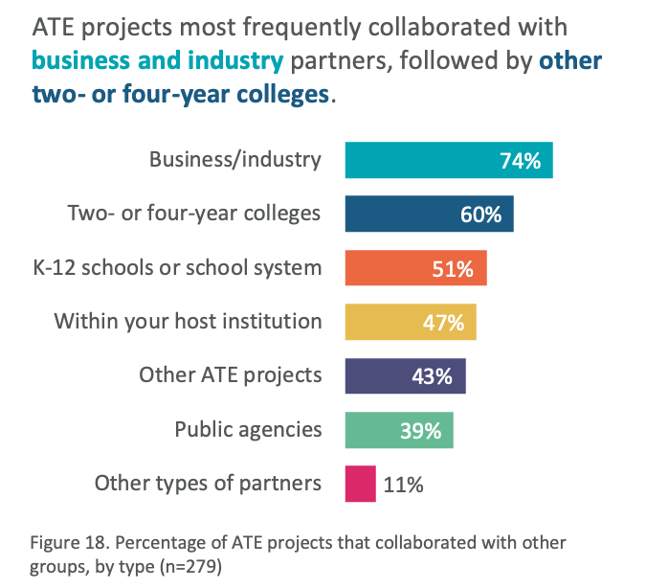
ATE Annual Survey Report Graphs 2019 Full report at www.evalu-ate.org/annual_survey

Slide 20
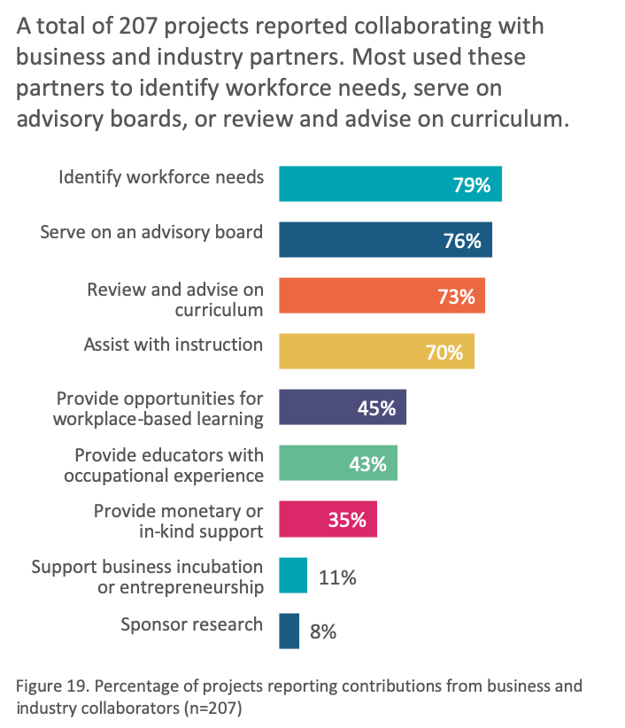
ATE Annual Survey Report Graphs 2019 Full report at www.evalu-ate.org/annual_survey

Slide 21
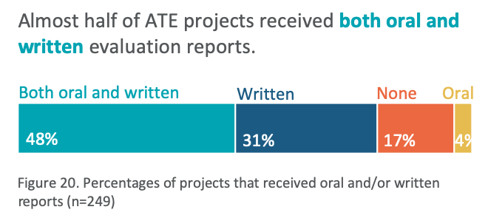
ATE Annual Survey Report Graphs 2019 Full report at www.evalu-ate.org/annual_survey

Slide 22
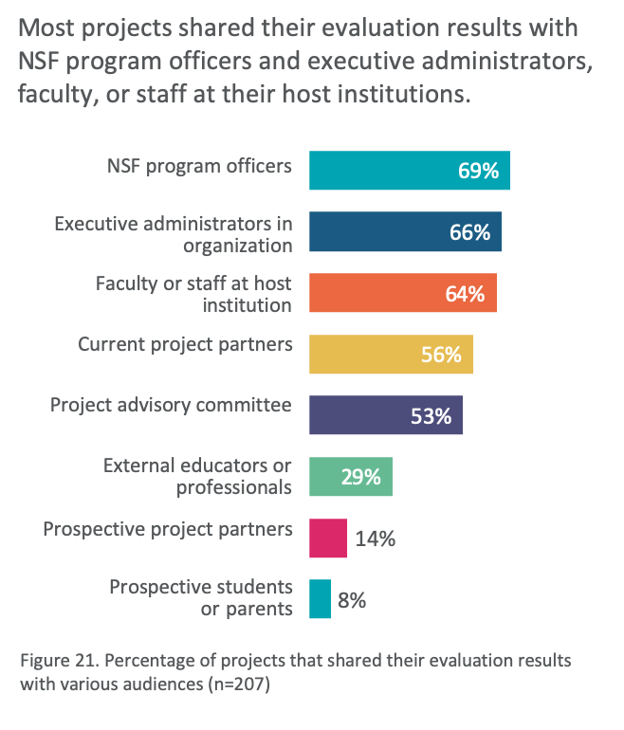
ATE Annual Survey Report Graphs 2019 Full report at www.evalu-ate.org/annual_survey

