Slide 1
Biocompatibility and
Cellular overview
Part 1

Slide 2
Introduction
Nanomanufacturing supplies many unique materials and processes for biological applications. These may range from nanoparticles for drug delivery to prosthetic devices.
So it is necessary to understand how biological entities like cells interact with products crafted on the nanoscale.
This packet will review basic biology with emphasis on scale and interface with materials. Then we will look at common nanomanufactured biomaterials with associated applications.

Slide 3
Outline
Biocompatibility
Quick overview of cellular interaction
Scale, size, generic animal cell
Nanoscale materials for biological interaction
Liposomes
Metal Nanoparticles
Nanoshells
Examples of bionano applications

Slide 4
Biocompatibility
Biocompatibility is the ability of a material to perform with an appropriate host response in a specific application.
To engineer biocompatibility, the nanotechnologist must amalgamate an understanding of materials and biological response.
The first part of this packet focuses on cellular function. This allows us to appreciate biological scale, and cellular activity.
The second part of this packet examines the biological response to engineered materials at the nanoscale.

Slide 5
Biocompatibility
The biological response to engineered material should consider both the short term response, and the long term response.
Acute response is the near term reaction of the body to the biomaterial.
Long term response can be chemical release, chemical degradation, shedding particles, etc.

Slide 6
Outline
Biocompatibility
Quick overview of cellular interaction
Scale, size, generic animal cell
Nanoscale materials for biological interaction
Liposomes
Metal Nanoparticles
Nanoshells
Examples of bionano applications

Slide 7
Cell Size
The logistics of carrying out metabolism sets limits on the size range of cells
As an object of a particular shape increases in size, its volume grows proportionally more rapidly than its surface area
Eukaryotic cells
Have a nucleus
~5 to 100 μm in diameter, depending upon function

Slide 8
Why Are Cells Microscopic?
For objects of the same shape, the smaller the object, the greater its surface area to volume ratio. (Also the nanoparticle definition)
If cells were larger, rates of chemical exchange with the extracellular environment might be inadequate to maintain the cell due to the great distance between the cell membrane and the nucleus

Slide 9
Why Are Cells Microscopic?
By dividing a large cell into smaller cells, the surface-area to-volume ratio is maximized
This serves the cell’s need for acquiring nutrients and expelling waste products
This relationship explains why larger organisms do not have larger cells, but more of them

Slide 10
Cell Size
How does this “standardization” of cell size impact nanotechnology?
Universal size for cells means universal scaling and this dictates the manufacturing tool set.
Same design algorithms and tools for mice cells as elephant cells.
Techniques and applications can be shared across the nano-biomaterial market.

Slide 11
Cell Size vs. Surface Area
5
5
1
(A)
(B)
(C)
1
 | A | B | C
Surface Area | 6 | 150 | 750
Volume | 1 | 125 | 125
Surface Area to Volume Ratio | 6 | 1.2 | 6
Public Domain: Generated by CNEU Staff for free use

Slide 12
Relative Particle Sizes
Gas Molecules
Virus
Tobacco Smoke
Bacteria
Fog
Adult Red Blood Cell
Flour dust, pollens
Human Hair
Beach Sand
0.1 - 1 nm
2 – 100 nm
10 – 300 nm
0.2 – 10 µm
1 – 50 µm
7.5 µm
5 – 50 µm
50 – 120 µm
100 µm and up
40 µm – Barely Visible to the Naked Eye
American Air filter Company

Slide 13
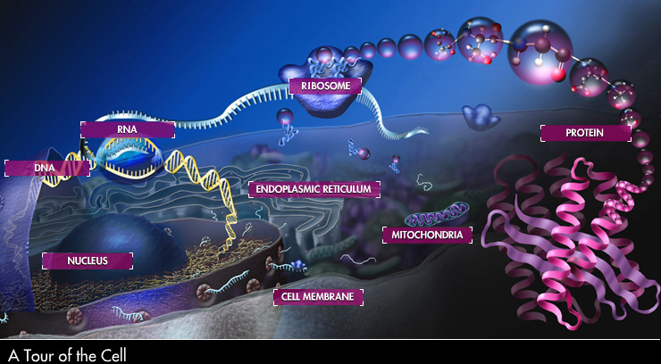
The Animal Cell
Source: http://www.nsf.gov/news/overviews/biology/interactive.jsp

Slide 14
Form Fits Function
The previous slide of the animal cell is a generic representation of a cell, no one cell really looks like that.
Cells are extremely diverse in appearance.
modified for specific purposes, express functionality.
Different cells contain different amounts of organelles, depending on the role they play in the body.
Form Fits Function, and we select and modify materials to interact with cell function
Again, we will reference cell function, then relate this information with materials.

Slide 15
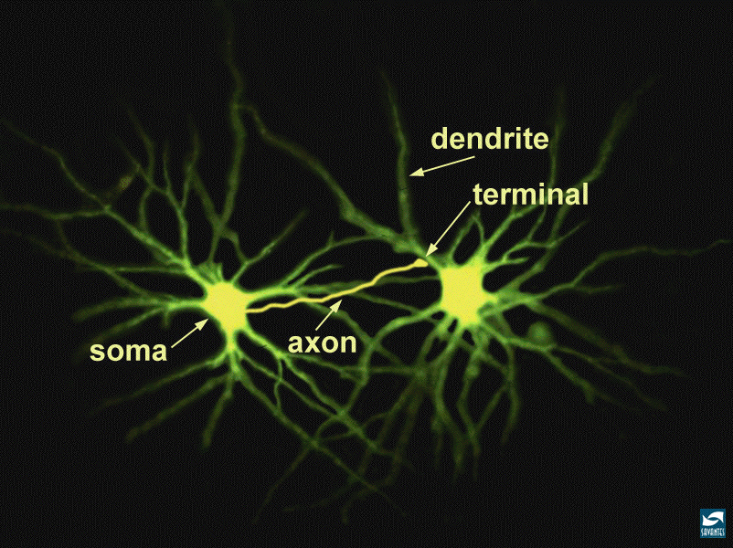
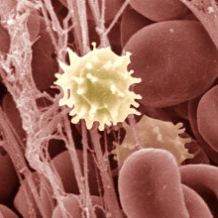
Cell Diversity
http://www.nida.nih.gov/pubs/Teaching/Teaching2/largegifs/slide5.gif
http://www.nih.gov/news/research_matters/june2009/06082009immune.htm
http://www.ncbi.nlm.nih.gov/bookshelf/br.fcgi?book=eurekah&part=A36863
Neuron
http://wheat.pw.usda.gov/~lazo/methods/minn/chap-shoot2.fm.html
Connective Tissue cell
Erythrocytes-
Red and white blood cells
http://www.nlm.nih.gov/medlineplus/ency/images/ency/fullsize/19495.jpg
http://2002annualreport.nichd.nih.gov/deb/images/bondy_fig4.jpg
Epithelial cells- Line body cavities
Osteocytes- bone cells
Skeletal Muscle cells

Slide 16
Examining Cell Structure and Related Function
Key points are the role of proteins, the role of DNA, and cell communication and interaction with materials.
We will first take a look at the cell wall.
The wall itself is made of a self assembling phospholipid.
Phospholipids are also used as a base to create liposomes that are used for drug delivery systems that we will discuss later.
The cell wall is made of a phospholipid sheet that has ports that regulate nutrients, waste material, communication, and interaction with other cells. So this is how cells, “see”, “communicate”, and “carry out life functions”.
Proteins are the “key” that opens and closes these ports.
Man made materials must interact or communicate with the cell.

Slide 17
Membrane Structure
Lipid bilayer
Hydrophobic
tails
Hydrophilic heads
Source: https://www.llnl.gov/str/JanFeb06/Schwegler.html

Slide 18
So what is a Phospholipid?
Natural self assembly unit
A phospholipid is a molecule related to fat
The molecule is comprised of:
A hydrophilic (water loving) phosphate head
Two hydrophobic (water fearing) fatty acid (hydrocarbon) tails
When phospholipids are added to water, they self-assemble.
The phosphate head points towards the water, keeping the fatty acid tails away from the water, forming a bilayer
These bilayers act as cell walls.

Slide 19
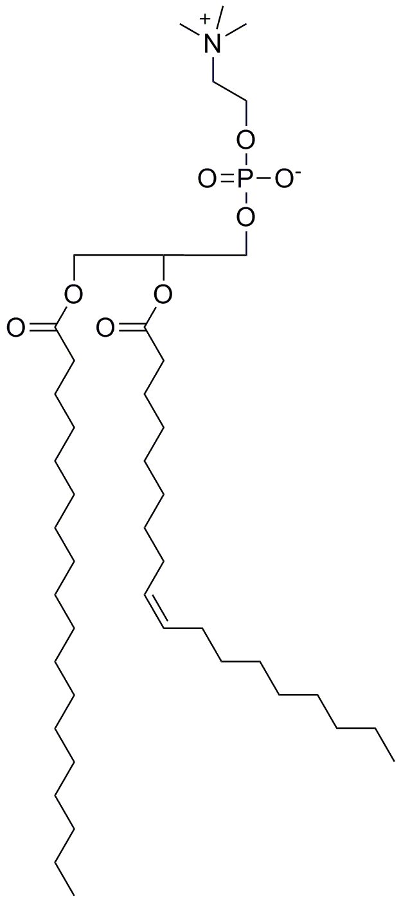
Phospholipid Structure
Choline
Hydrophilic Head
Phosphate
Hydrophobic Tail
Fatty Acid
Public Domain: image generated by CNEU Staff for free use

Slide 20
The Nucleus
Nuclear envelope is also formed from self assembled bilayer of phospholipid like the external cell wall.
The most prominent organelle in an animal cell.
The nucleus houses deoxyribonucleic acid (DNA), which is responsible for protein synthesis in the cell.
The nuclear envelope protects the DNA.
The DNA is like a “hard drive”, and it contains all the “programs” the body needs to carry out life functions.

Slide 21
The Nuclear Envelope
The entire nucleus is separated from the cytoplasm (the rest of the cell) by a nuclear envelope
A double membrane, lipid bilayers, separated by a space of 20 to 30 nm
The envelope is perforated by pores that are about 100nm in diameter, these regulate the transport of macromolecules and particles.
Naturally for the nanotechnologist these size parameters determine material interaction, material process tool set, and characterization tools.
The nucleus houses DNA, that is packaged as chromosomes during cell division.

Slide 22
DNA and Proteins
Why do we care about DNA and proteins?
DNA is an excellent example of controlled self assembly.
DNA is transcribed into RNA, which is translated into proteins
DNA is the “software/template”, proteins carry out life functions
We will review DNA first, then see how DNA is used to create proteins later in the presentation.

Slide 23
Deoxyribonucleic Acid (DNA)
Chemically, DNA consists of a series of nucleotides
The building block of nucleic acids, made up of a five carbon sugar, deoxyribose, covalently bonded to a nitrogenous base, base pairs, and a phosphate group.
The phosphate of one nucleotide is bonded to the sugar of the next nucleotide in line, resulting in a sugar-phosphate “backbone” from which the bases project
Co·don, A set of three consecutive nucleotides in a strand of DNA or RNA that provides the genetic information to code for a specific amino acid that will be incorporated into a protein chain or serve as a termination signal.

Slide 24
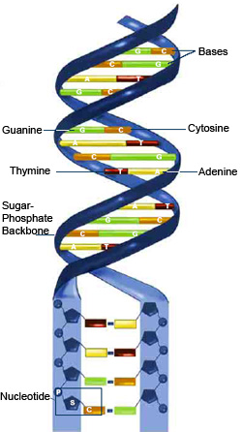
DNA Structure
1 nm
3.4 nm
0.34 nm sugar-to-sugar
Source: http://publications.nigms.nih.gov/thenewgenetics/chapter1.html

Slide 25
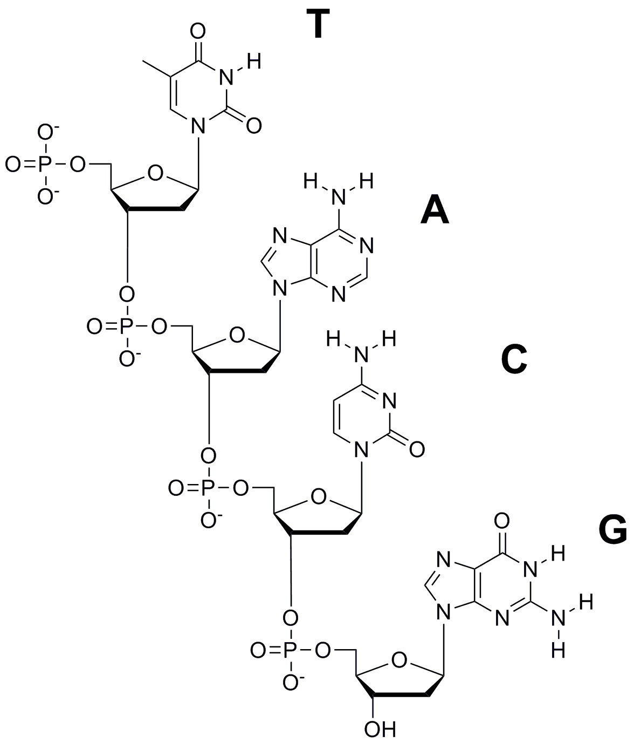
Deoxyribonucleic Acid (DNA), Single Strand
Sugar-phosphate backbone
Public Domain: image generated by CNEU Staff for free use, 2009

Slide 26
Assembly Rules of DNA
Purines bond to pyrimidines and vice versa via hydrogen bonding
never to each other
Bonding always occurs in the following convention
A-T
C-G
This allows ½ of the DNA chain to be replicated
Human DNA contains about 6 billion base pairs.
Nature uses three base pairs to define a specific amino acid, and these amino acids are coupled together to form functional proteins.

Slide 27
Self Assembly Rule

Slide 28
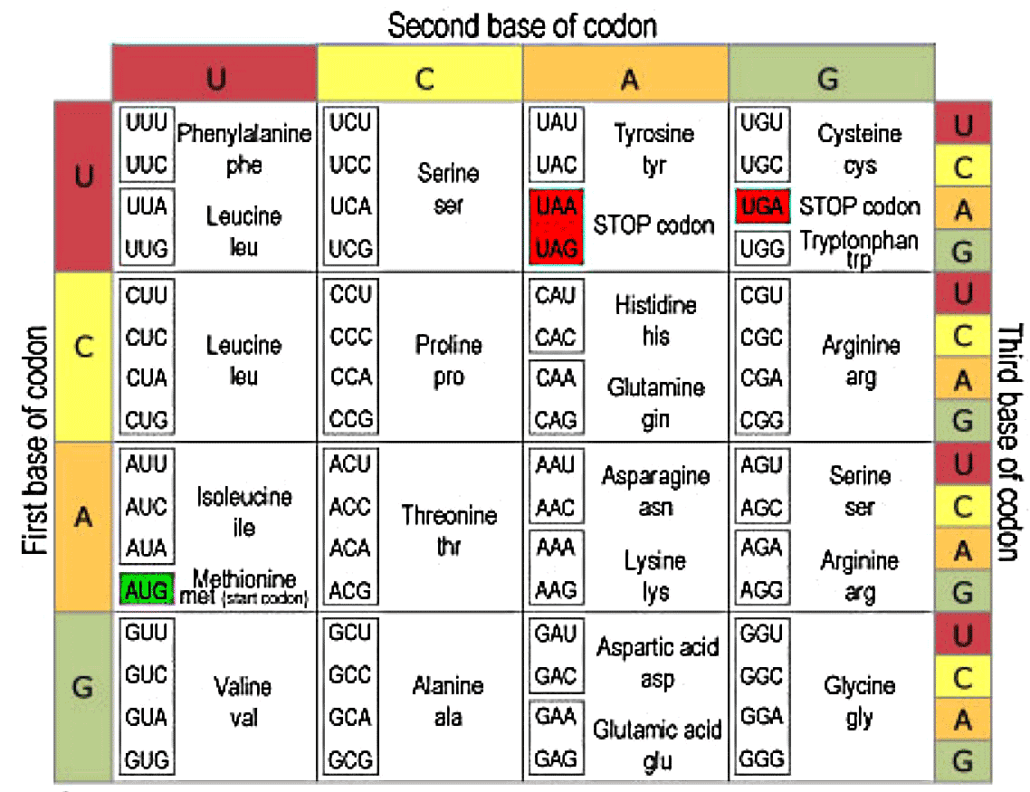
Codon Table for Amino Acids

Slide 29
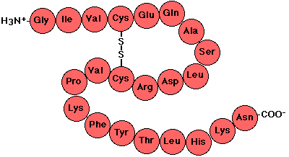
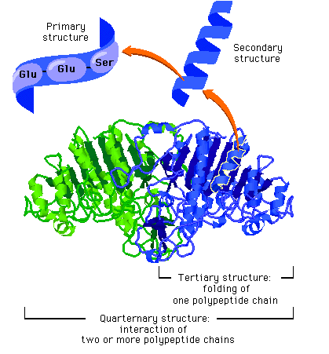
Codons, to Polypeptides, to Proteins
Codons encode the information for specific amino acids
Polypeptides are chains of amino acids
Proteins are made up of one or more polypeptide molecules
Protein shape gives functionality
We will review protein synthesis later in the presentation

Slide 30
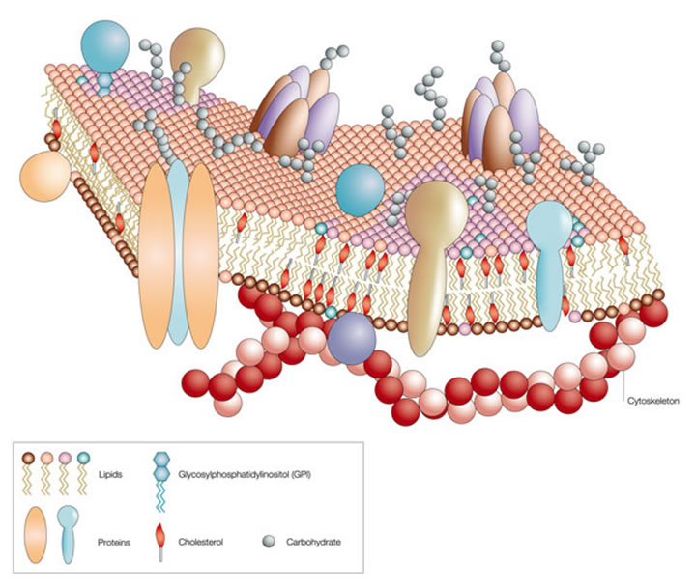
Membrane Structure/Protein Keys
Protein receptors for cell communication
Extracellular environment
Lipid Bilayer:
Excellent example of how “nature” does self assembly
Intercellular region (cytoplasm)
http://neutrons.ornl.gov/conf/dsm2008/registration.shtml

Slide 31
DNA Structure
Double Helix
Scale
The native form of DNA
Consists of two adjacent strands, held together by hydrogen bonds between base pairs and wound into a spiral shape
The double helix is 2 nm in diameter
The base pairs are 0.34 nm apart
There are ten pairs per turn of the helix

Slide 32
DNA Assembly Overview
Example of controlled self assembly.
During cell division, DNA is “split” between the old and new cell.
Before replication, the parent cell contains two complimentary strands of DNA.
The parent cell’s two strands are separated.
Each “old” strand serves as a template that controls the synthesis of “new” complimentary strands.
Each DNA molecule consists of one “old” strand and one “new” strand resulting in two identical copies.
Later in this presentation we will look at nanotechnology that inhibits DNA replication as a means to destroy cancer tumors (Doxil).

Slide 33
DNA Replication
G
C
G
C
G
C
G
C
G
C
G
C
A
T
A
T
A
T
A
T
A
T
A
T
T
A
T
A
T
A
T
A
T
A
T
A
A
T
A
T
A
T
A
T
A
T
A
T
G
C
G
C
G
C
G
C
G
C
G
C
A
T
A
T
A
T
A
T
A
T
A
T
C
G
C
G
C
G
C
G
C
G
C
G
A
T
A
T
A
T
A
T
A
T
A
T
G
C
G
C
G
C
G
C
G
C
G
C
T
A
T
A
T
A
T
A
T
A
T
A
1) Before DNA is replicated it two complete
strands
2) The enzyme helicase splits the two strands of DNA apart
3) The two original strands of DNA serve as templates for the self-assembly of two new complement strands of DNA starting with the nucleotides
4) After the nucleotides are aligned they connect to one another to form the sugar phosphate backbone, and are now two complete DNA chains
Public Domain: image generated by CNEU Staff for free use, 2009

