Slide 1

Nanoparticles for Biological Applications Including Liposomes:
Biocompatibility and Cellular Overview Part 3

Slide 2
Outline
Biocompatibility
Quick overview of cellular interaction
  Scale, size, generic animal cell
Nanoscale materials for biological interaction
  Liposomes
  Metal Nanoparticles
  Nanoshells
  Examples of bionano applications

Slide 3
Nanoparticles
Nanoparticles are useful due to the small size and scaling to biology
Nanoparticles made from a metal, semiconductor or polymer must interact on the cellular level. Some terms will be defined to understand this interaction
Size and scale are important to understanding how nanotechnology can be applied to medicine
On the cellular level, a cell is about 10 microns, and pores may be 100 nm, and an amino acid is about 1 nm

Slide 4
Nanoparticles-Liposomes
The first man made nanoparticle we will look at is the liposome
The word liposome is from two Greek words: lipo, "fat" and soma, "body". Phospholipids are the building block
Phospholipids in an aqueous environment orient themselves in a thermodynamically stable form called a bilayer. This bilayer can further orient itself into a sphere known as a liposome
So a liposome is an artificially-prepared vesicle composed of a lipid bilayer. The liposome can be used as a vehicle for administration of pharmaceutical drugs, DNA/RNA, tags, and nutrients. Liposomes are biodegradable

Slide 5
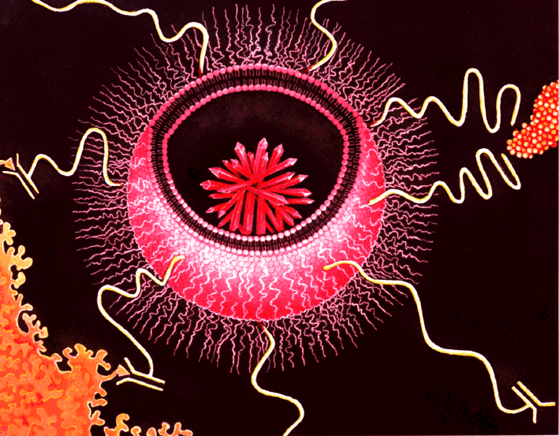
Nanoparticles-Liposomes
www.imcr.uzh.ch

Slide 6
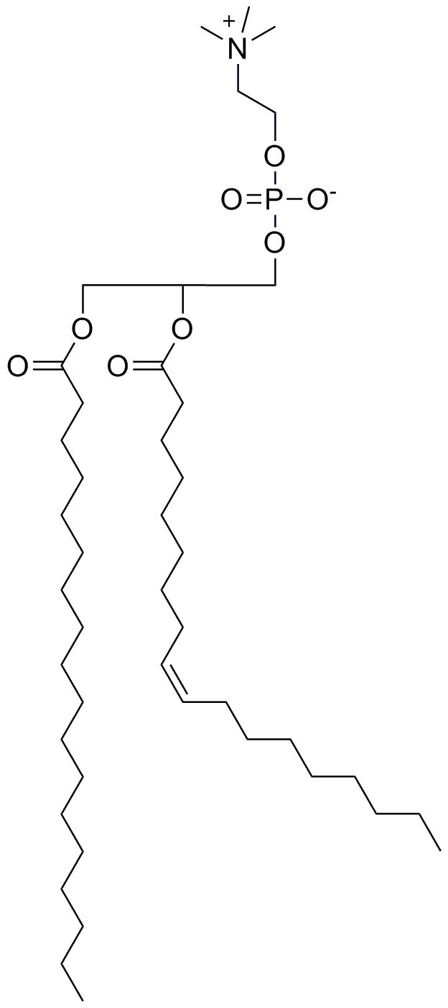
Phospholipid Structure
Choline
Hydrophilic Head
Phosphate
Hydrophobic Tail
Fatty Acid
Public Domain: image generated by CNEU Staff for free use

Slide 7
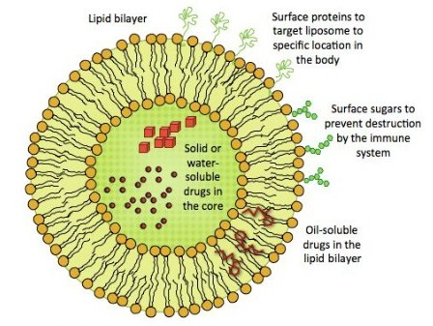
Nanoparticles-Liposomes
Illustration by Shannon McArdel

Slide 8
Nanoparticles-Liposomes
The FDA has set up guidelines to establish quality control of new therapies based on liposome technology. These chemistry, manufacturing and control guidelines are given in this document: http://www.fda.gov/downloads/Drugs/GuidanceComplianceRegulatoryInformation/Guidances/ucm070570.pdf
The physicochemical properties of the liposome drug product are critical to ensuring drug product quality
These manufacturing guidelines also reflect the interaction of liposomes and show variables that change the functionality of the man made particle

Slide 9
Nanoparticles-Liposomes
The FDA has proposed that properties specific to liposome drug products that may be useful to assess include:
  morphology of the liposome, including lamellarity determination, if applicable
  net charge
  volume of entrapment in liposomal vesicles
  particle size (mean and distribution profile)
  phase transition temperature
  spectroscopic data, as applicable
  in vitro release of the drug substance from the liposome drug product
  osmotic properties
  light scattering index

Slide 10
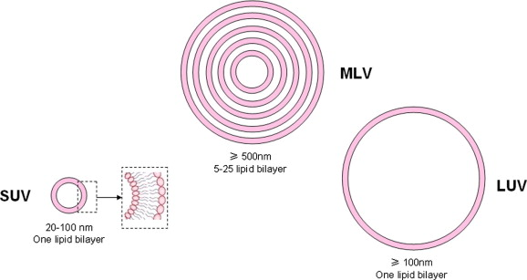
Nanoparticles-Liposomes
Liposomes can be used to deliver active molecules to the site of action, less waste and potential damage to other cells
The major types of liposomes are the multilamellar vesicle (MLV), the small unilamellar vesicle (SUV), the large unilamellar vesicle (LUV)

Slide 11
Nanoparticles-Liposomes
Sigma-Aldrich Liposome Kit: SKU L4395-1VL, Lipid mixtures for the preparation of liposomes Lyophilized powder. 85.00 USD
Composition: Cholesterol, 9 μmol/package, L-α-Phosphatidylcholine (egg yolk), 63 μmol/package Stearylamine, 18 μmol/package
http://www.sigmaaldrich.com/catalog/product/sigma/l4395?lang=en&region=US
http://www.sigmaaldrich.com/catalog/product/sigma/l4395?lang=en&region=US

Slide 12
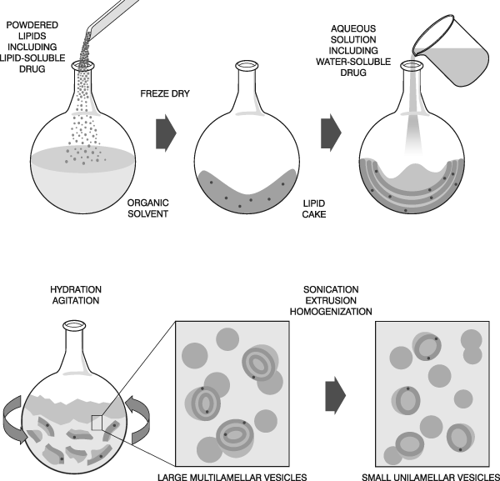

Nanoparticles-Liposomes

Slide 13
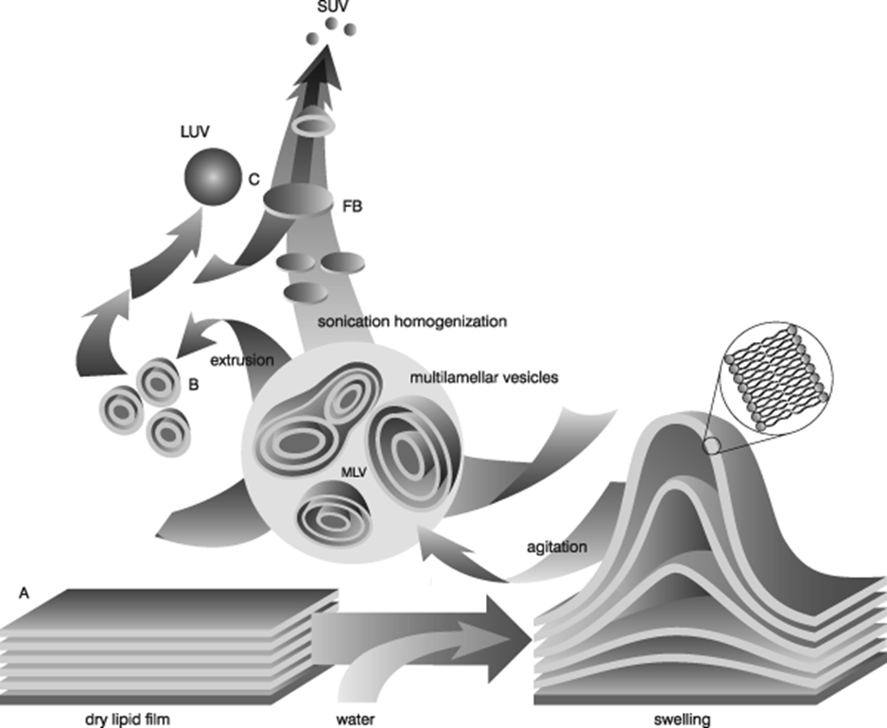
Nanoparticles-Liposomes

Slide 14
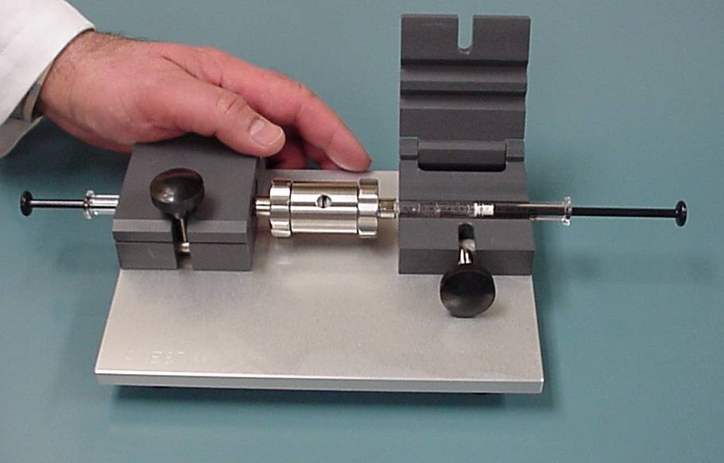
Nanoparticles-Liposomes

Slide 15
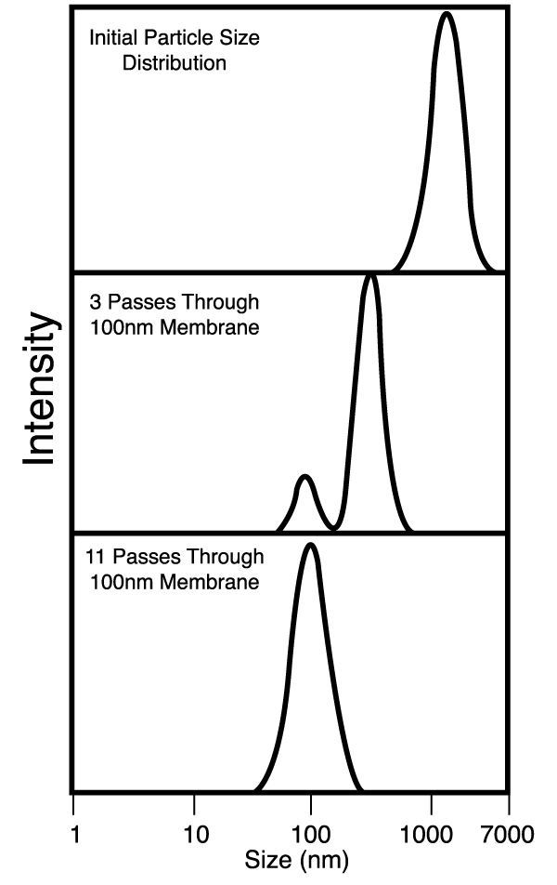
Nanoparticles-Liposomes
avantilipids.com/

Slide 16
Nanoparticles-Liposomes
Small unilamellar liposomes can hold a large payload, and suits many applications
Generally 20 – 100 nm in diameter
Liposomes can incorporate both water and fat soluble drugs or nutrients
First-generation liposomes did not use a protective layer that would prevent degradation. Second-generation liposomes use an additional layer of material to “hide” the liposome from breakdown. Stealth liposomes.

Slide 17
Liposome Uses
This “stealth” allows the liposome to survive in the body longer, and hopefully deliver the medicine to the desired area. Long-circulating liposomes are obtained by modulating the lipid composition, size, and charge of the vesicle
Different methods have been suggested to achieve long circulation of liposomes in vivo, including coating the liposome surface with inert, biocompatible polymers
A protective layer over the liposome surface and slows down liposome recognition by opsonins and therefore subsequent clearance of liposomes. Spleen and liver still filter
One of the most common coatings is PolyEthylene Glycol (PEG)

Slide 18
Nanoparticles-Liposomes
PEGylation is the process of covalent attachment of polyethylene glycol polymer chains to another molecule, normally a drug or therapeutic protein
The covalent attachment of PEG to a drug or therapeutic protein can "mask" the agent from the host's immune system
The PEG coating reduces uptake of the liposome within the ReticuloEndothelial System (RES) and therefore slows the rate of removal of the liposomes from the blood

Slide 19
Nanoparticles-Liposomes
This effectively increases the biological half-life of the liposome; in clinical studies conventional liposomes have been shown to have a half-life of 20 min in body fluids, whereas PEG-liposomes can have a half-life of up to 5 days. Doxil, a liposome cancer drug has a half life of 2 days
This circulation time is very critical
Ligands can be attached directly to the liposome shell. It has been found that antibodies tethered to the arms of the polyethylene glycol are more effective for attachment to specific receptors

Slide 20
Nanoparticles-Liposomes Uses
Liposomes can also be used to house tagging molecules. This tagging can be done inside the liposome and/or in the lipid shell of the bilayer, or on polymers bonded to the liposome shell
Liposomes can be used to encapsulate and deliver drugs, DNA or RNA, tags, or nutrients for delivery to a specific cell

Slide 21
Nanoparticles-Liposomes Tagging
QDs have been reported to be about 20 times brighter and 100 times more photostable in comparison with organic dyes such as rhodamine
Utilizing a 50 nm QD, and a liposome of 300 nm, incorporation of the QD is possible
Given these dimensions, 3 quantum dots were embedded in each liposome, and the resulting signal was the same as 3 free quantum dots. The authors proposed smaller QDs to incorporate into the liposome
Liposome encapsulation of fluorescent nanoparticles: Quantum dots and silica nanoparticles
Chien-Sheng Chen1, Jie Yao2 and Richard A. Durst1, Cornell University

Slide 22
Nanoparticles-Liposomes Tagging
This visual tagging can allow a surgeon to isolate diseased tissue from healthy tissue
Liposomes can also incorporate plasmons or radioactive markers
We will be looking at the liposome based cancer drug Doxil. It is interesting that gamma isotopes were used to track the effectiveness during drug trials. Results looked much like a PET scan

Slide 23
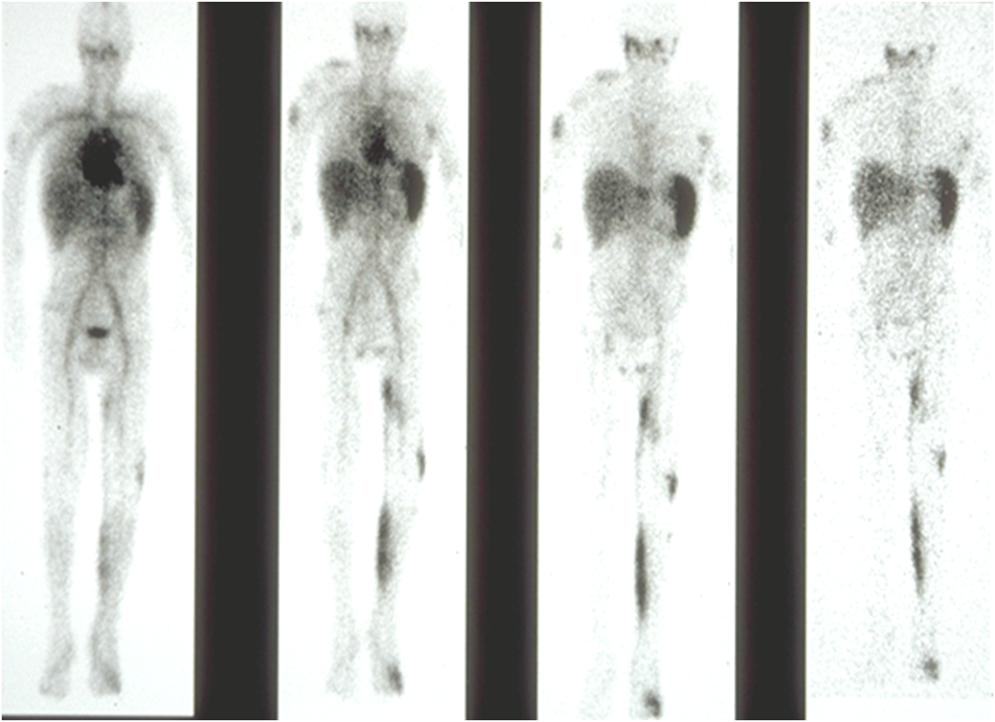
Gamma Scan of Kaposi’s Sarcoma Patient
4hours 24hours 48hours 96hours

Slide 24
Doxorubicin in KS Lesions and Normal Skin (Biopsy at 48 Hrs. after Doxil)
25
20
K S Lesion
Normal Skin
15
Doxorubicin Concentration (μg/g)
10
5
0
1
2
3
4
5
6
7

Slide 25
Nanoparticles-Liposomes Cancer Drug
As seen in the last slide, liposomes have a “natural ability” (size) to target cancer
In non cancerous samples the endothelial wall of all healthy human blood vessels are encapsulated by endothelial cells that are bound together by tight junctions. These tight junctions stop any particles in the blood from leaking out of the vessel. So healthy tissue will keep out small particles
Tumor vessels do not contain the same level of seal between cells and are diagnostically ''leaky''. This ability is known as the Enhanced Permeability and Retention (EPR) effect. So tumors are like Swiss cheese, and small particles can leak into these defects

Slide 26
Nanoparticles-Liposomes Cancer Drug
Liposomes of certain sizes, typically less than 100 nm, can rapidly enter tumor sites from the blood, but are kept in the bloodstream by the endothelial wall in healthy tissue vasculature. Anti-cancer drugs such as Doxorubicin (Doxil), Camptothecin and Daunorubicin (Daunoxome) are currently being marketed in liposome delivery systems and take advantage of the leaky tissue to selectively deliver the drug
Tumor tissues also usually lack effective lymphatic drainage, so they retain the drug. All of these factors lead to abnormal molecular and fluid transport dynamics, especially for macromolecular drugs. So tumors do not readily extract foreign material
So the key to Doxil is long circulatory lifetime provided by the PEG coating, and specific size uptake by the leaky tumor from the EPR effect. So Doxil uses passive targeting

Slide 27
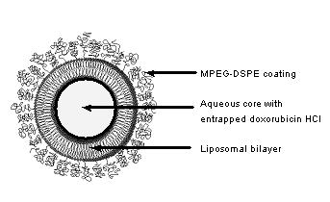
Nanoparticles-Liposomes Cancer Drug
Doxil
Drugs.com

Slide 28
Nanoparticles-Liposomes Cancer Drug
So what is the role of Doxil? (Myocet, or Caelyx)
Frank Szoka Ph.D founder of Sequess the company that invented Doxil and currently a member of the UCSF School of Pharmacy
The goal of many cancer drugs is to kill the tumor faster than the rest of the patient. So selectivity is very important
Doxil houses a “poison” called doxorubicin, known as red death
Doxorubicin is an anthracycline, it works by intercalating DNA, with the most serious adverse effect being life-threatening heart damage. This treatment inhibits DNA replication in rapidly growing cancer cells. Doxorubicin is produced naturally by Streptomyces peucetius, a species of actinobacteria

Slide 29
Nanoparticles-Liposomes Cancer Drug
Anthracyclines are among the most effective anticancer treatments ever developed and are effective against more types of cancer than any other class of chemotherapeutic agents
But daunorubicin is deadly to both the tumor and the heart
Naturally the goal is to direct the poison to the tumor, and prevent interaction with the heart and other non target tissue
As discussed, this selectivity is carried out with the use of the liposome that protects the heart, and at the same time shows preference to the tumor

Slide 30
Nanoparticles-Liposomes Cancer Drug
DaunoXome® (daunorubicin citrate liposome injection) is a prescription medicine, which belongs to a class of drugs known as anthracyclines. Anthracyclines are used to treat many types of cancer and work by interfering with the production of DNA, or genetic makeup, of the cancer cells, preventing them from multiplying. Since its US launch in 1996, thousands of patients have been treated with DaunoXome® worldwide
DaunoXome® has a different delivery system compared to conventional anthracyclines. In DaunoXome®, the molecules of the drug are enclosed in a protective coating, known as a liposome. This protective coating allows the drug to remain in the body for longer, so that more of the treatment is delivered to cancer cells

Slide 31
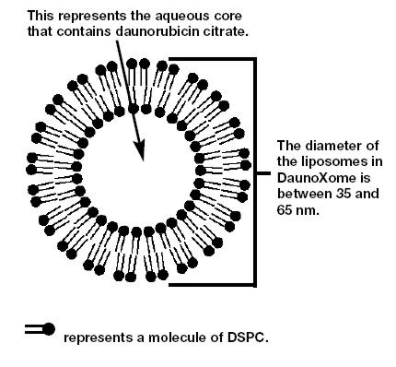
Nanoparticles-Liposomes Cancer Drug
DaunoXome

Slide 32
Nanoparticles-Liposomes Cancer Drug
DaunoXome® was the first cancer product based on liposomes
DaunoXome® also uses a PEG enhanced surface for long circulation time. These long circulating liposomes found to target tumor tissue by a mechanism known as enhanced permeation and retention
Again, EPR is the property by which certain sizes of molecules (typically liposomes, nanoparticles, and macromolecular drugs) tend to accumulate in tumor tissue much more than they do in normal tissues

Slide 33
Nanoparticles-Liposomes Cancer Drug
Liposomal delivery of doxorubicin HCL improves drug penetration into tumors and decreases drug clearance, thereby increasing the duration of therapeutic drug effects; a liposomal formulation of doxorubicin also modulates toxicity, specifically the cardiac effects commonly seen with anthracycline antitumor drugs
Doxorubicin intercalates between base pairs in the DNA helix, thereby preventing DNA replication and ultimately inhibiting protein synthesis. This inhibits rapidly growing cancer cells
So the liposome passively targets the tumor, not other cells. Coatings on the liposome keep it active in the blood stream longer so it can be filtered/trapped in the tumor

Slide 34
List of clinically approved liposomal drugs
Name | Trade name | Company | Indication
Liposomal amphotericin B | Abelcet | Enzon | Fungal infections
Liposomal amphotericin B | Ambisome | Gilead Sciences | Fungal and protozoal infections
Liposomal cytarabine | Depocyt | Pacira (formerly SkyePharma) | Malignant lymphomatous meningitis
Liposomal daunorubicin | DaunoXome | Gilead Sciences | HIV-related Kaposi’s sarcoma
Liposomal doxorubicin | Myocet | Zeneus | Combination therapy with cyclophosphamide in metastatic breast cancer
Liposomal IRIV vaccine | Epaxal | Berna Biotech | Hepatitis A
Liposomal IRIV vaccine | Inflexal V | Berna Biotech | Influenza
Liposomal morphine | DepoDur | SkyePharma, Endo | Postsurgical analgesia
Liposomal verteporfin | Visudyne | QLT, Novartis | Age-related macular degeneration, pathologic myopia, ocular histoplasmosis
Liposome-PEG doxorubicin | Doxil/Caelyx | Ortho Biotech, Schering-Plough | HIV-related Kaposi’s sarcoma, metastatic breast cancer, metastatic ovarian cancer
Micellular estradiol | Estrasorb | Novavax | Menopausal therapy

Slide 35
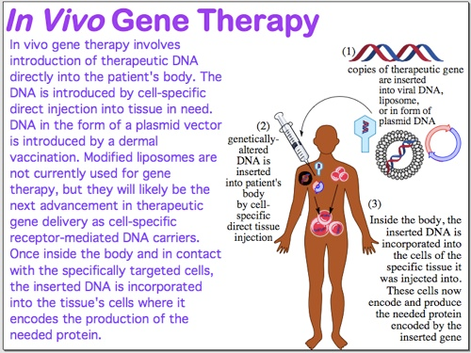
Nanoparticles-Liposomes Genes
http://genomics.energy.gov/

Slide 36
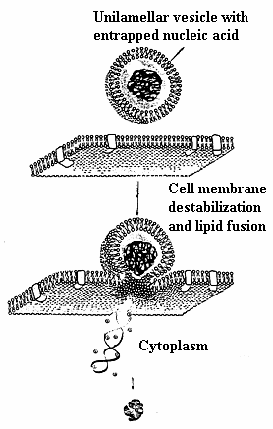
Nanoparticles-Liposomes Genes
Rev Electron Biomed / Electron J Biomed 2004;2:13-35

Slide 37
Nanoparticles-Liposomes Nutrition
Nutritional supplement companies are currently encapsulating nutrients such as vitamin C in liposomes
Liposome delivery increases the bioavailability of nutrients compared to traditional oral dietary capsules
Liposomes bypass the destructive elements of the gastric system and aid the encapsulated nutrient to be delivered to the cells and tissues
Hydrophilic drugs/nutrients/tags can be trapped in the central aqueous core of the liposomes, and lipophilic drugs can be solubilized within the lipid bilayer

