Slide 1
Dielectrics by Growth and Deposition

Slide 2
Outline
Introduction – Silicon Dioxide
Types of Oxide
Furnace Deposition
Dry Oxidation
Wet Oxidation
High Pressure Oxidation
Chemical Vapor Deposition
Modifying Dielectric Constant

Slide 3
Oxidation
Oxidation is a chemical reaction in which silicon and oxygen form a stable material called silicon dioxide

Slide 4
Silicon Dioxide
A high quality, stable electrical insulator material
Grows naturally on silicon
Has many uses

Slide 5
Silicon Dioxide
SiO₂
Oxide Lattice
Tetrahedral
Structure of oxide
Key:
Oxygen
Public Domain: Image generated by CNEU Staff for free use
Si

Slide 6
Oxide Quality
Determined by checking:
Film thickness and uniformity (nm)
Defects (#/volume)
Dielectric strength (MV/cm²)
Stress (MPa)
Interface properties

Slide 7
Film Thickness
Oxide film thickness can be roughly judged by the color of the oxide
This is a general measurement, but can be useful

Slide 8
Silicon Dioxide Thickness
Thickness | Color | Thickness | Color
0.05 μm | Tan | 0.54 | Yellow-green
0.12 | Royal Blue | 0.57 | Yellow to “yellowish”
0.17 | Metallic to v. light yellow-green | 0.60 | Carnation Pink
0.22 | Gold w/ orange-yellow | 0.63 | Violet-red
0.27 | Red-violet | 0.80 | Orange
0.32 | Blue to Blue-green | 0.85 | Dull, light Red-violet
0.36 | Yellow-green | 0.87 | Blue-violet
0.39 | Yellow | 0.92 | Blue-green
0.42 | Carnation Pink | 0.97 | Yellow to “yellowish”
0.50 | Blue-green | 1.00 | Carnation Pink

Slide 9
Mechanism
Oxygen moves through the oxide layer to react with the silicon below
Oxygen diffuses from an area of high concentration (gas) to an area of low oxygen conc. (silicon)
Fick’s first law states that the particle flow per unit area, J (particle flux), is directly proportional to the concentration gradient of the particle:
J = -D∂N(x,t)/∂x

Slide 10
Diffusion of Oxygen
O₂
SiO₂
Si
Public Domain: Image generated by CNEU Staff for free use

Slide 11
Mechanism
Silicon in the wafer is consumed as the oxide grows
Typically, for every 1000Å of oxide grown, 400Å of silicon is consumed
For a 1000Å layer of oxide, the wafer physically grows only 600Å

Slide 12
Outline
Introduction – Silicon dioxide
Types of Oxide
Furnace Deposition
Dry Oxidation
Wet Oxidation
High Pressure Oxidation
Chemical Vapor Deposition
Modifying Dielectric Constant

Slide 13
Types of Oxides
Native Oxide
Considered a contaminant. It grows naturally on silicon at room temperature due to the presence of O₂ in the ambient environment
Can reach a maximum thickness of ~40Å
Gate Oxide
A highly pure, specifically grown oxide that acts as a dielectric between the gate, source, and drain on the MOS structure
Optimal thickness is between 20Å and several hundred Å
Higher purity and thinner oxides lead to the production of faster devices

Slide 14
Types of Oxide
SiO₂ Native Oxide (200nm)
Gate Oxide
Gate
p+ Si
Source
Drain
p+ Si
Native Oxide
Gate Oxide
Public Domain: Image generated by CNEU Staff for free use

Slide 15
Types of Oxide
Field Oxide (FOX)
Used to isolate individual transistors from each other on a wafer
Ideal thickness is between 2,500Å – 15,000Å.
Barrier Oxide
Protects active devices and silicon from further processing
Ideal thickness is usually several hundred Å

Slide 16
Types of Oxide
Barrier Oxide
Field Oxide
Gate
Gate
Source
Drain
Source
Drain
p+ Si
p+ Si
Barrier Oxide
Field Oxide
Public Domain: Image generated by CNEU Staff for free use

Slide 17
Types of Oxide
Barrier
Used as a mask to prevent doping in unwanted areas
Also used in patterning of wafers. Its chemical resistance provides a strong barrier for etching/depositing/etc. patterns in a wafer
Optimal thickness ~400Å – 1,200Å, but it depends on the doping process
Pad Oxide
Reduces stress for Si₃N₄
Thickness is kept very thin

Slide 18
Types of Oxide
Dopant Barrier Oxide
Pad Oxide
Gate
p+ Si
Source
Drain
p+ Si
Dopant Barrier Oxide
Pad Oxide
Public Domain: Image generated by CNEU Staff for free use

Slide 19
Types of Oxide
Implant Screen Oxide
Used to prevent/minimize implant channeling and damage
Thickness varies depending on implant depth
Insulating Barrier
Placed between metal layers to prevent electrical shorts
Used because of its insulating properties (does not conduct electricity)
This layer is deposited (as opposed to grown) and the required thickness varies

Slide 20
Types of Oxide
Insulating barrier oxide
Metal 2
Screen Oxide
Metal 1
Gate
Source
Drain
Si
p+ Si
Implant Screen Oxide
Insulating Barrier Oxide
Public Domain: Image generated by CNEU Staff for free use

Slide 21
Outline
Introduction – Silicon dioxide
Types of Oxide
Furnace Deposition
Dry Oxidation
Wet Oxidation
High Pressure Oxidation
Chemical Vapor Deposition
Modifying Dielectric Constant

Slide 22
Oxidation
Three methods for growing oxide:
High temperature oxidation (furnace)
w/ oxygen: dry oxidation
w/ steam: wet oxidation
High-pressure oxidation – HiPOx
One method of depositing oxide:
CVD – chemical vapor deposition

Slide 23
Furnace Oxidation
Important parameters for furnace processes:
Time
Temperature
Temperature gradients
Gas composition and purity
Gas flow rate
Thermal stress management

Slide 24
Outline
Introduction – Silicon dioxide
Types of Oxide
Furnace Deposition
Dry Oxidation
Wet Oxidation
High Pressure Oxidation
Chemical Vapor Deposition

Slide 25
Dry Oxidation
Oxidation that occurs as a result of oxygen reacting with silicon
Si + O₂ ➔ SiO₂
Grows high quality thin layers of oxide (i.e. gate oxides)
Grows oxide at a slow rate

Slide 26
Dry Oxidation
The process is performed in the furnace at a high temperature (normally above 1000ºC)
Uses oxygen as the process gas
May use HCl in process to reduce charges at the wafer surface

Slide 27
Dry Ox. Process Recipe
Step | Time (min) | Temp. (°C) | Gas Flow (SLM)
 |  |  | N₂ | O₂ | HCL
1) Idle state |  | 850 | 3 | 0 | 0
2) Push wafer into furnace | 5 | 850 | 3 | 0 | 0
3) Ramp up temp. | 15 | 10°C/min | 3 | 0 | 0
4) Temp. stabilization | 5 | 1000 | 3 | 0 | 0
5) Dry oxide growth | 30 | 1000 | 0 | 2.5 | .067
6) Anneal | 30 | 1000 | 3 | 0 | 0
7) Ramp down temp. | 75 | -2°C/min | 3 | 0 | 0
8) Retrieve wafer | 850 | 3 | 0 | 0

Slide 28
Ramping
With any furnace process, temperatures need to be changed slowly when wafers are present
The ramp-up rate (in this recipe) is 10ºC/min. The ramp-down rate is –2ºC/min.
These slow rates are necessary to prevent warping or other thermal stress problems in the silicon wafers

Slide 29
Dry Ox. Growth Rate
5000
4000
3000
Oxide Thickness (Å)
2000
1000
Approximately linear growth region
100
200
300
400
500
Time (min)
Public Domain: Image generated by CNEU Staff for free use

Slide 30
Outline
Introduction – Silicon dioxide
Types of Oxide
Furnace Deposition
Dry Oxidation
Wet Oxidation
High Pressure Oxidation
Chemical Vapor Deposition
Modifying Dielectric Constant

Slide 31
Wet Oxidation
Oxidation that occurs as a result of steam reacting with silicon
Si + 2H₂O ➔ SiO₂ + 2H₂
Grows oxide at a much faster rate and produces a lower quality oxide
Use this technique when very thick oxides (i.e. field oxide) are needed rather than high quality

Slide 32
Wet Oxidation
The process is performed in the furnace at high temperatures (normally 1000ºC)
Uses steam as the process gas
Steam is pyrolytic meaning that in high heat H₂ and O₂ are reacted together to create water vapor molecules
This produces a much purer steam for oxidation

Slide 33
Chlorinated Agents
Using chlorinated gases in the oxidation process can neutralize charge accumulation at the silicon oxide interface
Chlorinated agents are kept under 3% so instability is not created in the oxide layer
Chlorinate agents can increase growth rates by 10-15%. This mechanism is poorly understood
Trichloroethane (TCA), an organochloride, offers low corrosion to the oxidation system

Slide 34
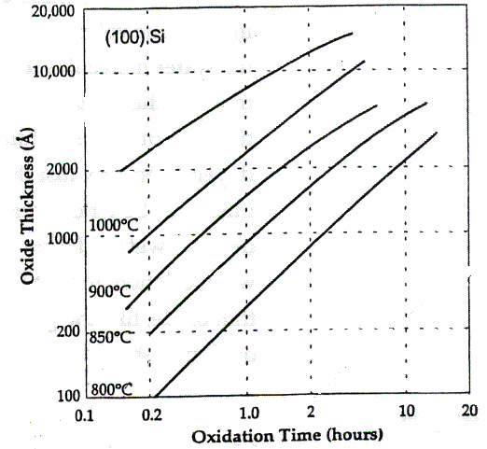
Wet Ox. Growth Rate

Slide 35
Wet Vs. Dry Oxidation
Dry Ox. Grows higher quality oxides
In Wet Ox., steam reacts with silicon and produces hydrogen molecules. These molecules become trapped in the oxide and change the stoichiometry of the oxide
Stoichiometry indicates how closely the deposited film approaches the ratio of the elements given by its chemical formula

Slide 36
Wet Vs. Dry Oxidation
Wet Ox. grows oxides faster
At 1000ºC, the solubility of water in silicon (total amount of water that can be present in a certain volume of silicon) is 600 times that of oxygen in silicon
Even though oxygen diffuses faster, it has a lower solubility and physically can fit fewer atoms in the silicon

Slide 37
Wet Vs. Dry Oxidation
Oxide Type | Temp (°C) | Thickness (Å) | Time
Dry | 1000 | 1000 | 2 hours
Wet | 1000 | 1000 | 12 minutes

Slide 38
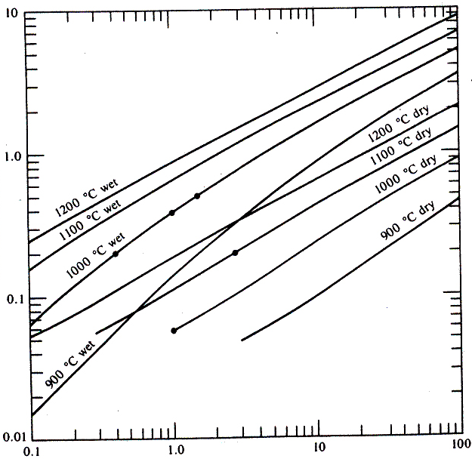
Wet and Dry Oxide Growth
Oxide Thickness (µm)
Time (hours)

Slide 39
Increasing Temp. – Decreasing Time
There are many problems with increasing the temperature at which a process runs
Increased diffusion of impurities present in the wafer
Crystal defects (stacking faults)
Permanent damage from thermal stress
Equipment damage/more costly equipment to run at higher temperatures

Slide 40
Outline
Introduction – Silicon dioxide
Types of Oxide
Furnace Deposition
Dry Oxidation
Wet Oxidation
High Pressure Oxidation
Chemical Vapor Deposition
Modifying Dielectric Constant

Slide 41
High Pressure Oxidation - HiPOx
Used to grow thick layers of oxide in reduced time and temperature (i.e. field oxide)
Uses steam and oxygen as process gases
Has special HiPOx system equipment

Slide 42
HiPOx System
Door
End Cap
Injector Baffle
Heating Element
Quartz Tube
Breech
Injector-
Steam
Public Domain: Image generated by CNEU Staff for free use

Slide 43
HiPOx
Runs at reduced temperatures:
~ 650ºC – 900ºC
And increased pressures:
~ 5 – 20 atm

Slide 44
HiPOx Relationships
Time and pressure are inversely related:
Temp. (°C) | Pressure (atm.) | Time
900 | 1 | 5 hours
900 | 5 | 1 hour
900 | 25 | 12 minutes
*Assuming that the wafers are of the same thickness

Slide 45
HiPOx Relationships
Temperature and Pressure:
For every increase of one atmosphere, the temperature can be dropped by 30ºC to obtain the same thickness in the same time
Time (hours) | Pressure (atm.) | Temp. (°C)
5 | 1 | 1000
5 | 10 | 700

Slide 46
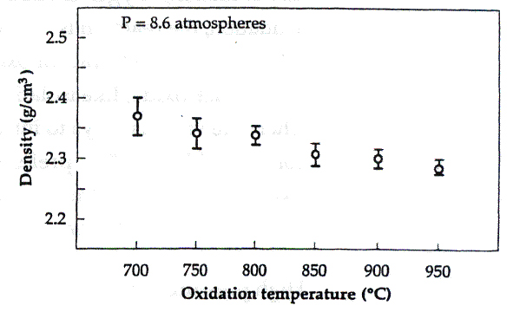
HiPOx Relationships
Temperature and oxide density:
As temperature decreases, oxide density increases

Slide 47
HiPOx
HiPOx allows the oxidation to occur at a lower temperature and higher pressure
As shown, HiPOx will produce a higher quality (greater density) oxide in a shorter time than dry or wet oxidation can produce (for equal thickness)

Slide 48
Outline
Introduction – Silicon dioxide
Types of Oxide
Furnace Deposition
Dry Oxidation
Wet Oxidation
High Pressure Oxidation
Chemical Vapor Deposition
Modifying Dielectric Constant

Slide 49
CVD
The deposition of oxide onto a wafer using the decomposition of silane
SiH₄ + O₂ ➔ SiO₂ + 2H₂
“Deposits” a layer of oxide as opposed to the other techniques that “grow” the oxide

Slide 50
CVD
Oxide is deposited at ~ 350ºC
Silicon and oxygen react in plasma and deposit onto the wafer (other techniques diffuse O₂ into the wafer and use the wafer’s silicon to produce oxide)
Creates a nearly stoichiometric layer

Slide 51
Index of Refraction
Air
n=1.0
SiO₂
n=1.46
θ
SiO₂
n=1.46
Air
n=1.0
θ
Public Domain: Image generated by CNEU Staff for free use

Slide 52
CVD
Nitrous oxide (N₂O) or carbon dioxide (CO₂) are actually preferred over oxygen
The oxygen reacts too easily in the plasma and can cause poor film quality

Slide 53
Outline
Introduction – Silicon dioxide
Types of Oxide
Furnace Deposition
Dry Oxidation
Wet Oxidation
High Pressure Oxidation
Chemical Vapor Deposition
Modifying Dielectric Constant

Slide 54
Engineering Dielectric Constant (k)
This concept centers around capacitance (C) and its relationship to signal time (T) when fabricating integrated circuits
k= dielectric constant
ε _{o}= permittivity of free space (constant)
A= area
d= distance between features
C =kε_{o} A
d

Slide 55
Engineering Dielectric Constant (k)
Signal Time (T)
R= resistance of metals
C= capacitance
In IC fabrication, the idea is to use the correct dielectric material with the right constants for a desired process
Keeps the capacitance the same to insure the signal time is not compromised
T= RC

Slide 56
Engineering Dielectric Constant (k)
Figure of Merit
The figure of merit is a number expressed in farads/meter and is calculated by dividing capacitance (C) by area (A)
Used as a constant in IC fabrication
If device scaling changes, the dielectric material must change to maintain the figure of merit’s value
C/A = figure of merit

Slide 57
Engineering Dielectric Constant (k)
Interconnects- wiring
The wire lines must be as close as possible in order to fit the maximum amount of transistors on a chip
The distance must be minimized, therefore; the dielectric material must have a low k
As d decreases, k must also decrease

Slide 58
Engineering Dielectric Constant (k)
Gates
Uniformity is a key quality parameter
It is easier to make the gates thicker, to insure that any variation in uniformity won’t impact device performance as drastically
Example 1: If a gate is 30Å:
Material uniformity that varies by 10Å drastically alters performance
Example 2: If a gate is 100Å
Material uniformity that varies by 10Å does not impact performance that drastically

Slide 59
Engineering Dielectric Constant (k)
Gates
A thicker gate requires a dielectric material with a high k value
As d increases, k must also increase

Slide 60
High k Dielectric Materials
Ta₂O₅, k = 22-30
TiO₂, k = 20-85
Nb₂O₅, k = 11
HfO₂, k = 17
Y₂O₃, k = 15

Slide 61
Low k Dielectric Materials
FSG, k = 3.4-4.1
HSQ, k = 2.9
Nanoporous silica, k = 1.3-2.5
Fluorinated polyimide, k = 2.6-2.9
PTFE, k = 1.9
DVS-BCB, k = 2.65
Aromatic hydrocarbon, k = 2.65

