Slide 1

Focused Ion Beam (FIB): “Seeing” and “Processing” at the Nano-Scale

Slide 2
Outline
FIB Overview
FIB Operation
FIB Applications

Slide 3

FIB overview

Slide 4
Ebeam vs. Ion Beam
Beam Interactions
Milling as it scans sample surface
No damage as it scans sample surface
Note difference in interaction volume

Slide 5
Applications of Focused Ion Beam (FIB)
Ion beam lithography
Image Analysis
Film Deposition
Ion Milling (Dry Etching)

Slide 6
Typical Configuration of FIB
Door
Electron Column
Ion Column
Vacuum Chamber

Slide 7
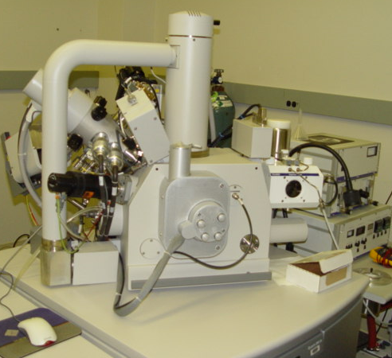
FEI Quanta 3D system
Typical Configuration of FIB (continued)
Ion column (Ion pump showing)
Electron Column
Pt Gas Injection
System (GIS)
Stage motors

Slide 8
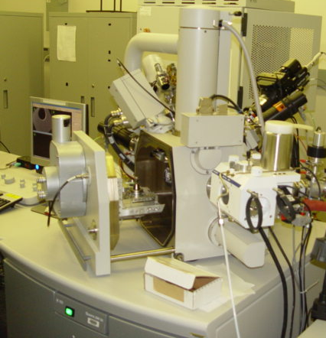
FEI Quanta 3D system
Typical Configuration of FIB (continued)
Omniprobe
Tungsten Gas Injection
System (GIS)

Slide 9
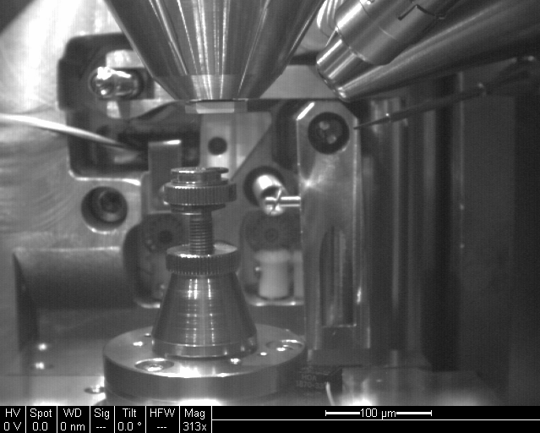
FEI Quanta 3D system
Typical Configuration of FIB (continued): 0 degree tilted
SEM Column
Ion Column
BSD
GIS (Pt)
Sample stage

Slide 10
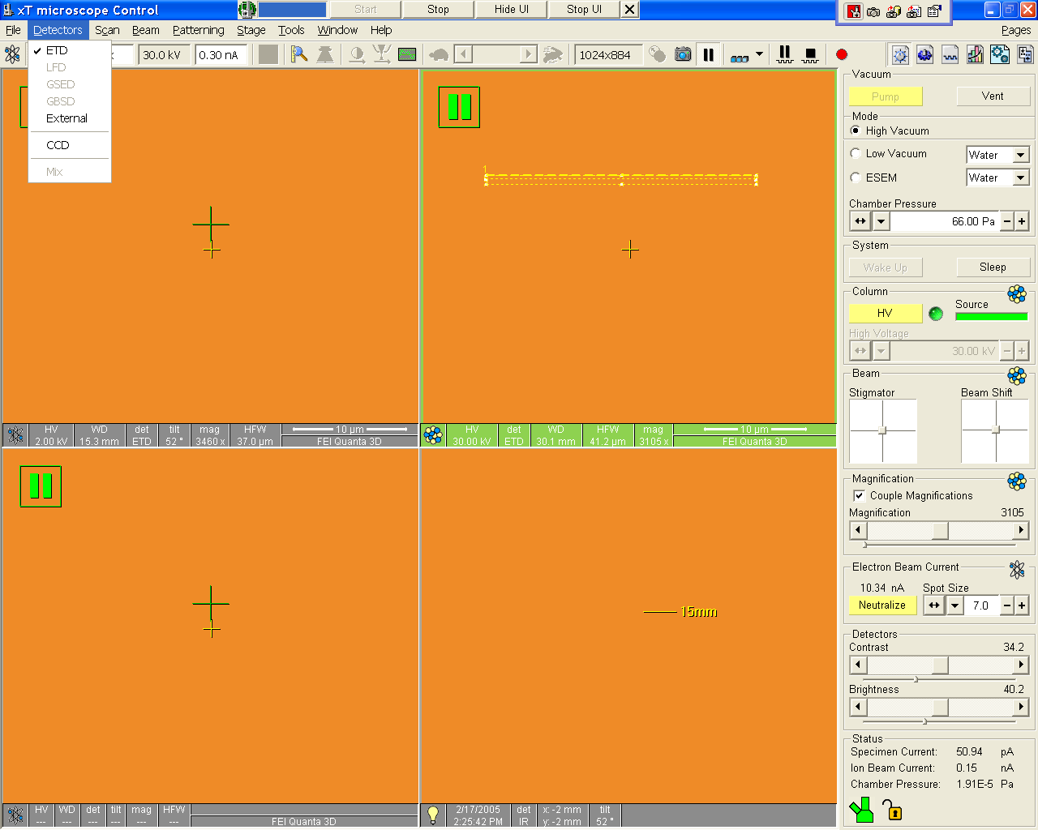
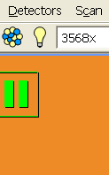
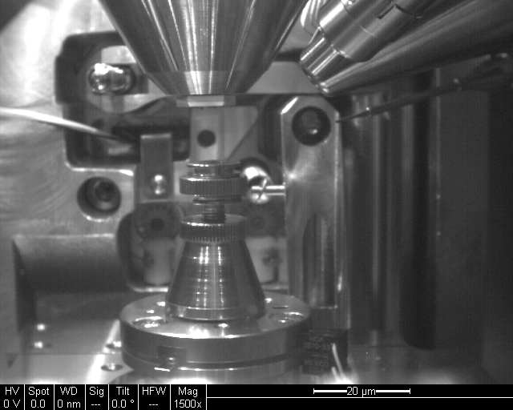
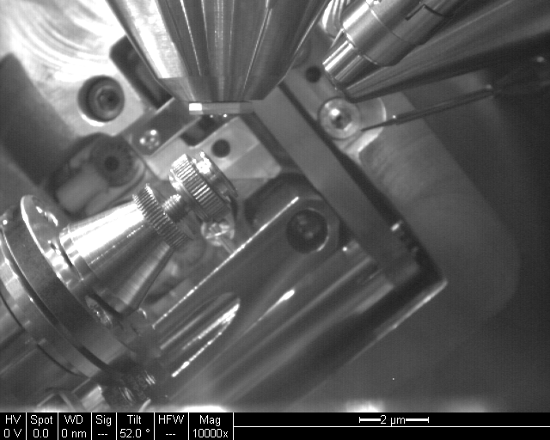
Typical Configuration of FIB (continued): 52 degree tilted

Slide 11
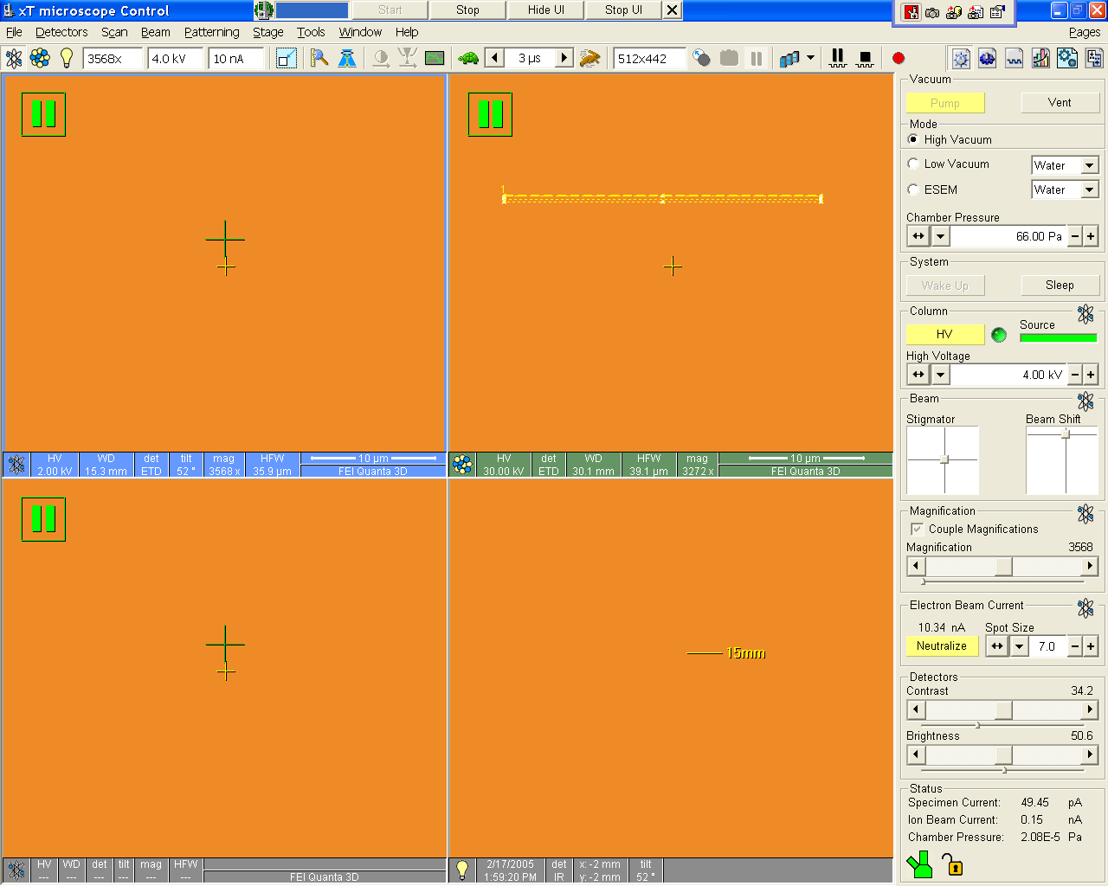
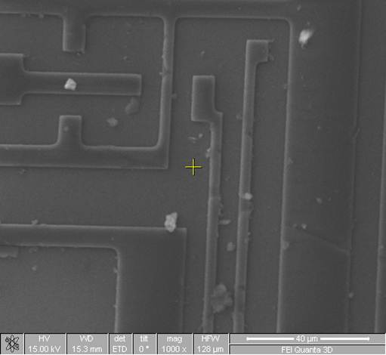
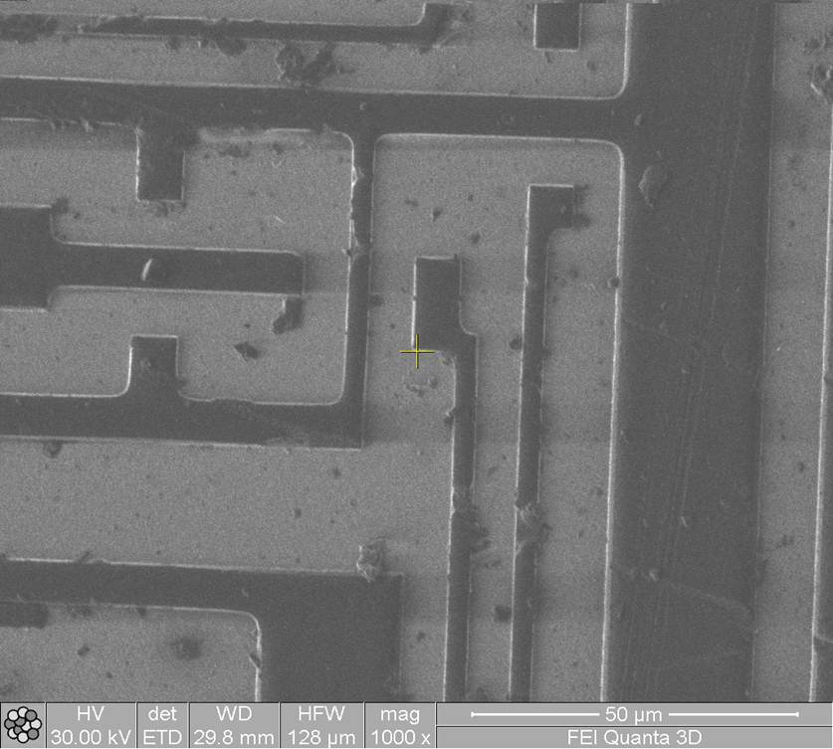
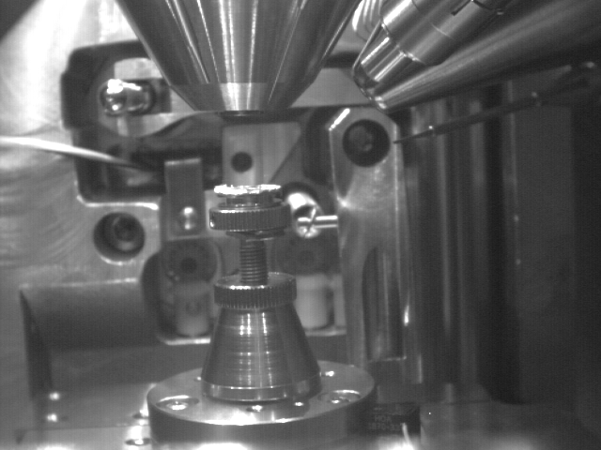
Typical Configuration of FIB (continued): User Interface

Slide 12
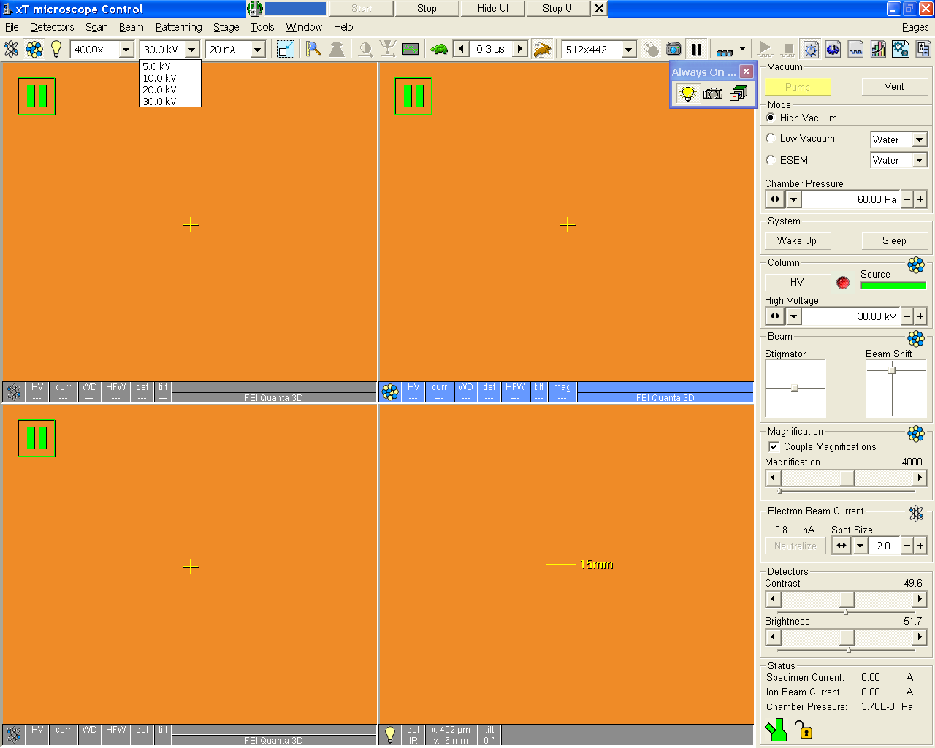
Typical Configuration of FIB (continued): User Interface

Slide 13
FIB operation

Slide 14
All equipment is pointed to one central spot !!
What is Eucentric Point ?
GIS
E-beam
Ion-beam
Eucentric height =15mm WD below e-column pole piece and 30mm from I column

Slide 15
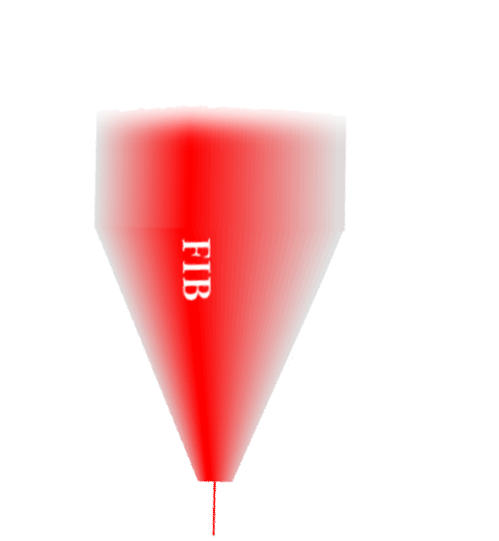
What is Eucentric Point ? (continued)
All aligned:
  “Eucentric” is a point in the stage height control (“Z”) where the sample’s image does not move when the sample is tilted.
  SEM imaging is used to find the physical point.
15 mm SEM WD
Tilt Plane
IMAGE

Slide 16

Eucentric Point (continued)
SEM:Imaging
FIB: Cutting
52°
52°
38°

Slide 17
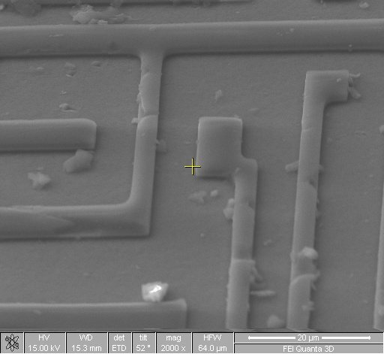
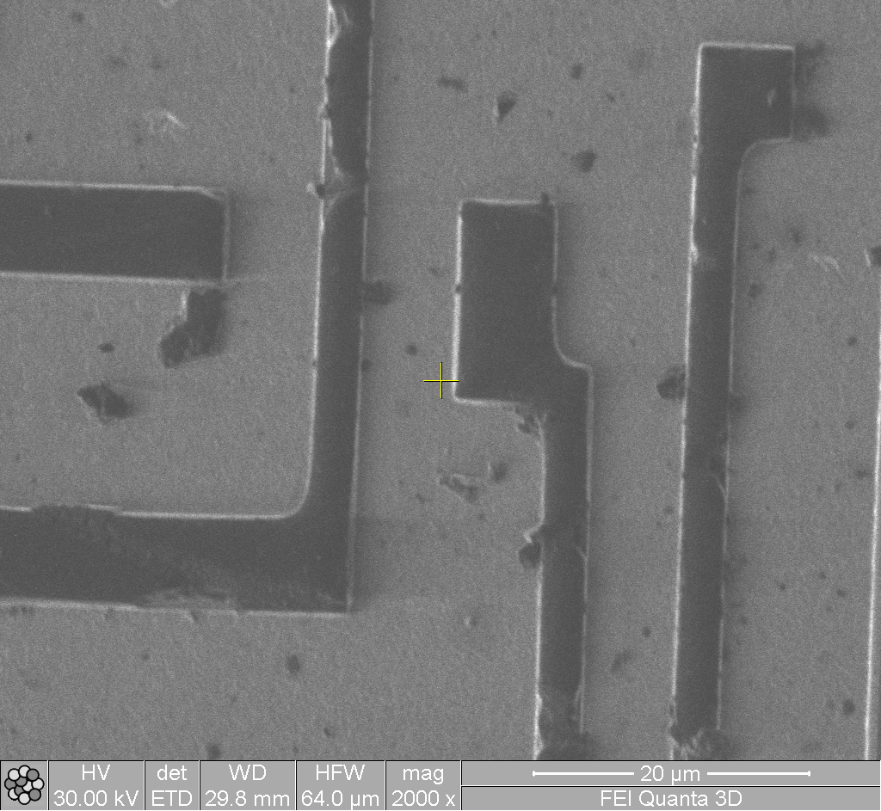
Eucentric Point (continued) – 52 degree tilted Images
SE image is foreshortened. The upper part of the image is at a longer WD than the lower portion of the image.
Ion mage - Appears to be looking straight on.

Slide 18
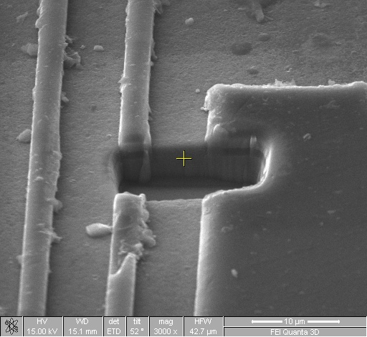
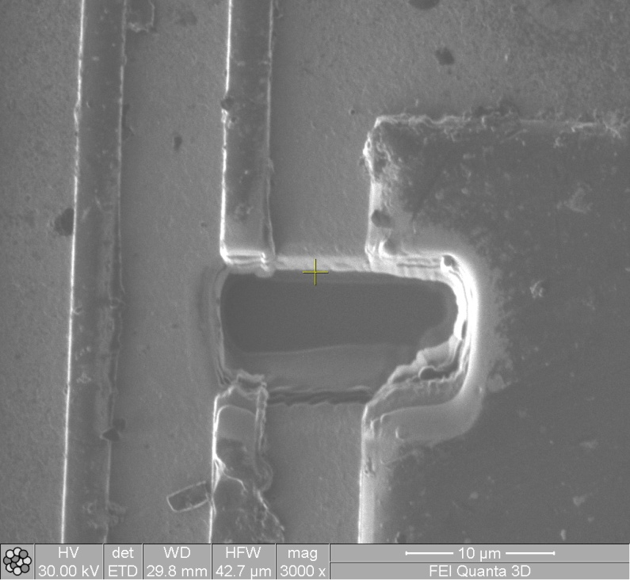
Eucentric Point (continued) – 52 degree tilted Images
SE image can look into the milled area.
Ion image is doing the cutting and “looking” down in the sample.

Slide 19
Eucentric Point Finding Steps
“Eucentric” is the point on the height of the stage in which the sample stays centered as the stage is tilted.
It’s assumed you are at about 15 mm WD (having done a Z<>FWD and moved the stage previously)
Only after finding the eucentric point, you have coincidence alignment of the beams!

Slide 20
Eucentric Point Finding Steps (continued)
You will perform the following steps in the upcoming slides:
  Start at ‘0’ degrees tilt
  Note a feature of interest and bring to a feature of interest (e.g., center of crosshairs)
  Tilt the stage to a positive 52 degrees
  Watch the image move either up or down on the screen
  Adjust the “Z” height on the specimen door to bring feature back to the center of the screen
  You may have to do this several times at higher and higher magnifications to get perfect eucentricity

Slide 21
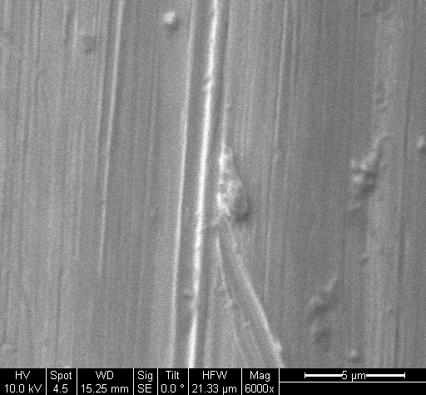
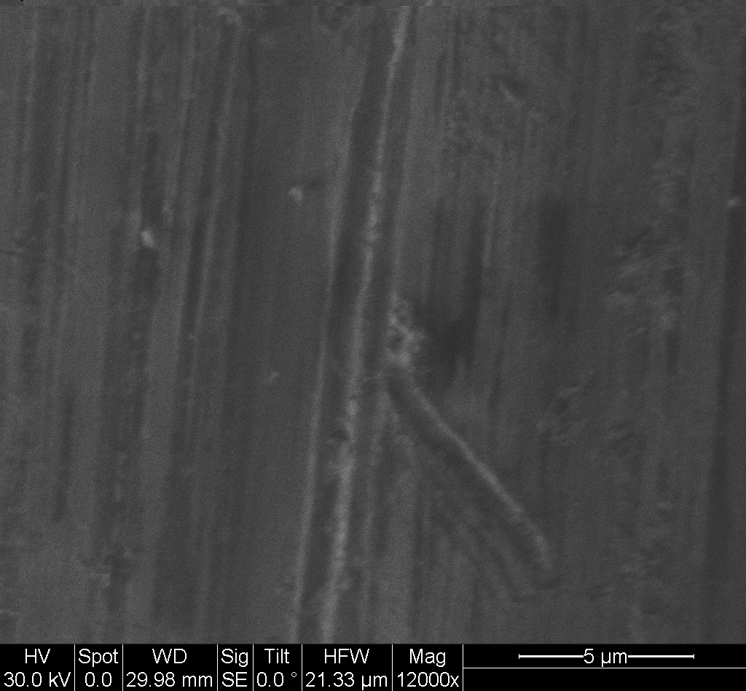
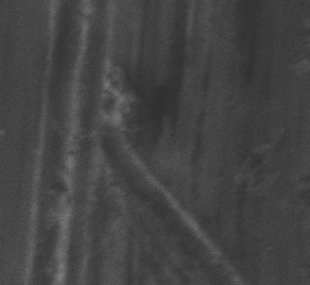
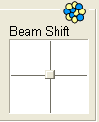
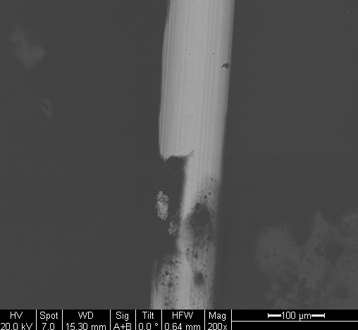
Fine Alignment of Ion Beam

Slide 22
We just set up the sample to face the Ion beam
E-Beam
Ion-Beam

Slide 23
Ion Beam Operation
The ion beam will damage your sample when viewing. It is important to use a small beam size when imaging!
When getting ready to mill with a large beam current, you must focus quickly and in as few of scans as possible!
While milling or depositing a film, you can highlight Quad 1 (SE column) and take a photo (F2) or click “snapshot.” or. It will pause the Ion beam and grab a quick SE image to see status of the Ion milling operation.

Slide 24
Film Deposition (Pt)
Pt. deposition can be used for many applications.
  adding a conductive layer to a non conductive sample
  setting up a pattern, to prevent “curtaining” with the FIB
  adhesive attachment for mechanical testing
  - This tutorial will cover the second point: making a protective shield for further processing

Slide 25
Film Deposition (Pt)-continued
Gas Injection System
Ion Beam
Notes:
The gas is delivered through a needle very close to sample. This needle is usually retracted out of the way until needed.
It is pre-adjusted to be about 100 microns above the sample, and about 100 microns away from the center of the scan.
Having the needle reasonably close allows a smaller volume of gas and this is easier on the pump and chamber.

Slide 26
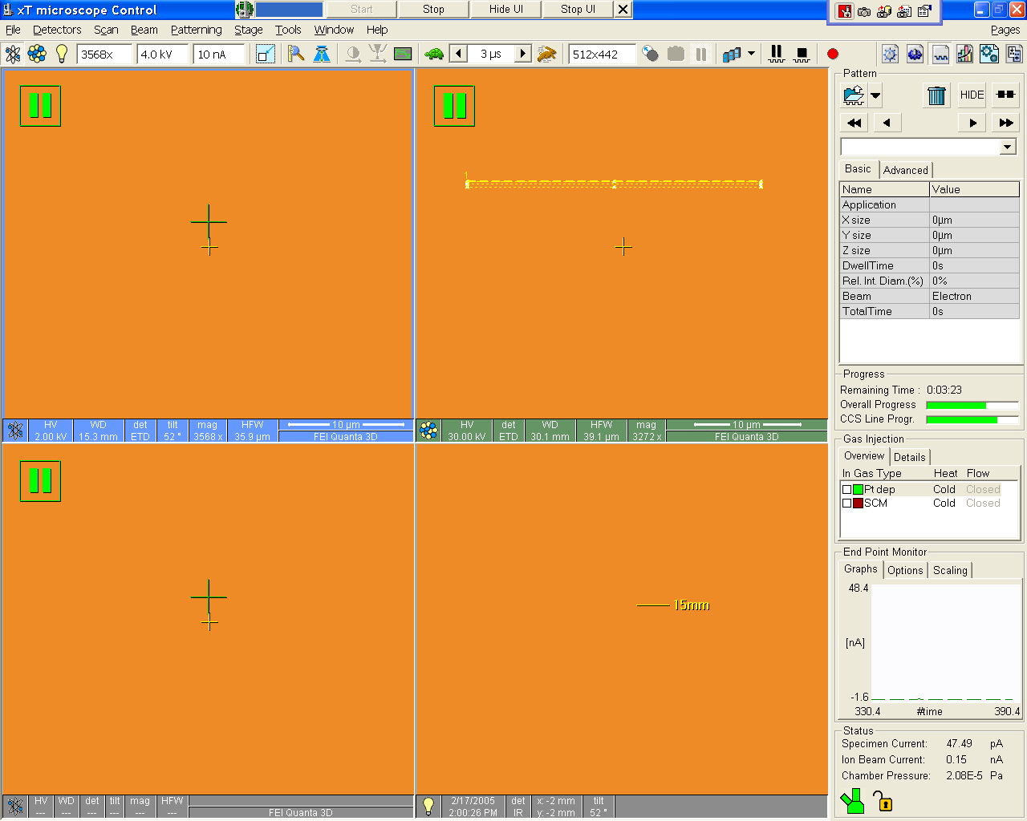

Film Deposition (Pt)- Find Deposition Spot
Click on the third Icon - the Patterning Page
This page controls:
Patterning type including size
Progress of mill or deposition
Gas injection
End Point Monitor

Slide 27

Film Deposition (Pt)-Warm up the Pt Source
Double click “cold” to toggle on “warm”
-This heats the Pt. Gas deposition system.

Slide 28
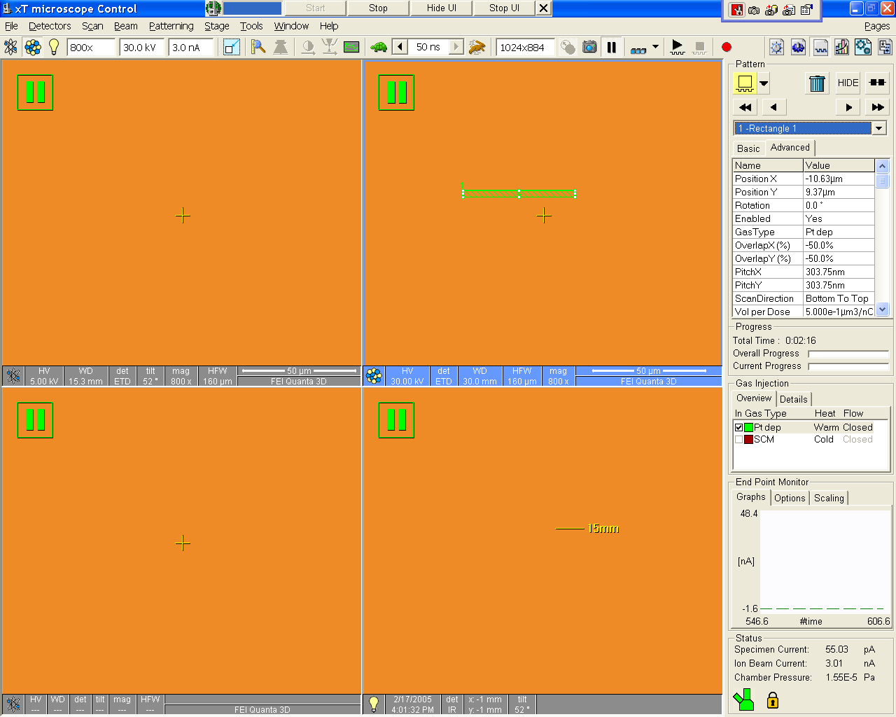
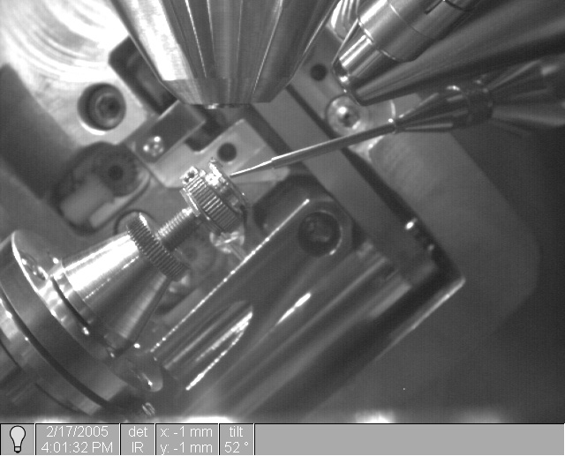

Film Deposition (Pt)-Insert Pt Gas Injector
Click on click box under “In”, to inject the GIS needle
Check Quad 4 to see that the needle appears to be inserted properly

Slide 29

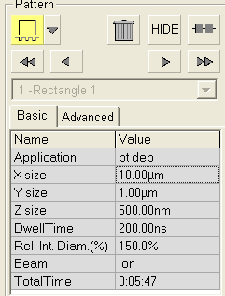
Film Deposition (Pt)-Define the Deposition Area
Select “Rectangle”.
Draw a rectangle on the frozen Ion image by clicking and dragging the left mouse button.
Make the rectangle about 10 X 1 X 1 Micron in X,Y, and Z values.
Increase mag so rectangle fills large fraction of screen
Verify “Pt dep” is selected as application on the “basic” tab

Slide 30
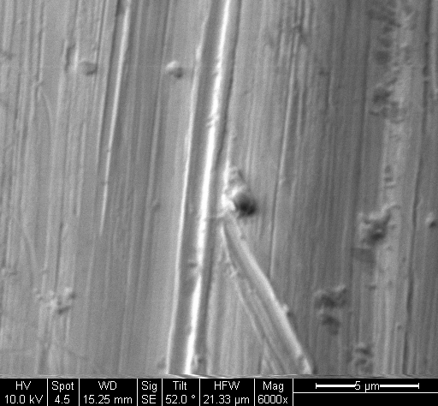

Film Deposition (Pt)- Deposition Condition Setup
Set Ion current to 0.10 nA for dep.
Un Pause and quickly focus, if a “Beam Shift” is necessary, move image so that it is still aligned to SEM image.
Re-alignment of the deposition pattern box may also be necessary.

Slide 31

Film Deposition (Pt)-Start Deposition
Start the Dep by clicking the “Start” icon
Note the various parameters in Pattern menu. These will become more important to you later, but its good to get exposed now, while you are waiting for a deposition.

Slide 32
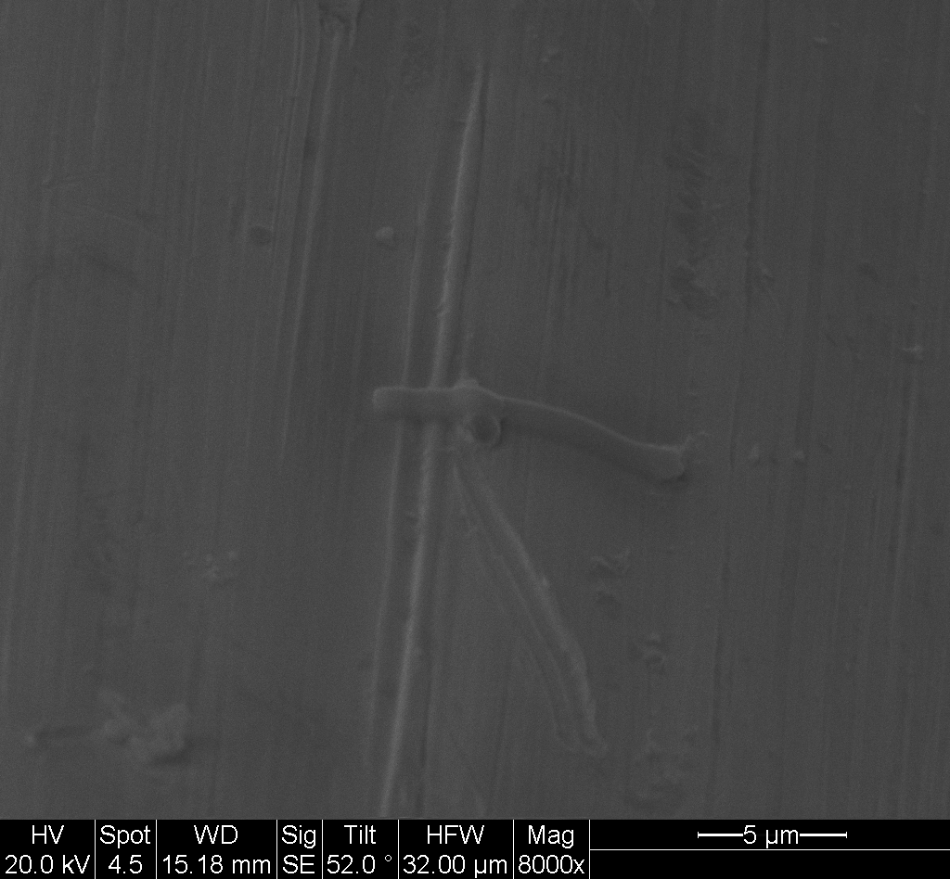


Film Deposition (Pt)- Deposition Progress Check
You may take a quick peak at the depositions, as it progresses by using the “Snapshot” feature.
- Enable Quad 1
- Click on the “SnapShot” icon

Slide 33
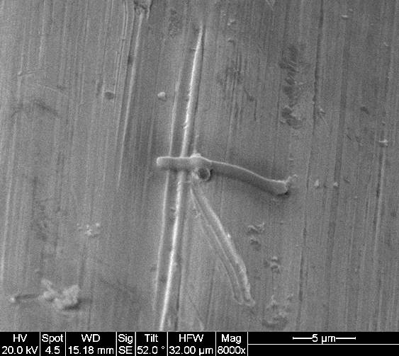
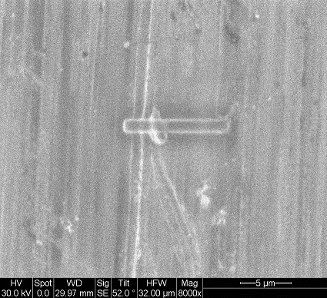
Film Deposition (Pt)- Images of Deposited Film
Electron beam image
Ion beam image

Slide 34
Ion Milling
Key
SEM:Imaging
Metal deposition
SEM
FIB
Sample plane
Cross section
Projection of sample plane to SEM image plane
Projection of cross section plane to SEM plane
Cross section image surface
Stage at 0°
FIB: Cutting
Cos 52°
Sin 52°
52°
38° from 0°
52°
38°

Slide 35
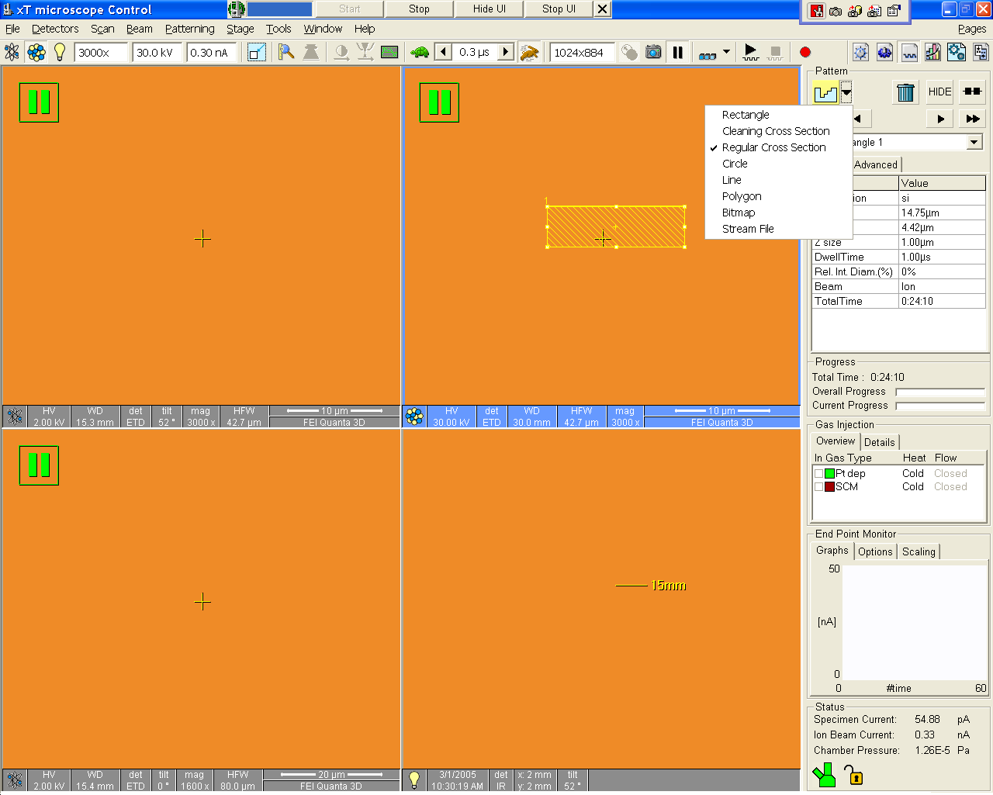
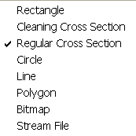
Ion Milling: Basic Step
Start with “Regular Cross Section”
Click and draw a rectangular box on the prepared sample
Align the rectangle just below the Pt.dep area
Set “Application” to “Si”, as default cutting parameters

Slide 36

Ion Milling: Ion Beam Setup
Increase the ion beam current to 5 nA
Quickly scan and focus (you are milling as you scan)
Pause as soon as the image is in focus
Re-align the milling pattern if necessary on the frozen image

Slide 37

Ion Milling: Milling
Verify that the rough cross section is 10 X 4.5 X 4 microns deep and aligned just touching the Pt. Dep pattern.
Start Milling
If you have a BSD, you may image live in Quad 3 as the sample is milled.

Slide 38
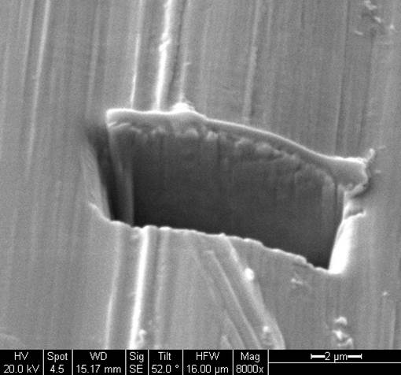
Ion Milling: Progress Check
Milling has now started
Note time remaining
Take a break for that time period (tell your boss its an order)
If you are curious, click on Quad 1 and then “snapshot”. That will give you a quick SE image of your milling progress

Slide 39

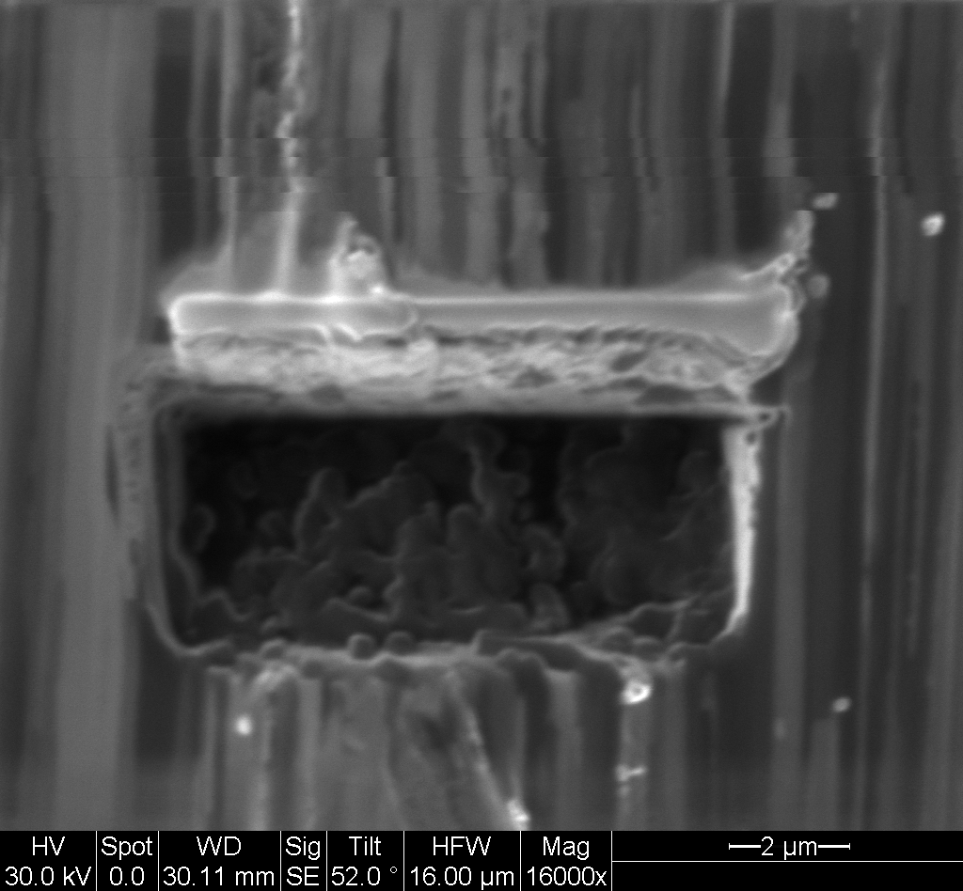
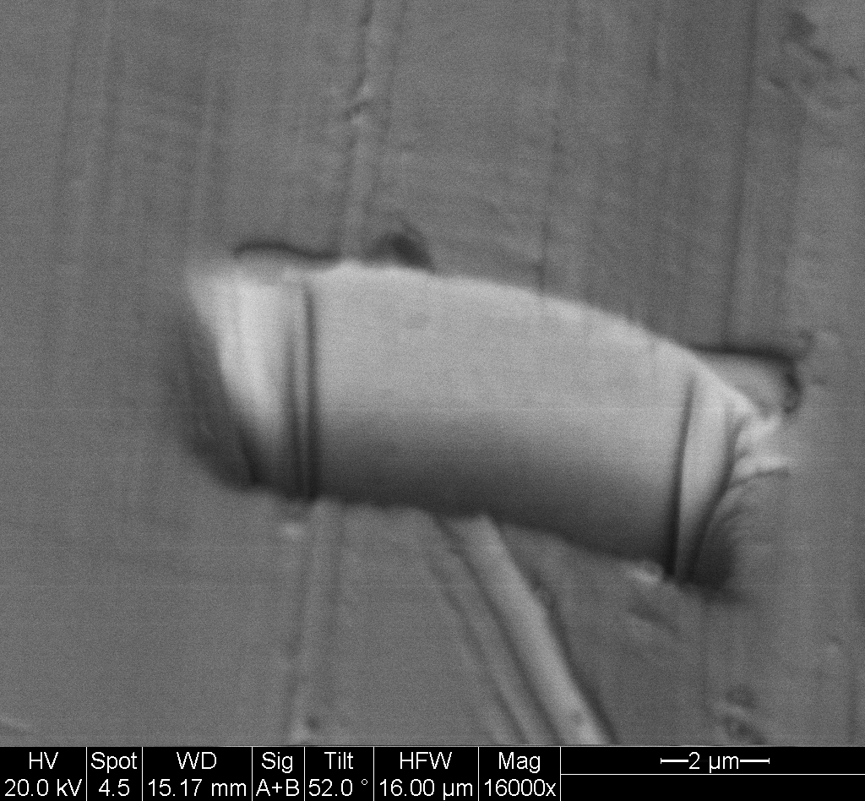

Ion Milling: Cleaning Cut
View the rough cut with the SEM
Click on Quad 2 and adjust ion beam current to 0.3 nA
Select “cleaning cross section” pattern
Scan and focus with the ion beam and then pause
Redraw a smaller pattern on the frozen ion beam image
Use a depth 1/3rd that of the regular cross section
Start milling

Slide 40
Ion Milling: Cleaning Cut
View the rough cut with the SEM
Click on Quad 2 and adjust ion beam current down to 50 pA
Select “cleaning cross section”
Scan and focus with the ion beam and then pause
Redraw a smaller pattern on the frozen ion beam image
Start milling

Slide 41
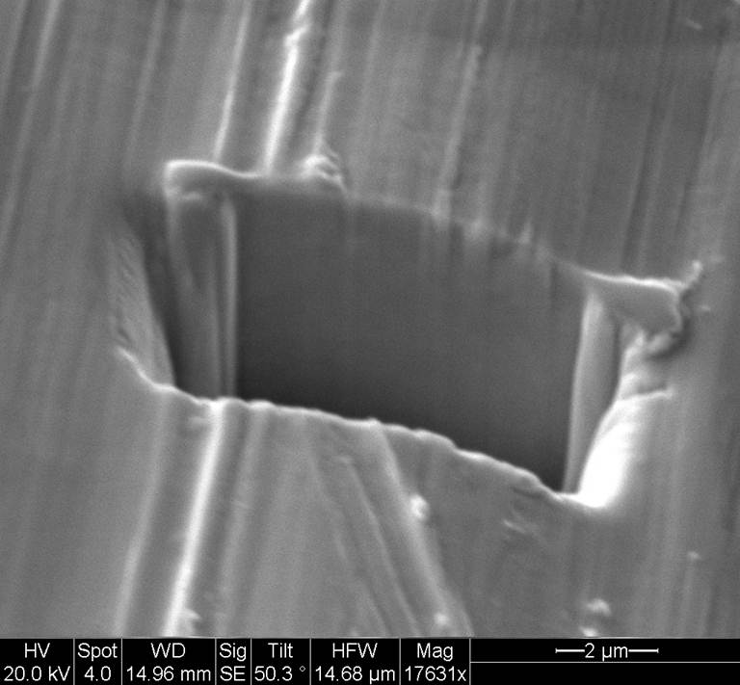
Ion Milling: SEM Image of the Cut

Slide 42
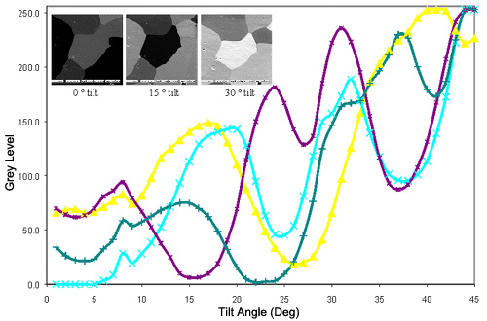
FIB Grain Contrast
FIB is more than four times as intense as that produced by backscattered electrons in the SEM, and results in spectacular grain contrast, as can easily be seen in the FIB image of aluminum grains in the image.
http://www.fibics.com/fib/tutorials/Grain-Orientation-Contrast/6/

Slide 43
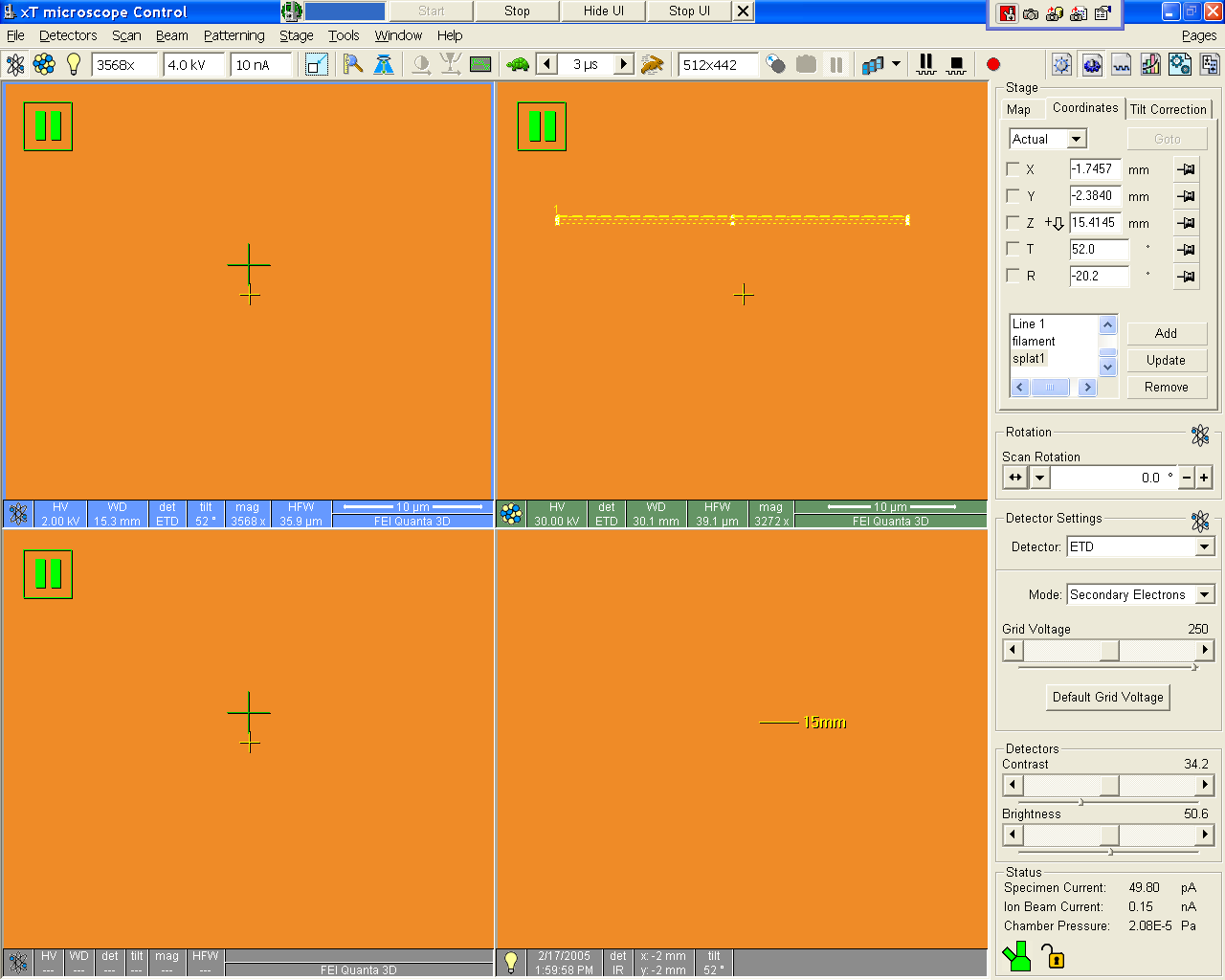

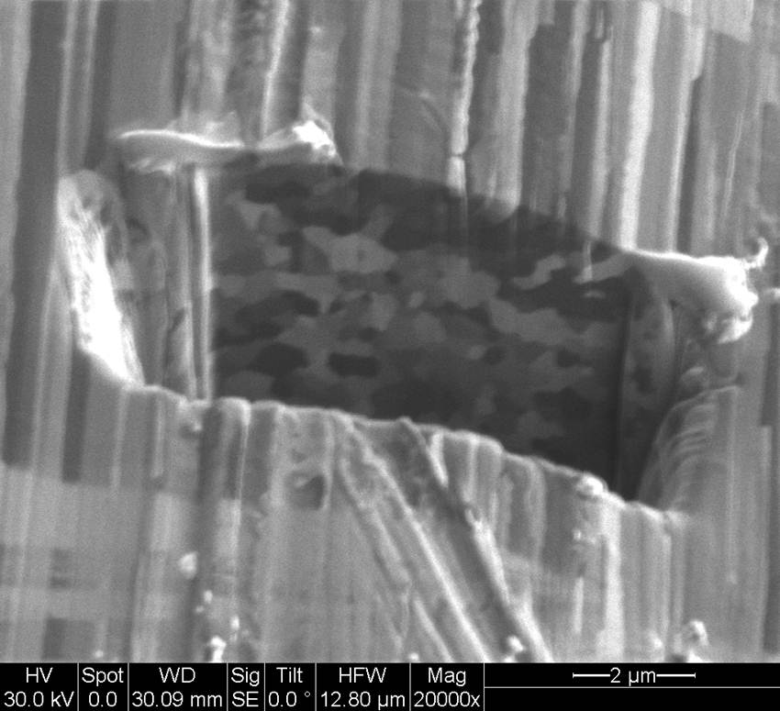
FIB Grain Images: W filament

Slide 44
FIB Applications

Slide 45
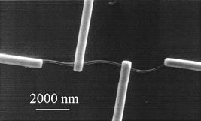
Electrode Formation for Nanowires
Y. Long et. al, Appl. Phys. Lett. (2003)

Slide 46
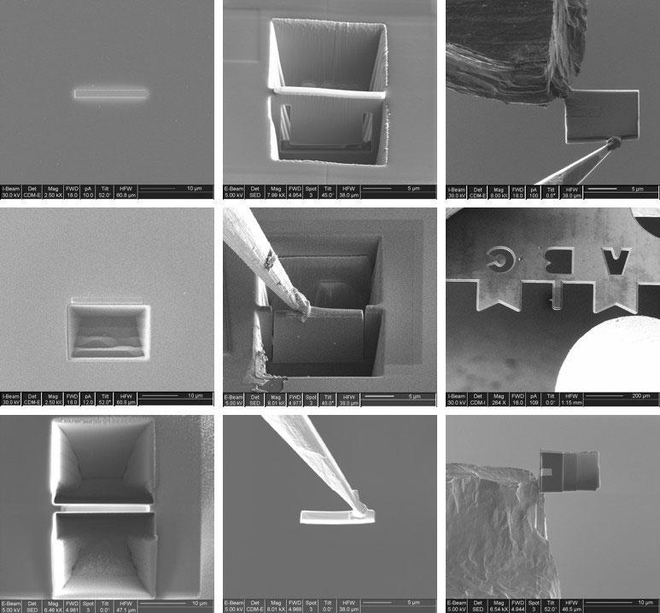
Cross Sectional TEM Sample Preparation
http://www.pdx.edu/cemn/fib-gallery

