Slide 1

Microfluidics, A Review with Selected Biological Applications

Slide 2
Outline
Microfluidics Overview
Physics of Microfluidics
Operational Components
Materials and Applications

Slide 3
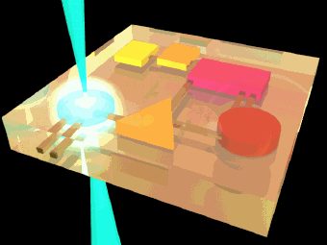
Microfluidics Overview
Microfluidics is the science of designing, manufacturing, and formulating devices and processes that process and handle volumes of fluid on the order of Nano (10⁻⁹) or Pico (10⁻¹²) liters.
Liquids in nanoliters
30 nL = 1/1000th of 1 droplet
Notes:
Microfluidics is the general term used to describe a lot of innovative research activities aimed at the development of miniaturized devices, systems, and applications relating to fluids.

Slide 4
Microfluidics Overview
Microfluidic devices handle small amounts of fluid. Good when only small amounts are available, or good for conservation
Generally use small amounts of energy
Sealed system so contamination is well controlled
Small size leads to mobility, no lab needed
Reaction can be fast

Slide 5
Microfluidics Overview
Microfluidics is a multidisciplinary field intersecting engineering, physics, chemistry, biochemistry, nanotechnology, and biotechnology, with practical applications to the design of systems in which small volumes of fluids will be handled
small volumes (µL, nL, pL, fL)
small size
low energy consumption
effects of the micro domain
Typically fluids are moved, mixed, separated or otherwise processed. Numerous applications employ passive fluid control techniques like capillary forces
http://en.wikipedia.org/wiki/Microfluidics

Slide 6
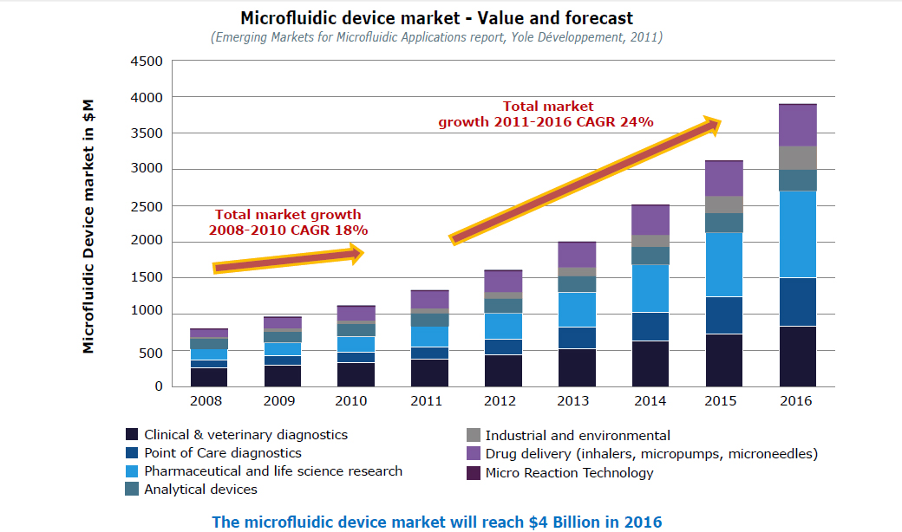
Growth of Microarrays
Contributed by Frédéric Breussin, Business Unit Manager Microfluidics & Medical Technologies, Yole Développement

Slide 7
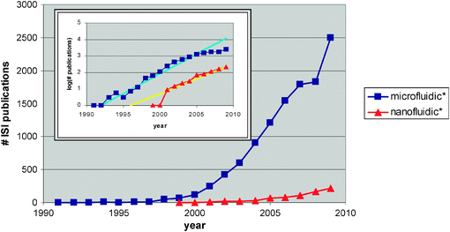
Growth of number of ISI publications found with microfluidic and nanofluidic over the past 20 years
Chemical Society Reviews
From microfluidic applications to nanofluidic phenomena
Albert van den Berg ,Harold G. Craighead and Peidong Yang

Slide 8
Outline
What is Microfluidics
Physics of Microfluidics
  Flow
  Renyolds Number
  Peclet Number
Operational Components
Materials and Applications

Slide 9
Physics of Microfluidics
The small scale of microfluidics leads to unique conditions and considerations
Factors like surface tension, unique flow characteristics, air traps, and many other factors contribute to the complexity of microfluidics.
We will briefly examine selected factors
  Flow
  Mixing

Slide 10
Physics of Microfluidics
Electrokinetic effects, general term to describe the movement of ions in a fluid that is subjected to an electric potential.
Two major types of flow types, electroosmosis, or electrophoesis
Electroosmosis, sidewall driven
Electrophroesis, particle flow

Slide 11
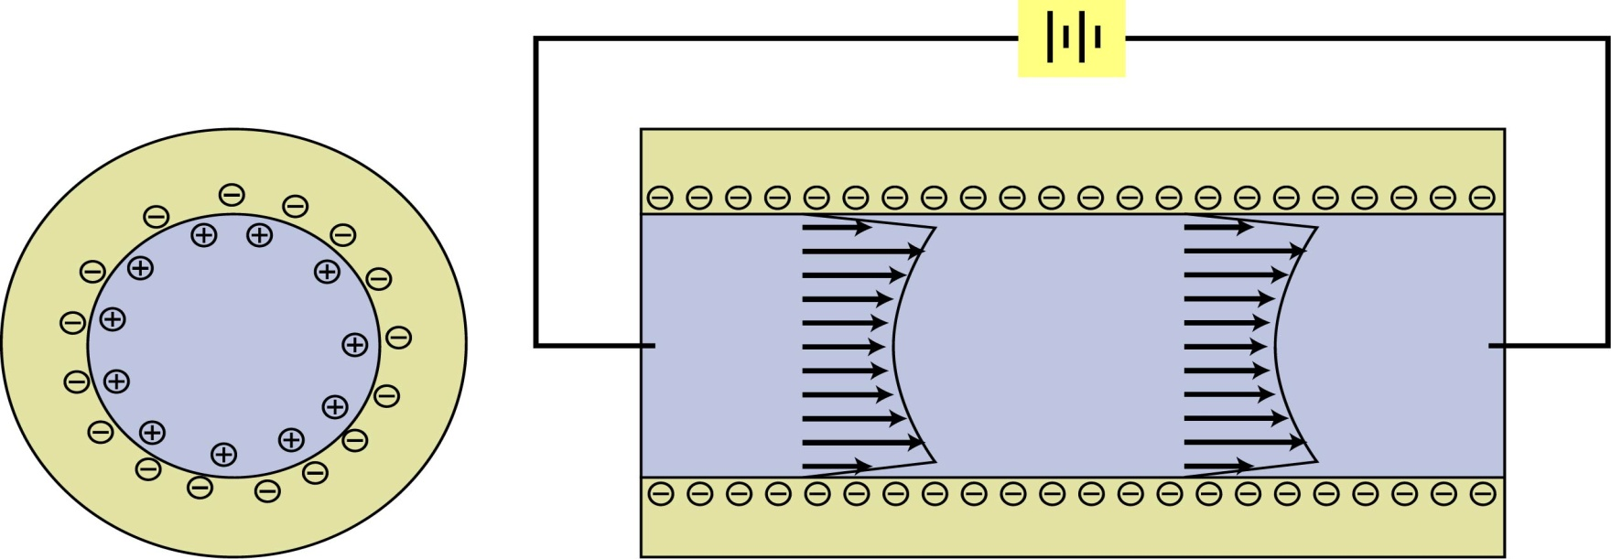
Electroosmosis
If the walls of a channel have an electric charge (-) ions in the fluid with an opposite charge (+) will be attracted to the walls.
A layer of immobile ions forms at the channel surface while a layer of mobile ions forms at the fluid side (electric double layer).
When an electrical potential is applied to the channel the ions in the fluid will be attracted to the opposite pole
These ions will drag along the remaining fluid.

Slide 12
Electro-Osmotic Flow (EOF)
Relates greatly to electrokinetic effects
Surface of fluid develops a charge, which influences fluid flow
Creates different layers in the fluid which contain different charges, such as the stern and diffuse layers

Slide 13
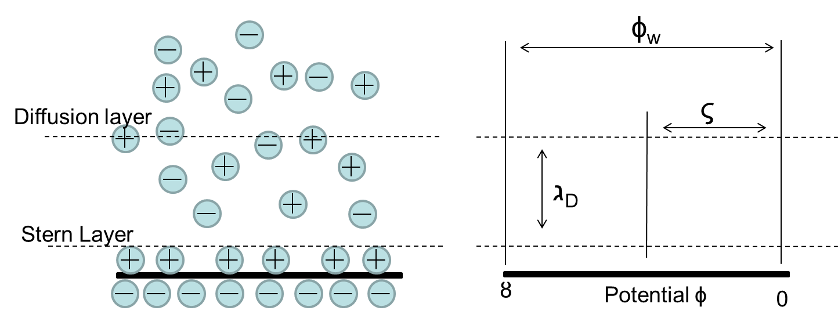
Electro-Osmotic Flow

Slide 14
Advantages Disadvantages
No moving parts.
No wear.
Low diffusion of the laminar flow.
Simple design.
High voltages (100’s – 1000’sV) makes it difficult to miniaturize.
Chemical absorption to the channel walls.
Sensitive to fluid and channel chemistry.
Joule heating.

Slide 15
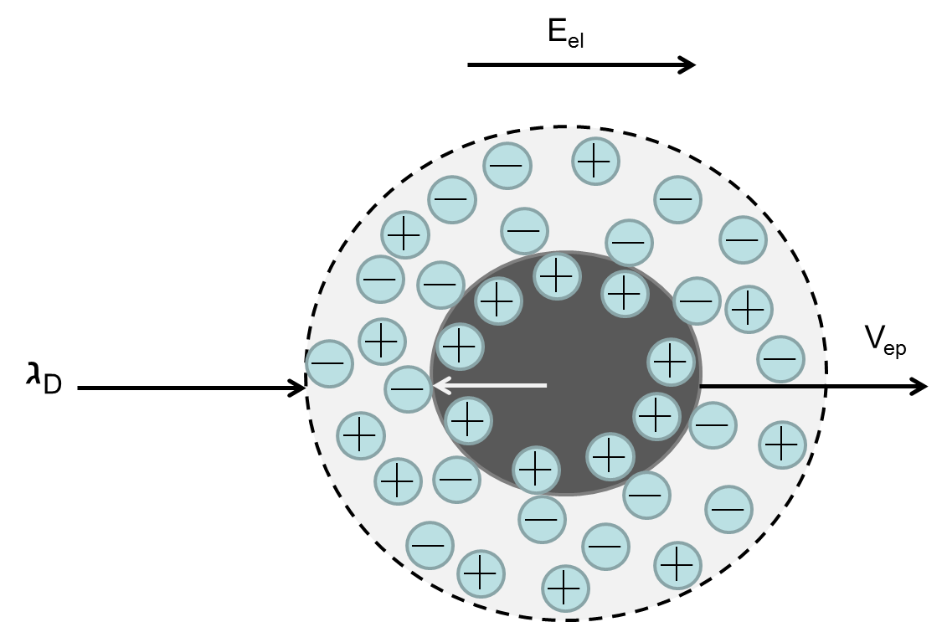
Electrophoresis
Movement of charged particles or molecules that are subjected to an electric field
“Cations move toward the cathode and anions move toward the anode.”

Slide 16
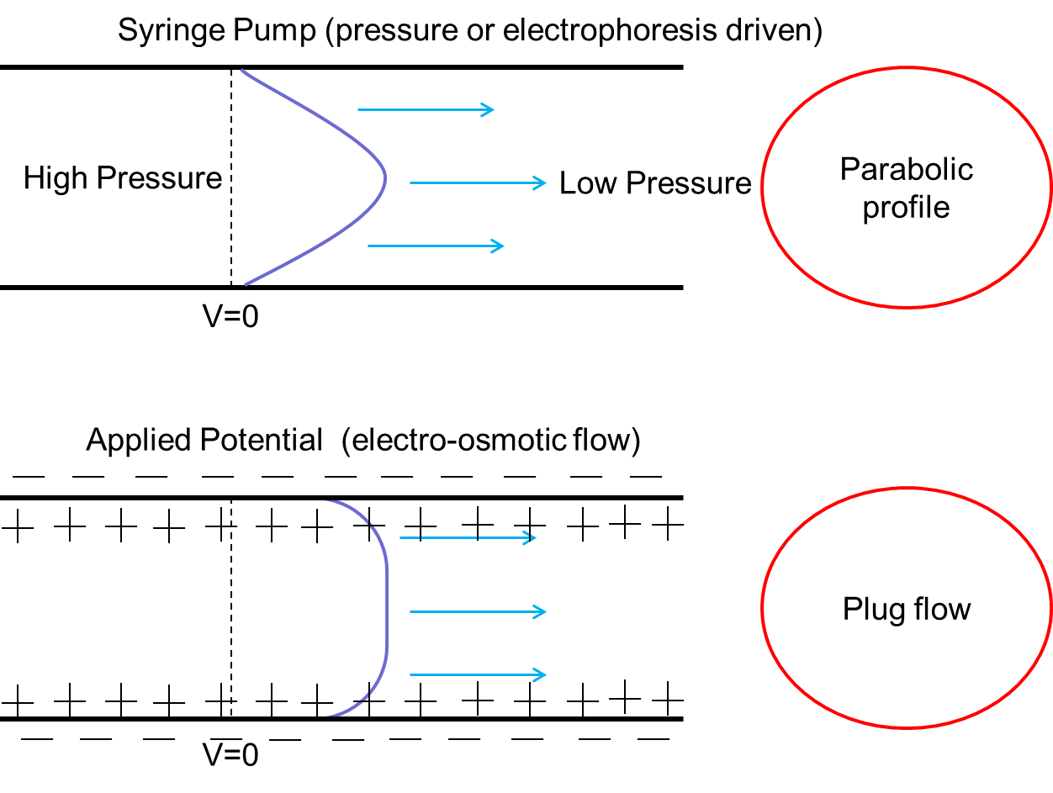

Slide 17
Some Non-ideal Considerations
Generally fluids at the micro scale do not want to mix
Pressure wave affects mixing
Curves in the design may cause mixing
Materials may have intrinsic properties that cause mixing or non-mixing
Because there are many variables, computer simulations are often used in the design of microfluidics

Slide 18
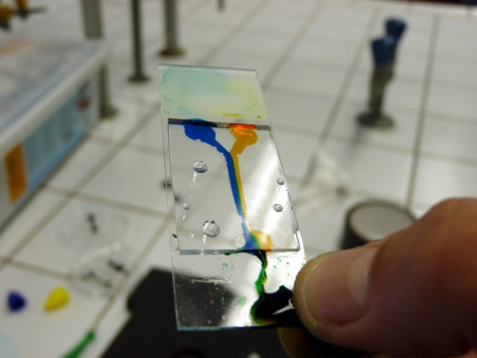
Laminar Flow
When all of the fluid particles move in paths parallel to the overall flow direction.
At the extremely small scale, fluids exhibit characteristics of laminar flow.
  When multiple fluids are introduced, they want to flow in straight lines with little to no mixing occurring.
http://wetpong.net/wetpong

Slide 19
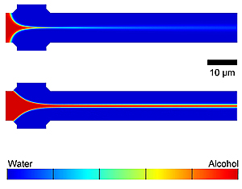
Laminar Flow
http://www.nist.gov/pml/div683/command_042710.cfm

Slide 20
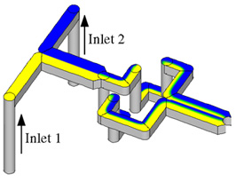
Laminar Flow
Laminar flow is the norm, and it is often not desired in a device
No turbulence
Fluids mix by diffusion only
Can be useful for fluid control, but makes solution formation difficult
Multi-level laminating mixer
Gray et al., Sens. Actuators, A 77, 1999

Slide 21
Fluid Mixing
Dealing with liquids in the amounts of nanoliters
  30 nL = 1/1000th of 1 droplet
Reactions occur in milliseconds
Macro mixing methods are difficult to miniaturize to this scale, smaller channels have laminar flow
Generally bends, turns, and increasing channel dimensions increase mixing

Slide 22
Reynolds Number
“Quick check number” used to determine if a fluid will have laminar or turbulent characteristics
Represents a ratio of momentum forces to viscous forces in fluid (liquid or gas) flow
Expresses the relationship of fluid density, velocity, channel dimensions, and viscosity coefficient. There are other variables that are not considered by this quick check equation.
Named after Osborne Reynolds (1824-1912)

Slide 23

Reynolds Number
Quick approximation to determine whether the flow of a typical fluid is laminar or turbulent.
D = Pipe Diameter
V = Fluid Velocity
p = Fluid Density
µ = Fluid Viscosity
Notes:
The Reynolds number is a non-dimensional number (i.e. has no units). It combines 3 important characteristics of the system fluid: velocity, viscosity and density. The diameter is termed the characteristic length. One of the many uses for this number is to establish if the flow is laminar or turbulent. A Reynolds number below 2000 indicates laminar flow and above 4000 turbulent flow.

Slide 24
Reynolds Number
Liquids flow smoothly when they have a low Reynolds Number
Microchannels with only 10’s of microns in dimensions create small Reynolds Numbers creating linear, turbulent-free streams
Mixing could be desirable to have a reaction, and low Reynolds numbers prevent mixing

Slide 25
Reynolds Number
For Laminar Flow
  Re << 1
For Turbulent Flow
  Re >> 1
At the extremely small scale (70 micron diameter channels) fluids will flow in a laminar fashion.
This is a problem
  For example, for a DNA lab on a chip to work, materials must be mixed. Small channel will prevent this from happening

Slide 26
Laminar flow depends upon boundary geometry
Cylindrical pipe Re < 2100
Parallel walls Re ≈ 1000
Wide open channel Re ≈ 500
Around a sphere Re ≈ 1

Slide 27
Water in a 50 ųm channel
D = 50 ųm
V = 1 m/s
p = 997.0 kg/m³
µ = .89 Pa · s
Re = .056 < 2100 = Laminar flow

Slide 28
Peclet Number
Determines whether diffusion or convection is the dominant means of mass transportation.
Diffusion > 1
Convection < 1
Pe = vl/D
ν = velocity of the fluid
l = characteristic length of the fluid
D = diffusion coefficient

Slide 29
Peclet Number
When fluids flow laminarly, the primary means of mass transportation is diffusion (extremely slow process).
To allow for mixing to occur quickly, must change flow so that it is turbulent, (meaning convection is the primary means of mass transportation).
In the next section, mixing will be accomplished with 90-degree bends to create fluid convection.

Slide 30
Outline
Microfluidics Overview
Physics of Microfluidics
Operational Components
  Micro pumps
  Mixers / stirrers
  Valves
Materials and Applications

Slide 31
Operations of Microfluidic Devices
Microfluidic devices need micro parts to run just like a normal size machine.
The parts of the device are used to move fluids (liquid or gas).
We will consider 3 major components.
  Micropumps
  Mixers/stirrers
  Valves

Slide 32
Micropumps
Among all of the microfluidic components, the micropumps may be considered the oldest
Micropumps are used to keep the fluids flowing from one area to the next in the small chambers
Generally these pumps are generally complex

Slide 33
Micropumps
With the multitude of fluidic design, micropumps could easily have many categories.
Using the flow of micropumps allows us to roughly divide them into two groups.
Reciprocating micropumps and Continuous flow micropumps.

Slide 34
Reciprocating Micropumps
Fluidics using these pumps are delivered in a series of small volumes.
This creates a pulsating flow, as would a heart pumping blood.
Reciprocating pumps can have valves to stop backflow of fluids.
The advantage of not having valves is the simple construction.

Slide 35
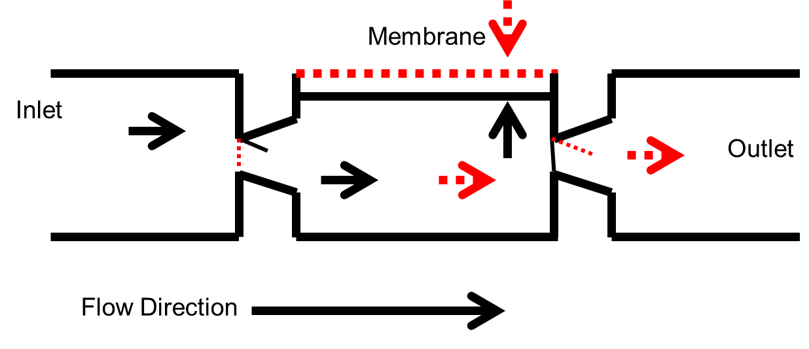
Reciprocating Micropumps
Majority of these pumps use a diaphragm and voltages to move fluids, creating a pulsating pump.
Key element is a check valve to control flow.

Slide 36
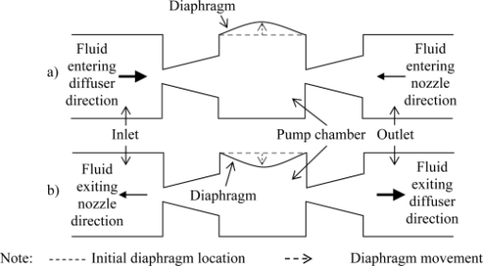
Micropumps
Piezoelectric Pump
openi.nlm.nih.gov

Slide 37
Mixers/Stirrers
Microfluidic devices usually have laminar flow. The fluids entering must be mixed in the chip to get the desired end product.
The most popular types of mixing is using channel angles.
Mixing can also be done by using stirrers (electronic or magnetic). Could be costly.

Slide 38
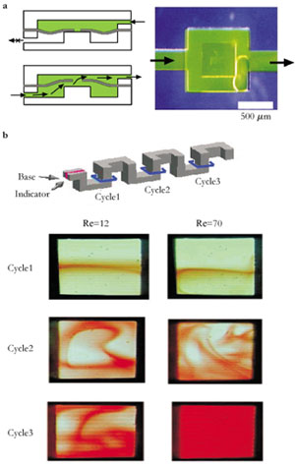
Mixers
Serpentine
mixers
http://www.niherst.gov.tt/scipop/sci-bits/microfluidics.htm

Slide 39
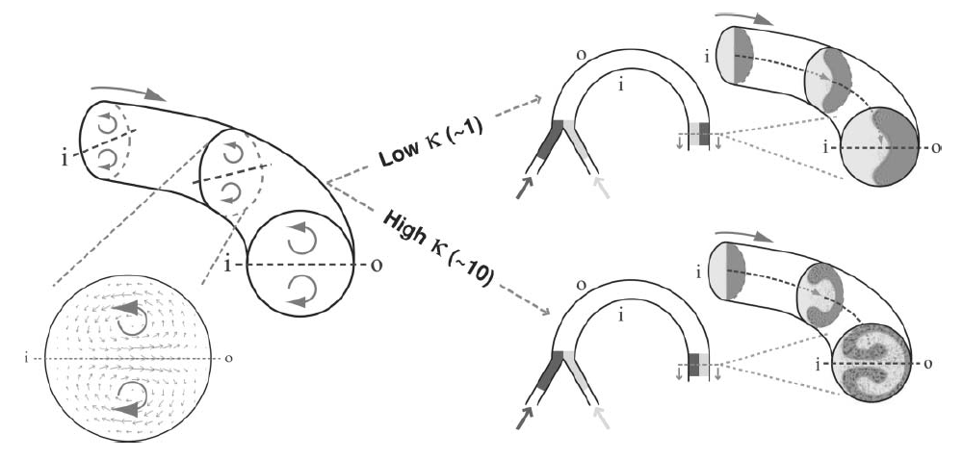
FLUID MIXING
IN PLANAR SPIRAL MICROCHANELS
Illustration of Dean flow effects in a curved microchannel (‘i’ and ‘o’ denote the inner and outer channel walls respectively). The transverse flow field is characterized by the presence of two counter-rotating vortices located above and below the channel midplane. At higher k, the combined action of these vortices cause two fluid streams to almost completely switch positions within the channel.
Sundersan Argon P., and Victor M. Ugaz. "Fluid mixing in planar spiral microchannels." Lab on a Chip 6.1: 74-82

Slide 40

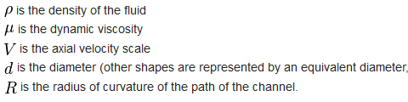
Dean Number
The Dean number is typically denoted by the symbol D, and is defined as
http://en.wikipedia.org/wiki/Dean_number

Slide 41
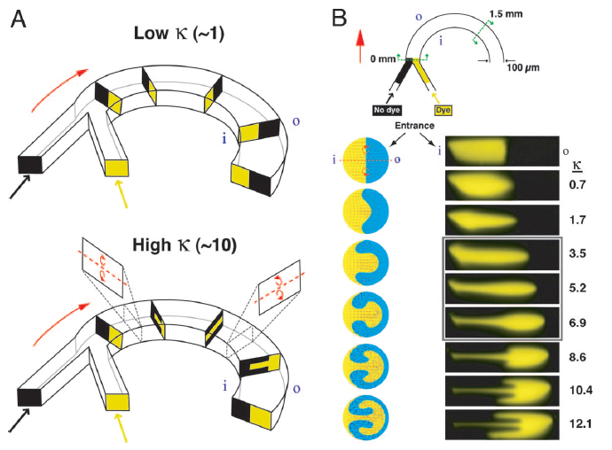
Multivortex micromixing
Sundarsan, Arjun P., and Victor M. Ugaz. "Multivortex micromixing."
Proceedings of the National Academy of Sciences 103.19 : 7228-7233

Slide 42
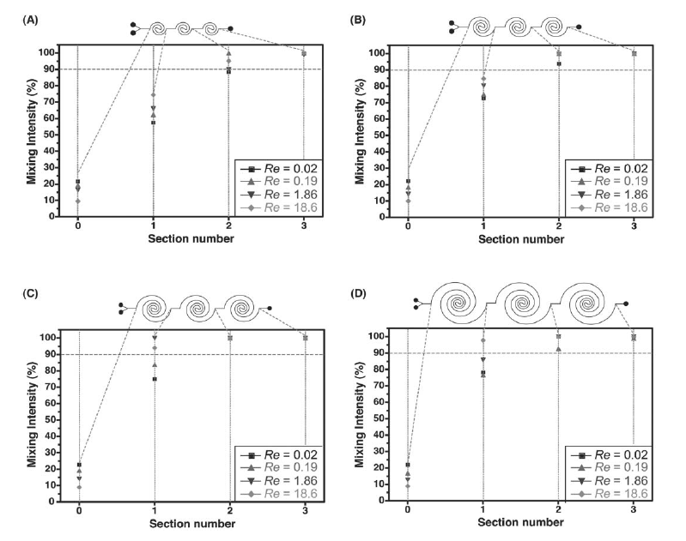
Mixing intensity as a function of Re at the end of each section for the four-arc (A), six-arc (B), eight-arc (C) and ten-arc (D) spiral channels.
Sundersan Argon P., and Victor M. Ugaz. "Fluid mixing in planar spiral microchannels." Lab on a Chip 6.1: 74-82

Slide 43
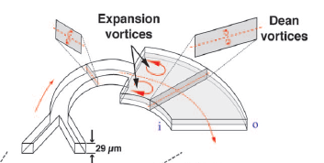
Multivortex Micromixing
Sundarsan, Arjun P., and Victor M. Ugaz. "Multivortex micromixing."
Proceedings of the National Academy of Sciences 103.19 : 7228-7233

Slide 44
Valves
The majority of vales in microfluidics are like diodes, with flow limited to one direction.
This reduces backflow, block-ups, and contamination.
Common terms for this type of device are gates, check, or flapper valves.

Slide 45
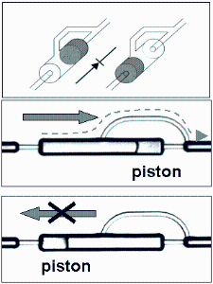
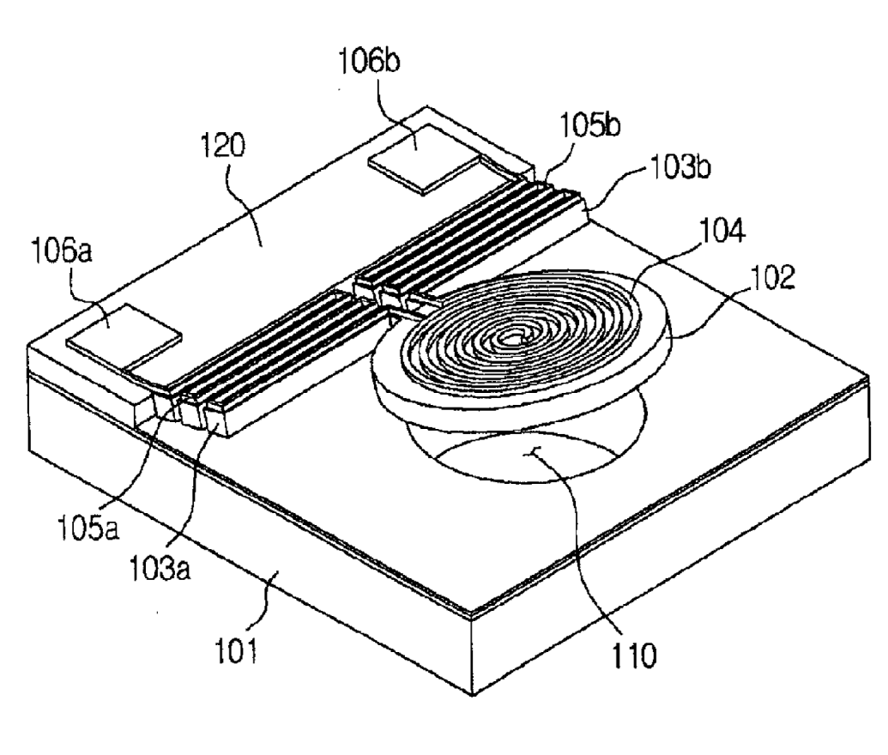
Valves
Cantilever (microvalve) Application: switches, resonators, chemical and biological sensors, accelerometers
http://www.uspto.gov/web/patents/classification/cpc/html/defB81B.html
ip.sandia.gov

Slide 46
Outline
Microfluidics Overview
Physics of Microfluidics
Operational Components
Materials and Applications

Slide 47
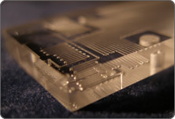
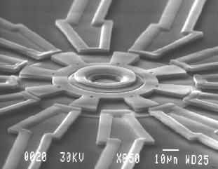
Common Materials
SiO₂ – etching and stacking
Metals – Additive and Subtractive Processes
http://www.energi-tech.co.uk/microfluidics.htm
http://www.tmi.vu.lt/legacy/pfk/funkc_dariniai/nanostructures/nano_robots.htm

Slide 48
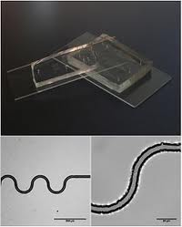
Common Materials
Polymers – physical deformation and shaping
Paper – substrate used for flow and cheap
http://www.websters-online-dictionary.org/definitions/Microfluidics?cx=partner-pub-0939450753529744%3Av0qd01-tdlq&cof=FORID%3A9&ie=UTF-8&q=Microfluidics&sa=Search#922

Slide 49
Common Materials
SiO₂ – Plasma etching or chemical etching
  Expensive, dangerous
Metals – sacrificial layers
  Expensive (materials wasted), much more complex
Polymers – photopatterning, molding, embossing
  Inexpensive, easy to mass produce
Paper – Active or passive results
  Inexpensive, ease of flow, generally slow

Slide 50
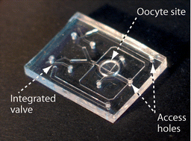
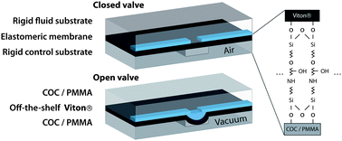
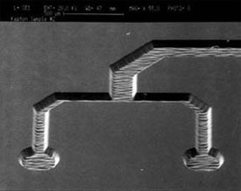
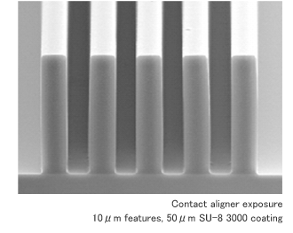
Common Polymer Materials
Polymers
PMMA, PDMS, Polyimides, SU-8
http://www.nanotechclearinghouse.com/module-NewsFeeds-view-option-viewfeed-fid-97-startnum-123.html
http://www.rsc.org/Publishing/Journals/lc/article.asp?Type=Issue&Journalcode=LC&Issue=11&SubYear=2008&Volume=8&Page=0&GA=on
http://medicaldesign.com/engineering-prototyping/research-development/biomems-evolution-advancement-20091201/
http://www.nkc-mems.com/product_e/su8_3000.html

Slide 51
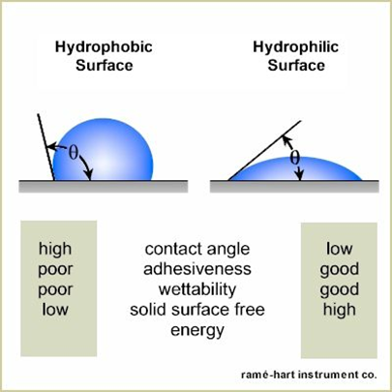
Common Materials
PDMS
Non-toxic, optically
transparent, surface is easily
modified
  Naturally hydrophobic,
  Oxygen plasma treatment
  renders it hydrophilic
  Useful for fluid flow
  and surface bonding
  Hyperelastic
  Biocompatible
http://www.ramehart.com/contactangle.htm.

Slide 52
Common Polymer Materials
PMMA – thermoplastic, used for molding, opaque to UV light
PDMS – thermoset, non-toxic, optically transparent, cured
Polyimides – thermoset, used for MEMS, high strength, dielectric strength, heat resistance, photopatterned
SU-8 – typically sacrificial layer, high mechanical strength, high aspect ratios, negative photoresist

Slide 53
Common Polymer Materials
Compared Fields | Polymers
 | Polyimides | PMMA | PDMS | SU-8
Primary Manufacturer | HD-Microsystems | Plaskolite INC | Dow Corning | MicroChem Corp.
Brand Name | HD-4100 series | Optix Acrylite | Sylgard 184 | SU-8
Approximate Cost | $2,185/kg | $2.70/kg | $16.40/kg | $500/kg
Optical Transparency | Yes | Yes (opaque to UV) | Yes | Yes (>340 nm)

Slide 54
Integrating the Parts
Pump are used to move the fluid through the channels.
Valves are used to control where and which direction the fluid flows.
Mixers/stirrer keep fluids together and stop laminar flow.
Many devices are made from the simple materials reviewed

Slide 55
Pulsed Amperometric Detection
Capillaryelectrophoresis chip with integrated pulsed amperometric detection. Channels: 50 μm width, 50 μm deep. Sample loop: 580 μm long. The diagram shows the electrode position at the end of the separation channel and the connections to the electrochemical analyzer.
Carlos D. Garcı ́a and Charles S. Henry, “Direct Determination of Carbohydrates, Amino Acids, and Antibiotics by Microchip Electrophoresis with Pulsed Amperometric Detection”
Anal. Chem. 2003, 75, 4778-4783

Slide 56
PULSED AMPEROMETRIC DETECTORS
ELECTROCHEMICAL DETECTORS
Pulsed Amperometric Detection (PAD)
This follows established electrochemical liquid detector technology
This detector is based on the measurements of the current resulting from oxidation/reduction reaction of the analyte at a suitable electrode. Since the level of the current is directly proportional to the analyte concentration, this detector could be used for quantification.
Can be used for the separation and detection of underivatized carbohydrates, amino acids, and sulfur-containing antibiotics in an electrophoretic microchip
http://hplc.chem.shu.edu/NEW/HPLC_Book/Detectors/det_elec.html

Slide 57
Pulsed Amperometric detectors
Direct Determination of Carbohydrates, Amino Acids, and Antibiotics by Microchip Electrophoresis with Pulsed Amperometric Detection (2003)
Lab on a chip configuration for microchip electrophoresis with pulsed amperometric detection (PAD)
The configuration consists of a layer of polydimethylsiloxane (PDMS) that contains the microfluidic channels, reservoirs, and a gold microwire, sealed to a second layer of polydimethylsiloxane.
The separation and the direct detection of underivatized carbohydrates, amino acids, and two antibiotics were achieved by optimizing the electric field, the electrolyte composition, and the PAD parameters.
The inclusion of a Au wire microelectrode was also demonstrated, showing very good stability and mass limits of detection in the femtomole range.
Carlos D. Garcı ́a and Charles S. Henry, “Direct Determination of Carbohydrates, Amino Acids, and Antibiotics by Microchip Electrophoresis with Pulsed Amperometric Detection” Anal. Chem. 2003, 75, 4778-4783

Slide 58
Pulsed Amperometric detectors
Pulsed Amperometric Detection Parameters for Detection of Carbohydrates, Amino Acids and Antibiotics
Test Material | Clean | Reactivate | Detect
carbohydrates | +1.4 V | -0.5 V | +0.7 V
amino acids | +1.8 V | -0.5 V | +0.7 V
antibiotics | +1.8 V | -0.5 V | +0.5 V
Cleaning, 0.05 s; reactivation, 0.025 s; and detection, 0.15 s.
Carlos D. Garcı ́a and Charles S. Henry, “Direct Determination of Carbohydrates, Amino Acids, and Antibiotics by Microchip Electrophoresis with Pulsed Amperometric Detection” Anal. Chem. 2003, 75, 4778-4783

Slide 59
A POCKET-SIZED CONVECTIVE
PCR THERMOCYCLER
Many diagnostic assays rely on the polymerase chain reaction (PCR), which requires thermocycling and conventional macro instruments that are relatively slow and consume considerable electrical power to perform repeated heating and cooling steps
Microfluidic thermocycling system that harnesses natural convection phenomena to amplify DNA rapidly by the PCR in a greatly simplified format.
A key element of this design is an architecture that allows the entire thermocycling process to be actuated pseudo-isothermally by simply maintaining a single heater at a constant temperature, thereby enabling a pocket-sized battery-powered device to be constructed at a cost of about US$10.
Agrawal, Nitin, Yassin A. Hassan, and Victor M. Ugaz. "A Pocket‐Sized Convective PCR Thermocycler." Angewandte Chemie International Edition 46.23: 4316-4319

Slide 60
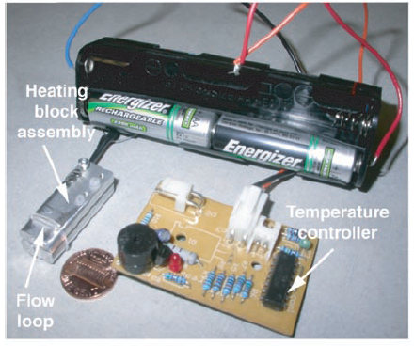
A Pocket-Sized Convective
PCR Thermocycler
Agrawal, Nitin, Yassin A. Hassan, and Victor M. Ugaz. "A Pocket‐Sized Convective PCR Thermocycler." Angewandte Chemie International Edition 46.23: 4316-4319

Slide 61
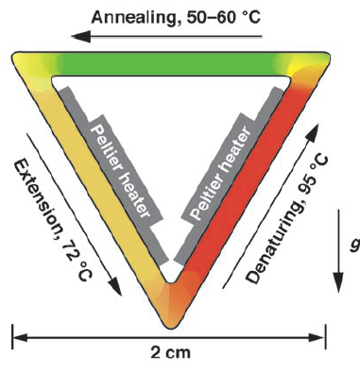
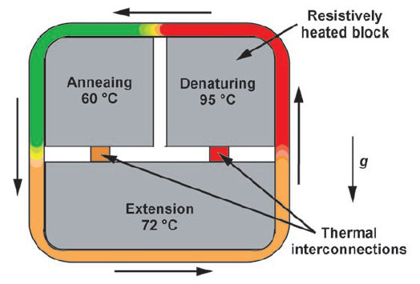
A Pocket-Sized Convective
PCR Thermocycler
Agrawal, Nitin, Yassin A. Hassan, and Victor M. Ugaz. "A Pocket‐Sized Convective PCR Thermocycler." Angewandte Chemie International Edition 46.23: 4316-4319

Slide 62
Paper based systems
1988 The first commercial immunoassay, Unipath launches home pregnancy test kits
1995 US Patent 5,409,664 describes a laminated assay device for detection of cholesterol with walls made by hydrophobic printing or cutting
2003 US Patent 6,573,108 presents the first example of a tangential flow device, incorporation of multiple channels, timers to show when the assay is over, and a filtration step for sample pretreatment. Walls could be made by screen printing, dipping in polymer with a template held against paper, or by a computer-controlled deposition system. Researchers proposed polymers such as heteropolysaccharides, acrylic polymers and copolymers, and silanes
2007 The first scientific journal publication by the Whitesides group describing a multichannel system with photoresist walls
2008 The first international conference on bioactive paper in Finland

Slide 63
Paper based systems
Colorimetric assays are conducted in the paper “wells,” utilizing the interaction between species-specific enzymes and chromogenic substrates
The presence of pathogenic bacteria is indicated by a color change, a result that may be easily interpreted by the user without the need for complex instrumentation
Semiquantitative analysis is performed by creating a digital image of the devices with an office scanner
Created by use of wax printing on filter paper, wax defines flow regions
Recent technology emulates conventional PDMS/Si systems
Jana C. Jokerst, Jaclyn A. Adkins, Bledar Bisha, Mallory M. Mentele, Lawrence D. Goodridge, and Charles S. Henry, “Development of a Paper-Based Analytical Device for Colorimetric Detection of Select Foodborne Pathogens’, Anal. Chem. 2012, 84, 2900−2907

Slide 64
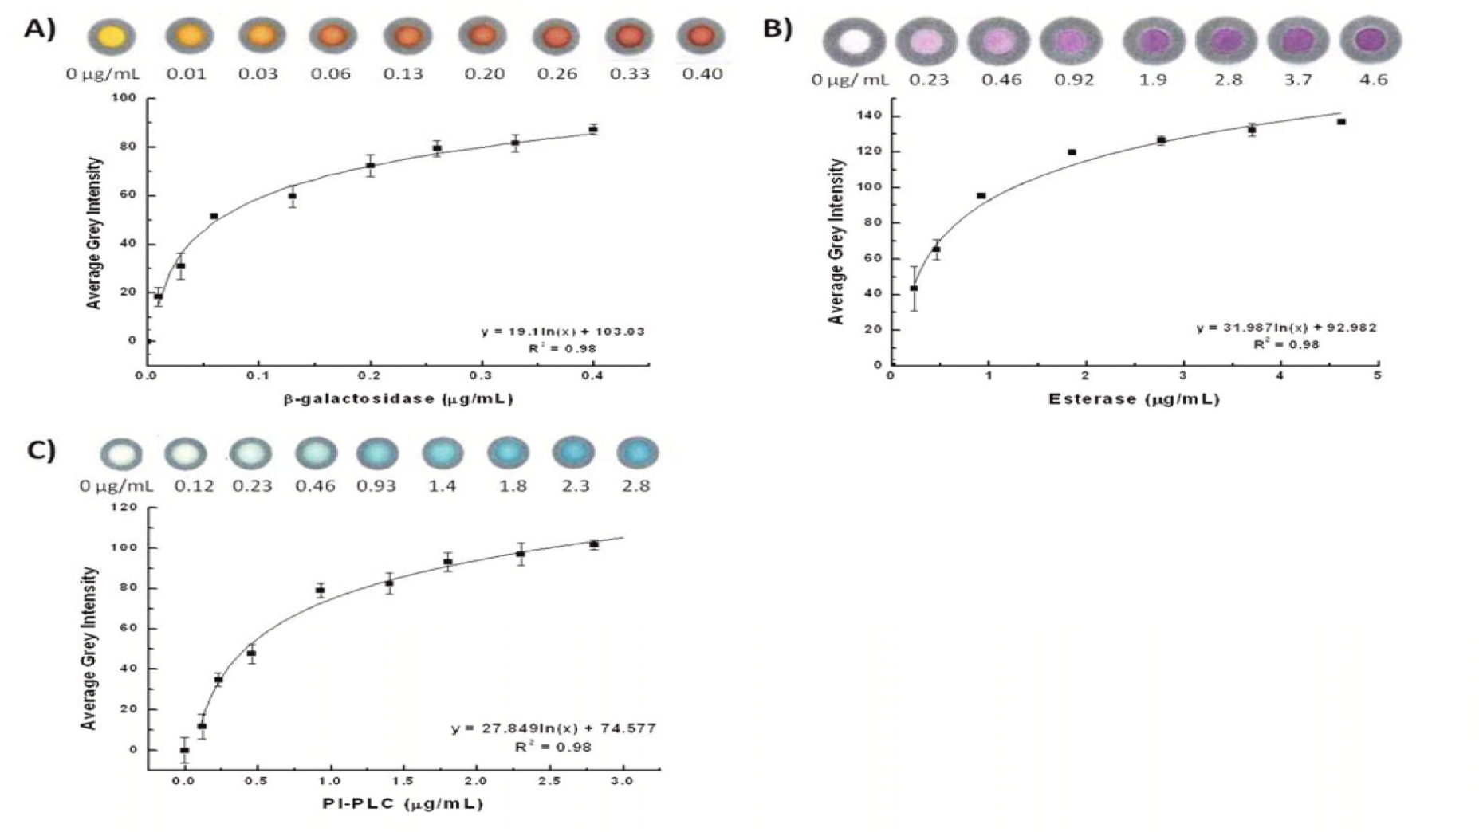
Paper based systems
Determination of lowest detectable amount of (A) β-galactosidase, (B) esterase, and (C) PI-PLC enzymes via optimal substrate concentrations. Average grey intensities are plotted vs the amount of enzyme in each spot
Jana C. Jokerst, Jaclyn A. Adkins, Bledar Bisha, Mallory M. Mentele, Lawrence D. Goodridge, and Charles S. Henry, “Development of a Paper-Based Analytical Device for Colorimetric Detection of Select Foodborne Pathogens’, Anal. Chem. 2012, 84, 2900−2907

Slide 65
Paper based systems
Immunoassays:
a Whitesides group assay with a movable strip, b. origami-based device for detection of tumor markers, c. electrochemiluminescence detection of tumor markers, d potentiometric immunoassay

Slide 66
Paper based systems
Used for the separation and detection of underivatized carbohy- drates, amino acids, and sulfur-containing antibiotics
This paper device determined glucose, lactate, and uric acid in biological samples using oxidase enzyme reactions (similar to previous research on a silicon/pdms system)
These include glucose oxidase, lactate oxidase, and uricase
These techniques are previously expressed in other technical publications by Dr. Henry in conventional devices
Wijitar Dungchai, Orawon Chailapakul, and Charles S. Henry ,Electrochemical Detection for Paper-Based Microfluidics Anal. Chem. 2009, 81, 5821–5826

Slide 67
Paper based systems
Multi stack configuration from Dr. Henry’s work.
Layer 1: Photo- lithography was used to pattern Whatman filter paper using SU8 resist
Layer 2: Electrochemical Detector for Paper-Based Microfluidic Devices. The electrodes were screen- printed in house using carbon ink containing PB as the working (WE) and counter electrode (CE) and silver/silver chloride ink as the reference electrode (RE) and conductive pads.
Wijitar Dungchai, Orawon Chailapakul, and Charles S. Henry ,Electrochemical Detection for Paper-Based Microfluidics Anal. Chem. 2009, 81, 5821–5826

Slide 68
Paper based systems
The hydrophilic area at the center of the device wicks sample into the three separate test zones where independent enzyme reactions occur.
The silver electrodes and contact pads are made
from Ag/AgCl paste with the black electrode portions being the Pb modified carbon electrodes.
The device size is 4 cm × 4 cm.
Basic design of the electrochemical detection cell for paper-based microfluidic devices.
WE, working electrode;
RE, reference electrode;
CE, counter electrode.
Wijitar Dungchai, Orawon Chailapakul, and Charles S. Henry ,Electrochemical Detection for Paper-Based Microfluidics
Anal. Chem. 2009, 81, 5821–5826

Slide 69
MicroBioLab
This is a device that can dissect a very small amount DNA, protein, cells, or drug
It can chemically analyze a liquid sample 10,000 times smaller than commercial analytical instruments
This time-saving chip could be built for genetic diagnosis, DNA fingerprinting, and drug research
Conserves test media, and reduces disposal issues

Slide 70
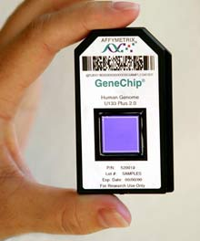
Micro Arrays
How they work
  Microarrays work by exploiting the ability of mRNA to bind to DNA templates.
What they do
  Analyzes gene expressions consisting of small membranes.
  Can determine the expression levels of hundreds or even thousands of genes in cells by measuring the amount of mRNA in a single experiment
http://genechip.com/index.affx

Slide 71
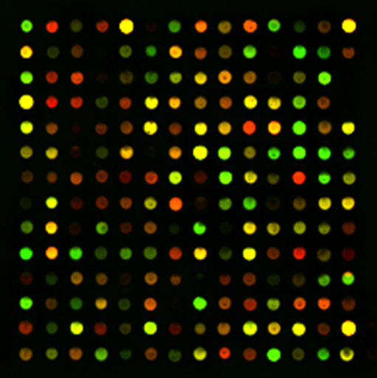
Micro Arrays Uses
Test structure that can be used with microfluidic technology to interrogate samples.
Used to understand fundamental aspects of growth and development.
Also used to identify and classify DNA sequence information and assign their function.

Slide 72
Micro Arrays
Why they are important
  You can survey large number of genes rather quickly.
  Can compose and contrast cells and tissues from being healthy of diseased.
  Show how and why certain genes can or can not work together.

Slide 73
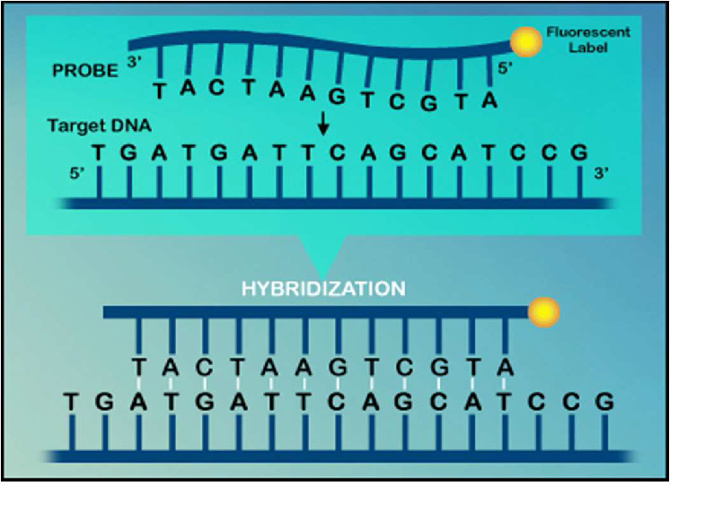
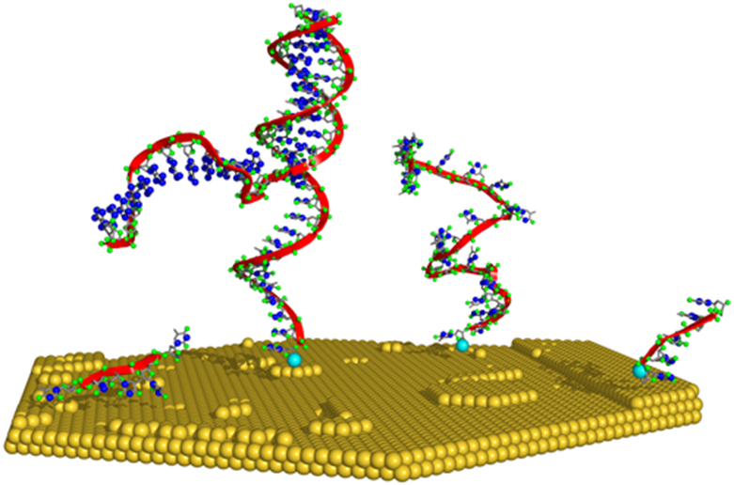
Micro Arrays
http://members.cox.net/amgough/Fanconigenetics-PGD.htm

Slide 74
Advantages/Disadvantages
Advantages
  Very Small
  Disposable
  Sealed
  Portable
  Very Fast response time
Disadvantages
  Takes place of jobs

Slide 75
Summary
Microfluidics is an important emerging technology, that uses the tools taught in the NMT program
Key points are fluid flow, components, and scaling
Many biological applications that may provide employment

