Slide 1

Microfluidics, A Review with
Selected Biological Applications
PART 2

Slide 2
Outline
Microfluidics Overview
Physics of Microfluidics
Operational Components
Materials and Applications

Slide 3
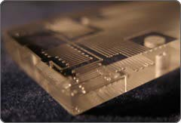
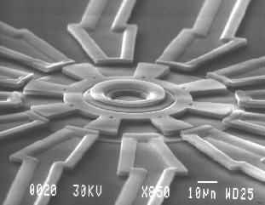
Common Materials
SiO₂ – etching and stacking
Metals – Additive and Subtractive Processes
http://www.energi- tech.co.uk/microfluidics.htm
http://www.tmi.vu.lt/legacy/pfk/funkc_darinia i/nanostructures/nano_robots.htm

Slide 4
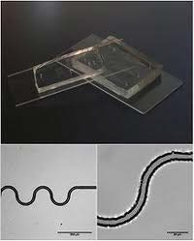
Common Materials
Polymers – physical deformation and shaping
Paper – substrate used for flow and cheap
http://www.websters-online- dictionary.org/definitions/Microfluidics?cx=partner-pub- 0939450753529744%3Av0qd01-
tdlq&cof=FORID%3A9&ie=UTF- 8&q=Microfluidics&sa=Search#922

Slide 5
Common Materials
SiO₂ – Plasma etching or chemical etching
  Expensive, dangerous
Metals – sacrificial layers
  Expensive (materials wasted), much more complex
Polymers – photopatterning, molding, embossing
  Inexpensive, easy to mass produce
Paper – Active or passive results
  Inexpensive, ease of flow, generally slow

Slide 6
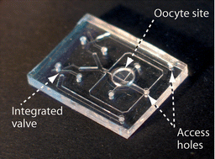
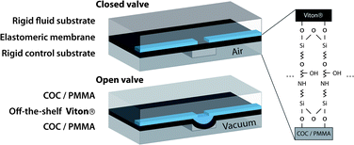
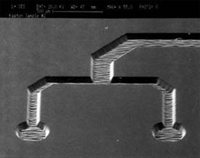
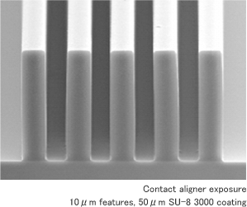
Common Polymer Materials
Polymers
PMMA, PDMS, Polyimides, SU-8
http://www.nanotechclearinghouse.com/module-NewsFeeds-view-option- viewfeed-fid-97-startnum-123.html
http://www.rsc.org/Publishing/Journals/lc/article.asp?Type=Issue&Jo urnalcode=LC&Issue=11&SubYear=2008&Volume=8&Page=0&GA=
on
http://medicaldesign.com/engineering-prototyping/research- development/biomems-evolution-advancement-20091201/
http://www.nkc-mems.com/product_e/su8_3000.html

Slide 7
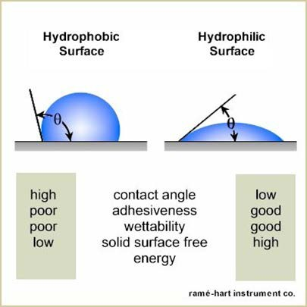
Common Materials
PDMS
Non-toxic, optically transparent, surface is easily modified
  Naturally hydrophobic, Oxygen plasma treatment renders it hydrophilic
  Useful for fluid flow and surface bonding
  Hyperelastic
  Biocompatible
http://www.ramehart.com/contactangle.htm.

Slide 8
Common Polymer Materials
PMMA – thermoplastic, used for molding, opaque to UV light
PDMS – thermoset, non-toxic, optically transparent, cured
Polyimides – thermoset, used for MEMS, high strength, dielectric strength, heat resistance, photopatterned
SU-8 – typically sacrificial layer, high mechanical strength, high aspect ratios, negative photoresist

Slide 9
Common Polymer Materials
Compared Fields | Polymers
 | Polyimides | PMMA | PDMS | SU-8
Primary Manufacturer | HD-Microsystems | Plaskolite INC | Dow Corning | MicroChem Corp.
Brand Name | HD-4100 series | Optix Acrylite | Sylgard 184 | SU-8
Approximate Cost | $2,185/kg | $2.70/kg | $16.40/kg | $500/kg
Optical Transparency | Yes | Yes (opaque to UV) | Yes | Yes (>340 nm)

Slide 10
Integrating the Parts
Pump are used to move the fluid through the channels.
Valves are used to control where and which direction the fluid flows.
Mixers/stirrer keep fluids together and stop laminar flow.
Many devices are made from the simple materials reviewed

Slide 11
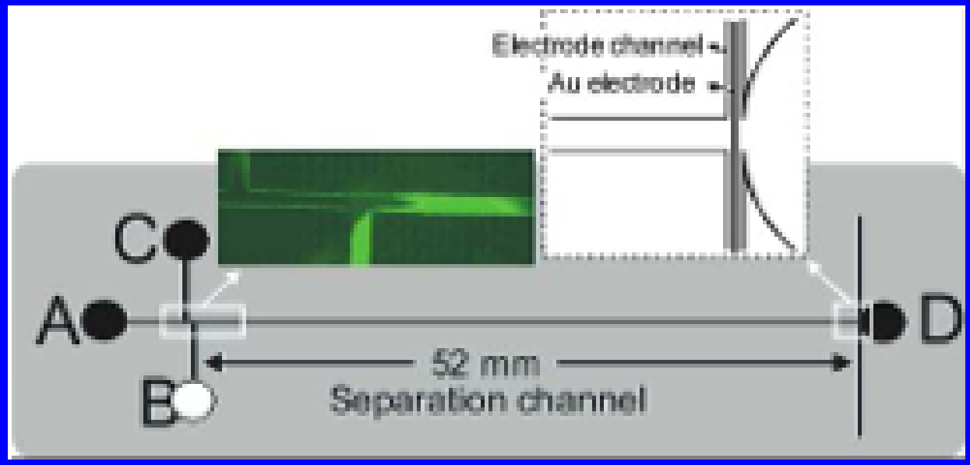
PULSED AMPEROMETRIC DETECTION
Capillaryelectrophoresis chip with integrated pulsed amperometric detection. Channels: 50 μm width, 50 μm deep. Sample loop: 580 μm long. The diagram shows the electrode position at the end of the separation channel and the
connections to the electrochemical analyzer.
Carlos D. Garcı ́a and Charles S. Henry, “Direct Determination of Carbohydrates, Amino Acids, and Antibiotics by Microchip Electrophoresis with Pulsed Amperometric Detection”
Anal. Chem. 2003, 75, 4778-4783

Slide 12
PULSED AMPEROMETRIC DETECTORS
ELECTROCHEMICAL DETECTORS
Pulsed Amperometric Detection (PAD)
This follows established electrochemical liquid detector technology
This detector is based on the measurements of the current resulting from oxidation/reduction reaction of the analyte at a suitable electrode. Since the level of the current is directly proportional to the analyte concentration, this detector could be used for quantification.
Can be used for the separation and detection of underivatized carbohydrates, amino acids, and sulfur- containing antibiotics in an electrophoretic microchip
http://hplc.chem.shu.edu/NEW/HPLC_Book/Detectors/det_elec.html

Slide 13
PULSED AMPEROMETRIC DETECTORS
Direct Determination of Carbohydrates, Amino Acids, and Antibiotics by Microchip Electrophoresis with Pulsed Amperometric Detection (2003)
Lab on a chip configuration for microchip electrophoresis with pulsed amperometric detection (PAD)
The configuration consists of a layer of polydimethylsiloxane (PDMS) that contains the microfluidic channels, reservoirs, and a gold microwire, sealed to a second layer of polydimethylsiloxane.
The separation and the direct detection of underivatized carbohydrates, amino acids, and two antibiotics were achieved by optimizing the electric field, the electrolyte composition, and the PAD parameters.
The inclusion of a Au wire microelectrode was also demonstrated, showing very good stability and mass limits of detection in the femtomole range.
Carlos D. Garcı ́a and Charles S. Henry, “Direct Determination of Carbohydrates, Amino Acids, and Antibiotics by Microchip Electrophoresis with Pulsed Amperometric Detection” Anal. Chem. 2003, 75, 4778-4783

Slide 14
PULSED AMPEROMETRIC DETECTORS
Pulsed Amperometric Detection Parameters for Detection of Carbohydrates, Amino Acids and Antibiotics
Test Material | Clean | Reactivate | Detect
carbohydrates | +1.4 V | -0.5 V | +0.7 V
amino acids | +1.8 V | -0.5 V | +0.7 V
antibiotics | +1.8 V | -0.5 V | +0.5 V
Cleaning, 0.05 s; reactivation, 0.025 s; and detection, 0.15 s.
Carlos D. Garcı ́a and Charles S. Henry, “Direct Determination of Carbohydrates, Amino Acids, and Antibiotics by Microchip Electrophoresis with Pulsed Amperometric Detection” Anal. Chem. 2003, 75, 4778-4783

Slide 15
A POCKET-SIZED CONVECTIVE PCR THERMOCYCLER
Many diagnostic assays rely on the polymerase chain reaction (PCR), which requires thermocycling and conventional macro instruments that are relatively slow and consume considerable electrical power to perform repeated heating and cooling steps
Microfluidic thermocycling system that harnesses natural convection phenomena to amplify DNA rapidly by the PCR in a greatly simplified format.
A key element of this design is an architecture that allows the entire thermocycling process to be actuated pseudo-isothermally by simply maintaining a single heater at a constant temperature, thereby enabling a pocket-sized battery-powered device to be constructed at a cost of about US$10.
Agrawal, Nitin, Yassin A. Hassan, and Victor M. Ugaz. "A Pocket‐Sized Convective PCR Thermocycler." Angewandte Chemie International Edition 46.23: 4316-4319

Slide 16
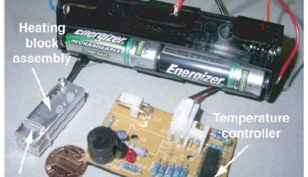
A POCKET-SIZED CONVECTIVE PCR THERMOCYCLER
Agrawal, Nitin, Yassin A. Hassan, and Victor M. Ugaz. "A Pocket‐Sized Convective PCR Thermocycler." Angewandte Chemie International Edition 46.23: 4316-4319

Slide 17
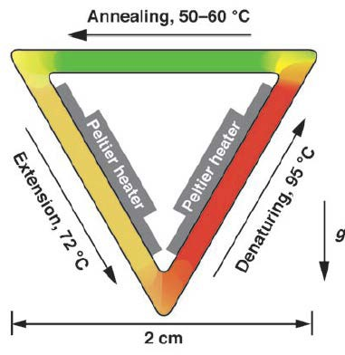
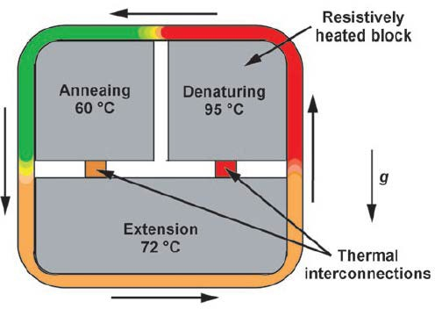
A POCKET-SIZED CONVECTIVE PCR THERMOCYCLER
Agrawal, Nitin, Yassin A. Hassan, and Victor M. Ugaz. "A Pocket‐Sized Convective PCR Thermocycler." Angewandte Chemie International Edition 46.23: 4316-4319

Slide 18
Paper based systems
1988 The first commercial immunoassay, Unipath launches home pregnancy test kits
1995 US Patent 5,409,664 describes a laminated assay device for detection of cholesterol with walls made by hydrophobic printing or cutting
2003 US Patent 6,573,108 presents the first example of a tangential flow device, incorporation of multiple channels, timers to show when the assay is over, and a filtration step for sample pretreatment. Walls could be made by screen printing, dipping in polymer with a template held against paper, or by a computer-controlled deposition system. Researchers proposed polymers such as heteropolysaccharides, acrylic polymers and copolymers, and silanes
2007 The first scientific journal publication by the Whitesides group describing a multichannel system with photoresist walls
2008 The first international conference on bioactive paper in Finland

Slide 19
Paper based systems
Colorimetric assays are conducted in the paper “wells,” utilizing the interaction between species-specific enzymes and chromogenic substrates
The presence of pathogenic bacteria is indicated by a color change, a result that may be easily interpreted by the user without the need for complex instrumentation
Semiquantitative analysis is performed by creating a digital image of the devices with an office scanner
Created by use of wax printing on filter paper, wax defines flow regions
Recent technology emulates conventional PDMS/Si systems
Jana C. Jokerst, Jaclyn A. Adkins, Bledar Bisha, Mallory M. Mentele, Lawrence D. Goodridge, and Charles S. Henry, “Development of a Paper-Based Analytical Device for Colorimetric Detection of Select Foodborne Pathogens’, Anal. Chem. 2012, 84, 2900−2907

Slide 20
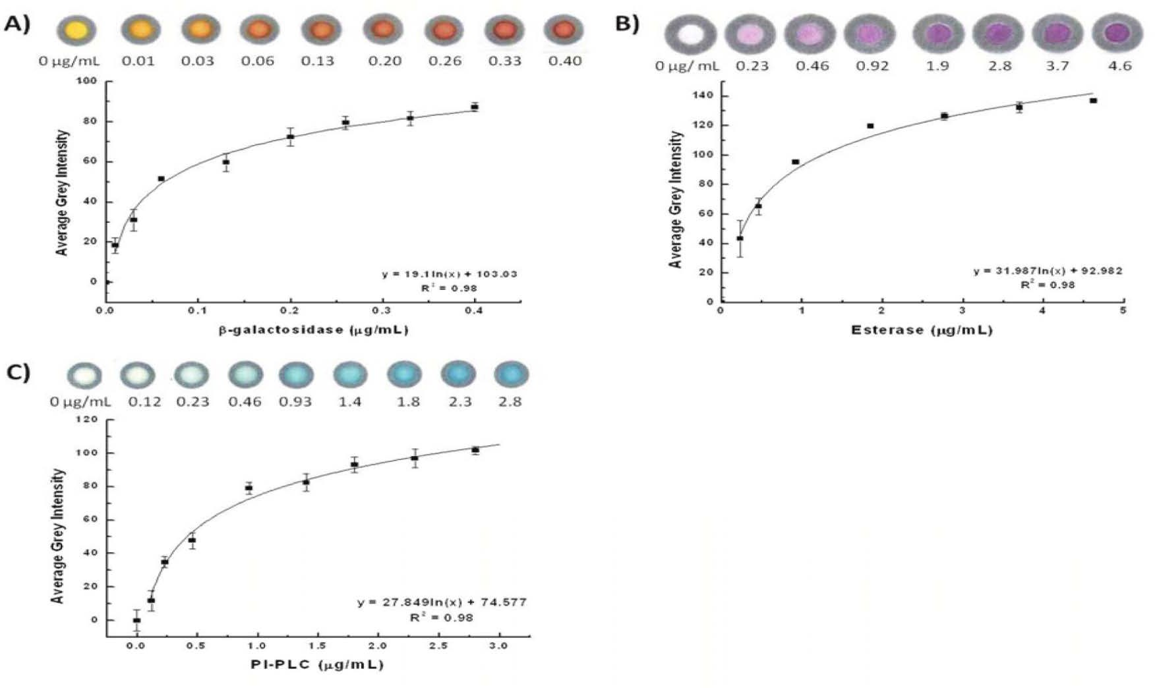
Paper based systems
Determination of lowest detectable amount of (A) β-galactosidase, (B) esterase, and (C)
PI-PLC enzymes via optimal substrate concentrations. Average grey intensities are plotted
vs the amount of enzyme in each spot
Jana C. Jokerst, Jaclyn A. Adkins, Bledar Bisha, Mallory M. Mentele, Lawrence D. Goodridge, and Charles S. Henry, “Development of a Paper-Based Analytical Device for Colorimetric Detection of Select Foodborne Pathogens’, Anal. Chem. 2012, 84, 2900−2907

Slide 21
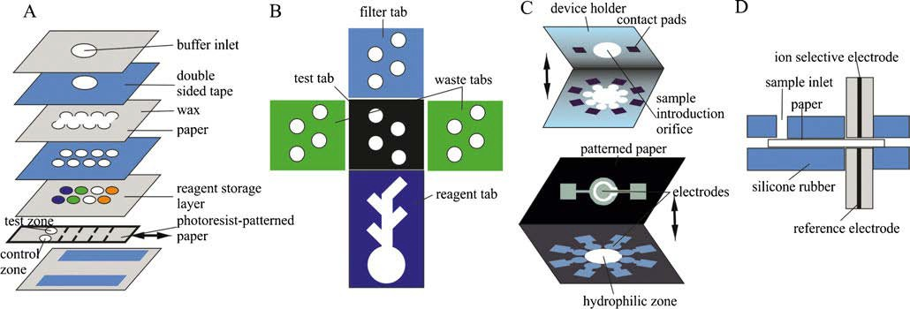
Paper based systems
Immunoassays:
a Whitesides group assay with a movable strip, b. origami-based device for detection of tumor markers, c. electrochemiluminescence detection of tumor markers, d potentiometric immunoassay

Slide 22
Paper based systems
Used for the separation and detection of underivatized carbohy- drates, amino acids, and sulfur-containing antibiotics
This paper device determined glucose, lactate, and uric acid in biological samples using oxidase enzyme reactions (similar to previous research on a silicon/pdms system)
These include glucose oxidase, lactate oxidase, and uricase
These techniques are previously expressed in other technical publications by Dr. Henry in conventional devices
Wijitar Dungchai, Orawon Chailapakul, and Charles S. Henry ,Electrochemical Detection for Paper-Based Microfluidics Anal. Chem.
2009, 81, 5821–5826

Slide 23
Paper based systems
Multi stack configuration from Dr. Henry’s work.
Layer 1: Photo- lithography was used to pattern Whatman filter paper using SU8 resist
Layer 2: Electrochemical Detector for Paper- Based Microfluidic Devices. The electrodes were screen- printed in house using carbon ink containing PB as the working (WE) and counter electrode (CE) and silver/silver chloride ink as the reference electrode (RE) and conductive pads.
•
Wijitar Dungchai, Orawon Chailapakul, and Charles S. Henry ,Electrochemical Detection for Paper-Based Microfluidics Anal. Chem. 2009, 81, 5821–5826

Slide 24
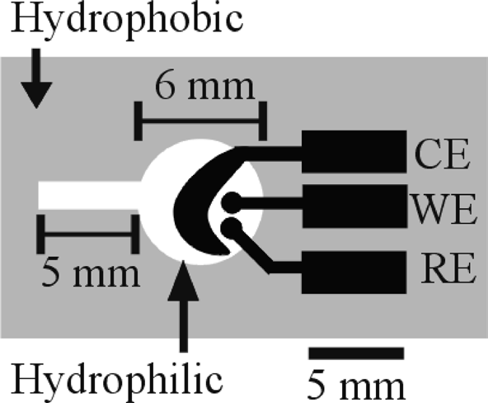
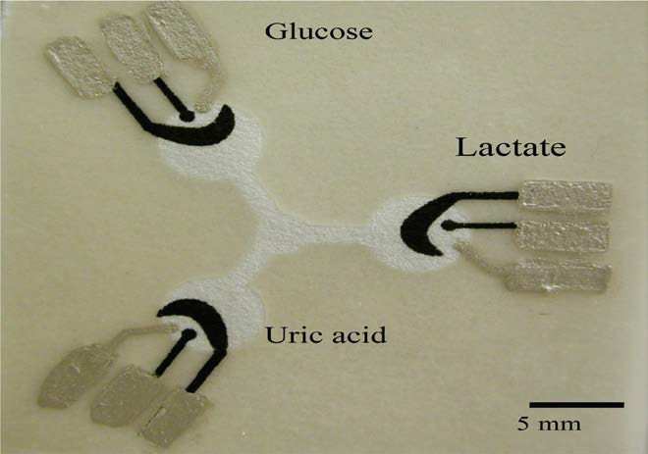
Paper based systems
The hydrophilic area at the center of the device wicks sample into the three separate test zones where independent enzyme reactions occur.
The silver electrodes and contact pads are made
from Ag/AgCl paste with the black electrode portions being the Pb modified carbon electrodes.
Basic design of the electrochemical detection cell for paper-based microfluidic devices.
WE, working electrode; RE, reference electrode; CE, counter electrode.
The device size is 4 cm × 4 cm.
Wijitar Dungchai, Orawon Chailapakul, and Charles S. Henry ,Electrochemical Detection for Paper-Based Microfluidics
Anal. Chem. 2009, 81, 5821–5826

Slide 25
MicroBioLab
This is a device that can dissect a very small amount DNA, protein, cells, or drug
It can chemically analyze a liquid sample 10,000 times smaller than commercial analytical instruments
This time-saving chip could be built for genetic diagnosis, DNA fingerprinting, and drug research
Conserves test media, and reduces disposal issues

Slide 26
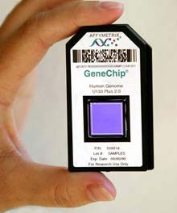
Micro Arrays
How they work
  Microarrays work by exploiting the ability of mRNA to bind to DNA templates.
What they do
  Analyzes gene expressions consisting of small membranes.
  Can determine the expression levels of hundreds or even thousands of genes in cells by measuring the amount of mRNA in a single experiment
http://genechip.com/index.affx

Slide 27
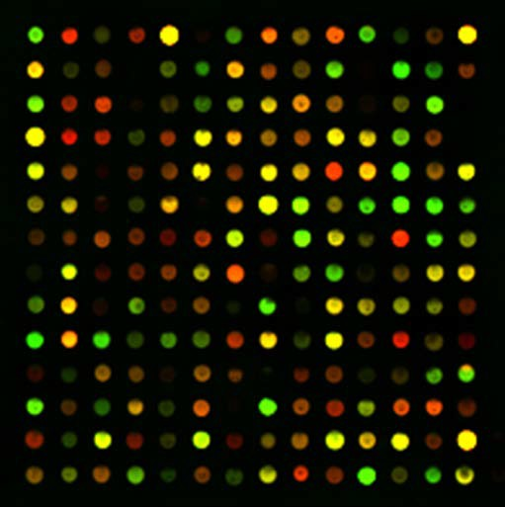
Micro Arrays Uses
Test structure that can be used with microfluidic technology to interrogate samples.
Used to understand fundamental aspects of growth and development.
Also used to identify and classify DNA sequence information and assign their function.

Slide 28
Micro Arrays
Why they are important
  You can survey large number of genes rather quickly.
  Can compose and contrast cells and tissues from being healthy of diseased.
  Show how and why certain genes can or can not work together.

Slide 29
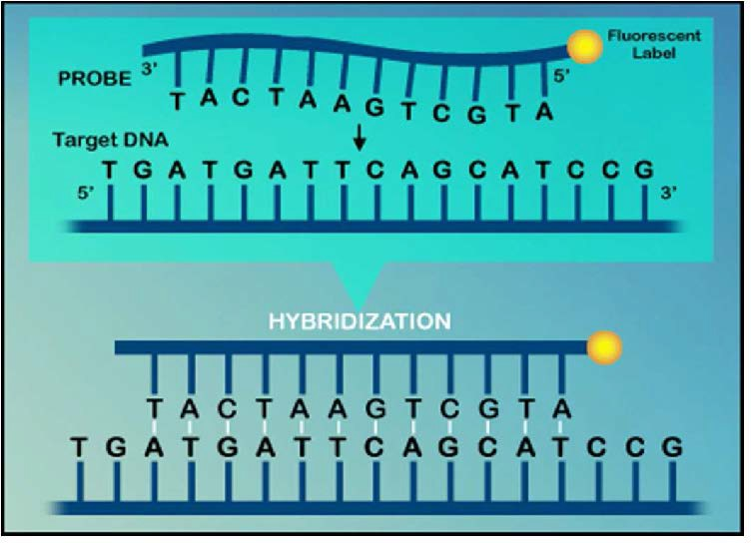
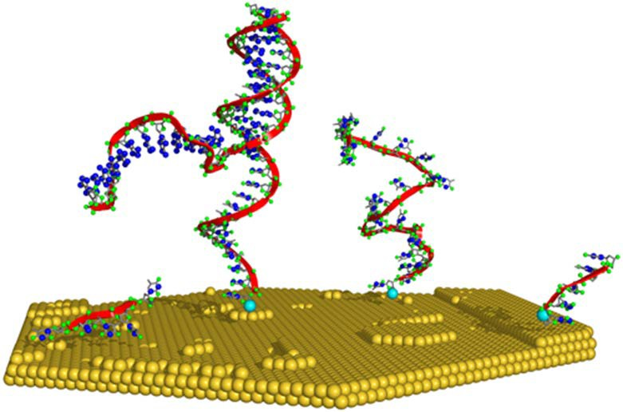
Micro Arrays
http://members.cox.net/amgough/Fanconigenetics-PGD.htm

Slide 30
Advantages/Disadvantages
Advantages
  Very Small
  Disposable
  Sealed
  Portable
  Very Fast response time
Disadvantages
  Takes place of jobs

Slide 31
Summary
Microfluidics is an important emerging technology, that uses the tools taught in the NMT program
Key points are fluid flow, components, and scaling
Many biological applications that may provide employment

