Slide 1
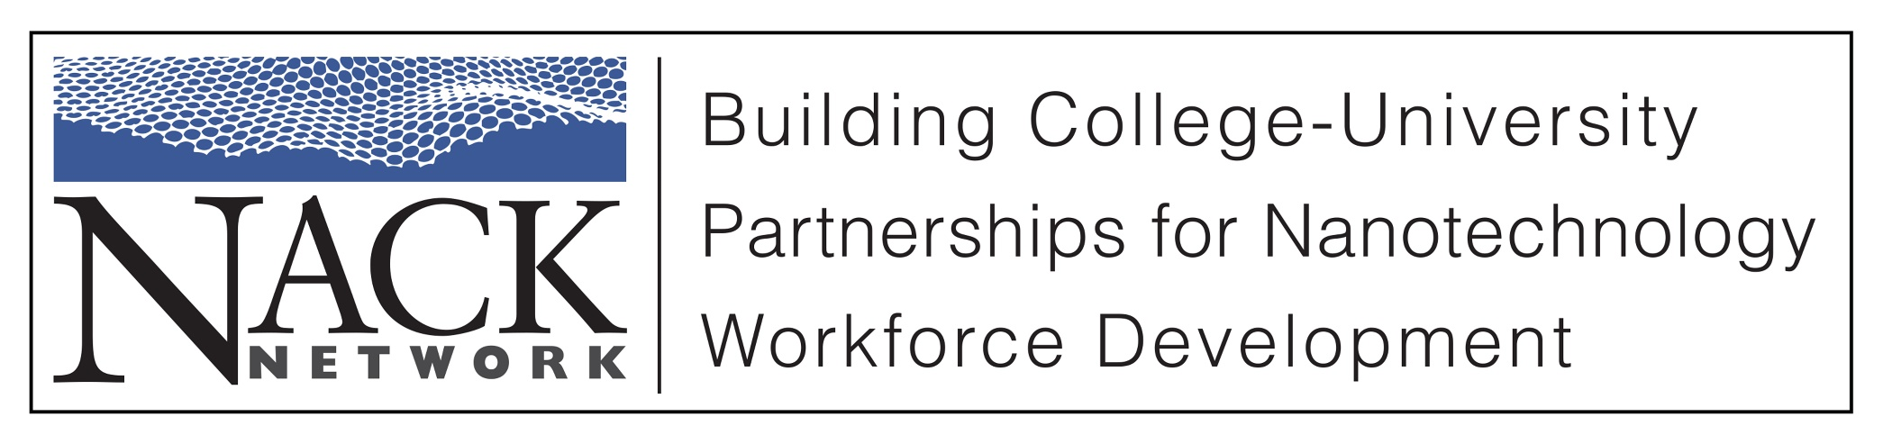
Nanoscale Science and Technology for Food

Slide 2
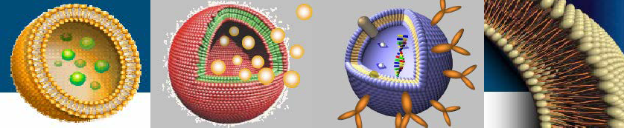
Nanoscale Science & Technology
for Food
J Lynne Brown Professor Emerita
Department of Food Science Pennsylvania State University
www.foodscience.psu.edu

Slide 3
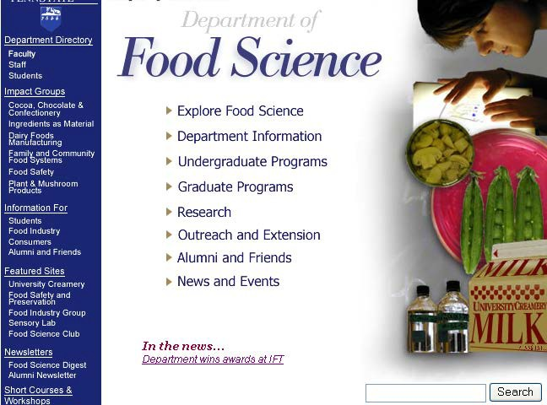
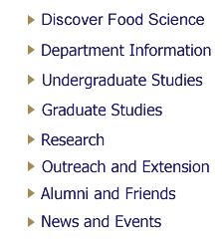
FOOD SCIENCE @ PENN STATE
Disciplines
Chemistry
Microbiology
Engineering
Nutrition
www.foodscience.psu.edu

Slide 4
Discussion Topics
Food Safety and Quality
Food Manufacturing Technologies
Food Packaging
Benefits and Risks
FDA Regulatory Approach

Slide 5

Nanoscale Science and Engineering What is Nanotechnology?
Generally, Nanotechnology is defined as the science and engineering of materials on the scale of 100 nm and below
A Nanometer is 10⁻⁹ meter
It is the use of materials between the atomic level and the macro/micro range
Hair
60-120,000 nm

Slide 6
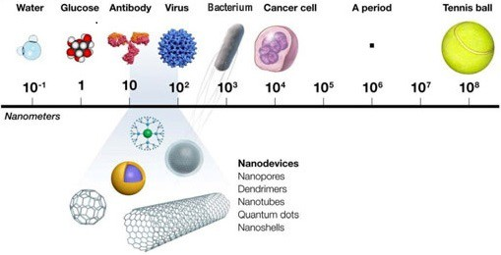
Size Comparison
Proteins

Slide 7
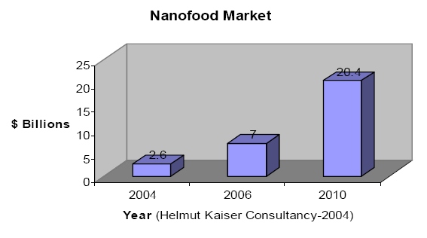
Impact of nanotechnology in the food system
20.4
7.0
2.6
www.nanoforum.com

Slide 8
Nanotechnology Research & Applications in Food
Food Safety and Quality
Food Manufacturing
Tracking and tracing systems
Nanoparticle utilization for delivery of ingredients
Nanolaminates to preserve food quality
Nanoemulsions
New membrane separation systems
Food Packaging
  Low permeability, high-strength plastics
  Active and Intelligent packaging

Slide 9
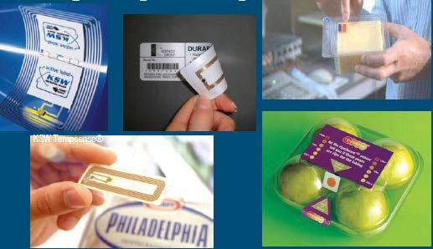
Tracking – Tracing – Monitoring

Slide 10

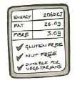
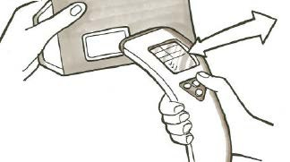
Improving Food Labeling
Improving label readability in the supermarket to suit costumers diet in nutritional requirements
www.cambridge consultants.com

Slide 11
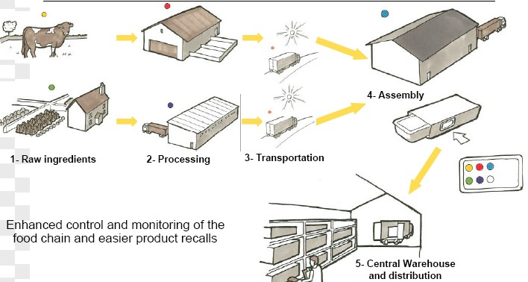
Food Traceability

Slide 12
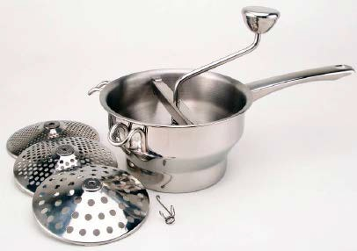
Nanotechnology in Food Manufacturing
Frans Kampers, 2007

Slide 13

Functional Water

Slide 14
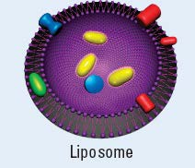
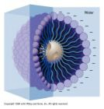
Encapsulation with Liposomes & Micelles
Use linear molecules with each end having different affinities for water to make capsules
Produce nanoparticles with different exterior and interior properties
Can put compounds of interest inside
  Flavors
  Antioxidants
  Vitamins

Slide 16
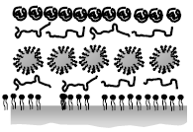
Nanolaminates
Outer wax coating
Antioxidant
Fruit surface

Slide 17
Nanoemulsions
□Fine oil in water mixtures where droplet size 50-200nm will appear clear rather than opaque
Possible uses
  Lower fat mayonnaise, ice cream
  Parenteral nutrition (actually in use)
  Carry bioactive compounds so bioavailability is increased
  Disinfect equipment surfaces where biofilms harbor pathogens

Slide 18
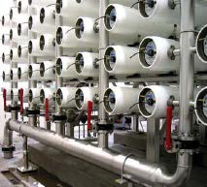
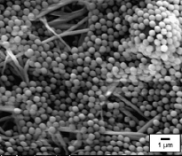
Nanofiltration – Molecular Separation Technologies
Jochen Weiss, 2007

Slide 19
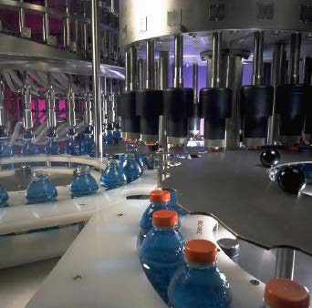
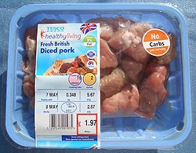
Nanotechnology in Food Packaging

Slide 20
Nanotechnology in Food Packaging
Protect food from contamination to preserve its quality and shelf- life
Microbial contamination
Chemical contamination
Oxygen
Water vapor
Light

Slide 21

Nano-Nylon (Imper)
Nanoclay with MXD6 Nylon in barrier layer in beer bottles Developed by Voridan & Nanocor

Slide 22
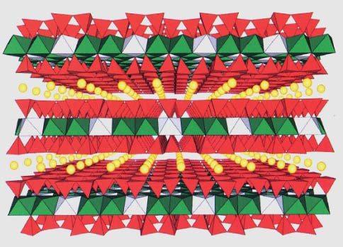
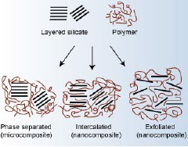
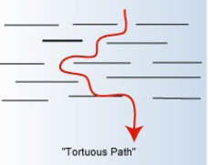
Clay Nanocomposites
 Based on clay-Montmorillonite
-Nylon
 Improve barrier properties

Slide 23
Biodegradable Nanocomposites
 Blends of biopolymers and clay
Starch/montmorillonite
Polylactic acid/clay
Polycaprolone/nylon
Exhibit reinforced mechanical properties, thermal, higher temperature resistance, reinforced barrier properties

Slide 24
Active & Intelligent Packaging
 Active Packaging: Actively changes the conditions of the packaged food to extend shelf-life or to improve food safety and quality
 Intelligent Packaging: Monitors the conditions of packaged food products and gives information about their safety and quality during transport and storage

Slide 25
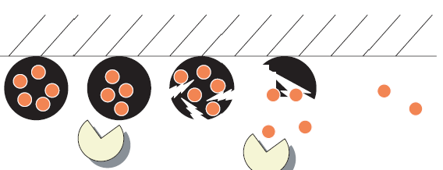
Schematic representation of antimicrobial active packaging
Antimicrobial active packaging. Microorganisms hydrolyze starch based particles causing release of the
antimicrobial
lysozyme resulting in inhibition of microbial growth
DeJong et al. 2005

Slide 26
Nanotechnology Research & Applications in Food
Food Safety and Quality
Food Manufacturing
Tracking and tracing systems √
Nanoparticle utilization for delivery of ingredients √
Nanolaminates to preserve food quality √
Nanoemulsions √
New membrane separation systems √
Food Packaging
  Low permeability, high-strength plastics √
  Active and Intelligent packaging √

Slide 27
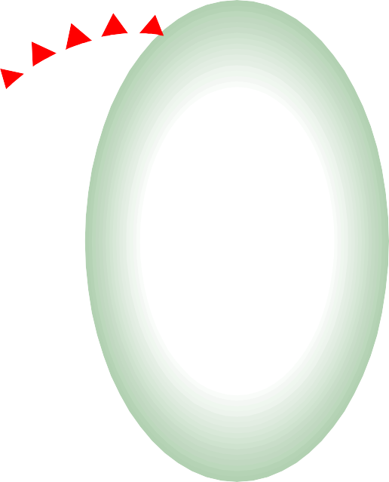
Benefits, Risk, Regulation

Slide 28
Benefits/Risks
□Information about products already in the marketplace and those food innovations proposed emphasize benefits
Question: Who benefits?
□But nanotechnology has risks too

Slide 29
Size Matters
Manufactured nanomaterials have different
  Chemical reactivity
  Optical properties
  Structural (strength) properties
  Electrical, magnetic properties
  Response to gravity
Undesirable effects are possible

Slide 30
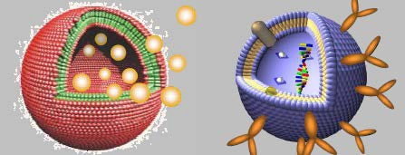
Focus of food safety concern
Manufactured or engineered nanoapplications produced for specific function
Natural nanoparticles include fat globules produced in homogenization, proteins like enzymes and starch molecules

Slide 31
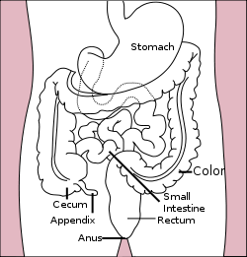
Metabolism of Food
Intestinal Tract
Houses gut bacteria
Controls nutrient uptake
Is subject to intestinal conditions and chronic diseases

Slide 32
Nanoencapsulation Impacts
Many food products are enriched with ‘phyto- chemicals’ --
  beta carotene,
  lycopene,
  green tea EGCG,
Also antioxidant vitamins (E,C) and minerals
Concern: More effective delivery of compounds like beta carotene by nano-encapsulation could lead to overdoses with compounds whose metabolism we do not understand well

Slide 33
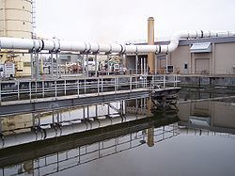
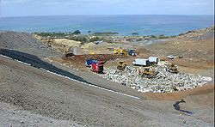

Downstream Impact of Food Nano- materials

Slide 34



Regulation

Slide 35
Summary FDA Regulatory Reach
Pre-market approval
  Food ingredients, additives
  Food contact materials
Pre-market notification
  Dietary supplement ‘new ingredients’
  Company GRAS determination (voluntary)
Post market notification
  Dietary supplements*
  Cosmetics*
* Inspect plants for adulteration, cleanliness

Slide 36
FDA and Nanotechnology
Nanotechnology use can occur in cosmetics, dietary supplements, food contact substances, food additives and in GRAS ingredients
FDA’s ability to regulate nanotechnology use across cosmetics, dietary supplements and GRAS ingredients is limited
No established rules that require a food company to declare changes in ingredient size, i.e. nano size
FDA was advised by its advisory group (2006) and GAO (2010) to address these deficiencies
FDA white paper, 2006, GAO Report, 2010

Slide 37
Proposed FDA Nanotechnology Definition
An FDA regulate product involves the use of nanotechnology if
  An engineered material or end product has at least one dimension in the 1- 100nm range
Or
  The engineered material or end product exhibits physical or chemical properties or biological effects that are attributed to dimensions up to 1000 nm (1 micrometer)
FDA, 2011. Draft Guidance for Industry – Considering whether an FDA-regulate product involves the application of nanotechnology

Slide 38
Food Manufacturing Guidance
In April 2012, draft guidance issued that instructed companies to be aware that significant changes in manufacturing or use of nanotechnology could warrant a regulatory submission to the FDA
Consultation is recommended, not required
Guidance covers
  Existing food or color additives previously reviewed
  Any food contact substance (packaging and films)
  Any long standing GRAS ingredient or newly determined GRAS ingredient
FDA, 2012. Draft Guidance for Industry: Assessing the effects of significant manufacturing process changes, etc.

Slide 39
Conclusions
Nanotechnology is part of our future
Developments in nanotechnology have the potential to benefit society
Nanotechnology use, including that in food, does entail some risk
Industry and regulatory agencies need to practice transparency and offer consumers choice

Slide 40
Thank You!
□ Websites for more information www.nanotechproject.org www.pewtrusts.org

