Slide 1

NanoScience and Nanotechnology

Slide 2
NanoScience and Nanotechnology: How the Smallest Building Blocks are Impacting Life Today and Tomorrow
Dr. Allen Kimel, Assistant Professor
Materials Science and Engineering
Pennsylvania State University

Slide 3
Overview
What is Materials Science and Engineering
  What is a material
  Engineering versus Science
  Example – Turkey Timer
Impact now and in the Future
  Interest in Nanotechnology
  Making materials small generates big changes
  Products
  Research
Questions

Slide 4
Ceramics in General
Bond metal to a non-metal
Ionic and covalent bonding
High stiffness with no toughness
Insulators
High temperature and chemical resistivity

Slide 5
Metals in General
Metallic bonding – sharing of electrons
Alloyed with addition of other elements
High strength, tough/ductile
Can engineer stiffness and toughness through both atomistic and microstructural manipulations
Conductors

Slide 6
Polymers in General
Long carbon chains (does not have to be carbon)
Covalent bonds within chains with covalent and van der Waals bonds between chains
Low stiffness and high ductility/toughness
Low temperature
Performance highly dependent on molecular weight and degree of crystallinity

Slide 7
THE MATERIALS’ SCIENCE TETRAHEDRON
Application
chemistry, thermodynamics,
kinetics, transport phenomena
crystallography, electron and x-ray diffraction, analytical methods
solid state physics, optics, electromagnetics, mechanical properties, chemical stability, etc.

Slide 8
Engineering versus Science
Engineering answers the question how
Science answers the question why
Example: creation of a hard surface to use to hit an object (hammer, golf club, tennis racket, etc.)
Engineering chooses a metal and develops a setup to generate power
Science asks what can we change within the components of the engineered system to exact improved properties for better performance

Slide 9
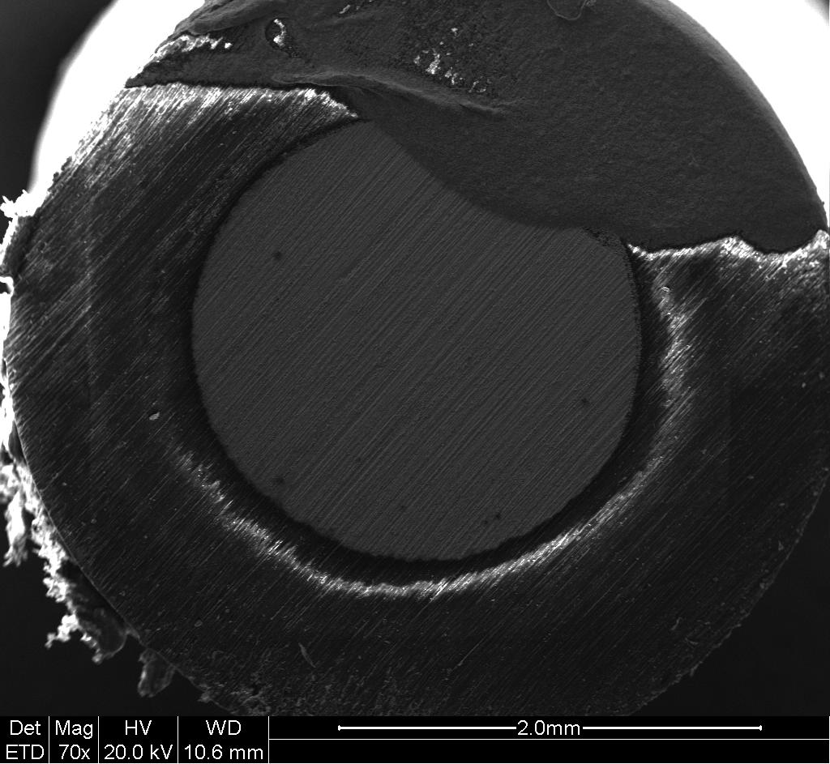
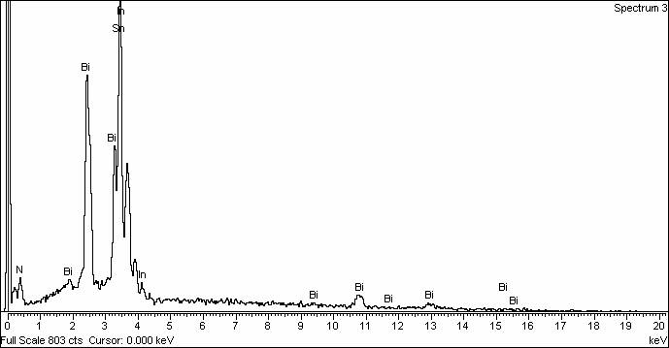
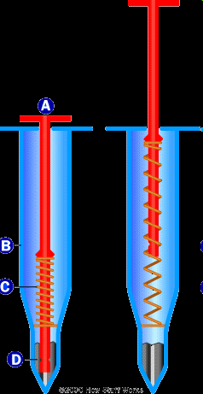
Turkey Day Materials Science
Element | Field’s Metal Weight % | Turkey Timer Weight %
Bismuth (Bi) | 32.5 | 32.5
Indium (In) | 51 | 18.7
Tin (Sn) | 16.5 | 48.5
Melting Point Celsius (F) | 62 (144) | 85 (185)

Slide 10
Nanoscience and Nanotechnology
Nano: 10⁻⁹ meters or 0.000000001 meters
Essentially any material with a defining property determined by a structure at the nanometer scale
Working definition for materials science and engineering is 0.1 – 100 nanometers

Slide 11
What Makes Nanotechnology Development and Education Challenging and Exciting?
It’s cross disciplinary!
Physics
Chemistry
Biology
Engineering
Agriculture
Medicine
Education
Business
Psychology
Sociology
Philosophy
Nanotechnology
New products and services

Slide 12
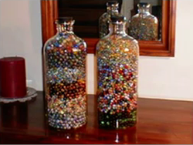
Large Effects of Smallness
Nanoparticles: as you DECREASE the diameter of the particles you INCREASE the surface area. (you can get a lot more particles into the same fixed volume of space
Left jar contains 3000 marbles 5/8”in diameter
Right jar contains 5000 marbles ½” in diameter
A reduction of 20% created a gain of 2000 marbles

Slide 13
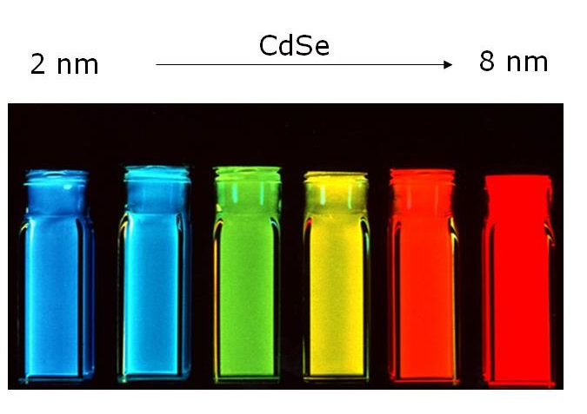
Large Effects of Smallness
Sometimes we are just interested in making really small particles
Here quantum dots of cadmium selenide (CdSe) are used to create an array of colors

Slide 14
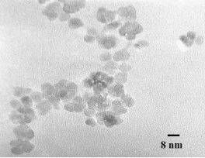

Large Effects of Smallness
Surface area: amount of surface available for chemical reaction
“traditional” ceramic powders
are typically around 1 to 10
micrometers in size
Surface area of <1 m²/g
These ceramic particles are
around 8 nanometers in size
A reduction of ~1000 times in
size
Surface area of ~130 m²/g
What does that mean physically?
A one centimeter cube full of this 8nm particle size powder
would have an equivalent surface area of ~1400 sq ft.!
1cm = 0.40 inches

Slide 15
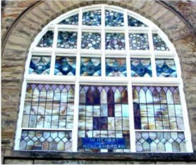
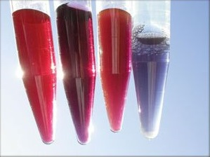
A Little History
Nanotechnology has been around for a long time – 2000 years
ago nano-gold particles were used in coloring of glass
The left picture shows the array of colors possible with gold nanoparticles

Slide 16
Career Pathways
Business
Communications
Human Services
Engineering and Industrial
Science

Slide 17



Making Things Smaller and Cheaper
Portable
telecommunication
Portable music player
Portable GPS
Pocket calculator
Portable video camera
Portable gaming device
Portable camera

Slide 18
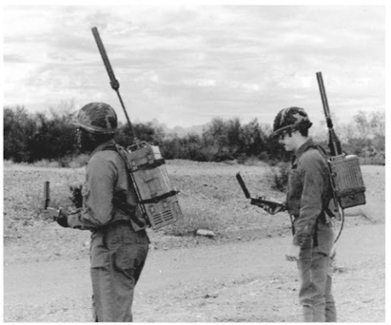
System Integration
Portable
telecommunication
Portable music player
Portable GPS
Pocket calculator
Portable video camera
Portable gaming device
Portable camera

Slide 19

System Integration
Portable
telecommunication
Portable music player
Portable GPS
Pocket calculator
Portable video camera
Portable gaming device
Portable camera

Slide 20
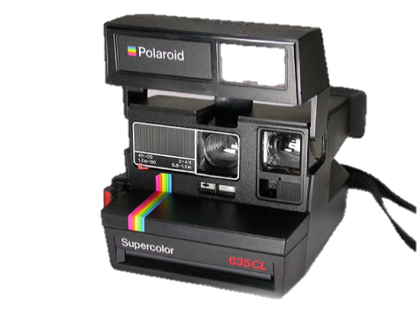
System Integration
Portable
telecommunication
Portable music player
Portable GPS
Pocket calculator
Portable video camera
Portable gaming device
Portable camera

Slide 21
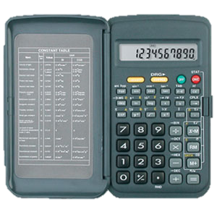
System Integration
Portable
telecommunication
Portable music player
Portable GPS
Pocket calculator
Portable video camera
Portable gaming device
Portable camera

Slide 22
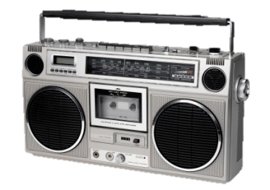
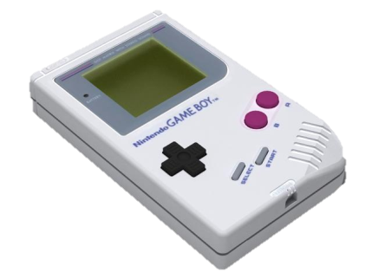
System Integration
Portable
telecommunication
Portable music player
Portable GPS
Pocket calculator
Portable video camera
Portable gaming device
Portable camera

Slide 23

System Integration
Portable
telecommunication
Portable music player
Portable GPS
Pocket calculator
Portable video camera
Portable gaming device
Portable camera

Slide 24
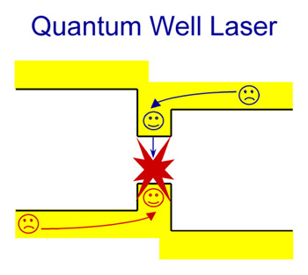
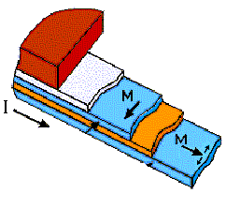
Nanotechnology on our Desktops
Hard Disk
Transistor
Sensor Medium
Gate
Source
Drain
Gate oxide
4 nm
Well
6 nm
Switching layer
5 nm
Magnetic grain
10 nm
Notes:
Here are examples of nanotechnology at work in our computers. A quantum well laser reads a CD or DVD, the standard MOSFET transistor that runs all our computers has a gate oxide only 2-4 nanometers thick, and a hard disk has actually two components at the single-digit nanometer scale, the magnetic layer in the reading head that senses a stored bit, and the magnetic grains that store the data.
In the following two lectures, we will go through these examples in more detail.

Slide 25
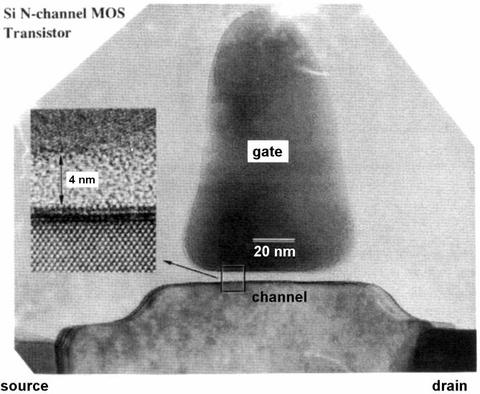
Power consumption by a leaky gate oxide: A show-stopper for Moore’s Law ?
Gate oxide has shrunk to < 2nm, < 10 atom layers.
Electrons can tunnel through when applying a gate voltage.
Uses up to ¹/₃ of the power.
Notes:
The shrinking thickness of the gate oxide is currently the biggest threat to silicon technology and to its continued improvement via Moore’s law. These oxide layers have become so thin that the electrons can tunnel through it. That creates a leakage current, which has grown to about the third of the power consumption (i.e. heat load) of a microprocessor. This led to a major change in silicon technology. After 40 years of using silicon dioxide as gate insulator the most recent generation of silicon chips uses new oxides with higher dielectric constants. These can be made thicker than SiO2 while maintaining the same electrical performance (same capacitance).

Slide 26
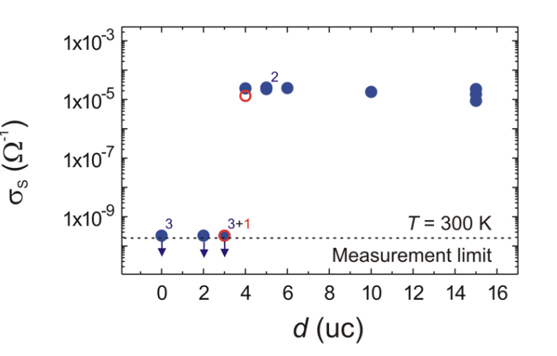
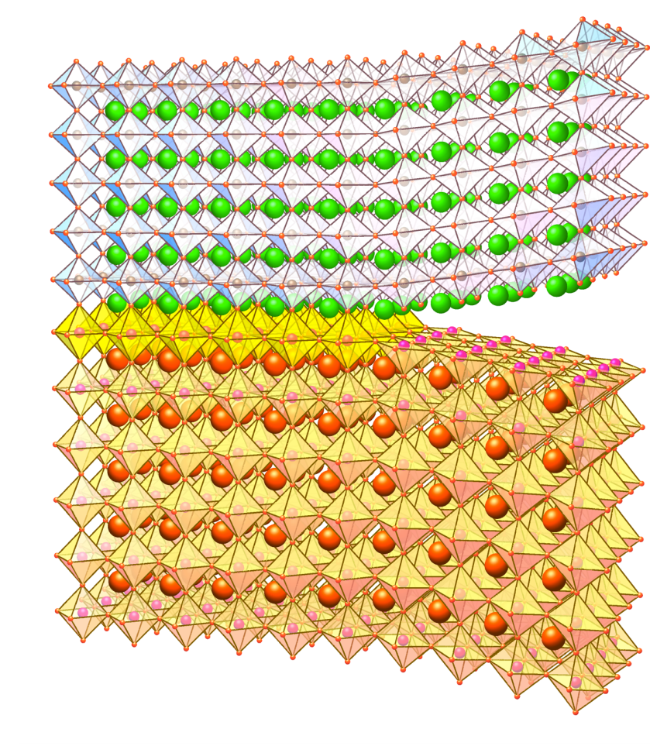
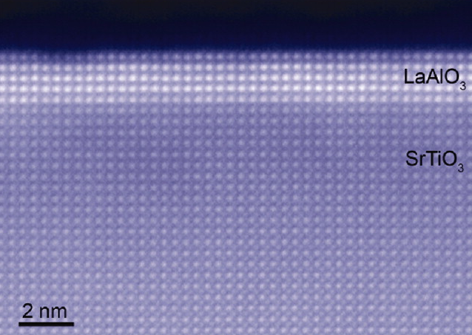
Surprising phenomena at oxide-oxide interfaces: formation of a 2dimensional electron gas between two bulk insulators

AlO₂
LaO
TiO₂
SrO

J. Mannhart¹,* and D. G. Schlom²,*
Science 327, 1607 (2010)
Ohtomo and H. Hwang
Nature 427 (2004) 423-426

Slide 27
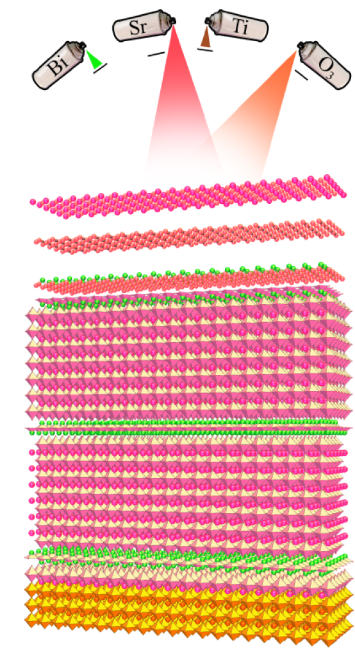
How Do We Arrange Them?
atomic spray painting approach
J. Am. Cer. Soc. 91, 2429 (2008).

Slide 28
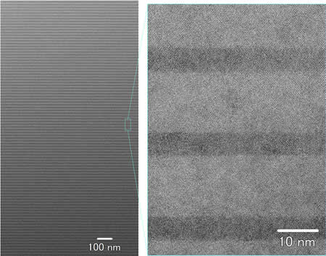
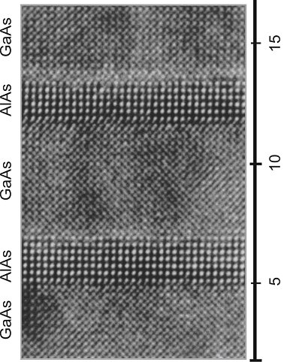
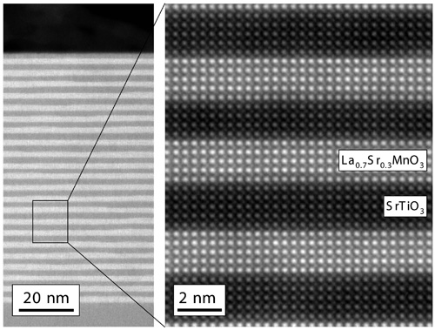
How Do We Arrange Them?
atomic spray painting approach
nm
InGaAsP superlattice for high-efficicency solar cells, Sugiyama Lab, U of Tokyo
AlAs/GaAs superlattices, atomically sharp interfaces, perfect atomic registry across interfaces, nanoscale arrangement of two structurally similar materials with entirely different electronic properties
D. Muller group, Cornell

Slide 29
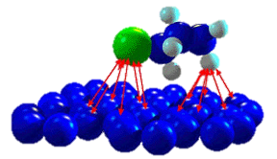
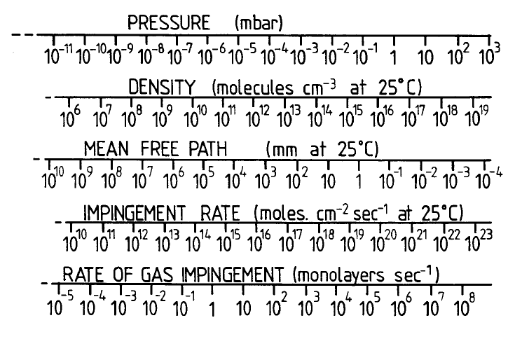
Ingredients for Atomic Scale Control
Keep the growth environment clean!
  adatom
  surface
  Ultrahigh vaccum is the choice!
  enough time to build up the crystal layer by layer without incorporating gas molecules

Slide 30
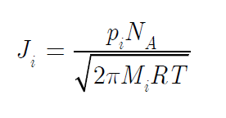
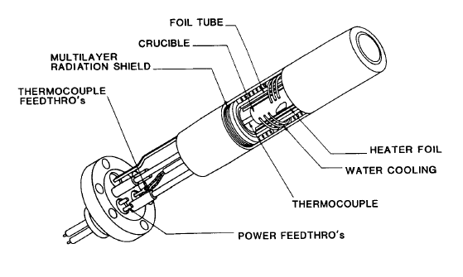
Grow Slowly to Maintain Control
We want to grow atomic layer by atomic layer
  How many atoms will form a monolayer?
  How do I generate this this much flux?
  Knudsen
  Effusion cell

Slide 31
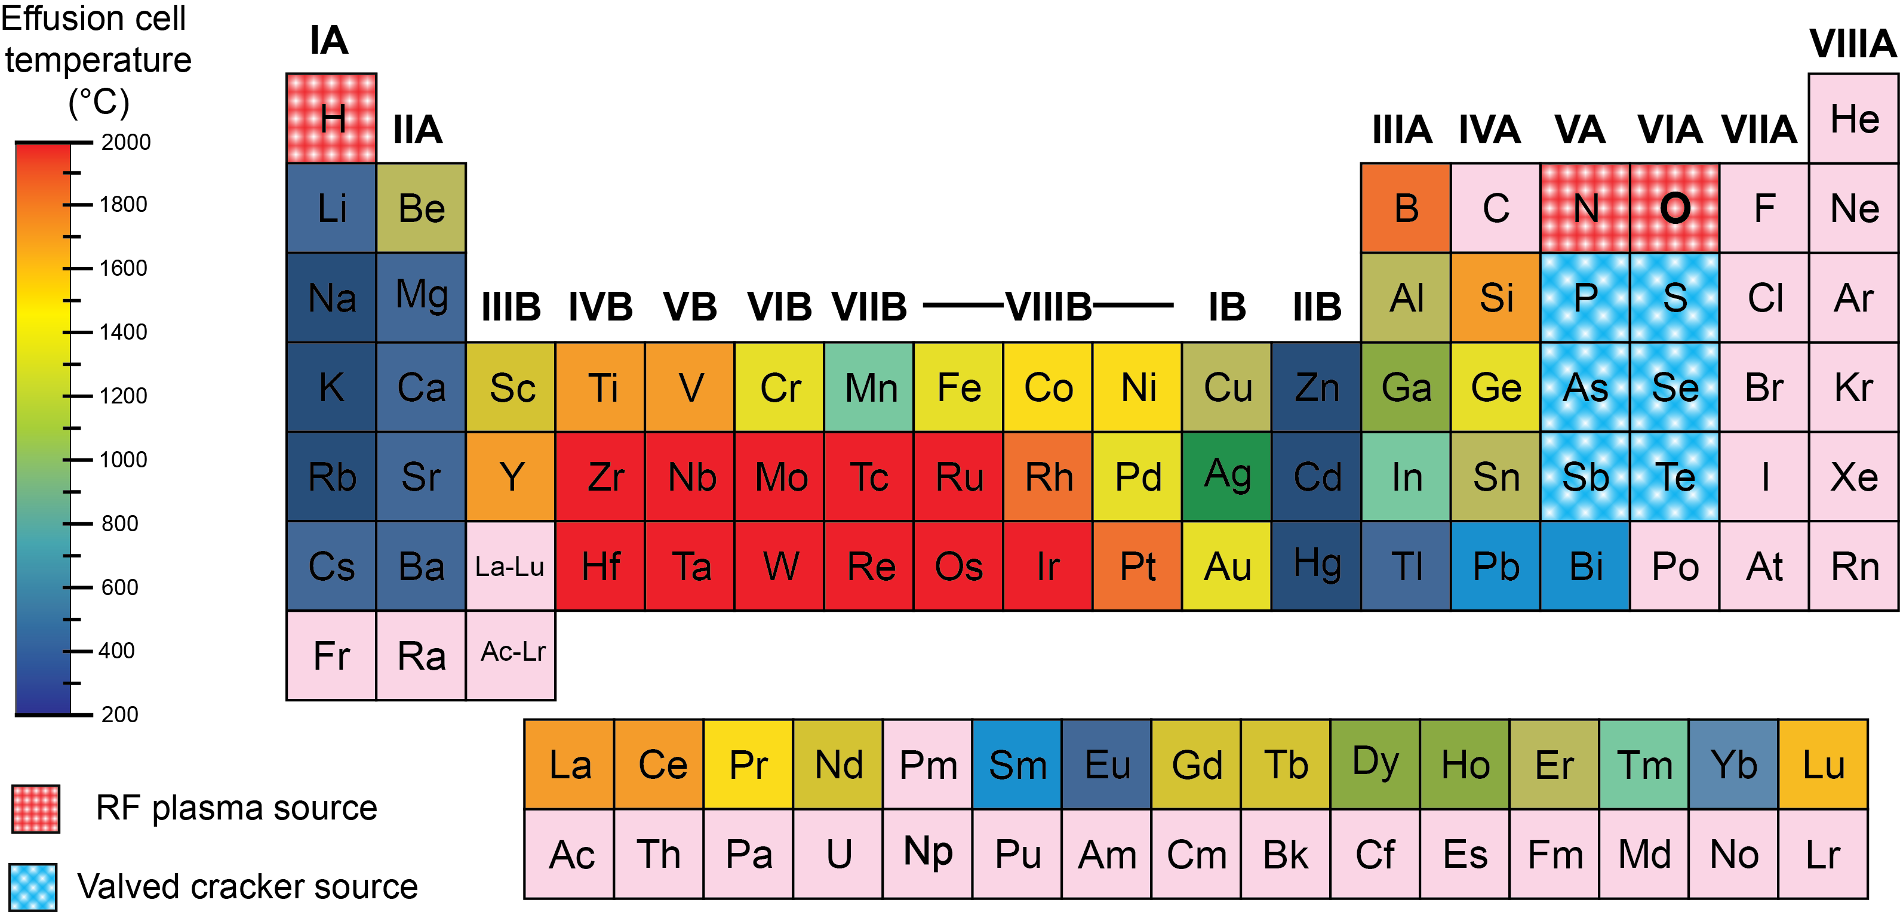
Is This Feasible?
What are the vapor pressures of elements?

Slide 32
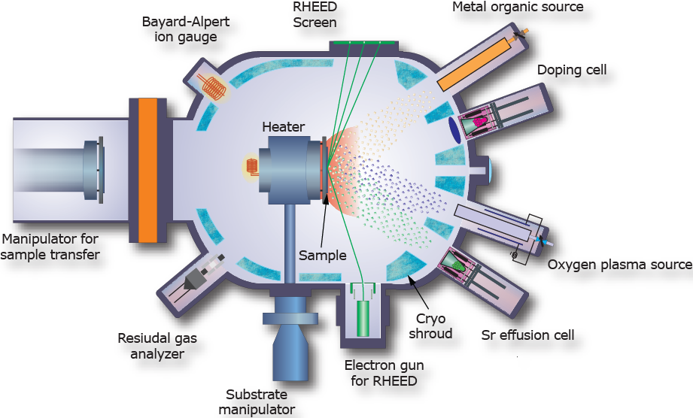
Put Everything Together into a System: MBE

Slide 33
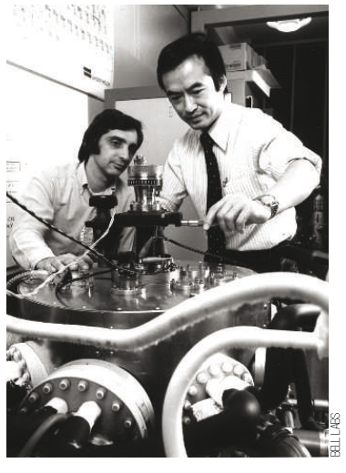
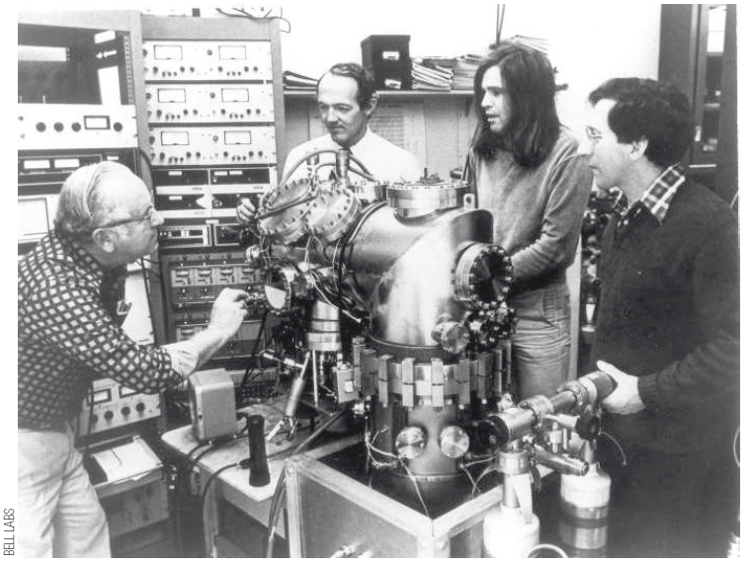
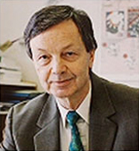
Can We Do Nanoscience with this Last Century Technology?
Pioneering work in the U.S.: Al Cho and Art Gossard
Pioneering work in Germany: Klaus Ploog

Slide 34
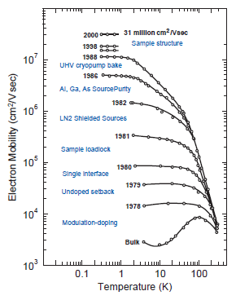
How Good is Good?

Slide 35

How Good is Good?
3 mph

Slide 36

Separate Scatters from Transport
65 mph

Slide 37

Materials Perfection: Impurity Control
10000 mph
hypersonic scram jet

Slide 38
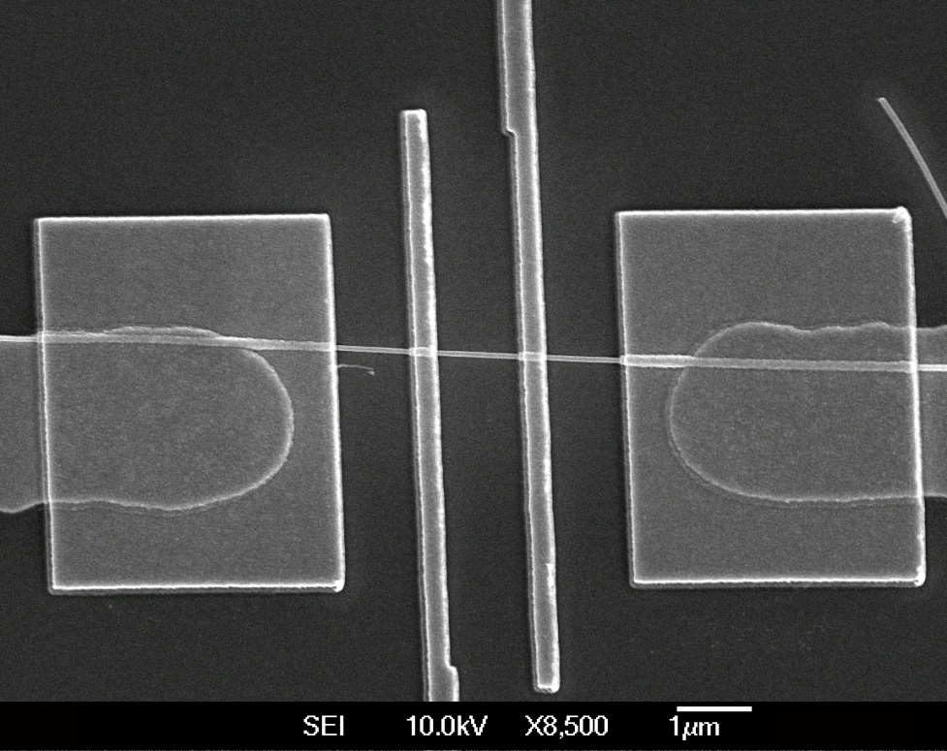
Semiconductor Nanowires
Less than 5nm in diameter
Increase speed of electrons in nanowires – faster computing, improve efficiency of solar cells
Large surface area attractive for chemical sensing – homeland security

Slide 39

The Many Uses of Gold Nanoparticles
First Response home pregnancy test
Gold nanoparticles with complementary DNA base pair sequence for HcG
The gold nanoparticles allow for more base pair detectors to be present on the applicator – thus heighten sensitivity to elevated levels of HcG

Slide 40

Nano-Sun block
Keys incorporates nanosized ZnO particles into a cream
ZnO nanoparticles adsorb UVA and UVB
radiation wavelengths
However, because of the small size of
the ZnO particles (around 25 nm)
the particles do not scatter visible light
No white appearance

Slide 41
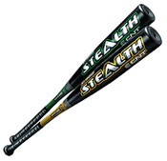
Easton Sports Stealth CNT Bat
Combines carbon fiber technology with carbon
nanotube (CNT) technology
In between the carbon fibers is a polymer
resin containing CNT
Optimizes stiffness of bat for maximum
energy transfer to the ball

Slide 42
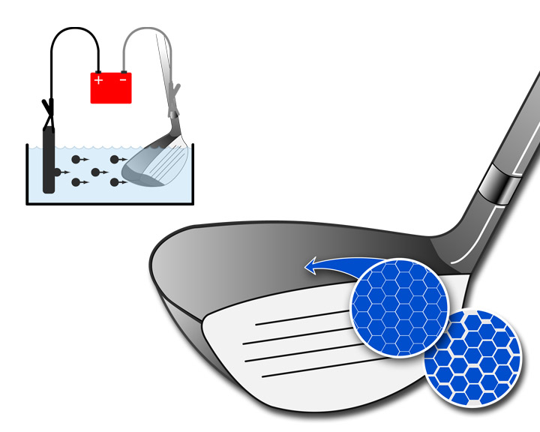
Nanotechnology in Golf
Electrodeposition is performed using an electrochemical cell. A negatively charged metal is dissolved and metal atoms redeposit on the positively charged club head.
Dense layer of a nano-grained metal on the surface of the club head. This leads to a lighter and stronger club face with a bigger “sweet spot”

Slide 43
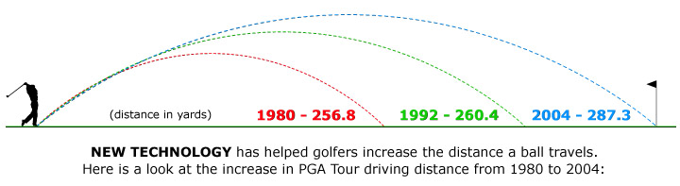
The Result of Materials Improvements
Distances are average drive lengths (in yards) for PGA Tour players over the last 25 years
Note the substantial increase in the last decade (over 25 yards)
not to scale

Slide 44
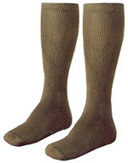
ARC Outdoors - ArcticShield Socks
Silver is known for its antimicrobial properties
Attempts have been made to incorporate
silver into linen socks via metal threads
Through the use of silver nanoparticles
ARC has incorporated the silver into
the polymer fibers
ARC claims permanent resistance
to odor or fungus

Slide 45
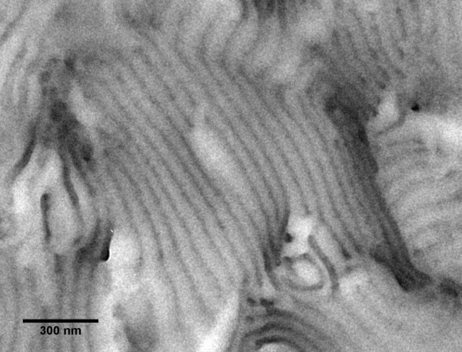
Block Copolymer Assemblies to Form Ionic Channels
Transmission electron micrograph of a block copolymer with hydrophobic and ionic phases. The ionic phases for channels for transport of ions and water.
Hydrophobic part of the polymer provides mechanical strength.
Ionic part of the polymer is hydrophilic and conducts ions and water.
+
-
+
-
+
-
+
-
+
-
+
-
+
-
Schematic of the self-assembly of like parts of the block copolymer.
+
-
+
-
+
-
+
-
+
-
+
-
+
-
+
-
+
-
+
-
+
-
+
-
+
-
+
-
+
-
+
-
+
-
+
-
+
-
+
-
+
-
+
-
+
-
+
-
+
-
+
-
+
-
+
-
+
-
+
-
+
-
+
-
+
-
+
-
+
-
Elabd and Hickner, Macromolecules 2011.

Slide 46
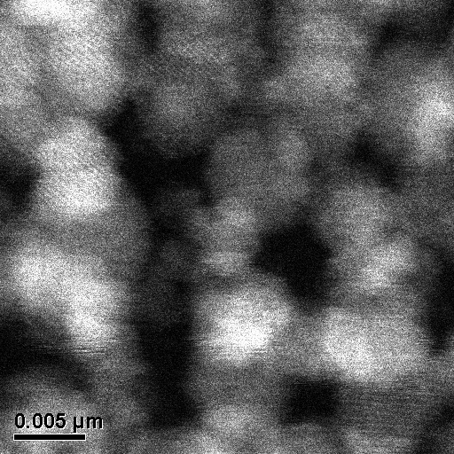
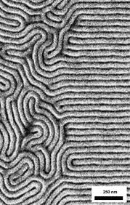
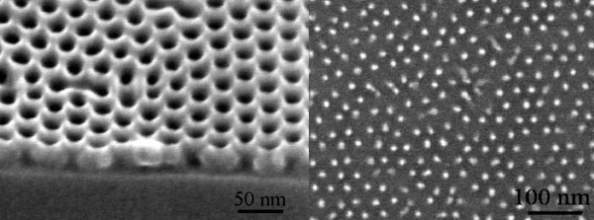
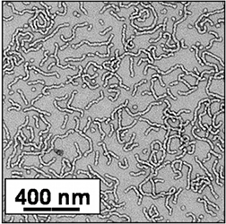
Block Copolymers can Form Many Different Structures
Selective patterning
5 nm phases
High aspect ratio lines and corners
Holes and isolated dots
Wormlike micelles in solution
Bates and Fredrickson, Physics Today 1999.

Slide 47
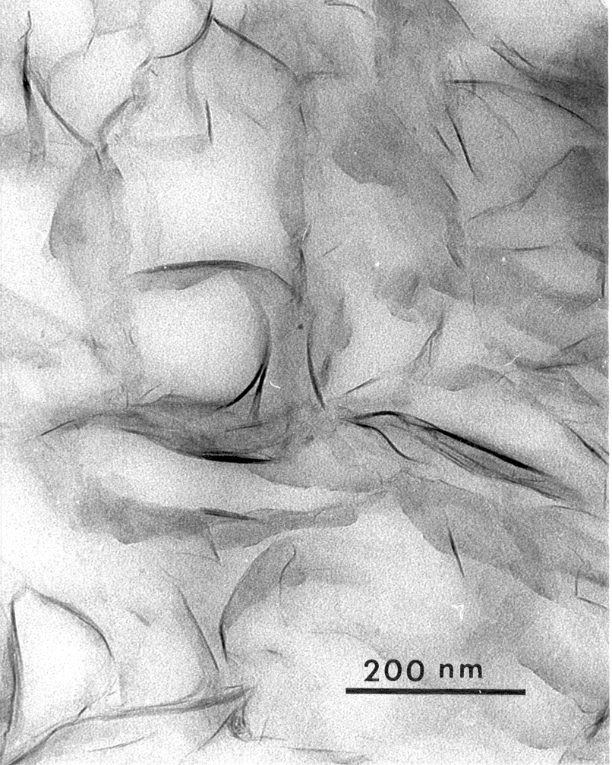
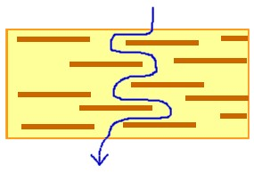
Polymer Nanocomposites
Addition of a small amount of nanoparticles gives large change in properties of polymer
However, important polymer properties such as optical transparency, flexibility, and low weight remain
Imagine this 10’s of 1000’s of times over

Slide 48
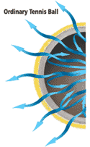
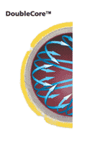
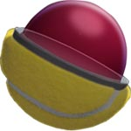

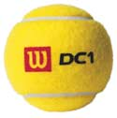
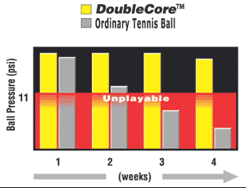
Wilson high performance tennis balls
inner core (barrier)
butyl-rubber + clay
http://www.wilsonsports.com.au/tennis/doublecore.html

Slide 49



Application of Nanocomposite
Polymer Materials
B
Pump for artificial heart
Decrease sneaker weight, increase response
Running boards and body panels for cars
A
C

Slide 50

Non-halogen, low flammability cables
Char formation of a cable with nanocomposite
Addition
of organo-clay
Improvements
on fire performance
and smoke density
J.W. Gilman, 2002

Slide 51

Improvement of Thermal Properties
& R.A. Vaia et al ,
Air Force Research Lab, 2001
SEM of nylon-6/5wt% clay nanocomposite after exposure to simulated solid-rocket motor exhaust &
Thermal Conductivity
PC with 5wt% clay nanocomposite

Slide 52

O'Lala Foods - Choco'la Chewing Gum
Incorporating chocolate into chewing gum has actually been challenging because the cocoa
butter fats in chocolate cause the
gum to lose its elastic nature
O’Lala has incorporated nano-
crystals that change the surface
characteristics of the gum allowing
for the incorporation of chocolate
flavoring

Slide 53

Raw
Nanomaterials
Biotechnology &
Biorobotics
Nanorobotics
Nanostructured
Materials
Tools and Diagnostics
Biological
Research
Molecular
Medicine
Drug Delivery
NANOMEDICINE
Artificial Binding
Sites
Cell Simulations
& Diagnostics
Artificial Enzymes
& Enzyme Control
Intracellular
Devices
Nanodevices
Nanopores
DNA Manipulation,
Sequencing, Diagnostics
Control of Surfaces

Slide 54


Surgical Tools
Bend bars made using 400 micron thick molds
Bend bars made using 25 micron thick molds
50 μm

Slide 55


Nanocomposite Particles
Particles on the order of 1 – 100 nm in diameter
Shell and core of particle are two different materials
Can be tailored to absorb specific radiation frequencies – military application
Can be designed to emit specific wavelengths of light – flat panel displays
Can be designed with any desired surface – biomedical imaging and drug delivery
Silica shell with rhodamine WT core
20 nm

Slide 56



Drug Delivery Systems
Erica Marden Senior Honors Thesis, 2012

