Slide 1

PDMS: An Example of a Versatile Material for Micro- and Nanotechnology

Slide 2
Outline
Background
Properties of PDMS
Applications of PDMS
Modification of PDMS

Slide 3
Background
PDMS is Polydimethylsiloxane
Polysiloxane discovered by Dow Chemical
Good elastomer / flexibility
R R R R
\ / ↔ \ /
—O—Si—O — Si
/ \
— O O—
Figure 1: The above representation of the PDMS molecule shows the flexibility of the entire backbone chain.

Slide 4
Background
There are at least six forms of commercially viable PDMS products that are common:
Fluids
Emulsions
Compounds
Lubricants
Resins
Elastomers or rubbers

Slide 5
Background
As shown in the last slide PDMS has many forms and uses. It is especially useful because it is relatively inexpensive.
Our focus will be on PDMS as a “substrate”. It is especially useful for microfluidics.
Another very good example of a PDMS application is soft contact lens.
  The lenses are inexpensive, have exacting tolerances, and must be biocompatible.

Slide 6
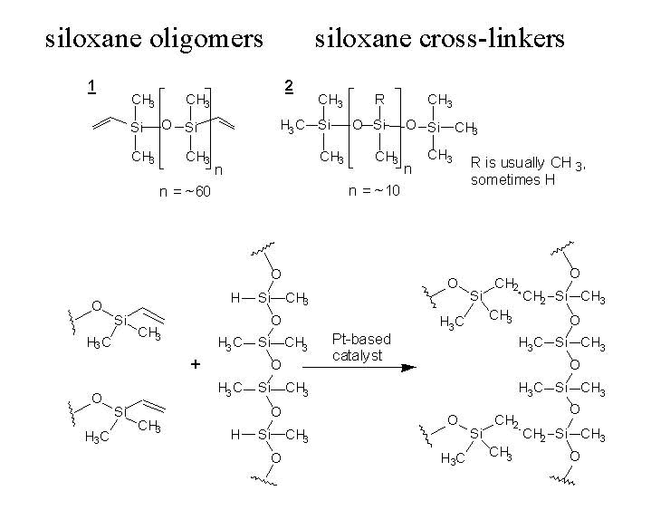
Background
Chemical Structure: A no waste reaction
The bonding of the siloxane oligomer and cross-linkers along with the
catalyst reaction. (Oligomer is a polymer or polymer intermediate that has
relatively few structural units)

Slide 7
Outline
Background
Properties of PDMS
Applications of PDMS
Modification of PDMS

Slide 8
Properties of PDMS
Its unique surface properties such as low surface tension are ideal for : Paper release agents, fiber lubricants, textile hand modifiers, mold release agents, anti-fouling materials and water repellents.
It is transparent, pliant, biocompatible, permeable to oxygen, chemically inert, homogeneous, and has low water absorption. Hydrophobicity can be altered to suit the application.
Resistant to sunlight, moisture, heat, cold, aging, or weather.

Slide 9
Properties of PDMS
The ratio of base to curing agent, is a 2 part mixture: 1:1 or 10:1
Room temperature curing may take a full day, or fast curing is accomplished using heat.
Safety Issues: Benign
National Fire Protection Agency (NFPA) rating:
Cure - Health -0 Flammability – 0 Instability/reactivity – 1
Base – Health – 0 Flammability – 1 Instability/reactivity – 0
Overexposure risk is minimal

Slide 10
PDMS Form Sylgard-184
Mixture of the curing agent and the base components in a 10:1 ratio (by weight).
De-gas the mixture by vacuum to draw air to the surface.
Curing for 24 hours at 23°C; 4 hours at 65°C; 1 hour at 100°C; or 15 minutes at 150°C.

Slide 11
Cost of PDMS
Cost of PDMS – Pricing of a ½ Kilo of PDMS (approx. 1.1lbs.) $40.00
Equipment – Spinner @ $6k – 8k
Squeegee or similar device
under $10.00
Hot Plate for under $500
PDMS has a shelf life of 24 months for an unopened container from the date of manufacture.

Slide 12
Suppliers of PDMS
Sigma-Aldrich - Poly(dimethylsiloxane)
Dow Corning - Sylgard 184
Polysciences Inc. - Poly(dimethylsiloxane)

Slide 13
Product Comparison
Cost Comparison for PDMS
CAS Number | Brand Name | Manufacture | Quantity | Cost
70131-67-8 | Polydimethylsiloxane | Alfa Aesar | 6.6 Gal | $260
NA | Sylgard 184 | Fisher Scientific | 1.1 Gal | $52
NA | TRANS-30 (PDMS) | Trans-Chemco | 1.1 Gal | $47

Slide 14
Product Comparison
Cost Comparison for PDMS
CAS Number | Brand Name | Manufacture | Quantity | Cost
63148-62-9 | Poly(dimethylsiloxane) | Sigma-Aldrich | 1 L | $120
68037-59-2 | Sylgard 184 | Dow Corning | 1.1 lb | $40
63148-62-9 | Poly(dimethylsiloxane) | Polysciences Inc. | 250g | $116

Slide 15
Product Comparison
Manufacture | Quantity | Density | Viscosity | Form | Cost
Alfa Aesar | 1.1 Gal | 0.97 g/mL | 105 mPa.sec | Liquid | $43
Fisher Scientific | 1.1 Gal | 1.33 g/mL | 4000 mPa.sec | Liquid | $52
Trans-Chemco | 1.1 Gal | 1.02g/mL | 3500 mPa.sec | Liquid | $47

Slide 16
Product Comparison
Manufacture | Quantity | Density | Viscosity | Form | Cost
Sigma-Aldrich | 1 L | 0.97 g/mL | 100 mPa.sec | Liquid | $181
Dow Corning | 1.1 lb | 1.03 g/mL | 3900 mPa.sec | Solid | $40
Polysciences Inc. | 250g | 1.02 g/mL | 80 mPa.sec | Solid | $116

Slide 17
Outline
Background
Properties of PDMS
Applications of PDMS
Modification of PDMS

Slide 18
Applications of PDMS
PDMS Stamp Fabrication Methods
Various Soft Lithography Techniques
Microfluidic Channel Casting
Implanted Biomedical Microsystems

Slide 19
PDMS Stamps
Using SU-8 Resist
Commonly used to fabricate polymeric microfluidic structures.
SU-8 has high a viscosity, and the ability to define layers between 1 and 200μm with high aspect ratio and vertical sidewalls.
SU-8 is patterned with contact lithography. The PDMS mixture is added on the SU-8 master, cured, and then, peeled off.

Slide 20
Soft Lithography
Use of elastomeric stamps or molds to transfer patterns onto a surface with different techniques:
  Microcontact printing (μCP)
  Replica Molding (REM)
  Microtransfer Molding (μTM)
  Micromolding in Capillaries (MIMIC)
  Solvent-assisted Micromolding (SAMIM)
  High Aspect Ratio Microstructure Replication (HARM)

Slide 21
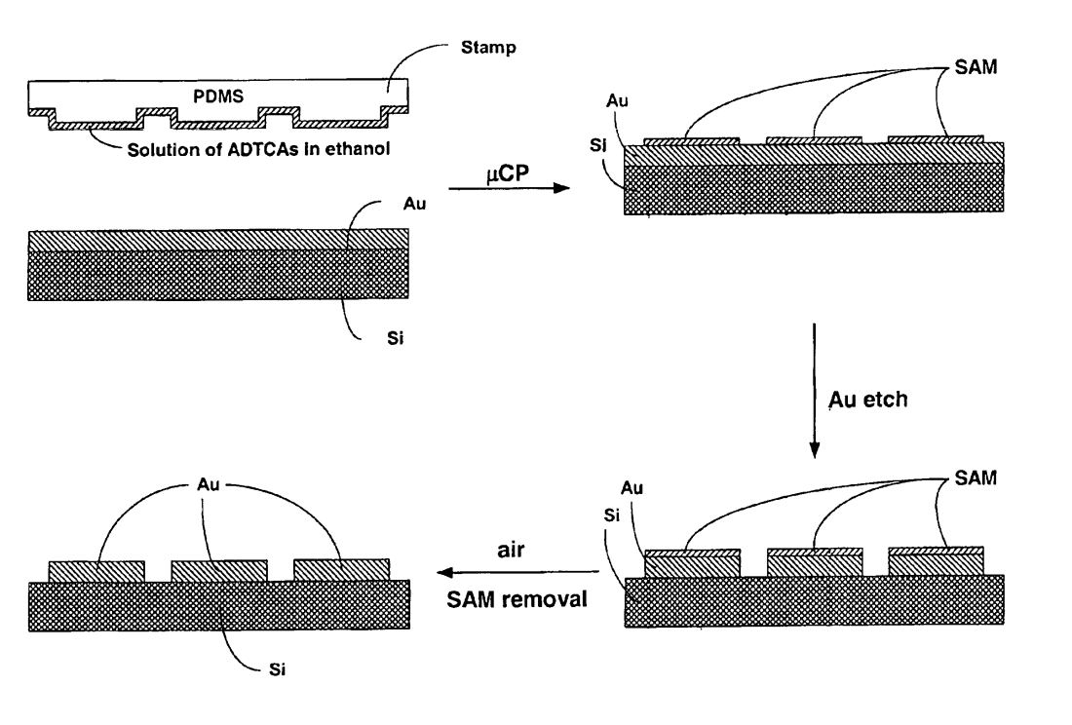
Microcontact Printing (μCP)
Generates micropatterns of self-assembled monolayer (SAMs) .
Transfer of the “ink” molecules from the PDMS stamp to the substrate by contact.
The use of PDMS stamps for μCP, make the patterning of nonplanar surfaces possible.
Features as small as 300nm
United States Patent 6890598

Slide 22
Replica Molding (REM)
Uses a PDMS stamp as the master to duplicate molds. Polyurethane (PU) is then molded in the PDMS master.
Sizes and shapes may be changed in a controlled way (mechanical compression, bending, or stretching).
Ability to fabricate structures of ~30nm in organic polymers.

Slide 23
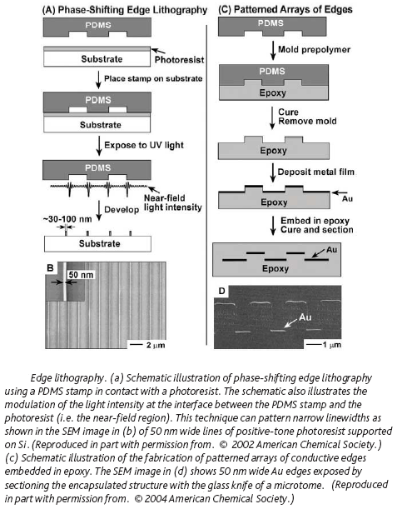
Replica Molding (REM)
Byron D. Gates
Department of Chemistry, Simon Fraser University, 8888 University Drive, Burnaby, BC V5A 1S6, Canada Materials Today February 2005

Slide 24
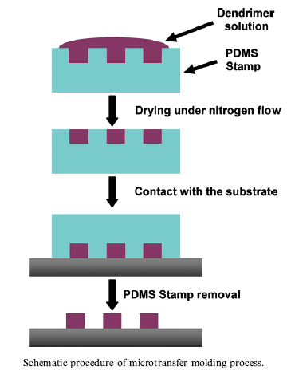
Microtransfer Molding (μTM)
A liquid prepolymer precursor is applied to the surface of a PDMS stamp. The excessive liquid is removed. The stamp is placed on the substrate and then, cured. The PDMS mold is then, peeled away.
Structures as small as ~250nm.
Between the raised structures a thin film is also formed from the precursor in the PDMS stamp.
C. Thibault et al. / Microelectronic Engineering 83 (2006) 1513–1516

Slide 25
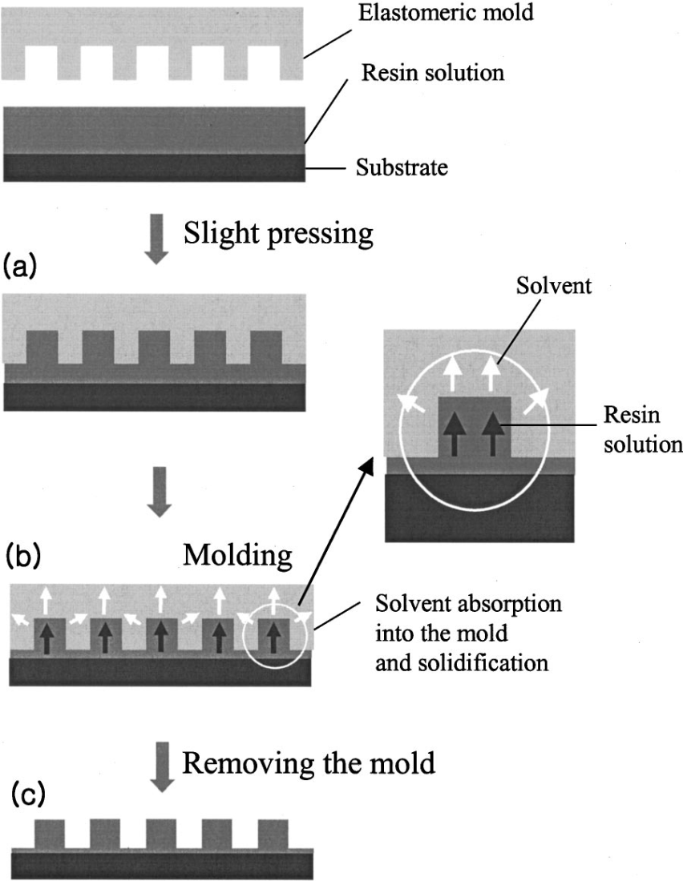
Solvent-Assisted Micromolding (SAMIM)
Polymer solvent is spread on the PDMS stamp, which is brought into contact with a polymer film. The solvent dissolves or swells the polymer film.
Small features of ~60nm (width) x ~50nm (height).
The solvent should dissolve the polymer surface, but it should not dissolve, swell, or distort the PDMS stamp.
Appl. Phys. Lett., Vol. 79, No. 14, 1 October 2001

Slide 26
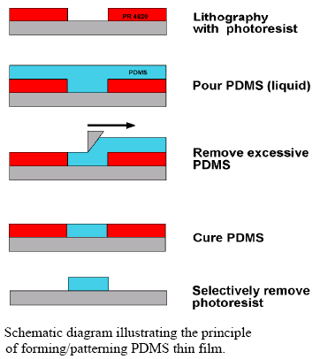
Fabricating PDMS Microfluidic Channels
Lithography process - silicon substrate
Apply SU-8, a negative photoresist (PR)
Pour PDMS
Remove excessive PDMS
Thermal cure
Selective removal of PR
Ryu, K., Liu, Ch. “Precision Patterning of PDMS Thin Film: A New Fabrication Method and its applications”

Slide 27
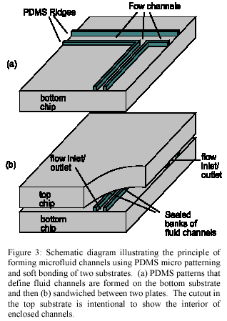
Steps:
The ridges of the patterned PDMS on the substrate forms the boundary of the fluidic channel
The channels are formed by applying another substrate on top of the substrate containing the PDMS ridges.
Schematic diagram illustrating the principle of forming microfluidic channel using PDMS micro patterning and soft bonding of two substrates. (a) PDMS patterns that define fluid channels are formed on the bottom substrate and then (b) sandwitched between two plates. The cutout in the top substrate to show the interior of the enclosed channels.
Ryu, K., Liu, Ch. “Precision Patterning of PDMS Thin Film: A New Fabrication Method and its applications”

Slide 28
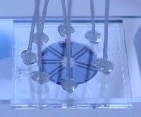
PDMS Microfluidic Devices
Properties that make PDMS a well suited material for microfluidic devices:
Biocompatibility
High gas permeability
Easy to fabricate complicated 3D microstructure
Application:
PDMS microfluidic devices with the embedded oxygen chamber provide a suitable environment for tissue cultures
University of Hertfordshire. Microfluidics and Microengineering Group.

Slide 29
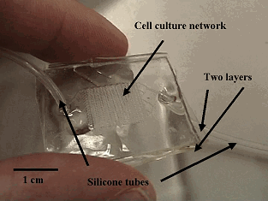
PDMS Microfluidic Devices
1.Microfluidic structure
(cell culture network)
Composed of a channel network with two levels.
-Inlet channels to distribute culture medium with uniform flow
-channel for cell culture
2.Two layers of PDMS bond together to form the culture chamber (microchannel structure).
PDMS Microfluidic device
Cell Culture in 3-Dimensional Microfluidic Structure of PDMS polydimethylsil...
Eric Leclerc; Yasuyuki Sakai; Teruo Fujii Biomedical Microdevices; Jun 2003; 5, 2; Health Module pg. 109

Slide 30
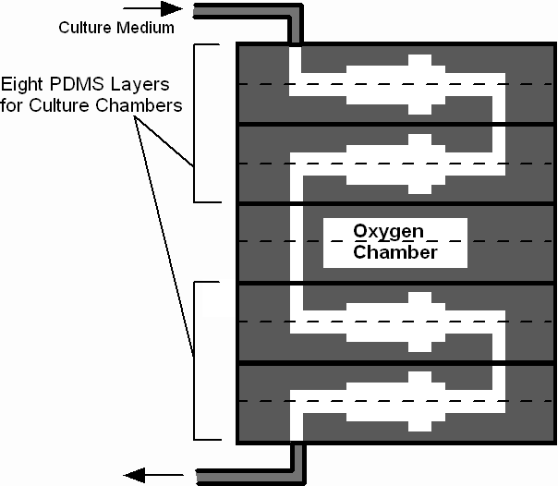
Multilayer Microfluidic Device
Stacking pairs of PDMS layers with oxygen chamber in between
-Oxygen chamber is opened to the atmosphere
-Oxygen is supplied into the culture chamber through PDMS layer
Structure of multilayer device
The Royal Society of Chemistry Lab Chip, 2006, 6, 1125–1139

Slide 31
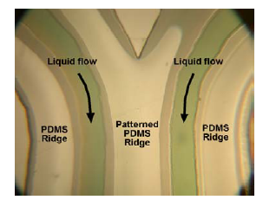
Fabricating PDMS Microfluidic Channels
An oxygen plasma treatment renders the channel hydrophilic allowing water based fluids to flow without the need for applying pressure.
Optical micrograph of two parallel fluid channels formed by the process shown in fig 2. Colored IPA solution runs in parallel fluid channels
Ryu, K., Liu, Ch. “Precision Patterning of PDMS Thin Film: A New Fabrication Method and its applications”

Slide 32
PDMS as Part of an Implanted Biomedical Microsystem
Retinal Prosthesis – Stimulating retinal neurons.
A high dynamic range external CMOS camera sends images to an encoder in spatio-temporal stimulation patterns.
These patterns match the input of the ganglion cell layer in an intact retina.
A data decoding chip stimulates the proper retina cells electronically, which cause them to send action potentials to the brain via the optical nerve.
T. Stieglitz, W. Haberer, C. Lau, M. Goertz Development of an Inductively Coupled Epiretinal Vision Prosthesis. Proceedings of the 26th Annual International Conference of the IEEE EMBS
San Francisco, CA, USA • September 1-5, 2004

Slide 33
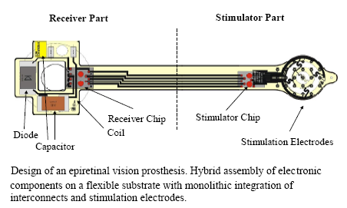
PDMS as Part of an Implanted Biomedical Microsystem
T. Stieglitz, W. Haberer, C. Lau, M. Goertz Development of an Inductively Coupled Epiretinal Vision Prosthesis. Proceedings of the 26th Annual International Conference of the IEEE EMBS
San Francisco, CA, USA • September 1-5, 2004

Slide 34
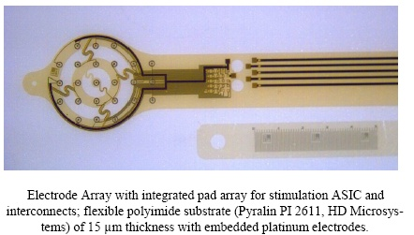
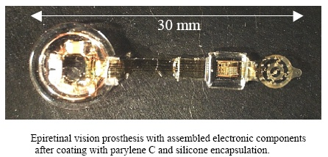
PDMS as Part of an Implanted Biomedical Microsystem
The retinal electrode array was synthesized on a flexible polyimide substrate with integrated platinum electrodes 15µm thick
50µm of PDMS encapsulated the entire device
The device was implanted in a cat and resulted in a 2.5º visual angel stimulation of the retina
Only human patients will be able to determine if this technology will result in the blind being able to “see”
T. Stieglitz, W. Haberer, C. Lau, M. Goertz Development of an Inductively Coupled Epiretinal Vision Prosthesis. Proceedings of the 26th Annual International Conference of the IEEE EMBS
San Francisco, CA, USA • September 1-5, 2004

Slide 35
Outline
Background
Properties of PDMS
Applications of PDMS
Modification of PDMS

Slide 36
PDMS Modification
Some PDMS applications require surface modification in order to improve the wettability and adhesion properties of PDMS surfaces.
  Oxygen Plasma.
  UV Light.
  UV Light and Ozone (UVO).
Efimenko, K., Wallace, W. E., and Genzer, J. “Surface Modification of Sylgard-184 Poly(Dimethyl Diloxane) Networkds
by Ultraviolet and Ultraviolet/Ozone Treatment.” Journal of Colloid and Interface Science. 2002, 254, 306-315.

Slide 37
Oxygen Plasma
Reactive Ion Etch (RIE) oxygen plasma, has been the most widely used technique.
Oxygen atoms substitute methyl groups on the PDMS surface leading to the formation of hydrophilic surfaces. Carbon pumped away as CO₂ and H₂O.
Modified surfaces of PDMS can be used to bond glass, silicon substrates and other PDMS molds or structures
Efimenko, K., Wallace, W. E., and Genzer, J. “Surface Modification of Sylgard-184 Poly(Dimethyl Diloxane) Networkds
by Ultraviolet and Ultraviolet/Ozone Treatment.” Journal of Colloid and Interface Science. 2002, 254, 306-315.

Slide 38
UV Light and
UV Light + Ozone (UVO)
UV light increases Si-O concentration, forming a silica-like substrate.
UVO is more effective than UV in creating hydrophilic groups because of the molecular oxygen and ozone present, which forms a larger number of hydrophilic species (OH).
B. Schnyder et al. / Surface Science 532–535 (2003) 1067–1071

Slide 39
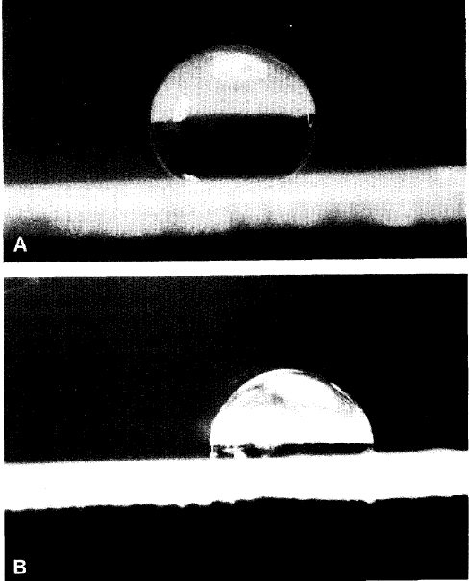
PDMS Treated with CO₂ Laser
Water drop on PDMS that was
treated with 3 pulses of the CO2 laser
untreated under a 50x objective [19].
Khorasani, Mirzadeh, and Sammes.Laser Induced Surface Modification of Polydimethylsiloxane
as a Super-Hydrophobic Material. Radiat. Phys. Chem. Vol. 47, No. 6, pp. 881-888.
Great Britain: Elsevier, 1996.

Slide 40
PDMS Bonding
Importance of PDMS bonding – Low temperature bonding
Bonding process : Standard lithography technique
Spin deposition of PDMS
Exposure with 420 nm Ultra Violet light
Brief exposure to oxygen plasma cure (at 20 mTorr and 25W, for 20 seconds)
Immediately join to glass, SiO2 or PDMS itself (with in 10 min)
Long exposure to plasma roughens the PDMS surface and interferes with bonding

Slide 41
Advantages of PDMS
Optical transparency (wavelength from 230 to 700nm makes it suitable for UV/ visible spectrophotometry).
Permeable to variety of liquids and vapors (allows it to absorb a variety of compounds).
Conforms to the surface of the substrate over a relatively large area
Conformal contact achievable on nonplanar surfaces
Can be released easily, even from complex and fragile structures
Low cost.
Simple fabrication process.

Slide 42
Disadvantages of PDMS
Wide and shallow micro channels can easily collapse during the bonding process.
Because PDMS is easily deformable, the technology is not well suited for devices that require precise pattern placement .
PDMS stamps also tend to shrink to a factor of 1% upon curing.
Some relief structures are not able to resist the compressive forces of printing and the adhesion between the stamp and the substrate, which leads to sagging.

Slide 43
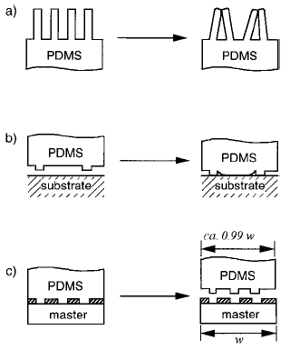
Disadvantages of PDMS
a. Collapsing / Paring
b. Sagging
c. Shrinking
J. Am. Chem. Soc. 1996, 118, 5722-5731

Slide 44
Summary of PDMS
  70 year technology with present and future
  applications in micro and nanofabrication such as microfluidics and biomedical applications
  Spun, wiped or pour deposited
  Heat decreased curing time
  Soft, pliable, clear, safe, easy to use and
  inexpensive
  24 month shelf life from date of manufacture

