Slide 1

Quantum Dots

Slide 2
Outline
Introduction
Quantum Confinement
QD Synthesis
  Colloidal Methods
  Epitaxial Growth
Applications
  Biological
  Light Emitters
  Additional Applications

Slide 3
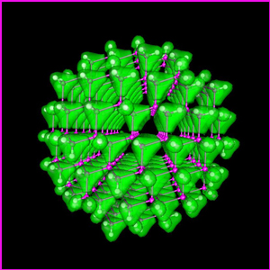
Introduction
Definition:
Quantum dots (QD) are nanoparticles/structures that exhibit 3 dimensional quantum confinement, which leads to many unique optical and transport properties.
Lin-Wang Wang, National Energy Research Scientific Computing Center at Lawrence Berkeley National Laboratory. <http://www.nersc.gov>
GaAs Quantum dot containing just 465 atoms.

Slide 4
Introduction
Quantum dots are usually regarded as semiconductors by definition.
Similar behavior is observed in some metals. Therefore, in some cases it may be acceptable to speak about metal quantum dots.
Typically, quantum dots are composed of groups II-VI, III-V, and IV-VI materials.
QDs are bandgap tunable by size which means their optical and electrical properties can be engineered to meet specific applications.

Slide 5
Quantum Confinement
Definition:
Quantum Confinement is the spatial confinement of electron-hole pairs (excitons) in one or more dimensions within a material.
  1D confinement: Quantum Wells
  2D confinement: Quantum Wire
  3D confinement: Quantum Dot
Quantum confinement is more prominent in semiconductors because they have an energy gap in their electronic band structure.
Metals do not have a bandgap, so quantum size effects are less prevalent. Quantum confinement is only observed at dimensions below 2 nm.

Slide 6
Quantum Confinement
Recall that when atoms are brought together in a bulk material the number of energy states increases substantially to form nearly continuous bands of states.
Energy
Energy
N

Slide 7
Quantum Confinement
The reduction in the number of atoms in a material results in the confinement of normally delocalized energy states.
Electron-hole pairs become spatially confined when the diameter of a particle approaches the de Broglie wavelength of electrons in the conduction band.
As a result the energy difference between energy bands is increased with decreasing particle size.
Energy
E_{g}
E_{g}

Slide 8
Quantum Confinement
This is very similar to the famous particle-in-a-box scenario and can be understood by examining the Heisenberg Uncertainty Principle.
The Uncertainty Principle states that the more precisely one knows the position of a particle, the more uncertainty in its momentum (and vice versa).
Therefore, the more spatially confined and localized a particle becomes, the broader the range of its momentum/energy.
This is manifested as an increase in the average energy of electrons in the conduction band = increased energy level spacing = larger bandgap
The bandgap of a spherical quantum dot is increased from its bulk value by a factor of 1/R², where R is the particle radius.*
* Based upon single particle solutions of the schrodinger wave equation valid for R< the exciton bohr radius.

Slide 9
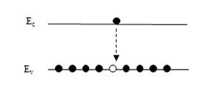
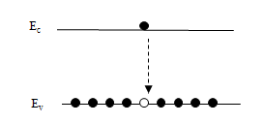
Quantum Confinement
What does this mean?
  Quantum dots are bandgap tunable by size. We can engineer their optical and electrical properties.
  Smaller QDs have a large bandgap.
  Absorbance and luminescence spectrums are blue shifted with decreasing particle size.
Energy
555 nm
650 nm

Slide 10
Quantum Dots (QD)
Nanocrystals (2-10 nm) of semiconductor compounds
Small size leads to confinement of excitons (electron-hole pairs)
Quantized energy levels and altered relaxation dynamics
Examples: CdSe, PbSe, PbTe, InP
E_{g}

Slide 11
Quantum Dots
Absorption and emission occur at specific wavelengths, which are related to QD size
E_{g}

Slide 12
Outline
Introduction
Quantum Confinement
QD Synthesis
  Colloidal Methods
  Epitaxial Growth
Applications
  Biological
  Light Emitters
  Additional Applications

Slide 13
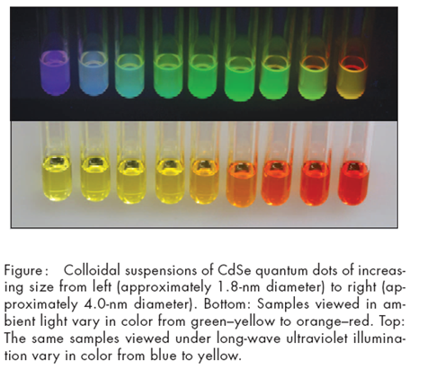
QD Synthesis: Colloidal Methods
Example: CdSe quantum dots
30mg of Elemental Se and 5mL of octadecene are used to create a stock precursor Se solution.
0.4mL of Trioctylphosphine oxide (TOPO) is added to the Se precursor solution to disassociate and cap the Se.
Separately, 13mg of CdO, 0.6mL of oleic acid and 10mL of octadecene were combined and heated to 225ºC
Once the CdO solution reaches 225ºC, room-temperature Se precursor solution was added. Varying the amount of Se solution added to the CdO solution will result in different sized QDs.
Journal of Chemcial Education. Vol. 82 No.11 Nov 2005

Slide 14
QD Synthesis: Epitaxial Growth
Epitaxial growth refers to the layer by layer deposition/growth of monocrystalline films.
A liquid or gaseous precursor condenses to form crystallites on the surface of a substrate.
The substrate acts as a seed crystal. Its lattice structure and crystallographic orientation dictate the morphology of epitaxial film.
Epitaxial growth techniques can be used to fabricate QD core/shell structures and QD films.

Slide 15
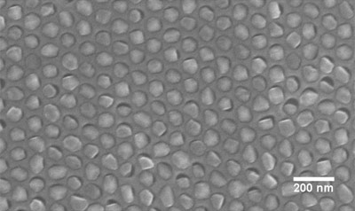
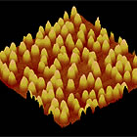
QD Synthesis: Epitaxial Growth
Quantum Dot Films
  QD Film – thin film containing small localized clusters of atoms that behave like quantum dots.
  QD films can be highly ordered quantum dot arrays or randomly agglomerated clusters with a broad size distribution.
  The structure of choice (arrayed or disordered) depends on the particular application.
SEM image of highly order InAs QD array
AFM image of QD film containing random
agglomerated clusters of InAs QDs.

Slide 16
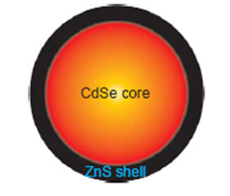
QD Synthesis: Epitaxial Growth
Core/Shell Structures:
Core/shell quantum dots are comprised of a luminescent semiconductor core capped by a thin shell of higher bandgap material.
The shell quenches non-radiative recombination processes at the surface of the luminescent core, which increases quantum yield (brightness) and photostabilty.
Core/shell quantum dots have better optical properties than organically passivated quantum dots and are widely used in biological imaging.
Jyoti K. Jaiswal and Sanford M. Simon. Potentials and pitfalls of fluorescent quantum
dots for biological imaging. TRENDS in Cell Biology Vol.14 No.9 September 2004

Slide 17
QD Synthesis: Epitaxial Growth
There are a variety of epitaxial methods, which each have their own sub-techniques:
  Laser Abblation
  Vapor Phase Epitaxy (VPE)
  Liquid Phase Epitaxy (LPE)
  Molecular Beam Epitaxy (MBE)

Slide 18
Outline
Introduction
Quantum Confinement
QD Synthesis
  Colloidal Methods
  Epitaxial Growth
Applications
  Biological
  Light Emitters
  Additional Applications

Slide 19
Applications of QDs: Biological
Biological Tagging and Labeling
  Biological assays and microarrays
  Labeling of cells and intracellular structures
  in vivo and in vitro imaging
  Pathogen and Toxin detection

Slide 20
Applications of QDs: Biological
Biological Tagging
  Organic fluorophores such as genetically encoded fluorescent protein, like GFP, or chemically synthesized fluorescent dyes have been the most common way of tagging biological entities.
  Some limitations of organic fluorophores:
    do not continuously fluoresce for extended periods of time
    Degrade or photo-bleach
    are not optimized for multicolor applications

Slide 21
Applications of QDs: Biological
The unique optical properties of quantum dots make them suitable for biological tagging and labeling applications.
QDs are excellent fluorophores.
  Fluorescence is a type of luminescence in which the absorption of an incident photon triggers the emission of a lower energy or longer wavelength photon.
  Quantum dots absorb over a broad spectrum and fluoresce over a narrow range of wavelengths. This is tunable by particle size.
  So, a single excitation source can be used to excite QDs of different colors making them ideal for imaging multiple targets simultaneously.

Slide 22
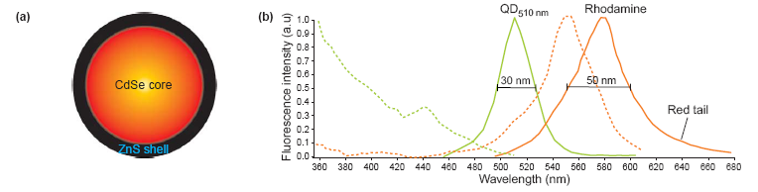
Applications of QDs: Biological
Absorption and emission Spectra of CdSe/ZnS QDs compared to Rhodamine, a common organic die.
  The absorption spectrum (dashed lines) of the QD (green) is very broad, whereas that of the organic die (orange) is narrow.
  Conversely, the emission spectrum (solid lines) of the QD is more narrow than that of the organic die
Jyoti K. Jaiswal and Sanford M. Simon. Potentials and pitfalls of fluorescent quantum
dots for biological imaging. TRENDS in Cell Biology Vol.14 No.9 September 2004

Slide 23
Applications of QDs: Biological
A broad absorption and narrow emission spectrum means a single excitation source can be used to excite QDs of different colors making them ideal for imaging multiple targets simultaneously.
CdSe/ZnS QDs used to image cancer cells in a live mouse.
Gao, Xiaohu. "In vivo cancer targeting and imaging with." Nature Biotechnology 22(2004): 8.

Slide 24
Applications of QDs: Biological
Quantum dots are an attractive alternative to traditional organic dies because of their high quantum yield and photostability.
Quantum Yield = # emitted photons / # absorbed photons.
  Quantum dots have a high quantum yield because they have a high density of energy states near the bandgap.
  A higher quantum yield means a brighter emission. The quantum yield of some QDs is 20 times greater than traditional organic fluorophores.
Photostability is a fluorophore’s resistance to photobleaching or photochemical degradation due to prolonged exposure to the excitation source.

Slide 25
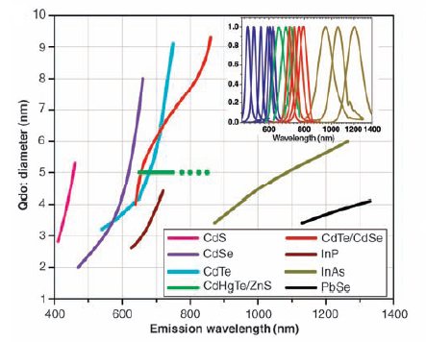
Applications of QDs: Biological
Common QD Materials, their size and emitted wavelengths
X. Michalet, et al. Quantum Dots for Live Cells, in Vivo Imaging, and Diagnostics Science 307, 538 (2005)

Slide 26
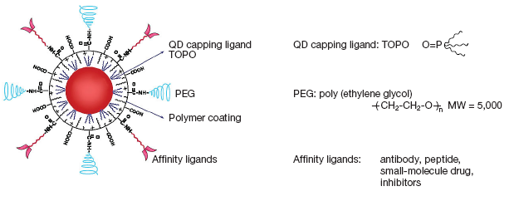
Applications of QDs: Biological
  Bioconjugated QDs:
  The surface of QDs can be functionalized with affinity ligands: antibodies, peptides, or small-molecule drug inhibitors, to target specific types of cells for in vivo or in vitro imaging.
  The affinity ligands are not bound directly to the surface of the quantum dots. They are usually connected to a linker molecule referred to as a capping ligand or coordinating ligand.
  Polymers such as poly ethylene glycol (PEG) may be introduced to reduce nonspecific binding of the affinity ligands.
Gao, Xiaohu. "In vivo cancer targeting and imaging with." Nature Biotechnology 22(2004): 8.

Slide 27
Applications of QDs: Biological
  Bioconjugated QDs:
  The coordinating ligands serve a dual purpose:
    To bind the affinity ligands to the surface of the QD.
    To encapsulate the quantum dot in a protective layer that prevents enzymatic degradation and aggregation.
  The coordinating ligands dictate the hydrodynamic behavior of the QD and are chosen according to the desired biocompatibility.
  Common coordinating ligands:
    Avidin-biotin complex
    Protein A or protein G
    Simple polymers and amphiphilic lipids

Slide 28
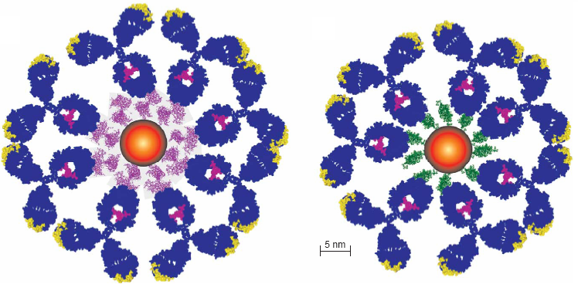
Applications of QDs
QDs conjugated with antibody molecules (blue) by using avidin (purple) or protein A (green) as linkers. Between 10 and 15 linker molecules can be attached covalently or electrostatically to a single QD, which facilitates the binding of many or a few antibody molecules on each QD.
Jyoti K. Jaiswal and Sanford M. Simon. Potentials and pitfalls of fluorescent quantum
dots for biological imaging. TRENDS in Cell Biology Vol.14 No.9 September 2004

Slide 29
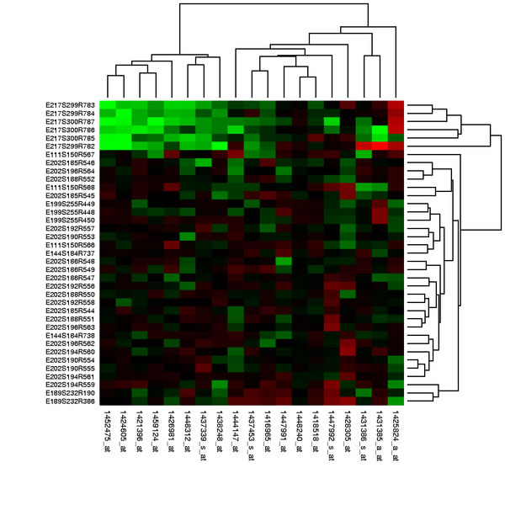
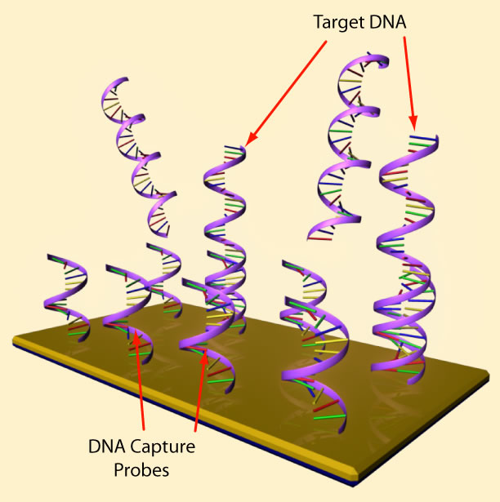
Applications of QDs: Biological
  DNA assays and microarrays
Each pixel contains a different DNA sequence
Fluorescence observed if sample binds
QD-functionalized DNA
BioMems Applications Overview
SCME: www.scme-nm.org
Image source: Wikipedia: Gene Expression Profiling

Slide 30
Outline
Introduction
Quantum Confinement
QD Synthesis
  Colloidal Methods
  Epitaxial Growth
Applications
  Biological
  Light Emitters
  Additional Applications

Slide 31
Applications of QDs: Light Emitters
The discovery of quantum dots has led to the development of an entirely new gamut of materials for the active regions in LEDs and laser diodes.
Indirect gap semiconductors that don’t luminesce in their bulk form such as Si become efficient light emitters at the nanoscale due quantum confinement effects.
The study of QDs has advanced our understanding of the emission mechanisms in conventional LED materials such as InGaN, the active region of blue LEDs.
The high radiative-recombination efficiency of epitaxial InGaN is due to self-assembled, localized, In rich clusters that behave like QDs.

Slide 32
Outline
Introduction
Quantum Confinement
QD Synthesis
  Colloidal Methods
  Epitaxial Growth
Applications
  Biological
  Light Emitters
  Additional Applications

Slide 33
Additional Applications of QDs
New applications for QDs are continuously being discovered.
For example: Solar cells that incorporate QDs may lead to more efficient light harvesting and energy conversion.

Slide 34
Quantum Dot Solar Cells
Possible benefits of using quantum dots (QD):
“Hot carrier” collection: increased voltage due to reduced thermalization
Multiple exciton generation: more than one electron-hole pair per photon absorbed
Intermediate bands: QDs allow for absorption of light below the band gap, without sacrificing voltage
MRS Bulletin 2007, 32(3), 236.
Notes:
34

Slide 35
QDs: Collect Hot Carriers
Band structure of bulk semi-conductors absorbs light having energy > E_{g}. However, photo-generated carriers thermalize to band edges.
Tune QD absorption (band gap) to match incident light.
Extract carriers without loss of voltage due to thermalization.
Conduction
Band
E_{g}
Valence
Band

Slide 36
QDs: Multiple Exciton Generation
In QDs:
1 photon = multiple excitons
In bulk semiconductors:
1 photon = 1 exciton
E_{g}
Impact ionization
Absorption of one photon of light creates one electron-hole pair, which then relaxes to the band edges.
The thermalization of the original electron-hole pair creates another pair.

Slide 37
QDs: Multiple Exciton Generation
Quantum efficiency for exciton generation: The ratio of excitons produced to photons absorbed
>100% means multiple exciton generation
Occurs at photon energies (E_{hv}) much greater than the band gap (E_{g})
300
250
Quantum Eff (%)
200
150
100
1
2
3
4
5
Photon Energy (E_{hv}/E_{g})

Slide 38
QDs: Intermediate Bands
Conventional band structure does not absorb light with energy < E_{g}
Intermediate bands in the band gap allow for absorption of low energy light
Intermediate band formed by an array of QDs
E_{g}

Slide 39
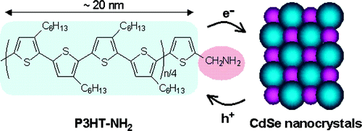
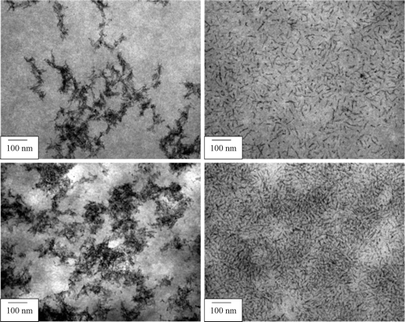
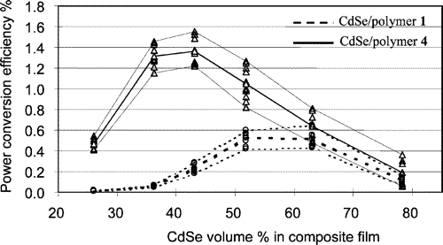
P3HT:CdSe Solar Cells
J. Am. Chem. Soc., 2004, 126 (21), 6550.

Slide 40
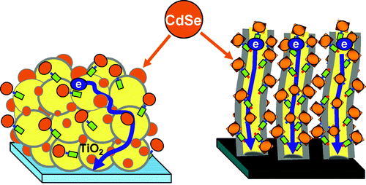
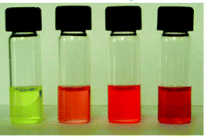
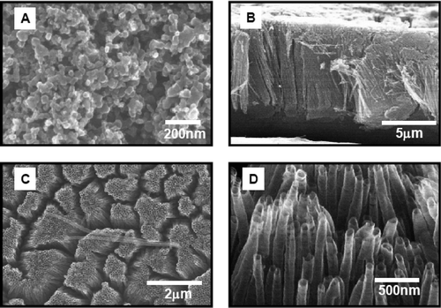
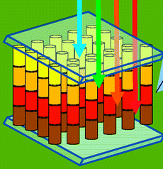
CdSe Sensitizers/Nano TiO₂
2.3 2.6 3.0 3.7 nm
“Rainbow Cell”
J. Am. Chem. Soc., 2008, 130 (12), 4007.

Slide 41
Conclusion
Introduction
Quantum Confinement
QD Synthesis
  Colloidal Methods
  Epitaxial Growth
Applications
  Biological
  Light Emitters
  Additional Applications

