Slide 1
The Use of Probes, Beams, and Waves for Characterization at the Nano-Scale

Slide 2
Lecture 2 Outline
The tools for characterizing materials and structures at the nano-scale
Probes
Photon beams
Electron beams
Ion beams
Acoustic waves

Slide 3
We saw last lecture that some techniques were termed
microscopies and some were termed spectroscopies.
What is the difference?
Microscopies produce images---they are for
“seeing”
Spectroscopies measure energy or wavelength
differences to deduce information---they are for
uses such as chemical detection.
(Today the terms Spectroscopy and Spectrometry
are generally used interchangeably)

Slide 4
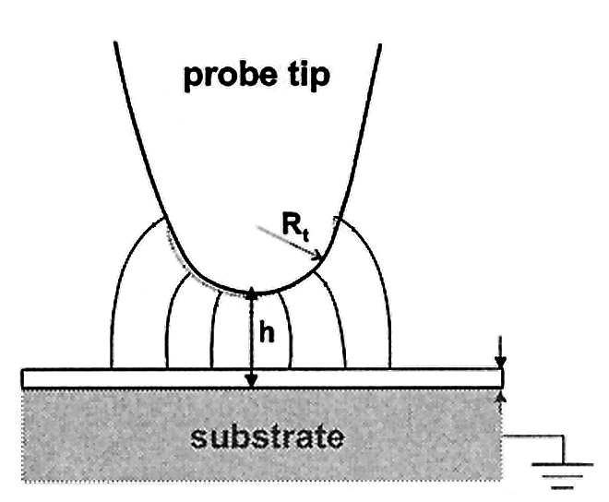
Probe Tools

Slide 5
Some Probe Tools
Probe Techniques | Physics used to sense surface | Comments
Contact Profilometer⁽¹⁾ | Van der Waals forces Interatomic forces Electrostatic forces | Gives trace of surface profile
atomic force microscope (AFM)⁽²⁾ (Contact AFM, Non-contact AFM, Dynamic Contact AFM ,Tapping AFM) | Van der Waals forces Interatomic forces Electrostatic forces | Operated in several modes
electrostatic force microscopy⁽³⁾ | Electrostatic forces | Measures electrostatic force from surface charges
magnetic force microscopy⁽⁴⁾ | Magnetic force | Magnetized tip scans sample and detects magnetic structure
piezoresponse force microscopy⁽⁵⁾ | Electrostatic forces | Alternating current bias applied between tip and ferroelectric (piezoelectric} to excite deformation
scanning capacitance microscopy⁽⁶⁾ | Electrostatic forces | Lateral variations of capacitance of a sample generate a capacitance image
Kelvin probe force microscopy⁽⁷⁾ | Electrostatic Forces | Measures contact potential (workfunction) tip/surface difference under T.E.
chemical force microscopy⁽⁸⁾ | Van der Waals forces Interatomic forces | Measures chemical bonding leading to friction and adhesion forces

Slide 6
Some Probe Tools (continued)
Probe Techniques | Physics used to sense surface | Comments
scanning electrochemical microscopy⁽⁹⁾ | Oxidation/reduction currents | Uses oxidation/reduction reactions at solid-state material, electrocatalyst material, enzyme and other biophysical surfaces
scanning spreading resistance microscopy⁽¹⁰⁾ | Current flow | Uses current to measure resistance and thereby resistivity and doping
scanning tunneling microscopy⁽¹¹⁾ | QM tunneling current flow | Uses QM current to image surface. Surface must be a conductor
spin polarized scanning tunneling⁽¹²⁾ | QM tunneling current flow of specific spin orientations. | Uses tunneling with a magnetized tip. Electrons in sample with spins matching the tip's magnetization have better chance of tunneling. The tip/surface essentially acts as a spin valve. Magnetic imaging down to the atomic scale possible. Topological and magnetic information can be simultaneously obtained.
Adapted from http://en.wikipedia.org/wiki/Scanning_probe_microscopy

Slide 7
Some Probe Tools (continued)
Probe Techniques | Physics used to sense surface | Comments
photon scanning tunneling microscopy⁽¹³⁾ | Near-field optical wave and photon tunneling | Near-field is created at a surface and photons tunnel from the surface to the probe. The received photons go to a detector that produces an output signal proportional to the number of photons received by the probe.
scanning thermal microscopy⁽¹⁴⁾ | Flow of heat | Uses heat flows from the tip to sample to create a temperature and/or thermal conductivity map of the sample
photothermal microspectroscopy⁽¹⁵⁾ | IR waves | IR spectroscopy with the nano-scale spatial resolution
near-field scanning optical microscopy (NSOM)⁽¹⁶⁾ | Wave behavior of light | Uses near-field wave optical response
Fourier transform infrared nanospectroscopy)⁽¹⁷⁾ | Molecular vibrations | Uses standard infrared databases of molecular vibrations for chemical identification
Adapted from http://en.wikipedia.org/wiki/Scanning_probe_microscopy

Slide 8
References
(1) http://mmrc.caltech.edu/DektakXT/Manuals/DektakXT%20specifications.pdf
(2) Binnig, G.; C. F. Quate; Ch. Gerber (1986-03-03). "Atomic Force Microscope". Physical Review Letters 56 (9): 930–933.
(3) Weaver, J. M. R.; David W. Abraham (1991). "High resolution atomic force microscopy potentiometry". Journal of Vacuum Science and Technology B 9 (3): 1559–1561.
(4) Hartmann, U. (1988). "Magnetic force microscopy: Some remarks from the micromagnetic point of view". Journal of Applied Physics 64 (3): 1561–1564.
(5) Roelofs, A.; U. Bottger, R. Waser, F. Schlaphof, S. Trogisch, L. M. Eng (2000). "Differentiating 180° and 90° switching of ferroelectric domains with three-dimensional piezoresponse force microscopy". Applied Physics Letters 77 (21): 3444–3446.
(6) Matey, J. R.; J. Blanc (1985). "Scanning capacitance microscopy". Journal of Applied Physics 57 (5): 1437–1444.
(7) Nonnenmacher, M.; M. P. O'Boyle; H. K. Wickramasinghe (1991). "Kelvin probe force microscopy". Applied Physics Letters 58 (25): 2921–2923.
(8) Noy, A; Dmitri V. Vezenov, and Charles M. Lieber (1997), “Chemical Force Microscopy”, Annual. Rev. Mater. Sci. 1997. 27:381–421
(9) Kiani A, M. Alpuche-Aviles, P. Eggers, M. Jones, J. Gooding, M. Paddon-Row, A.Bard (2008) ,“Scanning electrochemical microscopy. 59. Effect of defects and structure on electron transfer through self-assembled monolayers”, Langmuir, Mar 18, 2008;24(6):2841-9.
(10) De Wolf, P.; J. Snauwaert, T. Clarysse, W. Vandervorst, L. Hellemans (1995). "Characterization of a point-contact on silicon using force microscopy-supported resistance measurements". Applied Physics Letters 66 (12): 1530–1532.
(11) Binnig, G.; H. Rohrer, Ch. Gerber, E. Weibel (1982). "Tunneling through a controllable vacuum gap". Applied Physics Letters 40 (2): 178–180.
(12) Wiesendanger, R.; M. Bode (2001-07-25). “Nano- and atomic-scale magnetism studied by spin-polarized scanning tunneling microscopy and spectroscopy”. Solid State Communications 119 (4-5): 341–355.

Slide 9
References (continued)
(13) Goudonnet, Jean-Pierre; L. Laurent; F. de Fornel; G. Chabrier; R. Warmack;T. T. Ferrell; “Photon scanning tunneling microscopy”, Proceedings of the SPIE, Volume 1400, p. 116-123 (1991).
(14) Xu, J. B.; K. Lauger, K. Dransfeld, I. H. Wilson (1994). "Thermal sensors for investigation of heat transfer in scanning probe microscopy". Review of Scientific Instruments 65 (7): 2262–2266.
(15) http://en.wikipedia.org/wiki/Photothermal_microspectroscopy
(16) Reddick, R. C.; R. J. Warmack; T. L. Ferrell (1989-01-01). “New form of scanning optical microscopy”. Physical Review B 39 (1): 767.
(17) Huth,F; Alexander Govyadinov; Sergiu Amarie; Wiwat Nuansing; Fritz Keilmann; and Rainer Hillenbrand; “Nano-FTIR Absorption Spectroscopy of Molecular Fingerprints at 20 nm Spatial Resolution”, Nano Lett. 2012, 12, 3973−3978

Slide 10
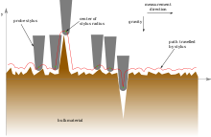
Contact Profilometer
http://upload.wikimedia.org/wikipedia/commons/thumb/3/39/Mechanical_filtering_of_surface_finish_trace.svg/220px-Mechanical_filtering_of_surface_finish_trace.svg.png

Slide 11
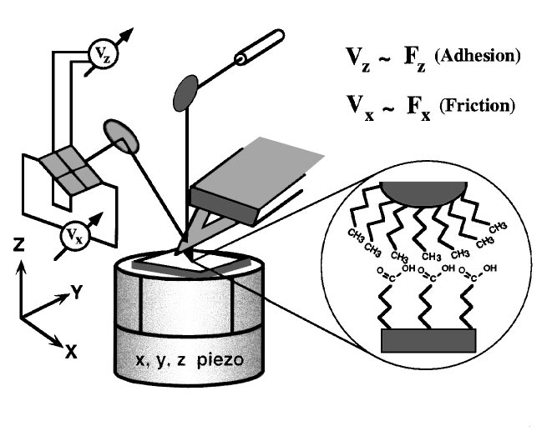
Chemical Force Microscopy
Schematic drawing of the CFM setup. The sample rests on a piezoelectric x, y, z translator. A laser beam is reflected from the backside of the tip onto a photodiode to measure two types of tip-surface interactions. When the sample approaches, touches, and is withdrawn from the tip, the tip will move up and down in response to surface normal forces Fz, resulting in the vertical deflection signal Vz. The cantilever will also twist in response to friction forces Fx, yielding the lateral deflection signal Vx.The inset illustrates the chemically specific interactions between a Au-coated, CH3-terminated tip
contacting a COOH-terminated region of a sample.( From Noy, A. et al.,Annu. Rev. Mater. Sci. 1997. 27:381–421))

Slide 12
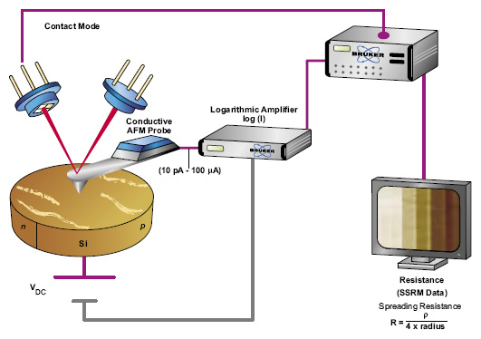
Scanning Spreading Resistance
Microscopy
http://blog.brukerafmprobes.com/guide-to-spm-and-afm-modes/scanning-spreading-resistance-microscopy-ssrm/

Slide 13
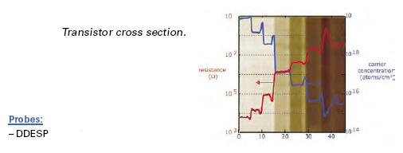
Scanning Spreading Resistance Microscopy
(continued)
http://blog.brukerafmprobes.com/guide-to-spm-and-afm-modes/scanning-spreading-resistance-microscopy-ssrm/

Slide 14
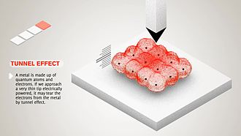
Scanning Tunneling Microscopy
http://en.wikipedia.org/wiki/Scanning_tunneling_microscope

Slide 15
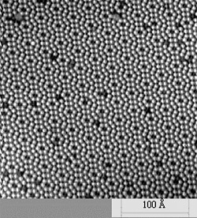
Scanning Tunneling Microscopy
http://www.nrel.gov/pv/measurements/images/photo_si_111_2d.jpg

Slide 16
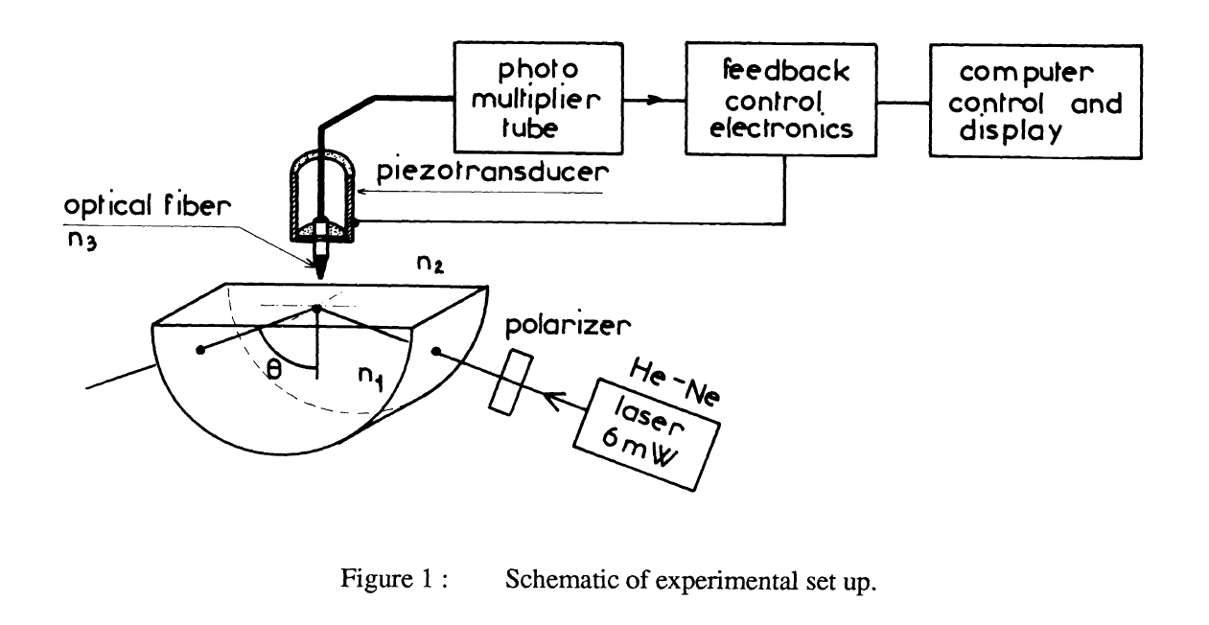
Photon Scanning Tunneling
Microscopy
Goudonnet, Jean-Pierre; L. Salomon; F. de Fornel; G. Chabrier.; R. Warmack.; T. Ferrell; “Photon scanning tunneling microscopy”, Proceedings of the SPIE, Volume 1400, p. 116-123 (1991).

Slide 17
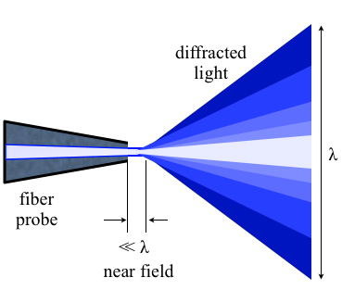
Near-field Scanning Optical
Microscopy
Side-stepping the diffraction limit
"Nearfield optics" by Zogdog602 - Own work. Licensed under CC BY 3.0 via Wikimedia Commons - http://commons.wikimedia.org/wiki/File:Nearfield_optics.png#/media/File:Nearfield_optics.png

Slide 18
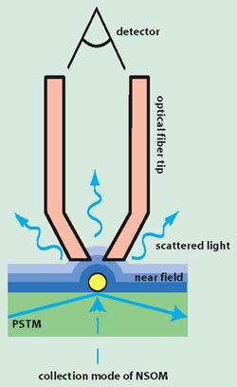
Near-field Scanning Optical
Microscopy
Side-stepping the diffraction limit
http://www.bing.com/images/search?q=NSOM&FORM=HDRSC2#view=detail&id=E4BA304E0490CEADBC07BF2101A35EB6D735DA6D&selectedIndex=6

Slide 19
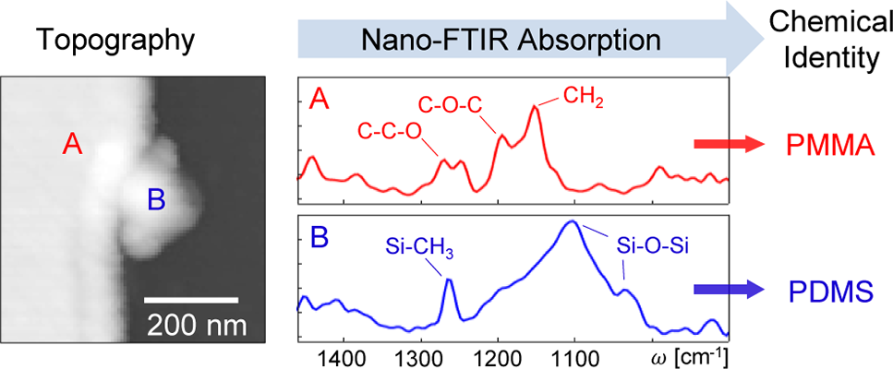
Fourier Transform Infrared
Nanospectroscopy
Can match to standard infrared databases of molecular vibrations
Huth,F; Alexander Govyadinov; Sergiu Amarie; Wiwat Nuansing; Fritz Keilmann;
and Rainer Hillenbrand; “Nano-FTIR Absorption Spectroscopy of Molecular Fingerprints at
20 nm Spatial Resolution”, Nano Lett. 2012, 12, 3973−3978

Slide 20
Some Photon Beam Tools

Slide 21
Some Photon Beam Tools
Photon Beam Techniques | Physics used to sense surface | Comments
Raman spectroscopy | Wave and particle nature of electromagnetic phenomenon Particle nature of vibrational phenomenon | Good for determining bonding structure; i.e., crystalline, amorphous
Photoelectron spectroscopy (Photoemission spectroscopy) | Particle nature of electromagnetic phenomenon Quantization of electron energy levels in solids | Chemical analysis uses
X-ray fluorescence (XRF) spectroscopy | Particle nature of electromagnetic phenomenon Quantization of electron energy levels in solids Fluorescence | Uses high-energy X-rays or gamma rays Used for chemical analysis uses

Slide 22
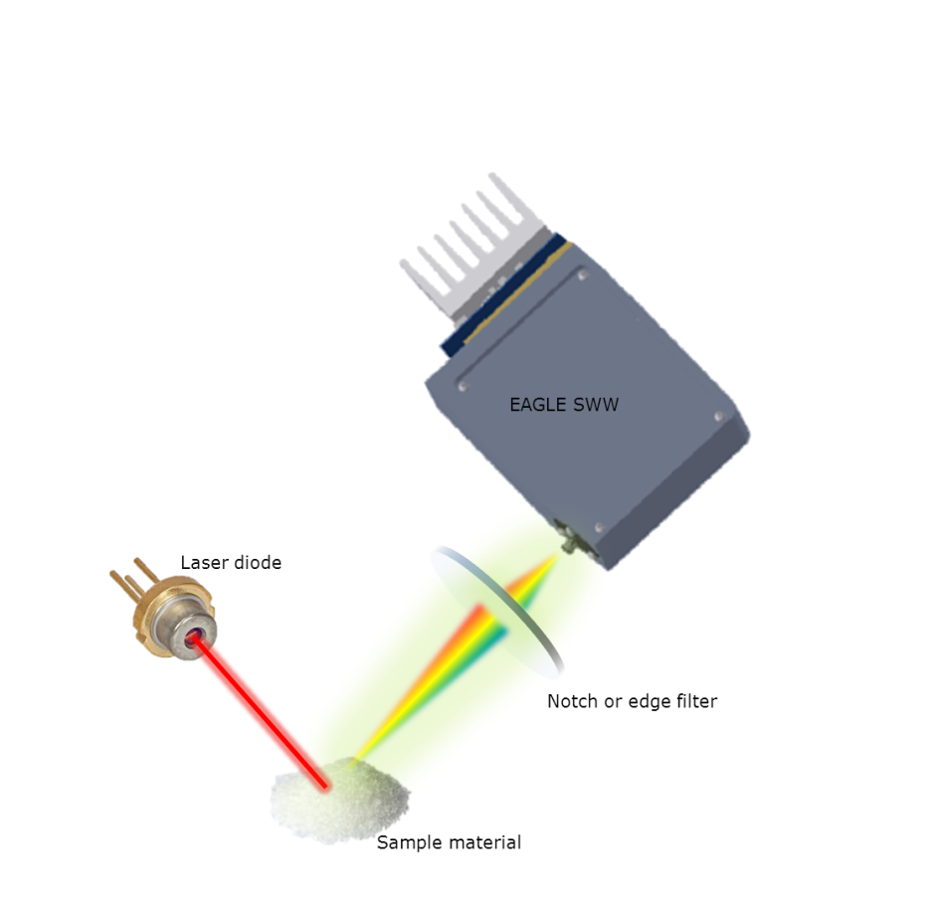
Raman Spectroscopy
http://www.ibsenphotonics.com/wp-content/uploads/Raman-system.png

Slide 23
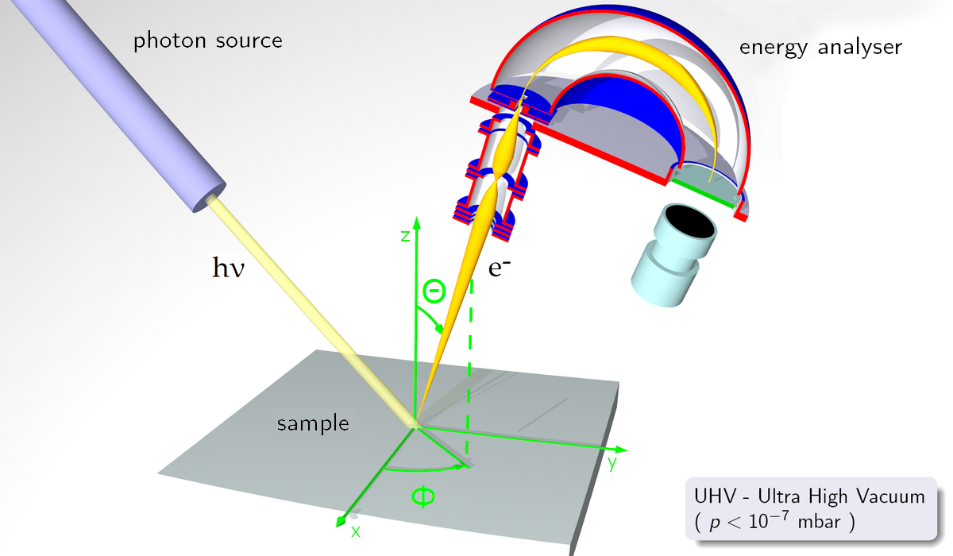
Photoelectron Spectroscopy
http://en.wikipedia.org/wiki/Photoemission_spectroscopy

Slide 24
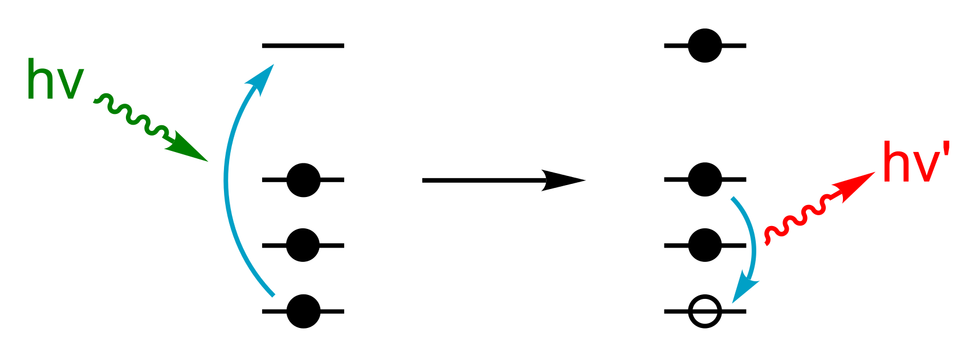
X-ray Fluorescence Spectroscopy
http://en.wikipedia.org/wiki/X-ray_fluorescence#/media/File:X-ray_fluorescence_simple_figure.svg

Slide 25
Some Light Wave Tools

Slide 26
Some Light Wave Tools
Light Wave Techniques | Physics used to sense surface | Comments
Fluorescence Microscopy | Wave and particle nature of electromagnetic phenomenon Quantization of electron energy levels in solids Fluorescence | Can give an image locating individual molecules Side-steps the diffraction limit
Fourier Transform IR Spectroscopy | Wave and particle nature of electromagnetic phenomenon Vibrational levels in solids | Gives an infrared spectrum of absorption, emission Bonding energies Structure Chemical analysis

Slide 27
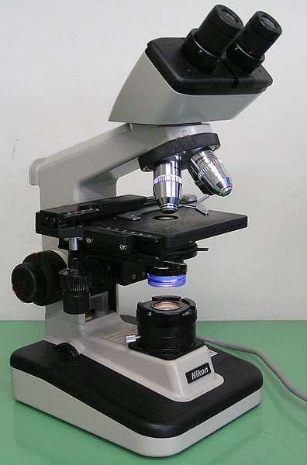
Some Light Wave Tools
Fluorescence Microscopy
http://en.wikipedia.org/wiki/Optical_microscope
Uses fluorescence produced by incoming
light to generate an image

Slide 28
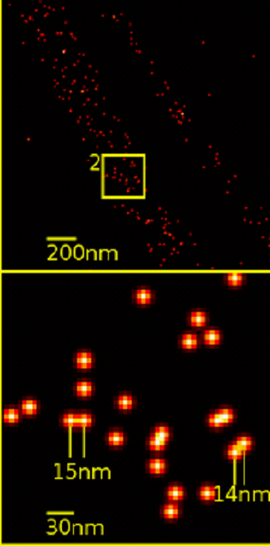
Some Light Wave Tools
Fluorescence Microscopy
Single YFP molecule detection in a human cancer cell. Typical distance measurements in the 15 nm range http://en.wikipedia.org/wiki/Fluorescence_microscope#/media/File:Single_YFP_molecule_superresolution_microscopy.png

Slide 29
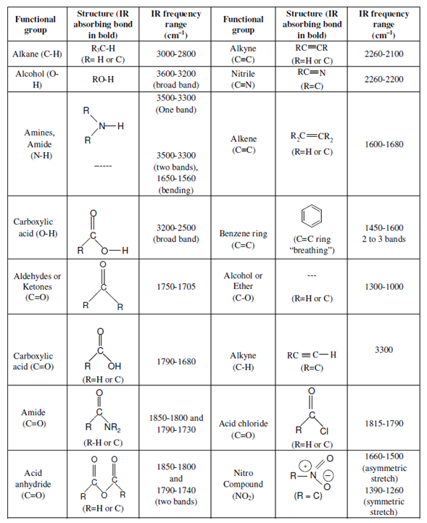
Some Infrared Spectroscopy Data
http://www.bing.com/images/search?q=IR+Spectra+Functional+Groups&Form=IQFRDR#view=detail&id=623B1375E5673B0F675A0A6DB45328906F1BF895&selectedIndex=0

Slide 30
Some Phonon Tools

Slide 31
Some Phonon Tools
Phonon Technique | Physics used to sense surface | Comments
Raman spectroscopy | Wave and particle nature of electromagnetic phenomenon Particle nature of vibrational phenomenon | Good for determining bonding structure; i.e., crystalline, amorphous

Slide 32
Some Acoustic Wave Tools

Slide 33
Some Acoustic Wave Tools
Photon Beam Techniques | Physics used to sense surface | Comments
Acoustic Wave Microscope | Use near-field to overcome diffraction | Used to study elastic properties of materials

Slide 34
Some Acoustic Wave Tools
Scanning Acoustic Wave Microscope

Slide 35
Some Ion Beam Tools

Slide 36
Some Ion Beam Tools
Photon Beam Techniques | Physics used to sense surface | Comments
Ion Microscope | Wave property of particles used to overcome diffraction de Broglie wavelength | Much smaller wavelength so much more relaxed diffraction issues.
Secondary ion mass spectroscopy | Particle bombardment | Uses ions to sputter the surface of a specimen with a focused primary ion beam while collecting and analyzing ejected secondary ions.

Slide 37
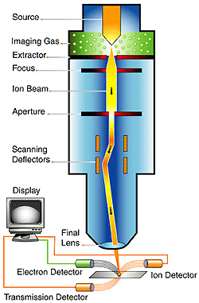
Ion Microscope
http://cdn.medgadget.com/img/542orr2.jpg

Slide 38
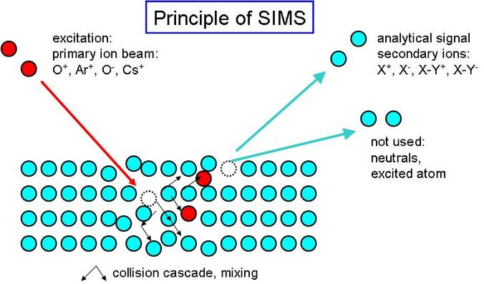
Secondary Ion Mass
Spectroscopy
http://www.bing.com/images/search?q=Secondary+ion+mass+spectroscopy&FORM=HDRSC2#view=detail&id=80021274F5B229A8CE11544645BD7BBF56744F3B&selectedIndex=3

Slide 39
LECTURE SUMMARY
Characterizing materials and structures at the nano-scale
Probes
Photon beams
Electron beams
Ion beams
Acoustic waves

