Slide 1

Touching, Seeing, Chemically Detecting, and Hearing at our Size Scale

Slide 2
Course Objective
This course provides an overview of the characterization and of the testing techniques used for materials and structures which involve the nano-scale

Slide 3
In this course, we use characterization to mean the determining, describing and defining of a material or structure in terms of features such as chemical composition, bonding, architecture, and topology and testing to mean the evaluation of the ability of a material or structure to perform a specified function

Slide 4
Lecture 1 Outline
Characterizing materials and structures at our size scale
The five senses
Touching at our size scale
Seeing at our size scale
Chemically Detecting at our size scale
Hearing at our size scale
Introduction to Touching, Seeing, Chemically Detecting, and Hearing at the nano-scale

Slide 5
The way we humans characterize (define, describe) things at any size scale is through our senses. There are 5 physical senses that we use: touch, sight, smell, taste, and hearing.
For our discussion, we will lump smell and taste into one category: chemical detection
Sometimes to characterize things we need assistance from machines and electronics.
For example, even at our size scale, some of us need hearing aides and eye glasses.
Characterization

Slide 6
It follows that we humans characterize things at the nano-scale by our senses also--through touch, sight, chemical detection, and hearing.
However, to characterize things at the nano-scale we always need assistance from machines and electronics.
This has led to a myriad of nano-scale characterization approaches with interesting names like scanning electron microscopy, Auger electron spectroscopy, and scanning tunneling microscopy.
The five senses

Slide 7
The five senses
Let’s talk more about the five senses and their use at our size scale.

Slide 8
Touching at our size scale
What do we think touching is?
A definition of touching is “physically feeling something through your skin or fingers”.
Another definition is “the sense that tells you what something feels like when putting your skin or fingers on it.”
Still another definition is “using tactile (physical interaction) sensing to detect a presence”. This is the definition we will use. It applies to all size scales.

Slide 9
Touching at our size scale
What do we think touching is?
Touching is “obtaining information via tactile sensing; i.e., from physical interaction with the environment.”
A group of Swedish scientists has recently explored how sensitive our touching sense is. They recently showed that people can detect nano-scale wrinkles while running their fingers across a seemingly smooth surface !
http://www.sciencedaily.com/releases/2013/09/130916110853.htm

Slide 10


Touching at our size scale
How do we use touch at our size scale?
To detect
To manipulate
To “see”---the brain
can convert touching into a
mental “picture”
http://img1.tgdaily.com/sites/default/files/stock/article_images/lg/lgwindows8touchmonitor.jpg
http://www.bing.com/images/search?q=seeing+with+braille&qpvt=Seeing+with+Braille&qpvt=Seeing+with+Braille&FORM=IGRE#view=detail&id=3949C5FBB546F0470C5A0BD8B586633789CF3BAC&selectedIndex=1

Slide 11
Seeing at our size scale
What do we think seeing is?
A definition of seeing is “to perceive with the eyes; to look at”.
A more scientific definition is “sensors in the retina of the eye responding to photons by sending a signal to the brain triggering a conscious response.”
The sensors in our eyes can detect a single photon; however, neural filters only allow a signal to pass to the brain when at least about five to nine photons arrive within less than 100 ms. This filtering prevents stimulus overload.
(http://math.ucr.edu/home/baez/physics/Quantum/see_a_photon.html)

Slide 12
Seeing at our size scale
What do we think seeing is?
The definition of seeing we will use in this course is much more general than the above definitions.
Our definition will be “using the eye, perhaps with machines/electronics, to convert physical information into an image in the human brain.” This is the definition we will use. It applies to all size scales.
At our size scale we generally just use photons (light) to see.

Slide 13
Seeing at our size scale
What do we think seeing is?
The light we use for seeing exhibits properties of particles (photons) and also of waves.
This fact can be very disconcerting.
As Einstein wrote: "It seems as though we must use sometimes the one theory and sometimes the other, while at times we may use either. We are faced with a new kind of difficulty. We have two contradictory pictures of reality; separately neither of them fully explains the phenomena of light, but together they do".
Harrison, David (2002). "Complementarity and the Copenhagen Interpretation of Quantum Mechanics“ UPSCALE. Dept. of Physics, U. of Toronto

Slide 14
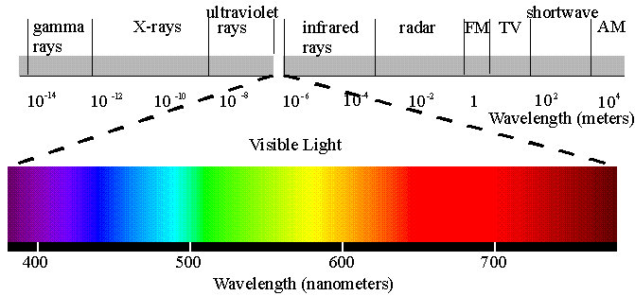
Seeing at our size scale
What do we think seeing is?
Photons are what we use at our size scale to collect information and our eyes are only responsive to a small portion of the photons in the environment. This portion is called visible light.
http://cfialabioassignment.wikispaces.com/file/view/spectrum.gif/76509733/spectrum.gif

Slide 15
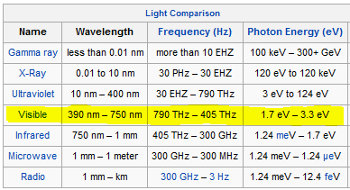
Seeing at our size scale
How do we use seeing at
our size scale?
In tabular form the whole light or electromagnetic
spectrum is as shown below. The small portion that is visible light is highlighted.
http://en.wikipedia.org/wiki/Telescope

Slide 16
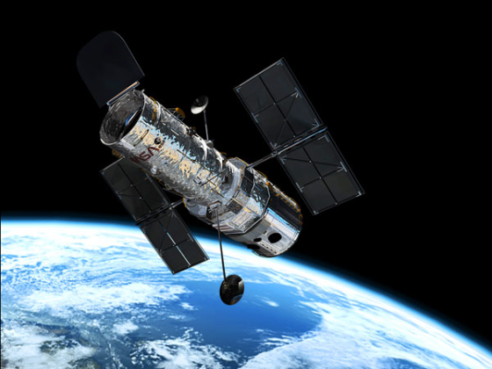
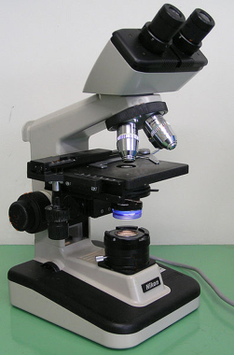
Seeing at our size scale
How do we use seeing with photons at
our size scale?
To detect everyday objects(e.g., cars, trains, people).
With the help of “machines” called telescopes we can
stretch the capabilities of our eyes to use visible light
to see astronomical features such as planets and stars.
With the help of “machines” called microscopes we can
stretch the capabilities of our eyes to use visible light
to see micron-sized features such as bacteria.
http://lunaf.com/images/space-telescope-hubble.jpg
http://en.wikipedia.org/wiki/Optical_microscope

Slide 17
Seeing at our size scale
The wave properties of light can limit its usefulness for “seeing”.
The diffraction limit, first described in 1873, states that the smallest thing we can make out with visible light, even with the help of a microscope, is about 0.2 microns or 200nm.
http://en.wikipedia.org/wiki/Optical_microscope

Slide 18
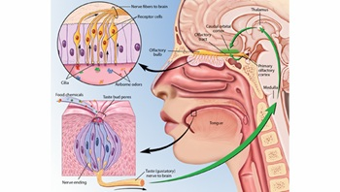
Chemically Detecting at
our size scale
What do we think chemically detecting is?
Tasting and smelling are our sensing system for “the detection of chemicals in the air or in food.”
Tasting and smelling each have their own receptor organs.
http://www.brainfacts.org/sensing-thinking-behaving/senses-and-perception/articles/2012/taste-and-smell/

Slide 19
Chemically Detecting at
our size scale
What do we use chemically detecting
for at our size scale?
This is how we chemically characterize or detect our environment ---with the senses of taste and smell.
The detection limit of human tasting and smelling depends on factors such as a molecule’s shape, polarity, partial charges and molecular mass. It can be in the parts per billion range. The recognition level is not as low.
http://en.wikipedia.org/wiki/Odor_detection_threshold

Slide 20
Hearing at our size scale
What do we think hearing is?
Hearing is “sensors in the ear responding to changes in air pressure by sending signals to the brain triggering a conscious response.”
Hearing is “the process of perceiving sound; specifically: the sense by which noises and tones are received by the brain as stimuli”.

Slide 21
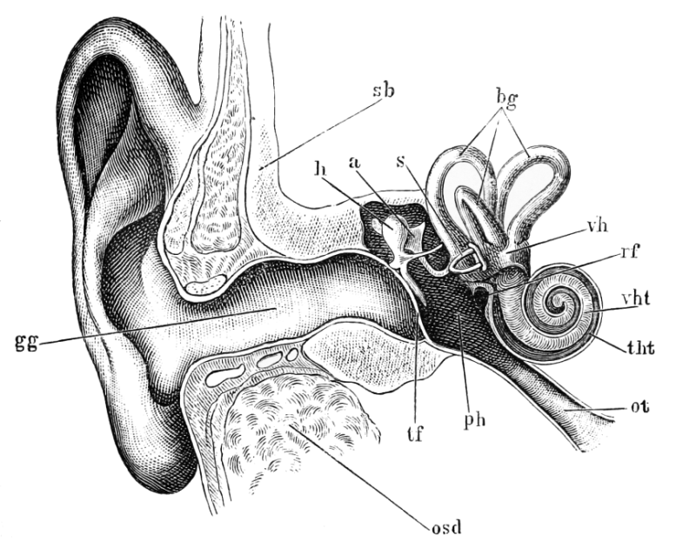
Hearing at our size scale
What do we think hearing is?
The range of frequencies that can be picked up by the human ear is usually cited as 20 — 20,000 Hz.
(http://io9.com/5926643/10-fundamental-limits-to-human-perception----and-how-they-shape-your-world)
Acoustic disturbances are waves but their energy is in packets called phonons. These are analogous to the photons of electromagnetics.
http://upload.wikimedia.org/wikipedia/commons/b/bf/Tidens_naturl%C3%A6re_fig40.png

Slide 22
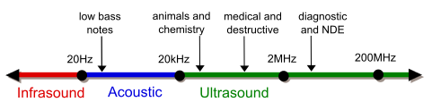
Hearing at our size scale
What do we use sound detection for?
The acoustic spectrum and some uses:
Some confusion: the part we can hear is called the acoustic range but the whole range is the acoustic spectrum.
Ranges outside the acoustic range require machines/electronics assistance to be detected by the human ear.
http://en.wikipedia.org/wiki/Ultrasound#/media/File:Ultrasound_range_diagram.svg

Slide 23
Introduction to Touching, Seeing, Chemically Detecting, and Hearing at the nano-scale
Touching at the nano-scale
Seeing at the nano-scale
Chemically Detecting at the nano-scale
Hearing at the nano-scale

Slide 24
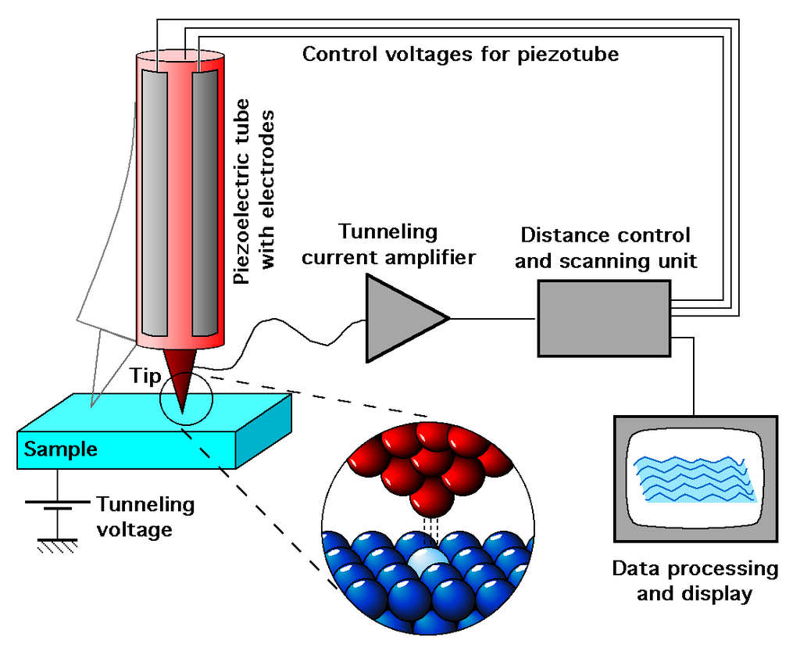
Introduction to touching at the nano-scale

Slide 25
Introduction to seeing at the nano-scale
With photons
λ < d
The diffraction limit has been circumvented allowing photons from the visible range to excite molecules to create an image at the nano-scale. This is done using fluorescence.
On 8 October 2014, the Nobel Prize in Chemistry was awarded to Eric Betzig, William Moerner and Stefan Hell for "the development of super-resolved fluorescence microscopy," which brings "optical microscopy into the nano-dimension”.

Slide 26
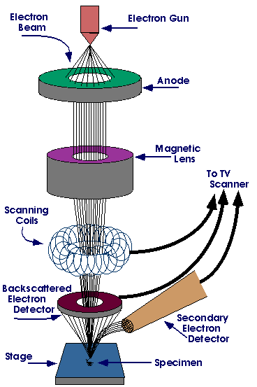
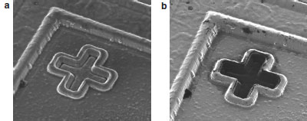
Introduction to seeing at the nano-scale
With electrons
λ < d
The scanning electron microscope uses electrons coming off a surface being bombarded by an electron beam to create an image.
http://www.americanlaboratory.com/913-Technical-Articles/772-The-Helium-Ion-
Microscope-The-Next-Stage-in-Nanoscale-Imaging/
http://www.purdue.edu/ehps/rem/rs/sem.htm

Slide 27
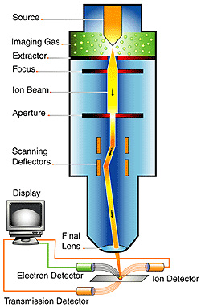
Introduction to seeing at the nano-scale
With ions
λ < d
Using ions coming off a surface being bombarded by an ion beam to create an image.
http://www.americanlaboratory.com/913-Technical-Articles/772-The-Helium-Ion-
Microscope-The-Next-Stage-in-Nanoscale-Imaging/
http://www.bing.com/images/search?q=helium+ion+microscope&qpvt=helium+ion+microscope&qpvt=helium+ion+microscope&FORM=IGRE#view=detail&id=1C016DBA01983E9FEEE32CA0590CBC9A03DE19D8&selectedIndex=19

Slide 28
Introduction to chemically detecting at the nano-scale
With photons
Photoelectron spectroscopy (PES) uses the energy of electrons emitted from a surface bombarded by photons for chemical characterization of the surface.
Depending on the photons used for the bombardment, PES is divided into Ultraviolet Photoelectron Spectroscopy (UPS) or X-ray Photoelectron Spectroscopy (XPS).
These are termed spectroscopies because they require measuring the energies of the emitted electrons.

Slide 29
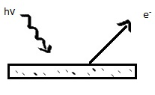
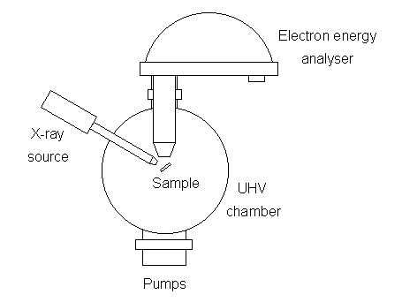
Introduction to chemically detecting at the nano-scale
With photons
Photoelectron Spectroscopy
http://www.chem.qmul.ac.uk/surfaces/scc/scat5_3.htm
http://chemwiki.ucdavis.edu/Physical_Chemistry/Spectroscopy/Photoelectron_Spectroscopy/Photoelectron_Spectroscopy%3a_Theory

Slide 30
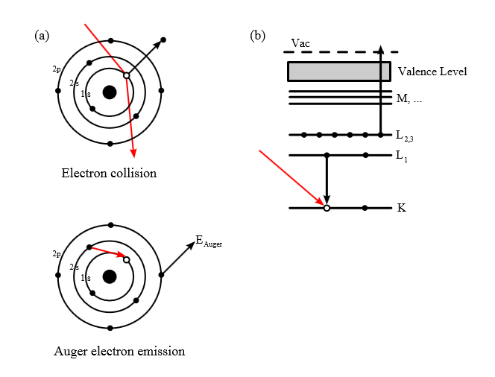
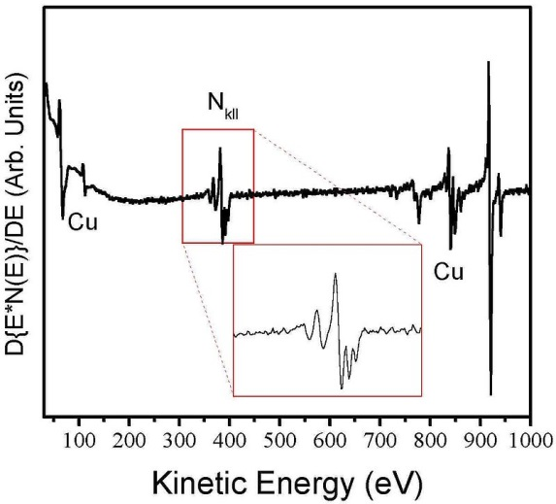
Introduction to chemically detecting at the nano-scale
With electrons
*A beam of energetic electrons is used to impinge on a
surface to knock other electrons out of their atomic states.
The resulting relaxation process produces what are called
Auger electrons which carry information about their atomic
states.
Auger spectrum of a copper nitride film as a function of energy. Different peaks for Cu and N are apparent.
http://upload.wikimedia.org/wikipedia/commons/c/c5
/Auger_Process.svg
"Cu3NAES" by Gerardo Soto; Wencel de la Cruz - Own work. Licensed under CC BY 2.5 via Wikimedia Commons - http://commons.wikimedia.org/wiki/File:Cu3NAES.JPG#/media/File:Cu3NAES.JPG

Slide 31
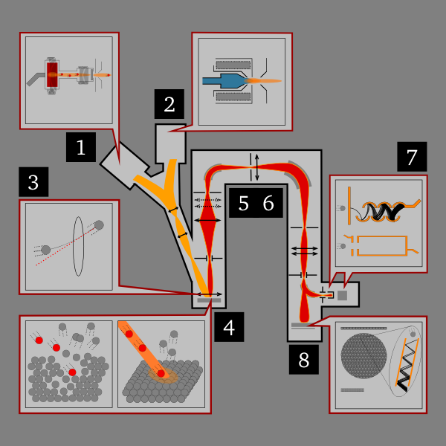
Introduction to chemically detecting at the nano-scale
With ions
Uses a beam of ions to knock-off and ionize constituent atoms of a solid. These are then mass analyzed giving chemical composition.
High energy (usually several keV) ions supplied by an ion gun (1 or 2) are focused on a sample (3). These sputter off and ionize some atoms (4). These secondary ions are collected by ion lenses (5) and filtered by atomic mass (6) for detection (7,8) and finally the resulting chemical composition is displayed
SIMS instrument scheme 600x600". Licensed under Public Domain via Wikimedia Commons http://commons.wikimedia.org/wiki/File:SIMS_instrument_scheme_600x600.png#/media/File:SIMS_instrument_scheme_600x600.png

Slide 32
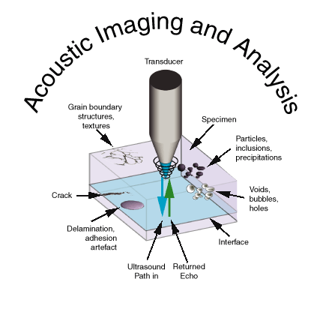
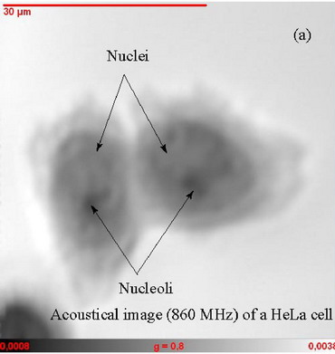
Introduction to hearing at the nano-scale
Acoustic microscopy uses sound waves to visualize structures too small to be resolved by the human eye. Frequencies up to several gigahertz are used in acoustic microscopes. In some cases, these tools can detect features as small as several hundred nm.
(http://insidix.com/Scanning-Acoustic-Microscopy-SAM.28.0.html)
http://www.ticgroup.com.tw/menu/products/sem/sam/aga/SAM4.gif
http://www.soest.hawaii.edu/HIGP/Faculty/zinin/images/SAM/Hela_chicken_800.jpg

Slide 33
We will look more deeply into to some of these nano-scale characterization techniques and others in subsequent lectures.

Slide 34
LECTURE SUMMARY
Characterizing materials and structures: the use of touch, sight, chemical assessment, and sound
Touching, Seeing, Chemically Detecting, and Hearing at our size scale
Touching, Seeing, Chemically Detecting, and Hearing at the nano-scale
Touching at the nano-scale
Seeing at the nano-scale
Chemically Detecting at the nano-scale
Hearing at the nano-scale

