Slide 1

Understanding Variation and Statistical Process Control:
Variation and Process Capability Calculations

Slide 2
Outline
Variation and It’s Relationship to Quality
The Normal Distribution as a Model for Describing Variation
Comparing Variation to Specifications
Relationship between Cp and Cpk
Calculation of Cpk and Ppk

Slide 3


New Face of Quality – Low Variation
Quality = possessing one or more functional characteristics that improve the performance of a product or service. i3 vs i5 has lower # of cores, low cache memory and no Turbo Boost for speed.
Michael Close is developing an addition process to adjust each batch of incoming raw material to the same acetate content before being released into production. -- I don’t care where they set it, I just wish it would stay the same! --
Carbon Nanotubes are a true example of nanotechnology, embodying a unique combination of electrical, thermal, and structural properties. Helix’s state-of-the- art chemical vapor deposition (CVD) process enables the production of nanotubes with controlled Diameter (1.2 ~ 1.5 nm diameter ) which is critical to those physical properties.

Slide 4
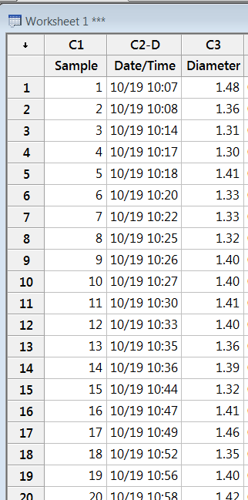
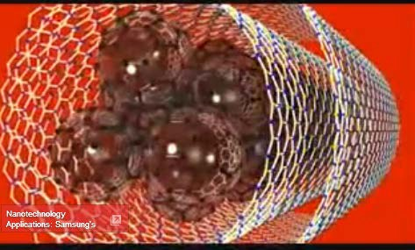
Data from the Process Provides Variation Insight
Since the physical properties of carbon nanotubes are a function of it’s volume
/ surface area ratio, the diameter of the nanotubes is a key quality characteristic.

Slide 5
A Histogram Outlines the Diameter Distribution
Histogram of Diameter
25
20
Frequency
15
10
5
0
1.44
Diameter
1.20
1.28
1.36
1.52
1.60

Slide 6
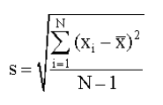
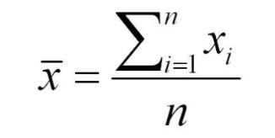
A Normal Distribution defines the Diameter Variation
Histogram of Diameter
25
Mean 1.393
StDev 0.05673
N 60
20
Frequency
15
10
5
0
1.44
Diameter
1.20
1.28
1.36
1.52
1.60

Slide 7
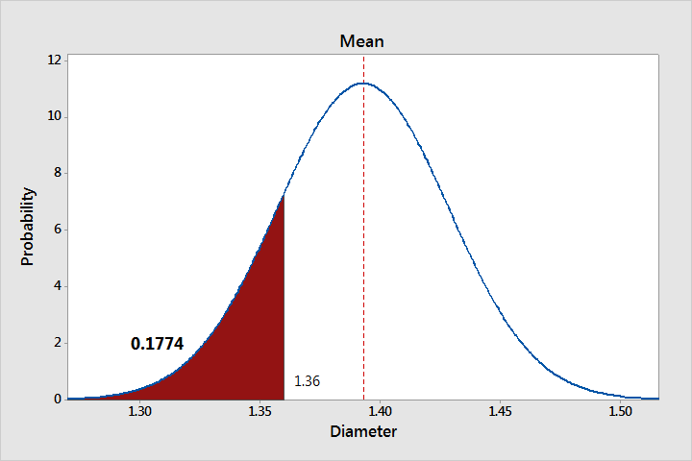


Data Assumed as a Sample of a Normal Population
Mean = 1.393 mm
Std Deviation = .0567 mm
Probability of a nanotube diameter of 1.36 or less is about 18%.
Assuming a normal population distribution allows calculation of probabilities of interest.

Slide 8
Assuming a Normal Distribution Establishes Limits
99.7% of the data will fall between + / - 3 sigma 95.5% of the data will fall between + / - 2 sigma 68.3% of the data will fall between + / - 1 sigma
- 2*Sigma - Sigma Mean + Sigma + 2*Sigma
- 3*Sigma
+ 3*Sigma
7
6
5
4
3
2
1
Probability
0
1.2
1.4
Diameter
1.3
1.5
1.6

Slide 9
Cp to Measure Process Capability
Is my process capable of meeting my customers specs?
Cp = (Upper Spec – Lower Spec) 6 * Standard Deviation
Lower Specification
Mean
Upper Specification
7
Mean=1.393 StDev=0.05673
6
5
4
3
2
1
0
Probability
1.0
1.1
1.2
1.3
1.4
Diameter
1.5
1.6
1.7
1.8

Slide 10
Cp to Measure Process Capability
Uncapable Process - Cp = .70
Mean
Mean=1.393 StDev=0.05673
5.0
2.5
Lower Specification
Upper Specification
Probability
0.0
1.0
1.1
1.2
1.3
1.4
Diameter
1.5
1.6
1.7
1.8
Just Capable Process - Cp = 1.0
Mean Upper Specification
Mean=1.393 StDev=0.05673
5.0
2.5
Lower Specification
Probability
0.0
1.0
1.1
1.2
1.3
1.4
Diameter
1.5
1.6
1.7
1.8
Very Capable Process - Cp = 1.5
Mean
Mean=1.393 StDev=0.05673
5.0
2.5
Lower Spec
Upper Spec
Probability
0.0
1.0
1.1
1.2
1.3
1.4
Diameter
1.5
1.6
1.7
1.8

Slide 11
Cp to Measure Process Capability
Is my process capable of meeting my customers specs?
Cp = (Upper Spec – Lower Spec) 6 * Standard Deviation
Mean Lower Specification
Upper Specification
7
Mean=1.393 StDev=0.05673
6
5
4
3
2
1
0
Probability
1.0
1.1
1.2
1.3
1.4
1.5 1.6
Diameter
1.7
1.8
1.9
2.0
2.1

Slide 12
Process Capability
Cpk = min [ (Upper Spec – Avg) or (Avg - Lower Spec) ]
3 * Standard Deviation
Lower Specification
Mean
Upper Specification
7
Mean=1.393 StDev=0.05673
6
5
4
3
2
1
0
Probability
Target
1.3
1.0
1.1
1.2
1.4
Diameter
1.5
1.6
1.7
1.8

Slide 13
Process Capability Calculations
Cp = (Upper Spec – Lower Spec)
Process Variation
Cpk = min [ (Upper Spec – Avg) or (Avg - Lower Spec) ]
Half the Process Variation
Mean=1.393 StDev=0.05673
Spec Range = 1.2 - 1.5 nm
Cp = (1.5 – 1.2 ) / (6 x .0567) = .88
Cpk = (1.5 – 1.393 ) / (3 x .0567) = .63

Slide 14
Process Capability
(Short-term and Long-term)
1
Std Dev Overall
Std Dev Long-term
2
3
4
5
6
7
8
9
10
11
12
13
14
15
16
17
18
19
20
Std Dev Short-term = Std Dev Pooled = Std Dev (within) =
S1
S2
[(S1**2 + S2**2 + S3**2 + S4**2) / 4 ]
.5
S3
Ppk & Pp are Cpk & Cp with Std Dev = Std Dev Overall
S4

Slide 15
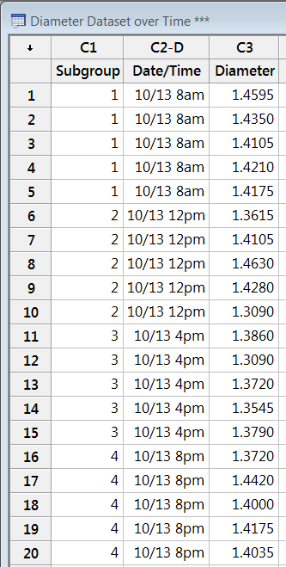
Data for Long-term Process Capability
Since the physical properties of carbon nanotubes are a function of it’s volume
/ surface area ratio, the diameter of the nanotubes is a key quality characteristic.

Slide 16
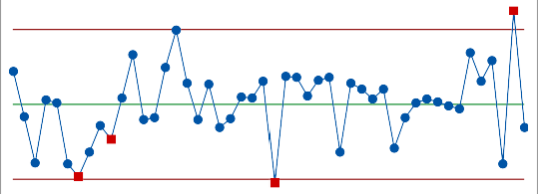


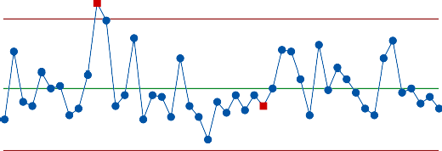
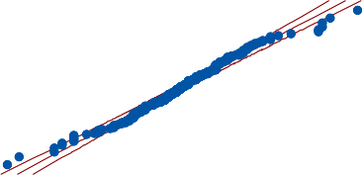

Calculate the Process Capability
Calculating long-term / short-term process capability requires;
Upper and/ or lower specifications.
Confirmation that the process is in control.
Confirmation that the process data is normally distributed.
Process data representing long-term & short-term variation.
Process Capability Sixpack Report for Diameter
Xbar Chart
1
Capability Histogram
USL
UCL=1.4606
LSL
Overall
Within
Sample Mean
1.45
_ X=1.4042
Specifications LSL 1.2
USL 1.5
1.40
1.35
6
1
6
5
11
16
1
LCL=1.3477
21 26
31
36
41
46
1.20 1.26 1.32 1.38 1.44 1.50 1.56
1
R Chart
Normal Prob Plot
AD: 0.959, P: 0.015
Sample Range
0.2
UCL=0.2071
0.1
_ R=0.0979
2
0.0
1
6
11
16 21 26 31
Last 25 Subgroups
36
41
46
LCL=0
1.3
1.4
1.5
1.6
Capability Plot
1.5
Within StDev 0.04339
Cp 1.15
Cpk 0.74
PPM 13596.62
Overall
Within
Specs
Overall StDev 0.04736
Pp 1.06
Ppk 0.67
Cpm *
PPM 21504.56
Values
1.4
1.3
25
30
35
40
45
Sample

Slide 17
Interpretation of Capability Output
Process Capability Report for Diameter
LSL USL
Process Data
LSL 1.2
Target *
USL 1.5
Sample Mean 1.40416
Sample N 240
StDev(Overall) 0.0473588
StDev(Within) 0.0433924
Overall
Within
Overall Capability Pp 1.06
Ppk 0.67
Potential (Within) Capability
Cp 1.15
Cpk 0.74
Diameter
1.20 1.26 1.32 1.38 1.44 1.50 1.56
Observed Expe % < LSL 0.00 | cted Defects 0.00
% > USL 2.92 | 1.36
% Total 2.92 | 1.36
Use the Capability Analysis to reach the following conclusions;
Process variation is about equal to the specs ( Pp is about = 1.0).
Process is off center ( Ppk < Pp ).
Process is fairly in control (Ppk is about = Cpk).

Slide 18
Relationship Between Cpk vs Ppk vs Cp
In Control
Cpk = Ppk Cpk = Cp
Cpk < Cp
Out of Control
Cpk < Cp Ppk < Cpk
Ppk < Cpk
Process Centered
Process Off -Center

Slide 19
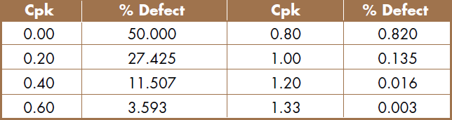
Acceptable Cpk Levels
Defect Levels Associated with Cpk Values
Airline Industry -
Safety
Cpk = 2 or more Cpk = .4 or less
Baggage
Pharmaceutical Industry - Auto Industry -
Typical Manufacturing -
Cpk = 1.75
Cpk = 1.33
Cpk = 1.00
Nanoscale Manufacturing = ?

Slide 20
Conclusions
Modern nanoscale processes seeking to produce high Quality products will seek to understand and minimize the variation in their key Quality characteristics.
Graphical analysis such as the histogram and normal probability plots allow one to understand and model the variability in process outputs.
Capability indices such as Cp and Cpk compare the process variation to the customers specifications. They are used to determine if the variation is wider than the specifications, the process is not centered or both.
If process data is collected over a long time period,
Pp and Ppk are used to determine the long-term process performance capability.

