Slide 1
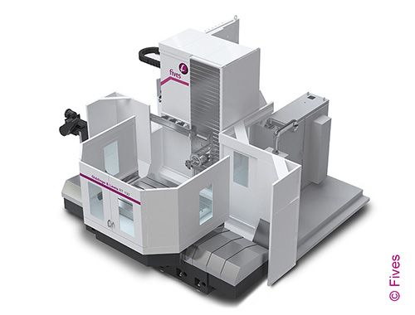
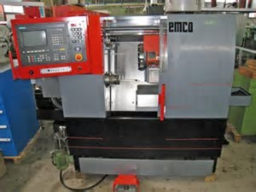
CNC – Computer Numerical Control
Courtesy of Fives Giddings & Lewis
Courtesy of EMCO Maier

Slide 2
CNC machines are programmed using an interpreter that is specified in a publication of the NIST.
http://ws680.nist.gov/publication/get_pdf.cfm?pub_id=823374
This specification is called RS274
This spec gives the definitions for the codes used to command axis movement, spindle functions, tool functions, and various machine functions.

Slide 3
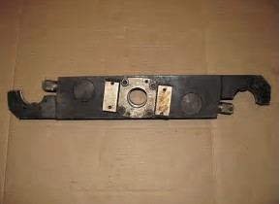
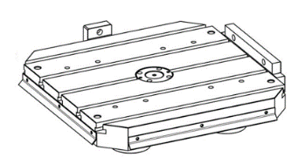

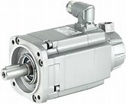
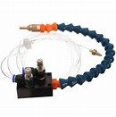
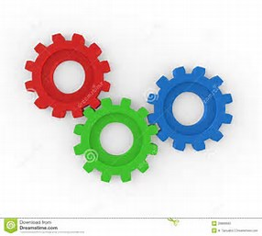

SPINDLE DIRECTION/START/STOP COMMAND
SPINDLE
DRIVE
CNC
STORES PART PROGRAM
LOOKS AHEAD IN PGM TO SIGNAL THE PLC
CALCULATES MULTIAXIS MOVEMENTS
COMMUNICATIONS
BETWEEN CNC AND PLC
PLC
TOOL CHANGER ARM & CHAIN
BASIC
SIMPLE
CNC
SYSTEM
PALLET CHANGER & CLAMP
COOLANT
Y
axis
B
axis
X
axis
Z
axis
SPINDLE XMSN
GEAR RANGE
FUNCTIONS ON MISCELANEOUS CODES
(M CODES)
FUNCTIONS ON “G” CODES FOR POSITIONING AND SPEED

Slide 4
CNC/Spindle
CNC provides speed command to the spindle drive.
Spindle drive provides power to the motor to run the proper speed
The PLC will control the gear range and commanded direction to the spindle drive.
Spindle encoder reports actual speed and position back to the CNC
CNC/Axis Drives
The CNC provides speed command to each of the programmed axes.
The CNC monitors speed and direction by reading the encoder or scale feedback.
The CNC controls the deceleration and stopping of the axes to prevent overshooting the axis at the travel endpoint.
CNC/Miscellaneous Functions
Most CNC controls look at least 10 program blocks ahead and prepare codes to be sent to the PLC so it is ready.
For instance, the PLC will be told which tool will be needed next so it can find the tool and have it in the tool changer to be ready as soon as the current tool is finished with it’s work.
The PLC executes commanded pallet changes and pallet locking
The PLC executes coolant on/off
The PLC executes shifting to the proper gear range for the programmed spindle speed

Slide 5
CNC controls are used for various automated production machines:
Horizontal Mills
Vertical/Gantry mills
Horizontal Lathes
Vertical Lathes
Nibblers
Plasma and torch cutting machines
Brakes & Punches
Laser cutters
Seat Cover Fabric cutting
Grinders
Planers
Woodworking machines
High Pressure water cutting of metals
The CNC and PLC can be interfaced with other PLC’s to integrate the CNC machine to conveyors, Pick and Place robots, storage and retrieval systems and any form of automation to provide an accurate and consistent manufacturing operation.

Slide 6
So, how do these machines operate?
What are some basics mechanically and electrically?
We shall take a look in the next few slides.
First, how do these machines move? Aren’t they heavy?

Slide 7
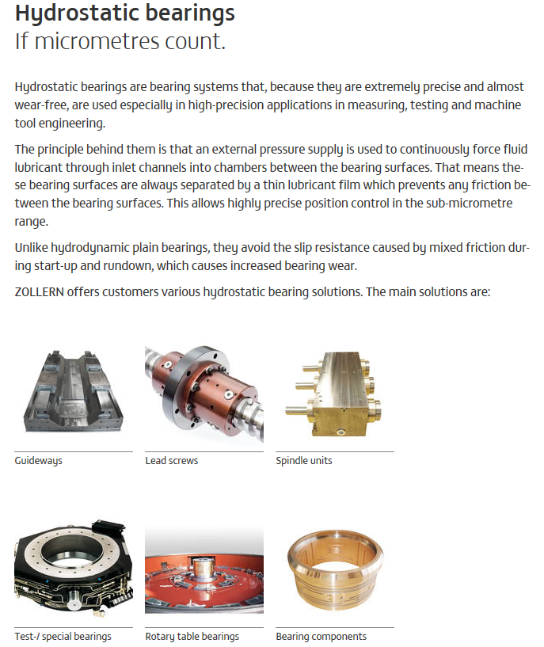
For linear axes, one surface will have a pocket that hydraulic oil is pumped into at a specific pressure. The oil pressure is adjusted for each pocket so that the moveable part is supported and glides on a thin film of oil.

Slide 8
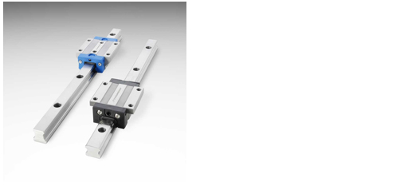
Many machines move tables, columns, and axes via
guide ways and slide bearings. These slide bearings
have recirculating bearings that continually move
when the axis is in motion. When servicing these
machines, never remove a slide bearing without a
bar, short piece of way guide or special shipping blank
to hold the bearings when the slide is removed.

Slide 9
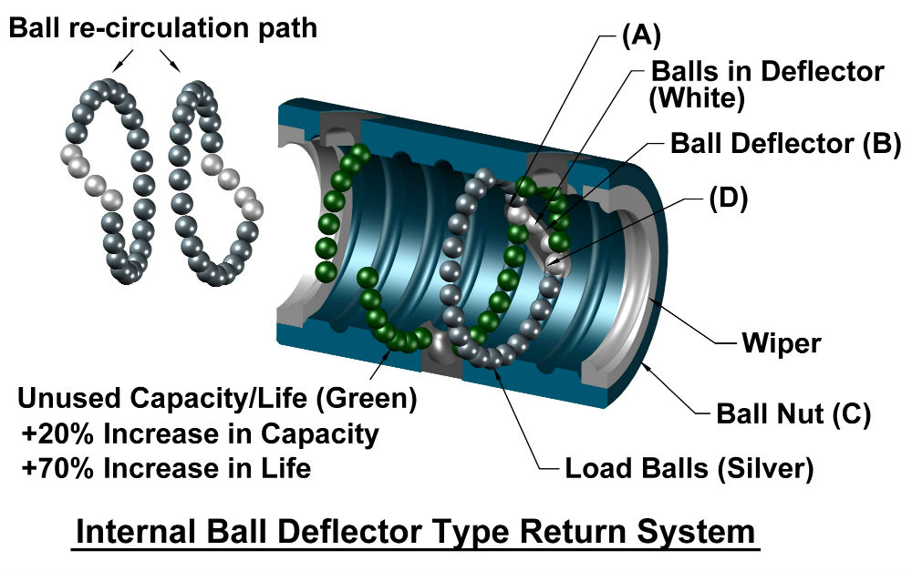

Slide 10
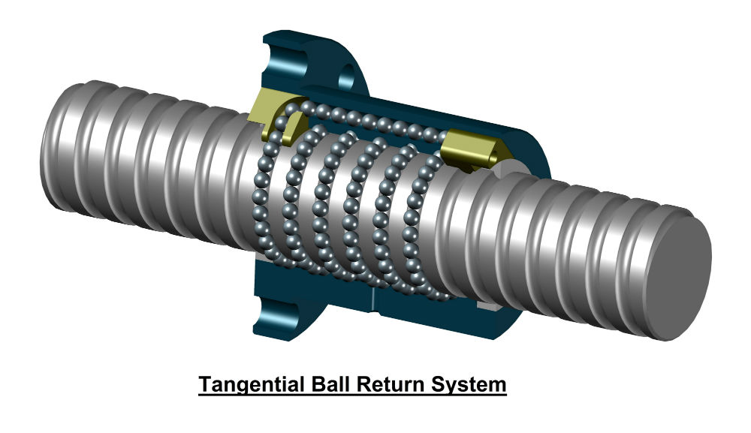

Slide 11
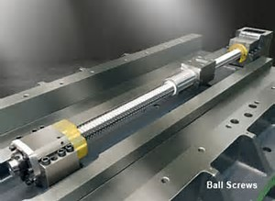
Drive motors may be connected to the ball
screw directly by a coupling, or through a
gearbox.
Gearboxes typically need maintenance as they
generally have lubricating oil inside as well as bearings.

Slide 12
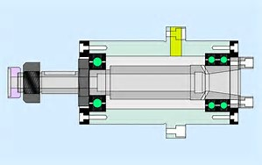
Spindle Cartridge
Spindle Info:
Some spindles clamp the tool by a screw that goes into the back of the tool holder.
The spindle collet keys keep the tool from twisting in the collet.
Some tools are clamped by fingers that “grab” the back of the tool holder using a drawbar.
Some spindles require tool holders with a hole in the middle to facilitate thru the spindle coolant.
Some spindles have bearings that need to be “packed” with grease, and “run in” for a period of time while being monitored for temperature rise, noise, or play.
Collet
Collet Key (2)
Spindle Bearings

Slide 13
Cast iron is the preferred material for machine bases and columns.
Cast iron is stable, does not warp as much and has better temperature characteristics (usually beefier)
Fabricated bases and columns are welded sheet metal.
Fabricated bases are more prone to warp under load, and because of the thinner thickness of the material, are also more sensitive to heat variations. (i.e. welded joints can be hard where the bulk of the surface may be more annealed or softer allowing for size variations and shape distortions.
Regardless of the frame makeup, a machine tool MUST have a solid foundation and base that often times requires I beams and reinforcement in the concrete. Some machines require foundations varying from a foot to several feet thick depending on the size of the machine.

Slide 14
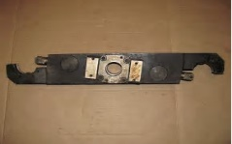

Feedback – “reporting home”
SPINDLE DIRECTION/START/STOP COMMAND
SPINDLE
DRIVE
CNC
STORES PART PROGRAM
LOOKS AHEAD IN PGM TO SIGNAL THE PLC
CALCULATES MULTIAXIS MOVEMENTS
COMMUNICATIONS
BETWEEN CNC AND PLC
PLC
TOOL CHANGER ARM & CHAIN
PALLET CHANGER & CLAMP
COOLANT
Y
axis
B
axis
X
axis
Z
axis
SPINDLE XMSN
GEAR RANGE
The spindle and each axis have an encoder, scale, or other device for speed and position feedback to the CNC.

Slide 15
In vintage machine tools, the spindle may have a DC tachometer for speed feedback and a resolver for angular position feedback.
It is important for the CNC to know the angular position of the spindle for tool change orientation and for tapping.
Axis motors many times had both a resolver and a tachometer. The tach went to the motor drive and the resolver reported to the CNC for axis position.
Modern digital drives will use the same encoder or scale that the CNC uses for position feedback to tell the motor drive how fast it is moving the axis.
Many times spindle drives were DC shunt type systems. This was so faster spindle speeds could be achieved for smoother or finer finishes on the cuts. Remember a shunt motor can rotate faster than the base speed by weakening or reducing the motor field excitation.
Devices used for position feedback on older machines include Farrand Scales, Accupin Scales, Resolvers, Synchro’s, but more recently, Encoders and Optical Scales are the feedback devices of choice.

Slide 16

It may not be obvious to the casual observer, but where the feedback device is located, makes a difference in accuracy and troubleshooting techniques. If all connections are mechanically tight and secure, any method of feedback location is accurate.
Encoder
Let’s say the picture above is my spindle motor. The encoder is mounted on the tail of the motor. It is attached to the spindle motor shaft by a coupling. The drive end of the motor is attached to the spindle gear box by a coupling. Couplings are a weak link, they can wear, break or sometimes develop some slop or backlash depending on how they are secured to the shaft. If the motor is to run at 1000 RPM and the coupling between the motor and encoder is secure, the encoder will report back to the CNC that the motor is running the proper speed. If the coupling between the motor and the gearbox develops backlash, the finish of the part would suffer because of chatter. If the coupling completely breaks, then the CNC will think the motor is turning 1000 RPM’s, when in reality it is not turning at all. If the spindle encoder was mounted to the spindle shaft itself, this would be a different scenario all together. The encoder would detect no rotation.

Slide 17
Axis drives are much the same, only there are more options. Many times for economy’s sake, encoders are placed on the back of the axis motor. Again, the drive end of the motor can be either directly attached to the ball screw or pinion gear for a rack and pinion drive.
Encoder
In the case of a ball screw, there are couplings at the end of the ball screw, there is the ball nut, and it’s mounting to the axis table or slide. Again, the encoder being on the motor does not alert the CNC to any backlash or physical mis-positioning on the driven side of the motor. Some machines placed the encoder on the end of the ball screw. Here we would eliminate the couplings on the motor shaft and the coupling to the ball screw itself. But the coupling from the ball screw to the encoder or any ball nut problems would not be seen by the CNC. A scale mounted to the machine bed or column with the slider of the scale attached to the ball nut is probably the most reliable and accurate system going. All backlash is between the ball nut and the motor shaft will be detected by the CNC.

Slide 18
Before we go too much farther, we need to discuss some of the other fine points of CNC machines.
The direction of rotation on the spindle is determined by looking at the rear of the spindle motor. Look at the rotor, and if the rotor is turning CW at the back of the motor, the spindle should also be turning CW. This is true of a lathe also.
A mill positions from the centerline of the spindle collet and the face of the spindle nose, not the spindle keys. That is important to remember. When running a CNC machine, if you have a tool in the spindle, you must load the tool length and tool radius offsets, or the machine will try to push the tool through the piece part to the spindle nose. That is called a “wreck”.
A lathe positions from the face of the tool turret to the face of the collet. If the machine does not have tool turret, it will position from the face of the tool holder. Remember the lathe turns the piece part and the tool is moved to cut the spinning part. A .1” cut will reduce the diameter of the piece part by .2”.
Face of spindle nose
Centerline of collet

Slide 19
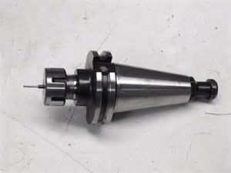
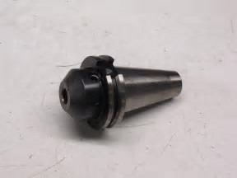
Two Common Types
Of Tool Holders
(but not the only two)
CAT40 tool holder with knob on back for a drawbar tool clamp.
CAT40 tool holder with internal threads at the back for a screw type tool clamp.

Slide 20
All CNC controls have an operating system. They may differ in features, memory, etc., but they all follow the NIST RS274 standard.
No, that’s not another communication protocol like RS232, RS485, RS422, etc. It is the “G-Code” language that CNC machines are programmed with. It is a .pdf document, go ahead, download it. It’s good reading.
So, we are going to park on this for a little bit and discuss some codes and how they affect the machine.
No, this won’t make you a whiz bang CNC programmer in 60 minutes. It is a 5000’ view of what this machine is supposed to do, and how it is commanded to do it.
CAM and some CAD software may have plugin’s that will automatically write code for particular types of machines and controls. So, grab a POST and let’s get started.

Slide 21
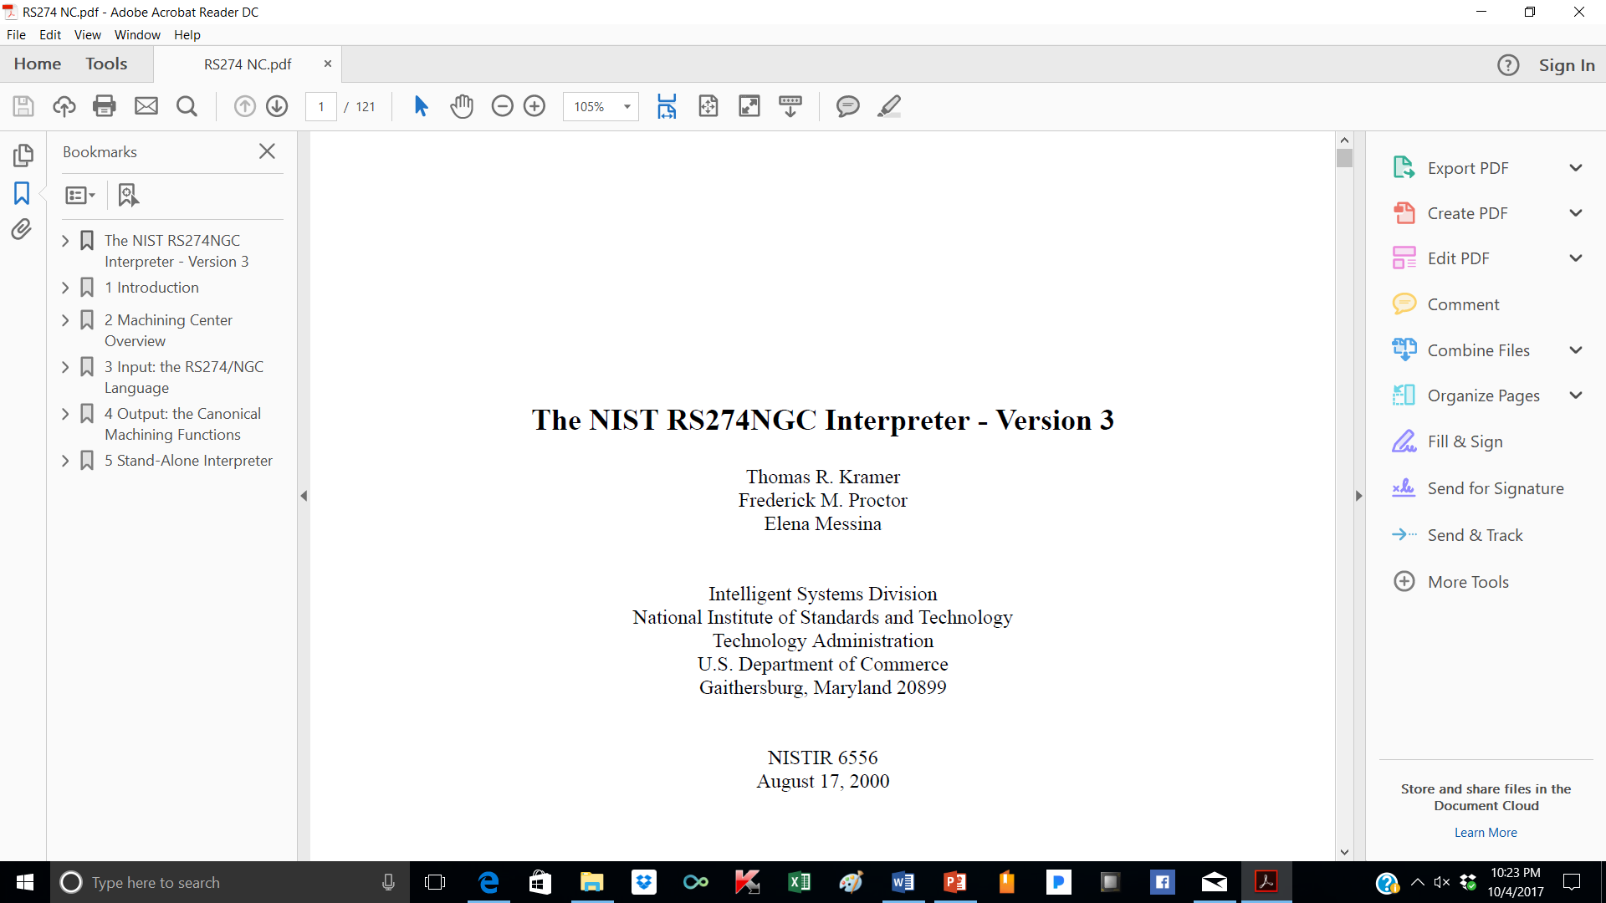

Slide 22
Many times a machine may have a pallet or B axis table with a hole in the middle of it. This many times is the actual machine zero point. When the machine has been torn down for repair, it many times will need to be checked for accurate zeroing. The center of this hole sets X 0 and Z 0. Y 0 is the surface of the table. When the machine is first turned “on” it should be referenced. This action is taken in Manual mode generally and will run each axis to a switch. Generally it will make the switch, pull off of the switch and find the next reference pulse on the encoder or scale. In the machine parameters there is a register for each axis in which a dimension is stored. This dimension is displayed on the axis display and represents the distance the machine’s present position is from machine zero, the position shown on the pallet below. A laser or dial indicator may be used to see if the dimensions of the parameter table are still correct. If not, the dimension numbers need to be changed to reflect the correct distance the reference switches are from machine zero.
= zero or reference point

Slide 23
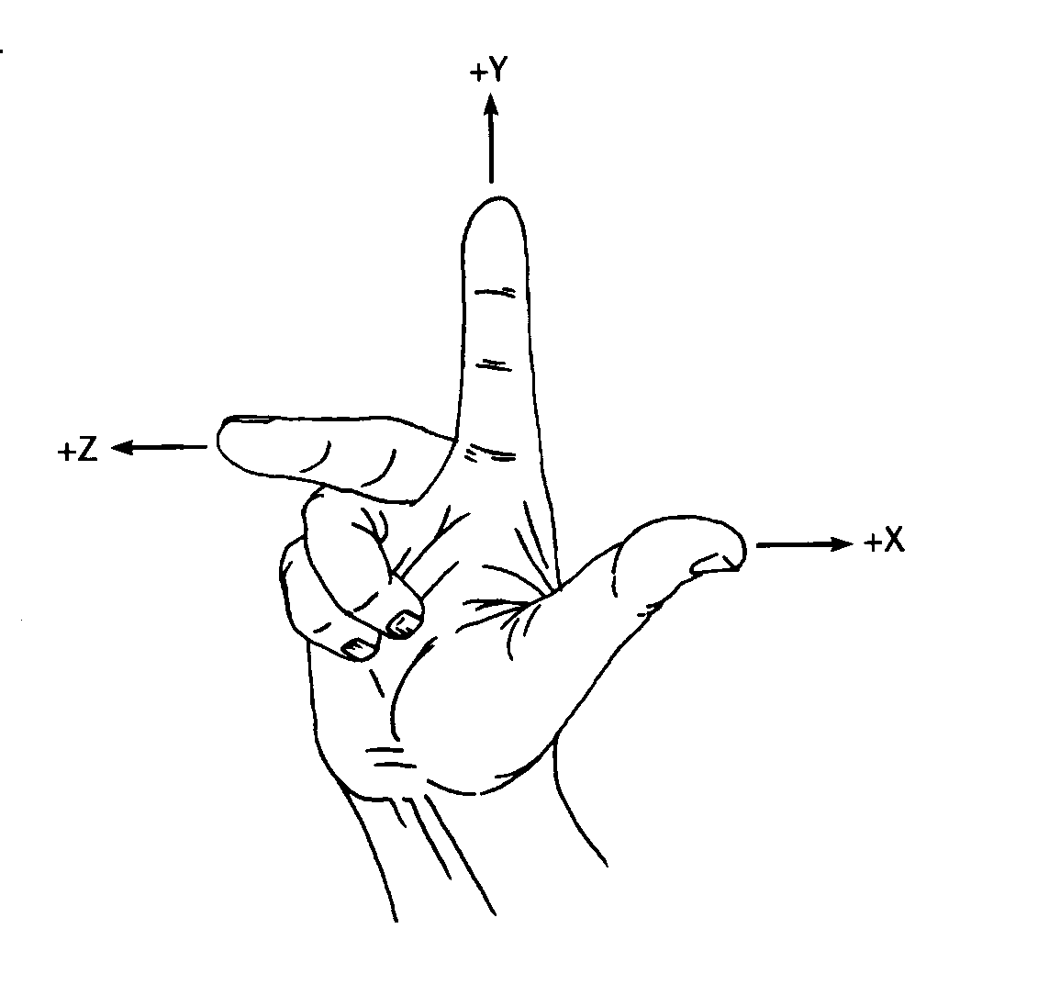
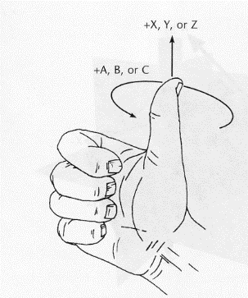
THE RIGHT HAND RULE
FOR DETERMINING AXIS DIRECTIONS
THE RIGHT HAND RULE
FOR DETERMINING AXIS DIRECTIONS
CONT’D
To determine the clockwise rotary motion of an axis that rotates
around the X, Y, or Z axis, close your hand with the thumb
sticking out, pointing in the positive direction of the axis you are
rotating around. (The thumb may represent X, Y, or Z) The
direction of the curl of your fingers is the clockwise or positive
rotation of the rotating axis.
Rotary axis designations are A, B, and C
A rotates around X
B rotates around Y
C rotates around Z
1. Hold your hand with the thumb, forefinger, and middle finger
perpendicular to each other.
Your thumb represents the X axis
Your forefinger represents the Y axis
Your middle finger represents the Z axis
2. The direction each finger points represents the positive direction
of axis travel.
3. The Z axis is always parallel to the main spindle. The positive
direction is normally into the spindle.
4. On a mill, the X axis is generally the axis with the longest travel
and is perpendicular to the Z axis. On lathes, the Z axis is the
longest axis.
5. Looking into the tip of your middle finger, the forefinger, which
is perpendicular to it, represents the Y axis.

Slide 24
Y+
2.1.1.1 Linear Axes
A machining center has independent mechanisms for producing relative linear motion of the tool workpiece in three mutually orthogonal directions. These are the X, Y and Z axes.
2.1.1.2 Rotational axes
Three additional independent mechanisms produce relative rotation of the workpiece and the tool around an axis. These mechanisms (often a rotary table on which the workpiece is mounted or a drum on which the spindle is mounted) are called rotational axes and labelled A, B, and C. The A-axis is parallel to the X-axis. B is parallel to the Y-axis, and C parallel to the Z-axis. Each
rotational mechanism may or may not have a mechanical limit on how far it can rotate.
RS274/NGC Interpreter - Version 3
C+
C-
Z-
A+
A-
X-
X+
B+ B -
Z+
Y-

Slide 25
NOTE:
A “B” Axis is typical on many horizontal machines. However, A and C axes require a drum or some way of moving the spindle.

Slide 26
Although the NIST does not specify it, many machines use a % character to indicate the beginning of a part program.
Let’s start with some easy things, OK?
Any time we write commands in a CNC program we use a “line of code”. Each line is considered a “Block” of the program. So, the line number becomes a Block number. A good programmer may number the blocks by 5’s or 10’s, so that if there is ever a need to edit the program, there are extra unused block numbers that can be inserted without having to renumber the whole cotton picking program.
3.3 Format of a Line
A permissible line of input RS274/NGC code consists of the following, in order, with the
restriction that there is a maximum (currently 256) to the number of characters allowed on a line.
1. an optional block delete character, which is a slash “/” .
2. an optional line number.
3. any number of words, parameter settings, and comments.
4. an end of line marker (carriage return or line feed or both).
RS274/NGC Interpreter - Version 3

Slide 27
N10 G00 X10.1250
Line Number Word 1 Word 2
Word 1 General Function 00 Rapid Travel
Word 2 X axis move From where we are now
to X 10.1250

Slide 28
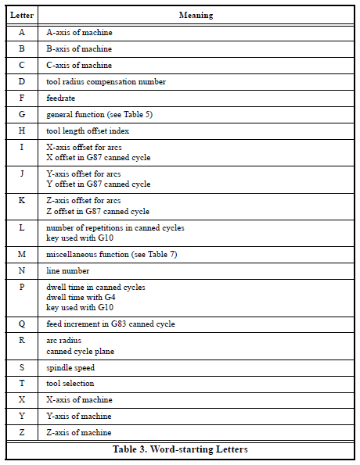
Table of “Word-starting Letters taken from the RS274
Document.
There can be multiple words in a block of program

Slide 29
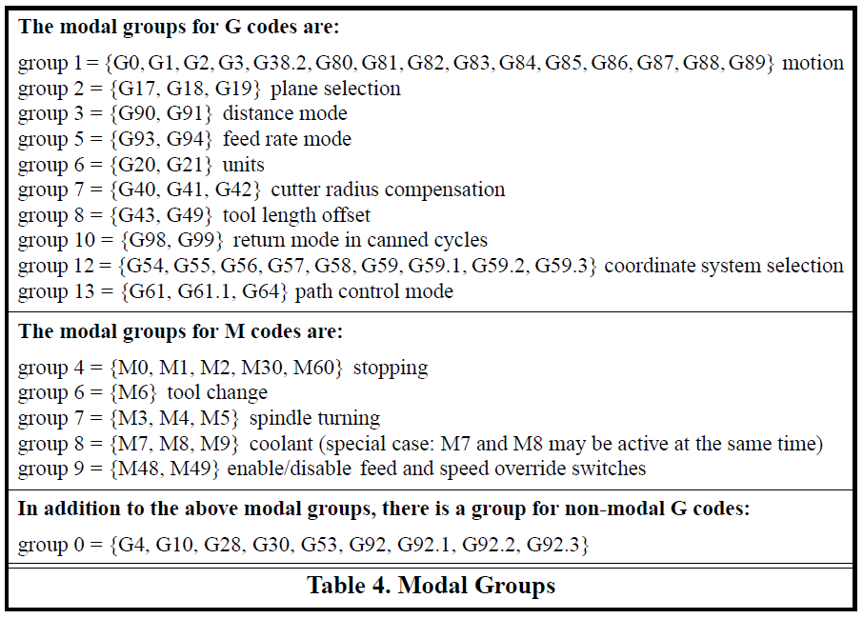
3.4 Modal Groups
Modal commands are arranged in sets called “modal groups”, and only one member of a modal group may be in force at any given time. In general, a modal group contains commands for which it is logically impossible for two members to be in effect at the same time — like measure in inches vs. measure in millimeters. A machining center may be in many modes at the same time, with one mode from each modal group being in effect. The modal groups are shown in Table 4.

Slide 30
For several modal groups, when a machining center is ready to accept commands, one member of
the group must be in effect. There are default settings for these modal groups. When the
machining center is turned on or otherwise re-initialized, the default values are automatically in
effect.
Group 1, the first group on the table, is a group of G codes for motion. One of these is always in
effect. That one is called the current motion mode.
It is an error to put a G-code from group 1 and a G-code from group 0 on the same line if both of
them use axis words. If an axis word-using G-code from group 1 is implicitly in effect on a line
In addition to the above modal groups, there is a group for non-modal G codes: (by having been activated on an earlier line), and a group 0 G-code that uses axis words appears on the line, the activity of the group 1 G-code is suspended for that line. The axis word-using G codes from group 0 are G10, G28, G30, and G92.

Slide 31
3.5 G Codes
G codes of the RS274/NGC language are shown in Table 5 and described following that.
The descriptions contain command prototypes, set in helvetica type.
In the command prototypes, three dots (…) stand for a real value. As described earlier, a real value may be (1) an explicit number, 4, for example, (2) an expression, [2+2], for example, (3) a parameter value, #88, for example, or (4) a unary function value, acos[0], for example.
In most cases, if axis words (any or all of X…, Y…, Z…, A…, B…, C…) are given, they specify a destination point. Axis numbers are in the currently active coordinate system, unless explicitly described as being in the absolute coordinate system. Where axis words are optional, any omitted axes will have their current value. Any items in the command prototypes not explicitly described as optional are required. It is an error if a required item is omitted.
In the prototypes, the values following letters are often given as explicit numbers. Unless stated otherwise, the explicit numbers can be real values. For example, G10 L2 could equally well be written G[2*5] L[1+1]. If the value of parameter 100 were 2, G10 L#100 would also mean the same. Using real values which are not explicit numbers as just shown in the examples is rarely useful.
If L… is written in a prototype the “…” will often be referred to as the “L number”. Similarly the
“…” in H… may be called the “H number”, and so on for any other letter.

Slide 32
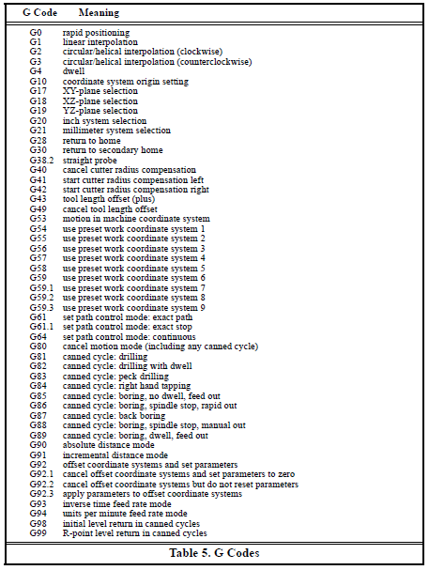
List of G codes taken from RS274/NGC Interpreter - Version 3

Slide 33
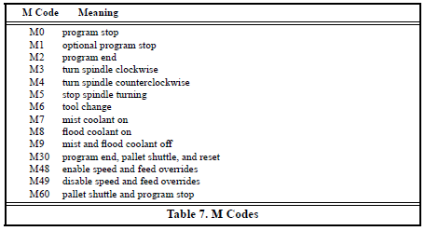
3.6 Input M Codes
M codes of the RS274/NGC language are shown in Table 7.

Slide 34
3.6.1 Program Stopping and Ending — M0, M1, M2, M30, M60
To stop a running program temporarily (regardless of the setting of the optional stop switch), program M0.
To stop a running program temporarily (but only if the optional stop switch is on), program M1.
It is OK to program M0 and M1 in MDI mode, but the effect will probably not be noticeable, because normal behavior in MDI mode is to stop after each line of input, anyway.
To exchange pallet shuttles and then stop a running program temporarily (regardless of the setting of the optional stop switch), program M60.
If a program is stopped by an M0, M1, or M60, pressing the cycle start button will restart the program at the following line.
To end a program, program M2. To exchange pallet shuttles and then end a program, program M30. Both of these commands have the following effects.
  1. Axis offsets are set to zero (like G92.2) and origin offsets are set to the default (like G54).
  2. Selected plane is set to CANON_PLANE_XY (like G17).
  3. Distance mode is set to MODE_ABSOLUTE (like G90).
  4. Feed rate mode is set to UNITS_PER_MINUTE (like G94).
  5. Feed and speed overrides are set to ON (like M48).
  6. Cutter compensation is turned off (like G40).
  7. The spindle is stopped (like M5).
  8. The current motion mode is set to G_1 (like G1).
  9. Coolant is turned off (like M9).
No more lines of code in an RS274/NGC file will be executed after the M2 or M30 command is
executed. Pressing cycle start will start the program back at the beginning of the file.

Slide 35
3.6.2 Spindle Control — M3, M4, M5
To start the spindle turning clockwise at the currently programmed speed, program M3.
To start the spindle turning counterclockwise at the currently programmed speed, program M4.
To stop the spindle from turning, program M5.
It is OK to use M3 or M4 if the spindle speed is set to zero. If this is done (or if the speed override switch is enabled and set to zero), the spindle will not start turning. If, later, the spindle speed is set above zero (or the override switch is turned up), the spindle will start turning. It is OK to use M3 or M4 when the spindle is already turning or to use M5 when the spindle is already stopped.

Slide 36
3.6.3 Tool Change — M6
To change a tool in the spindle from the tool currently in the spindle to the tool most recently
selected (using a T word — see Section 3.7.3), program M6. When the tool change is complete:
  • The spindle will be stopped.
  • The tool that was selected (by a T word on the same line or on any line after the previous tool change) will be in the spindle. The T number is an integer giving the changer slot of the tool (not its id).
  • If the selected tool was not in the spindle before the tool change, the tool that was in the spindle (if there was one) will be in its changer slot.
  • The coordinate axes will be stopped in the same absolute position they were in before the tool change (but the spindle may be re-oriented).
  • No other changes will be made. For example, coolant will continue to flow during the tool change unless it has been turned off by an M9.
The tool change may include axis motion while it is in progress. It is OK (but not useful) to program a change to the tool already in the spindle. It is OK if there is no tool in the selected slot; in that case, the spindle will be empty after the tool change. If slot zero was last selected, there will definitely be no tool in the spindle after a tool change.

Slide 37
3.6.4 Coolant Control — M7, M8, M9
To turn mist coolant on, program M7.
To turn flood coolant on, program M8.
To turn all coolant off, program M9.
It is always OK to use any of these commands, regardless of what coolant is on or off.
3.6.5 Override Control — M48 and M49
To enable the speed and feed override switches, program M48. To disable both switches, program M49. See Section 2.2.1 for more details. It is OK to enable or disable the switches when they are already enabled or disabled.

Slide 38
3.7 Other Input Codes
3.7.1 Set Feed Rate — F
To set the feed rate, program F… . The application of the feed rate is as described in Section 2.1.2.5, unless inverse time feed rate mode is in effect, in which case the feed rate is as described in Section 3.5.19.
3.7.2 Set Spindle Speed — S
To set the speed in revolutions per minute (rpm) of the spindle, program S… . The spindle will turn at that speed when it has been programmed to start turning. It is OK to program an S word whether the spindle is turning or not. If the speed override switch is enabled and not set at 100%, the speed will be different from what is programmed. It is OK to program S0; the spindle will not turn if that is done. It is an error if:
  • the S number is negative.
As described in Section 3.5.16.5, if a G84 (tapping) canned cycle is active and the feed and speed override switches are enabled, the one set at the lower setting will take effect. The speed and feed rates will still be synchronized. In this case, the speed may differ from what is programmed, even if the speed override switch is set at 100%.

Slide 39
3.7.3 Select Tool — T
To select a tool, program T…, where the T number is the carousel slot for the tool. The tool is not changed until an M6 is programmed (see Section 3.6.3). The T word may appear on the same line as the M6 or on a previous line. It is OK, but not normally useful, if T words appear on two or more lines with no tool change. The carousel may move a lot, but only the most recent T word will take effect at the next tool change. It is OK to program T0; no tool will be selected. This is
useful if you want the spindle to be empty after a tool change. It is an error if:
  • a negative T number is used,
  • a T number larger than the number of slots in the carousel is used.
On some machines, the carousel will move when a T word is programmed, at the same time machining is occurring. On such machines, programming the T word several lines before a tool change will save time. A common programming practice for such machines is to put the T word for the next tool to be used on the line after a tool change. This maximizes the time available for the carousel to move.

Slide 40
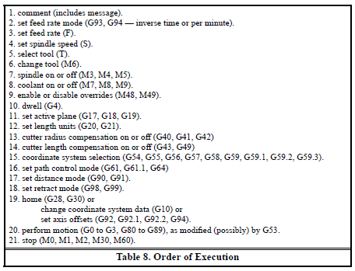
3.8 Order of Execution
The order of execution of items on a line is critical to safe and effective machine operation. Items are executed in the order shown in Table 8 if they occur on the same line.

Slide 41
3.5.10 Cutter Radius Compensation — G40, G41, and G42
To turn cutter radius compensation off, program G40. It is OK to turn compensation off when it is already off.
Cutter radius compensation may be performed only if the XY-plane is active.
To turn cutter radius compensation on left (i.e., the cutter stays to the left of the programmed path
when the tool radius is positive), program G41 D… . To turn cutter radius compensation on right
(i.e., the cutter stays to the right of the programmed path when the tool radius is positive),
program G42 D… . The D word is optional; if there is no D word, the radius of the tool currently
in the spindle will be used. If used, the D number should normally be the slot number of the tool
in the spindle, although this is not required. It is OK for the D number to be zero; a radius value of
zero will be used.
It is an error if:
• the D number is not an integer, is negative or is larger than the number of carousel slots,
• the XY-plane is not active,
• cutter radius compensation is commanded to turn on when it is already on.
The behavior of the machining center when cutter radius compensation is on is described in
Appendix B.

Slide 42
Appendix B. Cutter Radius Compensation
B.1 Introduction
The cutter radius compensation1capabilities of the Interpreter enable the programmer to specify that a cutter should travel to the right or left of an open or closed contour in the XY-plane composed of arcs of circles and straight line segments.
Cutter radius compensation is performed only with the XY-plane active. All the figures in this appendix, therefore, show projections on the XY-plane.
Where the adjacent sides of remaining material meet at a corner, there are two common ways to handle the tool path. The tool may pass in an arc around the corner, or the tool path may continue straight in the direction it was going along the first side until it reaches a point where it changes direction to go straight along the second side. Figure 2 shows these two types of path. On Figure 2:
  • Uncut material is shaded in the figures. Note that the inner triangles have the same shape with both tool paths.
  • The white areas are the areas cleared by the tool.
  • The lines in the center of the white areas represent the path of the tip of a cutting tool.
  • The tool is the cross-hatched circles.

Slide 43
Both paths will clear away material near the shaded triangle and leave the shaded triangle uncut. When the Interpreter performs cutter radius compensation, the tool path is rounded at the corners, as shown on the left in Figure 2. In the method on the right (the one not used), the tool does not stay in contact with the shaded triangle at sharp corners, and more material than necessary is removed.
There are also two alternatives for the path that is programmed in NC code during cutter radius compensation. The programmed path may be either (1) the edge of the material to remain uncut (for example, the edge of the inner triangle on the left of Figure 2), or (2) the nominal tool path (for example, the tool path on the left side of Figure 2). The nominal tool path is the path that would be used if the tool were exactly the intended size. The Interpreter will handle both cases without being told which one it is. The two cases are very similar, but different enough that they
are described in separate sections of this manual. To use the material edge method, read Appendix
B.3. To use the nominal path method, read Appendix B.4.

Slide 44
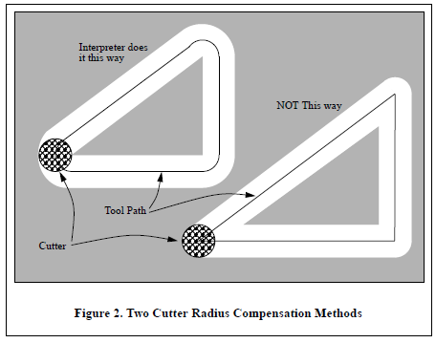

Slide 45
Z-axis motion may take place while the contour is being followed in the XY-plane. Portions of the contour may be skipped by retracting the Z-axis above the part, following the contour to the next point at which machining should be done, and re-extending the Z-axis. These skip motions may be performed at feed rate (G1) or at traverse rate (G0). The Z motion will not interfere with the XY path following. The sample NC code in this appendix does not include moving the Z-axis. In
actual programs, include Z-axis motion wherever you want it.
Rotational axis motions (A, B, and C axes) are allowed with cutter radius compensation, but using them would be very unusual.
Inverse time feed rate (G93) or units per minute feed rate (G94) may be used with cutter radius compensation. Under G94, the feed rate will apply to the actual path of the cutter tip, not to the programmed contour.

Slide 46
B.2 Programming Instructions
B.2.1 Turning Cutter Radius Compensation On
To start cutter radius compensation keeping the tool to the left of the contour, program G41 D… .
The D word is optional (see “Use of D Number”, just below).
To start cutter radius compensation keeping the tool to the right of the contour, program G42 D…
In Figure 2, for example, if G41 were programmed, the tool would move clockwise around the triangle, so that the tool is always to the left of the triangle when facing in the direction of travel.
If G42 were programmed, the tool would stay right of the triangle and move counterclockwise
around the triangle.
B.2.2 Turning Cutter Radius Compensation Off
To stop cutter radius compensation, program G40. It is OK to turn compensation off when it is
already off.

Slide 47
B.2.3 Sequencing
If G40, G41, or G42 is programmed on the same line as tool motion, cutter compensation will be turned on or off before the motion is made. To make the motion come first, the motion must be programmed on a separate, previous line of code.
B.2.4 Use of D Number
Programming a D word with G41 or G42, is optional.
If a D number is programmed, it must be a non-negative integer. It represents the slot number of the tool whose radius (half the diameter given in the tool table) will be used, or it may be zero (which is not a slot number). If it is zero, the value of the radius will also be zero. Any slot in the tool table may be selected. The D number does not have to be the same as the slot number of the tool in the spindle, although it is rarely useful for it not to be.
If a D number is not programmed, the slot number of the tool in the spindle will be used as the D
number.
B.3 Material Edge Contour
When the contour is the edge of the material, the outline of the edge is described in the NC program.
For a material edge contour, the value for the diameter in the tool table is the actual value of the diameter of the tool. The value in the table must be positive. The NC code for a material edge contour is the same regardless of the (actual or intended) diameter of the tool.

Slide 48
B.3.1 Programming Entry Moves
In general, two pre-entry moves and one entry move are needed to begin compensation correctly. However, if there is a convex corner on the contour, a simpler method is available using zero or one pre-entry move and one entry move. The general method, which will work in all situations, is described first. We assume here that the programmer knows what the contour is already and has the job of adding entry moves.
B.3.1.1 General Method
The general method includes programming two pre-entry moves and one entry move. See Figure 3. The shaded area is the remaining material. It has no corners, so the simple method cannot be used. The dotted line is the programmed path. The solid line is the actual path of the tool tip. Both paths go clockwise around the remaining material. A cutter one unit in diameter is shown part way around the path. The black dots mark points at the beginning or end of programmed or actual moves. The figure shows the second pre-entry move but not the first, since the beginning point of the first pre-entry move could be anywhere.

Slide 49
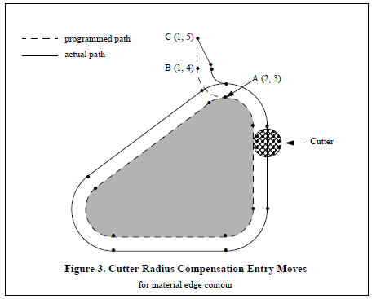
First, pick a point A on the contour where it is convenient to attach an entry arc. Specify an arc outside the contour which begins at a point B and ends at A tangent to the contour (and going in the same direction as it is planned to go around the contour). The radius of the arc should be larger than half the diameter given in the tool table. Then extend a line tangent to the arc from B to some point C, located so that the line BC is more than one tool radius long. After the construction is
finished, the code is written in the reverse order from the construction. The NC code is shown in Table 12; the first three lines are the entry moves just described.

Slide 50
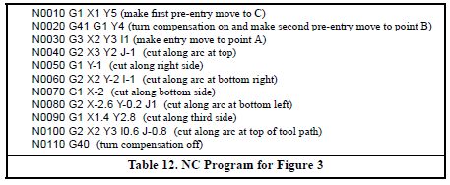
Cutter radius compensation is turned on after the first pre-entry move and before the second preentry move (including G41 on the same line as the second pre-entry move turns compensation on before the move is made). In the code above, line N0010 is the first pre-entry move, line N0020 turns compensation on and makes the second pre-entry move, and line N0030 makes the entry move.

Slide 51
3.5.11 Tool Length Offsets — G43 and G49
To use a tool length offset, program G43 H…, where the H number is the desired index in the tool table. It is expected that all entries in this table will be positive. The H number should be, but does not have to be, the same as the slot number of the tool currently in the spindle. It is OK for the H number to be zero; an offset value of zero will be used.
It is an error if:
  • the H number is not an integer, is negative, or is larger than the number of carousel slots.
To use no tool length offset, program G49.
It is OK to program using the same offset already in use. It is also OK to program using no tool
length offset if none is currently being used.

Slide 52
Most programs are written in Absolute mode. However, you may encounter programs written in Incremental where each move is a specified as the axis and distance from where the spindle is setting. The next incremental move is specified the same way.

