Slide 1
Prospecting for Energy in California
Jeffrey lane
Armijo High School
Fairfield, CA

Slide 2
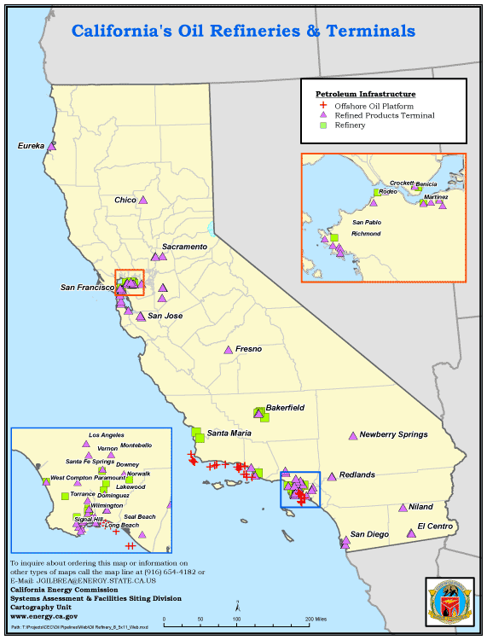
ca
California oil
Notes:
Natural resource of CA

Slide 3
CA Energy Consumption
²
Energy Source | % of total
Natural Gas | 46.5%
Nuclear | 14.9%
Large Hydro | 9.6%
Coal | 15.5%
Renewables | 13.5%
Electrical Generation

Slide 4
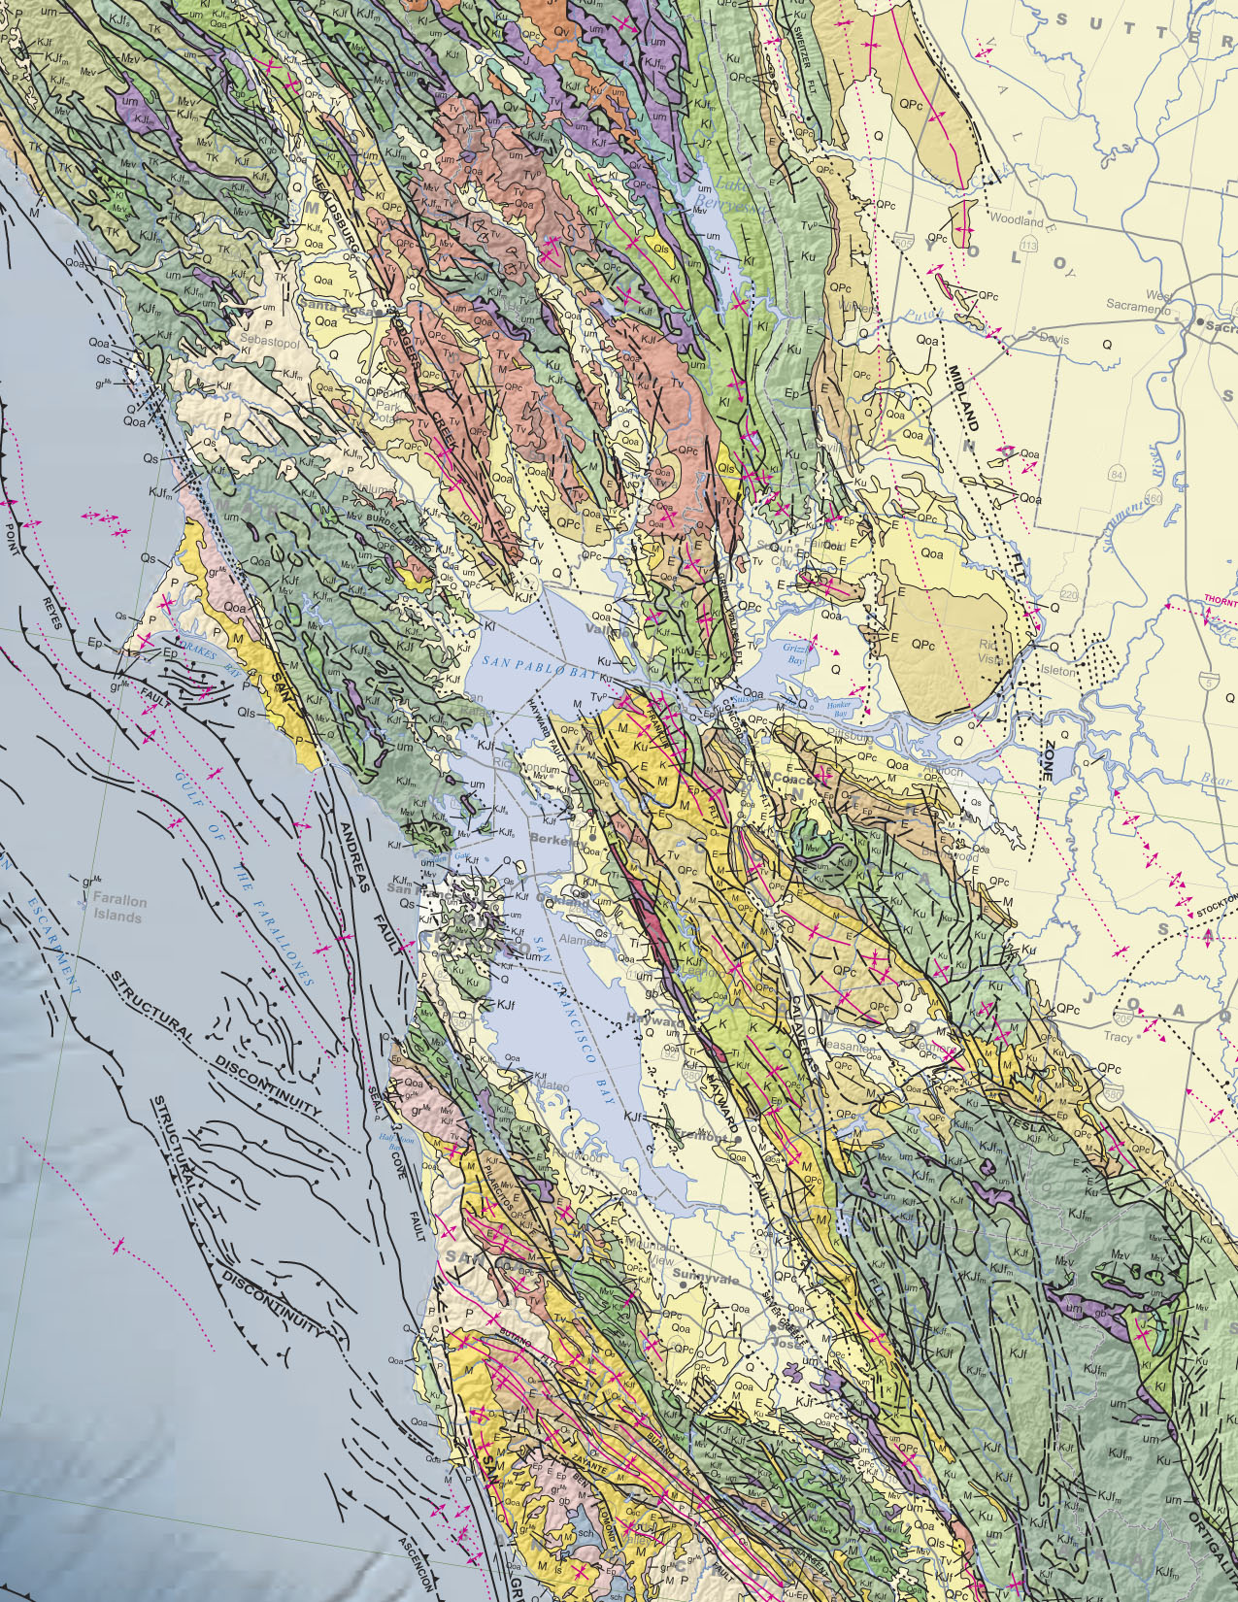
Fairfield
Notes:
Geological map centered on Fairfield, CA

Slide 5
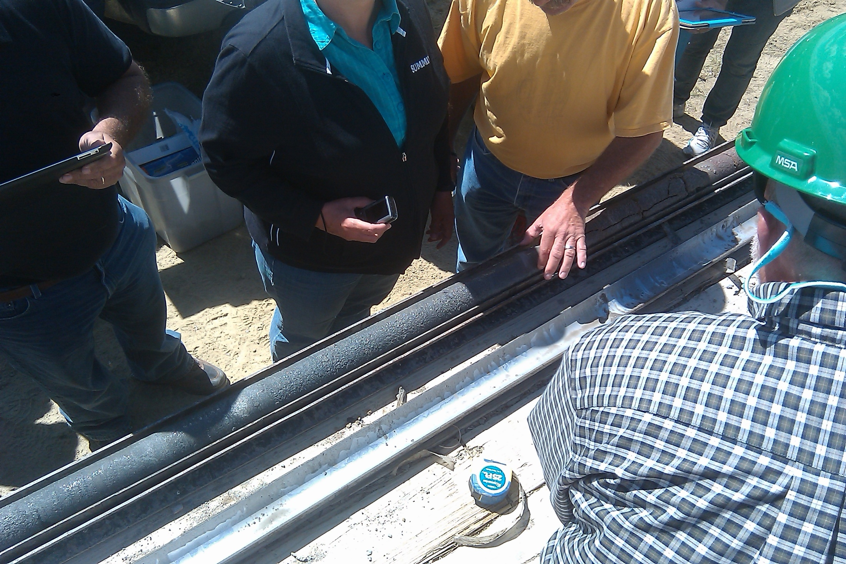
Notes:
Actual core sample

Slide 6
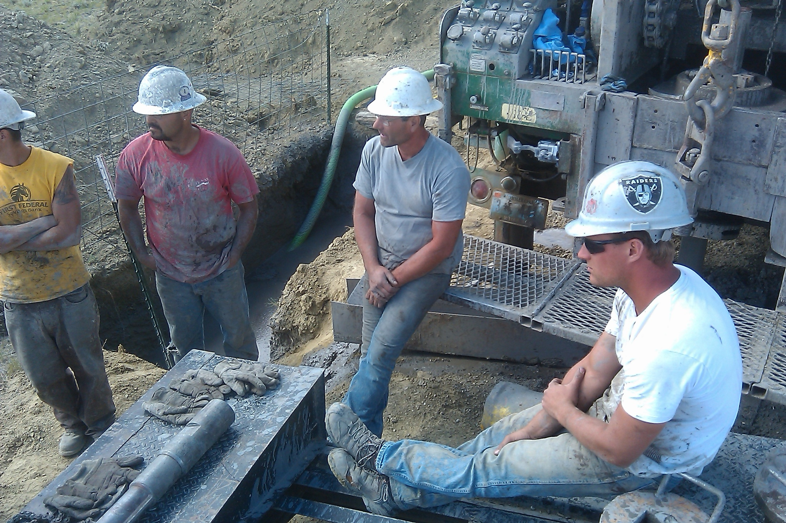
Notes:
Drilling crew for core samples. Note Oakland Raider hat from California!

Slide 7
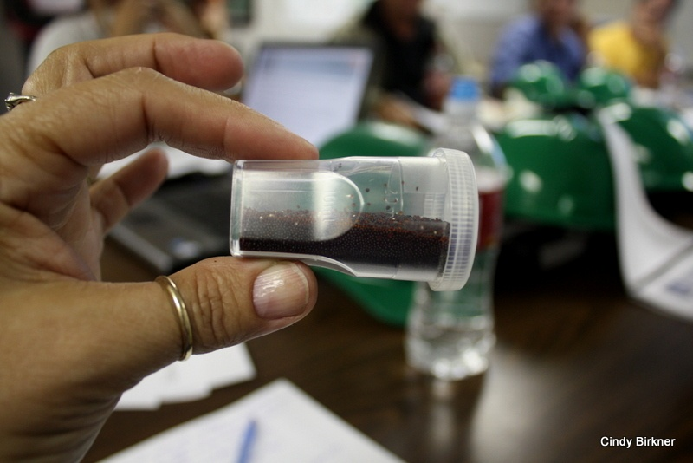
Notes:
Resin crystals for extraction of Uraninium

Slide 8
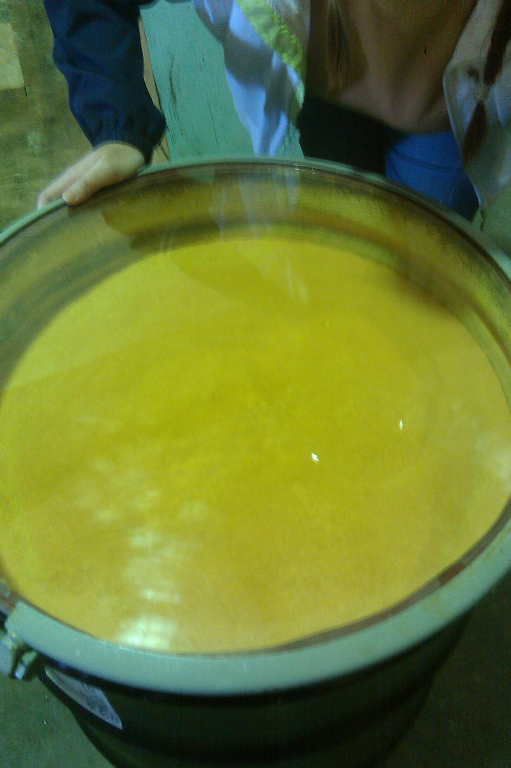
Yellow cake Uranium
Notes:
Processed Yellow Cake Uranium

Slide 9
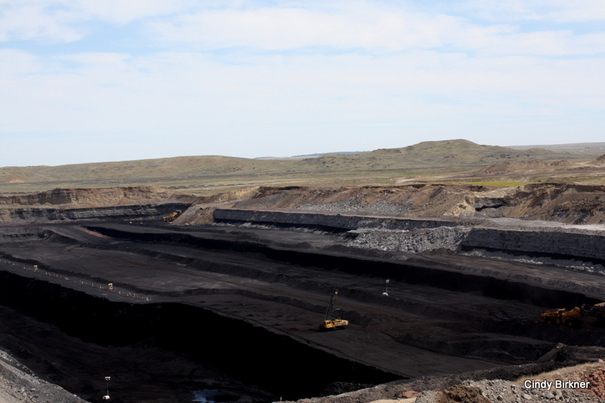
Notes:
Dry Fork WY Coal Mine

Slide 10
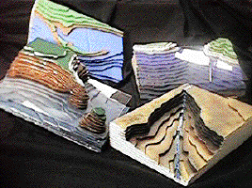
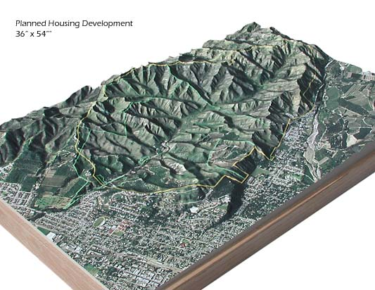

Slide 11
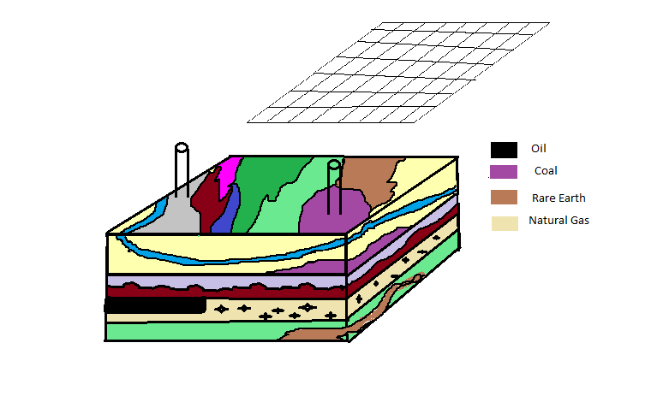
Notes:
Model for lab containing hidden resources and minerals. Note graph laided out on the top of model

