Slide 1
Mechatronics Module 3:
Developing a Control Algorithm Based on Vehicle Motion Requirements
Dr. Vladimir V. Vantsevich
awdrive@comcast.net

Slide 2
Wheel/Tire-terrain Interactive Dynamics

Slide 3
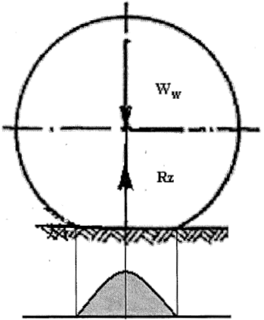
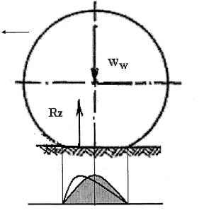
Wheel Normal Load and Reaction
Unmoving wheel:
Wheel in motion:
Distributed load symmetric about wheel vertical axis.
Asymmetric pattern caused by tire internal friction.

Slide 4
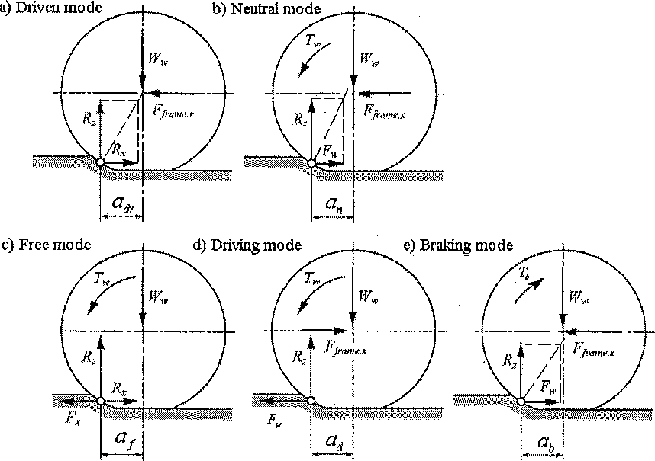
Wheel Power Loading Modes
W_{w} is the wheel weight.
R_{z} is normal reaction.
F_{frame.x} is the frame force in the x-direction.
R_{x} is rolling resistance.
a is the offset distance of the normal reaction.
F_{w} is net tractive force
T_{w} is wheel torque

Slide 5
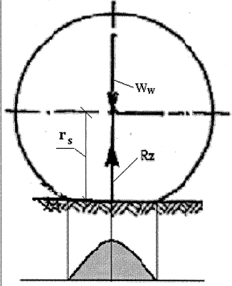
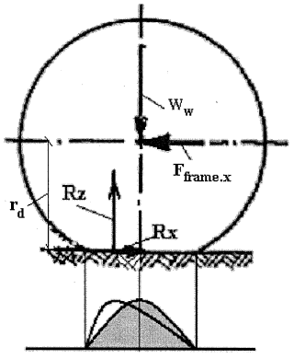
Measures of Tire Radius
Static Loaded Radius (r_{s})
Dynamic Loaded Radius (r_{d})
Difference caused by longitudinal deflection when the wheel rolls.
r_{d} is the shortest distance from the wheel center up to the action line of the longitudinal ground reaction.
Δ_{z} is normal deflection

Slide 6
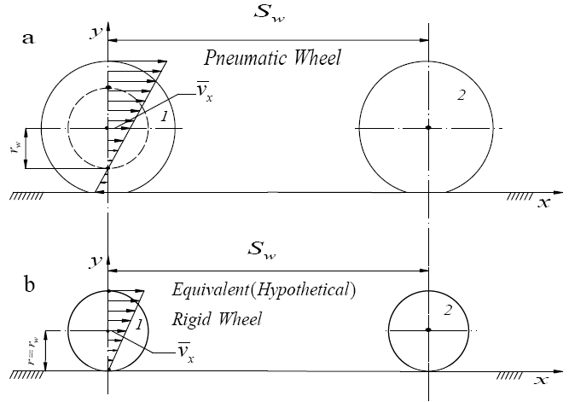
Effective Rolling Radius
Because of longitudinal elasticity and possible relative displacement between the tire and road surface (spinning), dividing actual speed by angular speed will not equal any of the previously mentioned radii.
Instead, an effective rolling radius is used:
Rolling radius is the radius of a hypothetical rigid wheel with the same velocity as the actual pneumatic wheel.
Rolling radius is not measured on the wheel itself.
It is the distance between the wheel center of rotation and the instantaneous center.
Pneumatic (a) and equivalent rigid (b) wheels [1]

Slide 7
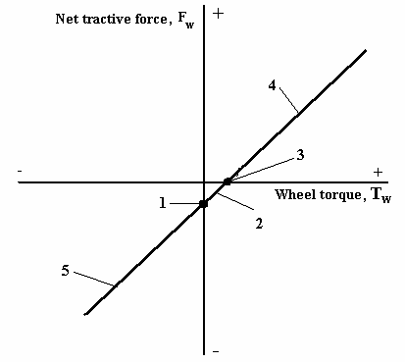
Rolling Radius in Different Modes
Driven mode
Neutral mode
Free mode
Driving mode
Braking mode
Rolling radius in driven mode
Rolling radius in Free mode
Rolling radius in Driving and braking modes
Wheel torque-force diagram [1]

Slide 8
Wheel Slippage
Reduces wheel velocity/rolling radius due to:
Tire tangential (longitudinal) deflection (on roads)
Joint tire and ground longitudinal deflection (on soft surfaces)
The tire sliding relative to the surface of motion.
s_{δ} is the wheel slip ratio (0 to 1)
v_{w} is actual wheel velocity (with slip)
v_{t} is theoretical wheel velocity (with s_{δ}=0)
v_{δ} is the slip velocity
If s_{δ}= 0:
Actual velocity = theoretical velocity.
If s_{δ}= 1:
Wheel is spinning and actual velocity = 0

Slide 9
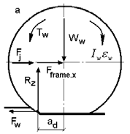
Wheel Power Balance: Non-steady Motion
Wheel in driving mode in non-steady motion:
Input wheel power comes from the torque to the wheel
Output chassis power is used to propel the vehicle.
Power losses include:
Rolling resistance power: Power lost due to normal deflection.
Slip power: Power lost from slippage.
Power needed to increase kinetic energy of the wheel in translational/rotational motion:
Wheel in non-steady motion [1]

Slide 10
Inverse Dynamics-based Control

Slide 11
Direct and Inverse Dynamics
The wheel dynamics equations can be used in two ways:
Direct Dynamics: Solve for wheel kinematic parameters when forces and torques are given.
Inverse Dynamics: Solve for torque T_{w} that will give the kinematic parameters that result in the desired motion.
The use of inverse dynamics in wheel control will be shown.

Slide 12
Inverse Dynamics Wheel Control
Control linear velocity by changing wheel torque coming from the vehicle driveline.
The necessary vehicle speed is known: Function v_{xs}(t) gives required values of velocity vs. time.
Rolling radius and angular velocity are assigned to give required velocity:
Torque T_{ws} is determined which will overcome resistance to motion.
Required rolling radius r_{ws} is determined from a r_{w} as a function of torque.
Angular velocity is then determined from v_{xs} and r_{ws}.

Slide 13
Inverse Dynamics Wheel Control
If the vehicle moves into poor road conditions, the slippage of the wheel will increase.
Linear speed of the wheel drops.
The effective rolling radius of the wheel drops.
By decreasing the wheel torque, if the angular velocity can be maintained, the linear velocity and the rolling radius can be increased to the required value.
If the rolling resistance force to be overcome does not allow the torque to be decreased while still keeping up the required angular velocity, instead of decreasing the torque, the angular velocity needs to be changed instead.

Slide 14
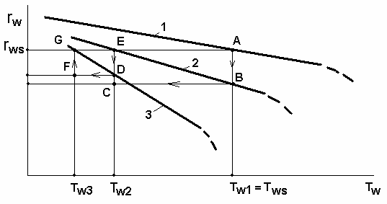
A) r_{w} is at required value r_{ws}
Changing Conditions of Rolling
B) Rolling radius decreases due to increasing slip in poor road conditions.
E) Angular velocity is maintained, but torque is dropped such that r_{w} returns to required value r_{ws}.
Torque-rolling radius diagram in different road conditions [1]
D) Road conditions are continually poor; r_{w} decreases further.
G) Torque is lowered again to restore r_{w} to r_{ws}.
If the torque needed to maintain r_{ws} is too low to overcome the rolling resistance, then instead the angular velocity should be changed such that r_{w} x ω_{w} = required linear velocity v_{xs}.

Slide 15
Angular Velocity Control
The resistance to the rolling motion (f_{w}) is a nonlinear function requiring sophisticated sensors and computation:
Rolling resistance forces change with the road conditions.
Acceleration is not necessarily constant.
It is desired to build a control algorithm such that:
Full information about the nonlinear function f_{w} does not need to be known.
The controller adapts to changing road conditions to give the required vehicle motion.

Slide 16
Control Strategy
Use a control-by-acceleration algorithm:
Find acceleration ε_{w}(t) = ε_{w*}(t) that corresponds to required angular velocity by differentiating angular velocity.
Acceleration exerted by torque T_{w*} can be determined by:
The controller will determine wheel torque T_{ws} that causes angular velocity ω_{w} to become required angular velocity ω_{ws}.
If angular acceleration
can be measured, then ε_{w}(ω_{w},T_{w}) is known
at any moment of time.

Slide 17
Control Strategy
Values of torque T_{w} should be set such that
If T_{w} = T_{w*}, then
If T_{w} = T_{w*}± ΔT_{w}, then
In the second case torque should be changed such that ΔT_{w}→0, which causes
Therefore, torque is controlled by the discrepancy in the acceleration

Slide 18
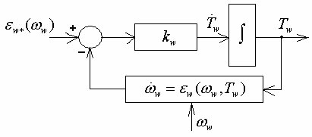
Control Strategy
The control is implemented in the shown control loop:
Input: required acceleration, ε_{w*.}
Acceleration loop diagram [1]
Difference between required and actual angular accelerations gives the rate that wheel torque should be changed,
k_{w} is a proportional coefficient for amplification in the control loop.
The rate of change is integrated to obtain the required wheel torque.

Slide 19
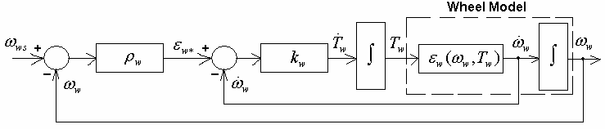
Control Block Diagram
The overall block diagram for the control strategy includes two control loops:
An internal loop controls acceleration
An external loop controls angular velocity
Control block-diagram [1]

Slide 20
Control Block Diagram
The actual acceleration used to compute the wheel torque, , is a function of torque and angular velocity. .
The non-linear function ƒ_{w} is included in .
If is measured by a sensor, there is no need to compute nonlinear function ƒ_{w}.
Control block-diagram [1]

Slide 21
Control Algorithm in LabVIEW Environment

Slide 22
Labview Simulation
An example of the control strategy is demonstrated using National Instruments Labview. The model includes the following steps:
Plot a required vehicle motion profile for velocity and acceleration vs. time. This will be the vehicle motion path that the controller needs the wheel motion to follow.
Model the plant: the mathematical model of the wheel with forces affecting the wheel motion including rolling resistance, frame force from the vehicle, and force needed to accelerate the wheel. The output of the plant is the wheel’s angular acceleration (which can then be integrated to find angular velocity).

Slide 23
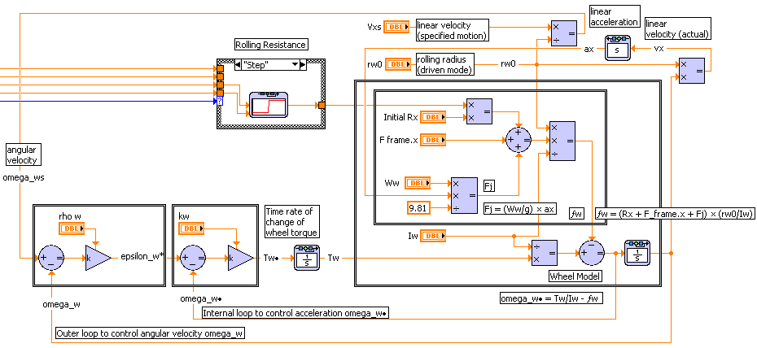
Labview Block Diagram

Slide 24
Labview Simulation
Set up two feedback control loops which compare the wheel’s actual angular velocity and acceleration from the planet model to the required values of the angular velocity and acceleration.
The output of the two control loops is wheel torque which needs to be applied to the plant model to adjust the motion towards the required motion.
Control block-diagram [1]

Slide 25
Control block-diagram [1] and Labview implementation

Slide 26
Labview Simulation
The simulation can be run with changes to the rolling resistance force to demonstrate the response to changing road conditions:
Constant: Rolling resistance force does not change.
Sine: Rolling resistance force increases, then decreases smoothly with a sinusoidal pattern.
Step: A sudden increase/decrease in the rolling resistance occurs at a moment of time as a multiplier to the starting rolling resistance force.
The values of velocity, acceleration, and forces are plotted on the front panel.

Slide 27
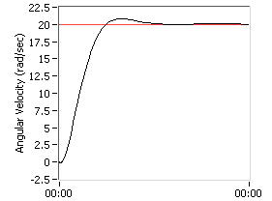
Labview Simulation
Amplification factor k_{w} is a control gain that affects the response of the system.
ω vs. time
Shown is the angular velocity of the wheel with k_{w} = 50.
Check the result of using different control gains by setting k_{w} = 200.
What effect does a decrease in the rolling resistance force have on the wheel torque?

Slide 28
References
[1] Vantsevich, V. V., “Inverse Wheel Dynamics,” ASME Conf. Proc. 2006, 227 (2006), DOI:10.1115/IMECE2006-13787

Slide 29
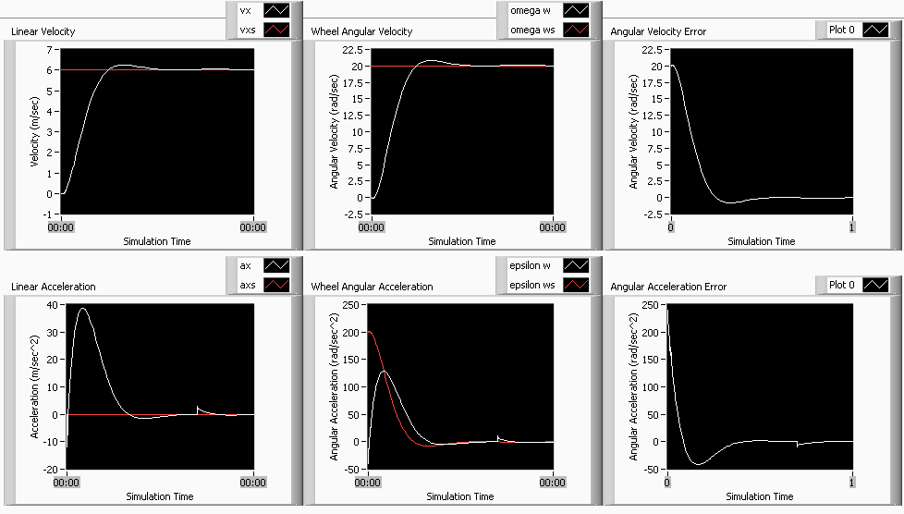
ρ_{w} = 10
k_{w} = 50
I_{w} = 1.5
Rolling res. input = step
Step time = 0.7
Multiplier = 0.5
t_{final} = 1
v_{xs} = 6
r_{w0} = 0.3
R_{x.initial} = 100
F_{frame.x} = 100
W_{w} = 100
Results

Slide 30
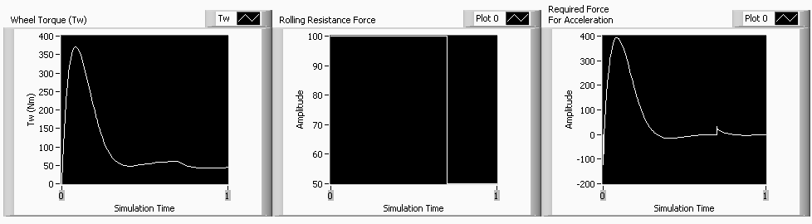
ρ_{w} = 10
k_{w} = 50
I_{w} = 1.5
Rolling res. input = step
Step time = 0.7
Multiplier = 0.5
t_{final} = 1
v_{xs} = 6
r_{w0} = 0.3
R_{x.initial} = 100
F_{frame.x} = 100
W_{w} = 100
Results

Slide 31
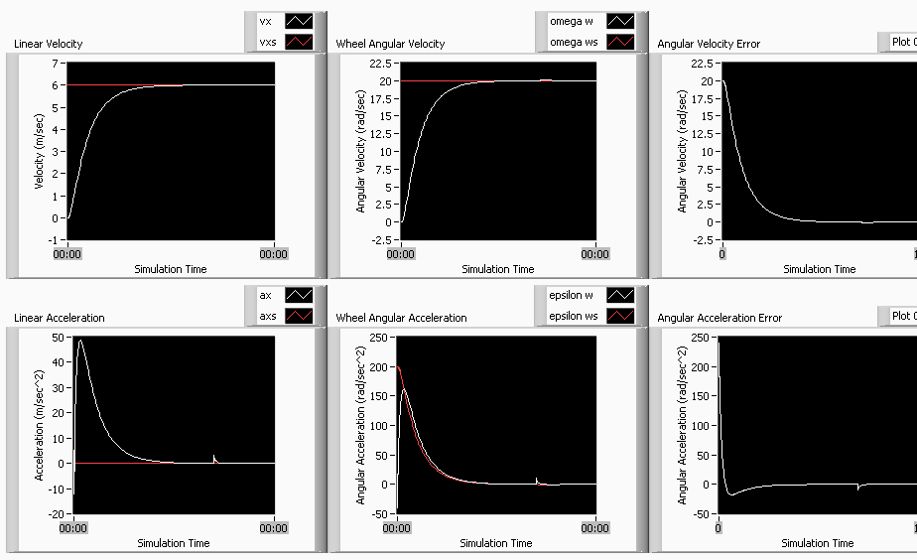
ρ_{w} = 10
k_{w} = 200
I_{w} = 1.5
Rolling res. input = step
Step time = 0.7
Multiplier = 0.5
t_{final} = 1
v_{xs} = 6
r_{w0} = 0.3
R_{x.initial} = 100
F_{frame.x} = 100
W_{w} = 100
Results

Slide 32
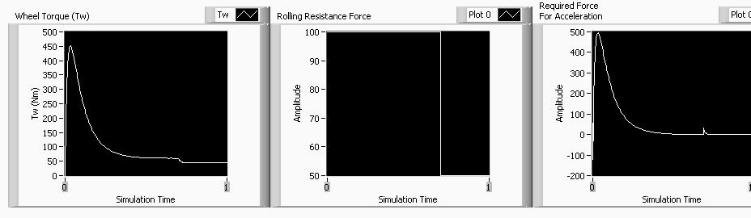
ρ_{w} = 10
k_{w} = 200
I_{w} = 1.5
Rolling res. input = step
Step time = 0.7
Multiplier = 0.5
t_{final} = 1
v_{xs} = 6
r_{w0} = 0.3
R_{x.initial} = 100
F_{frame.x} = 100
W_{w} = 100
Results

