Slide 1




Educating Technicians for the World of Electrified Vehicles
Doug Fertuck
Michigan Electric Vehicle Show and Rally
June 7, 2014

Slide 2
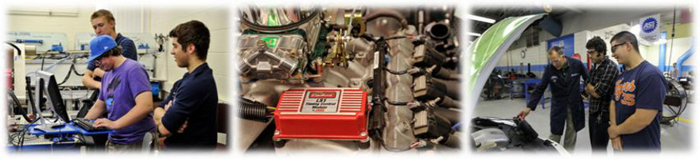
About the Center for Advanced
Automotive Technology (CAAT)
Located at Macomb Community College South Campus
Partnered with Wayne State University
Became an Advanced Technological Education Center in 2010 funded by the National Science Foundation ($2.8M Grant)
Mission
  Advance the preparation of skilled technicians for the automotive industry’s more environmentally friendly and safer vehicles.
  Be a regional resource for developing and disseminating advanced automotive technology education.

Slide 3
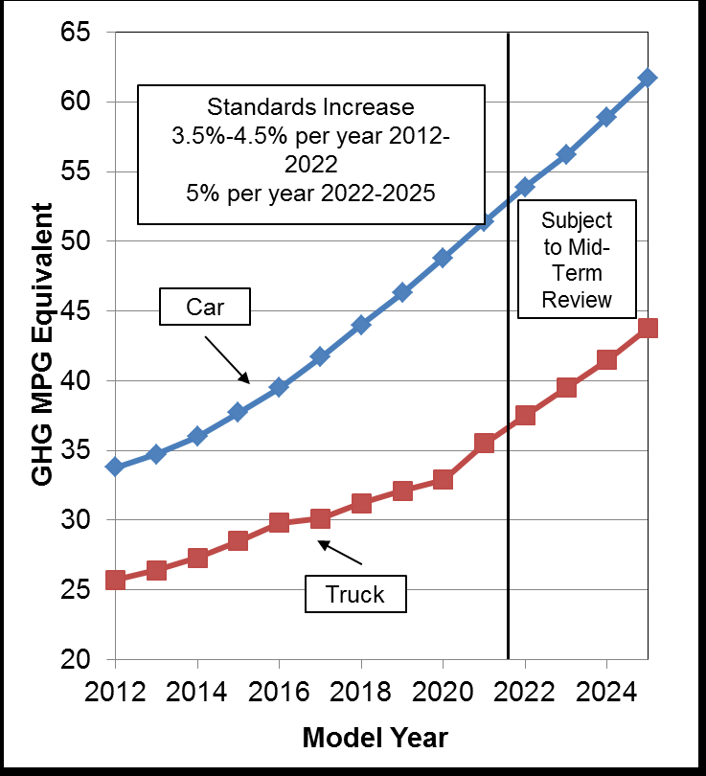
Fuel Economy Standards Getting Tough

Slide 4
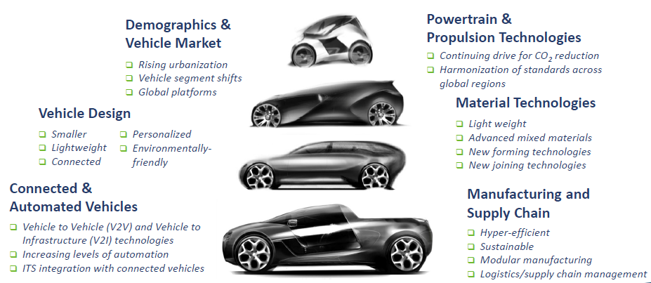
Drivers of the Auto Industry Future within CAAT’s Scope
Source: Automotive Industry Office, Michigan Economic Development Corporation

Slide 5
Overview of Electrified Vehicle Systems
Vehicle Drive System | ICE | Stop/Start Starter | Regener-ative Braking | Starter Generator 36-42v | Motor/ Gen at Flywheel 100-160v | Parallel Electric Motor 200-330v | Series Electric Motor 200-500v | External Battery Charging
Conventional ICE (Int. Combustion Engine) | X
Start/Stop | X | X
Mild HEV (Hybrid Electric Vehicle) | X |  | X | X
Medium HEV | X |  | X |  | X
Full HEV | X |  | X |  |  | X
Plug-In Series HEV | X |  | X |  |  |  | X | X
BEV (Battery Electric Vehicle) |  |  | X |  |  |  | X | X
Note: In parallel systems, power flows from either the ICE or the electric motor or both. In series systems, all power flows from the electric motor.

Slide 6
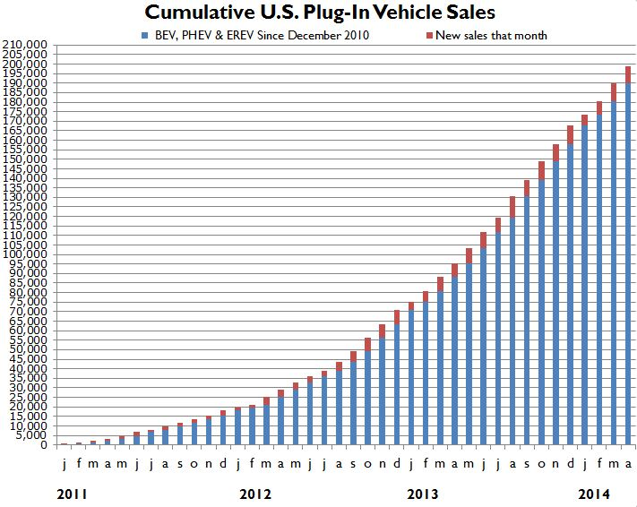
Cumulative US Plug-In Vehicle Sales
Monthly Dashboard of the Electric Drive Vehicle Transportation Association

Slide 7
Future US Plug-In Vehicle Sales
Forecasts vary significantly – and often
Typical is Navigant’s of 250k per year each of BEVs and PEVs by 2023
If realized, such sales levels would put almost 3 million BEVs and PEVs on the road by 2023
History

Slide 8
Do Hybrid and Electric Vehicles Make Sense?
Today
No
Yes
Increase vehicle prices
Internal combustion technologies becoming more energy efficient
May be viewed as unsafe
Recharging of BEVs takes too long
Require expensive plug-in infrastructure to support charging
Reduce greenhouse gases
Offer major reductions in oil dependency
Operate more efficiently and cost effectively
Vehicles now in production perform well and reliably
Reduce emissions at the tailpipe, important in large cities
Government subsidies for consumers may offset initial cost penalties
Future
Require increased R&D spending to realize performance potential
Require increased investment in new technologies and workforce training
May require increased generating capacity
Increase dependency on risky rare earth metals
May be necessary to meet strict future fuel economy standards
Battery costs likely to reduce 5-7% per year over next ten years
Petroleum likely to become more expensive relative to electricity
May be critical in race for global leadership in transportation technologies
Residual value of Li-ion batteries may partially offset initial costs
Technology can be applied to fuel cell vehicles

Slide 9
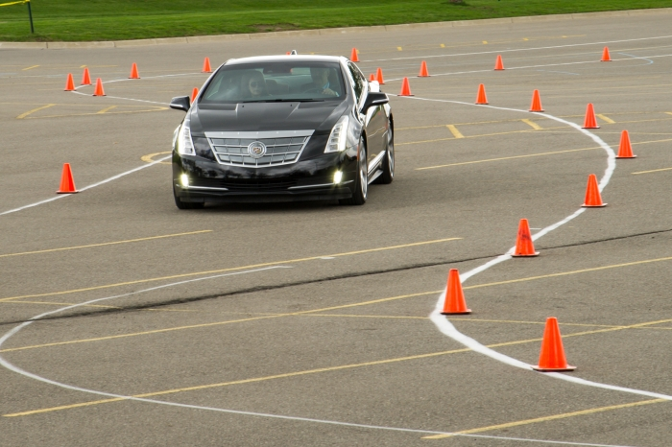
CAAT Electric Vehicle Ride & Drive
Held at Macomb Community College's South Campus on May 2, 2014
Open to the public from 3-8 p.m.
Evaluation Fleet:
  2014 Cadillac ELR
  2014 Chevrolet Volt
  2014 Ford C-MAX Energi
  2014 Ford Focus EV
  2014 Ford Fusion Energi
  2014 Nissan Leaf
  2014 Tesla Model S
  2013 Tesla Model S
  2014 Toyota Prius Plug-in
  2014 Toyota Highlander Hybrid
99% of the 151 ride & drive participants rated the event as “extremely valuable” (79%) or “very valuable” (20%)
65% of respondents indicated their perception of electrified vehicles had changed and 100% of these respondents noted that change was positive

Slide 10



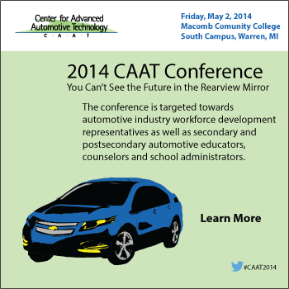
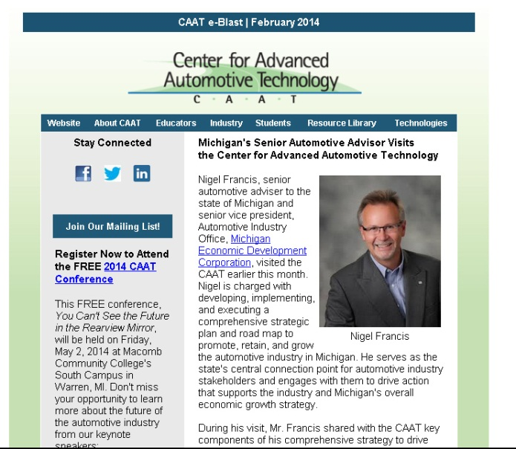
Stay Connected with the CAAT
Visit our website at www.autocaat.org
Follow us on social media
Sign up for our monthly newsletter
Register for one of our webinars
Access materials from our 2014 CAAT Conference

Slide 11
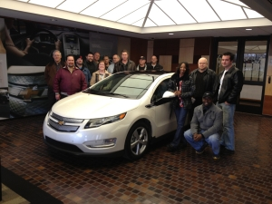
Macomb CC Automotive Programs
Automotive Technology Program
  NATEF Certified Automotive Training
  Manufacturer Programs
    GM ASEP
    Chrysler CAP
  Hybrid Electric Vehicle / Alternative Fuel Courses
Certificate Options
  Certificate in Automotive Technology
  Electric Vehicle Development Technology Certificate

Slide 12
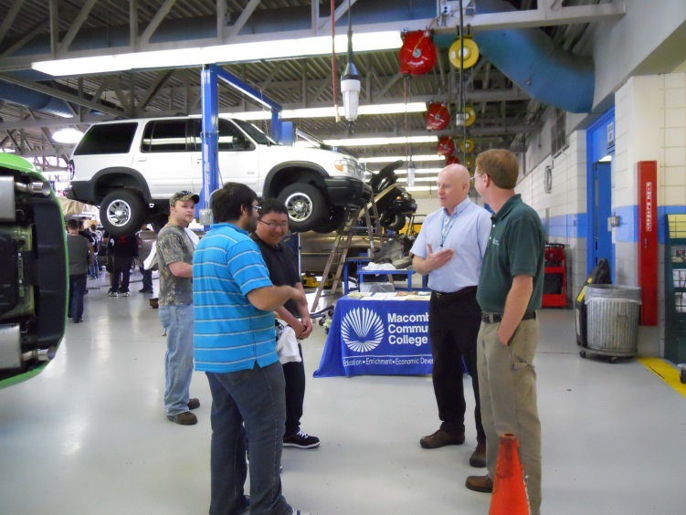
MCC Automotive Programs (Cont’d)
Degree Options
  Associate of Applied Science in Automotive Technology
  Associate of Applied Science in Manufacturing Technology
2+2 Career Pathways
  WSU Bachelor of Science in Electric Transportation Technology

Slide 13
Thank You!
Questions?

