Slide 1
Precision Agriculture Programs & Grants
Presenters:
Larry Everett, Ph.D. - Professor
Coordinator, Precision Agriculture
Susan Everett, Ph.D. - Professor
Coordinator, Agriculture/Horticulture
Arly Drake, Ph.D. – Assistant Professor

Slide 2
Precision Agriculture
What is it?

Slide 3
No plant left behind

Slide 4
Managing assets by the in²
One acre
Area = 209’ X 209’
43,560 ft²
Or 6,272,640 in²
Precision Agriculture Tools allow management decisions for each square inch rather than each field

Slide 5
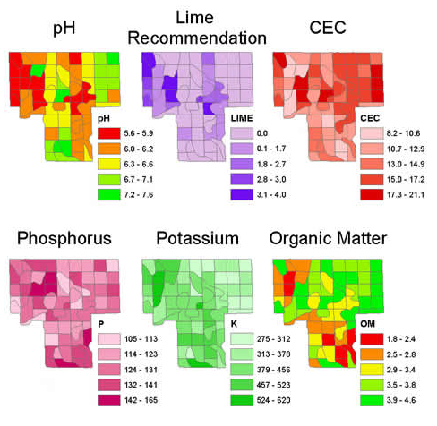
Managing “Uniqueness”
Grid Soil
Sampling

Slide 6
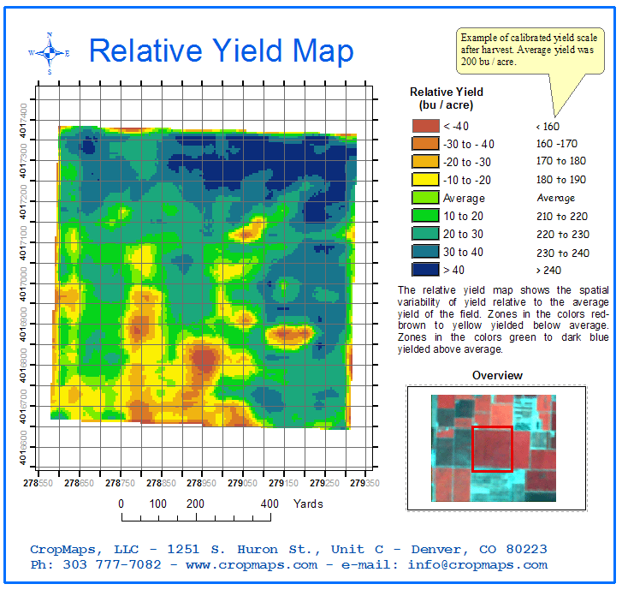
Managing “Uniqueness”
Crop Yield
Map

Slide 7
Develop Planting “Prescriptions”

Slide 8
Monitor Current Conditions

Slide 9
Monitor Current Conditions

Slide 10
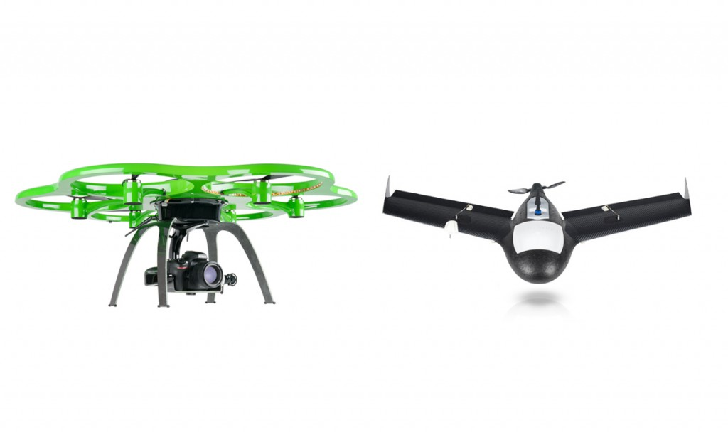
Monitor Current Conditions
UAV Fixed Wing or Rotary Wing

Slide 11
Monitor Current Conditions

Slide 12
Monitor Current Conditions

Slide 13
Treat Only “Problem” Areas

Slide 14
Advantages
Treats the problem before it spreads
Environmental Friendly
Saves Money
Saves Time
Fewer Problems with Residual Effects

Slide 15
State of the Art Equipment

Slide 16
State of the Art Equipment
GPS with repeatable accuracy of < 0.4”
Sensors (and lots of them)
Actuators and Control Devices
Complete integration with other units

Slide 17
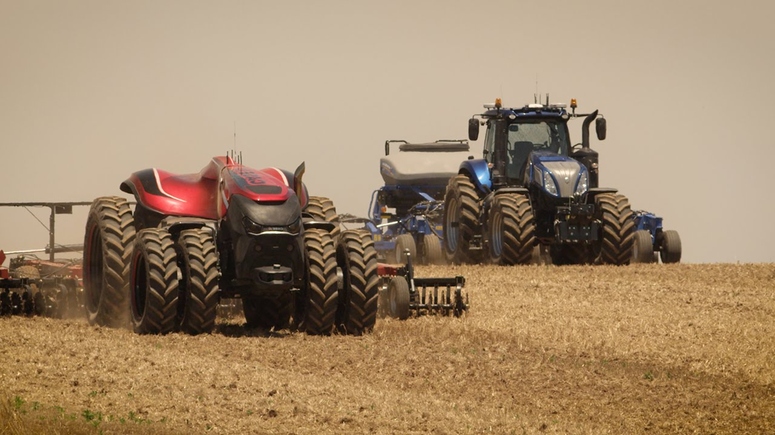
State of the Art Equipment
Where are we going?

Slide 18
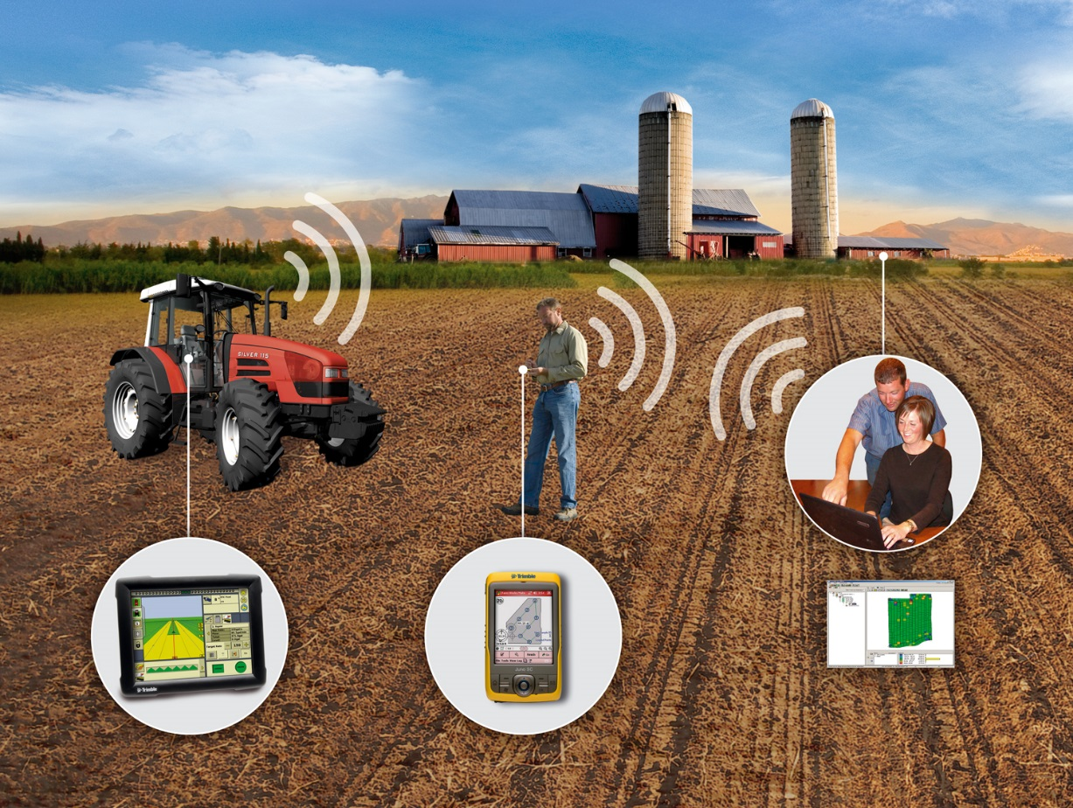
Agriculture
One of Clark State’s initial program offerings
We have 10 programs in Agriculture Including Precision Agriculture

Slide 19
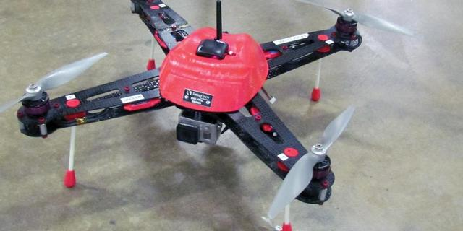
UAS Operations
Clark State received approval for our COA December 2014 (Springfield Airport)
Worked out MOU:
with SelectTech
Ohio/Indiana Test Center
Contracted with a pilot
Started our UAS flights 2015

Slide 20
National Science Foundation Grant
$402,000 – 3 year project
Goals
Develop Precision Ag Technician Degree
Develop Summer Workshops
High School Teachers and Students
Develop Curriculum With
Parkland College – Champaign, Illinois
Ellsworth College – Iowa Falls, Iowa

Slide 21
National Science Foundation Grant
Grant started 1 July 2016
In our first year of operation
Initial workshop for high school teachers 2017

Slide 22
Programming
Focuses on data analytics within precision agriculture
Intro to UAS is only 1 of the courses that the students take
Students also take GIS and Remote Sensing courses
GIS Applications for Agriculture is the capstone course

Slide 23
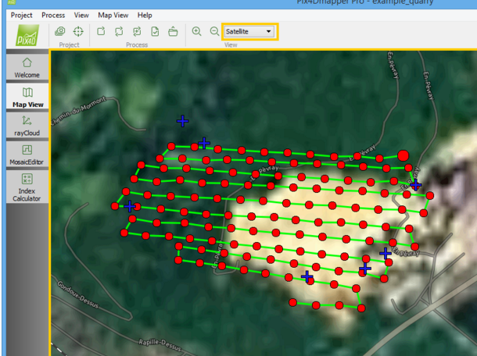
Pix4D

Slide 24
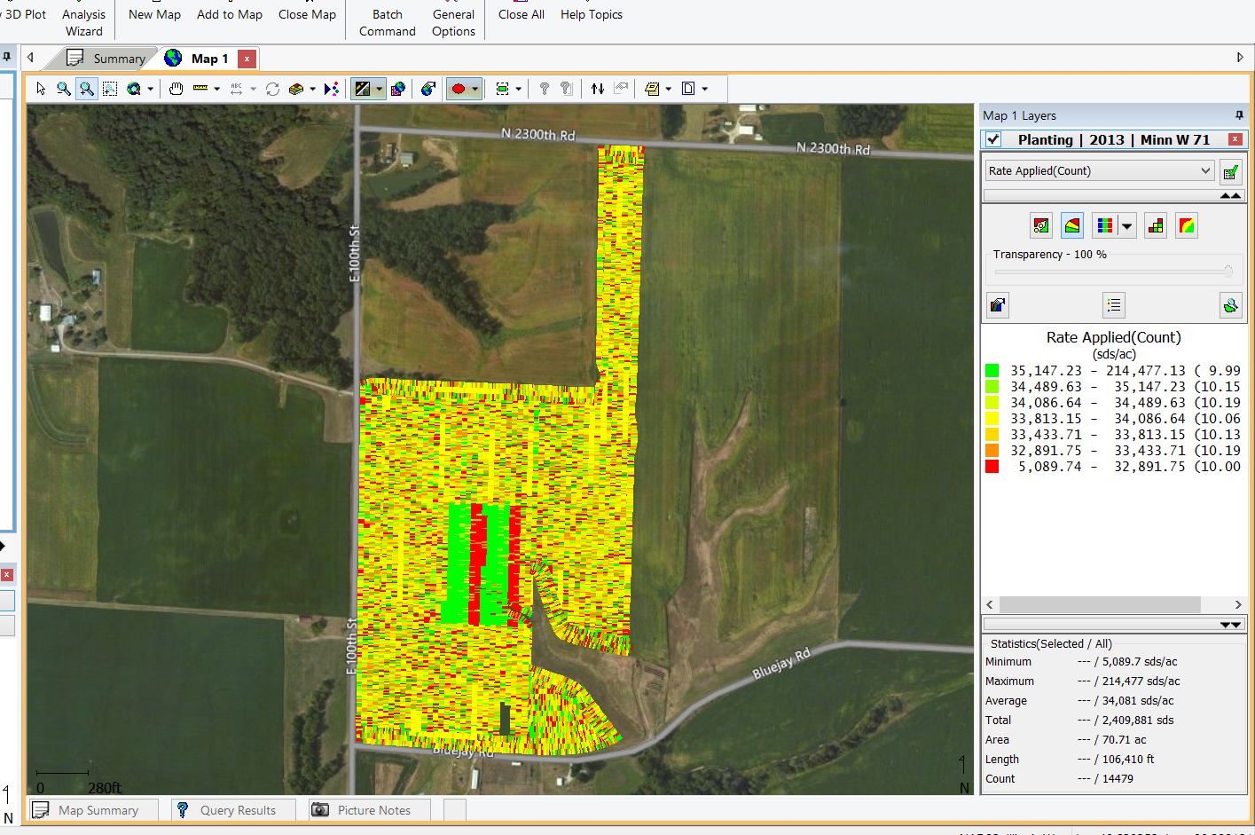
SMS
Students are using data imagery and IR data from UAS and from farm equipment and making recommendations

Slide 25
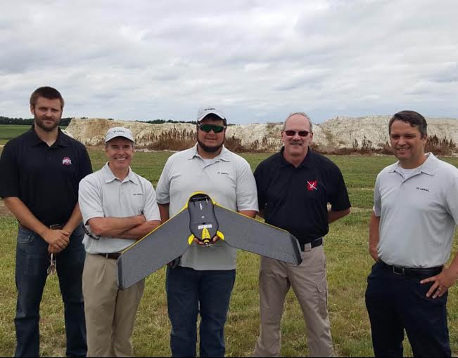
Real World Education
Precision Ag students must also complete a co-op work experience

Slide 26
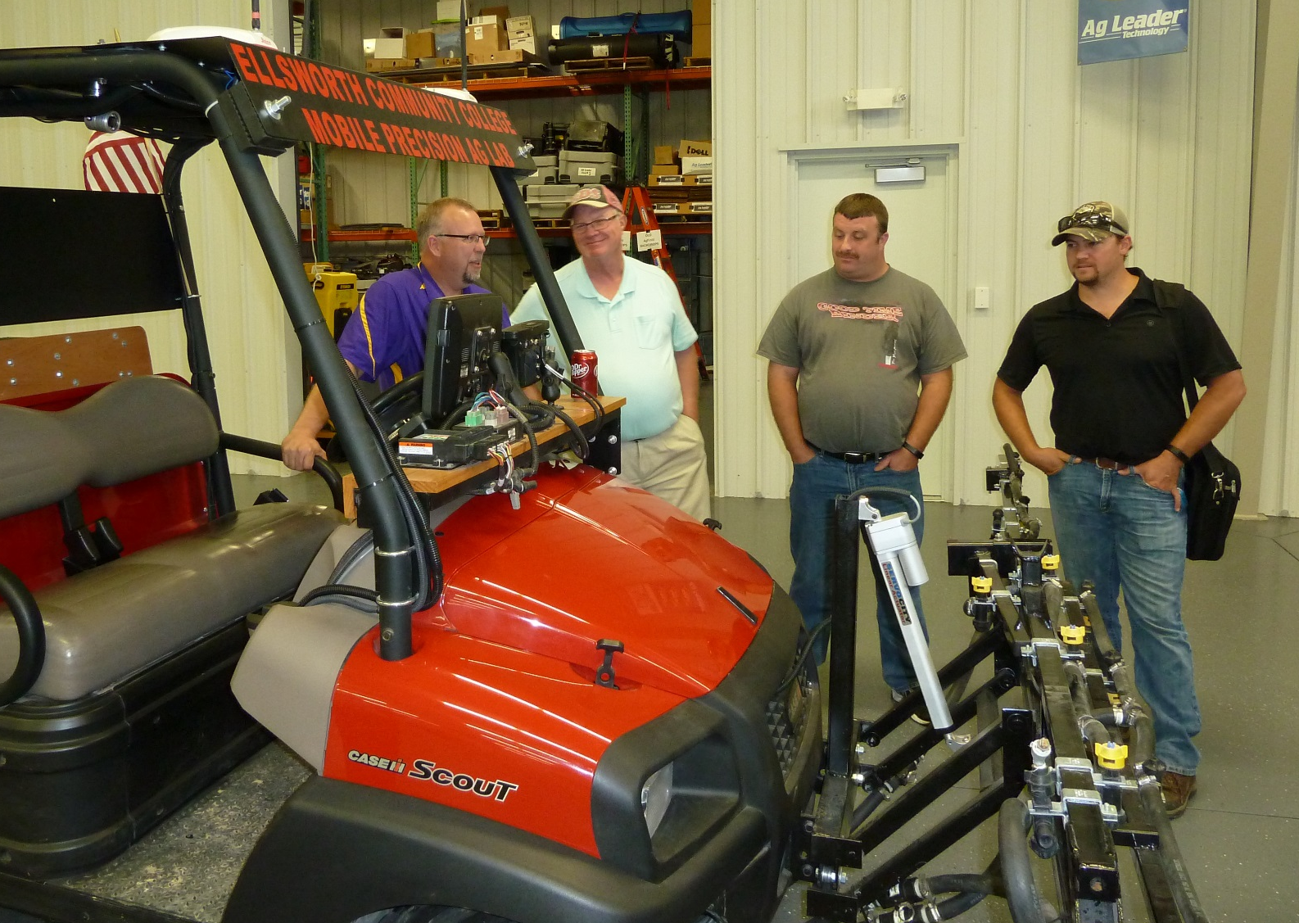
Ellsworth College Partners

Slide 27
Parkland College Partners

Slide 28
Only college in Ohio offering a degree in Precision Agriculture
Also the first to offer a degree in Precision Ag Tech
One of 5 schools east of the Mississippi River

Slide 29
Precision Agriculture Principles are also applicable to:
Animal Production
Natural Resources
Landscape Design
Golf Course Operations
Nursery Operations
Turf and Landscape Operations

Slide 30
Thank You!
Questions?

