Slide 1

Plan, Organize, Submit:
A Look at the ATE Central Archiving Process
Presenters:
Kendra Bouda, ATE Central
Rachael Bower, ATE Central
Webinar:
September 17, 2019
1pm EDT

Slide 2
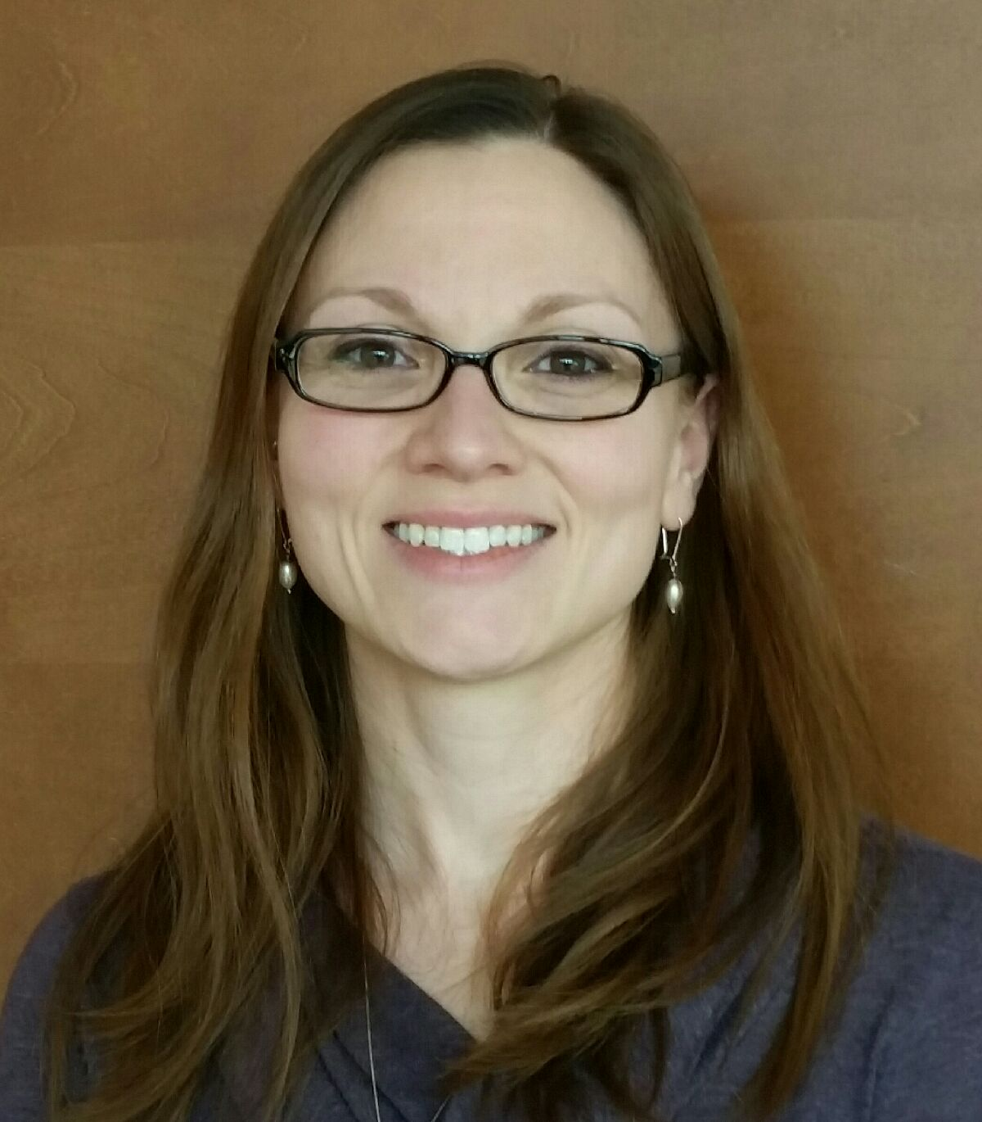
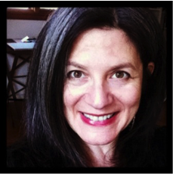
Today’s Presenters
Kendra Bouda
University of Wisconsin, Madison
Metadata and Information Specialist, ATE Central
Rachael Bower
University of Wisconsin, Madison
PI, ATE Central
Notes:
I added “Welcome” to the agenda here – either from Elaine or me ☺
Remind everyone that logistical/computer issues can be directed toward Corey
Quick run through binder

Slide 3
Goal of Today’s Webinar
Our goal is to answer these questions:
What does ATE Central archive?
How do I archive with ATE Central?
What happens after I submit my work?

Slide 4

Poll Question #1
I would describe myself as:
Affiliated with an ATE grant that was funded in or after 2015
Affiliated with an ATE grant that was funded in 2014 or earlier
Not currently funded, but writing an ATE grant
Other
Notes:
Given that we are going to be talking about “mission statements” etc. – should this say mission too or maybe use the word goal or purpose instead?

Slide 5
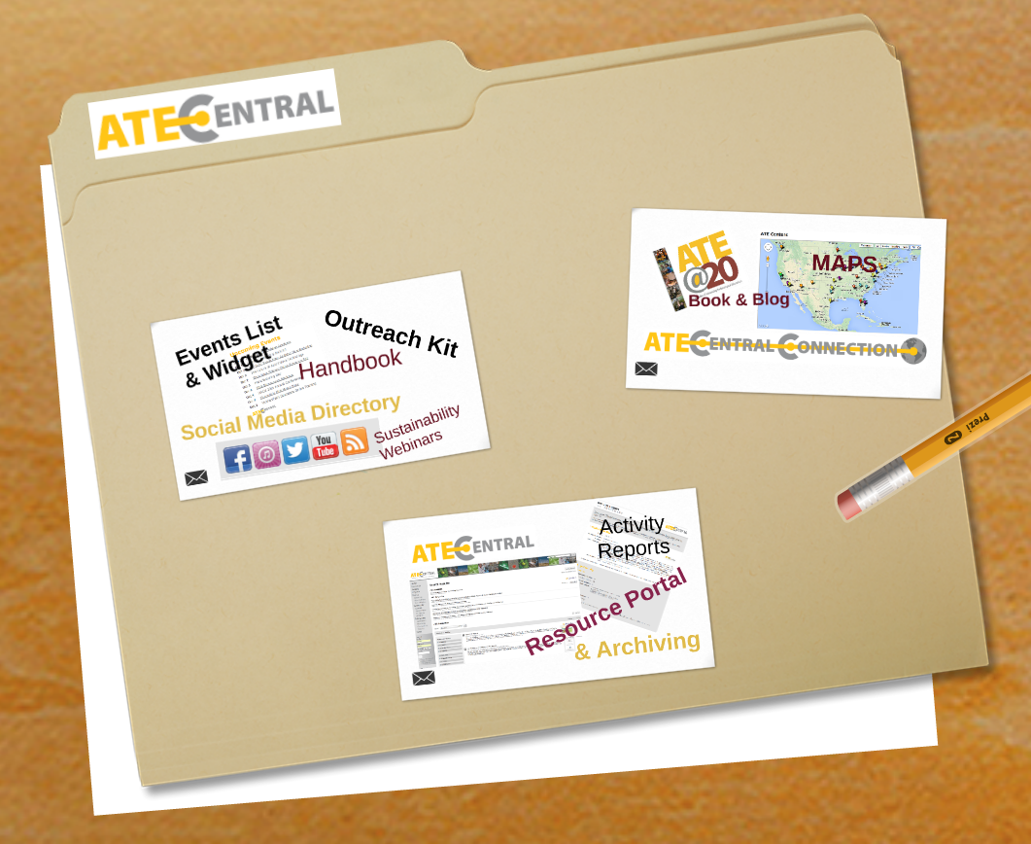
About ATE Central
ATE Central’s primary purpose is to amplify the impact of ATE.
ATE Central offers:
Information hub and portal
Resource collection
Services and tools
Outreach and dissemination
Notes:
I added “Welcome” to the agenda here – either from Elaine or me ☺
Remind everyone that logistical/computer issues can be directed toward Corey
Quick run through binder

Slide 6
About ATE Central: Archiving Support
ATE Central: community driven
ATE Community Needs Survey (2011)
Significant need: sustainability support
Workshops + webinars
Community driven service
Sustainability and data management planning
Webinars, archiving guidelines, and other support materials
Notes:
I added “Welcome” to the agenda here – either from Elaine or me ☺
Remind everyone that logistical/computer issues can be directed toward Corey
Quick run through binder

Slide 7
What is the ATE Central archive?
The ATE Central archive is a virtual space where deliverables and select administrative documents are collected, stored, and made available in a digital format.

Slide 8
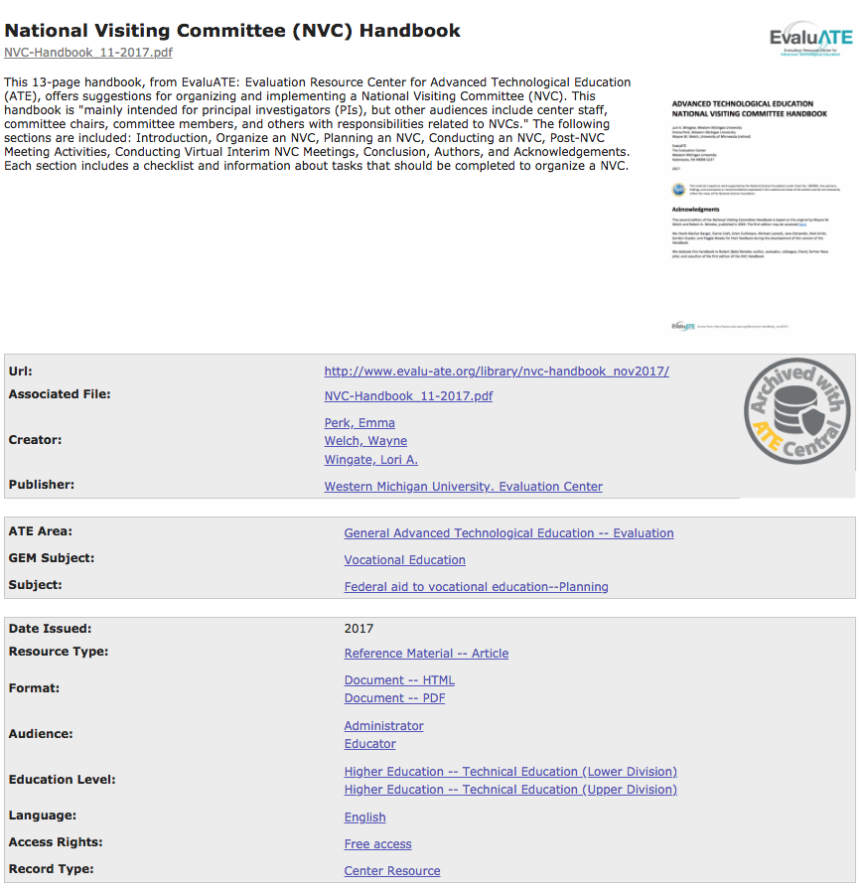
What is an archived resource?

Slide 9
What does the NSF ATE RFP say?
  New grantees who apply and are awarded funding under solicitation NSF 14-577 [NSF 17-568, NSF 18-571] are required to archive their deliverables, as described in their initial grant proposals, with ATE Central.
  These deliverables are to be in a digital and archivable format; with any intellectual property information clearly displayed.

Slide 10
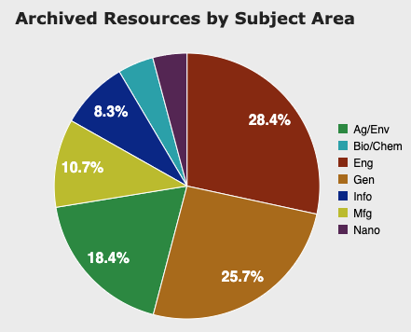
What does ATE Central archive?
Deliverables might include:
  Assessment, instructional, reference, and professional development materials
  Samples (e.g. research reports, best practices, manuals and guides, and surveys)
  Administrative (e.g. internal reports and datasets)

Slide 11
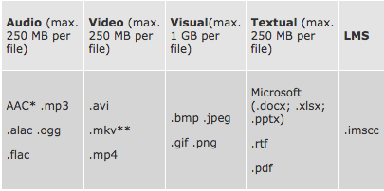
What formats are recommended?
Digital and archivable formats must meet format standards and max. file sizes

Slide 12
What license does NSF suggest?
Intellectual property information must be affixed to the work
Recommended licenses include:
  Attribution
  Attribution ShareAlike
  Attribution-NonCommercial- ShareAlike

Slide 13
Poll Question #2
I would say that I am:
Seeking information on archiving, either for grant writing purposes or to simply be better informed
Planning to archive with ATE Central within the next year
Ready to archive with ATE Central
Other
Notes:
Given that we are going to be talking about “mission statements” etc. – should this say mission too or maybe use the word goal or purpose instead?

Slide 14
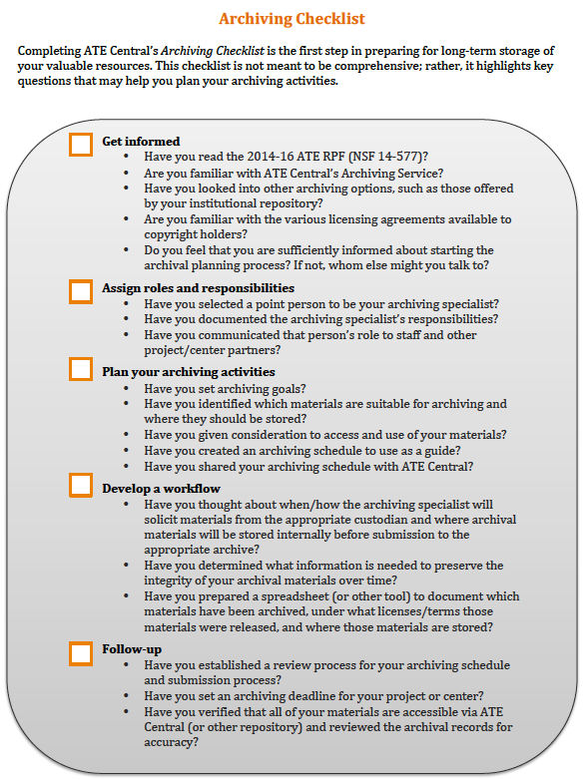
Check Out Our 2017 Webinar
  Get informed
  Assign roles and responsibilities
  Plan your archiving activities
  Develop a workflow
  Follow-up
Visit https://atecentral.net/webinars for our 2017 webinar Archiving with ATE Central - The Basics

Slide 15

Questions so far?
Notes:
Given that we are going to be talking about “mission statements” etc. – should this say mission too or maybe use the word goal or purpose instead?

Slide 16
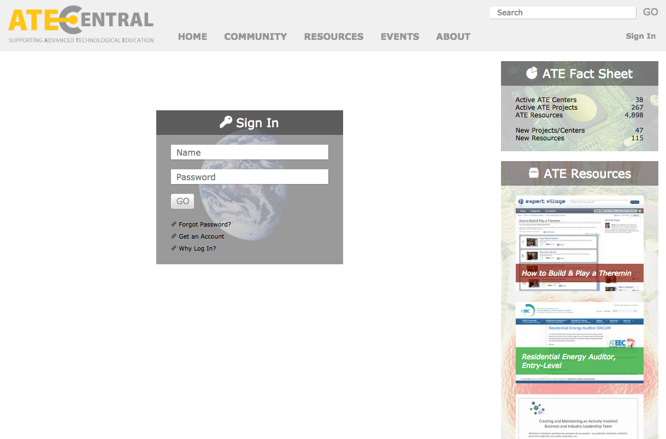
Submitting Materials
Sign in
to your account or create a new account

Slide 17
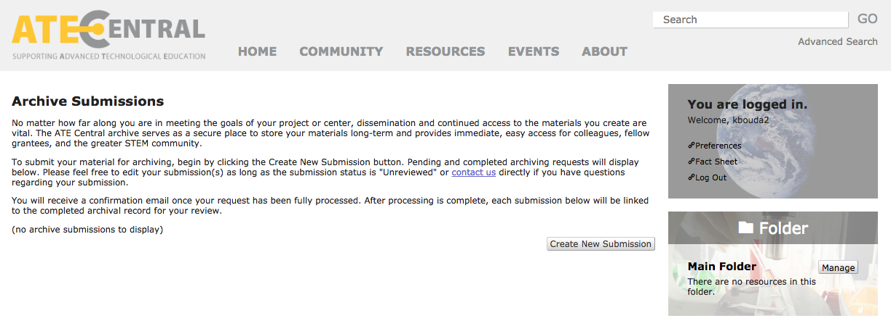
Submitting Materials (cont’d)
https://atecentral.net/archiving/submissions

Slide 18
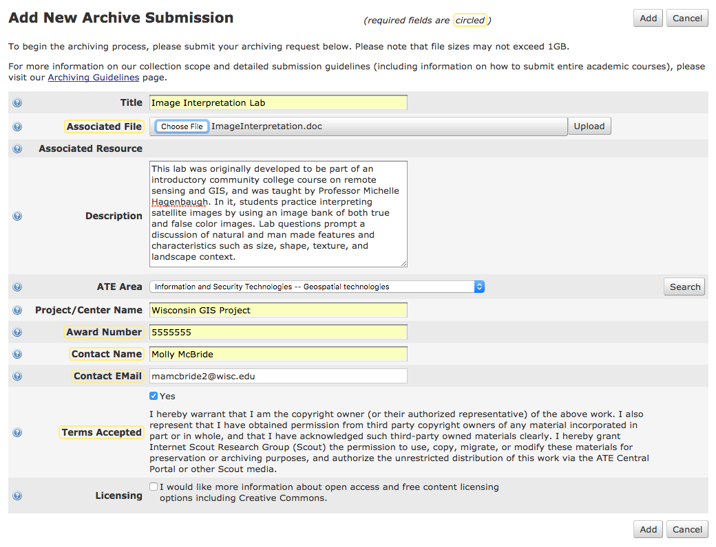
Submitting Individual Resources

Slide 19
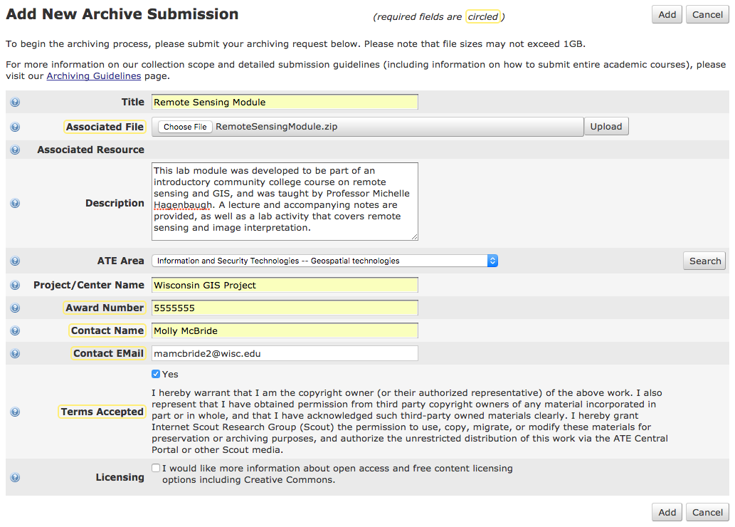
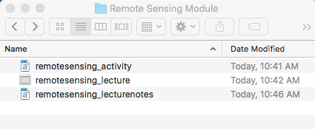
Submitting Related Resources

Slide 20
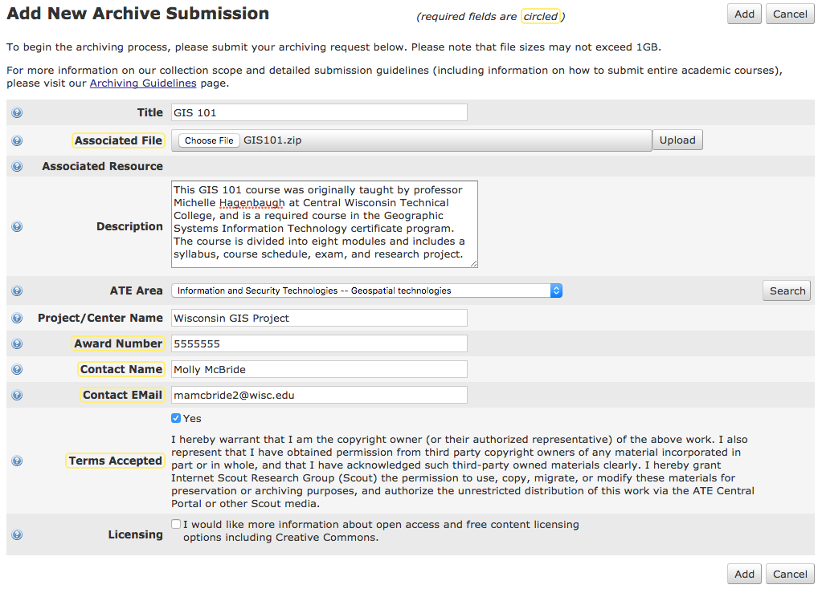
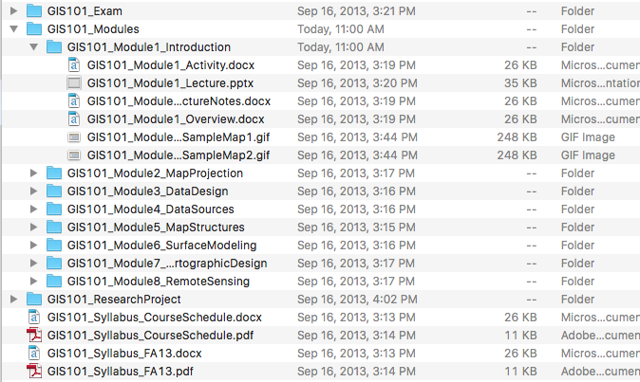
Submitting Academic Courses

Slide 21
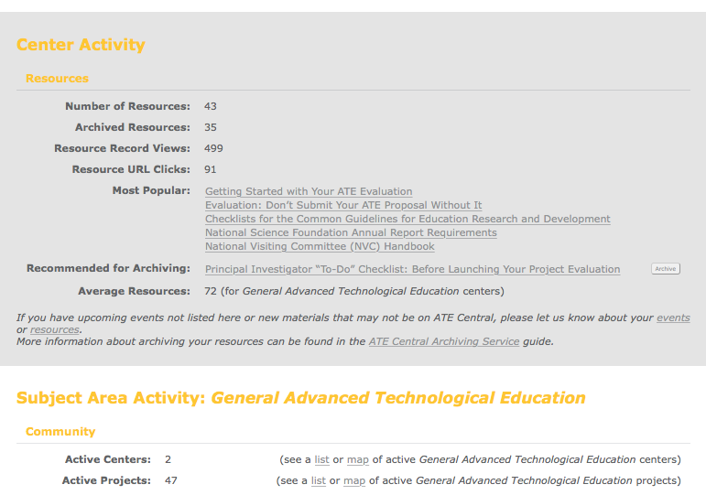
Submitting via Your Activity Report
Click the new Archive button in your Activity Report for easy submission

Slide 22
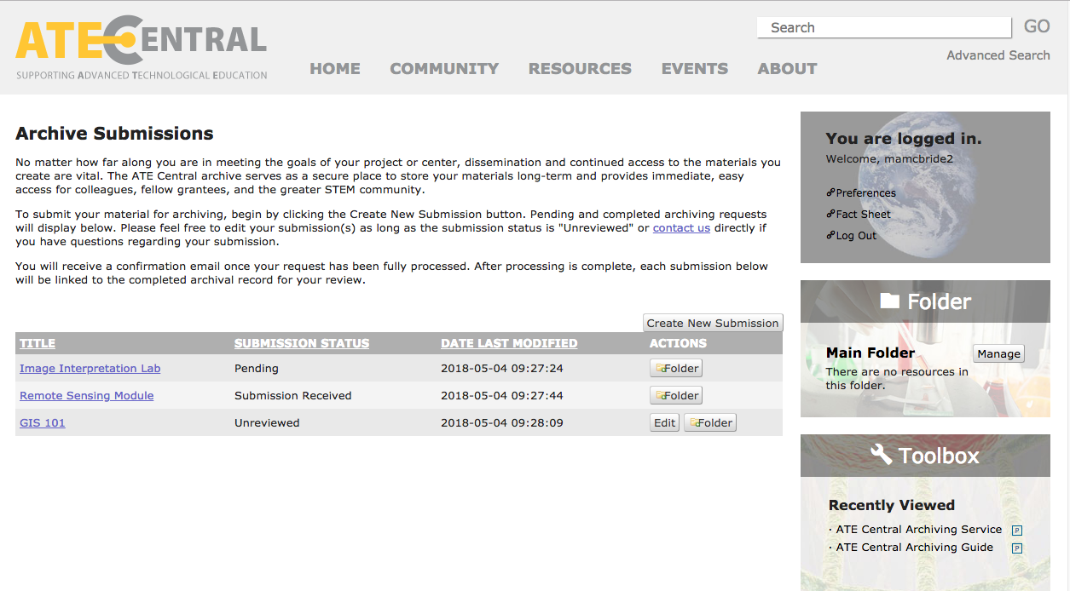
Tracking Your Submission

Slide 23
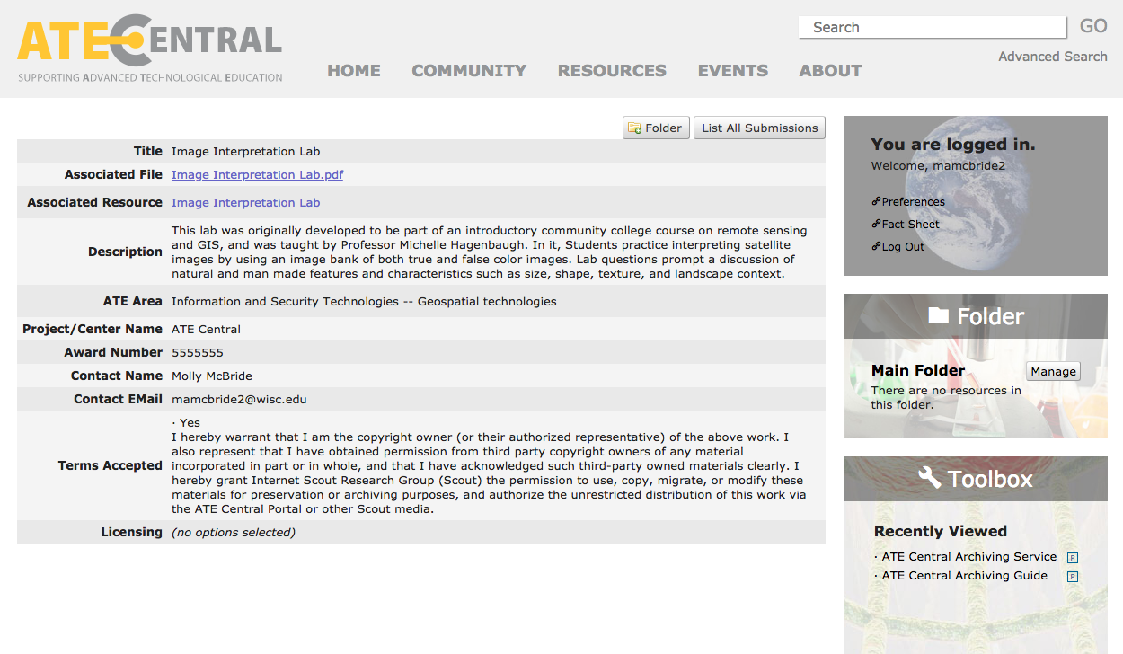
Tracking Your Submission (cont’d)

Slide 24
Questions so far?
Notes:
Given that we are going to be talking about “mission statements” etc. – should this say mission too or maybe use the word goal or purpose instead?

Slide 25
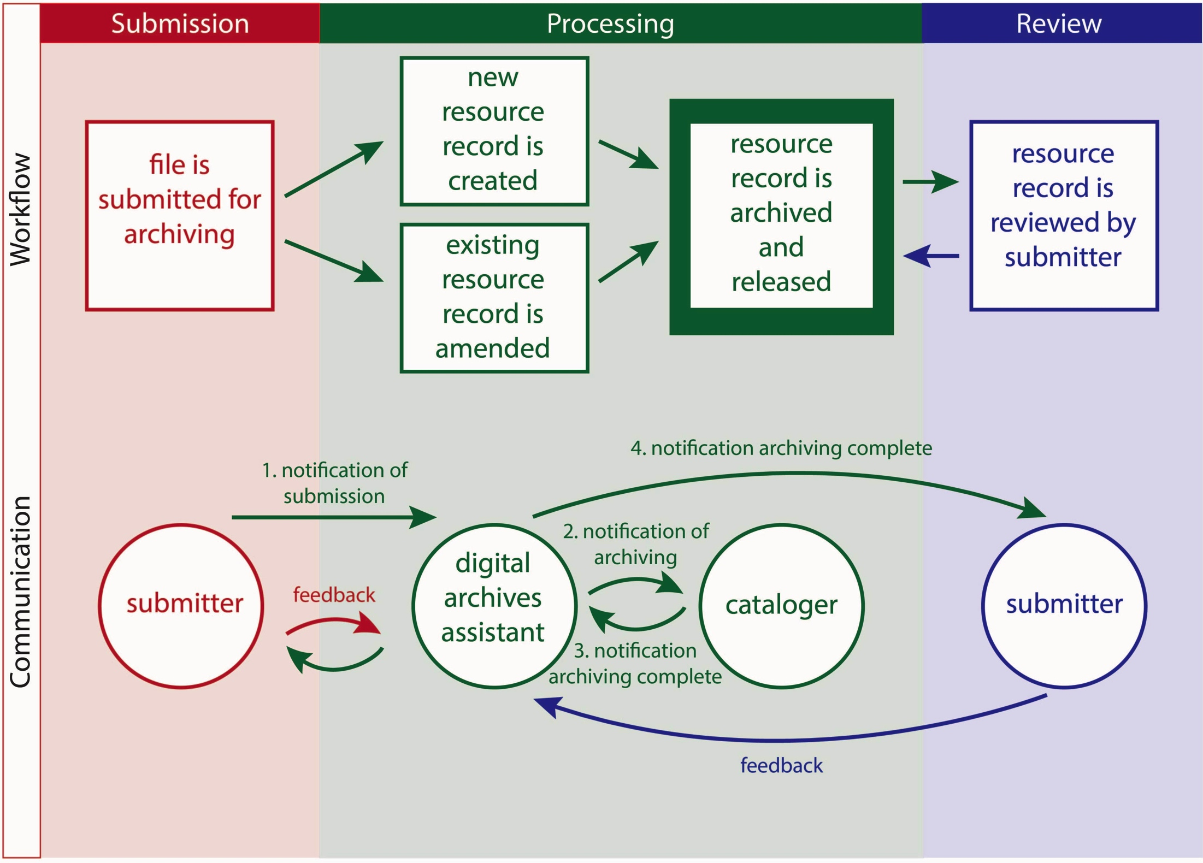
What happens after I submit?

Slide 26
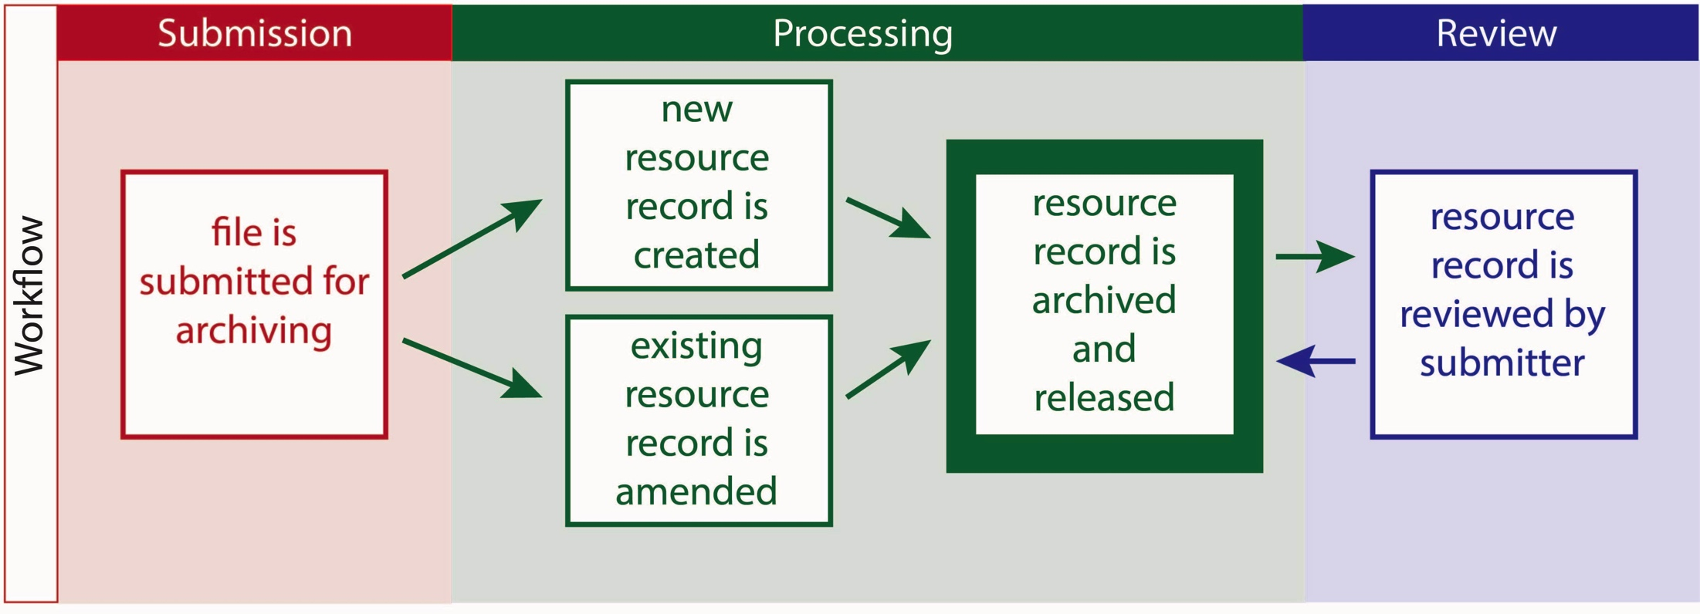
Our Workflow
  Submission: A file is submitted by the project/center
  Processing: A resource record is created/amended and archived by ATE Central staff
  Review: The newly archived resource record is reviewed by the project/center
    sssss

Slide 27

Processing: Metadata Added
  Title
  URL
  File(s)
  Series/Relation
  Creator/Publisher
  Description
  ATE Area/GEM/Subject
  Date
  Resource Type/Format/Language
  Audience/Audience Refinement
  Education Level/Pedagogy
  Rights/Access Rights/Content License
  Screenshot
…and more

Slide 28
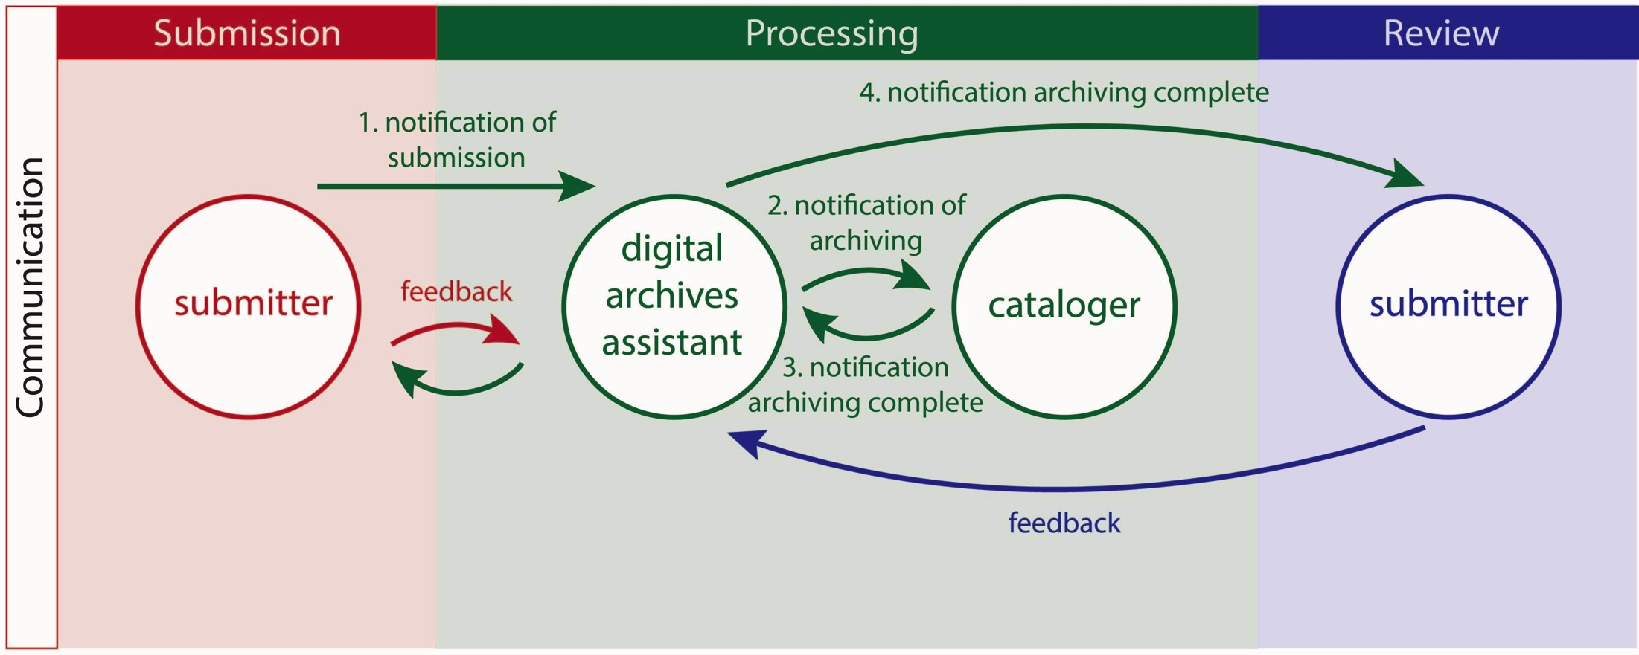
Communication Process

Slide 29
Questions?
Notes:
Given that we are going to be talking about “mission statements” etc. – should this say mission too or maybe use the word goal or purpose instead?

Slide 30
Poll Question #3
Now that I am more familiar with the archiving process, I’d like more information on or help with (select all that apply):
Preparing materials for archiving (i.e. formatting, etc.)
Addressing licensing and IP issues
Finding licensed ATE materials for my own use
All of the above
Other
Notes:
Given that we are going to be talking about “mission statements” etc. – should this say mission too or maybe use the word goal or purpose instead?

Slide 31

Where do I find more information?
About ATE Central services:
https://atecentral.net/archiving
https://atecentral.net/archivingguide
https://atecentral.net/arguide
https://atecentral.net/sustainability
ALSO…
About copyright and licensing:
http://www.copyright.gov
http://creativecommons.org/licenses
Visit us at the
ATE PI Meeting (Oct 23 & 24)
Booth #001

Slide 32
Thank you!
Please feel free to contact us with questions or comments at:
Kendra Bouda, kbouda@atecentral.net
Rachael Bower, bower@atecentral.net
PLEASE TAKE OUR SURVEY!

