Slide 1



Composite Recycling Technician Education Program
Module 1: Lecture 1
Module 1 – Overview on Materials Recycling
Lecture 1 – A Brief Introduction to Composites

Slide 2
A Brief Introduction to Composites
Module 1: Lecture 1
Objectives:
    Learn how to define composites.
    Understand the difference between ancient, modern and advanced composites.
    Understand different classification of composite materials.
    Learn the advantages and disadvantages of composites.
    Understand the application of composites and where composites are used
    Gain an understanding of the composite market and the future of composites.

Slide 3
A Brief Introduction to Composites
Module 1: Lecture 1
At the end of this lecture you will be able to:
    Define composites
    Identify the differences between ancient, modern and advanced composites.
    Describe types of composite materials classifications.
    Explain the advantages and disadvantages of composites.
    Identify where composites are used
    Describe the state of the composite market and the future of composites.

Slide 4


What are Composites?
Module 1: Lecture 1
Composites Defined
  Two or more different materials that when combined exhibit greater physical properties than any one of the individual materials.
"Boeing 748 Dreamliner" by Tomoaki INABA is licensed under CC BY 4.0
"Carbon Fiber Curves" by Janak Raja is licensed under CC BY 4.0
Notes:
What are composites? Composites is an interesting term because it does not refer to a specific material or process. Rather, it refers to the resulting combination of differ materials or constituents in which the each of the constituents remain separate and distinct in the final structure, and in which the final structure exhibits greater physical properties than any of the individual materials. Or, to put it more simply, composites are two or more different materials that when combined exhibit greater physical properties than any of individual materials.
The component materials don’t completely blend or lose their individual identities; they combine and contribute their most useful traits to improve the outcome or final product. Composites are typically designed with a particular use in mind, such as added strength, efficiency or durability.

Slide 5
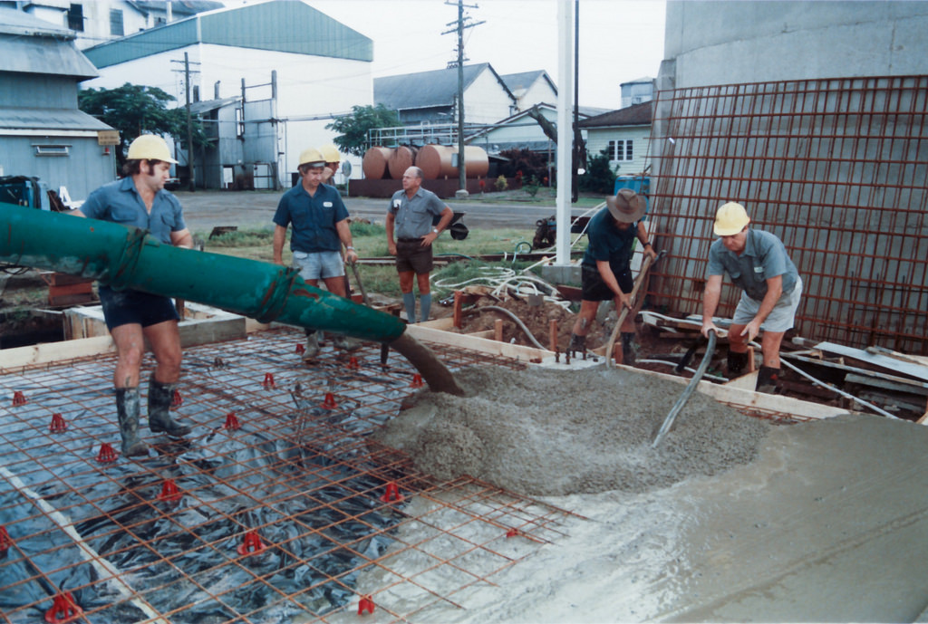
A Concrete Example
Module 1: Lecture 1
A simple example
"Concrete Floor" by srv007 is licensed under CC BY 4.0
Notes:
Typical composites consist of two or more different components or materials. Let’s take a look at some composites that you are already familiar. Take for example a concrete structure. There is two materials, the concrete and the rebar. The concrete is the matrix, and the rebar is the reinforcement.

Slide 6
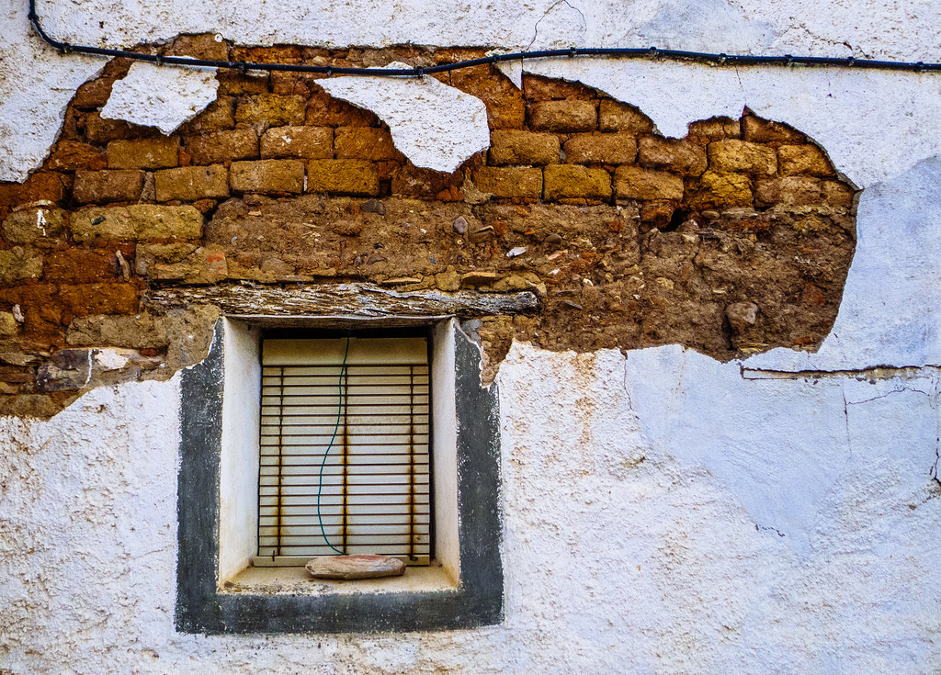

Composites Examples
Module 1: Lecture 1
The Adobe Brick
A Granola Bar
"Time Window" by Walimai.photo is licensed under CC BY 4.0
Natural or Synthetic Materials
Matrix transfers the load
Matrix protects the reinforcement
The reinforcement provides strength
"Homemade Granola Bars" by Mariam is licensed under CC BY 4.0
Notes:
Composites can be made from natural materials or synthetic materials (or a combination of both). Historically, the adobe brick is perhaps the oldest composite material, consisting of a matrix (the mud) and the reinforcement (the straw). Even a granola bar can be considered a composite. Fruits and grains are the reinforcement and the honey or syrup is the matrix. The purpose of the matrix is to transfer the load between the reinforcements and to protect the reinforcement. And the purpose of the reinforcement is to provide strength. Ancient Egyptians used composite bricks in the construction of the pyramids.

Slide 7

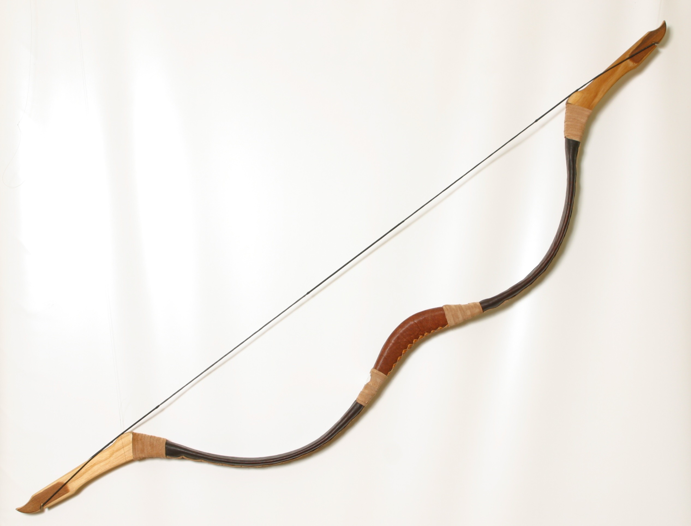
A Mongolian Warriors Bow
Module 1: Lecture 1
http://www.viahistoria.com/SilverHorde/main.html?MongolArchery.html
https://www.classic-bow.com/store/traditional-mongolian-recurve-bow-ti-107.html
Notes:
In the 12th century A.D., Mongol warriors used composite materials (bamboo, silk, sinew, tendons and horns or bone, and pine resin) to craft archery bows that were lighter, more responsive and more powerful than any other bow. The Tendons were placed on the tension (outer) side and sheets of horn on the compression (inner) side of the bow over a core of bamboo or birch. Silk was tightly wrapped around it and sealed with pine resin. Testing performed on the remaining bows which are over 900 years old, showed that they were nearly as strong as modern bows, accurate and could hit targets 490 yards away. The layers of material provided all the desired characteristics for a bow, each one providing its own physical characteristic and performance quality to the bow.

Slide 8
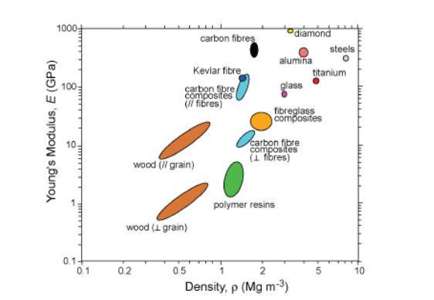
Composite Classifications
Module 1: Lecture 1
Ancient Composites
Modern Composites
Advanced Composites
Elastic Modulus of composite materials compared to traditional materials (Young’s Modulus vs. Density)
"Ashby property map (Young's Modulus against Density) for composites" by University of Cambridge is licensed under CC BY-NC-SA 4.0
Notes:
Our last examples were of Ancient Composites, and there is another general classification of composites that is called Modern Composites. Modern composites consist the incorporation of synthetic materials into the construction of parts, resulting in higher strength to weight advantages. Consider this chart and the comparison of different materials (both traditional and composite) and their density to Young’s modulus. Young’s modulus describes tensile elasticity, or the tendency of an object to deform along an axis when opposing forces are applied along that axis. Or the modulus can be defined as the ratio of tensile stress to tensile strain. It is often referred to simply as the elastic modulus.

Slide 9

Advanced Composites
Module 1: Lecture 1
Higher physical properties
Advanced processing techniques
  Reinforcements
  Carbon Fiber
  Aramids
  Nomex ®
Honeycomb Coring
Higher end resins
Prepreg
Oven Cures
Notes:
Our third classification of composites is Advanced Composites. Advanced composites is a classification for composites constructed with materials that have higher physical properties and utilized advanced processing techniques. This includes incorporating a combination of carbon fiber, aramids (Kevlar®) and Nomex® as reinforcements, honeycomb coring, epoxy and other high end resin systems, laminating with prepreg (reinforcement pre-impregnated with epoxy resin, B-stage cured and frozen and held in status until ready to use), and higher temperature oven curing (including autoclave curing).

Slide 10
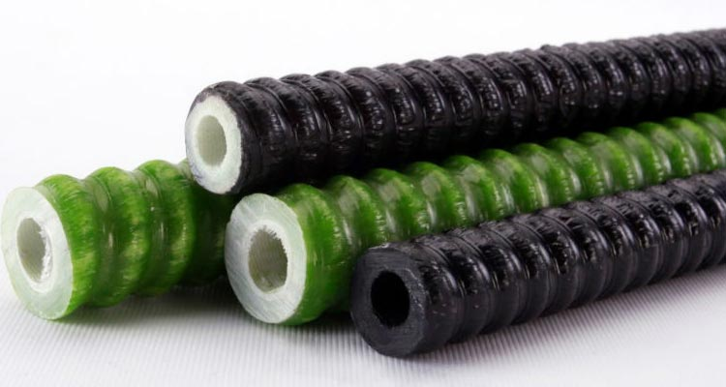
The Main Advantage of Composites
Module 1: Lecture 1
Lightweight
High Strength to Weight Ratio
http://compositesmanufacturingmagazine.com/2013/10/lighter-stronger-hollow-rebar-coming/
Notes:
As you have learned, composites tend to be lightweight and have an impressive strength to weight ratio as compared to traditional materials. For example, if you have a length of traditional rebar at a specific diameter and compared it to a composite piece of rebar (made from fiber reinforced plastic, FRP) at the same size, the traditional rebar would be stronger. But, if you made it to match in weight, the composite rebar would be significantly stronger. It has a greater strength to weight ratio than traditional rebar. This strength to weight ratio provides a strong economic incentive to use composite parts in transportation since reduction in weight is directly linked to better fuel economy.

Slide 11
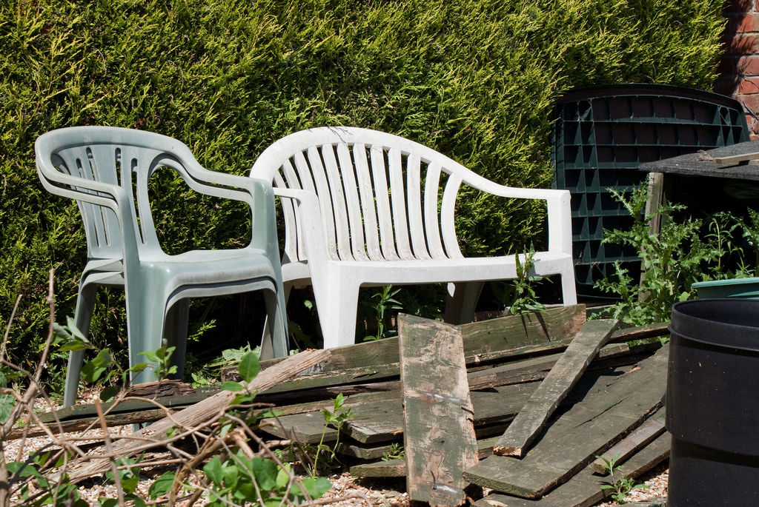
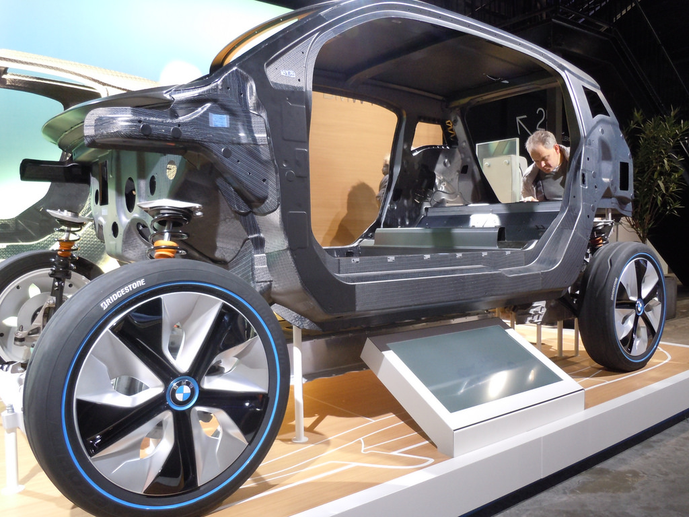
More Composite Classifications
Module 1: Lecture 1
Based upon matrix phase
  Thermoplastic
    Can be reheated and reformed
    Easily recycled
  Thermoset
    Crosslinked
    Is irreversible
    More difficult to recycle
"Carbon Fiber Reinforced Plastic" by LunchboxLarry is licensed under CC BY-NC-SA 4.0
"Plastic Chair" by Pleasence is licensed under CC BY-NC-SA 4.0
Notes:
Composites can also be put into two classifications based upon their matrix phase. The two classifications are thermoplastic and thermoset. Thermoplastic plastics or resins can be reheated after they have hardened, be reformed, or heated to a liquid state and reformed, and they are easily recycled. You are probably familiar with common thermoplastics you find in your home. Polyethylene, acrylic, nylon and polystyrene. Thermoset resins are resins that start as liquids, are initiated or catalyzed which causes the crosslinking of polymer chains (polymerization or esterification). This crosslinking is not easily reversible, and it is because of the crosslinking that thermoset resins cannot be melted, reshaped or reformed, and are difficult to recycle.

Slide 12
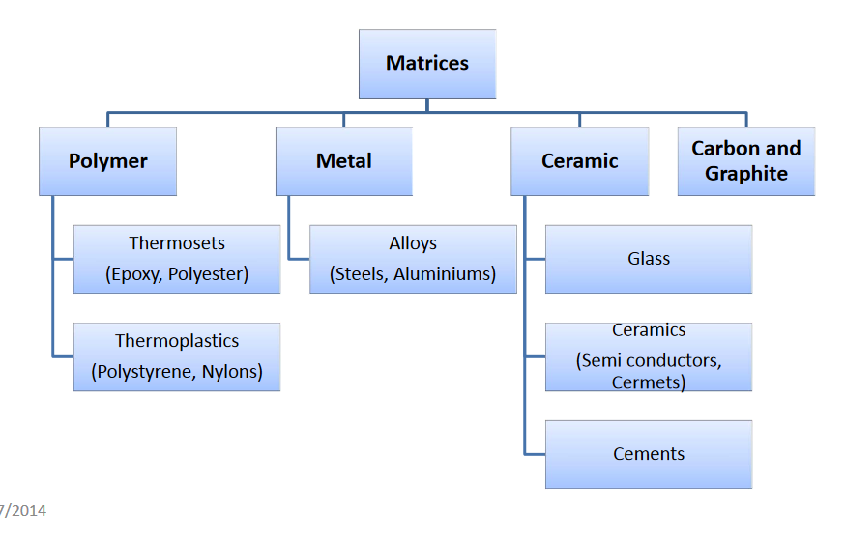
More Composite Classifications
Module 1: Lecture 1
  Based on the Matrix phase
    PMC’s – Polymer Matrix Composites
    CMC’s - Ceramic Matrix Composites
    MMC’s - Metal Matrix Composites
Notes:
Like we said before, classification can be based on the matrix used in the composite and can be classified as thermoplastic or thermoset. These can be organized according to their matrix phase. These classifications are polymer matrix composites (PMCs), ceramic matrix composites (CMC’s) and metal matrix composites (MMCs). It should be noted that materials within these categories are sometimes referred to as "advanced" if they combine the properties of high longitudinal strength values and high longitudinal stiffness values, with low weight, corrosion resistance, and in some cases specified electrical properties.

Slide 13
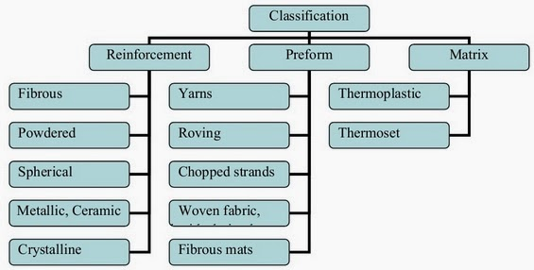
More Composite Classifications
Module 1: Lecture 1
Based on the Structural Components (the reinforcement)
  Fiberous
  Laminar
  Particulate
    Flake
    Skeletal
Notes:
We can also classify composites on the category of their structural components (the reinforcement) and the matrix. Composites can be classified based on the structural components used as, such as:
1) Fibrous (composed of fibers in a matrix) composites
2) Laminar (composed of layers of materials) composites
3) Particulate (composed of layers of materials ) composites
Particulate composites can be further subdivided into,
1. Flake ( flat flakes in a matrix)
2. Skeletal (composed of a continuous skeletal matrix filled by Second material).

Slide 14
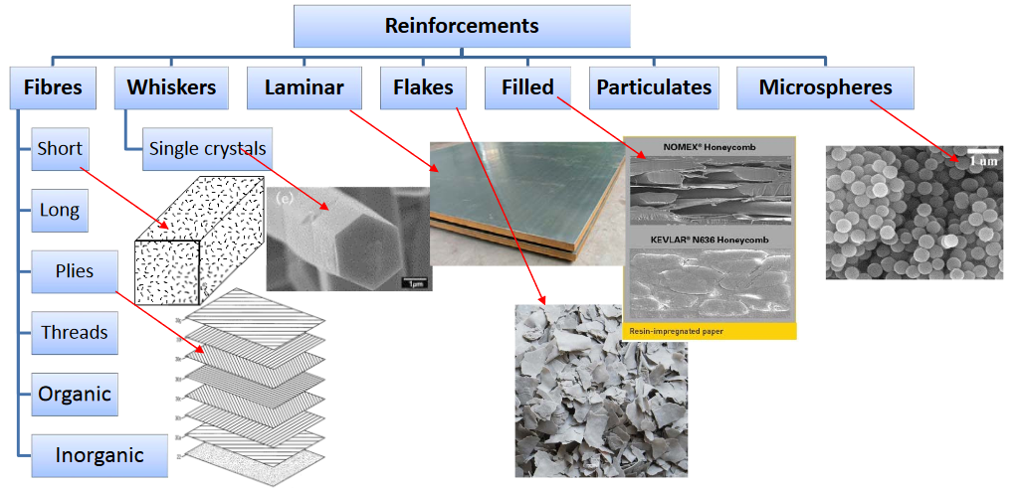
More Composite Classifications
Module 1: Lecture 1
Notes:
The type, distribution, size, shape, orientation, and arrangement of the reinforcement will determine the properties of the composite material and its anisotropy.

Slide 15
Where Composites are Used
Module 1: Lecture 1
Aerospace
Appliances/Business
Automotive/Transportation
Infrastructure
Energy
Architecture/Construction
Recreational and Consumer Products
Pipes and Tanks/Corrosion Resistant Equipment
Electrical
Marine
Notes:
Let’s take a look at where composites are used. They are a surprisingly prevalent number of composite products that we use everyday. FRP (Fiber Reinforced Plastic) composites are no longer considered "space-age" materials utilized only for stealth bombers and space shuttles. This versatile material system has become a part of everyday life.
Aerospace Commercial, pleasure and military aircrafts, including components for aerospace and related applications.
Appliance/Business Composite applications for the household and office including appliances, power tools, business equipment, etc.
Automotive/Transportation The largest of the markets, products include parts for automobiles, trucks, rail, ships, containers and farm applications. The lightweight nature and strength to weight characteristics lead to fuel savings.
Infrastructure A relatively new market for composites, these applications include the repair and replacement of civil infrastructure including buildings, roads, bridges, piling, etc.
Energy Composites are used throughout energy production industries, esp.: Wind Energy. The lightweight features of composite allows for the large (and growing) size of wind turbine blades.
Architecture/Construction Includes materials for the building of homes, offices, and architectural components. Products include swimming pools, bathroom fixtures, wall panels, roofing, architectural cladding.
Recreational and Consumer Products These include sports and recreational equipment such as golf clubs, tennis rackets, snowmobiles, skies, mobile campers, furniture, microwave cookware.
Pipe and Tank/Corrosion-Resistant Equipment Products for chemical-resistant service such as tanks, ducts and hoods, pumps, fans, grating, chemical processing, pulp and paper, oil and gas, and water/wastewater treatment markets.
Electrical This encompassing market includes components for both electrical and electronic applications such as pole line hardware, substation equipment, microwave antennas, printed wiring boards, etc.
Marine Products for commercial, pleasure and naval boats and ships. Composites perform well in harsh salt water conditions.

Slide 16
Advantages of Composites
Module 1: Lecture 1
Strength
  Specific Strength (strength to weight)
  Tensile Strength
    Flexural Strength
  Shear Strength
  Compressive Strength
  And………
Notes:
Specific Strength
A material’s strength-to-weight ratio – also called its specific strength – is a comparison of its strength in relation to how much it weighs. The strength of a material divided by its density will give you the specific strength.
Engineers, designers and specifiers are increasingly seeking materials with a high specific strength. Some materials are very strong and heavy, such as steel. Other materials can be strong and light, such as bamboo poles. Composites can be designed to be both strong and light. Because they have very high strength-to-weight ratios, composites are an appropriate material for applications where weight is paramount, such as airplanes and cars. Lighter vehicles and planes use less fuel.
Tensile Strength
Tensile strength refers to the amount of stress a material can handle before it breaks, cracks, becomes deformed or otherwise fails.
One measure of tensile strength is flexural strength – a material or structure’s ability to withstand bending. Tensile strength varies by material and is measured in megapascals (MPa). For example, the ultimate tensile strength of steel ranges from 400 to 690 MPa, while the ultimate strength of carbon fiber reinforced polymer composites ranges from 1,200 to 2,410 MPa, depending on fiber orientation and other design factors.
Shear Strength
Shear strength describes how well a material can resist strain when layers shift or slide.
It’s important to know the maximum amount of shear stress (or force per unit area) a material can handle prior to failure. This lets engineers and designers know the amount of weight – or load – a structure can support and what may happen to the structure when forces are applied in different directions.
Shear strength in composites varies based on the formulation and design. Composites can be designed so shear stresses are oriented within a plane, transverse to the plane or throughout the layers (interlaminar). There are several ways to control shear properties, including fiber orientation, the sequencing of layers, the type and volume of fibers used, the type and density of core materials and more.
Compressive Strength
Compressive strength indicates how a material performs when it’s compressed or flattened by pressure.
Some materials fracture or break when they hit their compressive strength limit, while others deform permanently.
Materials such as concrete and ceramics usually have a higher compressive strength, but lower tensile strength. Conversely, composites typically have higher tensile strengths than compressive strengths. Composites loaded in compression may buckle, kink or crush. That’s why it’s important to evaluate compressive loading for the specific fiber and resin combination chosen for an application and adjust the formulation accordingly.

Slide 17
Advantages of Composites (cont.)
Module 1: Lecture 1
Lightweight
Corrosion Resistance
Part Consolidation
Dimensional Stability
Design Flexibility
Durability
Radar Transparency
Low Thermal Conductivity
Resistance to Fatigue
Can be combined with other materials to achieve other properties (damping, dielectric or conductive, fire resistance, etc).
Cost
….and much more.
Notes:
Light Weight - Composites are light in weight, compared to most traditional materials. Their lightness is important in automobiles and aircraft, for example, where less weight means better fuel efficiency (more miles to the gallon). People who design airplanes are greatly concerned with weight, since reducing a craft’s weight reduces the amount of fuel it needs and increases the speeds it can reach.
Corrosion Resistance - Composites resist damage from the weather and from harsh chemicals that can eat away at other materials. Composites are good choices where chemicals are handled or stored. Outdoors, they stand up to severe weather and wide changes in temperature. Composites do not rust. There are many examples of glass fiber reinforced polymer ductwork being in service in chemical manufacturing plants for more than 25 years, operating in harsh chemical environments 24 hours a day, seven days a week. Composites offer corrosion-resistant solutions for many industries, including air pollution control, chemical processing, desalination, food and beverage, mineral processing and mining, oil and gas, pulp and paper, solid waste landfill and water and wastewater treatment.
Corrosion resistance is determined by the choice of resin and reinforcement used within the composite application. There are various resin systems available which provide long-term resistance to nearly every chemical and temperature environment. The choice of reinforcements is much more limited but crucial for certain chemical environments. Properly designed composites have a long service life and minimum maintenance.
Part Consolidation - A single piece made of composite materials can replace an entire assembly of metal parts. Reducing the number of parts in a machine or a structure saves time and cuts down on the maintenance needed over the life of the item.
Dimensional Stability - Composites retain their shape and size when they are hot or cool, wet or dry. Wood, on the other hand, swells and shrinks as the humidity changes. Composites can be a better choice in situations demanding tight fits that do not vary. They are used in aircraft wings, for example, so that the wing shape and size do not change as the plane gains or loses altitude.
Design Flexibility - Composites can be molded into complicated shapes more easily than most other materials. This gives designers the freedom to create almost any shape or form. Most recreational boats today, for example, are built from fiberglass composites because these materials can easily be molded into complex shapes, which improve boat design while lowering costs. The surface of composites can also be molded to mimic any surface finish or texture, from smooth to pebbly.
Durable - Structures made of composites have a long life and need little maintenance. We do not know how long composites last, because we have not come to the end of the life of many original composites. Many composites have been in service for half a century.
Radar Transparent - Radar signals pass right through composites, a property that makes composites ideal materials for use anywhere radar equipment is operating, whether on the ground or in the air. Composites play a key role in stealth aircraft, such as the U.S. Air Force’s B-2 stealth bomber, which is nearly invisible to radar.
Low Thermal Conductivity - Composites are good insulators—they do not easily conduct heat or cold. They are used in buildings for doors, panels, and windows where extra protection is needed from severe weather.
Nonconductive - Composites are nonconductive, meaning they do not conduct electricity. This property makes them suitable for such items as electrical utility poles and the circuit boards in electronics. If electrical conductivity is needed, it is possible to make some composites conductive.
Nonmagnetic - Composites contain no metals; therefore, they are not magnetic. They can be used around sensitive electronic equipment. The lack of magnetic interference allows large magnets used in MRI (magnetic resonance imaging) equipment to perform better. Composites are used in both the equipment housing and table. In addition, the construction of the room uses composites rebar to reinforced the concrete walls and floors in the hospital.
Lightweight and Easy Installations - One of the top advantages of using lightweight composites is that they are simple to handle, transport and install. This saves time on projects. Wolf Trap National Park in Virginia installed a pedestrian bridge with FRP decks in 2012. The bridge was 80 percent lighter than a concrete one, making it faster to lift, move and place by crane. The deck was installed in three days, while a concrete one would’ve taken at least four weeks. Lightweight composites also simplify installations in remote locations, such as utility poles in marshlands or pipelines on mountains.
Reduced Costs - Lighter parts and products often save money. And saving on weight and cost is music to the ears of many end users. NASA and Boeing recently tested an all-composite cryogenic tank used to carry fuel on deep space missions. The tank, one of the largest and lightest ever manufactured, is the latest step toward the planned 8.4-meter tank that could reduce the weight of rocket tanks by 30 percent and cut launch costs by at least 25 percent.
Adherence to Standards - Composites are often the answer when applications need to meet specific standards and regulations. The most notable example relates to fuel efficiency. Within the automotive industry, meeting Corporate Average Fuel Efficiency (CAFE) standards of 36.6 mpg by 2017 and 54.5 mpg by 2025 provides impetus for using lightweight materials. Major OEMs have optimistic plans – often involving composites – to drastically reduce the gross weight of vehicles. In 2013, GM introduced the Chevrolet Silverado Cheyenne concept vehicle featuring some carbon fiber-reinforced parts. It’s approximately 200 pounds lighter than the base curb weight of the 5.3L Silverado. Volkswagen created the Transporter, a utility concept truck weighing just 3.5 tons. It saves on diesel consumption and carbon dioxide emissions by providing 40 percent more payload and up to 30 percent savings in shipments.
Innovative Geometries - One of the biggest benefits of composites is the ability to mold them into complicated shapes more easily that most other materials. Intricate shapes and contours are possible without the need for high-pressure tools because composites are formed when the resin cures – or solidifies – during production. So composite parts can easily take on many shapes, whether they’re created in low volumes manually or manufactured using high-volume, automated processes.
Having options when it comes to the shape of parts and products is advantageous for nearly every industry that uses composites. Recreational boats have long been built with FRP composites because these materials can be easily molded into complex shapes, which improve boat design while lowering costs. More recently, high-profile buildings such as the San Francisco Museum of Modern Art have incorporated FRP cladding panels into their facades. None of the 700 undulating panels on the museum are alike, which makes for an eye-catching building.
Resistant to Fatigue - Composites are strong, allowing them to withstand repeatedly applied loads. This is particularly important for infrastructure applications such as bridge decks, which support traffic 24 hours a day. Many of the nation’s deteriorating bridges are being renovated with FRP decks, including the Broadway Bridge in Portland, Ore. Spanning the Willamette River in the heart of the Portland Harbor, the drawbridge handles 30,000 vehicles per day in addition to pedestrian traffic.
The first all-composite bridge in the United States – the No Name Creek span in Kansas – was installed nearly 20 years ago. It’s still in service and shows no signs of damage.
In 1963, a composite gasoline tank was buried at a service station in Chicago. When it was dug up 25 years later, the tank was in good condition, showing no signs of leakage, structural distress or corrosion. Experts predicted the tank could’ve lasted another 25 years. equipment to perform better. Composites are used in both the equipment housing and table. In addition, the construction of the room uses composites rebar to reinforced the concrete walls and floors in the hospital.
Cost – Initial costs may be higher due to material costs and the cost of labor. But, given the lifespan of the part, the reduced amount of maintenance and/or replacement, and, efficiencies and savings gained because of being lightweight, composites are cost effective in the long run.

Slide 18
Disadvantages of Composites
Module 1: Lecture 1
Not often environmentally friendly.
Low recyclability.
Cost can fluctuate.
When damaged, repair can be difficult or complex
Anisotropic properties.
Matrix degrades
Low reusability.
Delamination
High Cost
Complex Fabrication
Damage inspection
Composite to metal joining
Notes:
Not often environmentally friendly – depending upon the resin system used (in a production setting). Styrene emissions can be an issue. Thermoset resins are difficult to recycle, which has its own environmental cost.
Low recyclability. – Reuse can be difficult and processing costs of thermoset resins can be high.
Cost can fluctuate - Depending on the price of oil
When damaged, repair can be difficult or complex – Training can be extensive, and tools required to replicate the manufacturing process can be expensive.
Anisotropic properties – The final materials are not homogeneous. Inspection can be more difficult and although this allows great design flexibility, there is not known or published standards of strength values. With the multitude of variations in design, strength is customized taking into consideration and advantage of the anisotropic properties.
Matrix degrades – Matrixes can degrade. With additives and the proper resin choices, this degradation can be minimized. UV inhibitors is a common additive.
Low reusability – Largely due to the permeance of a thermoset bond
Delamination - Since composites are often constructed of different ply layers into a laminate structure, they can "delaminate" between layers where they are weaker.
Cost – The cost of materials can be high compared to traditional materials.
Complex Fabrication - The fabrication process is usually labor intensive and complex, which further increases cost.
Damage inspection - Delamination and cracks in composites are mostly internal and hence require complicated inspection techniques for detection.
Composite to metal joining - Metals expand and contract more on variations in temperature as compared to composites. This may cause an imbalance at joinery and may lead to failure.

Slide 19
Composites Now & In the Future
Module 1: Lecture 1
Since 1960, the U.S. composites industry has grown 25 times
The global composites end product market is expected to reach $113.2 billion by 2022, according to market research firm Lucintel.
In the US, more advanced than competitors abroad
More than 6,000 composite manufacturing plants and material distributors across the US
Over 125,000 employed
Additional 230,000 employed in business that support composites
The Future is Bright!
Notes:
The future is bright! Since 1960, the U.S. composites industry has grown 25 times, whereas the steel industry has only grown 1.5 times and the aluminum industry is three times larger, according to market research firm Lucintel.

Slide 20
Summary
Module 1: Lecture 1
In this lecture you have learned:
The definition of composites.
    Two or more different materials that when combined exhibit greater physical properties than any one of the individual materials.
Historically composites can be divided into three categories
  1) Ancient Composites 2) Modern Composites and 3) Advanced
  Composites
The purpose of the matrix and the reinforcement
  The Matrix transfers the load and protects the reinforcement. The reinforcement provides strength
That the primary advantage to composite is that they are lightweight and have a high strength to weight ratio.
That if you classify composites according to the matrix phase, composite matrixes can be either thermoplastic or thermoset.

Slide 21
Summary
Module 1: Lecture 1
In this lecture you have learned:
And if you classify composites Based on the Structural Components (the reinforcement) the classifications are:
  Fiberous
  Laminar
  Particulate
    Flake
    Skeletal
That the type, distribution, size, shape, orientation, and arrangement of the reinforcement will determine the properties of the composite material and its anisotropy.

Slide 22
Summary
Module 1: Lecture 1
In this lecture you have learned:
  The advantages and disadvantages of composites.
  Can you list them?
  That the composite market and the future of composites is growing and supports a vast array of jobs and that demand for skilled technicians is strong.
Advantages | Disadvantages
1) | 1)
2) | 2)
3) | 3)
4) | 4)
5) | 5)
6) | 6)
7) | 7)

Slide 23
Module 1: Lecture 2
Composite Recycling Technician Education Program
Module 1 – Overview on Materials Recycling
Lecture 2 – Waste vs. Scrap

Slide 24
Scrap vs. Waste
Module 1: Lecture 2
Objectives:
Learn appropriate terminology of different types of waste and the industries in which they are associated.
Learn the difference between scrap and waste
Learn about current materials recycling success stories.
Learn statistics on how much scrap is generated versus how much is currently recycled as it applies to macro trends in the world.

Slide 25
“Scrap” vs. “Waste”
Module 1: Lecture 2
At the end of the lecture you will be able to:
Demonstrate the ability to differentiate between "scrap" and "waste".
Demonstrate knowledge of successful material recycling industries.
Demonstrate knowledge of how macro trends in the world push the urgency for composite recycling.

Slide 26

How Much Do We Produce?
Module 1: Lecture 2
Composites ‘Waste’
1 Billion Pounds of Resin in North America per Year
3 Billion Pounds of Composites
  Assume 1.8 specific gravity
27 MM ft³ of Composite
Yankee Stadium: 24 MM ft³
Source: Green Composites Workshop 2012 in Chicago, IL, June 20-21, “Why Recycle Composites?” Presentation by Bob Moffit.

Slide 27
“Scrap” vs. “Waste”
Module 1: Lecture 2
Content:
Different types of waste
  Defining MSW, E-waste, composites, etc.
  The difference between terms ”waste” and “scrap”
Current recycling success stories
  Metals, plastics, etc.
How much we generate vs. produce vs. recycle
Macro trends in the world that push recycling’s urgency

Slide 28
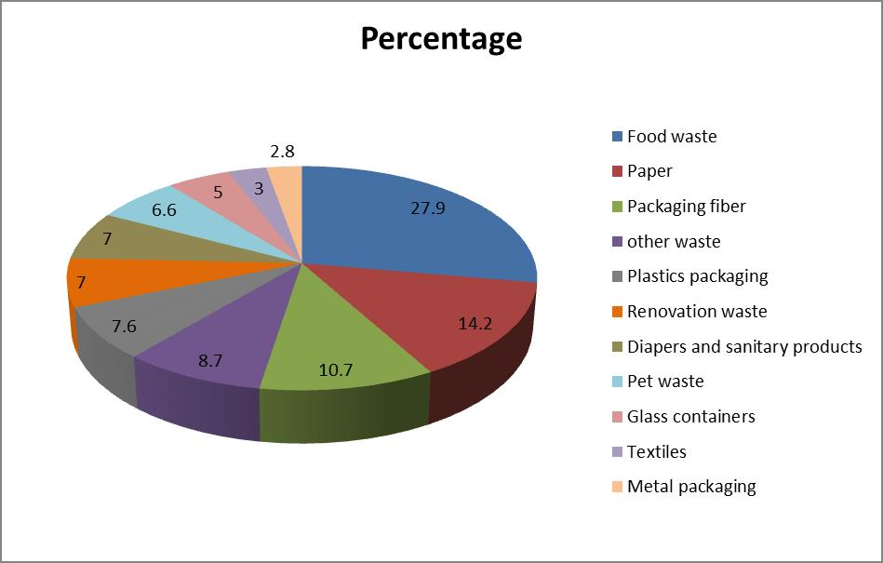
Different Types of Waste
Module 1: Lecture 2
1) Municipal solid waste (MSW), is known as trash or garbage and it is a waste type consisting of everyday items that are discarded by the public.
Source: https://en.wikipedia.org/wiki/File:Pie_Chart_of_Garbage_contents_in_winnipeg_city_in_2009.jpg

Slide 29
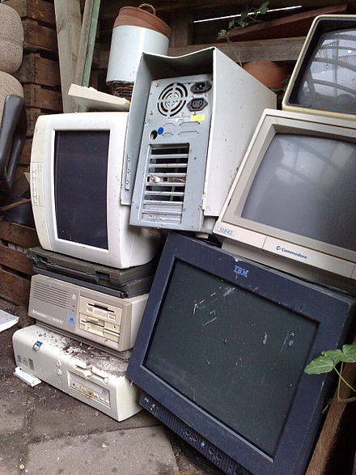
Different Types of Waste
Module 1: Lecture 2
2) E-waste (Electronic Waste) is discarded electrical or electronic devices. Used electronics which are destined for reuse, resale, salvage, recycling, or disposal are also considered e-waste.
Source: https://en.wikipedia.org/wiki/Electronic_waste

Slide 30
How Much Do We Generate?
Module 1: Lecture 2
Municipal Solid Waste
Per person, per year: 1,600 Lbs.
  Plastics: 215 lbs. (12%)
    75 % PET, HDPE & Flexible Packaging
    25% Composite Plastics & “Other”
  807 trillion BTU of energy contained in annual plastic MSW
Source: Green Composites Workshop 2012 in Chicago, IL, June 20-21, “Why Recycle Composites?” Presentation by Bob Moffit.

Slide 31
How Much Do We Recycle?
Module 1: Lecture 2
Plastics ‘Waste’
Recycled
  14 lbs. of 215 lbs. Plastics Stream
Energy Recovery
  17 lbs. of 215 lbs. Plastics Stream
Plastic “Energy” Equivalent Sent to Landfill:
  119 Million Barrels of Oil
Source: Green Composites Workshop 2012 in Chicago, IL, June 20-21, “Why Recycle Composites?” Presentation by Bob Moffit.

Slide 32
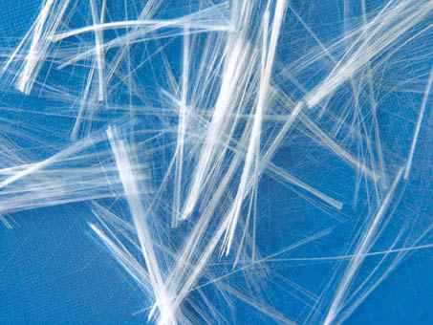
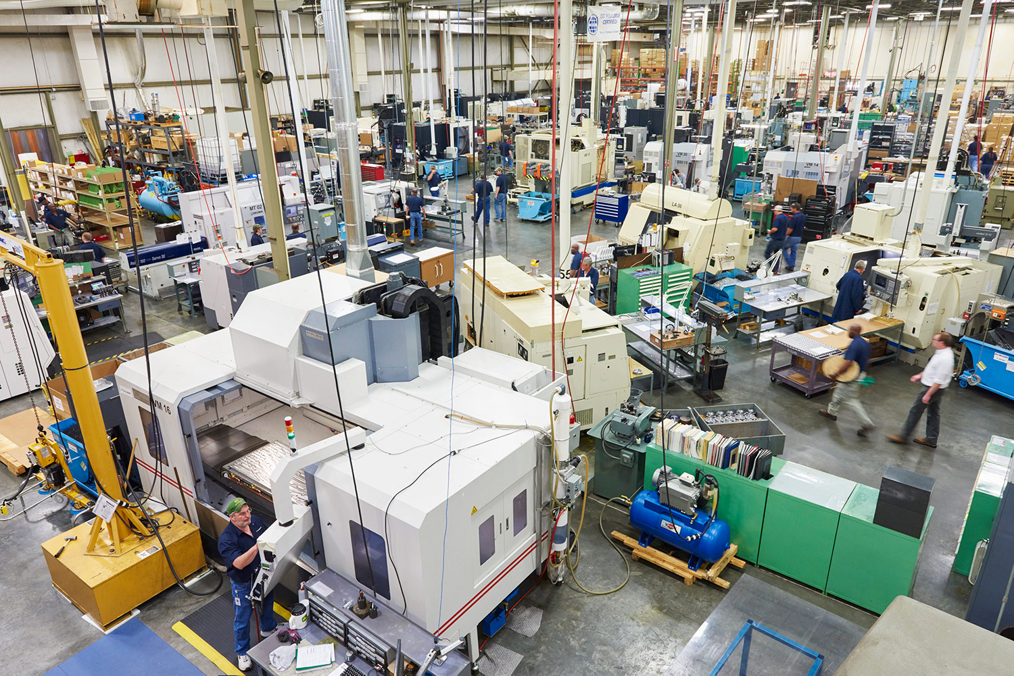
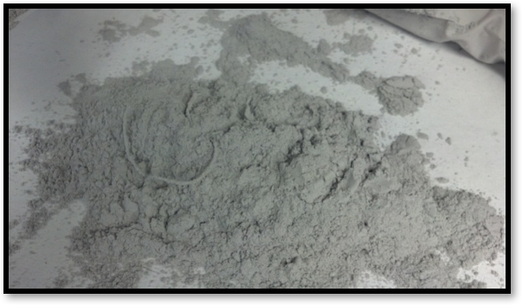
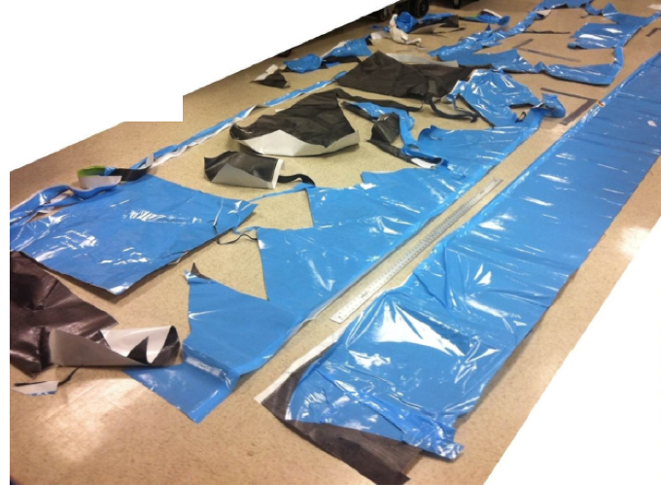
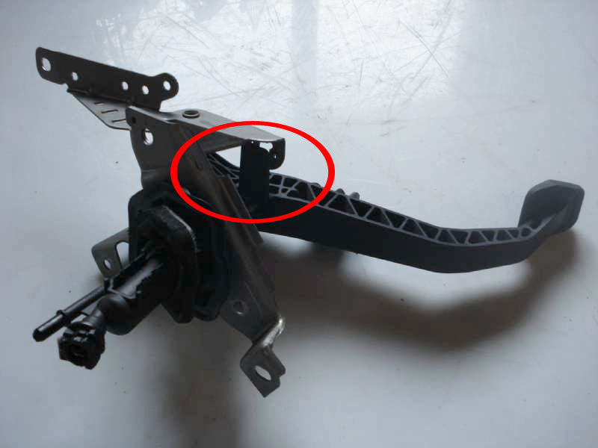
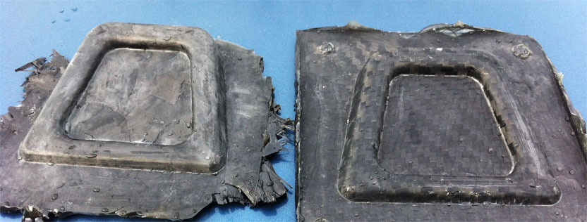

Different Types of Waste
Module 1: Lecture 2
Composites
A composite is made from a number of materials that are much difficult to separate and, in the case of thermoset composites, cannot be reclaimed through a melt process.
Six Sources of Composite Scrap
Machining/ Finishing Scrap
Raw Material Scrap
Material Trim Offs
Reject Parts
End of Life Components
Part Trim
Offs
Notes:
It is relatively easy to reclaim aluminum used in an aluminum alloy aileron from an aircraft wing by heating the alloy. The molten elements separate, and established processes can be used to reclaim those elements with predictable levels of purity. A composite, however, can be made from a number of materials that are much more difficult to separate and, in the case of thermoset composites, cannot be reclaimed through a melt process.

Slide 33
What is Waste and What is Scrap?
Module 1: Lecture 2
  Waste is material that either has no economic value or only the value of its basic material content recoverable through recycling
  Very different from scrap
    A perception?
  Scrap is different in that….
    It does have monetary value
    It consists of recyclable materials
    It is left over materials from product manufacturing and consumption, surplus or out of date materials.

Slide 34
What is Waste and What is Scrap?
Module 1: Lecture 2
  Scrap
  You could also say the scrap is the discarded or rejected material from an operation that is suitable for reprocessing.
  Scrap can be very expensive.
  Tipping fees, if the scrap is considered waste.
  The unrealized economic value of scrap and the recovery of money spent is squandered potential
  It is the recognition of, and the delineation between waste (no value) and scrap (has value), that creates a culture of sustainability.
Notes:
Scrap can be very expensive, since it can be left over materials in excess of those needed for the creation of a product, or it could be an entire batch of parts outside tolerances that need to be reworked or recycled. Or it can be parts that have been made and do not meet quality expectations / customer specifications.
The expense of scrap material, the time lost on creating a nonconforming part, the time spent, the time spent storing and dispensation of nonconforming parts, transporting the scrap material, and the time and cost of labor to rework and repair the parts for use can become very costly.

Slide 35
Hierarchy of Handling Scrap
Module 1: Lecture 2
Changes in business and motivation for reducing waste.
A number of waste prevention techniques are available, and they are commonly summarized as the 4Rs:
    Reduce
    Reuse
    Recycle
    Recovery
"The 4Rs - reduction, reuse, recycling and recovery" by The 4Rs - reduction, reuse, recycling and recovery is licensed under CC BY 4.0
Notes:
Businesses are being encouraged to change the way they perceive and manage waste. They have been given economic motivation, regulations, and public pressure. Faced with complying with regulations, landfill shortages and the need for increased resource efficiency, companies are moving away from the waste treatment approach and towards waste prevention. This includes changes in perspective of “waste” vs. “scrap”.
A number of waste prevention techniques are available, and they are commonly summarized as the so-called 4Rs: reduction, reuse, recycling and recovery.

Slide 36
Hierarchy of Handling Scrap
Module 1: Lecture 2
Most Desirable
REDUCE
Lowering the amount of waste product
REUSE
Using materials repeatedly
RECYCLE
Using materials to make new products
RECOVERY
Recovering energy from scrap
Least Desirable
LANDFILL
Safe disposal of waste to landfill
"The 4Rs - reduction, reuse, recycling and recovery" by The 4Rs - reduction, reuse, recycling and recovery is licensed under CC BY 4.0
Notes:
Reduction, reuse and recycling are known in the industry as the 3Rs. Companies sometimes focus only on the first three in resolving waste management problems. In more innovative companies, 4Rs solutions often emerge as a result of industry benchmarking or technological breakthroughs.

Slide 37
Hierarchy of Handling Scrap
Module 1: Lecture 2
Reduction
Wherever possible, waste reduction is the preferable option. Reduce the amount of scrap in production.
    Examples:
      Nesting
      Training and skill growth
      Safety first
      Diagnose and fix the root causes for scrap creation during processing
      Manage time sensitive materials with better planning
"The 4Rs - reduction, reuse, recycling and recovery" by The 4Rs - reduction, reuse, recycling and recovery is licensed under CC BY 4.0
Notes:
Wherever possible, waste reduction is the preferable option. Example: Nesting parts for more efficient use of material on a ply cutting table. Example: Provide better training and skill growth for production employees so that less mistakes are made. Putting safety first. You cannot have quality if you do not have a culture of safety. Diagnose the root cause for the production of scrap parts and fix it.
If waste is produced, every effort should be made to reuse it if practicable.
Recycling is the third option in the waste management hierarchy. Although recycling does help to conserve resources and reduce wastes, it is important to remember that there are economic and environmental costs associated with waste collection and recycling. For this reason, recycling should only be considered for waste which cannot be reduced or reused.
Finally, it may be possible to recover materials or energy from waste which cannot be reduced, reused or recycled.

Slide 38
Hierarchy of Handling Scrap
Module 1: Lecture 2
  Reduction
    For time sensitive materials (materials with an expiration date):
      Reduce the time that materials are purchased and when they are used
      Accurately order materials that match production needs.
      Over ordering and scrapping unusable material is an expensive waste.
      Monitor inventory closely (FIFO)
      Keep excellent records for materials that are frozen (out time) or have an expiration date.
      Segregate and control expired materials so that they cannot be used in the production of new parts.

Slide 39
Hierarchy of Handling Scrap
Module 1: Lecture 2
Reuse
If waste is produced, every effort should be made to reuse it if practicable. This is a perception shift from waste to scrap.
    Can implement back into own production line
    Create another production line that utilizes the scrap material
    Find another company that has a need for your scrap
    Be innovative
    Communicate with other companies your supply of scrap and work towards collaborative measures to reuse scrap.
"The 4Rs - reduction, reuse, recycling and recovery" by The 4Rs - reduction, reuse, recycling and recovery is licensed under CC BY 4.0

Slide 40
Hierarchy of Handling Scrap
Module 1: Lecture 2
Recycling
Recycling is the third option in the waste management hierarchy.
    Although recycling does help to conserve resources and reduce wastes, it is important to remember that there are economic and environmental costs associated with waste collection and recycling.
    For this reason, recycling should only be considered for waste/scrap which cannot be reduced or reused.
    Train employees the importance of separating, sorting, storing, and preventing contamination of recyclable materials
"The 4Rs - reduction, reuse, recycling and recovery" by The 4Rs - reduction, reuse, recycling and recovery is licensed under CC BY 4.0

Slide 41
Hierarchy of Handling Scrap
Module 1: Lecture 2
Recovery
In innovative companies, the fourth “R”, Recovery, solutions often emerge as a result of industry benchmarking or technological breakthroughs.
    It may be possible to recover materials or energy from scrap which cannot be reduced, reused or recycled.
    In all materials there is stored energy and that stored energy can be recovered. In a product that is petroleum based, that stored energy can be used for further energy production.
    Can the material be reprocessed for other uses?
"The 4Rs - reduction, reuse, recycling and recovery" by The 4Rs - reduction, reuse, recycling and recovery is licensed under CC BY 4.0

Slide 42
Hierarchy of Handling Scrap
Module 1: Lecture 2
Landfill
This is the last choice.
    Economically difficult to overcome.
    But, it comes with additional costs.
      Costs to the environment
      Ground water
      Land use
      Air
      Pollution
      Carbon footprint
      Tipping fees
      Transportation costs
    And, it runs contrary to sustainable practices
"The 4Rs - reduction, reuse, recycling and recovery" by The 4Rs - reduction, reuse, recycling and recovery is licensed under CC BY 4.0
Notes:
Economically difficult to overcome, because for immediate costs, there is nothing cheaper than a hole in the ground for disposing of waste.

Slide 43
Costs Savings from Waste Prevention
Module 1: Lecture 2
Empirical evidence suggests that by practicing waste prevention (reusing products, recycling, and making environmentally conscious purchases), businesses can cut costs and increase profits.
Cost savings take the form of:
    Lower waste disposal costs
    Lower waste treatment costs
    Lower hazardous waste disposal costs
    Lower energy costs
    Savings on materials and supplies
    A reduction in regulatory compliance costs
    Lower storage costs
    Cost recovery through the sale of recyclable materials
    Cost recovery through sales of 4Rs technologies
"The 4Rs - reduction, reuse, recycling and recovery" by The 4Rs - reduction, reuse, recycling and recovery is licensed under CC BY 4.0
Notes:
If you take a look at Lean Manufacturing principles, and the reduction of waste, all of these cost saving are the result of reducing waste. Waste in transportation, storage, movement, overproduction, over processing, scrap, inventory and waiting.

Slide 44
Success Stories
Module 1: Lecture 2
Smith & Vandiver Inc. of Watsonville, California, manufactures and distributes natural-ingredient toiletries and body care products.
To minimize packaging waste, it reuses boxes in which it has received shipments by re-cutting the cardboard into smaller cartons.
Its waste reduction program has enabled the company to reduce its inventory of shipper cartons, saving both storage space and $20,000 a year in material costs.
"The 4Rs - reduction, reuse, recycling and recovery" by The 4Rs - reduction, reuse, recycling and recovery is licensed under CC BY 4.0

Slide 45
Success Stories
Module 1: Lecture 2
In China, organic waste from thousands of small straw pulp mills is used as agricultural fertilizer.
Kraft General Foods in Tulare, California manufactures processed and natural cheese, and pre-baked bread shells.
  Its waste reduction program has not only reduced solid waste disposal fees, but generates some $40,000 a year from the sale of recyclable materials.
In Kalundborg, Denmark, a coal-fired power station, an oil refinery, a plasterboard factory, a pharmaceutical plant and the municipality have created an 'industrial symbiosis' by exploiting each other's waste streams.
"The 4Rs - reduction, reuse, recycling and recovery" by The 4Rs - reduction, reuse, recycling and recovery is licensed under CC BY 4.0

Slide 46

Success Stories
Module 1: Lecture 2
  ELG Carbon Fibre Ltd. (ELG CF, Coseley, West Midlands, UK), a subsidiary of German metals recycler ELG Haniel (Duisburg, Germany). ELG CF processes more than 2,000 MT of waste material per year in its patented pyrolysis process, including manufacturing waste and cured parts.
Source: "Composites recycling is gaining traction" by Composites World
Notes:
ELG Carbon Fibre Ltd. (ELG, Coseley, West Midlands, UK) and Land Rover BAR (Ben Ainslie Racing) are working together to ensure that the carbon fiber process waste and end-of-use components from the team are recycled as far as possible. ELG will become a technical supplier to the team and will process all carbon fiber manufacturing waste and end-of use parts to recover the high performance carbon fiber they contain. The recovered fibers will be converted into ELG’s milled and chopped fibers which are used to make thermoset and thermoplastic compounds and nonwoven mats that are utilized in the manufacture of composite structures. Both organizations view this collaboration as a vital step in addressing the issue of global carbon consumption and raising awareness of closed loop recycling within the marine industry.

Slide 47
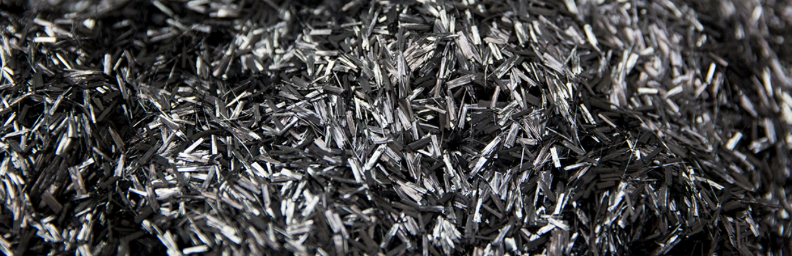
Success Stories
Module 1: Lecture 2
  Carbon Conversions (Lake City, SC, US) employs pyrolysis and can process “the entire composites waste stream”.
  That includes continuous tow from various markets, intermediates — dry fiber waste (from fabrics, trimming, braiding) and “wet” uncured prepreg and pultrusion waste
  And, end-of-life parts from commercial aerospace, recreational and industrial sources.
  The company has successfully demonstrated automotive parts, including a floorboard part for an automotive OEM.
Source: "Composites recycling is gaining traction" by Composites World
Notes:
Carbon Conversions (Lake City, SC, US) employs pyrolysis and can process “the entire composites waste stream”.
That includes continuous tow from various markets, intermediates — dry fiber waste (from fabrics, trimming, braiding) and “wet” uncured prepreg and pultrusion waste
And, end-of-life parts from commercial aerospace, recreational and industrial sources.
Their claim is that “We’ve built a robust business to take any industry’s waste stream and convert it into any one of our many products.”
Hexcel (Stamford, CT, US) recently purchased a minority stake in the company.
The company has successfully demonstrated automotive parts, including a floorboard part for an automotive OEM.

Slide 48
Success Stories
Module 1: Lecture 2
  CFK Valley Recycling (Wischhafen, Germany), is Europe’s largest composites recycler using pyrolysis
  They take in waste streams from automotive, aerospace and end-of-life sporting goods.
  Increased use of wind turbine blades made with carbon fiber has caused the waste from the wind industry to rise significantly.
  1,000 MT per annum yield of recycled fibers
  Distributed as chopped and milled products as well as wet-laid veils and air-laid nonwoven mats.
  Rademacker reports that milled recycled carbon fiber is used as a filler in polyurethane (PU) rear and front bumpers on the new Mercedes AMG GTC roadster.
Source: "Composites recycling is gaining traction" by Composites World
Notes:
CFK Valley Recycling (Wischhafen, Germany), part of the Karl Meyer Group, is Europe’s largest composites recycler using pyrolysis, and takes in waste streams from automotive, aerospace and end-of-life sporting goods, says Tim Rademacker, a managing director at the company: “Due to the increasing use of wind turbine blades made with carbon fiber, the quantity of waste from the wind industry has risen significantly. "With a 1,000 MT per annum yield of recycled fibers, CFK Valley Recycling’s partner company within Karl Meyer AG, CarboNXT (Wischhafen, Germany), distributes the recovered fiber as chopped and milled products as well as wet-laid veils and air-laid nonwoven mats. Rademacker reports that milled recycled carbon fiber is used as a filler in polyurethane (PU) rear and front bumpers on the new Mercedes AMG GTC roadster.

Slide 49
Success Stories
  Adherent Technologies Inc. has chosen a wet chemistry process they call chemolysis, also referred to as tertiary treatment.
  It uses a liquid transfer fluid and catalyst combined with low heat and pressure to recycle end-of-life parts and recover both carbon fibers as well as resin, without generating airborne emissions.
  The recovered resin can be reused as fuel or as process chemicals in other industries.
Source: "Composites recycling is gaining traction" by Composites World
Notes:
Adherent Technologies Inc. (ATI, Albuquerque, NM, US) started its recycling business at least 20 years ago. Company president Dr. Ron Allred and Dr. Jan-Michael Gosau, engineering and environmental project manager, chose a wet chemistry process they call chemolysis, also referred to as tertiary treatment, that uses a liquid transfer fluid and catalyst combined with low heat and pressure to recycle end-of-life parts and recover both carbon fibers as well as resin, without generating airborne emissions. The recovered resin can be reused as fuel or as process chemicals in other industries. ATI has recently formed a partnership with investment group DLC Capital (Melbourne, VC, Australia), owned by Damian Cessario, to commercialize the recycling technology. DLC Capital and ATI have collaborated for years and have now formed a composites company, V Carbon (London, UK), which will reclaim carbon fiber and then use the fibers to manufacture parts within the group.

Slide 50
Success Stories
Module 1: Lecture 2
  Vartega (Golden, CO, US), currently has a pilot-scale, proprietary and patent-pending low-energy solvolysis process, which treats uncured prepreg and towpreg scrap, from sources including Alchemy Bicycle Co. (Denver, CO, US).
  The company is developing a path whereby Vartega would eventually provide its process technology to licensees, who would lease modular equipment for in-house, closed-loop recycling on a regional basis, because, “It’s expensive to ship waste!”
  Vartega is working with Technical Fibre Products (TFP, Schenectady, NY, US), which converts the recovered fibers nonwoven mat and veil products.
Source: "Composites recycling is gaining traction" by Composites World
Notes:
A new entrant to the recycling community is Vartega (Golden, CO, US), headed by Andrew Maxey, an engineer whose interest in carbon fiber came from cycling: “We’re the new kids on the block, but things are accelerating and the opportunities for recycling are growing.” Vartega currently has a pilot-scale, proprietary and patent-pending low-energy solvolysis process, which treats uncured prepreg and towpreg scrap, from sources including Alchemy Bicycle Co. (Denver, CO, US). The company is developing a path whereby Vartega would eventually provide its process technology to licensees, who would lease modular equipment for in-house, closed-loop recycling on a regional basis, because, says Maxey, “It’s expensive to ship waste!” For now, Vartega is working with Technical Fibre Products (TFP, Schenectady, NY, US), which converts the recovered fibers (some of them continuous, from towpreg process waste), all with known pedigree and source, into nonwoven mat and veil products. The company has released testing data on its recovered fiber (see Learn More), where the tensile strength and modulus of recovered fiber are comparable to virgin fiber controls.

Slide 51
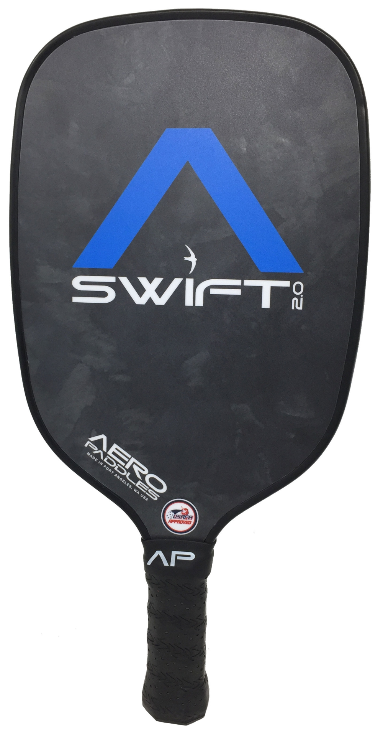
Success Stories
Module 1: Lecture 2
  Composite Recycling Technology Center
  (CRTC, Port Angeles, WA, US) is a
  nonprofit company.
  • Close to many composites manufacturing
  companies, Boeing and a variety of Boeing tier
  companies.
  • They are working to drive economic redevelopment
  and help reduce local unemployment, while
  modeling wise use of resources.
  • CRTC combines recycled carbon fiber product
  development with production processes for high-volume, low-cost production.
Source: "Composites recycling is gaining traction" by Composites World
Notes:
Composite Recycling Technology Center (CRTC, Port Angeles, WA, US). “We’re a nonprofit, and our mission is to inspire, grow and lead the recycling community.” Located in a region of concentrated composites manufacturing, in proximity to Boeing and many Boeing Tier companies Larsen says CRTC wants to drive economic redevelopment and help reduce Port Angeles’ unemployment, while modeling wise use of resources. CRTC combines recycled carbon fiber product development with production processes for high-volume, low-cost production. The company is co-located with Peninsula College and that school’s Composite Work Force Training program, to train future employees for planned growth. CRTC purchases “near first-quality” uncured aerospace prepreg scrap at a nominal rate from partner companies, including Toray Composites (America) Inc. (Tacoma, WA, US), and transforms it to make new, non-aerospace products, such as pickleball paddles. It has no plans to recycle cured composite parts: “We’re taking advantage of the chemistry that’s already there,” says Larsen. “We’re avoiding the need to add energy and cost to the material — carbon fiber already has more than twice the embodied energy of aluminum!”

Slide 52
Recycling Trends
Module 1: Lecture 2
Objectives:
Learn how consumer desire and perception pushes the need for composite recycling.
Learn about government regulations and initiatives.
Learn about non-governmental recycling initiatives.
Learn about what it takes to keep up landfills, the decline in available landfill space, and the harm of landfilling to the environment and public health.
Learn statistics on manufacturing waste and why industry is the best place to start recycling.

Slide 53
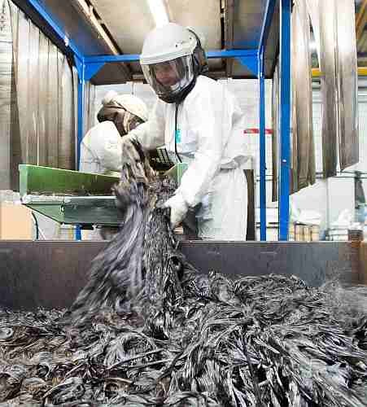
Recycling Trends
Module 1: Lecture 2
  Composite World’s coverage of composites recycling dates back over a decade
  Informal statistics still show that only ~2% of composites-related companies are active recyclers.
  That said, three years since Composites World has gathered the statics on the subject, there is demonstrably greater interest and activity, and real applications of recycled fiber are growing.
Source: "Composites recycling is gaining traction" by Composites World

Slide 54
Recycling Trends
Module 1: Lecture 2
It is important to note that up to 30% of carbon fibre is wasted during production or cutting and trimming operations to manufacture products.
And, global demand for carbon fiber is expected to double to 120,000 tonnes between 2016 and 2030
Carbon fibre producers are currently expanding their capacities
Products that contain carbon fibre are already reaching their end-of-life stage, such as the Boeing 777s and Airbus A320s which comprise up to 20% carbon fibre by weight.
Source: "Composites recycling is gaining traction" by Composites World
Notes:
Global demand for these fibres is expected to double to 120 000 tonnes between 2016 and 2030, and many carbon fibre producers are currently expanding their capacities; for example, Hexcel is spending US$ 250 million on a new production plant at Roussillon in France. However, up to 30% of carbon fibre is wasted during production or cutting and trimming operations to manufacture products.
Also, products that contain carbon fibre are already reaching their end-of-life stage, such as the Boeing 777s and Airbus A320s which comprise up to 20% carbon fibre by weight.
Worldwide, carbon fibre is being recycled by well over a dozen companies that have been founded in the past 20 years. Most of these businesses are located in the USA, Europe and Japan, including America’s Carbon Conversions, Hadeg of Germany, ELG Carbon Fibre of the UK and Japan’s Takayasu.
In 2014, the annual recycling capacity of these companies was estimated at between 3500 and 5000 tonnes but the figures could already be much higher given the rapid development of this industry.

Slide 55
Recycling Trends
Module 1: Lecture 2
Worldwide, carbon fibre is being recycled by well over a dozen companies that have been founded in the past 20 years.
Most of these businesses are located in the USA, Europe and Japan, including America’s Carbon Conversions, Hadeg of Germany, ELG Carbon Fibre of the UK and Japan’s Takayasu.
In 2014, the annual recycling capacity of these companies was estimated at between 3500 and 5000 tonnes but the figures could already be much higher given the rapid development of this industry.
Source: "Boom time for carbon fibre recycling" by Recycling International

Slide 56
Recycling Trends
Module 1: Lecture 2
  Composite World’s coverage of composites recycling dates back over a decade
  Informal statistics still show that only ~2% of composites-related companies are active recyclers.
  That said, three years since Composites World has gathered the statics on the subject, there is demonstrably greater interest and activity, and real applications of recycled fiber are growing.
Source: "Composites recycling is gaining traction" by Composites World

Slide 57
Recycling Trends
Module 1: Lecture 2
Companies that are engaged in reducing waste are employing several recycling strategies, separately or in combination.
Efforts focused on reclamation and reuse of high-quality carbon fiber material waste streams
Waste sources include off-spec material, cutting/trimming/kitting scraps (dry and prepreg) and bobbin ends, including thermoset and thermoplastic materials.
Current commercial methods for eliminating the resin from the carbon fibers are pyrolysis (thermal treatment) and solvolysis (chemical treatment).
More difficult is recycling of end-of-life (EOL) cured parts to complete a true “closed-loop” situation, where materials are recovered from scrapped products and reused in new iterations of those products.
Alternatively, there are at least two companies offer recyclable resin
Source: "Composites recycling is gaining traction" by Composites World
Notes:
Those who have jumped in are employing several recycling strategies, separately or in combination. Most initial efforts have focused on reclamation and reuse of high-quality carbon fiber material waste streams, typically from aerospace manufacturing, because they are relatively easy to work with and yield high-quality carbon fibers with properties virtually undiminished, albeit in chopped form (continuous fiber can also be recovered, discussed below). Waste sources include off-spec material, cutting/trimming/kitting scraps (dry and prepreg) and bobbin ends, including thermoset and thermoplastic materials.
Current commercial methods for eliminating the resin from the carbon fibers are pyrolysis (thermal treatment) and solvolysis (chemical treatment). Although pyrolysis requires thermal energy to burn off the resin, and can cause fibers to char, the energy of pyrolysis represents only a fraction of the embodied energy of virgin carbon fiber. Some sources say solvolysis requires even more energy than thermal treatment, but it enables recovery of fiber and resin. In both processes, the recovered fibers transfer well to nonwoven mats or thermoplastic pellets for injection molding, and are a natural fit for automotive part applications.
More difficult is recycling of end-of-life (EOL) cured parts to complete a true “closed-loop” situation, where materials are recovered from scrapped products and reused in new iterations of those products. Pyrolysis and solvolysis can be applied to cured parts, as can mechanical crushing, typically used for fiberglass parts; the resulting crushed glass/resin material is either reused as a resin filler, burned for energy (waste to energy plants) or co-processed in cement kilns.
Alternatively, two companies offer recyclable resin products that can be un-crosslinked in a chemical solution that leaves the original fiber reinforcements intact (more on that below) for closed loop recycling in some sporting goods applications. And, a number of materials suppliers are investigating in-house, closed-loop recycling of scrap and parts, avoiding a recycling middleman.

Slide 58
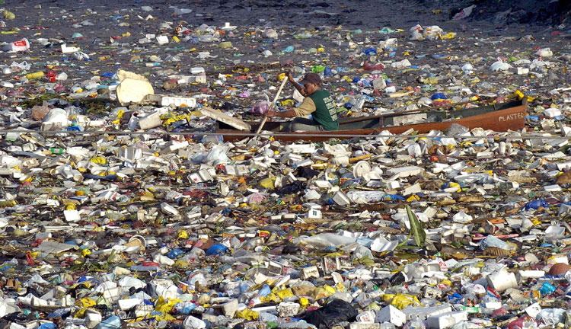
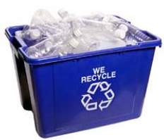
Recycling Trends
Module 1: Lecture 2
Public Perception of ‘plastic’ waste and Consumer Habits
    Can composites provide a solution instead of being considered ‘part of the problem’?
    Consumer interest is increasing
Pacific Ocean Garbage Island
Source: Green Composites Workshop 2012 in Chicago, IL, June 20-21, “Composites-’Life Cycle Thinking’ ACMA LCI Project” Presentation by Gary Jakubcin.
Notes:
The perspective of scrap being a solution is embedded in the idea that the identification and viewpoint of scrap (as opposed to seeing it as waste) can result in a reduction of costs, is good for the environment (think of the long term costs of producing waste), and it is the right thing to do.
Trained technicians can provide support and inspiration for other employees, assist in the identification of and methods to reduce scrap, and bring creative resolutions to reduce, reuse and recycling scrap.

Slide 59
Recycling Trends
Corporations
  Several European companies are taking in-house recycling initiatives (Fiberline, Zajons, Holcim)
  Utilization of composites in innovative areas (cement mixing, Boeing airplanes)
Governments
  EU Directive 2000/53/EC
  Café standards
  Legislation, Legislation, Legislation!
Pacific Ocean Garbage Island
Source: Green Composites Workshop 2012 in Chicago, IL, June 20-21, “Composites-’Life Cycle Thinking’ ACMA LCI Project” Presentation by Gary Jakubcin.

Slide 60
Recycling Trends
Module 1: Lecture 2
Non-Government Organizations
  Green Building Initiatives
    Leadership in energy and Environmental Design (LEED) US Green Building Council (USGBC) Program
    ZeroWaste
Life Cycle Assessment (LCA)
  Several case studies available highlighting importance for FRP recycling via LCA
  Show there is a benefit of recycling composites versus landfilling
Pacific Ocean Garbage Island
Source: Green Composites Workshop 2012 in Chicago, IL, June 20-21, “Composites-’Life Cycle Thinking’ ACMA LCI Project” Presentation by Gary Jakubcin.

Slide 61
Loss of Available Landfill Space
Module 1: Lecture 2
Landfills in North America (NA) have reached an all-time high capacity level!
  1979 ~ 18,500 landfills
  2010 ~ 3,091 landfills
In 5 years, with no further increases in rate of waste generated or in the opening of new landfills, NA will run out of landfill space completely!
Pacific Ocean Garbage Island
Source: Zerwasteamerica.org. LANDFILLS: Hazardous to the Environment. Zerowasteamerica.org [Online] http://www.zerowasteamerica.org/Landfills.htm.

Slide 62
The Harm in Using Landfills
Module 1: Lecture 2
Non-Biodegradable
Harmful Gases:
  Volatile organic compounds (VOC’s)
  Hazardous air pollutants (HAP’s)
  Odorous compounds
These dangerous gases adversely affect public health and the environment
  Linked to cancer and respiratory diseases
  Green House Gases (GHG’s)
Pacific Ocean Garbage Island
Source: Zerwasteamerica.org. LANDFILLS: Hazardous to the Environment. Zerowasteamerica.org [Online] http://www.zerowasteamerica.org/Landfills.htm.

Slide 63
Summary
Module 1: Lecture 2
In this lecture you have learned:
The difference between scrap and waste.
    That the largest difference between scrap and waste is in the value. Scrap has value and waster does not. The difference can often be a change in perspective.
The different types of waste
  1) Ancient Composites 2) Modern Composites and 3) Advanced
  Composites
The amount of composite waste per year
  Enough to fill Yankee stadium
That the hierarchy of handling waste is
  Reduce, Reuse, Recycle and Recovery

Slide 64
Summary
Module 1: Lecture 2
In this lecture you have learned:
The cost advantages of recycling composites
About a variety of companies that are successfully recycling composites.
Up to 30% of carbon fibre is wasted during production or cutting and trimming operations to manufacture products.
That the demand for carbon fiber is expected to double by 2030
That is now time for us to deal with composites that have reached their end of life.
That only ~2% of composites-related companies are active recyclers.
Public perception, regulations, protecting the environment and the loss of landfill space are the driving forces in composites recycling.

Slide 65
Composite Recycling Technician Education Program
Module 1: Lecture 3
Module 1 – Overview on Materials Recycling
Lecture 3 – Recycling Trends

Slide 66
Recycling Trends
Module 1: Lecture 3
Objectives:
Learn how consumer desire and perception pushes the need for composite recycling.
Learn about government regulations and initiatives.
Learn about non-governmental recycling initiatives.
Learn about what it takes to keep up landfills, the decline in available landfill space, and the harm of landfilling to the environment and public health.
Learn statistics on manufacturing waste and why industry is the best place to start recycling.

Slide 67
A Brief Introduction to Composites
Module 1: Lecture 3
At the end of this lecture you will be able to:
Describe how consumer desire and perception pushes the need for composite recycling.
Show and understanding of some government regulations and initiatives.
Identify non-governmental recycling initiatives.
Describe what it takes to keep up landfills, the decline in available landfill space, and the harm of landfilling to the environment and public health.
Identify statistics on manufacturing waste and describe why industry is the best place to start recycling.

Slide 68
Recycling Trends
Module 1: Lecture 3
  Composites World’s coverage of composites recycling dates back over a decade
  Informal statistics still show that only ~2% of composites-related companies are active recyclers.
  That said, three years since Composites World has gathered the statics on the subject, there is demonstrably greater interest and activity, and real applications of recycled fiber are growing.
Source: "Composites recycling is gaining traction" by Composites World
Notes:
Composites World magazine has coverage of composites recycling that dates back over a decade. Their informal statistics still show that only ~2% of composites-related companies are active recyclers. Companies have resigned themselves to paying for landfill disposal while metals suppliers touted recyclability to industry.

Slide 69
Recycling Trends
Module 1: Lecture 3
  The drive for growth in Composite Recycling (Marketplace realities):
  The European Union’s end-of-life-vehicle (ELV) directive requires that 85%, by weight, of the materials used in a car or light truck must be reusable or recyclable.
  Carbon fiber’s high manufacturing cost and high performance, even in chopped form, make it an attractive recycling target, which is creating market pull for recycled fiber products, most notably, from automotive.
  The newest generations of consumers were raised on environmental awareness, actively support recycling activities and closed-loop manufacturing, and seek out goods with recycled content.
Source: "Composites recycling is gaining traction" by Composites World
Notes:
At least three marketplace realities have converged to drive the growth of composites material recycling, particularly reclamation of carbon fiber:
First, the European Union’s end-of-life-vehicle (ELV) directive requires that 85%, by weight, of the materials used in a car or light truck must be reusable or recyclable.
Second, carbon fiber’s high manufacturing cost and high performance, even in chopped form, make it an attractive recycling target, which is creating market pull for recycled fiber products, most notably, from automotive.
Third, the newest generations of consumers were raised on environmental awareness, actively support recycling activities and closed-loop manufacturing, and seek out goods with recycled content.

Slide 70
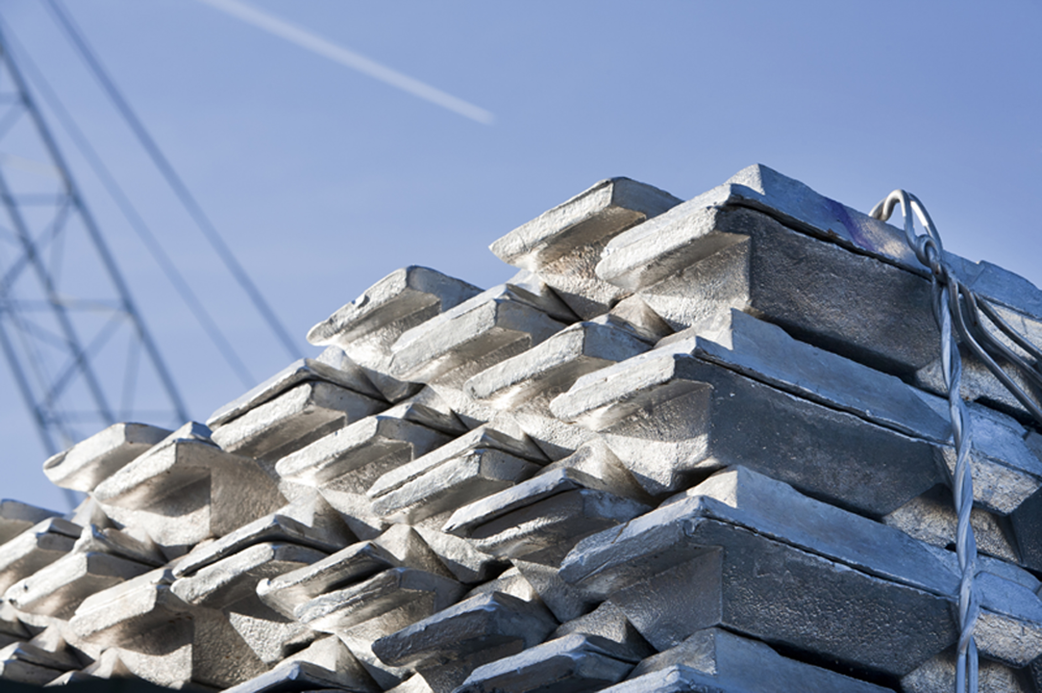
Recycling Trends
Module 1: Lecture 3
  Industry Comparisons
  One reason aluminum and steel remain formidable competitors to composites is their suppliers’ long track records in recycling.
  30-50 years to achieve their current success rate at recycling.
  80% for Aluminum
Source: "Composites recycling is gaining traction" by Composites World
Notes:
One reason aluminum and steel remain formidable competitors to composites is their suppliers’ long track records in recycling, which has helped reduce their overall material production costs, says Ed Pilpel, the current recycling committee chairman at the American Composites Manufacturers Assn. (ACMA. “But it took those industries 30-50 years to achieve their current success rate at recycling, which for aluminum is upward of 80%. The composites industry is much younger, and we have years to go,” he admits, “but we’ve got to jump into the deep end of the pool and get going.”
Most initial efforts have focused on reclamation and reuse of high-quality carbon fiber material waste streams, typically from aerospace manufacturing, because they are relatively easy to work with and yield high-quality carbon fibers with properties virtually undiminished, albeit in chopped form (continuous fiber can also be recovered, discussed below). Waste sources include off-spec material, cutting/trimming/kitting scraps (dry and prepreg) and bobbin ends, including thermoset and thermoplastic materials.
Current commercial methods for eliminating the resin from the carbon fibers are pyrolysis (thermal treatment) and solvolysis (chemical treatment). Although pyrolysis requires thermal energy to burn off the resin, and can cause fibers to char, the energy of pyrolysis represents only a fraction of the embodied energy of virgin carbon fiber. Some sources say solvolysis requires even more energy than thermal treatment, but it enables recovery of fiber and resin. In both processes, the recovered fibers transfer well to nonwoven mats or thermoplastic pellets for injection molding, and are a natural fit for automotive part applications.
More difficult is recycling of end-of-life (EOL) cured parts to complete a true “closed-loop” situation, where materials are recovered from scrapped products and reused in new iterations of those products. Pyrolysis and solvolysis can be applied to cured parts, as can mechanical crushing, typically used for fiberglass parts; the resulting crushed glass/resin material is either reused as a resin filler, burned for energy (waste to energy plants) or co-processed in cement kilns.
“Three years ago, it was a real push to get these materials out into the market. Now, there’s more ‘pull’ and we’re getting more inquiries on how to use recycled carbon. We are now designing products and developing them to meet specific customer requirements,” states Frazer Barnes, managing director at ELG Carbon Fibre Ltd. (ELG CF, Coseley, West Midlands, UK), a subsidiary of German metals recycler ELG Haniel (Duisburg, Germany). ELG CF processes more than 2,000 MT of waste material per year in its patented pyrolysis process, including manufacturing waste and cured parts.

Slide 71
Recycling Trends
Module 1: Lecture 3
  Initial Recycling Efforts
  Most initial efforts have focused on reclamation and reuse of high-quality carbon fiber material waste streams.
  Typically from Aerospace manufacturing
  Properties of fibers retained (to some degree)
  Waste Sources
    Off Spec Material
    Cutting/trimming/kitting scraps (dry and prepreg)
    Bobbin ends
    Includes thermoset and thermoplastic materials.
"Boeing 748 Dreamliner" by Tomoaki INABA is licensed under CC BY 4.0
Source: "Composites recycling is gaining traction" by Composites World
Notes:
Most initial efforts have focused on reclamation and reuse of high-quality carbon fiber material waste streams, typically from aerospace manufacturing, because they are relatively easy to work with and yield high-quality carbon fibers with properties virtually undiminished, albeit in chopped form (continuous fiber can also be recovered, discussed below). Waste sources include off-spec material, cutting/trimming/kitting scraps (dry and prepreg) and bobbin ends, including thermoset and thermoplastic materials.
Current commercial methods for eliminating the resin from the carbon fibers are pyrolysis (thermal treatment) and solvolysis (chemical treatment). Although pyrolysis requires thermal energy to burn off the resin, and can cause fibers to char, the energy of pyrolysis represents only a fraction of the embodied energy of virgin carbon fiber. Some sources say solvolysis requires even more energy than thermal treatment, but it enables recovery of fiber and resin. In both processes, the recovered fibers transfer well to nonwoven mats or thermoplastic pellets for injection molding, and are a natural fit for automotive part applications.
More difficult is recycling of end-of-life (EOL) cured parts to complete a true “closed-loop” situation, where materials are recovered from scrapped products and reused in new iterations of those products. Pyrolysis and solvolysis can be applied to cured parts, as can mechanical crushing, typically used for fiberglass parts; the resulting crushed glass/resin material is either reused as a resin filler, burned for energy (waste to energy plants) or co-processed in cement kilns.
“Three years ago, it was a real push to get these materials out into the market. Now, there’s more ‘pull’ and we’re getting more inquiries on how to use recycled carbon. We are now designing products and developing them to meet specific customer requirements,” states Frazer Barnes, managing director at ELG Carbon Fibre Ltd. (ELG CF, Coseley, West Midlands, UK), a subsidiary of German metals recycler ELG Haniel (Duisburg, Germany). ELG CF processes more than 2,000 MT of waste material per year in its patented pyrolysis process, including manufacturing waste and cured parts.

Slide 72
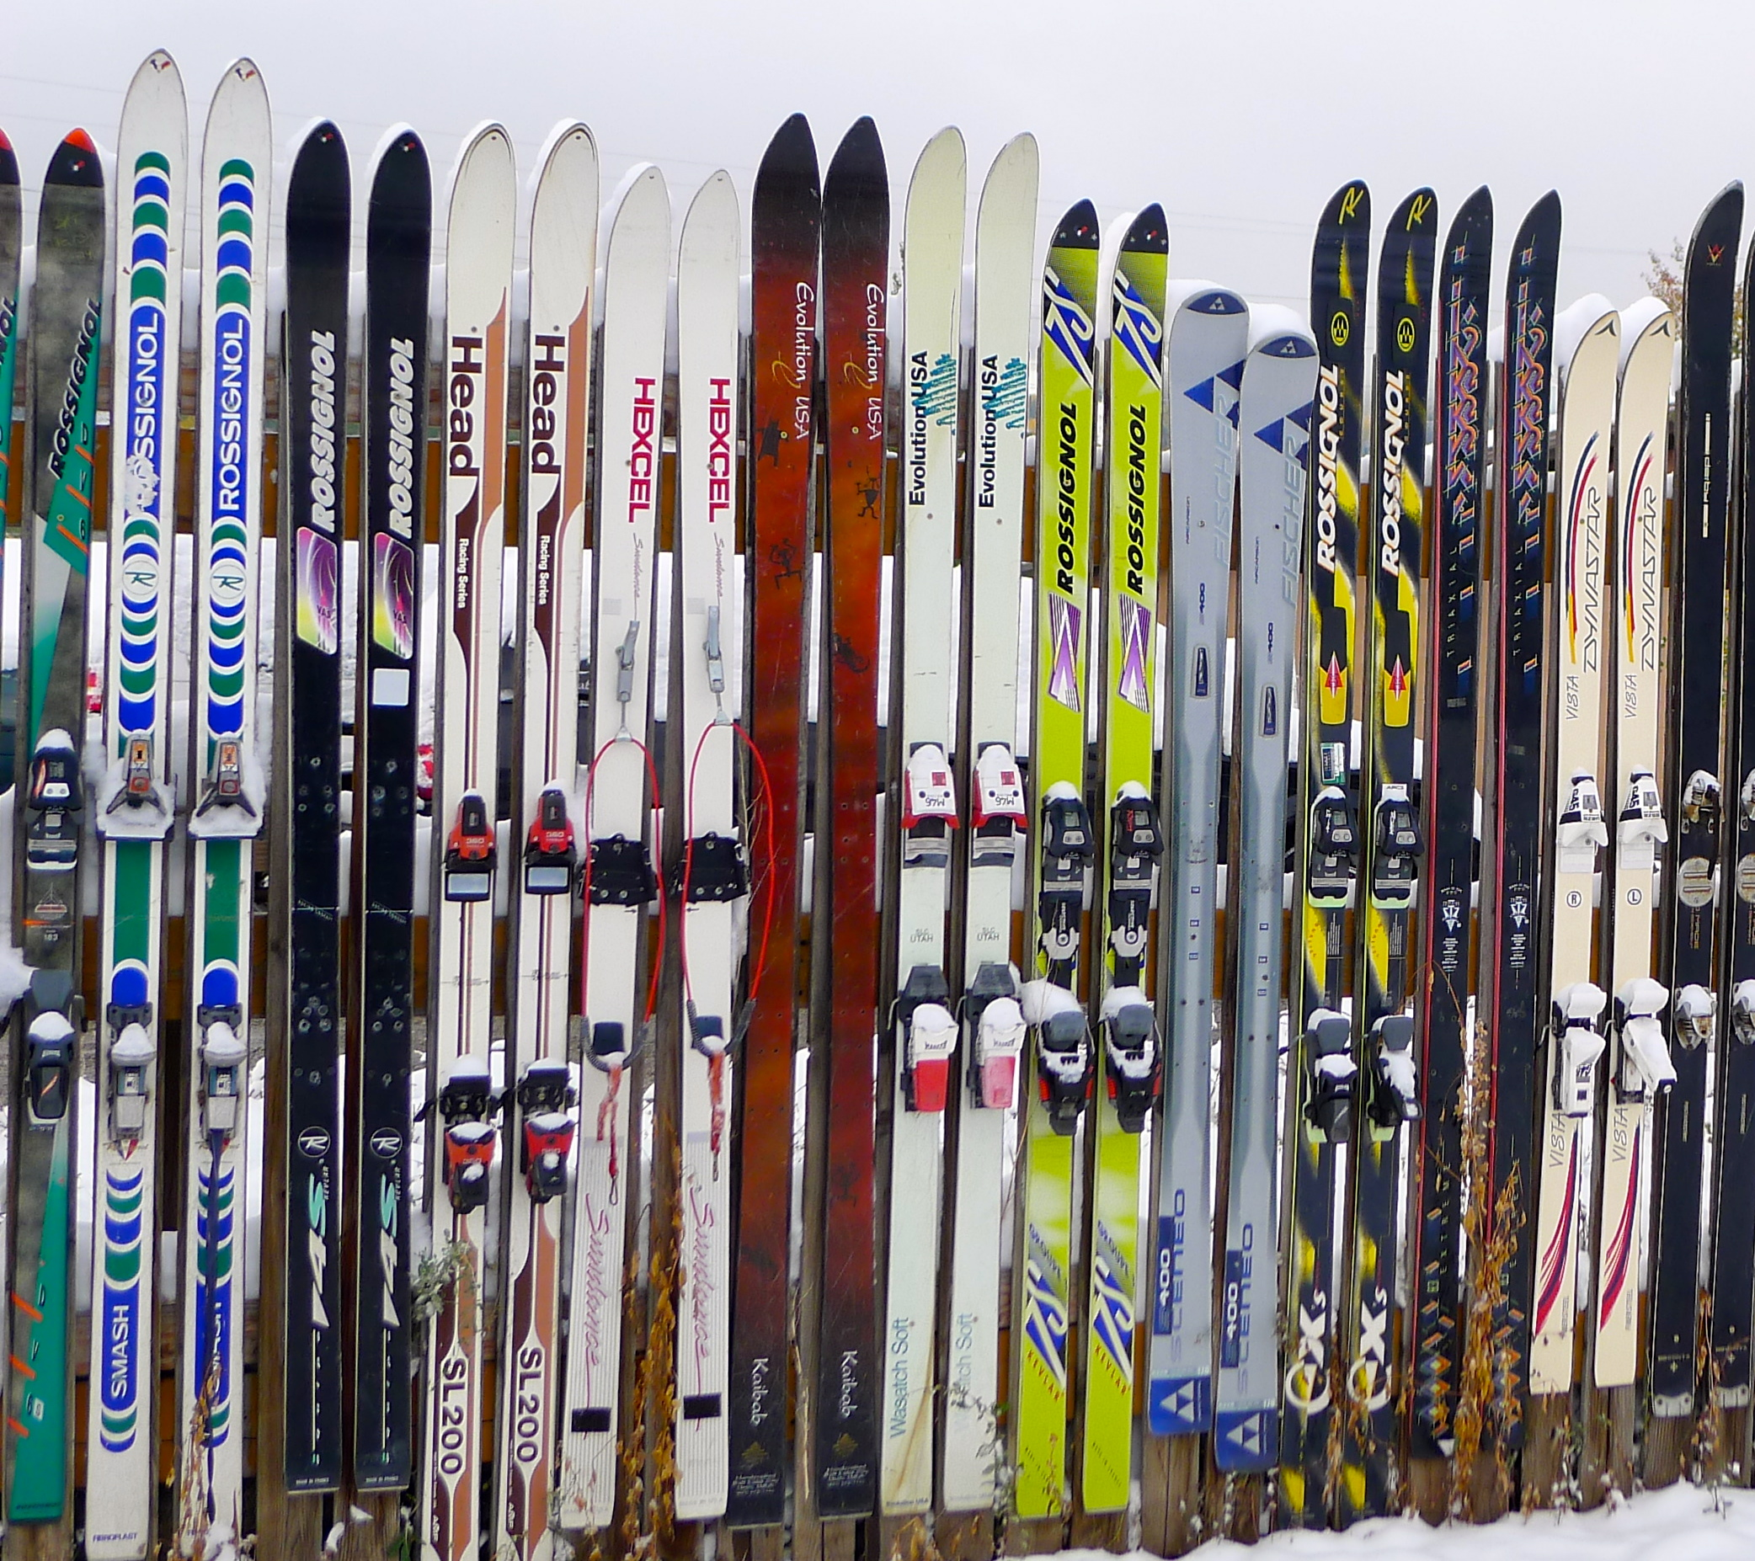
Recycling Trends
Module 1: Lecture 3
  Current Commercial Methods of Separating or Eliminating Resin from the Carbon Fiber
Pyrolysis (thermal treatment)
Solvolysis (chemical treatment)
More difficult is recycling of end-of-life (EOL) cured parts to complete a true “closed-loop” situation, where materials are recovered from scrapped products and reused in new iterations of those products.
Alternatively, there are at least two companies offer recyclable resin
Source: https://theusualbliss.files.wordpress.com/2013/10/p1100968.jpg
Source: "Composites recycling is gaining traction" by Composites World
Notes:
Current commercial methods for eliminating the resin from the carbon fibers are pyrolysis (thermal treatment) and solvolysis (chemical treatment). Although pyrolysis requires thermal energy to burn off the resin, and can cause fibers to char, the energy of pyrolysis represents only a fraction of the embodied energy of virgin carbon fiber. Some sources say solvolysis requires even more energy than thermal treatment, but it enables recovery of fiber and resin. In both processes, the recovered fibers transfer well to nonwoven mats or thermoplastic pellets for injection molding, and are a natural fit for automotive part applications.
More difficult is recycling of end-of-life (EOL) cured parts to complete a true “closed-loop” situation, where materials are recovered from scrapped products and reused in new iterations of those products. Pyrolysis and solvolysis can be applied to cured parts, as can mechanical crushing, typically used for fiberglass parts; the resulting crushed glass/resin material is either reused as a resin filler, burned for energy (waste to energy plants) or co-processed in cement kilns.
Alternatively, two companies offer recyclable resin products that can be un-crosslinked in a chemical solution that leaves the original fiber reinforcements intact for closed loop recycling in some sporting goods applications. And, a number of materials suppliers are investigating in-house, closed-loop recycling of scrap and parts, avoiding a recycling middleman.
“Three years ago, it was a real push to get these materials out into the market. Now, there’s more ‘pull’ and we’re getting more inquiries on how to use recycled carbon. We are now designing products and developing them to meet specific customer requirements,” states Frazer Barnes, managing director at ELG Carbon Fibre Ltd. (ELG CF, Coseley, West Midlands, UK). ELG CF processes more than 2,000 MT of waste material per year in its patented pyrolysis process, including manufacturing waste and cured parts.

Slide 73
Recycling Trends
Module 1: Lecture 3
“Composites recycling efforts are a puzzle right now, with lots of pieces that include technology, government and industry groups, standards and education,” says Pilpel.
“You have to start with a basic business case.”
    For example, a company’s simplest step is to convert its waste to energy at the plant site, avoiding the cost of landfill disposal and recouping a small portion of the original material cost.
    Greater return on material cost can be gained if waste can be converted to new, useable forms for sale, or returned internally to a company’s process.
“We need to find the hidden applications for recycled material,” he adds, pointing to the success of used auto tire recycling in the US, where uses of shredded tire waste were eventually found, to keep tires out of landfills.
Source: "Composites recycling is gaining traction" by Composites World

Slide 74

Recycling Trends
Module 1: Lecture 3
Thermolyzer Video
Source: "Composites recycling is gaining traction" by Composites World
Notes:
Global demand for these fibers is expected to double to 120,000 tonnes in France. However, up to 30% of carbon fiber is wasted during production or cutting and trimming operations to manufacture products. Also, products that contain carbon fiber are already reaching their end-of-life stage, such as the Boeing 777s and Airbus A320s which comprise up to 20% carbon fiber by weight.
Worldwide, carbon fiber is being recycled by well over a dozen companies that have been founded in the past 20 years. Most of these businesses are located in the USA, Europe and Japan, including America’s Carbon Conversions, Hadeg of Germany, ELG Carbon Fibre of the UK and Japan’s Takayasu.
In 2014, the annual recycling capacity of these companies was estimated at between 3500 and 5000 tonnes but the figures could already be much higher given the rapid development of this industry.

Slide 75
Recycling Trends
Module 1: Lecture 3
It is important to note that up to 30% of carbon fiber is wasted during production or cutting and trimming operations to manufacture products.
And, global demand for carbon fiber is expected to double to 120,000 tonnes between 2016 and 2030
Carbon fiber producers are currently expanding their capacities
Products that contain carbon fiber are already reaching their end-of-life stage, such as the Boeing 777s and Airbus A320s which comprise up to 20% carbon fiber by weight.
Source: "Composites recycling is gaining traction" by Composites World
Notes:
Global demand for these fibers is expected to double to 120,000 tonnes in France. However, up to 30% of carbon fiber is wasted during production or cutting and trimming operations to manufacture products. Also, products that contain carbon fiber are already reaching their end-of-life stage, such as the Boeing 777s and Airbus A320s which comprise up to 20% carbon fiber by weight.

Slide 76
Recycling Trends
Module 1: Lecture 3
Worldwide, carbon fibre is being recycled by well over a dozen companies that have been founded in the past 20 years.
Most of these businesses are located in the USA, Europe and Japan, including America’s Carbon Conversions, Hadeg of Germany, ELG Carbon Fibre of the UK and Japan’s Takayasu.
In 2014, the annual recycling capacity of these companies was estimated at between 3500 and 5000 tonnes but the figures could already be much higher given the rapid development of this industry.
Source: "Boom time for carbon fibre recycling" by Recycling International
Notes:
Worldwide, carbon fiber is being recycled by well over a dozen companies that have been founded in the past 20 years. Most of these businesses are located in the USA, Europe and Japan, including America’s Carbon Conversions, Hadeg of Germany, ELG Carbon Fibre of the UK and Japan’s Takayasu.
In 2014, the annual recycling capacity of these companies was estimated at between 3500 and 5000 tonnes but the figures could already be much higher given the rapid development of this industry.

Slide 77
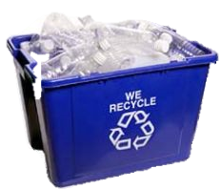
Recycling Trends
Module 1: Lecture 3
Pacific Ocean Garbage Island
Public Perception of ‘plastic’ waste and Consumer Habits
    Can composites provide a solution instead of being considered ‘part of the problem’?
    Consumer interest is increasing
Source: Green Composites Workshop 2012 in Chicago, IL, June 20-21, “Composites-’Life Cycle Thinking’ ACMA LCI Project” Presentation by Gary Jakubcin.
Notes:
The perspective of scrap being a solution is embedded in the idea that the identification and viewpoint of scrap (as opposed to seeing it as waste) can result in a reduction of costs, is good for the environment (think of the long term costs of producing waste), and it is the right thing to do.
Trained technicians can provide support and inspiration for other employees, assist in the identification of and methods to reduce scrap, and bring creative resolutions to reduce, reuse and recycling scrap.

Slide 78
Recycling Trends
Module 1: Lecture 3
Corporations
  Several European companies are taking in-house recycling initiatives (Fiberline, Zajons, Holcim)
  Utilization of composites in innovative areas (cement mixing, Boeing airplanes)
Governments
  EU Directive 2000/53/EC
  Café standards
  Legislation, Legislation, Legislation!
Source: Green Composites Workshop 2012 in Chicago, IL, June 20-21, “Composites-’Life Cycle Thinking’ ACMA LCI Project” Presentation by Gary Jakubcin.
Notes:
A new concept for processing fiberglass and composite industry waste, christened CompoCycle, has been developed by two German companies, Zajons and Holcim (Deutschland) AG. CompoCycle uses a patented process to convert fiberglass waste into a raw material for cement manufacture. Fiberline is the first Danish company to take advantage of this process, which will have significance for many industries using fiberglass.
In the process, Fiberline sends its fiberglass waste to Cajon's. At Zajons the fiberglass enters a giant grinder where its calorific value is adjusted by the addition of other types of recycling materials in a patented process. The finished recycling mix is sent to Holcim, which feeds the mix to its production kilns in northern Germany which make the finished cement. This saves significant amount of resources and no dusts, ash or other by-products are formed in the process.
Material impact: recycling 1000 tonnes of fiberglass through the process saves around 450 tonnes of coal, 200 tonnes of chalk, 200 tonnes of sand and 150 tonnes of aluminum oxide
EU Directive 2000/53/EC
Every year, end-of-life vehicles (ELV) generate between 7 and 8 million tonnes of waste in the European. Directive 2000/53/EC on end-of life vehicles, aims at making dismantling and recycling of ELVs more environmentally friendly. It sets clear quantified targets for reuse, recycling and recovery of the ELVs and their components. It also pushes producers to manufacture new vehicles without hazardous substances (in particular lead, mercury, cadmium and hexavalent chromium), thus promoting the reuse, recyclability and recovery of waste vehicles.
What are CAFE Standards?
First enacted by Congress in 1975, the purpose of CAFE is to reduce energy consumption by increasing the fuel economy of cars and light trucks. The CAFE standards are fleet-wide averages that must be achieved by each automaker for its car and truck fleet, each year, since 1978. When these standards are raised, automakers respond by creating a more fuel-efficient fleet, which improves our nation’s energy security and saves consumers money at the pump, while also reducing greenhouse gas (GHG) emissions.

Slide 79
Recycling Trends
Module 1: Lecture 3
Non-Government Organizations
  Green Building Initiatives
    Leadership in energy and Environmental Design (LEED) US Green Building Council (USGBC) Program
    ZeroWaste
Life Cycle Assessment (LCA)
  Several case studies available highlighting importance for FRP recycling via LCA
  Show there is a benefit of recycling composites versus landfilling
Source: Green Composites Workshop 2012 in Chicago, IL, June 20-21, “Composites-’Life Cycle Thinking’ ACMA LCI Project” Presentation by Gary Jakubcin.
Notes:
LEED, or Leadership in Energy and Environmental Design, is a green building rating system in the world. Available for virtually all building, community and home project types, LEED provides a framework to create healthy, highly efficient and cost-saving green buildings.

Slide 80
Recycling Trends
Module 1: Lecture 3
Non-Government Organizations
    Leadership in energy and Environmental Design (LEED)
Source: https://www.youtube.com/watch?v=tlVseOWToL4#action=share
Notes:
LEED, or Leadership in Energy and Environmental Design, is a green building rating system in the world. Available for virtually all building, community and home project types, LEED provides a framework to create healthy, highly efficient and cost-saving green buildings.

Slide 81
Recycling Trends
Module 1: Lecture 3
Non-Government Organizations
  US Green Building Council (USGBC) Program
Source: https://www.youtube.com/watch?v=kjyWI10xpHw#action=share
Notes:
USGBC was established in 1993 with a mission to promote sustainability-focused practices in the building industry. Representatives from around 60 firms and several nonprofits gathered to establish the USGBC. It was then that ideas were shared for an open and balanced coalition spanning the entire building industry and for a green building rating system, which would later become LEED. Since the rating system’s unveiling in 2000, it has become an international standard for environmentally sound buildings, certifying hundreds of thousands of square feet per day.

Slide 82
Recycling Trends
Module 1: Lecture 3
Non-Government Organizations
  ZeroWaste
Source: https://www.youtube.com/watch?v=_E2u_LbboKE#action=share
Notes:
A Zero Waste System is cyclical, like in nature, and does two fundamental things: It redesigns our systems and resource use—from product design to disposal—to prevent wasteful and polluting practices that lead to waste. It then captures discards and uses them, instead of natural resources, to make new products, creating far less pollution and feeding the local economy.

Slide 83

Recycling Trends
Module 1: Lecture 3
Life Cycle Assessment (LCA)
Source: https://www.youtube.com/watch?v=r0ucT1KRiO4&feature=youtu.be
Notes:
Life-cycle assessment has emerged as a valuable data driven decision-support tool for both policy makers and industry in assessing the cradle-to-grave impacts of a product or process. Three forces are driving this evolution.
First, government regulations are moving in the direction of "life-cycle accountability;" the notion that a manufacturer is responsible not only for direct production impacts, but also for impacts associated with product inputs, use, transport, and disposal.
Second, business is participating in voluntary initiatives which contain LCA and product stewardship components. These include, for example, ISO 14000 and the Chemical Manufacturer Association's Responsible Care Program, both of which seek to foster continuous improvement through better environmental management systems.
Third, environmental "preferability" has emerged as a criterion in both consumer markets and government procurement guidelines. Together these developments have placed LCA in a central role as a tool for identifying cradle-to-grave impacts both of products and the materials from which they are made.
The "life-cycle" or "cradle-to-grave" impacts include the extraction of raw materials; the processing, manufacturing, and fabrication of the product; the transportation or distribution of the product to the consumer; the use of the product by the consumer; and the disposal or recovery of the product after its useful life.
There are four linked components of LCA:
1) Goal definition and scoping: identifying the LCA's purpose and the expected products of the study, and determining the boundaries (what is and is not included in the study) and assumptions based upon the goal definition;
2) Life-cycle inventory: quantifying the energy and raw material inputs and environmental releases associated with each stage of production;
3) Impact analysis: assessing the impacts on human health and the environment associated with energy and raw material inputs and environmental releases quantified by the inventory;
4) Improvement analysis: evaluating opportunities to reduce energy, material inputs, or environmental impacts at each stage of the product life-cycle.

Slide 84
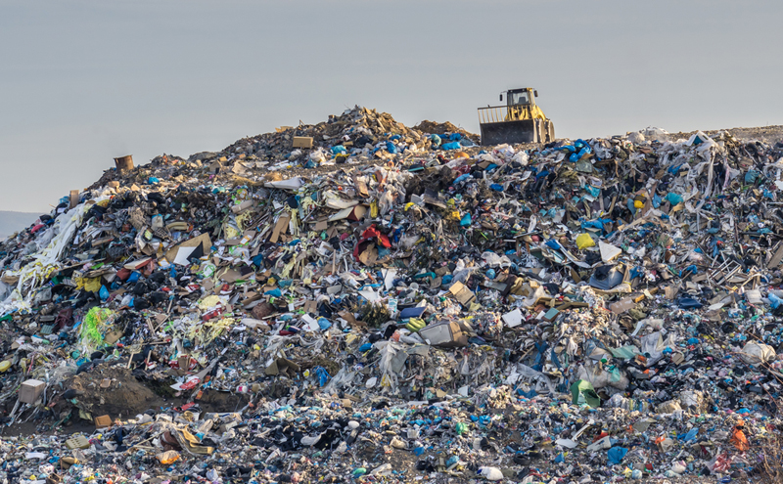
Recycling Trends
The Benefit of recycling composites versus landfilling
Module 1: Lecture 3
Landfills in North America have reached an all-time high capacity level!
  In 1979 there were approximately 18,500 landfills
  In 2010 there were approximately 3,091 landfills
In 5 years, with no further increases in rate of waste generated or in the opening of new landfills, North America will run out of landfill space completely!
Source: Zerwasteamerica.org. LANDFILLS: Hazardous to the Environment. Zerowasteamerica.org [Online] http://www.zerowasteamerica.org/Landfills.htm.

Slide 85
The Harm in Using Landfills
Module 1: Lecture 3
Non-Biodegradable
Harmful Gases:
  Volatile organic compounds (VOC’s)
  Hazardous air pollutants (HAP’s)
  Odorous compounds
These dangerous gases adversely affect public health and the environment
  Linked to cancer and respiratory diseases
  Green House Gases (GHG’s)
Source: Zerwasteamerica.org. LANDFILLS: Hazardous to the Environment. Zerowasteamerica.org [Online] http://www.zerowasteamerica.org/Landfills.htm.

Slide 86
Summary
Module 1: Lecture 3
In this lecture you have learned:
  Informal statistics still show that only ~2% of composites-related companies are active recyclers.
  The drive for growth in Composite Recycling includes:
    The European Union’s end-of-life-vehicle (ELV) directive
    Carbon fiber’s high manufacturing cost and high performance, even in chopped form, make it an attractive recycling target.
    The newest generations of consumers seek out goods with recycled content.

Slide 87
Summary
Module 1: Lecture 3
In this lecture you have learned:
  That Waste Sources include
      Off Spec Material
      Cutting/trimming/kitting scraps (dry and prepreg)
      Bobbin ends
      Includes thermoset and thermoplastic materials.
  Current Commercial Methods of Separating or Eliminating Resin from the Carbon Fiber
    Pyrolysis (thermal treatment)
    Solvolysis (chemical treatment)

Slide 88
Summary
Module 1: Lecture 3
In this lecture you have learned:
  That up to 30% of carbon fiber is wasted during production or cutting and trimming operations to manufacture products.
  Global demand for carbon fiber is expected to double to 120,000 tonnes between 2016 and 2030
Governments legislation is driving interest in recycling
  EU Directive 2000/53/EC
  Café standards
Non-Government Organizations include:
    Leadership in energy and Environmental Design (LEED)/ US Green Building Council (USGBC) Program
    ZeroWaste
Life Cycle Assessment (LCA)

Slide 89
Composite Recycling Technician Education Program
Module 1: Lecture 4
Module 1 – Overview on Materials Recycling
Lecture 4 – Industry Perspective on Recycling

Slide 90
Industry Perspective on Recycling
Module 1: Lecture 4
Content:
  CRTEP findings from subject matter experts (industry and academic) on two main statements:
      What are the major challenges that companies face if they are to reduce the volume of scrap material going into landfills?
      As new composite reclamation processes and technologies are developed what new demands will be placed on composite technicians?
  A brief introduction to various logistics associated with composite recycling at the manufacturing level

Slide 91
Industry Perspective on Recycling
Module 1: Lecture 4
Objectives:
Learn how industry perceives composite recycling and what they see as the biggest challenges.
Learn what demands are placed on composite technicians as composite recycling is introduced.
Learn what subject matter experts see as logistical problems for composite recycling.

Slide 92
Industry Perspective on Recycling
Module 1: Lecture 4
At the end of this lecture you will be able to:
  Be able to identify challenges in a manufacturing setting that complicates composite recycling as it pertains to collection, storage, sorting, etc. and be able to suggest logistical solutions.
  Be able to identify new demands technicians experience due to composite recycling and suggest how they can overcome them.

Slide 93
Industry Perspective on Recycling
Module 1: Lecture 4
Profit as Motivation
  Seven years ago, mainstream composites recycling was considered an aspirational goal but not a commercial reality, according to Dan Coughlin, ACMA’s Vice President of Composites Market Development. While recyclability of end-of-life composite products could make FRP as desirable as metals, it is hard for composite manufacturers to justify recycling without proof that it can be profitable.
Notes:
Seven years ago, mainstream composites recycling was considered an aspirational goal but not a commercial reality, according to Dan Coughlin, ACMA’s Vice President of Composites Market Development. While recyclability of end-of-life composite products could make FRP as desirable as metals, it is hard for composite manufacturers to justify recycling without proof that it can be profitable.

Slide 94
Industry Perspective on Recycling
How Industry Perceives Composite Recycling
Module 1: Lecture 4
  Five Perspectives
    Recycling is not a ‘nice to have’ add on, but a huge opportunity.
    Design for a circular economy.
    Develop more markets for recycling.
    Don’t call scrap or end-of-life products ‘waste.
    It’s happening!
http://compositesmanufacturingmagazine.com/2017/12/5-key-messages-carbon-fiber-recycling-camx-2017/

Slide 95
Industry Perspective on Recycling
Module 1: Lecture 4
1) Recycling is not a ‘nice to have’ add on, but a huge opportunity.
  ISRI says that their organization represents the “biggest industry you’ve never heard”
  With $117 billion and more than 500,000 related U.S. jobs.
  The recycling industry is currently dominated by iron and steel (50 percent) and paper (40 percent).
  Markets are ripe for recycling.
  Adesso Advanced Materials, which has developed Cleavamine® degradable curing agent and Recycloset® recyclable resin.
  In the EU, they have already set up a regulation that 95 percent of automotive parts must be recycled.
  So, it is the time to solve this problem
http://compositesmanufacturingmagazine.com/2017/12/5-key-messages-carbon-fiber-recycling-camx-2017/
Notes:
David L. Wagger, chief scientist and director of environmental management at the Institute of Scrap Recycling Industries Inc. (ISRI) says that his organization represents the “biggest industry you’ve never heard” with $117 billion and more than 500,000 related U.S. jobs. He said the recycling industry is currently dominated by iron and steel (50 percent) and paper (40 percent). He says, “We’d like to change that to make your businesses and our businesses more sustainable and grow,” said Wagger.
Markets are ripe for recycling, stressed Bo Liang, chairman and CEO of Adesso Advanced Materials, which has developed Cleavamine® degradable curing agent and Recycloset® recyclable resin. “Right now, in the EU, they have already set up a regulation that 95 percent of automotive parts must be recycled. So, it is the time to solve this problem!” said Liang. “Otherwise, the composites industry really faces a dilemma.”

Slide 96
Industry Perspective on Recycling
Module 1: Lecture 4
2) Design for a circular economy
    Composites can be “intractable by design.”
    Consider designing for end-of-life and recycling from the outset.
    It is crucial to work with the waste management industry to develop realistic solutions that can accelerate the commercial viability of recycling.
    ISRI’s Design for Recycling® program
http://compositesmanufacturingmagazine.com/2017/12/5-key-messages-carbon-fiber-recycling-camx-2017/
Notes:
Composites can be “intractable by design.” Job and other presenters at the Composites Recycling Conference in Knoxville, TN urged manufacturers to consider designing for end-of-life and recycling from the outset. She added that it is also crucial to work with the waste management industry to develop realistic solutions that can accelerate the commercial viability of recycling. “There’s no point in creating a process that relies on, for example, cars being dismantled in a certain way, if they are not going to be dismantled in that way.”
Wagger, another presenter told attendees that ISRI’s Design for Recycling® program is available to help manufacturers think of ways to eliminate or reduce hazardous materials and substances that impede the recycling process, incorporate the highest amount of recyclable materials into designs and realize the highest yield of recyclable materials at end-of-life.

Slide 97
Industry Perspective on Recycling
Module 1: Lecture 4
3) Develop more markets for recycling.
    Markets for recycled carbon fiber need to be aggressively expanded.
    A bottleneck
    There is a need to develop markets
    We need to learn how to use this ‘fluffy stuff’ that comes out of [recycling] that doesn’t look anything like prepreg.”
    You need markets
    You can do a lot of collecting and processing, but at the end of the day if you don’t have anyone to sell it to, you haven’t recycled.
http://compositesmanufacturingmagazine.com/2017/12/5-key-messages-carbon-fiber-recycling-camx-2017/
Notes:
All panelists agreed that markets for recycled carbon fiber need to be aggressively expanded. “That’s where the bottleneck is,” explained Job. “We’ve got some good processes out there,” but we need to develop markets, we need to learn how to use this ‘fluffy stuff’ that comes out of [recycling] that doesn’t look anything like prepreg.”
“You need markets,” added Wagger. “You can do a lot of collecting and processing, but at the end of the day if you don’t have anyone to sell it to, you haven’t recycled.”

Slide 98
Industry Perspective on Recycling
Module 1: Lecture 4
4) Don’t call scrap or end-of-life products Waste
    We want to call this a secondary use material.
    We do not want to refer to it as waste
    Regulation of secondary materials as “waste” limits its:
        Availability
        Value
        Marketability
        Mobility
    A patchwork of state regulations that impede the flow of materials to recyclers and commodities to markets.
http://compositesmanufacturingmagazine.com/2017/12/5-key-messages-carbon-fiber-recycling-camx-2017/
Notes:
’“We want to call this a secondary use material. We do not want to refer to it as waste,” emphasized Pete George of Boeing. Regulation of secondary materials as “waste” limits its availability, value, marketability and mobility.
Of concern, according to Wagger, is the patchwork of state regulations that impede the flow of materials to recyclers and commodities to markets.

Slide 99
Industry Perspective on Recycling
Module 1: Lecture 4
5) It’s happening!
    V-Carbon reports that their one-year-old company, is successfully recycling carbon fiber from 787 parts from Spirit Euro using:
        Low-pressure, low-temperature and high-pressure, high-temperature chemolysis and pyrolysis and fiber finishing.
    The company is now looking to use its own recycled fibers to make non-woven fabric, aligned short fiber tape and spun staple continuous yarn, and to turn those materials into end products.
    Current prototypes include bicycle saddles and luxury yacht window frames.
http://compositesmanufacturingmagazine.com/2017/12/5-key-messages-carbon-fiber-recycling-camx-2017/
Notes:
Ronald E. Allred of V-Carbon reports that his company, which is just one-year-old, is successfully recycling carbon fiber from 787 parts from Spirit Euro using both low-pressure, low-temperature and high-pressure, high-temperature chemolysis and pyrolysis and fiber finishing. The company is now looking to use its own recycled fibers to make non-woven fabric, aligned short fiber tape and spun staple continuous yarn, and to turn those materials into end products. Current prototypes include bicycle saddles and luxury yacht window frames.

Slide 100
Industry Perspective on Recycling
Module 1: Lecture 4
5) It’s happening!
    The iStream concept car
    Developed by Gordon Murray Design for TVR, launched at the Goodwood Revival in the United Kingdom last September.
    The iStream Carbon concept further reduces weight compared to the already lightweight and efficient original iStream concept
    A fully mechanized procedure with a cycle time of just 100 seconds.
    A honeycomb structure sandwiched between two carbon fiber sheets
    “This is real. This is happening.”
http://compositesmanufacturingmagazine.com/2017/12/5-key-messages-carbon-fiber-recycling-camx-2017/
Source: http://compositesmanufacturingmagazine.com/2015/11/yamaha-carbon-fiber-chassis-could-change-how-cars-are-made/
Notes:
Ronald E. Allred of V-Carbon reports that his company, which is just one-year-old, is successfully recycling carbon fiber from 787 parts from Spirit Euro using both low-pressure, low-temperature and high-pressure, high-temperature chemolysis and pyrolysis and fiber finishing. The company is now looking to use its own recycled fibers to make non-woven fabric, aligned short fiber tape and spun staple continuous yarn, and to turn those materials into end products. Current prototypes include bicycle saddles and luxury yacht window frames.
Alasdair Gledhill, commercial director of ELG Carbon Fiber Ltd., discussed the iStream concept car developed by Gordon Murray Design for TVR, launched at the Goodwood Revival in the United Kingdom last September. The iStream Carbon concept further reduces weight compared to the already lightweight and efficient original iStream concept, which used glass fiber panels. Unlike other manufacturing processes, the iStream Carbon is a fully mechanized procedure with a cycle time of just 100 seconds. Gordon Murray’s technique utilizes a honeycomb structure sandwiched between two carbon fiber sheets – a procedure that’s fast and cheap, but just as efficient as the more expensive ones. Gledhill stressed, “This is real. This is happening.”

Slide 101
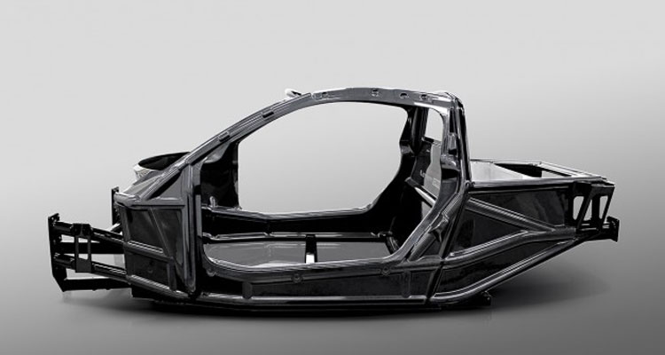
Industry Perspective on Recycling
Module 1: Lecture 4
The iStream Concept Car
Source: http://compositesmanufacturingmagazine.com/2015/11/yamaha-carbon-fiber-chassis-could-change-how-cars-are-made/

Slide 102
Logistics
Module 1: Lecture 4
SYSTEMIC
  The industry does not provide a pathway
Growing environmental concerns
Increasing government regulations pushes industries to recycle and/or reuse materials from scrap, trim-offs and end of life components
Overcoming these challenges will foster growth of a new industry that utilizes post-industrial scrap material and end-of-life waste from fiber reinforced composite (FRC) manufacturers and markets
  Cost of landfilling Legislation
  Penalties
  Environmental health and safety
MOTIVATION
  Rating and composition
  Labeling/cataloging
  Handling
  SDS Creation (GHS)
  Getting a consistent supply
  Supply quality
MATERIAL ORGANIZATION
LOGISTICS
  Determine best process and ideal parameters
  Storage
  Transportation Infrastructure
  Power/electricity demand
HEALTH AND SAFETY
  Knowing the impact
  How to regulate/monitor the impact
  Knowing what personal protective equipment (PPE) is needed
MARKET PENETRATION
  What are the end uses of the recyclate?
  What properties make it competitive?
EDUCATION
  Work with manufacturers, management and operators to change their perception on “waste” (think of as scrap or a valuable by-product)
  Work with them to show how to recycle and/or reuse scrap
Notes:
There are growing environmental concerns and increasing government regulations pushing industries to recycle and/or reuse materials from scrap, trim-offs and end of life components and while thermoset composites are desirable they are considered non recyclable
Challenges to recycling and a cost model are presented
Overcoming these challenges will foster growth of a new industry that utilizes post-industrial scrap material and end-of-life waste from fiber reinforced composite (FRC) manufacturers and markets

Slide 103
Logistics
Module 1: Lecture 4
SYSTEMIC
  The industry does not provide a pathway
MOTIVATION
  Cost of landfilling Legislation
  Penalties
  Environmental health and safety
MATERIAL ORGANIZATION
  Rating and composition
  Labeling/cataloging
  Handling
  SDS Creation (GHS)
  Getting a consistent supply
  Supply quality
Notes:
There are growing environmental concerns and increasing government regulations pushing industries to recycle and/or reuse materials from scrap, trim-offs and end of life components and while thermoset composites are desirable they are considered non recyclable
Challenges to recycling and a cost model are presented
Overcoming these challenges will foster growth of a new industry that utilizes post-industrial scrap material and end-of-life waste from fiber reinforced composite (FRC) manufacturers and markets

Slide 104
Logistics
Module 1: Lecture 4
LOGISTICS
  Determine best process and ideal parameters
  Storage
  Transportation Infrastructure
  Power/electricity demand
HEALTH AND SAFETY
  Knowing the impact
  How to regulate/monitor the impact
  Knowing what personal protective equipment (PPE) is needed
MARKET PENETRATION
  What are the end uses of the recyclate?
  What properties make it competitive?
Notes:
There are growing environmental concerns and increasing government regulations pushing industries to recycle and/or reuse materials from scrap, trim-offs and end of life components and while thermoset composites are desirable they are considered non recyclable
Challenges to recycling and a cost model are presented
Overcoming these challenges will foster growth of a new industry that utilizes post-industrial scrap material and end-of-life waste from fiber reinforced composite (FRC) manufacturers and markets

Slide 105

Logistics
Module 1: Lecture 4
EDUCATION
  Work with manufacturers, management and operators to change their perception on “waste” (think of as scrap or a valuable by-product)
  Work with them to show how to recycle and/or reuse scrap
Source: http://clipart-library.com/personal-skills-cliparts.html
Notes:
There are growing environmental concerns and increasing government regulations pushing industries to recycle and/or reuse materials from scrap, trim-offs and end of life components and while thermoset composites are desirable they are considered non recyclable
Challenges to recycling and a cost model are presented
Overcoming these challenges will foster growth of a new industry that utilizes post-industrial scrap material and end-of-life waste from fiber reinforced composite (FRC) manufacturers and markets

Slide 106
Problems with Recycling
Module 1: Lecture 4
Not a lot of knowledge about the methods that composites (particularly thermosets) can be recycled
Composite scrap = ‘waste’
  Scrap should be thought of as valuable
  Can implement back into own production line or sell to another company
Source: Zerwasteamerica.org. LANDFILLS: Hazardous to the Environment. Zerowasteamerica.org [Online] http://www.zerowasteamerica.org/Landfills.htm.

Slide 107
Summary
Module 1: Lecture 4
In this lecture you have learned:
  It is hard for composite manufacturers to justify recycling without proof that it can be profitable.
  Five perspectives from the industry on composite recycling
      Recycling is not a ‘nice to have’ add on, but a huge opportunity.
      Design for a circular economy.
      Develop more markets for recycling.
      Don’t call scrap or end-of-life products ‘waste.
      It’s happening!

Slide 108
Summary
Module 1: Lecture 4
In this lecture you have learned:
    There are growing environmental concerns and increasing government regulations pushing industries to recycle and/or reuse materials from scrap, trim-offs and end of life components.
    Industry challenges include:
        A Systemic Problem: Not a clear pathway (but is getting much better)
        Material Organization
        Logistics
        Heath and Safety
        Market Penetration
        Education

Slide 109
Summary
Module 1: Lecture 4
In this lecture you have learned:
    Overcoming these challenges will foster growth of a new industry that utilizes post-industrial scrap material and end-of-life waste from fiber reinforced composite (FRC) manufacturers and markets

Slide 110
Composite Recycling Technician Education Program
Module 1: Lecture 5
Module 1 – Overview on Materials Recycling
Lecture 5 – Basic Introduction to Current Composite Recycling in Industry

Slide 111
Basic Introduction to Current Composite Recycling in Industry
Module 1: Lecture 5
Content
  Basic introduction to current thermoset/thermoplastic recycling methods
  Class Discussion on associated logistics
    Recycling your own scrap vs. selling/giving to another company
    Recycling infrastructure; in-house grinding/shredding vs. outsourcing

Slide 112
Basic Introduction to Current Composite Recycling in Industry
Module 1: Lecture 5
Objectives
    Learn about current composite recycling methods used in industry.
    Learn about challenges associated with in-house recycling as well as the outsourcing of composite scrap.

Slide 113
Basic Introduction to Current Composite Recycling in Industry
Module 1: Lecture 5
At the end of the lecture you will be able to:
    Demonstrate knowledge of current composite recycling technologies, and the different challenges as they are associated to thermoplastics and thermosets.
    Be able to identify challenges associated with in-house recycling and be able to suggest solutions.
    Be able to identify challenges associated with outsourcing scrap or taking in another companies scrap; be able to suggest ways to streamline/address these challenges.

Slide 114
Basic Introduction to Current Composite Recycling in Industry
Module 1: Lecture 5
Thermosets and Thermoplastics
Polymeric materials can be classiﬁed as thermosets and thermoplastics.
Thermoset polymers refer to the irreversible polymerization and this type of polymer is cured by chemical reaction or heat and becomes infusible and insoluble material.
Thermoplastics are made up of linear molecular chains and this polymer softens on heating and hardens when cooled.
Source: http://www.mdpi.com/2313-4321/2/4/24/htm

Slide 115
Basic Introduction to Current Composite Recycling in Industry
Module 1: Lecture 5
Thermosets and Thermoplastics
Thermoplastic polymers are represented by a large range of plastic materials. There are three types of thermoplastic polymers:
    Crystalline thermoplastics
    Amorphous thermoplastics
    Semi-crystalline polymers
Source: http://www.mdpi.com/2313-4321/2/4/24/htm

Slide 116
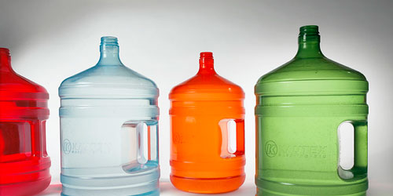
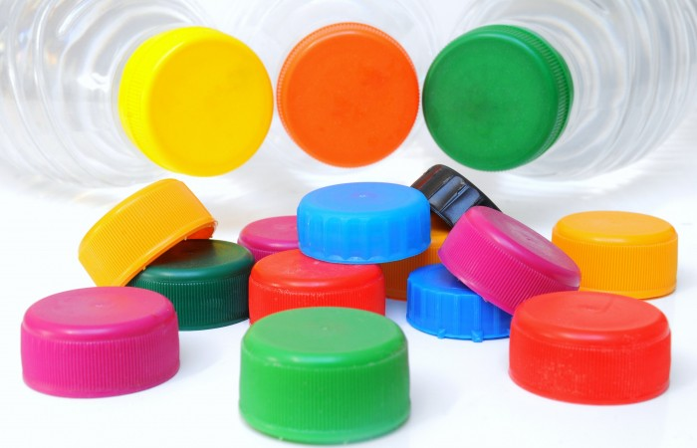
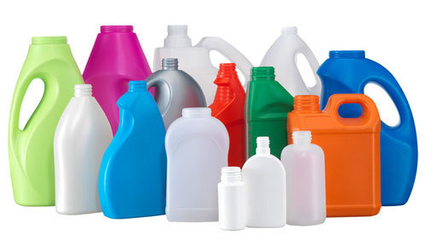
Basic Introduction to Current Composite Recycling in Industry
Module 1: Lecture 5
Crystalline Thermoplastics
Usually translucent with molecular chains which present a regular arrangement
Compared to other types, these polymers have more mechanical impact resistance.
    Examples of this type of polymers are:
      Polypropylene (PP)
      Low-density polyethylene (LDPE)
      High-density polyethylene (HDPE)
Polypropylene (PP)
Low-density polyethylene (LDPE)
High-density polyethylene (HDPE)
Source: http://www.mdpi.com/2313-4321/2/4/24/htm
Notes:
Crystalline thermoplastics, usually translucent with molecular mechanical impact resistance.
Crystalline structures are generally very ordered, which is what gives them strength and rigidity. Think of diamond or steel as examples. A crystalline polymer, where the molecular chains are largely locked in place against one another, is similar. Apply a load and it will break rather than bend.
Usually translucent with molecular chains which present a regular arrangement.
Compared to other types, these polymers have more mechanical impact resistance.

Slide 117
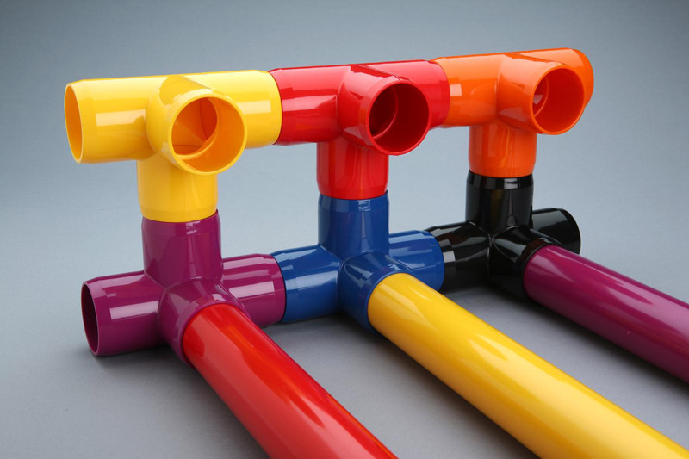
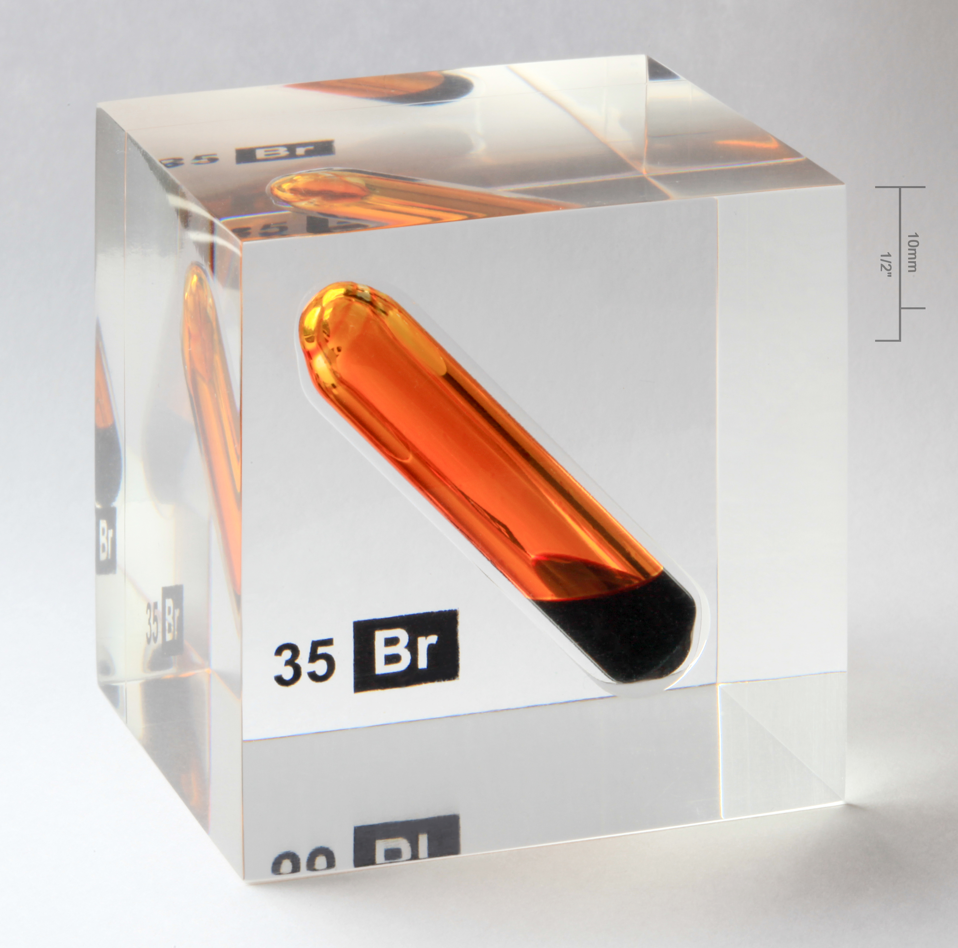
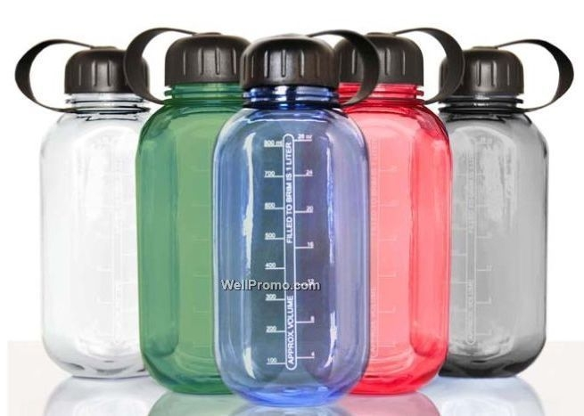
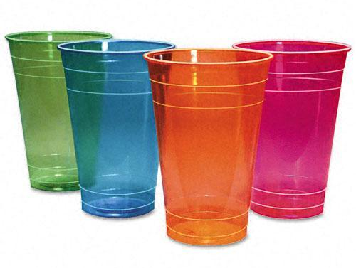
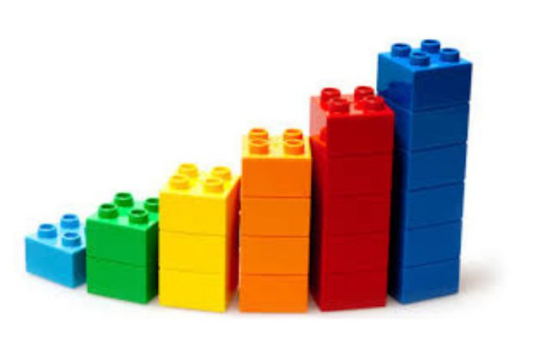
Basic Introduction to Current Composite Recycling in Industry
Module 1: Lecture 5
Amorphous Thermoplastics
Amorphous thermoplastics, usually transparent with the molecules arranged randomly
Compared to other types, these polymers have more mechanical impact resistance.
PMMA is often used as a shatter-resistant substitute for glass.
    Examples of this type of polymers are:
      Poly Vinyl Chloride (PVC)
      Poly Methyl Methacrylate (PMMA)
      Polycarbonate (PC)
      Polystyrene (PS)
      Acrylonitrile Butadiene Styrene (ABS)

Poly Vinyl Chloride (PVC)

Poly Methyl Methacrylate (PMMA)

Polycarbonate (PC)

Polystyrene (PS)

Acrylonitrile Butadiene Styrene (ABS)
Source: http://www.mdpi.com/2313-4321/2/4/24/htm
Notes:
Amorphous thermoplastics, usually transparent with the molecules arranged randomly. Compared to other types, these polymers have more mechanical impact resistance. PMMA is often used as a shatter-resistant substitute for glass.
Amorphous polymers are the opposite. Rather than being rigid, the random molecular jumble lets the chains move across each other when the polymer is pushed or pulled. In short, amorphous polymers have flexibility and elasticity.
In reality the distinction is not black or white. Within virtually all polymers there’s a mix of crystalline and amorphous structures. The proportion of each is influenced by how the polymer is processed, it’s composition, and temperature. An amorphous polymer might still contain 10% crystalline structures while one that’s crystalline might actually only have 80% of its structure truly ordered in a crystalline manner.

Slide 118
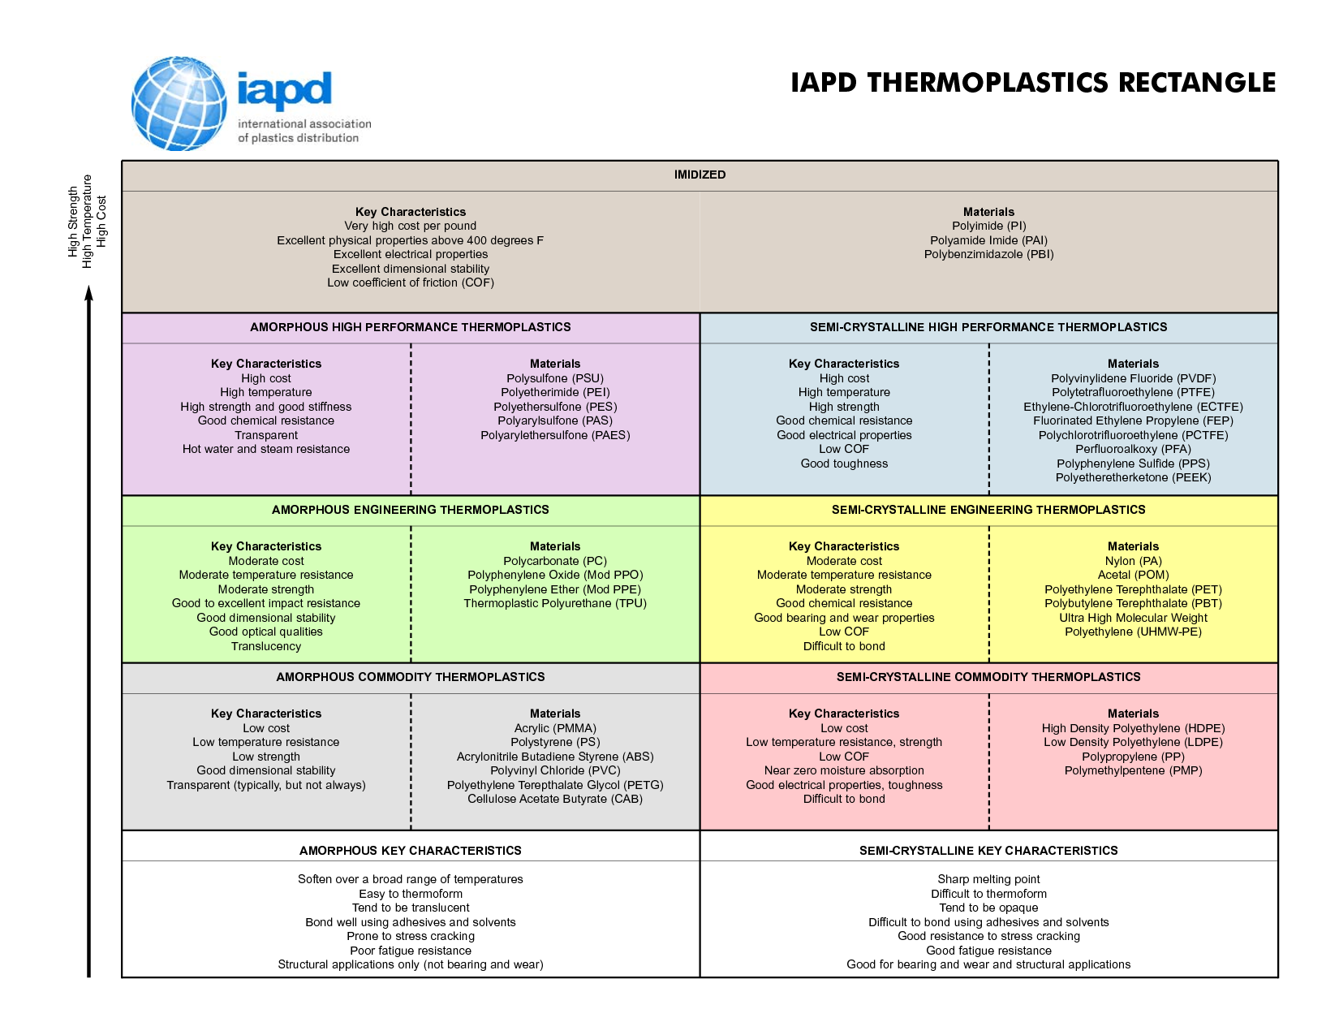
Basic Introduction to Current Composite Recycling in Industry
Module 1: Lecture 5
Source: https://www.redwoodplastics.com/education-2/amorphous-vs-semi-crystalline-thermoplastics/
Notes:
Amorphous Thermoplastics:
These are most of your clear plastics. They include polycarbonate, acrylic, PETG, ABS and polysulfone.
Advantages of these plastics are that they are easy to thermoform, they soften over a range of temperatures, and they bond well using adhesives.
When compared to semi-crystalline thermoplastics of a similar grade, amorphous plastics tend to have better dimensional stability and impact resistance.
Drawbacks include amorphous plastics having poor fatigue resistance and are prone to stress cracking.
Semi-Crystalline Thermoplastics:
These are most of your traditional plastics when you think of plastic “parts”. They include the polyethylene family (LDPE, HDPE, UHMW-PE), Polypropylene, nylon, acetal and fluoropolymers.
Advantages of these plastics are that they are excellent for bearing, wear and structural applications.
When compared to amorphous thermoplastics, these semi-crystallines tend to have better chemical resistance, electrical properties and a lower coefficient of friction.
Drawbacks include semi-crystalline plastics being difficult to thermoform, difficult to bond, have a sharp melting point and only average impact resistance.

Slide 119

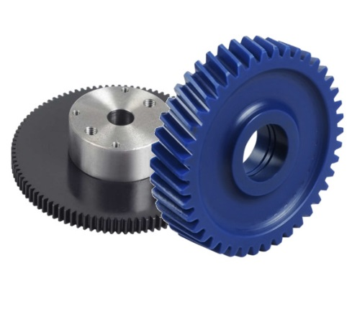
Basic Introduction to Current Composite Recycling in Industry
Module 1: Lecture 5
Semi-crystalline Polymers
Semi-crystalline polymers present combined properties of crystalline polymers and amorphous polymers.
  Advantages
    Low water absorption
    Moldability
    Strength
  Limitations
    Affected by boiling water
    Maximum use temperature is 300 degrees F (149 degrees C)
    Chemical resistance
Examples of this type of polymers are:
  Polyester Polybutylene Terephthalate (PBT)
  Polyamide
Polyester Polybutylene Terephthalate (PBT)
Polyamide
Source: http://www.mdpi.com/2313-4321/2/4/24/htm
Notes:
Polybutylene Terephthalate (PBT) is a crystalline, high molecular weight polymer that has a balance of properties and processing characteristics. Because the material crystallizes rapidly, mold cycles are short and molding temperatures can be lower than for many engineering plastics. This thermoplastic polyester has very good dimensional stability. It also exhibits high heat resistance, chemical resistance and good electricals.
In general, PBT materials exhibit higher tensile, flexural and dielectric strengths and faster, more economical molding characteristics than many thermosets.
Polyamides (PA) are semi-crystalline polymers. They have very good mechanical properties, are particularly tough and have excellent sliding and wear characteristics. Properties vary from the hard and tough PA 6.6 to the soft and flexible PA 12. Depending on the type, polyamides absorb different amounts of moisture, which also affect the mechanical characteristics as well as the dimensional accuracy.

Slide 120
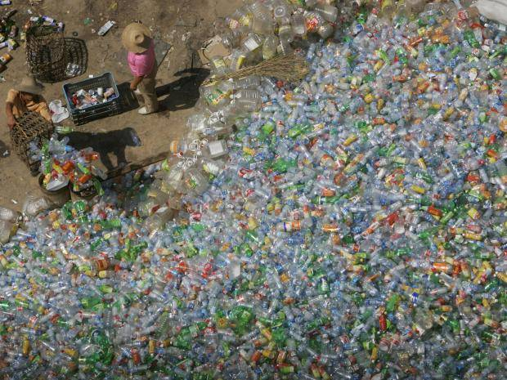
Basic Introduction to Current Composite Recycling in Industry
Module 1: Lecture 5
  Recycled Thermoplastic Polymers
  Ideal properties of the thermoplastic polymers
    Corrosion resistance
    Low density
    High strength
    User-friendly design
  Plastic usage has become much higher than the usage of aluminum or other metals.
  Density is a very important parameter
Source: http://www.mdpi.com/2313-4321/2/4/24/htm
Notes:
Density is a very important parameter because it reveals information about the intrinsic strength of the construction that is supposed to be created, as in the case of ﬂax reinforcement when PP and LDPE are the best choices (because of their low density) since its purpose is to produce a composite that is as light as possible.
Heat most crystalline structures and there’s a clear point at which they suddenly become liquid. This of course is the melting point. Amorphous polymers have no clear melting point. Instead they have a glass transition temperature of Tg. This is where the polymer transitions from rigid or solid to being soft and pliable. The glass transition temperature (Tg) is another characteristic that is very important when studying polymer mechanical properties, because the ﬂexibility of amorphous polymers is reduced drastically when they are cooled below Tg. At these temperatures, there are no dimensional changes or segmental motion in the polymer.
Also, the mechanical properties are very important in the case of thermoplastic polymers, mostly the tensile strength (important for their performance under stress) and tensile modulus (the resistance of polymers to elastic deformation)

Slide 121
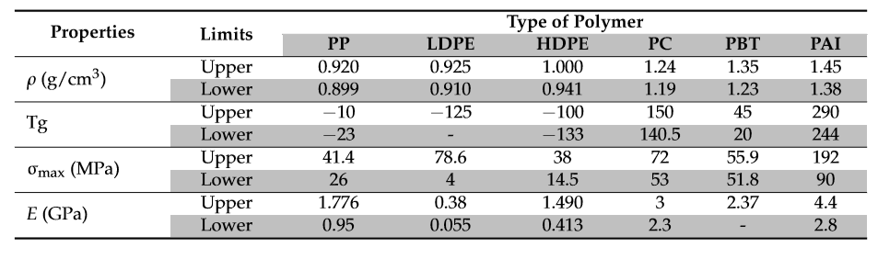
Basic Introduction to Current Composite Recycling in Industry
Module 1: Lecture 5
The Properties of Various Polymers
The plastic manufacturing cost is lower due to its simple mass production
The main reasons which make the thermoplastic polymers used in various applications are:
    The thermoplastic polymers can be processed by several methods leading to various kinds of plastic products
    They are used for a speciﬁc application
    The ability to produce plastic items with the lowest cost range
Source: http://www.mdpi.com/2313-4321/2/4/24/htm
Notes:
The plastic manufacturing cost is lower due to its simple mass production
The main reasons which make the thermoplastic polymers used in various applications are:
The thermoplastic polymers can be processed by several methods leading to various kinds of plastic products
They are used for a speciﬁc application: several compounding, operating condition, additives, ﬁllers, and reinforcements
Several manufacturing systems are used at this moment to produce plastic items with the lowest cost range

Slide 122

Basic Introduction to Current Composite Recycling in Industry
Module 1: Lecture 5
Recycling and Incineration
The recycling and incineration are the usual aspects of recovery methods in the case of thermoplastic polymers.
The incineration presents some problems like
    The production of toxic gases
    Residue ash which contains lead and cadmium
The recycling presents advantages such as reduction of environmental problems and saving both material and energy
The steps involved in thermoplastic polymers recycling.
Source: http://www.mdpi.com/2313-4321/2/4/24/htm

Slide 123
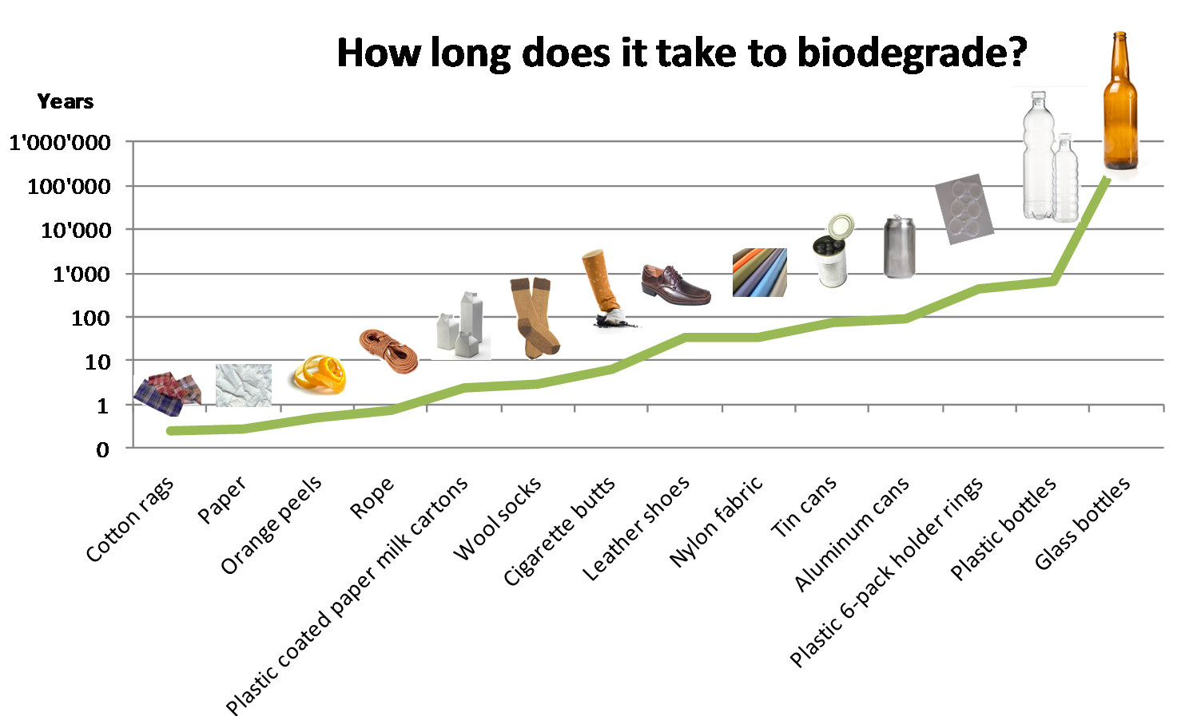
Basic Introduction to Current Composite Recycling in Industry
Module 1: Lecture 5
Environmental Degradation
Plastic can be degraded in the environment by four mechanisms:
    Photodegradation
    Thermo-oxidative degradation
    Hydrolytic degradation
    Biodegradation by microorganisms
Source: http://www.mdpi.com/2313-4321/2/4/24/htm
Notes:
The natural degradation of plastic begins with photodegradation due to the UV light from the sun which provides the activation energy required to initiate the incorporation of oxygen atoms into the polymer, leading to thermo‐oxidative degradation. In this step, the plastic becomes brittle and its fracturing into smaller pieces until the polymer chains reach sufficiently low molecular weight to be metabolized by microorganisms. The microorganisms convert the carbon of the polymer chains to carbon dioxide or incorporate it into biomolecules, but this process will take at least 50 years [36]. A solution to these problems will be the recycling, because most commodity plastics are relatively stable, making monomer recovery poor.
Photodegradation is the process by which a substance is altered via photons, especially those found in the wavelengths of the sun’s rays. Though photodegradation does eventually degrade plastic, this is a very slow and inefficient process.
Thermal degradation of polymers is molecular deterioration as a result of overheating. At high temperatures the components of the long chain backbone of the polymer can begin to be broken (chain scission) and react with one another to change the properties of the polymer.
Hydrolytic Degradation: This process occurs in polymers that are water sensitive active groups, especially those that take a lot of moisture. Polymers that have an ability for hydrolytic destruction usually have heteroatoms in the main or side chain. Hydrolysis : the scission of chemical functional groups by reaction with water. Some polymers are very stable to hydrolysis.
Different steps of plastic degradation by microorganisms
Several steps occur in the plastic biodegradation process and could be identified by specific terminology:
-Bio-deterioration
Defines the action of microbial communities and other decomposer organisms responsible for the physical and chemical deterioration that resulted in a superficial degradation that modifies the mechanical, physical and chemical properties of the plastic.
-Bio-fragmentation
Refers to the catalytic actions that cleave polymeric plastics into oligomers, dimers or monomers by ecto-enzymes or free-radicals secreted by microorganisms.
-Assimilation
Characterizes to the integration of molecules transported in the cytoplasm in the microbial metabolism.
-Mineralization
Refers to the complete degradation of molecules that resulted in the excretion of completely oxidized metabolites (CO₂, N₂, CH₄, H₂O).

Slide 124
Basic Introduction to Current Composite Recycling in Industry
Module 1: Lecture 5
Primary Recycling
The most popular process
This process refers to the reuse of products in their original
structure.
The disadvantage: The existence of a limit on the number of cycles for each material.
Secondary Recycling or Mechanical Recycling
In this process, only the thermoplastic polymers can be used
Does not involve the alteration of the polymer during the process
A physical method, in which the plastic wastes will be formed by cutting, shredding or washing.
Can be blended with virgin material to obtain superior results.
The quantity of the waste plastic will be dramatically reduced.
The disadvantages of this method include the deterioration of product’s properties in each cycle.
Source: http://www.mdpi.com/2313-4321/2/4/24/htm
Notes:
Primary Recycling
The most popular process is represented by the primary recycling due to their simplicity and low cost.
This process refers to the reuse of products in their original structure.
The disadvantage of this process is represented by the existence of a limit on the number of cycles for each material.
Secondary Recycling or Mechanical Recycling
In this process, only the thermoplastic polymers can be used, because they can be re‐melted and reprocessed into end products.
The mechanical recycling does not involve the alteration of the polymer during the process.
This process is represented by a physical method, in which the plastic wastes will be formed by cutting, shredding or washing into granulates, flakes or pellets of appropriate quality for manufacturing, and then melted to make the new product by extrusion.
The reprocessed material can be blended with virgin material to obtain superior results.
After the plastic is sorted, cleaned, dried and then directly processed into end products, the quantity of the waste plastic will be dramatically reduced.
The disadvantages of this method refer to the heterogeneity of the solid waste and the deterioration of product’s properties in each cycle which occurs due to the low molecular weight of the recycled resin.
It happens because of chain‐scission reactions caused by the presence of water and traces acidic impurities and to avoid lowering molecular weight intensive drying is recommended, the use of chain extender compounds or reprocessing with vacuum degassing. This method is relatively inexpensive but needs substantial initial investment

Slide 125
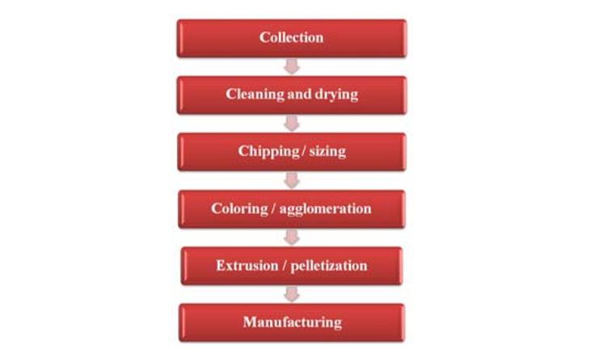
Basic Introduction to Current Composite Recycling in Industry
Module 1: Lecture 5
The Steps involved in Mechanical Recycling
Source: http://www.mdpi.com/2313-4321/2/4/24/htm

Slide 126
Basic Introduction to Current Composite Recycling in Industry
Module 1: Lecture 5
Feedstock or Chemical Recycling
  Can be used with mechanical recycling as a complementation.
  Chemical recycling is deﬁned as the process in which polymers are chemically converted to monomers or partially depolymerized to oligomers through a chemical reaction (a change occurs to the chemical structure of the polymer).
  The resulted monomers can be used for new polymerizations
  This method can transform the plastic material into smaller molecule
Source: http://www.mdpi.com/2313-4321/2/4/24/htm
Notes:
This process can be used with mechanical recycling as a complementation.
Chemical recycling is deﬁned as the process in which polymers are chemically converted to monomers (a molecule that can be bonded to other identical molecules to form a polymer) or partially depolymerized to oligomers (a polymer whose molecules consist of relatively few repeating units) through a chemical reaction (a change occurs to the chemical structure of the polymer).
The resulted monomers can be used for new polymerizations to reproduce the original or a related polymeric product. This method is able to transform the plastic material into smaller molecules, suitable for use as feedstock material starting with monomers, oligomers, or mixtures of other hydrocarbon compounds

Slide 127
Basic Introduction to Current Composite Recycling in Industry
Module 1: Lecture 5
Feedstock or Chemical Recycling
The chemical reactions and methods used for decomposition of polymers into monomers are:
    Hydrogenation
    Glycolysis
    Gasiﬁcation
    Hydrolysis
    Pyrolysis
    Methanolysis
    Chemical depolymerization
    Thermal cracking
    Catalytic cracking and reforming
    Photodegradation
    Ultrasound degradation
    Degradation in microwave reactor
Source: http://www.mdpi.com/2313-4321/2/4/24/htm
Notes:
The chemical reactions and methods used for decomposition of polymers into monomers are:
Hydrogenation
Glycolysis
Gasiﬁcation
Hydrolysis
Pyrolysis
Methanolysis
Chemical depolymerization
Thermal cracking
Catalytic cracking and reforming
Photodegradation
Ultrasound degradation
Degradation in microwave reactor

Slide 128
Basic Introduction to Current Composite Recycling in Industry
Module 1: Lecture 5
Feedstock or Chemical Recycling
Chemical recycling is not fully developed
Only a few companies are working on it
Numerous methods are under investigation
For example:
    Gasiﬁcation and pyrolysis method is under extensive research
Processes that have reached commercial maturity at this moment are:
    Glycolysis and methanolysis
For example:
    PET (polyethylene terephthalate) can be cleaved by some reagents, like water (hydrolysis), acids (acidolysis), glycols (glycolysis) or alcohols (alcoholysis).
    According to the reagent used, different products are obtained.
Source: http://www.mdpi.com/2313-4321/2/4/24/htm
Notes:
Chemical recycling is not fully developed, only a few companies are working on it because this method needs a lot of investment and expert personnel. At this moment, numerous methods for feedstock and chemical recycling are under investigation; for example, the gasiﬁcation and pyrolysis method is under extensive research to establish the suitable conditions. The processes that have reached commercial maturity at this moment are glycolysis and methanolysis. For example, PET (polyethylene terephthalate) can be cleaved by some reagents, like water (hydrolysis), acids (acidolysis), glycols (glycolysis) or alcohols (alcoholysis). According to the reagent used, different products are obtained.

Slide 129
Basic Introduction to Current Composite Recycling in Industry
Module 1: Lecture 5
Feedstock or Chemical Recycling
  Hydrolysis is a recycling method that involves a reaction of PET with water in an acid, alkaline or neutral environment
  This leads to total depolymerization into its monomers.
  The disadvantages are represented by:
      The high temperatures (between 200 and 250◦C)
      By pressures (between 1.4 and 2 MPa)
      And by the long time needed to complete depolymerization.
      This method is not widely used, because of the high cost.
Source: http://www.mdpi.com/2313-4321/2/4/24/htm
Notes:
Hydrolysis is a recycling method that involves a reaction of PET with water in an acid, alkaline or neutral environment
This leads to total depolymerization into its monomers.
The disadvantages are represented by:
The high temperatures (between 200 and 250◦C)
By pressures (between 1.4 and 2 MPa)
And by the long time needed to complete depolymerization.
This method is not widely used, because of the high cost.

Slide 130
Basic Introduction to Current Composite Recycling in Industry
Module 1: Lecture 5
Feedstock or Chemical Recycling
Hydrolysis of PET ﬂakes can be carried out by:
    Alkalinehydrolysis
    Acid hydrolysis of PET
    Neutral hydrolysis
Of all these methods of hydrolysis, the neutral hydrolysis gets an increased interest because it is considered more environmentally friendly, but this method presents a main disadvantage namely that all mechanical impurities present in PET are left in the TPA, thus the product can be considered of lower purity than the product of acid or alkaline hydrolysis.
Source: http://www.mdpi.com/2313-4321/2/4/24/htm
Notes:
Hydrolysis of PET ﬂakes can be carried out by:
Alkalinehydrolysis, which uses an aqueous alkaline solution of NaOHorKOH, of a concentration of 4–20wt%. In a study, PET from post-consumer soft-drink bottles was cut into small pieces and then subjected to alkaline hydrolysis. After that, an autoclave was used; the temperature ranged from 120–200◦C with aqueous NaOH solutions and at 110–120 ◦C with a nonaqueous solution of KOH in methyl cellosolve. Sulfuric acid was used to separate terephthalic acid (TPA) of high purity. It was reported that it was obtained about 2% admixture of isophthalic acid together with the pure 98% TPA and the activation energy calculated was 99 kJ/mol [42]. Also, it was demonstrated by alkaline hydrolysis the possibility of simultaneously recycling PET and PVC from PVC-coated woven fabrics
Acid hydrolysis used concentrated sulfuric acid and also other mineral acids like nitric or phosphoric acid. In several studies, it was reported that the depolymerization of PET powder from waste bottles using nitric acid was carried out at temperatures between 70 and 100◦C. Also, it was reported the hydrolysis of PET using sulfuric acid (96 wt. %) at room temperature (30 ◦C)
Neutral hydrolysis, using hot water or steam, high-pressure autoclaves at temperatures between 200 and 300 ◦C and pressures of 1–4 MPa. It was reported that this method is more effective at temperatures higher than 245◦C, with complete depolymerization taking place at 275◦C and its TPA yield being usually above 95%.
Of all these methods of hydrolysis, the neutral hydrolysis gets an increased interest because it is considered more environmentally friendly, but this method presents a main disadvantage namely that all mechanical impurities present in PET are left in the TPA, thus the product can be considered of lower purity than the product of acid or alkaline hydrolysis.

Slide 131
Basic Introduction to Current Composite Recycling in Industry
Module 1: Lecture 5
Feedstock or Chemical Recycling
Chemical recycling of PET by glycolysis involves…
  Ethylene glycol insertion into PET chains to give bis(hydroxyethyl) terephthalate (BHET), which is a substrate for PET synthesis and other oligomers.
  In a study, it was found that the puriﬁcation process of the products in the glycolysis catalyzed by ionic liquids was simpler than that catalyzed by traditional compounds (metal acetate).
  Also, it was reported that the reactivity order of different glycols varies according to the conditions of temperature and catalysis.
  The global reactivity depends on the chemical reactivity of the glycol and on its physicochemical properties such as the polarity of the reaction mixture and ability to solvate the solid polyesters.
Source: http://www.mdpi.com/2313-4321/2/4/24/htm

Slide 132
Basic Introduction to Current Composite Recycling in Industry
Module 1: Lecture 5
Feedstock or Chemical Recycling
Chemical recycling of PET by methanolysis involves…
  PET degradation by methanol at temperatures between 180 and 280◦C and pressures from 2 to 4 MPa with the main products being dimethyl terephthalate (DMT) and ethylene glycol (EG).
  Optimal depolymerization conditions
  DMT is puriﬁed by distillation to remove all of the physical contaminants and then it can be reused to produce PET
  The rate of methanolysis strongly depends on the solubility of PET
  Polymers like PET produce mainly the monomers from which they have been produced.
  In comparison, polyoleﬁns cannot be degraded with simple chemicals to their monomers due to the random scission of the C-C bonds.
Source: http://www.mdpi.com/2313-4321/2/4/24/htm

Slide 133
Basic Introduction to Current Composite Recycling in Industry
Module 1: Lecture 5
Feedstock or Chemical Recycling
Chemical recycling of PET by methanolysis involves…
  Polyoleﬁn are a major group of thermoplastics used throughout the world in applications such as toys, containers, bags, ﬁlm, battery cases, and electrical components.
  Chemical recycling uses a chemical process like pyrolysis
  Oil and gaseous fractions recovered by pyrolysis of PP presented great potential to be recycled back into the petrochemical industry as a feedstock for the production of new plastics.
Source: http://www.mdpi.com/2313-4321/2/4/24/htm

Slide 134
Basic Introduction to Current Composite Recycling in Industry
Module 1: Lecture 5
Feedstock or Chemical Recycling
Chemical recycling of PET by methanolysis
  With the recycling of LDPE, HDPE and PP by both a dissolution/reprecipitation technique (mechanical recycling) and pyrolysis (chemical/feedstock recycling)….
    It was observed that mechanical recycling leads to high recovery of pure polymer
    The disadvantage of using large amounts of organic solvents, while chemical recycling resulted to be the most promising technique.
Source: http://www.mdpi.com/2313-4321/2/4/24/htm
Notes:
Chemical recycling of PET by glycolysis involves…
Ethylene glycol insertion into PET chains to give bis(hydroxyethyl) terephthalate (BHET), which is a substrate for PET synthesis and other oligomers.
In a study, it was found that the puriﬁcation process of the products in the glycolysis catalyzed by ionic liquids was simpler than that catalyzed by traditional compounds (metal acetate).
Also, it was reported that the reactivity order of different glycols varies according to the conditions of temperature and catalysis.
The global reactivity depends on the chemical reactivity of the glycol and on its physicochemical properties such as the polarity of the reaction mixture and ability to solvate the solid polyesters.

Slide 135
Basic Introduction to Current Composite Recycling in Industry
Module 1: Lecture 5
Feedstock or Chemical Recycling
  Chemical recycling of PET by methanolysis
    In the case of pyrolysis, there is a higher decomposition in PP, followed by LDPE and ﬁnally HDPE
    The less crystalline or more branched polymers are less stable in thermal degradation.
    The degradation of PS in various supercritical solvents (benzene, toluene, ethylbenzene) at 310–370 ◦C and 6.0 MPa pressure was studied. It was reported that PS had been successfully depolymerized; toluene was more effective than other solvents for the recovery of styrene from PS. The highest yield of styrene was obtained from PS in toluene at 360◦C for 20 min.
Source: http://www.mdpi.com/2313-4321/2/4/24/htm
Notes:
Chemical recycling of PET by methanolysis involves…
In the case of pyrolysis, a higher decomposition in PP, followed by LDPE and ﬁnally HDPE. The less crystalline or more branched polymers are less stable in thermal degradation.
The degradation of PS in various supercritical solvents (benzene, toluene, ethylbenzene) at 310–370 ◦C and 6.0 MPa pressure was studied. It was reported that PS had been successfully depolymerized; toluene was more effective than other solvents for the recovery of styrene from PS. Also, the highest yield of styrene was obtained from PS in toluene at 360◦C for 20 min.

Slide 136
Basic Introduction to Current Composite Recycling in Industry
Module 1: Lecture 5
Feedstock or Chemical Recycling
Chemical recycling of PET by methanolysis
  The recycling of LDPE, HDPE and PP by both a dissolution/reprecipitation technique (mechanical recycling) and pyrolysis (chemical/feedstock recycling).
    Mechanical recycling leads to high recovery of pure polymer with the disadvantage of using large amounts of organic solvents, while chemical recycling resulted to be the most promising technique.
    In the case of pyrolysis, a higher decomposition in PP, followed by LDPE and ﬁnally HDPE, was observed
    The less crystalline or more branched polymers are less stable in thermal degradation.
    Degradation of PS in various supercritical solvents
    PS had been successfully depolymerized; toluene was more effective than other solvents for the recovery of styrene from PS.
Source: http://www.mdpi.com/2313-4321/2/4/24/htm
Notes:
The recycling of LDPE, HDPE and PP by both a dissolution/reprecipitation technique (mechanical recycling) and pyrolysis (chemical/feedstock recycling).
It was observed that mechanical recycling leads to high recovery of pure polymer with the disadvantage of using large amounts of organic solvents, while chemical recycling resulted to be the most promising technique.
In the case of pyrolysis, a higher decomposition in PP, followed by LDPE and ﬁnally HDPE, was observed and also it was reported that the less crystalline or more branched polymers are less stable in thermal degradation.
The degradation of PS in various supercritical solvents (benzene, toluene, ethylbenzene) at 310–370 ◦C and 6.0 MPa pressure was studied. It was reported that PS had been successfully depolymerized; toluene was more effective than other solvents for the recovery of styrene from PS. Also, the highest yield of styrene was obtained from PS in toluene at 360◦C for 20 min.

Slide 137
Basic Introduction to Current Composite Recycling in Industry
Module 1: Lecture 5
Energy Recovery or Quaternary Recycling
  This method refers to the recovery of the plastic’s energy content.
  The most effective way to reduce the volume of organic materials which involves the recovery of energy is incineration.
  This method is a good solution because it generates considerable energy from polymers
  There is the potential for not being ecologically acceptable because of the health risk from airborne toxic substances
  For example:
      Dioxins (in the case of heavy metals, chlorine-containing polymers, toxic carbon, and oxygen-based free radicals).
  Among the recycling techniques, the only one acceptable according to the principles of sustainable development is chemical recycling, because this method leads to the formation of the monomers from which the polymer is made.
Source: http://www.mdpi.com/2313-4321/2/4/24/htm
Notes:
This method refers to the recovery of the plastic’s energy content.
The most effective way to reduce the volume of organic materials which involves the recovery of energy is represented by incineration.
This method is a good solution because it generates considerable energy from polymers
There is the potential for not being ecologically acceptable because of the health risk from airborne toxic substances
For example,
Dioxins (in the case of heavy metals, chlorine-containing polymers, toxic carbon, and oxygen-based free radicals).
Among the recycling techniques, the only one acceptable according to the principles of sustainable development is chemical recycling, because this method leads to the formation of the monomers from which the polymer is made.

Slide 138
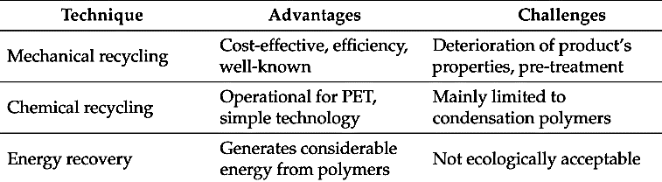
Basic Introduction to Current Composite Recycling in Industry
Module 1: Lecture 5
Advantages and Challenges of Thermoplastic Recycling
Source: http://www.mdpi.com/2313-4321/2/4/24/htm

Slide 139
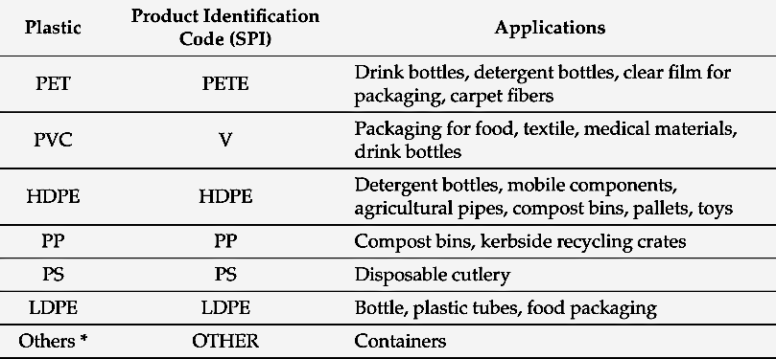
Basic Introduction to Current Composite Recycling in Industry
Module 1: Lecture 5
Applications of Recycled Plastics
Other plastics, including polylactic acid, ABS, nylon and polycarbonate.
Source: http://www.mdpi.com/2313-4321/2/4/24/htm

Slide 140
Basic Introduction to Current Composite Recycling in Industry
Module 1: Lecture 5
Perspectives for a Green Industry
  The total production of plastics in 2015 was more than 322 million tons per year, In which will increase to 400 million tons in 2020
    In 2015, global plastic’s production grew by 3.4% compared to 2014.
    Equates to more than 12% of the urban solid waste stream.
    9 countries in Europe reached up until 2015 a recovery ratio of more than 95% of the post-consumer plastic waste
  The recycling process is the best technique to treat waste polymer products
  Other traditional methods, such as combustion of waste polymers or burying underground, lead to negative inﬂuences on the environment via the formation of dust, fumes and toxic gases or the pollution of underground water and other resources.
  The innovations in recycling technologies are represented by detectors and recognition software that collectively increase the accuracy and productivity of automatic sorting such as Fourier Transform Near-Infrared (FT-NIR) detectors which can operate for up to 8000 h between faults in the detectors.
Source: http://www.mdpi.com/2313-4321/2/4/24/htm
Notes:
The total production of plastics in 2015 was more than 322 million tons per year, which will increase to 400 million tons in 2020
In 2015, global plastic’s production grew by 3.4% compared to 2014.
The increasing consumption of polymer products in various ﬁelds generates a lot of waste materials, which equates to more than 12% of the urban solid waste stream.
9 countries in Europe reached until 2015 a recovery ratio of more than 95% of the post-consumer plastic waste because of the landﬁll ban being well managed.
Over the years, it was observed that the recycling process is the best technique to treat waste polymer products, and the old-style methods, such as combustion of waste polymers or burying underground, lead to negative inﬂuences on the environment via the formation of dust, fumes and toxic gases or the pollution of underground water and other resources. The innovations in recycling technologies are represented by detectors and recognition software that collectively increase the accuracy and productivity of automatic sorting such as Fourier Transform Near-Infrared (FT-NIR) detectors which can operate for up to 8000 h between faults in the detectors.

Slide 141
Basic Introduction to Current Composite Recycling in Industry
Module 1: Lecture 5
Group Discussion
Recycling Infrastructure;
In-house Grinding/Shredding vs. Outsourcing
  Compare and contrast in-house grinding/shredding vs. outsourcing
  List the advantage and disadvantages
  Suggest ways to streamline/address these challenges.

Slide 142
Basic Introduction to Current Composite Recycling in Industry
Module 1: Lecture 5
Group Discussion
Recycling Your Own Scrap vs. Selling/Giving To Another Company
Compare and contrast recycling your own scrap vs. selling/giving to another company
  List the advantage and disadvantages
  Suggest ways to streamline/address these challenges.
Notes:
Disadvantages to Recycling your own scrap:
Cost of sorting in-house (could be done for less at a different company).
Creates additional skills for workers
Storage can be cumbersome
Your scrap may be of no value to you and/or you cannot determine a use for it.
Additional investment
Disadvantages to Recycling your own scrap:
Cost of sorting in-house (could be done for less at a different company).
Creates additional skills for workers
Storage can be cumbersome
Your scrap may be of no value to you and/or you cannot determine a use for it.
Additional investment

Slide 143
Summary
Module 1: Lecture 5
In this lecture you have learned:
Thermoset polymers refer to the irreversible polymerization and this type of polymer is cured by chemical reaction or heat and becomes infusible and insoluble material.
Thermoplastics are made up of linear molecular chains and this polymer softens on heating and hardens when cooled.
Thermoplastic polymers are represented by a large range of plastic materials. There are three types of thermoplastic polymers:
    Crystalline thermoplastics
    Amorphous thermoplastics
    Semi-crystalline polymers

Slide 144
Summary
Module 1: Lecture 5
In this lecture you have learned:
  The ideal properties of the thermoplastic polymers are
    Corrosion resistance
    Low density
    High strength
    User-friendly design
  The steps involved in thermoplastic polymers recycling.
    Collection
    Separation
    Manufacturing
    Marketing
  Plastic can be degraded in the environment by four mechanisms:
    Photodegradation
    Thermo-oxidative degradation
    Hydrolytic degradation
    Biodegradation by microorganisms

Slide 145
Summary
Module 1: Lecture 5
In this lecture you have learned:
Primary Recycling is the most popular process
  This process refers to the reuse of products in their original structure.
Secondary Recycling or Mechanical Recycling
  In this process, only the thermoplastic polymers can be used
  A physical method, in which the plastic wastes will be formed by cutting, shredding or washing.
  Can be blended with virgin material to obtain superior results.
  The quantity of the waste plastic will be dramatically reduced.
  The disadvantages of this method include the deterioration of product’s properties in each cycle.

Slide 146
Summary
Module 1: Lecture 5
In this lecture you have learned:
The Steps involved in Mechanical Recycling
  Collection
  Cleaning and Drying
  Chipping/Sizing
  Coloring/Agglomeration
  Extrusion/Pelletization
  Manufacturing

Slide 147
Summary
Module 1: Lecture 5
In this lecture you have learned:
Chemical recycling is deﬁned as the process in which polymers are chemically converted to monomers or partially depolymerized to oligomers through a chemical reaction
Hydrolysis is a recycling method that involves a reaction of PET with water in an acid, alkaline or neutral environment
Glycolysis involves Ethylene glycol insertion into PET chains to give bis(hydroxyethyl) terephthalate (BHET), which is a substrate for PET synthesis and other oligomers.
Methanolysis involves PET degradation by methanol at temperatures between 180 and 280◦C and pressures from 2 to 4 MPa with the main products being dimethyl terephthalate (DMT) and ethylene glycol (EG).

Slide 148
Summary
Module 1: Lecture 5
In this lecture you have learned:
The advantages and challenges of thermoplastic recycling
The applications of recycled plastics
  Ways to streamline/address the challenges of in-house grinding/shredding and outsourcing
Ways to streamline/address the challenges of recycling your own scrap and selling/giving to another company

Slide 149

Contact Information
Skagit Valley College
Composites Technician Recycling Program
Darren.Greeno@skagit.edu
Lars.antonsen@Skagit.edu
University of Alabama Birmingham
Engineering Department
pillay@uab.edu
Edmonds Community College
National Resource Center for
Materials Technology Education
Mel.cossette@edcc.edu
This work is part of a larger project funded by the Advanced Technological Education Program
of the National Science Foundation, DUE #1400619 and #1601216

