Slide 1



Composite Recycling Technician Education Program
Module 2: Lecture 1
Module 2 - Composite Manufacturing Methods - Thermosets and Thermoplastic
Lecture 1 – Types of Composites

Slide 2
Composite Manufacturing Methods: Types of Composites
Module 2: Lecture 1
Objectives:
Describe the three categorizations of composites based upon their matrix.
Differentiate the characteristics of Metal Matrix Composites (MMC’s), Ceramic Matrix Composites (CMC’s) and Polymer Matrix Composites (PMC’s)
Explain the purpose of the matrix and the reinforcement
Gain a familiarity with the different type of fibers used in PMC’s
Explore the advantages and disadvantages of PMC’s
Describe the difference between Thermoplastic and Thermoset resins.

Slide 3
Composite Manufacturing Methods: Types of Composites
Module 2: Lecture 1
At the end of the lecture you will be able to:
Identify the three common categorization of composites according to their matrix.
Describe and identify the differences between the characteristics of Metal Matrix Composites (MMC’s), Ceramic Matrix Composites (CMC’s) and Polymer Matrix Composites (PMC’s)
Identify the purpose of the matrix in PMC’s
Identify the purpose of reinforcement in PMC’s
Identify the different types of reinforcement used in PMC’s
List the advantages and disadvantages of PMC’s
Describe the difference between Thermoplastic and Thermoset resins.

Slide 4
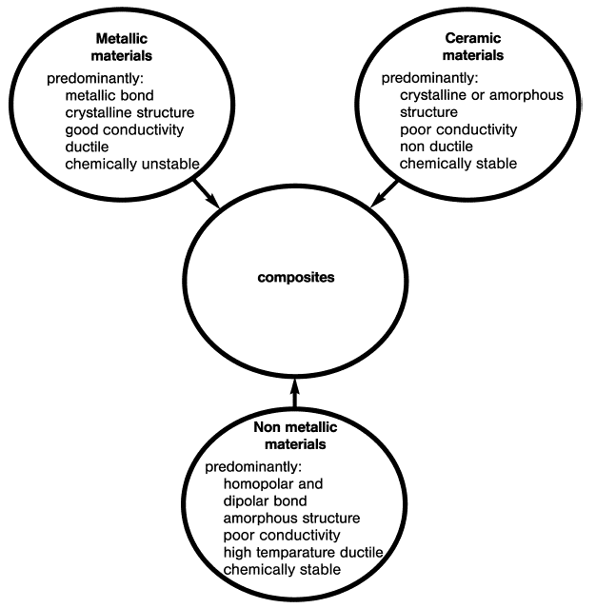
Types of Composites
Module 2: Lecture 1
MMC’s: Metal Matric Composites
CMC’s: Ceramic Matric Composites
PMC’s: Polymer Matric Composites
Source: Green Composites Workshop 2012 in Chicago, IL, June 20-21, “Why Recycle Composites?” Presentation by Bob Moffit.
Notes:
To understand the application of composite materials to a structure, an understanding is required of the component materials themselves and of the ways in which they can be processed. In its most basic form, a composite material is one which is composed of at least two elements working together to produce material properties that are better than the properties of those elements on their own. In practice, most composites consist of a bulk material (the matrix) and a reinforcement of some kind, added primarily to increase the strength and stiffness of the matrix. This reinforcement is usually in fiber form.
The continuous phase of a composite is the matrix, and composites can be identified or classified according to their matrix. Polymer, metal and ceramic are the three main matrix classifications for composites.
Polymer Matrix Composites (PMC's) ­ These are the most common composites. They are also known as FRP - Fiber Reinforced Polymers (or Plastics) or Glass Reinforced Plastics - these materials use a polymer-based resin as the matrix, and a variety of fibers such as glass, carbon and aramid as the reinforcement.
Metal Matrix Composites (MMC's) - Increasingly found in the automotive industry, these materials use a metal such as aluminum as the matrix and reinforce it with fibers such as silicon carbide.
Ceramic Matrix Composites (CMC's) - Used in very high temperature environments, these materials use a ceramic as the matrix and reinforce it with short fibers, or whiskers such as those made from silicon carbide and boron nitride.

Slide 5
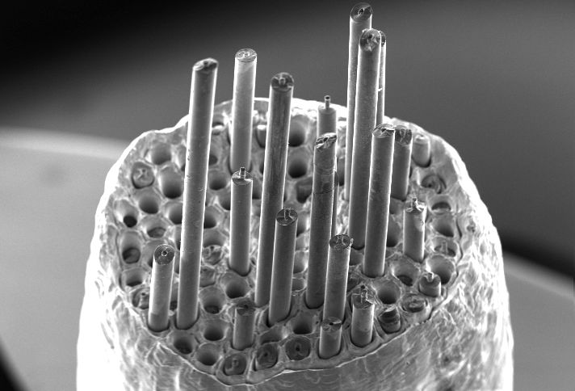
Types of Composites
Module 2: Lecture 1
Metal Matrix Composites (MMC’s)
  Metal matrix with metallic or ceramic reinforcements
  High temperature applications
  Impart ductility/toughness
  Increase wear resistance
  Most common processing methods:
    Liquid Phase (casting liquid matrix with solid reinforcement)
    Solid Phase (powder metallurgy—sintering
Fracture Surface Of A Sic Fiber-Reinforced Cu MMC.
Source: http://arnabocean.com/whatarecomposites.html
Notes:
In metal matrix composites form strong bonds between the fiber and the matrix, the matrix transfers the load between the fibers. There is shear loading at the interface. The function of the reinforcement is, as its very name implies, is to reinforce the matrix, or primary phase. The reinforcement can be called the imbedded phase and can take place as Fibers, Particles or Flakes. In addition, the secondary phase can take the form of an infiltrated phase in a skeletal or porous matrix. For example: a powder metallurgy part infiltrated with a polymer.
Materials consisting of metallic matrices, reinforced with ceramic particles or fibers are know as Metal Matrix Composites (MMC’s). MMC’s can offer a broader range of properties and can enhance properties of monolithic alloys. Different types of reinforcing phases included
a) particles of ceramic (the MMC’s are commonly called cermets,
and b) fibers of a variety of materials: Ceramics, carbon and boron.
From Wikipedia:
A cermet is a composite material composed of ceramic (cer) and metal (met) materials.
A cermet is ideally designed to have the optimal properties of both a ceramic, such as high temperature resistance and hardness, and those of a metal, such as the ability to undergo plastic deformation.
The metal is used as a binder for an oxide, boride, or carbide.
Generally, the metallic elements used are nickel, molybdenum and cobalt.
Depending on the physical structure of the material, cermets can also be matrix composites, but cermets are usually less than 20% metal by volume.

Slide 6
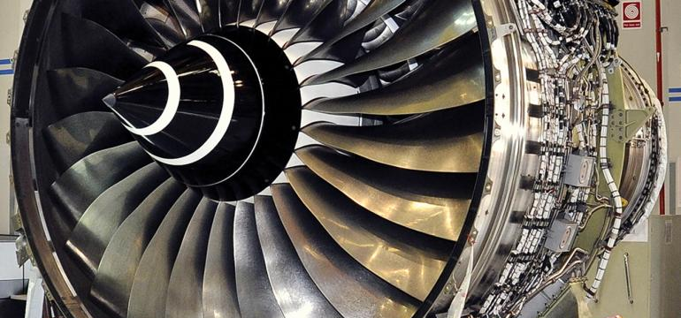
Types of Composites
Module 2: Lecture 1
Source: http://www.machinedesign.com/materials/future-metal-matrix-composites
Metal Matrix Composites (MMC’s)
  Higher temperature capability
  Fire resistance
  Higher transverse stiffness and strength
  No moisture absorption
  Higher electrical and thermal conductivities
  Better radiation resistance
Notes:
You can find MMC’s used in many applications in our everyday lives. Materials like cast iron with graphite, or steel with a high carbide content, as well as tungsten carbides, consisting of carbides and metallic binders, belong to this group.
Other advantages of MMC’s include:
Higher temperature capability
Fire resistance
Higher transverse stiffness and strength
No moisture absorption
Higher electrical and thermal conductivities
Better radiation resistance

Slide 7
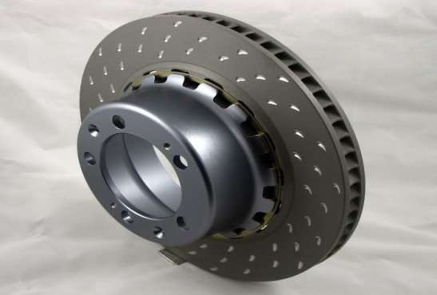
Types of Composites
Module 2: Lecture 1
Metal Matrix Composites (MMC’s)
  The reinforcement of metals can have the following as objectives:
  To increase yield strength and tensile strength as room temperature and higher while maintaining the minimum ductility (or toughness)
  To increase creep resistance at higher temperatures
  To increase fatigue strength, especially at higher temperatures
  To improve thermal shock resistance
  To improve corrosion resistance
  To show an increase in Young’s modulus
  To reduce thermal elongation.
Aluminum Based MMC
Source: Essays, UK. (November 2013). Aluminium Based Metal Matrix Composites. Retrieved from https://www.ukessays.com/essays/engineering/aluminium-based-metal-matrix-6811.php?vref=1
Source: https://www.slideshare.net/HiepTran51/metal-matrix-composites-68130090
Notes:
The reinforcement of metals can have the following as objectives:
To increase yield strength and tensile strength as room temperature and higher while maintaining the minimum ductility (or toughness)
To increase creep resistance at higher temperatures
To increase fatigue strength, especially at higher temperatures
To improve thermal shock resistance
To improve corrosion resistance
To show an increase in Young’s modulus
To reduce thermal elongation.
From https://www.thoughtco.com/youngs-modulus-4176297:
Young's modulus
(E or Y) is a measure of a solid’s stiffness or resistance to elastic deformation under load. It relates stress (force per unit area) to strain (proportional deformation) along an axis or line.
The basic principle is that a material undergoes elastic deformation when it is compressed or extended, returning to its original shape when the load is removed.
More deformation occurs in a flexible material compared to that of a stiff material.
In other words:
A low Young's modulus value means a solid is elastic.
A high Young's modulus value means a solid is inelastic or stiff.

Slide 8
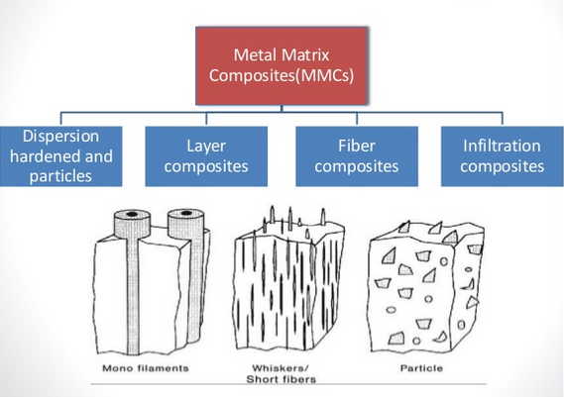
Types of Composites
Module 2: Lecture 1
Source: https://www.slideshare.net/HiepTran51/metal-matrix-composites-68130090
Notes:
MMC’s can be classified according to the type of reinforcement;
Dispersion hardened and particles
Layer composites
Fiber composites
Infiltration composites
Metal-matrix composites and methods for producing these composites:
Manufacturing methods include providing a ceramic preform having a uniform distribution of ceramic particles sintered to one another.
The particles include an average particle size of no greater than about 3 microns, and at least one half of the volume of the preform is occupied by porosity.
The preform is then set into a mold and contacted by molten metal.
The molten metal is then forced into the pores of the preform and permitted to solidify to form a solid metal-matrix composite.
Source: https://patents.google.com/patent/EP0869855B1/en

Slide 9
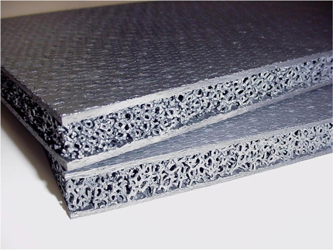
Types of Composites
Module 2: Lecture 1
Ceramic Matrix Composites (CMC’s)
  Very high temperature applications
  Used to improve strength and toughness
  Processing Methods:
    Slurry infiltration—matrix powder + carrier liquid + organic binder (slurry)
    Solgel—Sol (colloidal fluid containing fibers) is converted to a gel and heat treated (sinter/HIP)
    Chemical-Vapor Infiltration—Fiber preform infiltrated via chemical vapor deposition; Expensive!
The NASA Glenn Research Center has developed a family of ceramic composite sandwich materials composed of a ceramic foam core between two ceramic composite face sheets. These materials are being investigated as multifunctional, integrated structures.
Source: http://www.grc.nasa.gov/WWW/RT/2006/RX/RX11C-hurwitz1.html

Slide 10
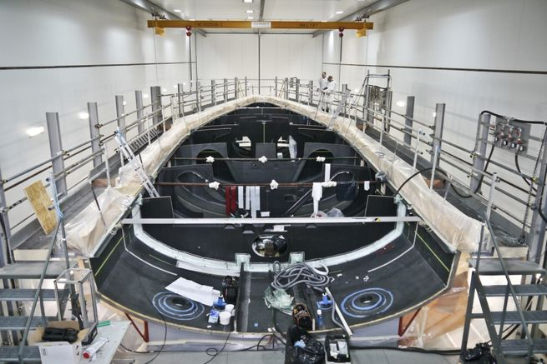
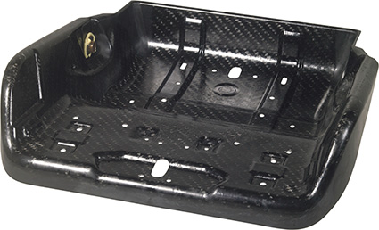
Types of Composites
Module 2: Lecture 1
Polymer Matrix Composites (PMC’s)
  Account for largest sector of composite usage
  Combination of reinforcing phase and a thermoset or thermoplastic
  Reinforcing phase is typically a fiber
  Common matrix materials:
Source: https://www.sailingworld.com/meet-designer-future-volvo-ocean-race-yachts
Thermoset
  Epoxy
  Phenolic
  Polyester
  Vinyl Ester
Thermoplastic
  PEEK
  PP
  Nylon
  PE
https://www.chemanager-online.com/en/topics/chemicals-distribution/perfect-symbiosis-material-and-design {Photo: Lanxess}

Slide 11
Types of Composites
Module 2: Lecture 1
Reinforcement Types for PMC’s
  Glass
    E-glass
    S-glass
    C-glass
  Thermoplastic polymer
    Aramid (KevlarTM)
    Ultra high molecular weight polyethylene (SpectraTM/DyneemaTM)
    Nylon
  Metals
    Beryllium
    Boron
    Tungsten
    Nickel
    Copper
    Steel
  Carbon
    High strength (HS) carbon fiber
    High modulus (HM) carbon fiber
  Natural
    Cotton
    Hemp
    Sisal
    Jute
    Silk
  Ceramic
    Basalt
    Al2O3
    B4C
    SiC
    ZrO2
  Nano
    Montmorillonite clay (layered silicate)
    Multi-wall carbon nanotubes
    Single wall carbon nanotubes

Slide 12
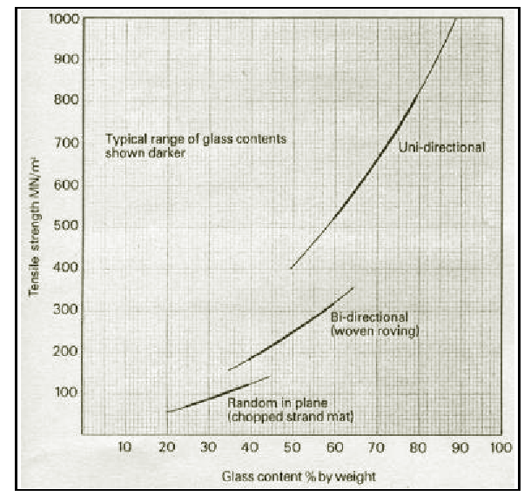
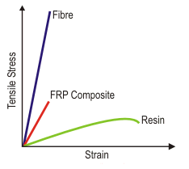
Strength and Stiffness of PMC’s
Types of Composites
Module 2: Lecture 1
Strongly dependent on the fiber orientation and fiber volume content!

Slide 13
Polymer Matrix Composites (PMC’s)
Types of Composites
Module 2: Lecture 1
Advantages
Weight saving
Corrosion resistance
Long fatigue life
Manufacturing
  Reduced parts count (complex geometries can be molded)
  Novel shapes possible
  Low cost tooling
  Low temperature processing
Design freedom
  Continuous spectrum of properties
  Anisotropic properties possible
Disadvantages
High cost of raw materials
Lack of design standards
Properties not well characterized
Low through-thickness tensile and shear strengths
Sensitivity to stress concentrations
Dependence of properties on manufacture (TP, TS)
Few mass production processes

Slide 14
Polymer Matrix Composites (PMC’s)
Types of Composites
Module 2: Lecture 1
Thermoplastics
Aka: thermosoftening plastics
Composed of long chain monomers and are susceptible to high temperatures
  Makes them easily reheated and remolded (recyclable)
Thermosets
A polymer set irreversibly
Generally are much stronger than thermoplastics due to network of cross-linked three-dimensional bonds
Considered non recyclable but are attractive as insulating materials and for durability
Formed via heating, electron beam processing or irradiation

Slide 15
Summary
Module 2: Lecture 1
In this lecture you have learned:
That the three categorizations of composites based upon their matrix are:
    Metal Matrix Composites (MMC’s)
    Ceramic Matrix Composites (CMC’s)
    Polymer Matrix Composites (PMC’s)
Characteristics of Metal Matrix Composites include:
  A metal matrix can have metallic or ceramic reinforcements
  They are used in high temperature applications
  Impart ductility/toughness
  Increase wear resistance
  Most common processing methods:
    Liquid Phase (casting liquid matrix with solid reinforcement)
    Solid Phase (powder metallurgy—sintering

Slide 16
Summary
Module 2: Lecture 1
Characteristics of Ceramic Matrix Composites include:
  They are used in very high temperature applications
  They are used to improve strength and toughness
  Processing Methods include:
    Slurry infiltration—matrix powder + carrier liquid + organic binder (slurry)
    Solgel—Sol (colloidal fluid containing fibers) is converted to a gel and heat treated (sinter/HIP)
    Chemical-Vapor Infiltration—Fiber preform infiltrated via chemical vapor deposition; Expensive!

Slide 17
Summary
Characteristics of Polymer Matrix Composites include:
Advantages
  Weight saving
  Corrosion resistance
  Long fatigue life
  Manufacturing
    Reduced parts count (complex geometries can be molded)
    Novel shapes possible
    Low cost tooling
    Low temperature processing
Design freedom
  Continuous spectrum of properties
  Anisotropic properties possible
Disadvantages
High cost of raw materials
Lack of design standards
Properties not well characterized
Low through-thickness tensile and shear strengths
Sensitivity to stress concentrations
Dependence of properties on manufacture (TP, TS)
Few mass production processes

Slide 18
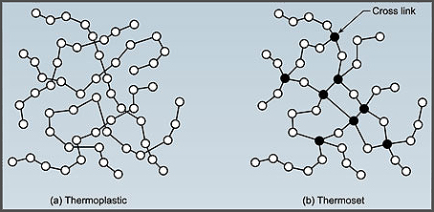
Summary
Thermosets
The polymer is set irreversibly
Generally are much stronger than thermoplastics due to network of cross-linked three-dimensional bonds
Considered non recyclable but are attractive as insulating materials and for durability
Formed via heating, electron beam processing or irradiation
Thermoplastics
(Aka: thermosoftening plastics)
Composed of long chain monomers and are susceptible to high temperatures
Makes them easily reheated and remolded (recyclable)
Image source: https://www.recycledplastic.com/index.html%3Fp=10288.html

Slide 19
Composite Recycling Technician Education Program
Module 2: Lecture 2
Module 2 - Composite Manufacturing Methods - Thermosets and Thermoplastic
Lecture 2 – Injection Molding and Compression Molding

Slide 20
Composite Manufacturing Methods:
Injection Molding and Compression Molding
Module 2: Lecture 2
Objectives:
Learn the process of Injection Molding
Learn about the materials used in Injection Molding
Learn about the products made with Injection Molding
Learn about the difference between thermoset and thermoplastic injection molding
Learn about the process of Compression Molding
Learn about the materials used in Compression Molding
Learn about the products made with Compression Molding
Learn about the difference between thermoset and thermoplastic Compression Molding

Slide 21
Composite Manufacturing Methods:
Injection Molding and Compression Molding
Module 2: Lecture 2
At the end of the lecture you will be able to:
Describe the process of Injection Molding
Identify the materials used in Injection Molding
Identify products made with Injection Molding
Describe the difference between thermoset and thermoplastic injection molding
Describe the process of Compression Molding
Identify the materials used in Compression Molding
Identify products made with Compression Molding
Describe the difference between thermoset and thermoplastic Compression Molding

Slide 22
Lecture 2
Module 2: Lecture 2
Composite Manufacturing Methods:
Injection Molding and Compression Molding
Manufacturing methods and processes for Thermoplastics vs. Thermosets
Thermoset Processes
Thermoplastic Processes
Injection Molding
Rotational Molding
Compression Molding
Casting, Foam Molding
Vacuum-Bag Molding
Hand/Spray Layup
Resin Transfer Molding
Filament Winding
Pultrusion
Transfer Molding
Reaction Injection Molding
Extrusion
  Blow Molding
  Thermoforming

Slide 23
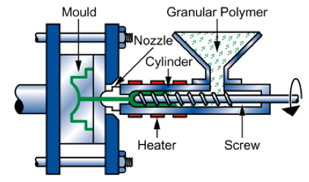
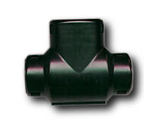
Lecture 2
Module 2: Lecture 2
Composite Manufacturing Methods:
Injection Molding and Compression Molding
Injection Molding
Injection Molding is highly productive method providing high accuracy and control of shape of the manufactured parts. The method is profitable in mass production of large number of identical parts.
Injection Molding is used mainly for Thermoplastics, but Elastomers and Thermosets also may be extruded. In this case cross-linking occurs during heating and melting of the material in the heated barrel.
Injection Molding Process
Part made by injection molding
Source: http://www.substech.com/dokuwiki/doku.php?id=injection_molding_of_polymers
Notes:
Injection molding can be performed with either thermosets or thermoplastics.
It is a rapid and high volume process
Very complex shapes can be achieved resulting in a wide product range
But, it come with a downside. The tooling costs are high and the equipment is expensive.
Injection molding process
Granular plastics fed by gravity from hopper to heated barrel
Screw moves granules to heating chamber for melting
Melted Plastic forced through a nozzle into cold mold cavity through a gate-runner system
Injection Molding is a process in which molten polymer is forced under high pressure into a mold cavity through an opening (sprue).
Polymer material in form of pellets is fed into an Injection Molding machine through a hopper. The material is then conveyed forward by a feeding screw and forced into a split mold, filling its cavity through a feeding system with sprue gate and runners.
Injection Molding machine is similar to Extruder. The main difference between the two machines is in screw operation. In extruder screw rotates continuously providing output of continuous long product (pipe, rod, sheet). Screw of injection molding machine is called reciprocating screw since it not only rotates but also moves forward and backward according to the steps of the molding cycle.
It acts as a ram in the filling step when the molten polymer is injected into the mold and then it retracts backward in the molding step.
Heating elements, placed over the barrel, soften and melt the polymer.
The mold is equipped with a cooling system providing controlled cooling and solidification of the material.
The polymer is held in the mold until solidification and then the mold opens and the part is removed from the mold by ejector pins.
Injection Molding is used mainly for Thermoplastics, but Elastomers and Thermosets are also may be extruded. In this case cross-linking occurs during heating and melting of the material in the heated barrel.
A principal scheme of an Injection Molding Machine is shown in the picture.
Injection Molding is highly productive method providing high accuracy and control of shape of the manufactured parts. The method is profitable in mass production of large number of identical parts.
Thermoplastics commonly used in Injection Molding are as follows:
Polypropylene (PP)
Polycarbonate (PC)
Acrylonitrile-Butadiene-Styrene (ABS)
Nylon 6 (N6)
Injection Molding is used for manufacturing DVDs, pipe fittings, battery casings, toothbrush bases, bottle lids, disposable razors, automobile bumpers and dash boards, power-tool housing, television cabinets, electrical switches, telephone handsets, automotive power brake, automotive fascias, transmission, and electrical parts, mirror housings, steam irons, washer pumps, spoilers, butter tubs, moisture vaporizers, yogurt containers, toilet seats, cell-phone housings, cradles or bases for personal digital assistants, case of a notebook-computer, computer mouse, electrical connector housings, lawn chairs, automotive ashtrays, and cookware appliance handles and knobs, aerosol caps, household items, bottle caps, toys.

Slide 24
Lecture 2
Module 2: Lecture 2
Composite Manufacturing Methods:
Injection Molding and Compression Molding
Injection Molding
Thermoplastics commonly used in Injection Molding are as follows:
  Polypropylene (PP)
  Polycarbonate (PC)
  Acrylonitrile-Butadiene-Styrene (ABS)
  Nylon 6 (N6)
Thermosets commonly used in Injection Molding are as follows:
  Bulk Molding Compound (BMC) or Dough Molding Compound (DMC), which are saturated and unsaturated polyesters and vinyl esters
  Phenolic Molding Compound, Epoxy, and Diallyl Phthalate (DAP)
Injection Molding Process
Part made by injection molding
Source: http://www.substech.com/dokuwiki/doku.php?id=injection_molding_of_polymers and https://www.woodlandplastics.com/understanding-thermoset-plastics.html
Notes:
Thermoplastics commonly used in Injection Molding are as follows:
Polypropylene (PP)
Polycarbonate (PC)
Acrylonitrile-Butadiene-Styrene (ABS)
Nylon 6 (N6)
Thermosets commonly used in Injection Molding are as follows:
Bulk Molding Compound (BMC) or Dough Molding Compound (DMC), which are saturated and unsaturated polyesters and vinyl esters
Phenolic Molding Compound, Epoxy, and Diallyl Phthalate (DAP)

Slide 25

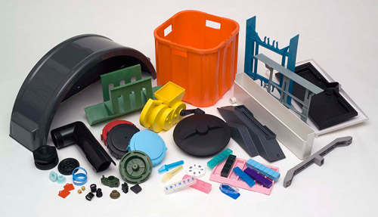
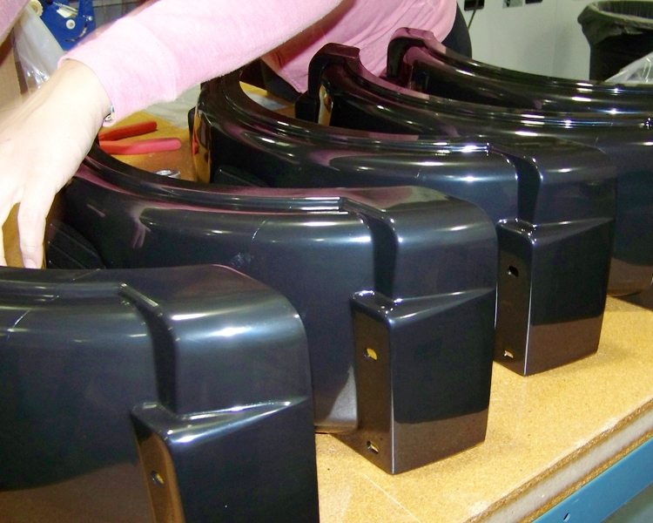
Lecture 2
Module 2: Lecture 2
Composite Manufacturing Methods:
Injection Molding and Compression Molding
Injection Molding
Injection Molding is used for manufacturing a very wide variety of products!
Source: http://www.pmplastic.com/injection-molded-part-product-look-like/
Notes:
DVDs, pipe fittings, battery casings, toothbrush bases, bottle lids, disposable razors, automobile bumpers and dash boards. Power-tool housing, television cabinets, electrical switches, telephone handsets, automotive power brake parts, automotive transmission parts, and electrical parts. Mirror housings, steam irons, washer pumps, spoilers, butter tubs, moisture vaporizers, yogurt containers, toilet seats, cell-phone housings, case of a notebook-computer, computer mouse, electrical connector housings, lawn chairs, automotive ashtrays, and cookware appliance handles and knobs, aerosol caps, household items, bottle caps, toys.

Slide 26
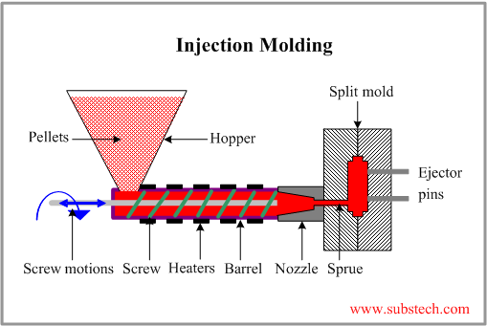
Lecture 2
Module 2: Lecture 2
Composite Manufacturing Methods:
Injection Molding and Compression Molding
Injection Molding
Injection Molding is a process in which a molten polymer is forced under high pressure into a mold cavity through an opening (the sprue).
Injection Molding Process
Polymer material in form of pellets or granular plastics is fed by gravity into a heated barrel within an Injection Molding machine, through a hopper.
The material is then conveyed forward by a feeding screw, melted, and forced into a split mold, filling its cavity through a feeding system with sprue gate and runners.
The screw of an injection molding machine is called reciprocating screw since it not only rotates but also moves forward and backward according to the steps of the molding cycle.
Source: http://www.substech.com/dokuwiki/doku.php?id=injection_molding_of_polymers
Notes:
Injection Molding is a process in which a molten polymer is forced under high pressure into a mold cavity through an opening (the sprue).
Polymer material in form of pellets or granular plastics is fed by gravity into a heated barrel within a Injection Molding machine, through a hopper.
The material is then conveyed forward by a feeding screw, melted, and forced into a split mold, filling its cavity through a feeding system with sprue gate and runners.
The screw of an injection molding machine is called reciprocating screw since it not only rotates but also moves forward and backward according to the steps of the molding cycle.
Molding machine is like an Extruder. The main difference between the two machines is in screw operation. In extruder screw rotates continuously providing output of continuous long product (pipe, rod, sheet). Screw of injection molding machine is called reciprocating screw since it not only rotates but also moves forward and backward according to the steps of the molding cycle.
It acts as a ram in the filling step when the molten polymer is injected into the mold and then it retracts backward in the molding step.
Heating elements, placed over the barrel, soften and melt the polymer.
The mold is equipped with a cooling system providing controlled cooling and solidification of the material.
The polymer is held in the mold until solidification and then the mold opens, and the part is removed from the mold by ejector pins.

Slide 27
Lecture 2
Module 2: Lecture 2
Composite Manufacturing Methods:
Injection Molding and Compression Molding
Thermoset Vs. Thermoplastic Injection Molding: A Comparison
The primary difference in these two plastics comes down to heat and chemical resistance.
In thermoset injection molding, cold material is injected into an extremely hot mold to create a part. This process cures the part so it can never be melted again.
In thermoplastic injection molding, plastic material is melted and injected into a mold to create a part. Once this part cools, the mold opens, and the part is ejected.
Thermoset injection molders are typically more difficult to find than thermoplastic injection molders.
Source https://www.micronproducts.com/blog/thermoset-vs-thermoplastic
Notes:
The properties of thermosets and thermoplastics are quite different—but the similarities and differences are often asked about. The primary difference in these two plastics comes down to heat and chemical resistance. Heat resistance is the primary function of a thermoset material, while thermoplastics—which are much more common—can only withstand heat to a certain degree. It’s worth noting that plastic injection molding companies typically do either thermoset or thermoplastic injection molding, but rarely do they handle both.
Below, we’ve broken down how thermosets and thermoplastics differ in the injection molding process, material availability, uses, cost, and recyclability. Take a look:
Thermoset Vs. Thermoplastic Injection Molding: A Comparison
Injection Molding Process
In thermoset injection molding, cold material is injected into an extremely hot mold to create a part. This process cures the part so it can never be melted again.
In thermoplastic injection molding, plastic material is melted and injected into a mold to create a part. Once this part cools, the mold opens and the part drops out.
Availability
The very first plastic materials created were thermosets, but today, thermoset injection molding is not as common except with electrical contact applications and liquid silicone. Thus, thermoset injection molders are typically more difficult to find than thermoplastic injection molders.

Slide 28
Lecture 2
Module 2: Lecture 2
Composite Manufacturing Methods:
Injection Molding and Compression Molding
Thermoset Vs. Thermoplastic Injection Molding: A Comparison
Thermosets are most frequently used in situations where the part must be able to withstand high temperatures.
Thermoplastic parts are more likely to be used for consumer plastics that either won’t encounter high temperatures.
Consider whether the part will regularly be contact with certain chemistries.
Source https://www.micronproducts.com/blog/thermoset-vs-thermoplastic
Notes:
Thermosets are most frequently used in situations where the part must be able to withstand high temperatures. Medical parts are a good example; dental tools with silicone handles and metal parts must be able to withstand the autoclaving process in order to be sanitized and reused over and over again, so the silicone must be thermoset. Higher voltage electrical applications also use thermosets.
Thermoplastic parts are more likely to be used for consumer plastics that either won’t come in contact with high temperatures, like the plastic used in milk jugs, or will need to withstand moderately high temperatures. Certain polycarbonates, for example, are resistant to hot liquids and often used to make plastic to-go mugs—but they can still deform or melt at high-enough temperatures.
When considering thermoset vs. thermoplastic parts, you’ll also want to consider whether the part will regularly be contact with certain chemistries. If you’re manufacturing plastic casing for an EKG, for example, the material used will need to be able to withstand any hospital-grade chemical disinfectants.
Cost
The cost difference between thermoset and thermoplastic injection molding is not black and white. While the thermoset process is typically slower—which equates to a higher cost—the material difference in thermoplastic could range from 90 cents to $10 per pound, depending on the properties. That said, cost considerations should not be enough to sway an engineer toward one type or another—a decision should be based far more on material properties and the functionality of the part needed.
Recyclability
Thermoplastics are created by melting pellets and then cooling them, which ensures the finished part can also be remelted. This allows thermoplastics to be recycled. Of course, certain properties are no longer the same once you’ve melted a part down, so recycling a thermoplastic doesn’t ensure you’ll get the same quality plastic part—but it is worth noting.
Thermosets, on the other hand, cannot be remelted—so while thermoplastic parts could, hypothetically, be ground up and used in a sandbag, their recyclability factor is limited.

Slide 29
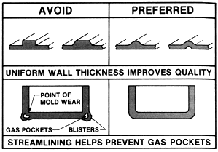
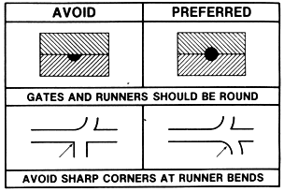
Lecture 2
Module 2: Lecture 2
Composite Manufacturing Methods:
Injection Molding and Compression Molding
Injection Molding
Regarding Quality:
  Uniform wall thickness
  Thin walls
  Streamlining
    Gates and runners
    Contoured parts
    Venting
    Filets
Source: http://www.engin.umich.edu/labs/EAST/me589/gallery/bioplastics_f01/599Website/pmf.htm#_Injection_molding
Notes:
Regarding Quality:
Uniform wall thickness
Thin walls require less material and curing time
Streamlining – helps prevent gas pockets
Gates and runners should be round, and sharp corners at runners should be avoided to prevent plastic solidify at the runner
Contoured parts warp less than flat parts
Venting of molds removes trapped air
Filets should be used at the base of ribs or bosses

Slide 30
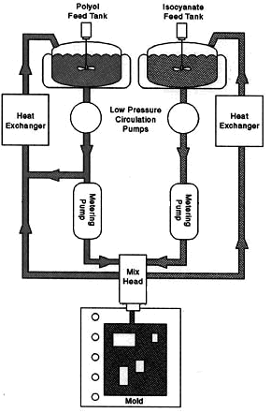
Lecture 2
Module 2: Lecture 2
Composite Manufacturing Methods:
Injection Molding and Compression Molding
Reaction Injection Molding (RIM)
  For thermosets only
  Monomer + 2 or more reactive fluids forced at high speed into mixing chamber and then into the mold cavity
    10-20 Mpa
  Chemical reactions take place rapidly to solidify polymer
Diagram of reaction injection molding.
Source: http://www.engin.umich.edu/labs/EAST/me589/gallery/bioplastics_f01/599Website/pmf.htm#_Injection_molding

Slide 31
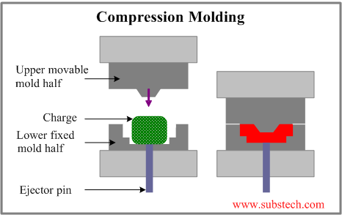
Lecture 2
Module 2: Lecture 2
Composite Manufacturing Methods:
Injection Molding and Compression Molding
Compression Molding
What is Compression Molding?
Mostly for molding thermosetting resins, but some thermoplastic parts may also be produced
Uses a split mold mounted in a hydraulic press
Compression Molding process involves the following steps:
A charge is placed into the lower half of the mold.
The charge is usually preheated prior to placement into the mold.
The mold is closed, pressing on the charge and forcing it to fill the mold cavity.
The mold, equipped with a heating system, provides curing (for thermosets).
The mold is opened, and the part is removed
Source: http://www.substech.com/dokuwiki/doku.php?id=compression_molding_of_polymers
Notes:
Compression Molding is a process in which a molding polymer is squeezed into a preheated mold taking a shape of the mold cavity and performing curing due to heat and pressure applied to the material.
The method is used mostly for molding thermosetting resins (thermosets), but some thermoplastic parts may also be produced by Compression Molding.
The method uses a split mold mounted in a hydraulic press
Compression Molding process involves the following steps:
A pre-weighed amount of a polymer mixed with additives and fillers (charge) is placed into the lower half of the mold.
The charge may be in form of powders, pellets, putty-like masses or pre-formed blanks.
The charge is usually preheated prior to placement into the mold.
Preheated polymer becomes softer resulting in shortening the molding cycle time.
The upper half of the mold moves downwards, pressing on the polymer charge and forcing it to fill the mold cavity.
The mold, equipped with a heating system, provides curing (cross-linking) of the polymer (if thermoset is processed).
The mold is opened and the part is removed from it by means of the ejector pin.
If thermosetting resin is molded, the mold may be open in hot state – cured thermosets maintain their shape and dimensions even in hot state.
If thermoplastic is molded, the mold and the molded part are cooled down before opening.

Slide 32
Lecture 2
Module 2: Lecture 2
Composite Manufacturing Methods:
Injection Molding and Compression Molding
Compression Molding
Compression Molding cycle time is about 1-6 min, which is longer than Injection Molding cycle.
The method is suitable for molding large flat or moderately curved parts.
Materials commonly processed by Compression Molding are:
  Epoxies (EP)
  Urea Formaldehyde (UF)
  Melamine Formaldehyde (MF)
  Phenolics (PF)
Compression Molding is used for manufacturing a wide variety of products.
Source: http://www.substech.com/dokuwiki/doku.php?id=compression_molding_of_polymers
Notes:
Compression Molding cycle time is about 1-6 min, which is longer than Injection Molding cycle.
The method is suitable for molding large flat or moderately curved parts.
Materials commonly processed by Compression Molding are:
Epoxies (EP)
Urea Formaldehyde (UF)
Melamine Formaldehyde (MF)
Phenolics (PF)
Compression Molding is used for manufacturing a wide variety of products. Electrical wall receptacles, brush and mirror handles, meter cases, trays, circuit breakers, cookware knobs, clothes dryer blower fan blade, electronic and cooking utensils, milling machine adjustment wheel, automotive parts, water testing equipment buttons, television cabinets, dinnerware, appliance housings, radio cases, aircraft main power terminal housing, hoods, pot handles, spoilers, electric plugs and sockets, fenders, dinnerware plates, scoops.

Slide 33
Lecture 2
Module 2: Lecture 2
Composite Manufacturing Methods:
Injection Molding and Compression Molding
Compression Molding
Compression molding is a high-volume, high-pressure method that is suitable for molding complex, high-strength fiber reinforced parts.
Advanced composite thermoplastics can also be compression molded with unidirectional tapes, woven fabrics, randomly oriented fiber mat or chopped strand.
The advantage of compression molding is its ability to mold large, slightly intricate parts.
It is one of the lowest cost molding methods compared with other methods such as transfer molding and injection molding.
It wastes relatively little material, giving it an advantage when working with expensive compounds.
Source: https://en.wikipedia.org/wiki/Compression_molding
Notes:
Compression molding is a high-volume, high-pressure method that is suitable for molding complex, high-strength fiber reinforced parts.
Advanced composite thermoplastics can also be compression molded with unidirectional tapes, woven fabrics, randomly oriented fiber mat or chopped strand.
The advantage of compression molding is its ability to mold large, slightly intricate parts.
It is one of the lowest cost molding methods compared with other methods such as transfer molding and injection molding.
It wastes relatively little material, giving it an advantage when working with expensive compounds.

Slide 34
Lecture 2
Module 2: Lecture 2
Composite Manufacturing Methods:
Injection Molding and Compression Molding
Compression Molding Advantages
Tooling costs are low because of the simplicity of the usual molds.
Little material is wasted since there are usually no sprues or runners Unless compared to runnerless injection molding
Thermosets, when compared to thermoplastics are not subject to retaining internal stresses after being cured.
Mechanical properties remain high since material receives little mastication in the process and when using reinforcements, they are literally not damaged or broken.
Less clamping pressure required than in most other processes.
Capital equipment is less costly.
Wash-action erosion of cavities is minimal and mold maintenance is low since melt flow length is short.
Source: https://fuziontrading.co.za/compression-moulding-process/
Notes:
Tooling costs are low because of the simplicity of the usual molds.
Little material is wasted since there are usually no sprues or runners
Unless compared to runnerless injection molding
Thermosets, when compared to thermoplastics are not subject to retaining internal stresses after being cured.
Mechanical properties remain high since material receives little mastication in the process and when using reinforcements, they are literally not damaged or broken.
Less clamping pressure required than in most other processes.
Capital equipment is less costly.
Wash-action erosion of cavities is minimal and mold maintenance is low since melt flow length is short.

Slide 35
Lecture 2
Module 2: Lecture 2
Composite Manufacturing Methods:
Injection Molding and Compression Molding
Compression Molding Limitations
Limitations of the method include:
  Fine pins, blades, and inserts in the cavity can become damaged as the press closes when cold material is used in the cavities.
  Complex shapes may not fill out as easily as by the transfer or injection molding processes.
  Extremely thick and heavy parts will cure more slowly than in transfer or injection molding, but preheating preforms or powder can shorten these cures.
  Thermosets with their low viscosity will produce flash during their cure that has to be removed.
Source: https://fuziontrading.co.za/compression-moulding-process/
Notes:
Limitations of the method include:
Fine pins, blades, and inserts in the cavity can become damaged as the press closes when cold material is used in the cavities.
Complex shapes may not fill out as easily as by the transfer or injection molding processes.
Extremely thick and heavy parts will cure more slowly than in transfer or injection molding, but preheating preforms or powder can shorten these cures.
Thermosets with their low viscosity will produce flash during their cure that has to be removed.

Slide 36
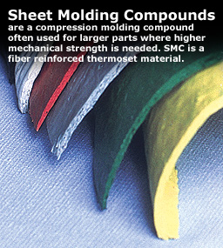
Lecture 2
Module 2: Lecture 2
Composite Manufacturing Methods:
Injection Molding and Compression Molding
Compression Molding Compounds (Materials)
- SMC – Sheet Molding Compound
  SMC's are suitable for molding a wide range of parts.
  The pliable sheet allows enough body for handling and cutting but enough rigidity for manual charge building or automation.
Source: http://www.idicomposites.com/smc-bmc-overview.php
Source: http://www.idicomposites.com/smc-bmc-overview.php
Notes:
SMC – Sheet Molding Compound
Sheet Molding Compounds (SMC) are primarily used in compression molding.
They are suitable for molding a wide range of parts from very small to very large, from flat panel to very complex shapes.
The pliable sheet allows enough body for handling and cutting but enough rigidity for manual charge building or automation.

Slide 37
Lecture 2
Module 2: Lecture 2
Composite Manufacturing Methods:
Injection Molding and Compression Molding
Compression Molding Compounds (Materials)
-SMC – Sheet Molding Compound
  The SMC manufacturing process allows glass percentages from 15% to 65% to be incorporated into the matrix.
  The glass length can also be increased up to 2" vs. a BMC (Bulk Molding Compound) that may range between 1/8" and 1/2".
  SMC also offers the possibility of continuous strand or matte.
  SMC's come in a wide range of colors and can often be color matched.
Source: http://www.idicomposites.com/smc-bmc-overview.php
  A thermoset SMC is a mixture of polymer resin, inert fillers, fiber reinforcement, catalysts, pigments, stabilizers, release agents, and thickeners.
Source: https://fuziontrading.co.za/compression-moulding-process/
Notes:
SMC – Sheet Molding Compound
The glass length can also be increased up to 2" vs. a BMC (Bulk Molding Compound) that may range between 1/8" and 1/2".
SMC also offers the possibility of continuous strand or matte.
SMC's come in a wide range of colors and can often be color matched.
As with other thermosets, a thermoset SMC is a mixture of polymer resin, inert fillers, fiber reinforcement, catalysts, pigments, stabilizers, release agents, and thickeners.

Slide 38
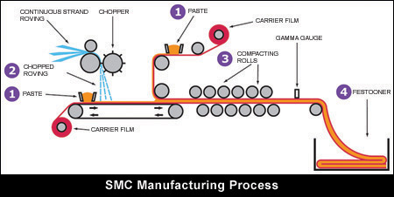
Lecture 2
Module 2: Lecture 2
Composite Manufacturing Methods:
Injection Molding and Compression Molding
Compression Molding Compounds (Materials)
  Manufacturing of SMC is a continuous in-line process.
Source: http://www.idicomposites.com/smc-bmc-overview.php
Notes:
SMC – Sheet Molding Compound
Manufacturing of SMC is a continuous in-line process.
The base components of liquids and solids (paste) are bulk mixed and continuously metered onto to the surface of a carrier/barrier film, coating the film surface.
Two mirror imaged metering stations operate simultaneously.
One of the paste-coated carrier films are then layered with chopped fibers.
The second carrier is fed on top, while paste & fiber are then brought together in the compaction section, where the sandwich-like layered components are kneaded into one homogenous compound sheet.
The sheet is then fan folded into a container and stored in a controlled environment where maturation takes place, on its way to a specified viscosity.

Slide 39
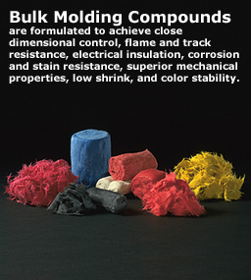
Lecture 2
Module 2: Lecture 2
Composite Manufacturing Methods:
Injection Molding and Compression Molding
Compression Molding Compounds (Materials)
-BMC – Bulk Molding Compound
  Bulk Molding Compound (BMC) is a thermoset plastic resin blend that form a viscous, 'puttylike' molding compound.
  It is highly filled and reinforced with short fibers.
  Glass reinforcement represents between 10% and 30%, with glass length typically between 1/32-inch and 1/2-inch (12.5mm).
Source: http://www.idicomposites.com/smc-bmc-overview.php
Source: http://www.idicomposites.com/smc-bmc-overview.php
Notes:
BMC – Bulk Molding Compound
Bulk Molding Compound (BMC) is a resin blend of various inert fillers, fiber reinforcement, catalysts (for thermosets), stabilizers, and pigments that form a viscous, 'puttylike' molding compound.
Bulk Molding Compound (BMC) is highly filled and reinforced with short fibers.
Glass reinforcement represents between 10% and 30%, with glass length typically between 1/32-inch and 1/2-inch (12.5mm).
Depending on the end-use application, bulk molding compounds are formulated to achieve close dimensional control, flame and track resistance, electrical insulation, corrosion and stain resistance, superior mechanical properties, low shrink, and color stability.
Its excellent flow characteristics, dielectric properties, and flame resistance make this thermoset material well-suited to a wide variety of applications requiring precision in detail and dimensions as well as high performance.
The material is available in a broad selection of colors.

Slide 40
Lecture 2
Module 2: Lecture 2
Composite Manufacturing Methods:
Injection Molding and Compression Molding
Compression Molding Compounds (Materials)
-BMC – Bulk Molding Compound
  Depending on the end-use application, bulk molding compounds are formulated to achieve:
    Close dimensional control
    Flame and track resistance
    Electrical insulation,
    Corrosion and stain resistance
    Superior mechanical properties
    Low shrink, and color stability.
Source: http://www.idicomposites.com/smc-bmc-overview.php
Source: http://www.idicomposites.com/smc-bmc-overview.php
Notes:
BMC – Bulk Molding Compound
Depending on the end-use application, bulk molding compounds are formulated to achieve close dimensional control, flame and track resistance, electrical insulation, corrosion and stain resistance, superior mechanical properties, low shrink, and color stability.

Slide 41
Lecture 2
Module 2: Lecture 2
Composite Manufacturing Methods:
Injection Molding and Compression Molding
Compression Molding Compounds (Materials)
-BMC – Bulk Molding Compound
  Its excellent flow characteristics, dielectric properties, and flame resistance make this thermoset material well-suited to a wide variety of applications requiring precision in detail and dimensions as well as high performance.
  The material is available in a broad selection of colors.
Source: http://www.idicomposites.com/smc-bmc-overview.php
Source: http://www.idicomposites.com/smc-bmc-overview.php
Notes:
BMC – Bulk Molding Compound
Its excellent flow characteristics, dielectric properties, and flame resistance make this thermoset material well-suited to a wide variety of applications requiring precision in detail and dimensions as well as high performance.
The material is available in a broad selection of colors.

Slide 42

Lecture 2
Module 2: Lecture 2
Composite Manufacturing Methods:
Injection Molding and Compression Molding
Compression Molding Compounds (Materials)
-BMC – Thick Molding Compound
These thermoset materials are manufactured using a unique process that produces a material with the best combined properties of a BMC and SMC properties.
The glass/paste combining process creates a glass orientation like BMC, while allowing longer fiber lengths (up to 2"), like SMC, to be incorporated.
TMC is are available in festooned sheets, slabs or post-extruded slug form.
  The actual thickness of TMC is up to 6x a typical SMC.
  The additional thickness enables molding charges to be built for compression molding with a fewer number of layers.
  The result is a stronger part for complex shapes.
Source: https://www.premix.com/materials/tmc.php
Notes:
TMC – Thick Molding Compound
These materials are manufactured using a unique process that produces a material with the best combined properties of a BMC (excellent flow properties) and SMC (excellent mechanical properties).
The glass/paste combining process creates a glass orientation like BMC, while allowing longer fiber lengths (up to 2"), like SMC, to be incorporated.
TMC is are available in festooned sheets, slabs or post-extruded slug form.
The actual thickness of TMC is up to 6x a typical SMC.
The additional thickness enables molding charges to be built for compression molding with a fewer number of layers.
The result is a stronger part for complex shapes.

Slide 43
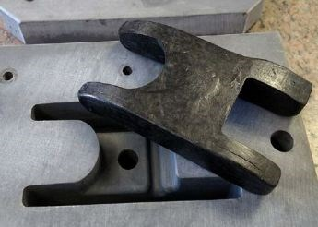
Lecture 2
Module 2: Lecture 2
Composite Manufacturing Methods:
Injection Molding and Compression Molding
Recycled Carbon Fiber Molding Compounds
Another method is gaining momentum worldwide.
Scrap prepreg is cut into chips and formed into a compound that can also be readily molded with a compression molding press.
This technology holds a lot of promise, both as an alternative method for recycling composite manufacturing waste and as a new aesthetic.
This “new carbon look” has been featured in everything from golf clubs to motorcycles to high-end sports cars.
SOURCE: R&M International.
Source: https://www.compositesworld.com/blog/post/compression-molding-new-materials-and-markets
Notes:
Recycled Carbon Fiber Molding Compounds
There is another method of using recycled carbon fiber in molding compounds that is gaining momentum worldwide.
In this method, scrap prepreg is cut into chips and formed into a compound that can also be readily molded with a compression molding press.
This technology holds a lot of promise, both as an alternative method for recycling composite manufacturing waste and as a new aesthetic.
This “new carbon look” has been featured in everything from golf clubs to motorcycles to high-end sports cars.

Slide 44
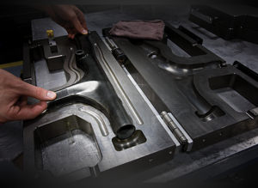
Lecture 2
Module 2: Lecture 2
Composite Manufacturing Methods:
Injection Molding and Compression Molding
Trek's Carbon Recycling Program
  Trek Bicycle has instituted a full-scale carbon recycling program at its Waterloo, WI-based US manufacturing facility.
  They are now recycling all scrap carbon fiber; the material primarily used in its domestic production.
  Through a partnership with Materials Innovation Technologies, Trek completed a three-month trial period to determine the viability of adopting the step as an official part of the manufacturing process.
  Trek collects excess trimmings, non-compliant molded parts and combines it with select reclaimed warranty frames to send to MIT’s South Carolina facility.
Source: https://www.compositesworld.com/blog/post/compression-molding-new-materials-and-markets
Notes:
Trek's Carbon Recycling Program
Trek Bicycle has instituted a full-scale carbon recycling program at its Waterloo, WI-based US manufacturing facility and is now recycling all scrap carbon fiber; the material primarily used in its domestic production.
The material that Trek introduced to the cycling world and has pioneered the usage of since 1992 is revered for its strength and weight properties, but has long been believed nearly impossible to recycle.
Through a partnership with Materials Innovation Technologies (MIT LLC) and its wholly owned subsidiary MIT-RCF, a South Carolina carbon reclamation facility that is revolutionizing carbon recycling processes, Trek completed a three month trial period to determine the viability of adopting the step as an official part of the manufacturing process.
Throughout the manufacturing process, Trek collects excess trimmings, non-compliant molded parts and combines it with select reclaimed warranty frames to send to MIT’s South Carolina facility to begin their reclamation process.

Slide 45
Summary
Module 2: Lecture 2
In this lecture you have learned:
The process of Injection Molding
    Polymer material in form of pellets or granular plastics is fed by gravity into a heated barrel within a Injection Molding machine, through a hopper.
    The material is then conveyed forward by a feeding screw, melted, and forced into a split mold, filling its cavity through a feeding system with sprue gate and runners.
    The screw of an injection molding machine is called reciprocating screw since it not only rotates but also moves forward and backward according to the steps of the molding cycle.
To identify materials used in Injection Molding
    Polypropylene (PP)
    Polycarbonate (PC)
    Acrylonitrile-Butadiene-Styrene (ABS)
    Nylon 6 (N6)

Slide 46
Summary
Module 2: Lecture 2
In this lecture you have learned:
The many different products made with Injection Molding
The difference between thermoset and thermoplastic injection molding
  In thermoset injection molding, cold material is injected into an extremely hot mold to create a part. This process cures the part so it can never be melted again.
  In thermoplastic injection molding, plastic material is melted and injected into a mold to create a part. Once this part cools, the mold opens, and the part is ejected.
  Thermoset injection molders are typically more difficult to find than thermoplastic injection molders.

Slide 47
Summary
Module 2: Lecture 2
In this lecture you have learned:
The process of Compression Molding
  Compression Molding process involves the following steps:
    A charge is placed into the lower half of the mold.
    The charge is usually preheated prior to placement into the mold.
    The mold is closed, pressing on the charge and forcing it to fill the mold cavity.
    The mold, equipped with a heating system, provides curing (for thermosets).
    The mold is opened, and the part is removed

Slide 48
Summary
Module 2: Lecture 2
In this lecture you have learned:
To identify the materials used in Compression Molding
  SMC, BMC and TMC
The advantages of Compression Molding
  Tooling costs are low because of the simplicity of the usual molds.
  Little material is wasted since there are usually no sprues or runners Unless compared to runnerless injection molding
  Thermosets, when compared to thermoplastics are not subject to retaining internal stresses after being cured.
  Mechanical properties remain high since material receives little mastication in the process and when using reinforcements, they are literally not damaged or broken.
  Less clamping pressure required than in most other processes.
  Capital equipment is less costly.
  Wash-action erosion of cavities is minimal and mold maintenance is low since melt flow length is short.

Slide 49
Summary
In this lecture you have learned:
The limitations of Compression Molding
  Fine pins, blades, and inserts in the cavity can become damaged as the press closes when cold material is used in the cavities.
  Complex shapes may not fill out as easily as by the transfer or injection molding processes.
  Extremely thick and heavy parts will cure more slowly than in transfer or injection molding, but preheating preforms or powder can shorten these cures.
  Thermosets with their low viscosity will produce flash during their cure that has to be removed.
The many different products made with Compression Molding
The difference between thermoset and thermoplastic Compression Molding

Slide 50
Composite Recycling Technician Education Program
Module 2: Lecture 3
Module 2 - Composite Manufacturing Methods - Thermosets and Thermoplastic
Lecture 3 – Resin Infusion

Slide 51
Composite Manufacturing Methods:
Resin Infusion
Module 2: Lecture 3
Objectives:
Learn the definition and process of Resin Infusion
Learn about Darcy’s Law and how it is applied to Resin Infusion
Learn the set-up and sequence of operation for Resin Infusion
Learn the advantages of Resin Infusion
Learn the limitations of Resin Infusion
Learn the critical elements of Resin Infusion

Slide 52
Composite Manufacturing Methods:
Resin Infusion
Module 2: Lecture 3
At the end of the lecture you will be able to:
Define Resin Infusion
Explain the process of Resin Infusion
Apply Darcy’s Law to Resin Infusion
Explain the set-up and sequence of operation for Resin Infusion
List the advantages of Resin Infusion
List the limitations of Resin Infusion
Describe the critical elements of Resin Infusion

Slide 53
Lecture 2
Module 2: Lecture 3
Composite Manufacturing Methods:
Resin Infusion
Manufacturing methods and processes for Thermoplastics vs. Thermosets
Thermoset Processes
Thermoplastic Processes
Injection Molding
Rotational Molding
Compression Molding
Casting, Foam Molding
Vacuum-Bag Molding
Hand/Spray Layup
Resin Transfer Molding
Filament Winding
Pultrusion
Transfer Molding
Reaction Injection Molding
Extrusion
  Blow Molding
  Thermoforming

Slide 54
Composite Manufacturing Methods: Resin Infusion
Module 2: Lecture 3
Resin Infusion (Vacuum Infusion Process)
Resin infusion is a process where the voids in an evacuated stack of reinforcement material (and coring material) are filled with a liquid resin.
When the resin solidifies, the solid resin matrix binds the reinforcement (and coring) into a unified rigid composite.
The reinforcement can be any porous material compatible with the resin.
Typical materials are inorganic fibers (with glass fibers being most common), organic fibers such as flax, or combinations of fibers with other materials such as closed cell foams, balsawood, and honeycomb.
Porous materials can also be infused onto the surfaces of non-porous materials such as sheet metal.
Source: https://www.vacmobiles.com/resin_infusion.html

Slide 55
Composite Manufacturing Methods: Resin Infusion
Module 2: Lecture 3
Resin Infusion (Vacuum Infusion Process)
Resins are usually thermosetting types, but thermoplastic resins can also be used for infusion.
In a typical hand lay-up, reinforcements are laid into a mold and manually wet out using brushes, rollers, plural application spray up, or through other means.
An improvement on that method is to use a vacuum bag:
  To remove air and remove excess resin out of the laminate which improves the fiber-to-resin ratio, and results in a stronger and lighter product.
  To achieve better compaction.
  To achieve consistent distribution of the resin.
  To have a repeatable process.
  And to create a "clean process" which also controls VOC’s.
  Vacuum bagging greatly improves the fiber-to-resin ratio, and results in a stronger and lighter product.
Source: https://www.fibreglast.com/product/vacuum-infusion-Guide/Learning_Center

Slide 56
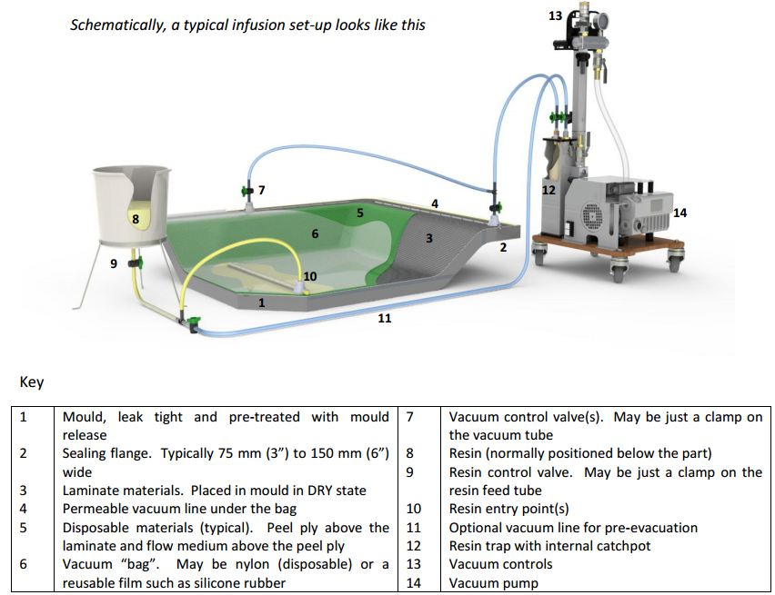
Composite Manufacturing Methods: Resin Infusion
Module 2: Lecture 3
Resin Infusion (Vacuum Infusion Process)
The set-up:
Source: https://www.vacmobiles.com/resin_infusion.html
Notes:
A key part of the process, after the materials are placed in the mold, is the evacuation, or removal, of the air from the porous material prior to admitting the resin.
The air needs to be removed from the porous material to allow the resin to take its place.
Key –
Mold, leak tight and pre-treated with mold release.
Sealing flange. Typically 6 inch minimum
Laminate materials. Place in mod DRY
Permeable vacuum line under the vacuum bag
Peal ply above the laminate (for removal of disposables) and flow medium above the peel ply
Vacuum bag. May be nylon (disposable) or a reusable silicone bag.
Vacuum control valve (can be just a clamp)
Resin (positioned below the part to avoid gravity feeding the resin)
Resin control valve (can be just a clamp)
Resin entry point (can be several points)
Option vacuum line for pre-evacuation
Resin trap with internal catch pot
Vacuum controls
Vacuum pump

Slide 57
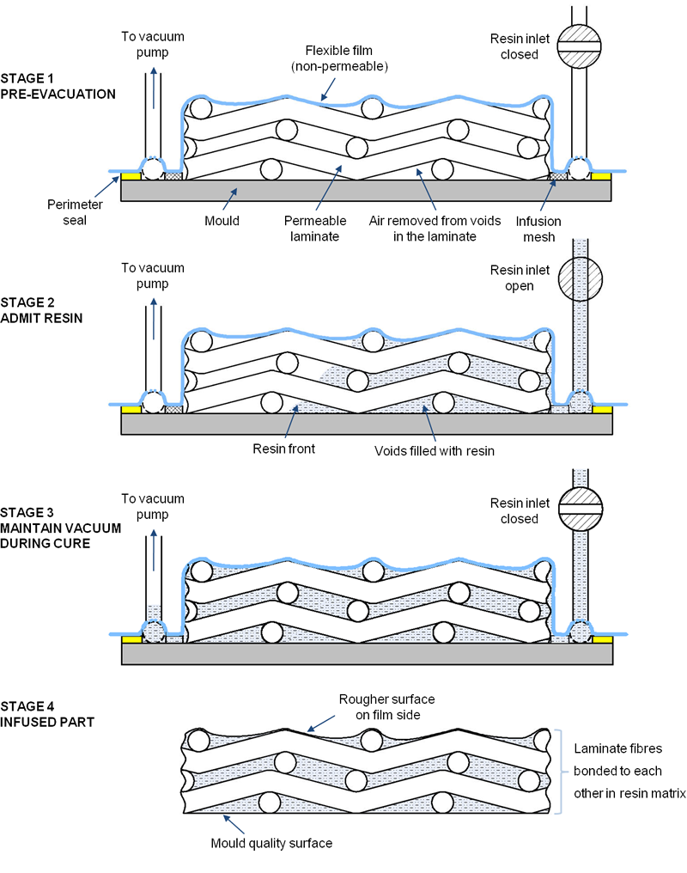
Composite Manufacturing Methods: Resin Infusion
Module 2: Lecture 3
Resin Infusion (Vacuum Infusion Process)
In its simplest form the process can be broken down into the following stages:
Source: https://www.vacmobiles.com/resin_infusion.html

Slide 58
Composite Manufacturing Methods: Resin Infusion
Module 2: Lecture 3
Resin Infusion (Vacuum Infusion Process)
Source: https://www.vacmobiles.com/resin_infusion.html

Slide 59
Composite Manufacturing Methods: Resin Infusion
Module 2: Lecture 3
Resin Infusion – Darcy's Law
The Importance of Darcy's Law
Darcy studied the flow of water through porous materials and his studies established Darcy's Law.
Darcy's law is a mathematical formula.
The application of, and the principles of Darcy's law, as applied to the Vacuum Infusion Process (VIP), can be stated as follows:
  Resin flow is controlled by four factors:
    The pressure differential between the inside of the bag and the outside of the bag.
    The porosity of the material. The flowability.
    The viscosity of the resin.
    The flow distance.
Notes:
The Importance of Darcy's Law
Darcy studied the flow of water through porous materials and his studies established Darcy's Law.
Darcy's law is a mathematical formula.
The law was formulated by Henry Darcy based on results of experiments on the flow of water through beds of sand, forming the basis of hydrogeology, a branch of earth sciences.
The application of, and the principles of Darcy's law, as applied to the Vacuum Infusion Process (VIP), can be stated as follows:
Resin flow is controlled by four factors:
The pressure differential between the inside of the bag and the outside of the bag.
The porosity of the material. The flowability.
The viscosity of the resin.
The flow distance.

Slide 60
Composite Manufacturing Methods: Resin Infusion
Module 2: Lecture 3
Resin Infusion
Critical elements of the infusion process
  A stack of DRY material(s) to be laminated is placed in an AIR-TIGHT, LEAK-PROOF mold.
  An AIR-TIGHT, LEAK-PROOF flexible film (a vacuum bag) is placed over the laminate and SEALED to the mold beyond the perimeter of the laminate.
  A minimum of two connections are made to the bag; one (the vacuum) to permit air to be removed from the cavity between the bag and the mold and the other to allow liquid resin to enter (the resin feed).
  With the resin entry line temporarily CLOSED, the cavity between the bag and the mold is evacuated by a vacuum pump. In accordance with Darcy's law, in order to achieve the best resin transfer, the highest achievable pressure differential is required. That is, one full atmosphere at sea level (29.9 inches of mercury).
Source: https://www.vacmobiles.com/resin_infusion.html
Notes:
Critical elements of the infusion process
A stack of DRY material(s) to be laminated is placed in an AIR-TIGHT, LEAK-PROOF mold that has been prepared with a release agent. That release agent can be mechanical (Wax and PVA) or a chemical release. Often, gel coat is sprayed into the mold after the release is applied, and before the reinforcement is laid up into the mold. Gel coat, a pigmented polyester resin, assists in the release of the part from the mold. Some composite manufactures will use a clear gel coat, even when a part is not required to have gel coat, to help in the release of the part from the mold.
An AIR-TIGHT, LEAK-PROOF flexible film (a vacuum bag) is placed over the laminate and SEALED to the mold beyond the perimeter of the laminate. The seal is made to the flange of the bag and the mold where release has not been applied. The material used is a gum-like tacky tape, a butyl sealant tape.
A minimum of two connections are made to the bag; one (the vacuum) to permit air to be removed from the cavity between the bag and the mold and the other to allow liquid resin to enter (the resin feed).
With the resin entry line temporarily CLOSED, the cavity between the bag and the mold is evacuated by a vacuum pump. In accordance with Darcy's law, in order to achieve the best resin transfer, the highest achievable pressure differential is required. That is, one full atmosphere at sea level (29.9 inches of mercury).

Slide 61
Composite Manufacturing Methods: Resin Infusion
Module 2: Lecture 3
Resin Infusion
Critical elements of the infusion process
Drop Test - After this preliminary evacuation, the bag and mold should be temporarily closed off from the vacuum pump and the level of vacuum remaining in the part observed on a vacuum gauge. This is called a drop test.
    If the vacuum level remains constant, or at least reasonably constant, the mold and bag will be considered sufficiently AIR-TIGHT and LEAK-PROOF, and the process can continue to the next stage.
    If the vacuum leaks and air enters the evacuated cavity and the process should not continue.
    In this case, the air leaks must be found and eliminated before proceeding further.
Source: https://www.vacmobiles.com/resin_infusion.html
Notes:
Critical elements of the infusion process
After this preliminary evacuation, the bag and mold should be temporarily closed off from the vacuum pump and the level of vacuum remaining in the part observed on a vacuum gauge. This is called a drop test. If the vacuum level remains constant, or at least reasonably constant, the mold and bag will be considered sufficiently AIR-TIGHT and LEAK-PROOF, and the process can continue to the next stage. If the vacuum level deteriorates at a faster level than can be accepted, air will be leaking into the evacuated cavity and the process should not continue. In this case, the air leaks must be found and eliminated before proceeding further. Although no leak is acceptable, there is, for some, an acceptable drop test rate. For a large part, that could be a leak rate of less than 3 mbar/minute (approximately 1” Hg in 10 minutes) that would be acceptable. For small, or critical parts an acceptable leak back rate might be 10% of the above, say 3 mbar in 10 minutes, or 0.1” Hg in 10 minutes.

Slide 62
Composite Manufacturing Methods: Resin Infusion
Module 2: Lecture 3
Resin Infusion
Critical elements of the infusion process
  Once a satisfactory level of leak-tightness has been achieved, the line to the vacuum pump can be reopened.
  The resin supply container can be filled with mixed resin and the line to the resin supply can be opened. With the resin supply line open, liquid resin will be forced into the part by the PRESSURE DIFFERENCE between atmospheric pressure acting on the resin and the level of vacuum in the part.
      14.7 lbs. per square inch at 30” of mercury.
      Instrumental in the compaction of the reinforcement
Source: https://www.vacmobiles.com/resin_infusion.html
Notes:
Critical elements of the infusion process
Once a satisfactory level of leak-tightness has been achieved, the line to the vacuum pump can be reopened. Ideally, the part should remain under vacuum for a period, normally overnight. This time allows the part (the reinforcement, coring and flow media), to de-gas. Any trapped air and/or moisture will be evacuated.
The resin supply container can be filled with mixed resin and the line to the resin supply can be opened. With the resin supply line open, liquid resin will be forced into the part by the PRESSURE DIFFERENCE between atmospheric pressure acting on the resin and the level of vacuum in the part. This pressure differential is equivalent to 14.7 lbs. per square inch at 30” of mercury. This same air pressure not only drives the resin into the reinforcement, but is instrumental in the compaction of the reinforcement, providing excellent bonds between materials and distributing the resin consistently.

Slide 63
Composite Manufacturing Methods: Resin Infusion
Module 2: Lecture 3
Resin Infusion
Critical elements of the infusion process
  If resin feed lines and vacuum off-takes have been correctly positioned on or around the dry laminate stack before the bag is placed, the liquid resin will or INFUSE through the whole laminate.
  When thermosetting resins are used, time must be allowed for the resin to CURE after the laminate has been completely infused with resin.
  Once the resin has solidified, the bag and the part can be removed from the mold.
Source: https://www.vacmobiles.com/resin_infusion.html
Notes:
Critical elements of the infusion process
If resin feed lines and vacuum off-takes have been correctly positioned on or around the dry laminate stack before the bag is placed, the liquid resin will or INFUSE through the whole laminate (provided the implications of Darcy’s law as it is applied, have been considered and met).
When thermosetting resins are used, time must be allowed for the resin to CURE after the laminate has been completely infused with resin. This time may vary from a few minutes to a few hours depending on the resin system, the size of the part, the amount of resin within the part, the level of initiation/catalyzation, the temperature of the resin, the temperature of the mold, and the ambient temperature. If the vacuum is release prematurely, the reinforcement will “spring back”, and this lofting of the material will defeat the purpose of the vacuum bag to compact the material.
Once the resin has solidified, the bag and the part can be removed from the mold.

Slide 64
Composite Manufacturing Methods: Resin Infusion
Module 2: Lecture 3
Resin Infusion Advantages
Low investment cost.
Capable of producing minimum weight, high performance laminates with high physical properties.
Infusion allows the reinforcement materials to be handled dry.
The process is carried out within a “closed” system.
When performed under a flexible film, infusion uses the minimum amount of resin needed to fill the voids in the dry laminate.
Source: https://www.vacmobiles.com/resin_infusion.html
Notes:
Resin Infusion Advantages
Low investment cost. Typically more investment than that required to make composite parts using hand lay-up in open molds and less expensive than other processes.
Capable of producing minimum weight, high performance laminates with high physical properties.
Infusion allows the reinforcement materials to be handled dry. This avoids the need for laminators to have contact with the resin, significantly reducing workforce exposure to the resin. Allergic reactions to resins such as epoxy can be avoided. That being said, the greatest advantage for resin infusion is that there is not a time restriction in laying up the reinforcement (compared to hand lay-up or open molding where time is constrained to the pot life of your resin and how fast your work).
The process is carried out within a “closed” system; that is within the void between a sealed bag and a mold, or between two sealed molds. There is minimal exposure of the uncured resin to the atmosphere. The potential for harm to worker health and to the environment from volatile resin components is consequently reduced.
When performed under a flexible film, infusion uses the minimum amount of resin needed to fill the voids in the dry laminate. Especially for smaller/repetition parts where multiple-use flexible films are practical, infusion offers an opportunity to reduce manufacturing cost compared with hand lay-up, while enhancing laminate quality.

Slide 65
Composite Manufacturing Methods: Resin Infusion
Module 2: Lecture 3
Resin Infusion Advantages
It is a repeatable process with consistent results.
The process is predictable.
There is essentially, no limit to the size of the part.
Infusion is a particularly practical and cost-effective solution for the construction of large, high strength/light weight one-piece parts.
The number of components required to make a part can often be significantly reduced using infusion.
Source: https://www.vacmobiles.com/resin_infusion.html
Notes:
Resin Infusion Advantages
It is a repeatable process with consistent results.
The process is predictable.
There is essentially, no limit to the size of the part.
Infusion is a particularly practical and cost-effective solution for the construction of large, high strength/light weight one-piece parts, such as boat hulls, wind turbine blades, bridge beams and building cladding panels.
The number of components required to make a part can often be significantly reduced using infusion.

Slide 66
Composite Manufacturing Methods: Resin Infusion
Module 2: Lecture 3
Resin Infusion Limitations
Temperature control can be critical.
There is lots of disposables.
The is one shot at getting it right.
A more skilled labor force is needed.
Infusion is a relatively slow manufacturing process. It is usually not worth considering for applications requiring high production rates where another manufacturing solution is feasible.
Source: https://www.vacmobiles.com/resin_infusion.html
Notes:
Resin Infusion Limitations
Temperature control can be critical since the viscosity of the resin, and therefore resin flow, is based upon temperature. For the best predictable results, the mold, the resin and the ambient temperature should be consistent. 70°- 75° F
For one-off or large parts where multiple-use flexible films, silicon bags, or top molds are not practical, or are prohibitively expensive, the process can result in considerable waste (vacuum bag film, resin tubing, some of the vacuum tubing and, possibly, flow media and peel ply if flow medium cannot be left in the laminate).
The is one shot at getting it right. If the vacuum should fail, and you have a failed infusion, the part might be, or might not be salvageable. Depending on the costs involved in making a repair, or salvaging the infusion, the part could be scrapped (which would require remaking the part).
A more skilled labor force is needed.
Infusion is a relatively slow manufacturing process. It is usually not worth considering for applications requiring high production rates where another manufacturing solution is feasible.

Slide 67
Summary
Module 2: Lecture 3
In this lecture you have learned:
Resin infusion is a process where the voids in an evacuated stack of reinforcement material (and coring material) are filled with a liquid resin.
That the voids are evacuated of air by use of a vacuum.
An improvement on open molding/contact molding, is to use a vacuum bag:
  To remove air and remove excess resin out of the laminate which improves the fiber-to-resin ratio, and results in a stronger and lighter product.
  To achieve better compaction.
  To achieve consistent distribution of the resin.
  To have a repeatable process.
  And to create a "clean process" which also controls VOC’s.
  Vacuum bagging greatly improves the fiber-to-resin ratio, and results in a stronger and lighter product.

Slide 68
Summary
Module 2: Lecture 3
In this lecture you have learned:
Darcy’s Law:
  The application of, and the principles of Darcy's law, as applied to the Vacuum Infusion Process (VIP), can be stated as follows:
  Resin flow is controlled by four factors:
    The pressure differential between the inside of the bag and the outside of the bag.
    The porosity of the material. The flowability.
    The viscosity of the resin.
    The flow distance.

Slide 69
Summary
Module 2: Lecture 3
In this lecture you have learned:
Critical elements of the infusion process
  Reinforcements are dry stacked in an AIR-TIGHT, LEAK-PROOF mold.
  A vacuum bag) is placed over the laminate and SEALED to the mold beyond the perimeter of the laminate.
  A minimum of two connections are made to the bag; the vacuum line and the resin feed line
  With the resin entry line temporarily CLOSED, the cavity between the bag and the mold is evacuated by a vacuum pump, one full atmosphere at sea level (29.9 inches of mercury).
  Drop Test - If the vacuum level remains constant, or at least reasonably constant, the mold and bag will be considered sufficiently AIR-TIGHT and LEAK-PROOF, and the process can continue to the next stage.
Notes:
Reinforcements are dry stacked in an AIR-TIGHT, LEAK-PROOF mold.
A vacuum bag) is placed over the laminate and SEALED to the mold beyond the perimeter of the laminate.
A minimum of two connections are made to the bag; the vacuum line and the resin feed line
With the resin entry line temporarily CLOSED, the cavity between the bag and the mold is evacuated by a vacuum pump, one full atmosphere at sea level (29.9 inches of mercury).
Drop Test - If the vacuum level remains constant, or at least reasonably constant, the mold and bag will be considered sufficiently AIR-TIGHT and LEAK-PROOF, and the process can continue to the next stage.
If the vacuum leaks and air enters the evacuated cavity and the process should not continue.
In this case, the air leaks must be found and eliminated before proceeding further.

Slide 70
Summary
Module 2: Lecture 3
In this lecture you have learned:
Critical elements of the infusion process
  Once a satisfactory level of leak-tightness has been achieved, the line to the vacuum pump can be reopened.
  The resin supply container can be filled with mixed resin and the line to the resin supply can be opened. With the resin supply line open, liquid resin will be forced into the part by the PRESSURE DIFFERENCE.
  The liquid resin will or INFUSE through the whole laminate.
  When thermosetting resins are used, time must be allowed for the resin to CURE after the laminate has been completely infused with resin.
  Once the resin has solidified, the bag and the part can be removed from the mold.
Notes:
Once a satisfactory level of leak-tightness has been achieved, the line to the vacuum pump can be reopened.
The resin supply container can be filled with mixed resin and the line to the resin supply can be opened. With the resin supply line open, liquid resin will be forced into the part by the PRESSURE DIFFERENCE between atmospheric pressure acting on the resin and the level of vacuum in the part.
14.7 lbs. per square inch at 30” of mercury.
Instrumental in the compaction of the reinforcement
If resin feed lines and vacuum off-takes have been correctly positioned on or around the dry laminate stack before the bag is placed, the liquid resin will or INFUSE through the whole laminate.
When thermosetting resins are used, time must be allowed for the resin to CURE after the laminate has been completely infused with resin.
Once the resin has solidified, the bag and the part can be removed from the mold.

Slide 71
Summary
Module 2: Lecture 3
In this lecture you have learned:
Advantages of resin infusion:
  Relatively low investment cost.
  Capable of producing minimum weight, high performance laminates with high physical properties.
  Infusion allows the reinforcement materials to be handled dry.
  The process is carried out within a “closed” system.
  Limited or no resin waste
  It is a repeatable process with consistent results.
  It is predictable.
  No limit to the size of the part.
  Infusion is a particularly practical and cost-effective solution
  Less components
Notes:
Low investment cost.
Capable of producing minimum weight, high performance laminates with high physical properties.
Infusion allows the reinforcement materials to be handled dry.
The process is carried out within a “closed” system.
When performed under a flexible film, infusion uses the minimum amount of resin needed to fill the voids in the dry laminate.
It is a repeatable process with consistent results.
The process is predictable.
There is essentially, no limit to the size of the part.
Infusion is a particularly practical and cost-effective solution for the construction of large, high strength/light weight one-piece parts.
The number of components required to make a part can often be significantly reduced using infusion.

Slide 72
Summary
Module 2: Lecture 3
In this lecture you have learned:
Limitations of resin infusion:
  Temperature control can be critical.
  There is lots of disposables.
  The is one shot at getting it right.
  A more skilled labor force is needed.
  Infusion is a relatively slow manufacturing process. It is usually not worth considering for applications requiring high production rates where another manufacturing solution is feasible.
Notes:
Temperature control can be critical.
There is lots of disposables.
The is one shot at getting it right.
A more skilled labor force is needed.
Infusion is a relatively slow manufacturing process. It is usually not worth considering for applications requiring high production rates where another manufacturing solution is feasible.

Slide 73
Composite Recycling Technician Education Program
Module 2: Lecture 4
Module 2 - Composite Manufacturing Methods - Thermosets and Thermoplastic
Lecture 4 – Contact Molding and Filament Winding

Slide 74
Composite Manufacturing Methods:
Contact Molding and Filament Winding
Module 2: Lecture 4
Objectives:
Learn the methodology of Hand Lay-up/Open Molding/Contact Molding/Wet Lay-up
Learn the advantages and limitations of Hand Lay-up/Open Molding/Contact Molding/Wet Lay-up
Learn the methodology of Spray-up
Learn the advantages and limitations of Spray-up
Learn the methodology of Filament Winding
Learn the advantages and limitations of Filament Winding

Slide 75
Composite Manufacturing Methods:
Contact Molding and Filament Winding
Module 2: Lecture 4
At the end of the lecture you will be able to:
Describe the methodology of Hand Lay-up/Open Molding/Contact Molding/Wet Lay-up
Identify the advantages and limitations of Hand Lay-up/Open Molding/Contact Molding/Wet Lay-up
Describe the methodology of Spray-up
Identify the advantages and limitations of Spray-up
Compare and contrast Hand Lay-up/Open Molding/Contact Molding and Spray-up
Describe the process of Filament Winding
Describe the attributes and limitations of Filament Winding

Slide 76
Composite Manufacturing Methods:
Contact Molding and Filament Winding
Lecture 2
Module 2: Lecture 4
Manufacturing methods and processes for Thermoplastics vs. Thermosets
Thermoset Processes
Thermoplastic Processes
Injection Molding
Rotational Molding
Compression Molding
Casting, Foam Molding
Vacuum-Bag Molding
Hand/Spray Layup
Resin Transfer Molding
Filament Winding
Pultrusion
Transfer Molding
Reaction Injection Molding
Extrusion
  Blow Molding
  Thermoforming

Slide 77
Module 2: Lecture 4
Composite Manufacturing Methods:
Contact Molding and Filament Winding
Contact Molding
  Process has many different synonymous names:
    Contact molding
    Open molding
    Hand lay-up
    Wet lay-up
    Spray-up
    And, Filament Winding
  It is one of the simplest methods of creative polymer products
  And, requires the least amount of investment
  Hand Lay-up is a manual, slow, labor consuming method
Source: http://compositeslab.com/composites-manufacturing-processes/open-molding/hand-lay-up/
Notes:
The contact molding process has many different synonymous names, and they all have a common attributes. They are all done with the resin and layup open to the environment.
Hand lay-up is an open molding method suitable for making a wide variety of composites products from very small to very large. Production volume per mold is low; however, it is feasible to produce substantial production quantities using multiple molds. Hand lay-up is the simplest composites molding method, offering low cost tooling, simple processing, and a wide range of part sizes. Design changes are readily made. There is a minimum investment in equipment. With skilled operators, good production rates and consistent quality are obtainable.

Slide 78
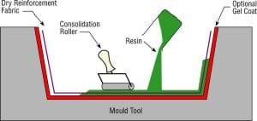
Module 2: Lecture 4
Composite Manufacturing Methods:
Contact Molding and Filament Winding
Contact Molding – Hand Lay-up
The mold is coated with a release agent.
Gel coat is applied to the mold.
The surface is coated with resin
Fiberglass or another type of fiber reinforcement is manually placed on the mold and wetted out with resin.
The laminating resin is applied by pouring, brushing, spraying, or using a paint roller.
Source: http://compositeslab.com/composites-manufacturing-processes/open-molding/hand-lay-up/
Image Source: https://netcomposites.com/guide/manufacturing/wet-hand-lay-up/
Notes:
Hand lay-up is the most common and least expensive open-molding method because it requires the least amount of equipment. Fiber reinforcements are placed by hand in a mold and resin is applied with a brush or roller. This process is used to make both large and small items, including boats, storage tanks, tubs and showers.
The mold is coated with a release agent.
Gel coat is applied to the mold using a spray gun for a high-quality surface.
When the gel coat has cured sufficiently, the surface is coated with resin.
Fiberglass or another type of fiber reinforcement is manually placed on the mold and wetted out with resin.
The laminating resin is applied by pouring, brushing, spraying, or using a paint roller. FRP (Fiber Reinforced Plastic) rollers, paint rollers, or squeegees are used to consolidate the laminate, thoroughly wetting the reinforcement and removing entrapped air.
Subsequent layers of fiberglass reinforcement are added to build laminate thickness.
Low density core materials such as end-grain balsa, foam, and honeycomb, are commonly used to stiffen the laminate. This is known as sandwich construction.

Slide 79
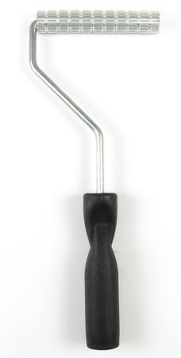
Module 2: Lecture 4
Composite Manufacturing Methods:
Contact Molding and Filament Winding
Contact Molding – Hand Lay-up
FRP rollers, paint rollers, or squeegees are used to consolidate the laminate.
Subsequent layers of fiberglass reinforcement are added to build laminate thickness.
Low density core materials such as end-grain balsa, foam, and honeycomb, are commonly used to stiffen the laminate.
Source: http://compositeslab.com/composites-manufacturing-processes/open-molding/hand-lay-up/

Slide 80
Module 2: Lecture 4
Composite Manufacturing Methods:
Contact Molding and Filament Winding
Hand Lay-up Advantages
  It is the simplest production method
  Least expensive process
  Low cost set up
  Flexible process
  Easy to train people
  Can make large or small parts
  Design changes easily made - Preferred method for prototype development
  With skilled technicians, good production rates and consistent quality are obtainable.
  Can accommodate single or multi-piece molds
  Creates a single-sided mold acts as the form and cosmetic surface of the part.
  Any combination of fibers and matrix materials can be used.
Notes:
While closed molding processes offers many advantages, including the ability to make parts faster, open molding has its own unique benefits. The open molding process represents lower start-up costs, can accommodate very large parts with the ability to change mold sizes, and enables a wide range of cost-effective versatility in part capability. Although only one side of the product will be smooth in open molding, a high gloss can still be achieved on the smooth side, with resin and gel-coats that can be color matched to eliminate the need for secondary finishing.
With a vast fluidity in part size and design options, flexible open molding processes are typically used by companies who manufacture a wide range of products where automated processes are unfeasible, or those who produce customized parts or only a small quantity of parts that cannot substantiate the greater mold costs of automated processes.
Source: https://www.mvpind.com/announcements/advantages-of-open-molding-in-precision-part-production/

Slide 81
Module 2: Lecture 4
Composite Manufacturing Methods:
Contact Molding and Filament Winding
Hand Lay-up Limitations
  The resin is open to the environment which creates air quality concerns
  There is a higher reliance of the technician to control the fiber volume fraction as well as the thickness.
  The process offers a good surface finish on one side and a rough surface finish on the other side.
  The process is not suitable for parts where dimensional accuracy and process repeatability are prime concerns.
  Products tend to be very resin-rich.
  Does not accommodate high volume production
  Labor intensive
Notes:
The primary disadvantage to contact molding is that the resin is open to the environment which creates air quality concerns. When using polyester resins, styrene is released and creates issues. Those issues include: the smell, fire hazards and maintaining permissible exposure limits.
Styrene emissions are governed by the EPA and extensive emissions may require tracking of styrene purchases, use, and release.
There is a higher reliance of the technician to control the fiber volume fraction as well as the thickness. These parameters highly depend on operator skill.
The process offers a good surface finish on one side and a rough surface finish on the other side.
The process is not suitable for parts where dimensional accuracy and process repeatability are prime concerns.
Products tend to be very resin-rich.
Does not accommodate high volume production
Labor intensive

Slide 82
Module 2: Lecture 4
Composite Manufacturing Methods:
Contact Molding and Filament Winding
Contact Molding – Spray-up
  Spray-up, or chopping, is an open mold method, similar to hand lay-up in that the processes is open to the environment.
  It requires a Chopper Gun.
  The Chopper Gun makes it easy to quickly cover large surfaces with fiberglass.
  Roving is fed into the rear of the gun. A daisy wheel, with very sharp blades, chops the roving into short pieces and propels them, along with the initiated resin, onto the mold.
  The fibers and resin are compacted, removing the air, with an FRP roller.
  By altering the number and location of chopper blades, the length of the fibers can be varied from 4" down to 5⁄16".
Source: http://compositeslab.com/composites-manufacturing-processes/open-molding/spray-up/
Notes:
Spray-up, or chopping, is an open mold method similar to hand lay-up in its suitability for making boats, tanks, transportation components, and tub/shower units in a large variety of shapes and sizes. A chopped laminate has good conformability and is sometimes faster to produce than a part made with hand lay-up when molding complex shapes.
It requires a Chopper Gun, a plural application, air powered sprayer, that mixes resin and initiator with chopped strands of mat and propels it into a mold.
The Chopper Gun makes it easy to quickly cover large surfaces with fiberglass.
Roving is fed into the rear of the gun. A daisy wheel, with very sharp blades, chops the roving into short pieces and sprays them, along with the initiated resin, onto the mold.
The fibers and resin are compacted, removing the air, with an FRP roller.
By altering the number and location of chopper blades, the length of the fibers can be varied from 4" down to 5⁄16".

Slide 83
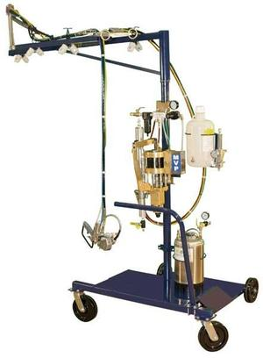
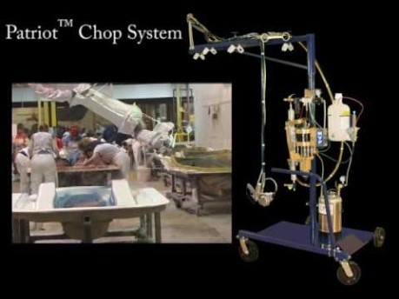
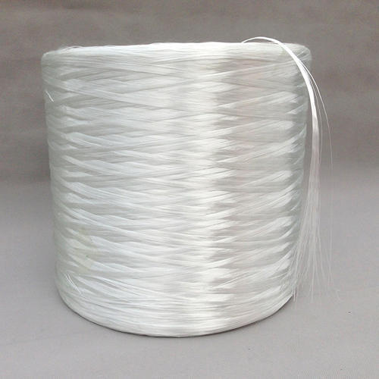
Module 2: Lecture 4
Composite Manufacturing Methods:
Contact Molding and Filament Winding
Contact Molding – Spray-up
(1)
(2)
Source: https://www.youtube.com/watch?time_continue=6&v=0kGWZCwUlNg, https://www.mvpind.com/product/patriot-chopwetout-system/ and http://compositeslab.com/composites-manufacturing-processes/open-molding/spray-up/
Notes:
Chopper gun and plural application set-up
Fiberglass roving
In the spray-up process, the operator controls thickness and consistency, therefore the process is more operator dependent than hand lay-up.
Although production volume per mold is low, it is feasible to produce substantial production quantities using multiple molds.
This process uses simple, low cost tooling and simple processing. Portable equipment permits on-site fabrication with virtually no part size limitations.
The process may be automated for larger volume production, such as shower stalls and hot tubs.
Additional layers of chop laminate are added as required for thickness. Roll stock reinforcements, such as woven roving or knitted fabrics, can be used in conjunction with the chopped laminates. Core materials of the same variety as used in hand lay-up are easily incorporated.

Slide 84
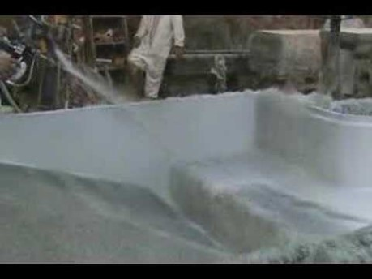
Module 2: Lecture 4
Composite Manufacturing Methods:
Contact Molding and Filament Winding
Contact Molding – Spray-up
Source: https://www.youtube.com/watch?v=QRYT0HqzuCs

Slide 85
Module 2: Lecture 4
Composite Manufacturing Methods:
Contact Molding and Filament Winding
Spray-up Advantages
  Low cost way of quickly depositing fiber and resin.
  It is suitable for small to medium quantities of parts.
  It is a very economical process for making small to large parts.
  It utilizes low-cost tooling as well as low-cost material systems
  Low labour costs (compared to hand-lamination).
  Versatile part shape/laminate configuration, including thickness variations.
  Potential for automation with robots.
  Automated mixing or resin and initiator/catalyst.
Notes:
Spray-up Advantages
Low cost way of quickly depositing fiber and resin.
It is suitable for small to medium quantities of parts.
It is a very economical process for making small to large parts.
It utilizes low-cost tooling as well as low-cost material systems
Low labour costs (compared to hand-lamination).
Versatile part shape/laminate configuration, including thickness variations.
Potential for automation with robots.
Automated mixing or resin and initiator/catalyst.

Slide 86
Module 2: Lecture 4
Composite Manufacturing Methods:
Contact Molding and Filament Winding
Open Molding – Filament Winding
  Filament winding is an automated open molding process
  A rotating mandrel is used as the mold.
  Filament winding results in a high degree of fiber loading.
  The process makes high strength-to-weight ratio laminates and provides a high degree of control over uniformity and fiber orientation.
  The filament winding process can be used to make structures that are highly engineered and meet strict tolerances.
  Because filament winding is computer-controlled and automated, the labor factor for filament winding is lower than other open molding processes.
Source http://compositeslab.com/composites-manufacturing-processes/open-molding/filament-winding/
Notes:
Filament winding is an automated open molding process that uses a rotating mandrel as the mold.
The male mold configuration produces a finished inner surface and a laminate surface on the outside diameter of the product.
Filament winding results in a high degree of fiber loading, which provides high tensile strength in the manufacture of hollow, generally cylindrical products such as chemical and fuel storage tanks, pipes, stacks, pressure vessels, and rocket motor cases.
The process makes high strength-to-weight ratio laminates and provides a high degree of control over uniformity and fiber orientation.
The filament winding process can be used to make structures that are highly engineered and meet strict tolerances.
Because filament winding is computer-controlled and automated, the labor factor for filament winding is lower than other open molding processes.

Slide 87
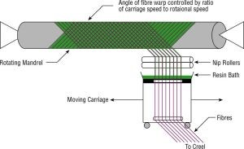
Module 2: Lecture 4
Composite Manufacturing Methods:
Contact Molding and Filament Winding
Open Molding – Filament Winding
Source: https://netcomposites.com/guide/manufacturing/filament-winding/
Notes:
Continuous strand roving is fed through a resin bath and wound onto a rotating mandrel under tension.
The roving feed runs on a trolley that travels the length of the mandrel.
The filament is laid down in a predetermined geometric pattern to provide maximum strength in the directions required.
When all the layers have been applied, the laminate is cured on the mandrel.
The molded part is then de-molded from the mandrel.
Equipment is available for filament winding on a continuous basis with axis winding for pressure cylinders.
Filament winding can be combined with the chopping process and is known as the hoop chop process.

Slide 88
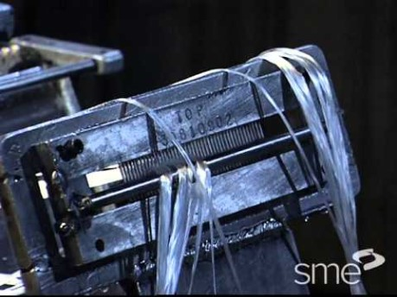
Module 2: Lecture 4
Composite Manufacturing Methods:
Contact Molding and Filament Winding
Open Molding – Filament Winding
Source: https://www.youtube.com/watch?v=4ihtyjydzqA

Slide 89
Module 2: Lecture 4
Composite Manufacturing Methods:
Contact Molding and Filament Winding
Filament Winding Advantages
Very fast and economic method
Resin content can be controlled
Fiber cost is minimized since there is no secondary process to convert fiber into fabric prior to use.
Structural properties of laminates can be very good.
Reinforcement is applied under load.
The accuracy can be superior to that of fiber placement and automated tape-laying machines.
Continuous fibers over the whole component area (without joints).
Notes:
Filament Winding Advantages
This can be a very fast and therefore economic method of laying material down.
Resin content can be controlled by metering the resin onto each fiber tow through nips or dies.
Fiber cost is minimized since there is no secondary process to convert fiber into fabric prior to use.
Structural properties of laminates can be very good since straight fibers can be laid in a complex pattern to match the applied loads.
Reinforcement is applied under load, provided greater physical properties.
The accuracy can be superior to that of fiber placement and automated tape-laying machines.
Continuous fibers over the whole component area (without joints).

Slide 90
Module 2: Lecture 4
Composite Manufacturing Methods:
Contact Molding and Filament Winding
Filament Winding Advantages
Orientation of fibers in the load direction.
Elimination of the capital expense (and size restrictions) of an autoclave.
Ability to manufacture a composite with high fiber volume.
Mandrel costs can be lower than other tooling costs
Less labor than many other processes.
Can wind multiple small components.
Less disposables.
Notes:
Filament Winding Advantages
Elimination of the capital expense (and size restrictions) of an autoclave and the recurring expense for inert gas. Thick-walled structures can be built that are larger than any autoclave can accommodate.
Ability to manufacture a composite with high fiber volume.
Mandrel costs can be lower than other tooling costs because there is usually only one tool, the male mandrel, that sets the inside diameter and the inner surface finish.
Lower cost for large numbers of components because there can be less labor than many other processes.
It is possible to filament wind multiple small components, such as up to several golf shafts at once leading to sharply reduced costs compared to flag rolling.
Costs are eliminated for bagging and disassembly of the bagging materials, as well as the recurring costs of these materials.

Slide 91
Module 2: Lecture 4
Composite Manufacturing Methods:
Contact Molding and Filament Winding
Filament Winding Limitations
Limited to cylindrical and hollow shaped components.
Fiber cannot easily be laid exactly along the length of a component.
Mandrel costs for large components can be high, complex or expensive
External surface of the component is cosmetically unattractive.
Low viscosity resins usually needed.
Mandrel must allow removal of the part
Difficulty in winding reverse curvature
Notes:
Filament Winding Limitations
The process is limited to cylindrical and hollow shaped components.
Fiber cannot easily be laid exactly along the length of a component.
Mandrel costs for large components can be high, complex or expensive
The external surface of the component is not against a mold, and therefore cosmetically unattractive.
Low viscosity resins usually need to be used with their attendant lower mechanical and health and safety properties.
There is a necessity for a component shape that permits mandrel removal (negative draft). Long, tubular mandrels generally do not have a taper. Unless nonuniform shapes are capable of mechanical disassembly, mandrels must be made from a dissolvable or frangible material. Different mandrel materials, because of differing thermal expansion and differing composite materials and laminate lay-up percentages of hoops versus helical plies, will have varying amounts of difficulty in removal of the part from the mandrel.
Difficulty in winding reverse curvature

Slide 92
Summary
Module 2: Lecture 4
In this lecture you have learned:
  Contact molding has many different names. What are the other names for processes that leaves the resin exposed to the environment?
  Hand lay-up is one of the simplest methods of creative polymer products.
  Hand lay-up requires the least amount of investment
  Hand Lay-up is a manual, slow, labor consuming method

Slide 93
Summary
Module 2: Lecture 4
In this lecture you have learned:
  The advantages of hand lay-up include:
    Least expensive process
    Low cost set up
    Flexible process
    Easy to train people
    Can make large or small parts
    Design changes easily made
    Good production rates and consistent quality are obtainable.
    Can accommodate single or multi-piece molds
    Creates a single-sided mold acts as the form and cosmetic surface of the part.
    Any combination of fibers and matrix materials can be used.

Slide 94
Summary
Module 2: Lecture 4
In this lecture you have learned:
  The limitations of hand lay-up include:
    The resin is open to the environment which creates air quality concerns
    There is a higher reliance of the technician to control the fiber volume fraction as well as the thickness.
    The process offers a good surface finish on one side and a rough surface finish on the other side.
    The process is not suitable for parts where dimensional accuracy and process repeatability are prime concerns.
    Products tend to be very resin-rich.
    Does not accommodate high volume production
    Labor intensive

Slide 95
Summary
Module 2: Lecture 4
In this lecture you have learned:
  Spray-up
    Spray-up, or chopping, is an open mold method, similar to hand lay-up in that the processes is open to the environment.
    It requires a Chopper Gun.
    The Chopper Gun makes it easy to quickly cover large surfaces with fiberglass.
    Roving is fed into the rear of the gun. A daisy wheel, with very sharp blades, chops the roving into short pieces and propels them, along with the initiated resin, onto the mold.
    The fibers and resin are compacted, removing the air, with an FRP roller.
    By altering the number and location of chopper blades, the length of the fibers can be varied from 4" down to 5⁄16".

Slide 96
Summary
Module 2: Lecture 4
In this lecture you have learned:
  The advantages of spray-up include:
    Low cost way of quickly depositing fiber and resin.
    It is suitable for small to medium quantities of parts.
    It is a very economical process for making small to large parts.
    It utilizes low-cost tooling as well as low-cost material systems
    Low labour costs (compared to hand-lamination).
    Versatile part shape/laminate configuration, including thickness variations.
    Potential for automation with robots.
    Automated mixing or resin and initiator/catalyst.

Slide 97
Summary
Module 2: Lecture 4
In this lecture you have learned:
  Spray-up limitations
    Not suitable for parts that have high structural requirements.
    Difficult to control the fiber volume fraction as well as the thickness. These parameters highly depend on operator skill.
    High styrene contents of spray lay-up resins.
    Not suitable for parts where dimensional accuracy and process repeatability are prime concerns.
    No control over fiber orientation
    Does not provide a good surface finish (by itself) or dimensional control on both or all the sides of the product.
    Only short fibers can be used in this process
    Expense of equipment
    Lots of acetone for clean up
    Resins need to be low in viscosity to be sprayable.

Slide 98
Summary
Module 2: Lecture 4
In this lecture you have learned:
  Filament Winding
    Spray-up, or chopping, is an open mold method, similar to hand lay-up in that the processes is open to the environment.
    It requires a Chopper Gun.
    The Chopper Gun makes it easy to quickly cover large surfaces with fiberglass.
    Roving is fed into the rear of the gun. A daisy wheel, with very sharp blades, chops the roving into short pieces and propels them, along with the initiated resin, onto the mold.
    The fibers and resin are compacted, removing the air, with an FRP roller.
    By altering the number and location of chopper blades, the length of the fibers can be varied from 4" down to 5⁄16".

Slide 99
Summary
Module 2: Lecture 4
In this lecture you have learned:
    Very fast and economic method
    Resin content can be controlled
    Fiber cost is minimized
    Structural properties can be very good.
    Reinforcement is applied under load.
    The accuracy can be superior.
    Continuous fibers
    Fibers in the load direction.
    High fiber volume.
    Mandrel costs can be lower than other tooling costs
    Less labor than many other processes.
    Can wind multiple small components.
    Less disposables.
  The advantages of filament winding include:

Slide 100
Summary
Module 2: Lecture 4
In this lecture you have learned:
  The limitations of filament winding include:
    Limited to cylindrical and hollow shaped components.
    Fiber cannot easily be laid exactly along the length of a component.
    Mandrel costs for large components can be high, complex or expensive
    External surface of the component is cosmetically unattractive.
    Low viscosity resins usually needed.
    Mandrel must allow removal of the part
    Difficulty in winding reverse curvature

Slide 101
Composite Recycling Technician Education Program
Module 2: Lecture 5
Module 2 - Composite Manufacturing Methods - Thermosets and Thermoplastic
Lecture 5 – Pultrusion and Extrusion

Slide 102
Composite Manufacturing Methods:
Pultrusion and Extrusion
Module 2: Lecture 5
Objectives:
Learn the process of Pultrusion
Learn the advantages and limitations of Pultrusion
Learn the process of Extrusion
Learn the types of Extrusion processes (Sheet/film Extrusion, Thermoforming, Blown Film Extrusion, Extruded Tubing, Multi-layer Tubing, Over Jacketing Extrusion, Co-extrusion, Extrusion Coating and Extrusion Compounding)
Learn the advantages, limitations and applications of the different Extrusion processes

Slide 103
Composite Manufacturing Methods:
Pultrusion and Extrusion
Module 2: Lecture 5
At the end of the lecture you will be able to:
Describe the process of Pultrusion
List the advantages and limitations of Pultrusion
Describe the process of Extrusion
Compare and contrast the different the types of Extrusion processes
Identify the advantages, limitations and applications of the different Extrusion processes

Slide 104
Composite Manufacturing Methods:
Pultrusion and Extrusion
Lecture 2
Module 2: Lecture 5
Manufacturing methods and processes for Thermoplastics vs. Thermosets
Thermoset Processes
Thermoplastic Processes
Injection Molding
Rotational Molding
Compression Molding
Casting, Foam Molding
Vacuum-Bag Molding
Hand/Spray Layup
Resin Transfer Molding
Filament Winding
Pultrusion
Transfer Molding
Reaction Injection Molding
Extrusion
  Blow Molding
  Thermoforming

Slide 105
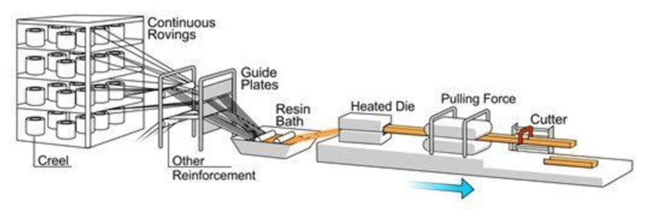
Pultrusion
Lecture 2
Module 2: Lecture 5
Pultrusion Defined
Pultrusion is a continuous, highly automated, fast production process that creates composite parts with a constant cross sections and material properties tailored to specific purposes.
Pultrusion takes place by continual reinforcement being pulled through a guide where the fibers are placed precisely in the correct position within the profile cross section.
Source: https://www.researchgate.net/figure/A-pultrusion-line-or-a-pultrusion-machine-is-used-to-produce-the-pultruded-GFRP-profile_fig10_303921353

Slide 106
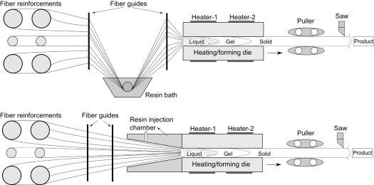
Pultrusion
Lecture 2
Module 2: Lecture 5
Pultrusion With Direct Injection
When the reinforcement is pulled into the processing equipment, the matrix can be added by injection.
Pultrusion by injection is advantageous because of the ease in controlling and checking the reinforcement; it speeds changing from one profile to another, and eases matrix changes during a process.
The injection method is a fully enclosed process which keeps evaporation of solvents at a minimum.
This ensures a good work environment in comparison with traditional pultrusion, in which reinforcement is led through an open vat containing the matrix.
Source: I. Baran, in Advances in Composites Manufacturing and Process Design, 2015
Notes:
Alternative wet-out systems inject the resin directly into the heated die and multiple fiber streams can be pultruded in a single die with several cavities. To form hollow or multiple-cell parts, the wetted fiber wraps around heated mandrels that extend through the die. If off-axis structural strength is required, mat and/or stitched fabrics may be folded into the material package before it enters the die.

Slide 107
Pultrusion
Lecture 2
Module 2: Lecture 5
Pultrusion With Direct Injection
These Alternative wet-out systems inject the resin directly into the heated die and multiple fiber streams can be pultruded in a single die with several cavities. To form hollow or multiple-cell parts, the wetted fiber wraps around heated mandrels that extend through the die.
The degree of impregnation of the fibers is another decisive factor for the properties of the finished product.
Pultrusion Resin
A wide variety of thermosetting and thermoplastic resin systems are available for pultrusion. Heading the list are unsaturated vinyl- ester, epoxy, unsaturated polyester, and phenol-resins, as well as methacrylate resins (due to optimum halogen-free flame-retardant properties), Polyurethane; and various thermoplastics.
Source: https://www.compositesone.com/process/pultrusion/
Notes:
These alternative wet-out systems inject the resin directly into the heated die and multiple fiber streams can be pultruded in a single die with several cavities. To form hollow or multiple-cell parts, the wetted fiber wraps around heated mandrels that extend through the die. If off-axis structural strength is required, mat and/or stitched fabrics may be folded into the material package before it enters the die. Pultrusion applications typically uses fiberglass and thermoset resins such as polyester, vinyl ester, epoxy, and phenolic. Carbon fiber and other knitted and hybrid reinforcements can also be used depending on the performance requirements of the product.
The degree of impregnation of the fibers is another decisive factor for the properties of the finished product.
A wide variety of thermosetting and thermoplastic resin systems are available for pultrusion. Heading the list are unsaturated vinyl- ester, epoxy, unsaturated polyester, and phenol-resins, as well as methacrylate resins (due to optimum halogen-free flame-retardant properties), Polyurethane; and various thermoplastics.

Slide 108
Pultrusion
Lecture 2
Module 2: Lecture 5
Pultrusion Advantages
This can be a very fast, and therefore economic.
Resin content can be accurately controlled.
Fiber cost is minimized.
Structural properties of laminates can be very good.
Resin impregnation area can be enclosed.
Pultrusion Limitations
Limited to constant or near constant cross-section components
Heated die costs can be high
Sustainability Issues
Source: https://netcomposites.com/guide/manufacturing/pultrusion/
Notes:
Pultrusion Advantages
This can be a very fast, and therefore economic, way of impregnating and curing materials.
Resin content can be accurately controlled.
Fiber cost is minimized since the majority is taken from a creel.
Structural properties of laminates can be very good since the profiles have very straight fibres and high fibre volume fractions can be obtained.
Resin impregnation area can be enclosed thus limiting volatile emissions.
Pultrusion Limitations
Limited to constant or near constant cross-section components.
The technique of pultrusion naturally limits the shape of materials that can be made using the process. Pultrusion can only produce materials with a cross-section of a consistent thickness. While pultrusion can quickly produce large sections of pipe or support beams, materials with more complex shapes or varying diameter over their length cannot be made using the process.
The materials that can be used in pultrusion are also limited. While an extrusion manufacturing process may use wood-based composites or aluminum, pultrusion is limited to materials that can be pulled through in strands, such as polyester and epoxy.
Heated die costs can be high
Sustainability Issues - While pultrusion is efficient in its use of materials, the process is entirely automated and requires a constantly heated die. This constant use of heat and electricity needed to power the process makes pultrusion less energy efficient than other manufacturing methods and represents additional heating costs for the manufacturer who's using a pultrusion system. In addition, the limited types of materials that can be used in the pultrusion process are rarely recyclable.

Slide 109
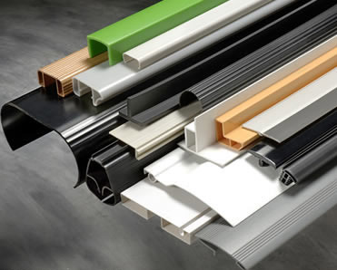
Extrusion
Lecture 2
Module 2: Lecture 5
Plastic Extrusion
Thermoplastics only
Produces the largest volume of plastics
It is a continuous and high- volume process
Accurate control of material thickness
Products are cut to desired lengths
Has low tooling costs
Intricate profiles can be produced
Parts made by extrusion.
Source: https://polymeracademy.com/plastic-extrusion-process/
Notes:
Plastics extrusion is a continuous high-volume manufacturing process, in which raw plastic is melted and formed into a continuous profile.
Typical materials used are:
Polyethylene (PE),
Polypropylene (PP),
Acetal,
Acrylic,
Nylon (polyamides),
Polystyrene (PS),
Polyvinyl chloride (PVC),
Acrylonitrile butadiene styrene (ABS)
Polycarbonate (PC)

Slide 110
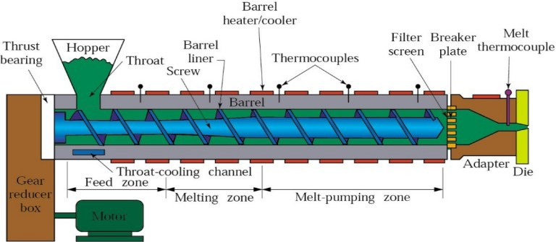

Extrusion
Lecture 2
Module 2: Lecture 5
The Extrusion Process
Source: https://polymeracademy.com/plastic-extrusion-process/
Notes:
This process starts by gravity feeding plastic material (pellets, granules, flakes or powders) from a hopper into the barrel of the heated extruder. The material is gradually melted. Mechanical energy generated by turning screws and by heaters arranged along the barrel. The molten polymer is then forced into a die, which shapes the polymer into a shape that hardens during cooling. Additives, such as colorants and UV inhibitors, in either liquid or pellet form are often used and can be introduced into the resin before arriving at the hopper. The process has much in common with plastics injection molding though differs in that the process is usually continual. While injection molding can offer many similar profiles in continuous lengths, usually with added reinforcing, the finished product is pulled out of a die instead of extruding the fluid resin through a die.
The material enters through the feed throat (an opening near the rear of the barrel) and contacts the screw. The rotating screw (normally turning at about 120 rpm) forces the plastic beads forward into the heated barrel. The desired extrusion temperature is rarely equal to the set temperature of the barrel due to viscous heating and other effects. In most processes, a heating profile is set for the barrel in which three or more independent PID-controlled heater zones gradually increase the temperature of the barrel from the rear (where the plastic enters) to the front. This allows the plastic beads to melt gradually as they are pushed through the barrel and lowers the risk of overheating which may cause degradation in the polymer.
Additional heat is contributed by the intense pressure and friction taking place inside the barrel. If an extrusion line is running certain materials fast enough, the heaters can be shut off and the melt temperature maintained by pressure and friction alone inside the barrel. Most extruders have cooling fans to keep the temperature below a set value if too much heat is generated. If forced air cooling proves insufficient then cast-in cooling jackets or blowers are employed.
At the front of the barrel, the molten plastic leaves the screw and travels through a screen pack to remove any contaminants in the melt. The screens are reinforced by a breaker plate (a thick metal puck with many holes drilled through it) since the pressure at this point can exceed 5,000 psi (34 MPa). The screen pack/breaker plate assembly also serves to create back pressure in the barrel. Back pressure is required for uniform melting and proper mixing of the polymer, and how much pressure is generated can be changed by varying screen pack.
After passing through the breaker plate molten plastic enters the die. The die is what gives the final product its profile and must be designed so that the molten plastic evenly flows from a cylindrical profile, to the product’s profile shape.
The product must now be cooled, and this is usually achieved by pulling the material through a water bath. Plastics are very good thermal insulators and are therefore difficult to cool quickly. Compared to steel, plastic conducts its heat away 2,000 times more slowly. In a tube or pipe extrusion line, a sealed water bath is acted upon by a carefully controlled vacuum to keep the newly formed and still molten tube or pipe from collapsing. For products such as plastic sheeting, the cooling is achieved by pulling through a set of cooling rolls. For films and very thin sheeting, air cooling can be effective as an initial cooling stage.
Plastic extruders are also extensively used to reprocess recycled plastic waste or other raw materials after cleaning, sorting and/or blending. This material is commonly extruded into filaments suitable for chopping into the bead or pellet stock to use as a precursor for further processing.

Slide 111
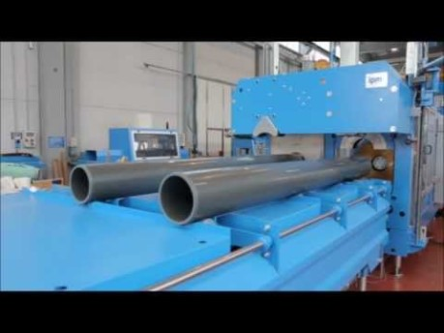
Extrusion
Lecture 2
Module 2: Lecture 5
Types of Extrusion
Sheet/film Extrusion
Thermoforming
Blown Film Extrusion
Extruded Tubing
Multi-layer Tubing
Over Jacketing Extrusion
Co-extrusion
Extrusion Coating
Extrusion Compounding
Source: https://polymeracademy.com/plastic-extrusion-process/ and https://www.ptonline.com/knowledgecenter/Profile-Extrusion/profile-extrusion-fundamentals/Extrusion-methods
Notes:
Types of Extrusion:
Sheet/film extrusion is used to extrude plastic sheets or films that are too thick to be blown. There are two types of dies used: T-shaped and coat hanger. The purpose of these dies is to reorient and guide the flow of polymer melt from a single round output from the extruder to a thin, flat planar flow. In both die types ensure constant, uniform flow across the entire cross-sectional area of the die.
A common post-extrusion process for plastic sheet stock is thermoforming, where the sheet is heated until soft (plastic) and formed via a mold into a new shape. When vacuum is used, this is often described as vacuum forming.
Blown film Extrusion is used to manufacture plastic film. Blown film is like any regular extrusion until it reaches the die. The die is an upright cylinder with an annular opening. The molten resin is pulled upwards from the die by a pair of nip rolls high above the die. Changing the speed of these nip rollers will change the gauge or wall thickness of the film. Around the die sits a cooling ring that blows air onto the film tube as it travels past. The airflow cools the film as it travels upwards. In the center of the die is an air outlet trough which compressed air can be forced into the inside of the extruded cylindrical profile, adjusting the bubble volume. The film can then be slit, spooled, printed on or cut into shapes and heat sealed into bags or other items.
Extruded tubing, such as PVC pipes, is manufactured using very similar dies as used in blown film extrusion. Positive pressure can be applied to the internal cavities through the pin, or negative pressure can be applied to the outside diameter using a vacuum sizer to ensure correct final dimensions.
Multi-layer tubing applications are also ever present within the automotive industry, plumbing & heating industry and packaging industry.
Over jacketing extrusion allows for the application of an outer layer of plastic onto an existing wire or cable. This is the typical process for insulating wires. There are two different types of die tooling used for coating over a wire, tubing (or jacketing) and pressure. In jacketing tooling, the polymer melt does not touch the inner wire until immediately before the die lips. In pressure tooling, the melt contacts the inner wire long before it reaches the die lips; this is done at a high pressure to ensure good adhesion of the melt. If intimate contact or adhesion is required between the new layer and existing wire, pressure tooling is used. If adhesion is not desired/necessary, jacketing tooling is used instead.
Co-extrusion is the extrusion of multiple layers of material simultaneously. This type of extrusion utilizes two or more extruders to melt and deliver a steady volumetric through put of different viscous plastics to a single extrusion head (die) which will extrude the materials in the desired form. This technology is used on any of the processes described above (blown film, over jacketing, tubing, sheet). In many circumstances, a single polymer cannot meet all the demands of a product. Compound extrusion allows a blended material to be extruded, but coextrusion retains the separate materials as different layers in the extruded product, allowing appropriate placement of materials with differing properties such as oxygen permeability, strength, stiffness, and wear resistance.
Extrusion coating is using a blown or cast film process to coat an additional layer onto an existing roll stock of paper, foil or film. For example, this process can be used to improve the characteristics of paper by coating it with polyethylene to make it more resistant to water. The extruded layer can also be used as an adhesive to bring two other materials together.
Extrusion Compounding: Compounding extrusion is a process that mixes one or more polymers with additives to give plastic compounds. The feeds may be pellets, powder and/or liquids, but the product is usually in pellet form, to be used in other plastic-forming processes such as extrusion and injection molding. While either single- or double-screw extruders may be used in traditional extrusion, the necessity of adequate mixing in compounding extrusion makes twin-screw extruders necessary.

Slide 112
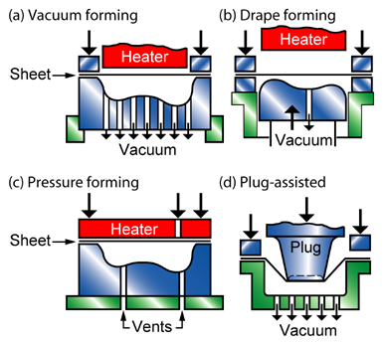
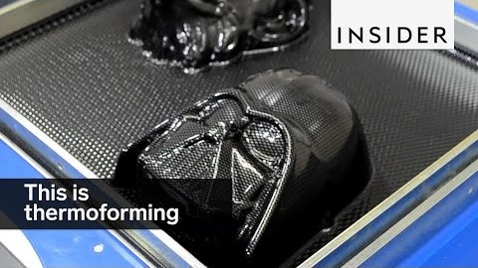
Lecture 2
Extrusion
Module 2: Lecture 5
Thermoforming
  Thermoplastic sheets (or films) are utilized
  The material is heated by convection or radiant heat
  The softened sheet is pressed on the mold by using vacuum, air or mechanical means
  Simple shapes with large radii and no undercuts can be produced
  The finished product can have varying thickness
Source: http://www.techniform-plastics.com/thermoforming.html
Notes:
The thermoforming processes starts with heating sheet plastic and forming it over a male or female mold.
The two basic types of thermoforming processes - vacuum forming and pressure forming - and derivative processes, like twin sheet thermoforming, make plastic thermoforming a broad and diverse plastic forming process.
Thermoformed plastics are ideally suited for automotive, consumer products, packaging, retail and display, sports and leisure, electronics, and industrial applications.
The most advantageous aspects of thermoforming are its low tooling and engineering costs and fast turnaround time which makes thermoforming or vacuuforming, which is ideal for prototype development and low-volume production.
Advantages of the Thermoforming Plastic Sheet Process
Extremely adaptive to customer design needs
Rapid prototyping development
Material and process is optimized for cost effectiveness
High-speed production allows for just-in-time shipments
Flexible tooling design offers a competitive advantage
On-the-fly product enhancements with low additional costs
Visually pleasing appearance
Weight savings for consumer and manufacturer
Wider design scope
Lower tooling costs
No anticorrosion spray necessary
Paintable and colored plastic availability
Fully integrated process with limitless flexibility for small to large product designs

Slide 113
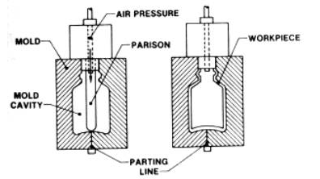
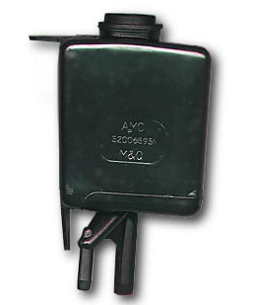
Extrusion
Lecture 2
Module 2: Lecture 5
Blow Molding
  For Thermoplastics
  A softened parison tube is inflated to the contour of a mold cavity
  Thin walled hollow products are formed
  Wall thickness can be increased by increasing the parison tube wall thickness (limited to 1 cm)
  There are parting lines on the products
  Points of extreme stretching or of too deep draw should be avoided
  The stiffness of the final part greatly depend on the wall thickness, so control of wall thickness throughout the part is important
  Corners and edges of the part must be adequately rounded
The blow molding process.
A blow molded reservoir.
Source: https://www.rodongroup.com/blog/blow-molding-vs.-injection-molding-whats-the-difference
Notes:
The process of blow molding follows the basic steps found in glass blowing. The blow molding process is designed to manufacture high volume, one-piece hollow objects. Blow molding creates very uniformly, thin-walled containers. It can do so very economically due to the economics of high-volume production. Examples of parts and products that are created using blow molding include water bottles, shampoo and other small bottles, automotive parts, stadium seating and chairs, watering cans, coolers, or any other type of hollow parts.
Blow molding offers several distinct advantages including:
The costs in blow molding are lower as compared to injection molding
Machinery costs are typically lower as well
One-piece construction so that there’s no need to connect part halves, which can achieve shapes that injection molding cannot produce
With blow molding, a plastic tube is heated and filled with air until it essentially becomes a balloon of hot plastic called a “parison.”
A mold is then clamped around this, trapping the plastic while air continues to fill the parison into the shape of your part. The size of the machine and associated costs to produce a blow molded product is based on the weight of the plastic shot used in the mold.
Blow molds have more design freedom between mold halves since each mold half forms its own wall shape. With blow molding, creating the mold is important but there are variables as well such as wall thinning, air leaks, flash, and streaks that must be monitored. For example, wall thickness variation is often an essential factor for product designers to consider. Quality control is an important part of the process.

Slide 114
Summary
Module 2: Lecture 5
In this lecture you have learned:
Pultrusion is a continuous, highly automated, fast production process that creates composite parts with a constant cross sections and material properties tailored to specific purposes.
Pultrusion takes place by continual reinforcement being pulled through a guide where the fibers are placed precisely in the correct position within the profile cross section.

Slide 115
Summary
Module 2: Lecture 5
In this lecture you have learned:
  Pultrusion Advantages
  This can be a very fast, and therefore economic.
  Resin content can be accurately controlled.
  Fiber cost is minimized.
  Structural properties of laminates can be very good.
  Resin impregnation area can be enclosed.
  Pultrusion Limitations
  Limited to constant or near constant cross-section components
  Heated die costs can be high
  Sustainability Issues

Slide 116
Summary
Module 2: Lecture 5
In this lecture you have learned:
  Plastic Extrusion
  Thermoplastics only
  Produces the largest volume of plastics
  It is a continuous and high- volume process
  Accurate control of material thickness
  Products are cut to desired lengths
  Has low tooling costs
  Intricate profiles can be produced

Slide 117

Summary and Group Discussion
Module 2: Lecture 5
As a group, discuss the difference between the following types of extrusion processes:
  Sheet/film Extrusion
  Thermoforming
  Blown Film Extrusion
  Extruded Tubing
  Multi-layer Tubing
  Over Jacketing Extrusion
  Co-extrusion
  Extrusion Coating
  Extrusion Compounding

Slide 118

Contact Information
Skagit Valley College
Composites Technician Recycling Program
Darren.Greeno@skagit.edu
Lars.antonsen@Skagit.edu
University of Alabama Birmingham
Engineering Department
pillay@uab.edu
Edmonds Community College
National Resource Center for
Materials Technology Education
Mel.cossette@edcc.edu
This work is part of a larger project funded by the Advanced Technological Education Program
of the National Science Foundation, DUE #1400619 and #1601216

